Slide 1
File Formats and Compression in Big Data and Spark
By Ramesh Medisetti
Data Engineer, ITC

Slide 2
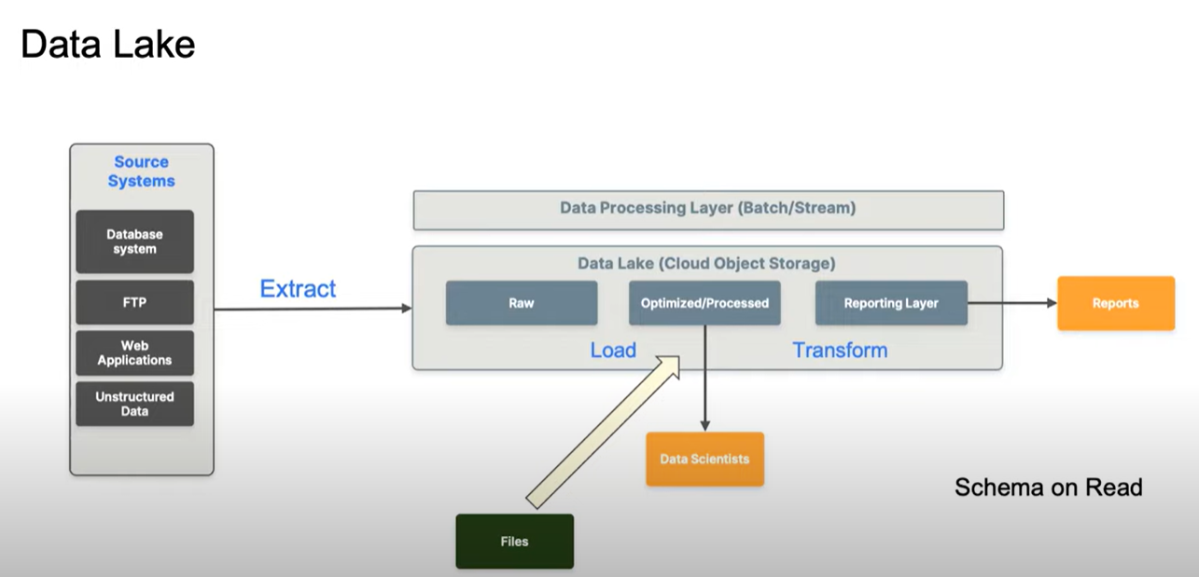
Why File Formats?

Slide 3
File Formats and Compression in Big Data and Spark
These two factors play a crucial role in optimizing storage, data processing speed, and overall performance in big data ecosystems.
Need for different file formats:
Store and process large Datasets
Continuously evolving schema
Time taken to read data from one location and write it back to another location
There is no ideal format and structure for every use case

Slide 4
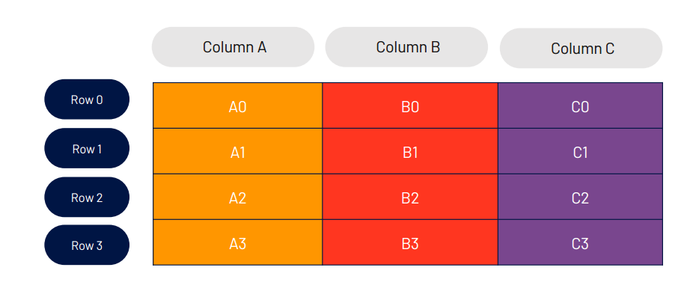
Row vs Columnar

Slide 5
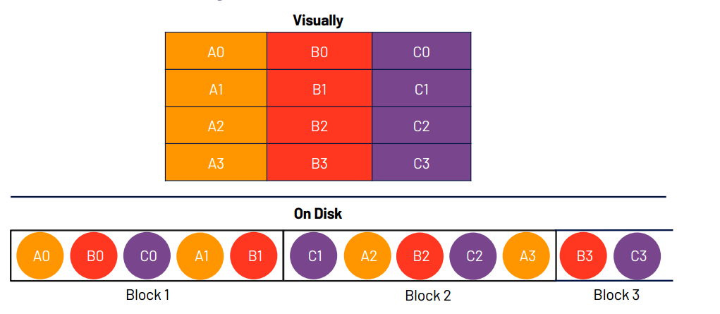
Row vs Columnar

Slide 6
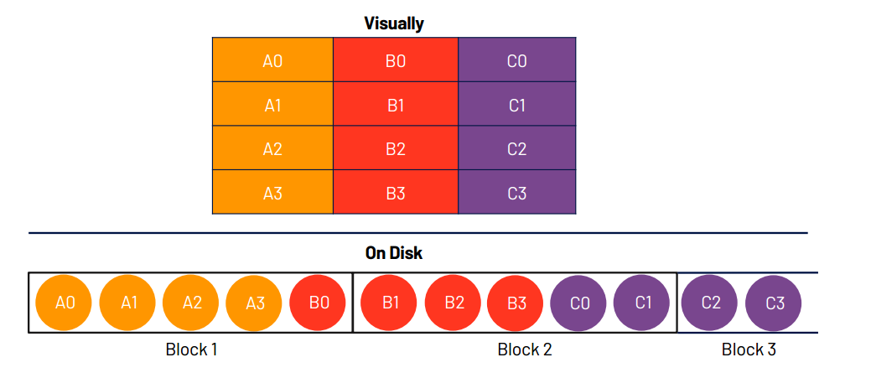
Row vs Columnar

Slide 7
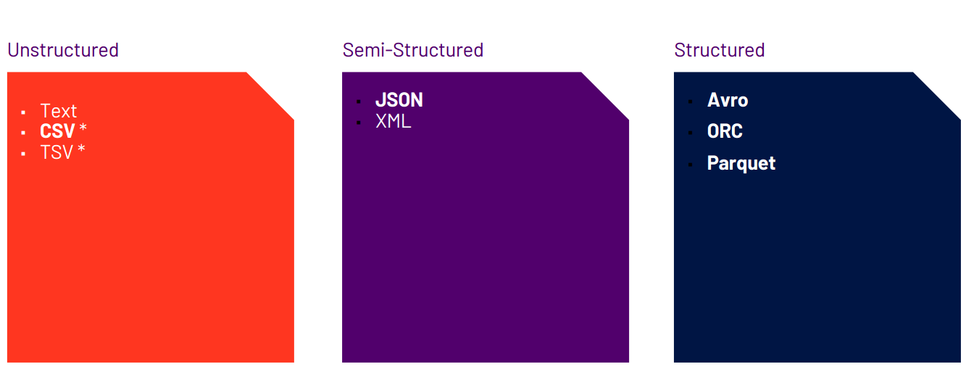
File Formats

Slide 8
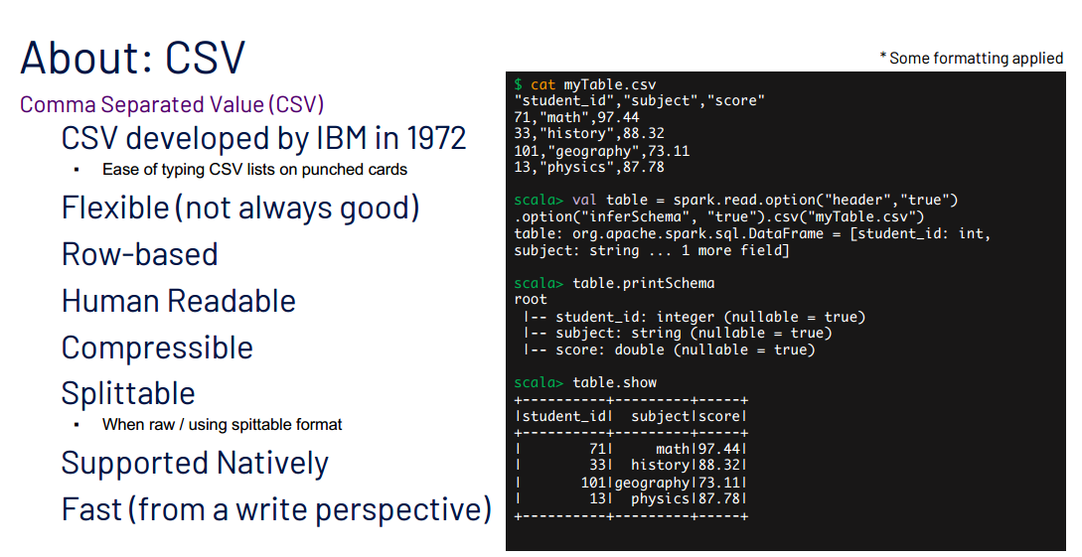
.Csv Format

Slide 9
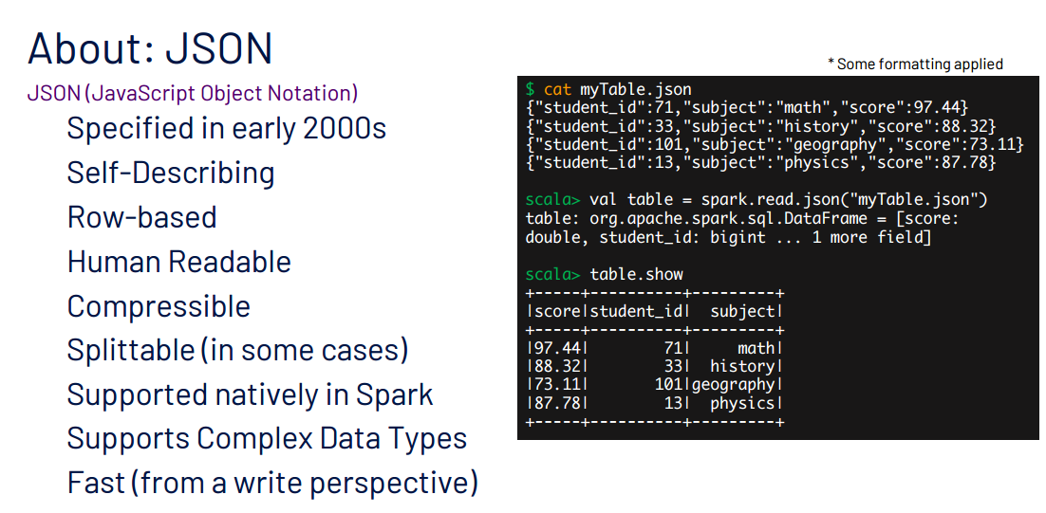
Json

Slide 10
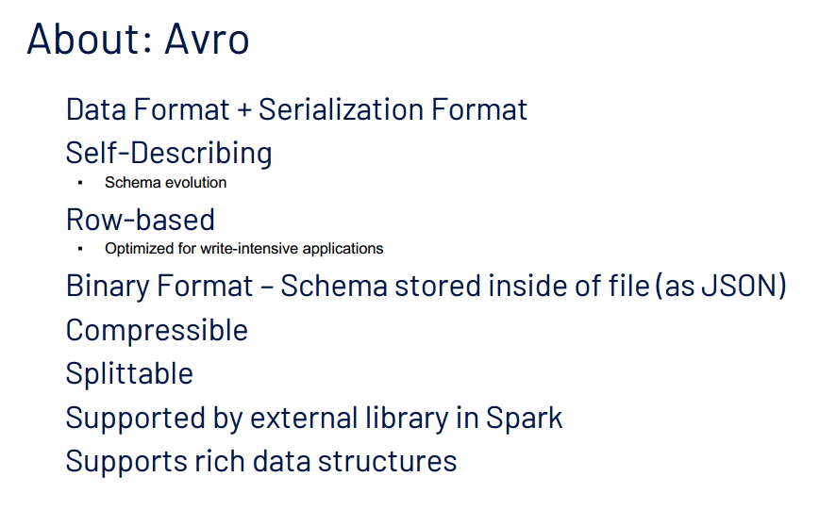
Avro

Slide 11
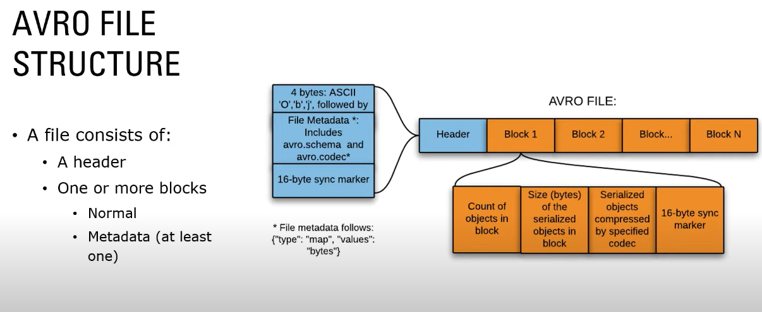
Avro Structure

Slide 12
Avro Advantages
Compressed Automatically
Fully typed
Schema + Data
Data can be read across any language
Schema Evolution
Data stored in Avro can be passed from programs written in different languages

Slide 13
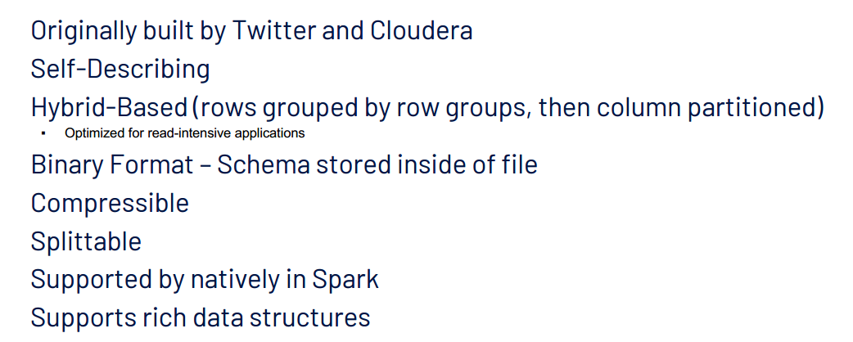
Parquet

Slide 14
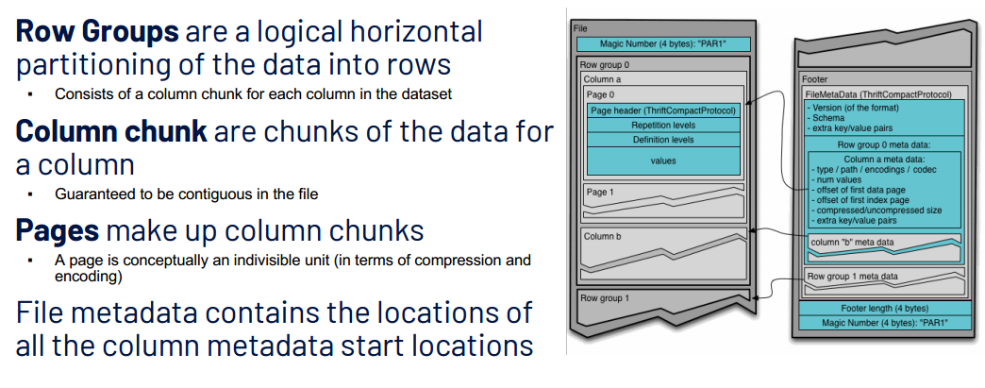
Structure: Parquet

Slide 15
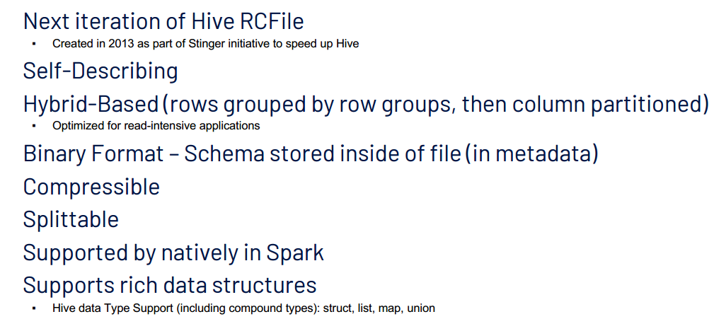
ORC (Optimized Row Columnar)

Slide 16
ORC (Optimized Row Columnar)
ORC (Optimized Row Columnar) is a high-performance columnar storage file format developed for Hadoop and used widely in big data processing frameworks like Apache Hive and Apache Spark. It was created by the Hive community to address the limitations of other file formats and improve data processing efficiency.
ORC Internals:
Stripes
File Footer
Postscript

Slide 17
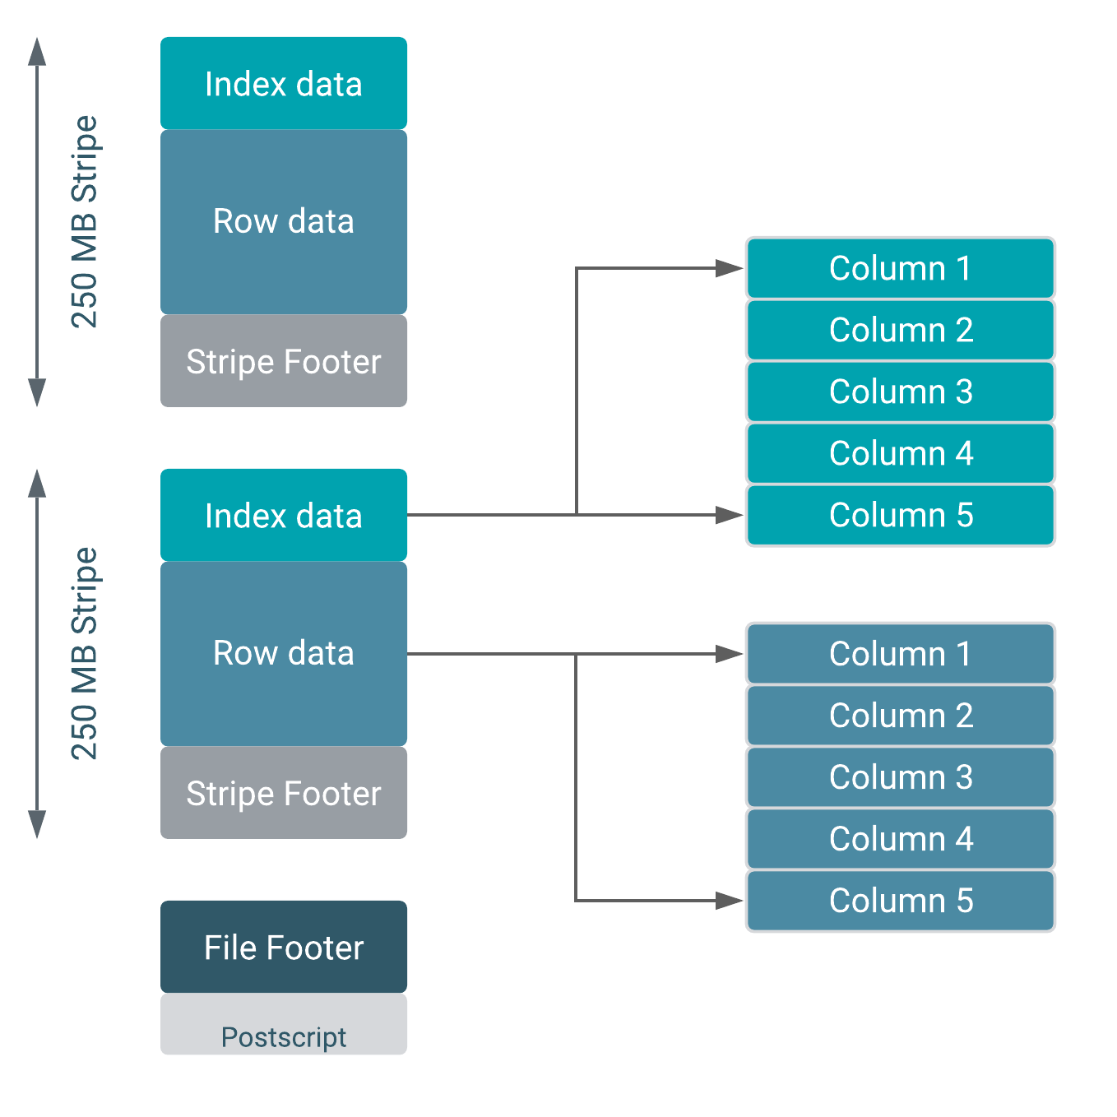
ORC Internals

Slide 18
Compression is vital for reducing storage costs and improving data processing speed. Let's explore some common compression techniques:
Compression Techniques in Big Data and Spark

Slide 19
Gzip
Gzip (GNU Zip) is a widely used file compression format and one of the most popular compression methods.
It uses the DEFLATE algorithm to compress data, which combines LZ77 and Huffman coding techniques.
Gzip is commonly used for compressing individual files and is not specifically designed for big data processing.

Slide 20
Gzip cont..
Advantages:
Effective Compression: Gzip can significantly reduce file sizes, making it useful for data storage and transmission.
Widely Supported: Gzip is supported by most operating systems and tools, making it easily accessible.
Limitations:
Performance Overhead: While Gzip provides good compression ratios, it can introduce overhead during data processing due to decompression requirements.
Not Optimized for Big Data: Gzip lacks built-in parallel processing capabilities, which can affect its performance in big data frameworks like Hadoop and Spark.

Slide 21
Snappy
Snappy is a fast compression/decompression library developed by Google.
It uses a variation of LZ77 and does not use Huffman coding, resulting in faster compression and decompression speeds compared to Gzip.
Snappy is designed for real-time data processing and is well-suited for big data frameworks.

Slide 22
Snappy cont..
Advantages:
Speed: Snappy is much faster in both compression and decompression compared to Gzip.
Low CPU Usage: It requires less CPU resources, making it suitable for real-time processing on low-power devices.
Limitations:
Compression Ratio: Snappy's compression ratio is generally lower than that of Gzip, resulting in larger compressed file sizes.
Not Suitable for All Data: Snappy may not perform as well as Gzip on highly redundant or repetitive data.

Slide 23
LZO (Lempel-Ziv-Oberhumer)
LZO is another fast compression library based on the Lempel-Ziv algorithm, developed by Markus Oberhumer.
It is designed to provide high-speed compression and decompression with a focus on efficient CPU usage.
Like Snappy, LZO is suitable for real-time processing scenarios and big data frameworks.

Slide 24
LZO (Lempel-Ziv-Oberhumer) cont..
Advantages:
High Speed: LZO is known for its fast compression and decompression speeds, rivaling Snappy.
Low CPU Overhead: LZO is optimized for efficient CPU usage, making it ideal for processing data in resource-constrained environments.
Limitations:
Compression Ratio: Similar to Snappy, LZO may not achieve compression ratios as high as Gzip on certain types of data.
Not Ideal for Archival: LZO's focus on speed might lead to larger compressed file sizes compared to Gzip for the same data.

Slide 25
Comparison Summary
Gzip is a general-purpose compression format with good compression ratios but may have higher performance overhead in big data processing.
Snappy and LZO are both designed for speed and low CPU usage, making them better choices for real-time processing in big data frameworks like Hadoop and Spark.
When choosing between these compression formats, consider factors such as data characteristics, required compression ratios, and processing requirements to select the best fit for your specific use case.

Slide 26
Thank you
Any Queries?

