Slide 1
Bank Fraud Analysis
Using Apache Spark, Hadoop..
By Ramesh Medisetti
Company: ITC
Designation: Data Engineer

Slide 2
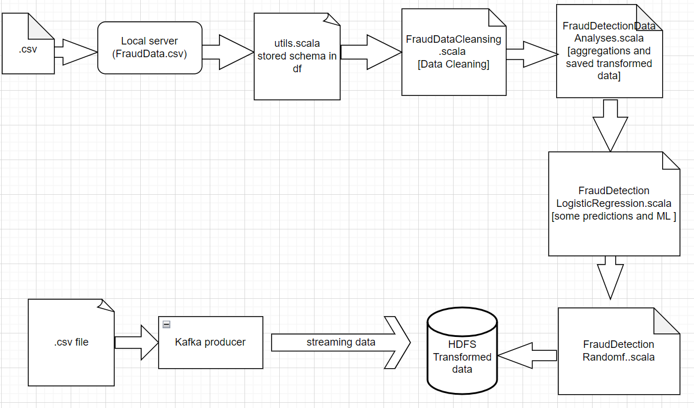
Data Pipeline

Slide 3
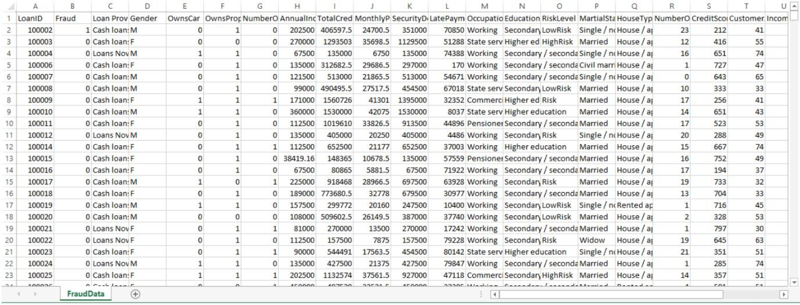
About Data Source
Dataset:
- Fraud dataset with loan applicant and loan information.
- Attributes: Gender, income, credit score, and risk level.
- Enables analyses and predictive modeling for fraud detection.
- Provides insights into loan applicant characteristics and potential risks.

Slide 4
Storing Data in to HDFS
Create input directory in HDFS and put data into input directory. Create output directory in HDFS to store outputs.
Commands:
hdfs dfs -mkdir /FraudAnalysis ---hdfs dfs -mkdir /user/ec2-user/FraudAnalysis hdfs dfs -mkdir /user/ec2-user/FraudAnalysis/Input
hdfs dfs -put FraudData.csv /user/ec2-user/FraudAnalysis/Input hdfs dfs -mkdir /user/ec2-user/FraudAnalysis/Output

Slide 5
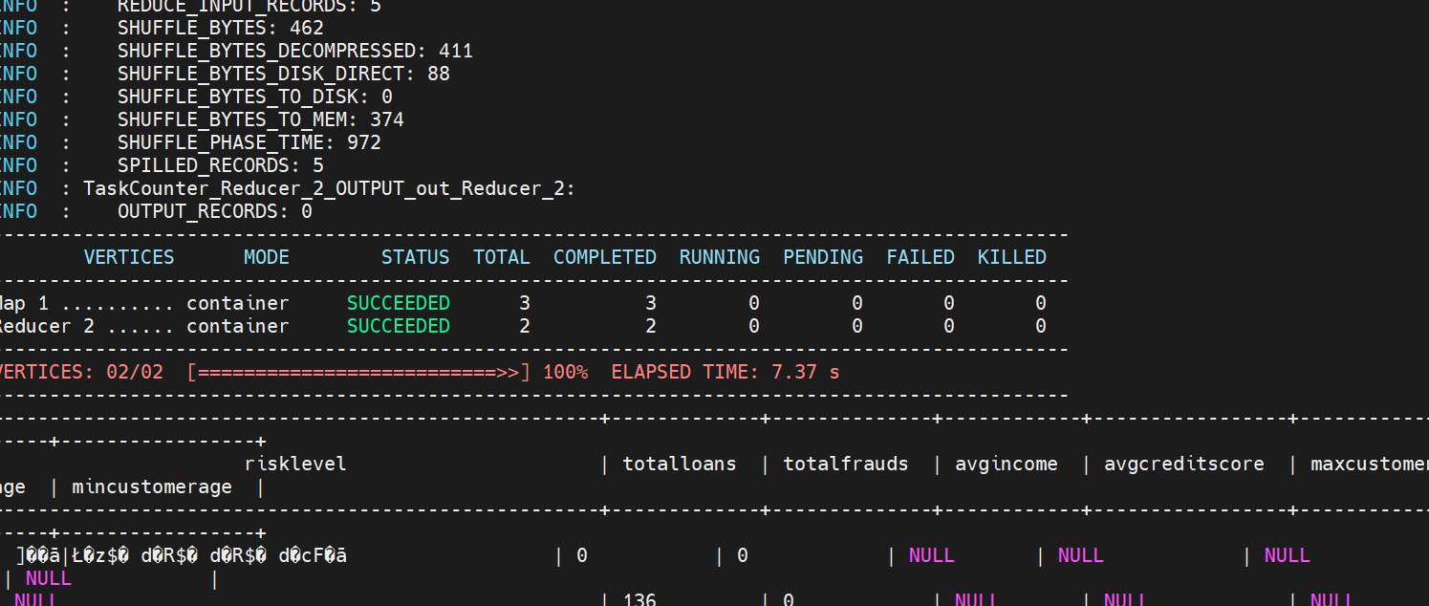
Hive

Slide 6
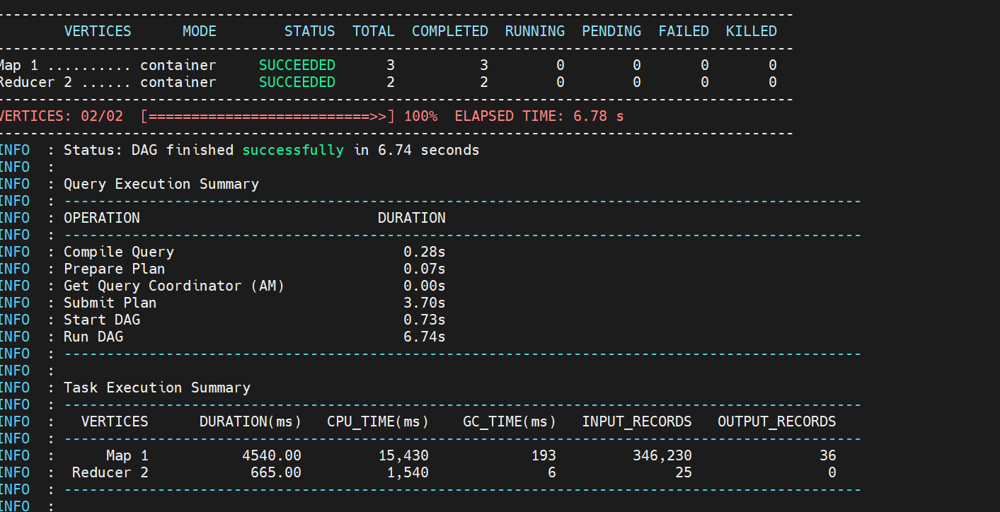
Hive cont..

Slide 7
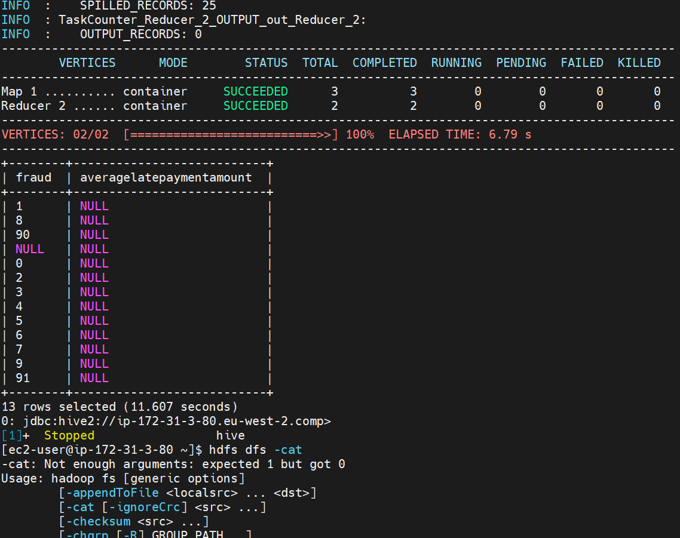
Hive cont..

Slide 8
RiskLevel Analysis
CustomerAge From FraudData, RiskLevelAnalysis Group By RiskLevel; Group Data By RiskLevel and calculate TotalLoans, TotalFrauds, AvgIncome,
AvgCreditScore, MaxCustomerAge, MinCustomerAge. Also replace empty string in RiskLevel column with ‘NoRisk’.
Query:
Select RiskLevel, Count (LoanId) As TotalLoans, Sum (Fraud) As Total Frauds, Avg (Annual Income) As AvgIncome, Avg (CreditScore) As AvgCreditScore, Max (CustomerAge) As MaxCustomerAge, Min (CustomerAge) As MinCustomer Age From (Select LoanID, Fraud, Annual Income, CASE WHEN RiskLevel = THEN
'NoRisk' ELSE RiskLevel END AS RiskLevel, CreditScore

Slide 9
LatePaymentAmount Analysis
Calculate average LatePaymentAmount for frauds and non-frauds.
Query:
Select Fraud, AVG(LatePaymentAmount) as AverageLatePaymentAmount From FraudData Group By Fraud;
Fraud Analysis on Spark (Scala):Code:
Read Dataset From HDFS:
Create a spark session and read dataset from HDFS into Spark DataFrame.

Slide 10
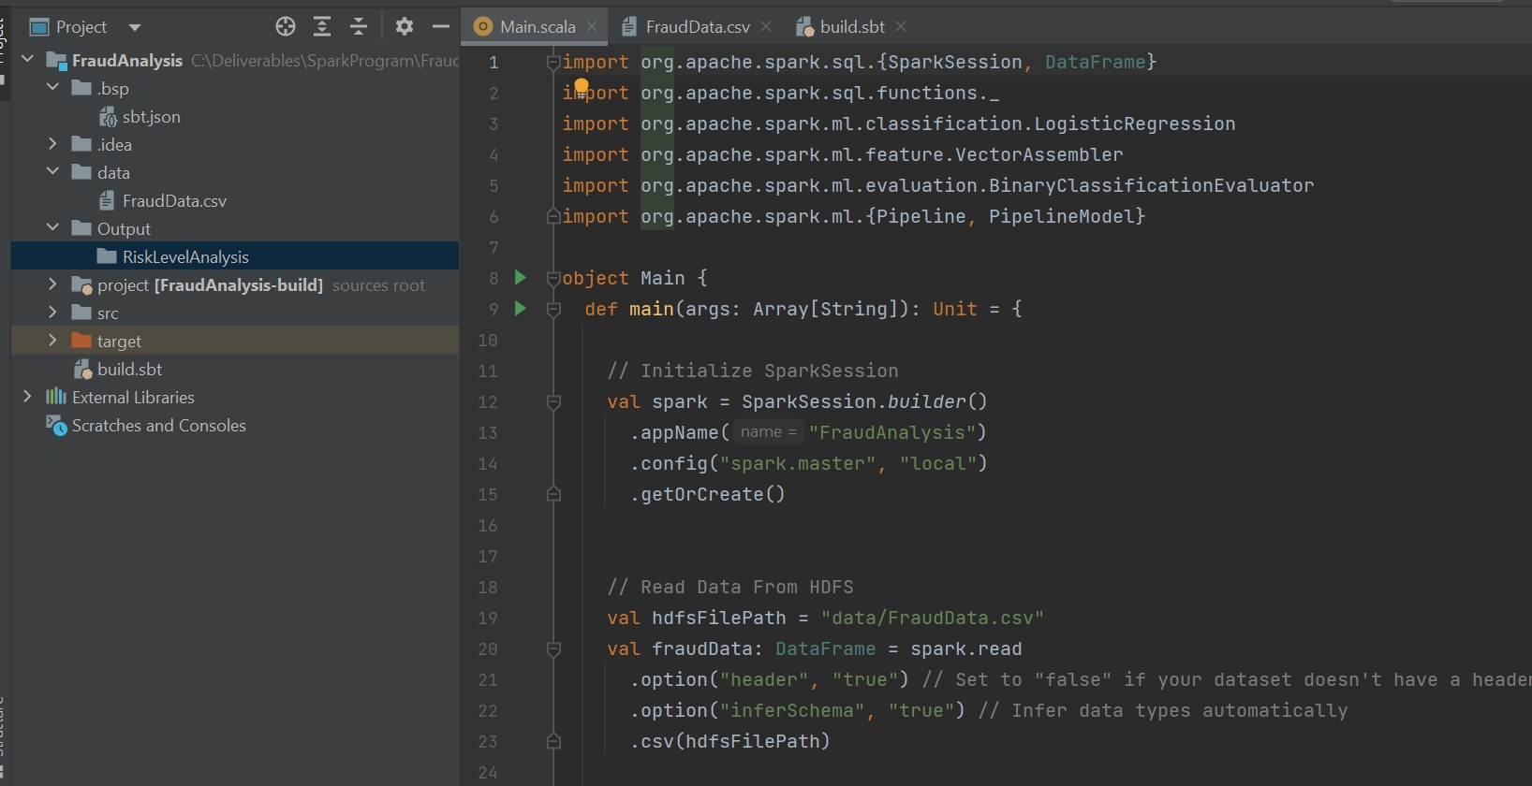
LatePaymentAmount Analysis cont..

Slide 11
First Analysis Using Spark Dataframe:
Query:
Group Data By RiskLevel and calculate TotalLoans, TotalFrauds, AvgIncome, AvgCreditScore, MaxCustomerAge, MinCustomerAge by applying aggregations on Spark Dataframe.
Save the results into HDFS output directory.

Slide 12
Spark-Submit
spark-submit --class com.dataanalysis.FraudDataCleansing /home/ec2-user/junbatch/Ramesh/spark-fraud-data-analyses-1.0-SNAPSHOT.jar /user/ec2-user/junebatch/Ramesh/FraudDatac.csv
spark-submit --class com.dataanalysis.FraudDetectionDataAnalyses /home/ec2-user/junbatch/Ramesh/spark-fraud-data-analyses-1.0-SNAPSHOT.jar /user/ec2-user/junebatch/Ramesh/FraudDatac.csv
spark-submit --class com.dataanalysis.FraudDetectionLogisticRegression /home/ec2-user/junbatch/Ramesh/spark-fraud-data-analyses-1.0-SNAPSHOT.jar /user/ec2-user/junebatch/Ramesh/FraudDatac.csv
spark-submit --class com.dataanalysis.FraudDetectionRandomForestClassifier /home/ec2-user/junbatch/Ramesh/spark-fraud-data-analyses-1.0-SNAPSHOT.jar /user/ec2-user/junebatch/Ramesh/FraudDatac.csv

Slide 13
Kafka
python3 kafka-source.py --topics logs --delay 10 --log_file_path FraudDatac.csv
kafka-console-consumer --bootstrap-server ip-172-31-13-101.eu-west-2.compute.internal:9092 --topic logs --from-beginning

Slide 14
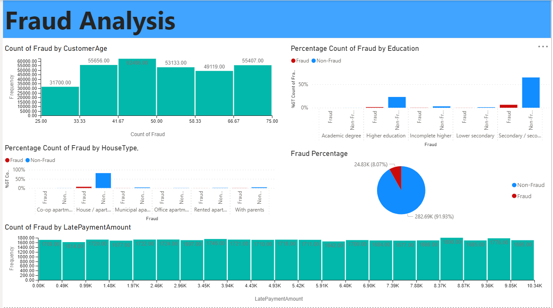
Fraud Analysis

Slide 15
Thank you
Any Queries?

