Slide 1

Apache Spark Memory Management

Slide 2
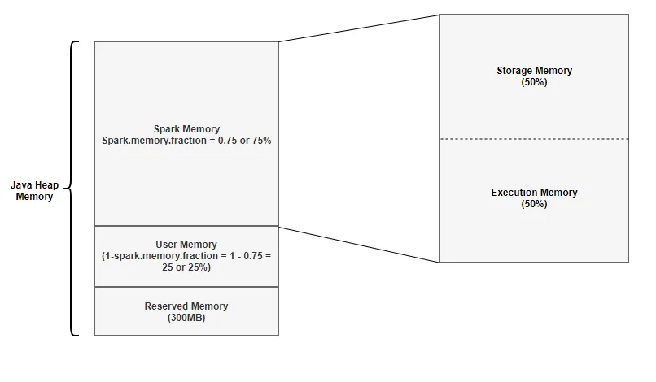
Spark Memory Management

Slide 3
Example: 4gb Allocation
Two main configurations that control executor memory allocation:
spark.memory.fraction — defaults to 0.75
spark.memory.storageFraction — defaults to 0.5
1. Reserved Memory
Formula : Reserved Memory = 300MB
Calculation for 4GB : Reserved Memory = 300MB
2. User Memory
Formula : User Memory = (Java Heap — Reserved Memory) * (1.0 — spark.memory.fraction)
Calculation for 4GB : User Memory = (4024MB — 300MB) * (1.0–0.75) = 949MB
3. Spark Memory
Formula : (Java Heap — Reserved Memory) * spark.memory.fraction
Calculation for 4GB : (4096MB -300MB) * 0.75 = 2847MB

Slide 4
cont..
Spark Memory is broken into 2 segments Storage Memory and Execution Memory. We will briefly discuss these two segments:
Formula: Storage Memory = (Java Heap — Reserved Memory) * spark.memory.fraction * spark.memory.storageFraction
Calculation for 4GB : Storage Memory = (4096MB — 300MB) * 0.75 * 0.5 = ~1423MB
Formula: Execution Memory = (Java Heap — Reserved Memory) * spark.memory.fraction * (1.0 — spark.memory.storageFraction)
Calculation for 4GB : Execution Memory = (4096MB — 300MB) * 0.75 * (1.0 — 0.5) = ~1423MB

Slide 5
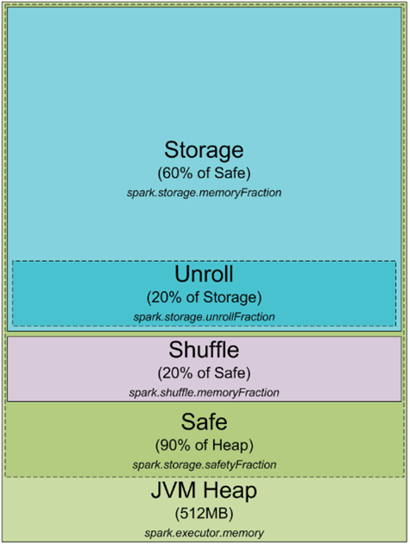
Spark Memory Management
Memory utilization is essential in Spark (Caching)
Spark process is a JVM process

Slide 6
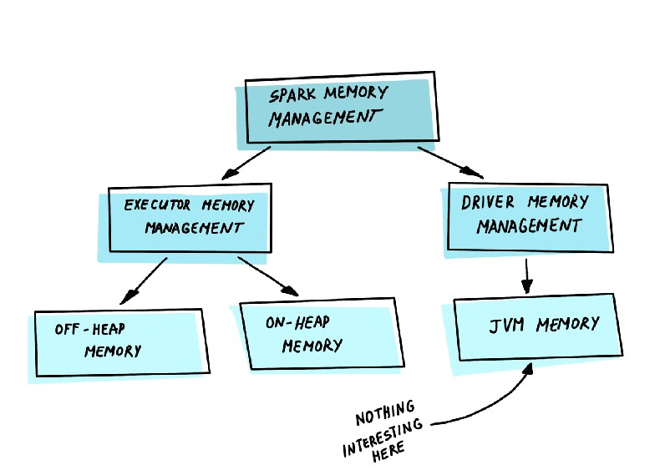
Spark Memory Management

Slide 7
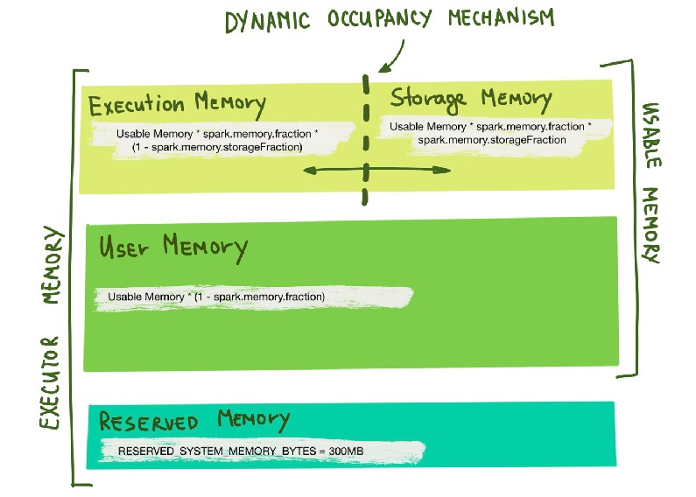
Dynamic Occupancy Mechanism

Slide 8
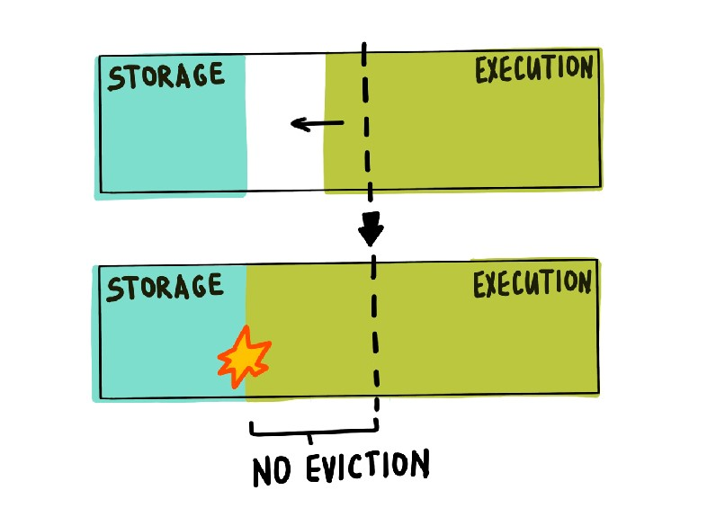
Cont..

Slide 9
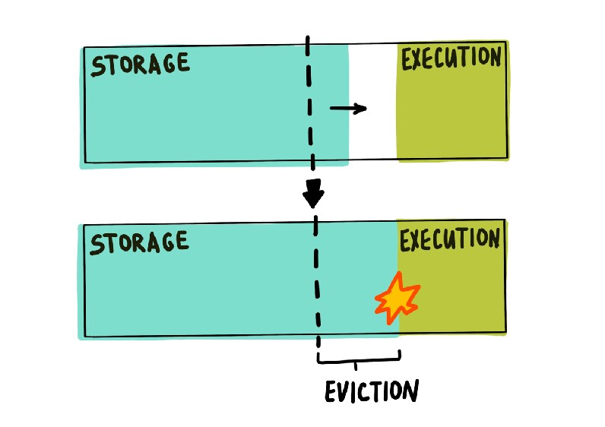
Cont..

Slide 10
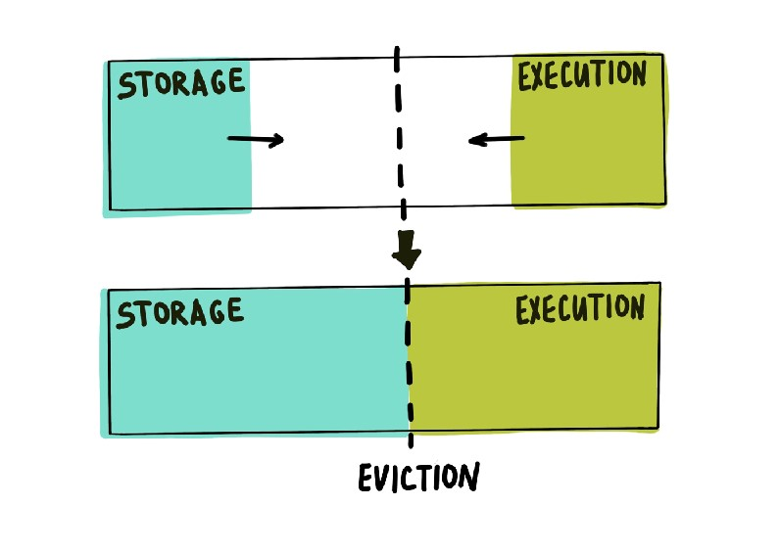
Cont..

Slide 11
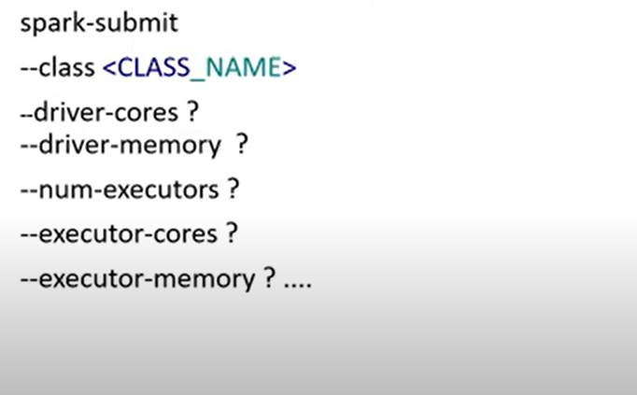
Spark-Submit?

Slide 12
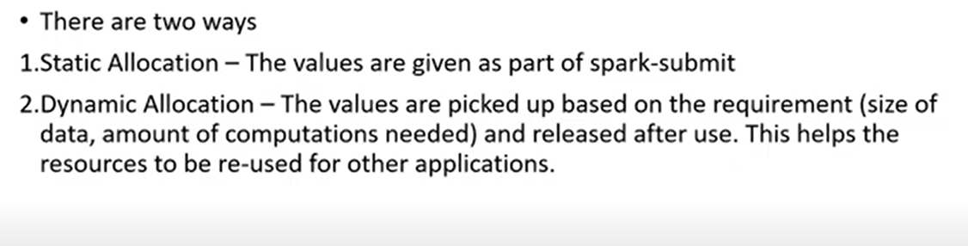
Spark-Submit?

Slide 13
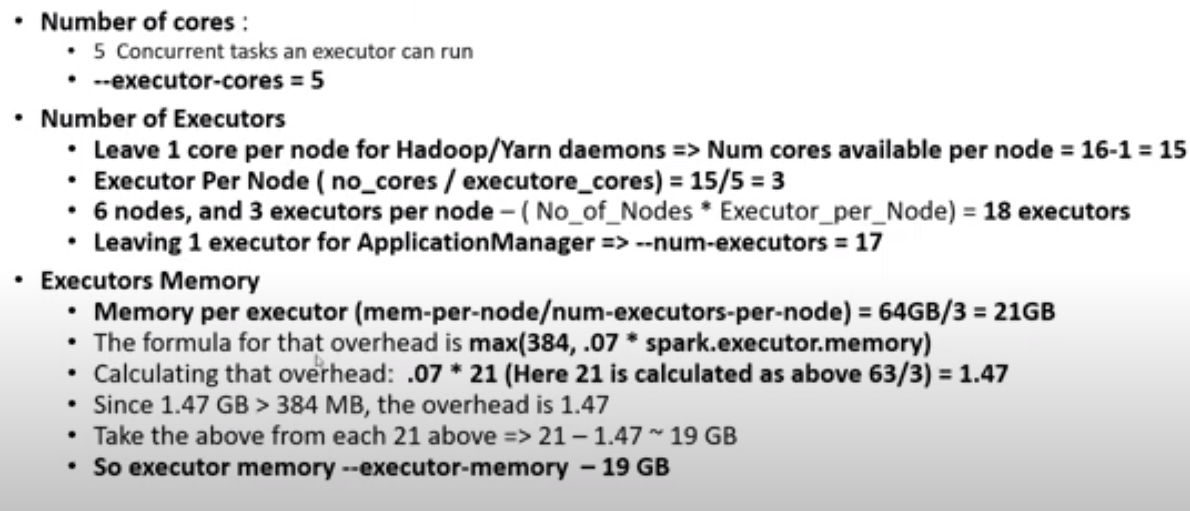
Example: 6 Nodes, each node have 16 cores, 64gb RAM

Slide 14
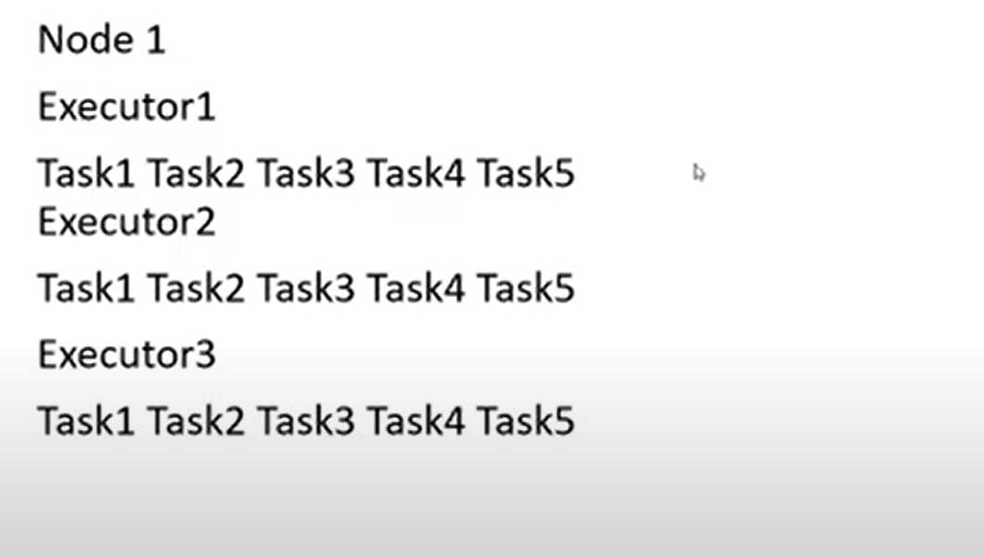
Task Execution

Slide 15
Representation of RDDs
Each RDD is divided into:
Multiple partitions
Dependencies on parent RDD(s)
Two types of Dependencies
Narrow
Wide

Slide 16
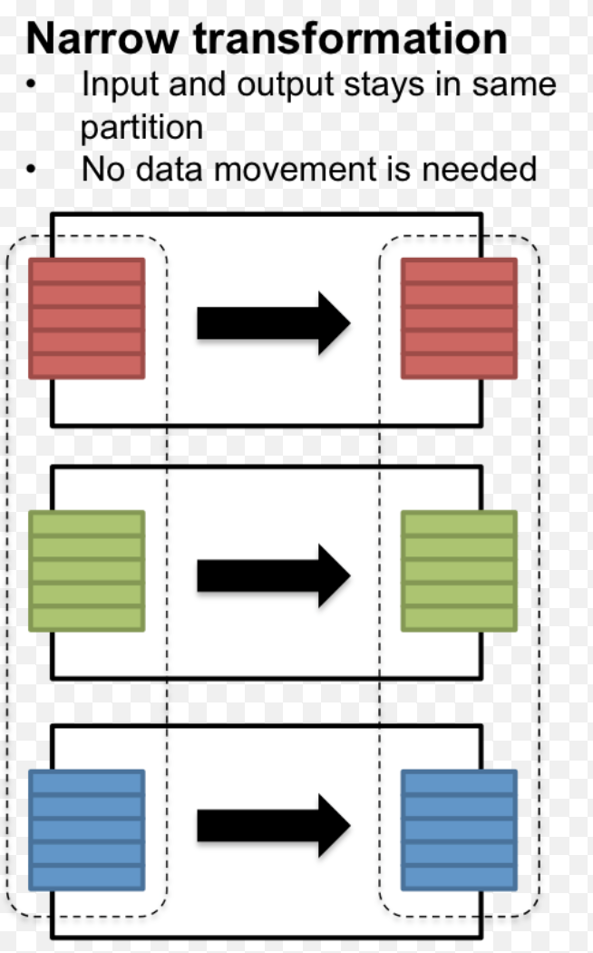
Narrow Dependency
1-1 relationship between child-parent partitions
Example Ops: Filter & Map
Relatively cheap process

Slide 17
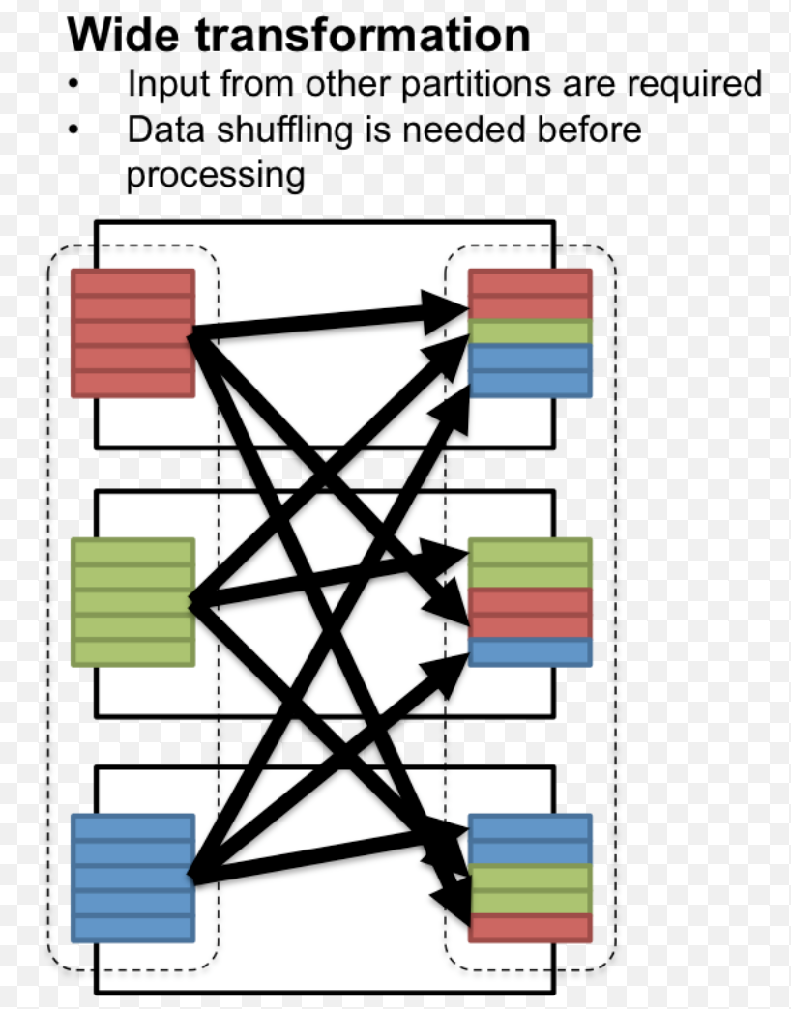
Wide Dependency
M-1 or M-M relationship between child-parent partitions
Example Ops: Join & Grouping
More expensive

Slide 18
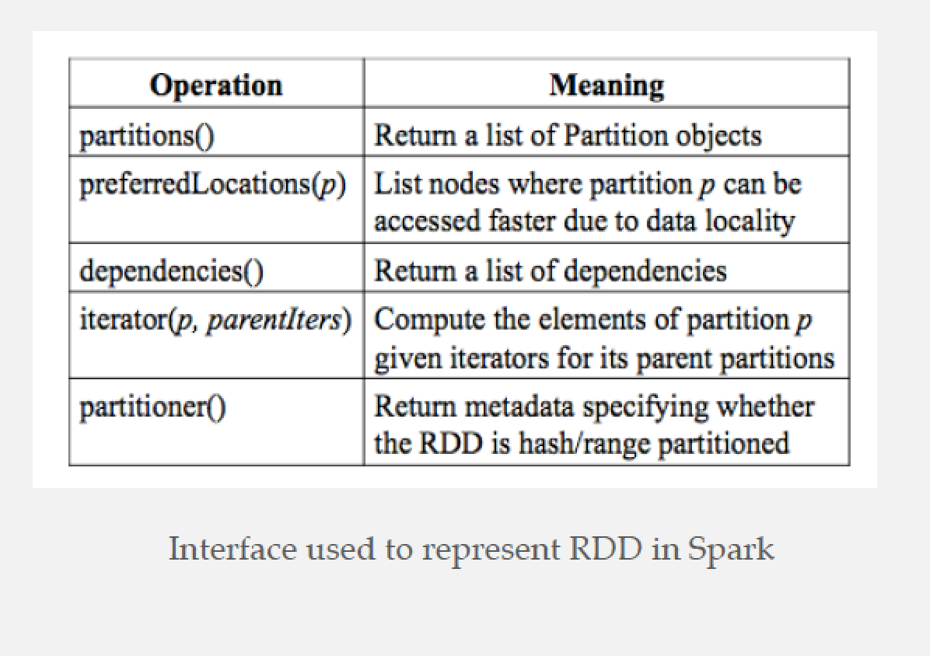
Interfaces on RDDs

Slide 19
Scheduling & Memory Management

Slide 20
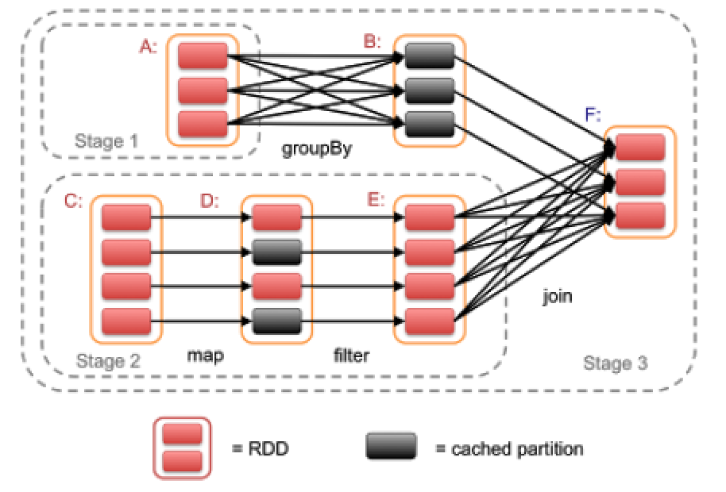
Scheduling
Execution is triggered when an “Action” op is invoked
Scheduler checks the lineage graph to execute

Slide 21
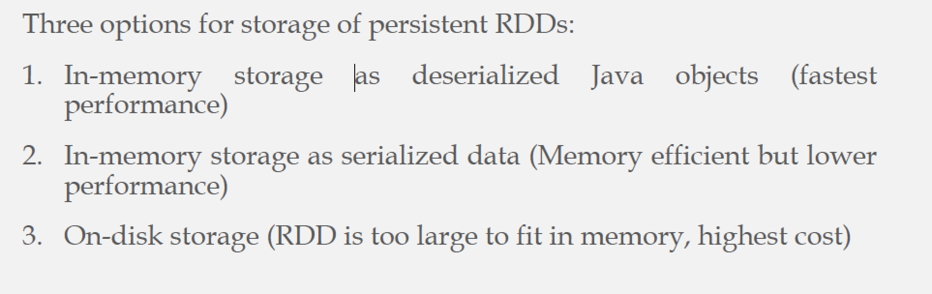
Spark Memory Management
Memory utilization is essential in Spark (Caching)

Slide 22
Replacement Policy
LRU eviction policy at the level of RDD partitions is used
When a new RDD partition is created
If there is space in memory ➔ Cache it
If not ➔ evict one or more partitions from the LRU RDD
Use “persistence priority” to prevent eviction of important RDDs

Slide 23
RDD Recovery
In case of failure and losing an RDD partition
This partition is lost
X
X
This partition is lost

Slide 24
RDD Recovery
Recovery can be time consuming for RDDs with long lineage chains
Use of Checkpoint Mechanism to make some RDDs persistent
User defined, OR
System controlled, OR
More intelligent ways, e.g., workload driven

