Slide 1
Assessment of Marginal Workers in Tamil Nadu- A Socioeconomic Analysis
TEAM NUMBER=01
Kapatralla Narendra naidu
(Team member

Slide 2
In [1]:
#importing the libraries in python import pandas as pd
import matplotlib.pyplot as plt #import seaborn for using piechart import seaborn as sns
import numpy as np
Importing csv file data sets
In [2]:
# Load the dataset into a Pandas DataFrame
df = pd.read_csv('Downloads/DDW_B06SC_3300_State_TAMIL_NADU-2011.csv')
checking the data fully filled that is fully true
In [3]:
#checking the dataset given is null or not df.isnull()
Out [3]:
Worked for 3 months
or more but less than 6 months
Worked for 3 months
or more but less than 6 months
Worked for 3 months or more but less than 6 months
Total/ Rural/ Urban
Worked
for less
than 3 ... months
Industrial Category
- N to O -
Females
Industrial Industrial
Industrial Category
- P to - P to
Q - Q -
Males Females
Industrial Category
- R to U - HHI
Industri
Table Code
State Code
District Code
Area Name
Age group
Category Category
Catego
- P to Q -
Persons
- R
-
-
U - H
-
- Females
- Persons
Persons
- Mal
0 False
False
False
False
False
False
Persons
Males
False
False
False
False
... False
False
False
False
False
False
1 False False False False False False False False False False ... False False False False False False
2 False False False False False False False False False False ... False False False False False False
3 False False False False False False False False False False ... False False False False False False
4 False False False False False False False False False False ... False False False False False False
... ... ... ... ... ... ... ... ... ... ... ... ... ... ... ... ... ...
589 False False False False False False False False False False ... False False False False False False
590 False False False False False False False False False False ... False False False False False False
591 False False False False False False False False False False ... False False False False False False
592 False False False False False False False False False False ... False False False False False False
593 False False False False False False False False False False ... False False False False False False
594 rows × 69 columns
Fetching and describe the data
^{In [4]:} l1=tuple([df['Worked for 3 months or more but less than 6 months - Females'],df['Worked for 3 months or more but less th
In [5]:
l2=tuple([df['Industrial Category - N to O - Females'],df['Industrial Category - P to Q - Persons']])
In [6]:
df.describe()
Out [6]:
Worked for 3 months or more but less than 6
months - Persons
Worked for 3 months or more but less than 6 months - Males
Worked for 3 months or more but less than 6 months - Females
Worked for less than 3 months
- Persons
Worked for less than 3 months - Males
Worked for less than 3 months - Females
Industrial Category - A
- Cultivators
- Persons
Industrial Category - A
- Cultivators
- Males
Industrial Category - A
rs es
- Cultivato
- Femal
count 5.940000e+02 594.000000 594.000000 594.000000 594.000000 594.000000 594.000000 594.000000 594.000000
mean 1.617277e+04 7932.700337 8240.067340 2981.629630 1338.289562 1643.340067 865.117845 466.424242 398.693603
std 7.607172e+04 36864.822704 39259.545337 13909.621137 6127.047670 7808.832522 4274.458077 2298.072295 1978.682322
min 0.000000e+00 0.000000 0.000000 0.000000 0.000000 0.000000 0.000000 0.000000 0.000000
25% 2.872500e+02 147.250000 144.000000 27.000000 14.250000 13.000000 9.000000 5.000000 4.000000
50% 2.225500e+03 1147.000000 1076.000000 430.000000 198.500000 213.000000 69.500000 35.500000 32.000000
75% 9.628500e+03 4770.500000 4887.500000 1775.250000 774.250000 946.500000 466.000000 244.250000 204.750000
max 1.200828e+06 589003.000000 611825.000000 221386.000000 99368.000000 122018.000000 64235.000000 34632.000000 29603.000000

Slide 3
In [7]:
8 rows × 63 columns
l1
Out [7]: (0 | 611825
1 | 13666
2 | 254780
3 | 290624
4 | 52270
 | ...
589 | 143
590 | 1631
591 | 1903
592 | 297
593 | 1
Name: Worked for 3 months or more but less than 6 months - Females, Length: 594, dtype: int64,
0 | 589003
1 | 14125
2 | 259560
3 | 251957
4 | 62833
 | ...
589 | 129
590 | 1654
591 | 1769
592 | 399
593 | 1
In [8]:
Name: Worked for 3 months or more but less than 6 months - Males, Length: 594, dtype: int64)
l2
Out [8]: (0 | 3565
1 | 11
2 | 1754
3 | 1619
4 | 175
 | ...
589 | 0
590 | 20
591 | 33
592 | 0
593 | 0
Name: Industrial Category - N to O - Females, Length: 594, dtype: int64,
0 | 11080
1 | 122
2 | 7536
3 | 3205
4 | 211
589 | ... 0
590 | 44
591 | 35
592 | 3
593 | 0
Name: Industrial Category - P to Q - Persons, Length: 594, dtype: int64)
In [9]:
# assigning the csv data to variable of piechart
pie_chart_data df['Worked for 3 months or more but less than 6 months - Persons'] #asigning values to the pie chart
plt.pie(pie_chart_data, labels=df['Worked for 3 months or more but less than 6 months - Persons'], autopct='%1.1f%%',ra
plt.title('Pie Chart Title') #printing the pie chart plt.show()
=

Slide 4
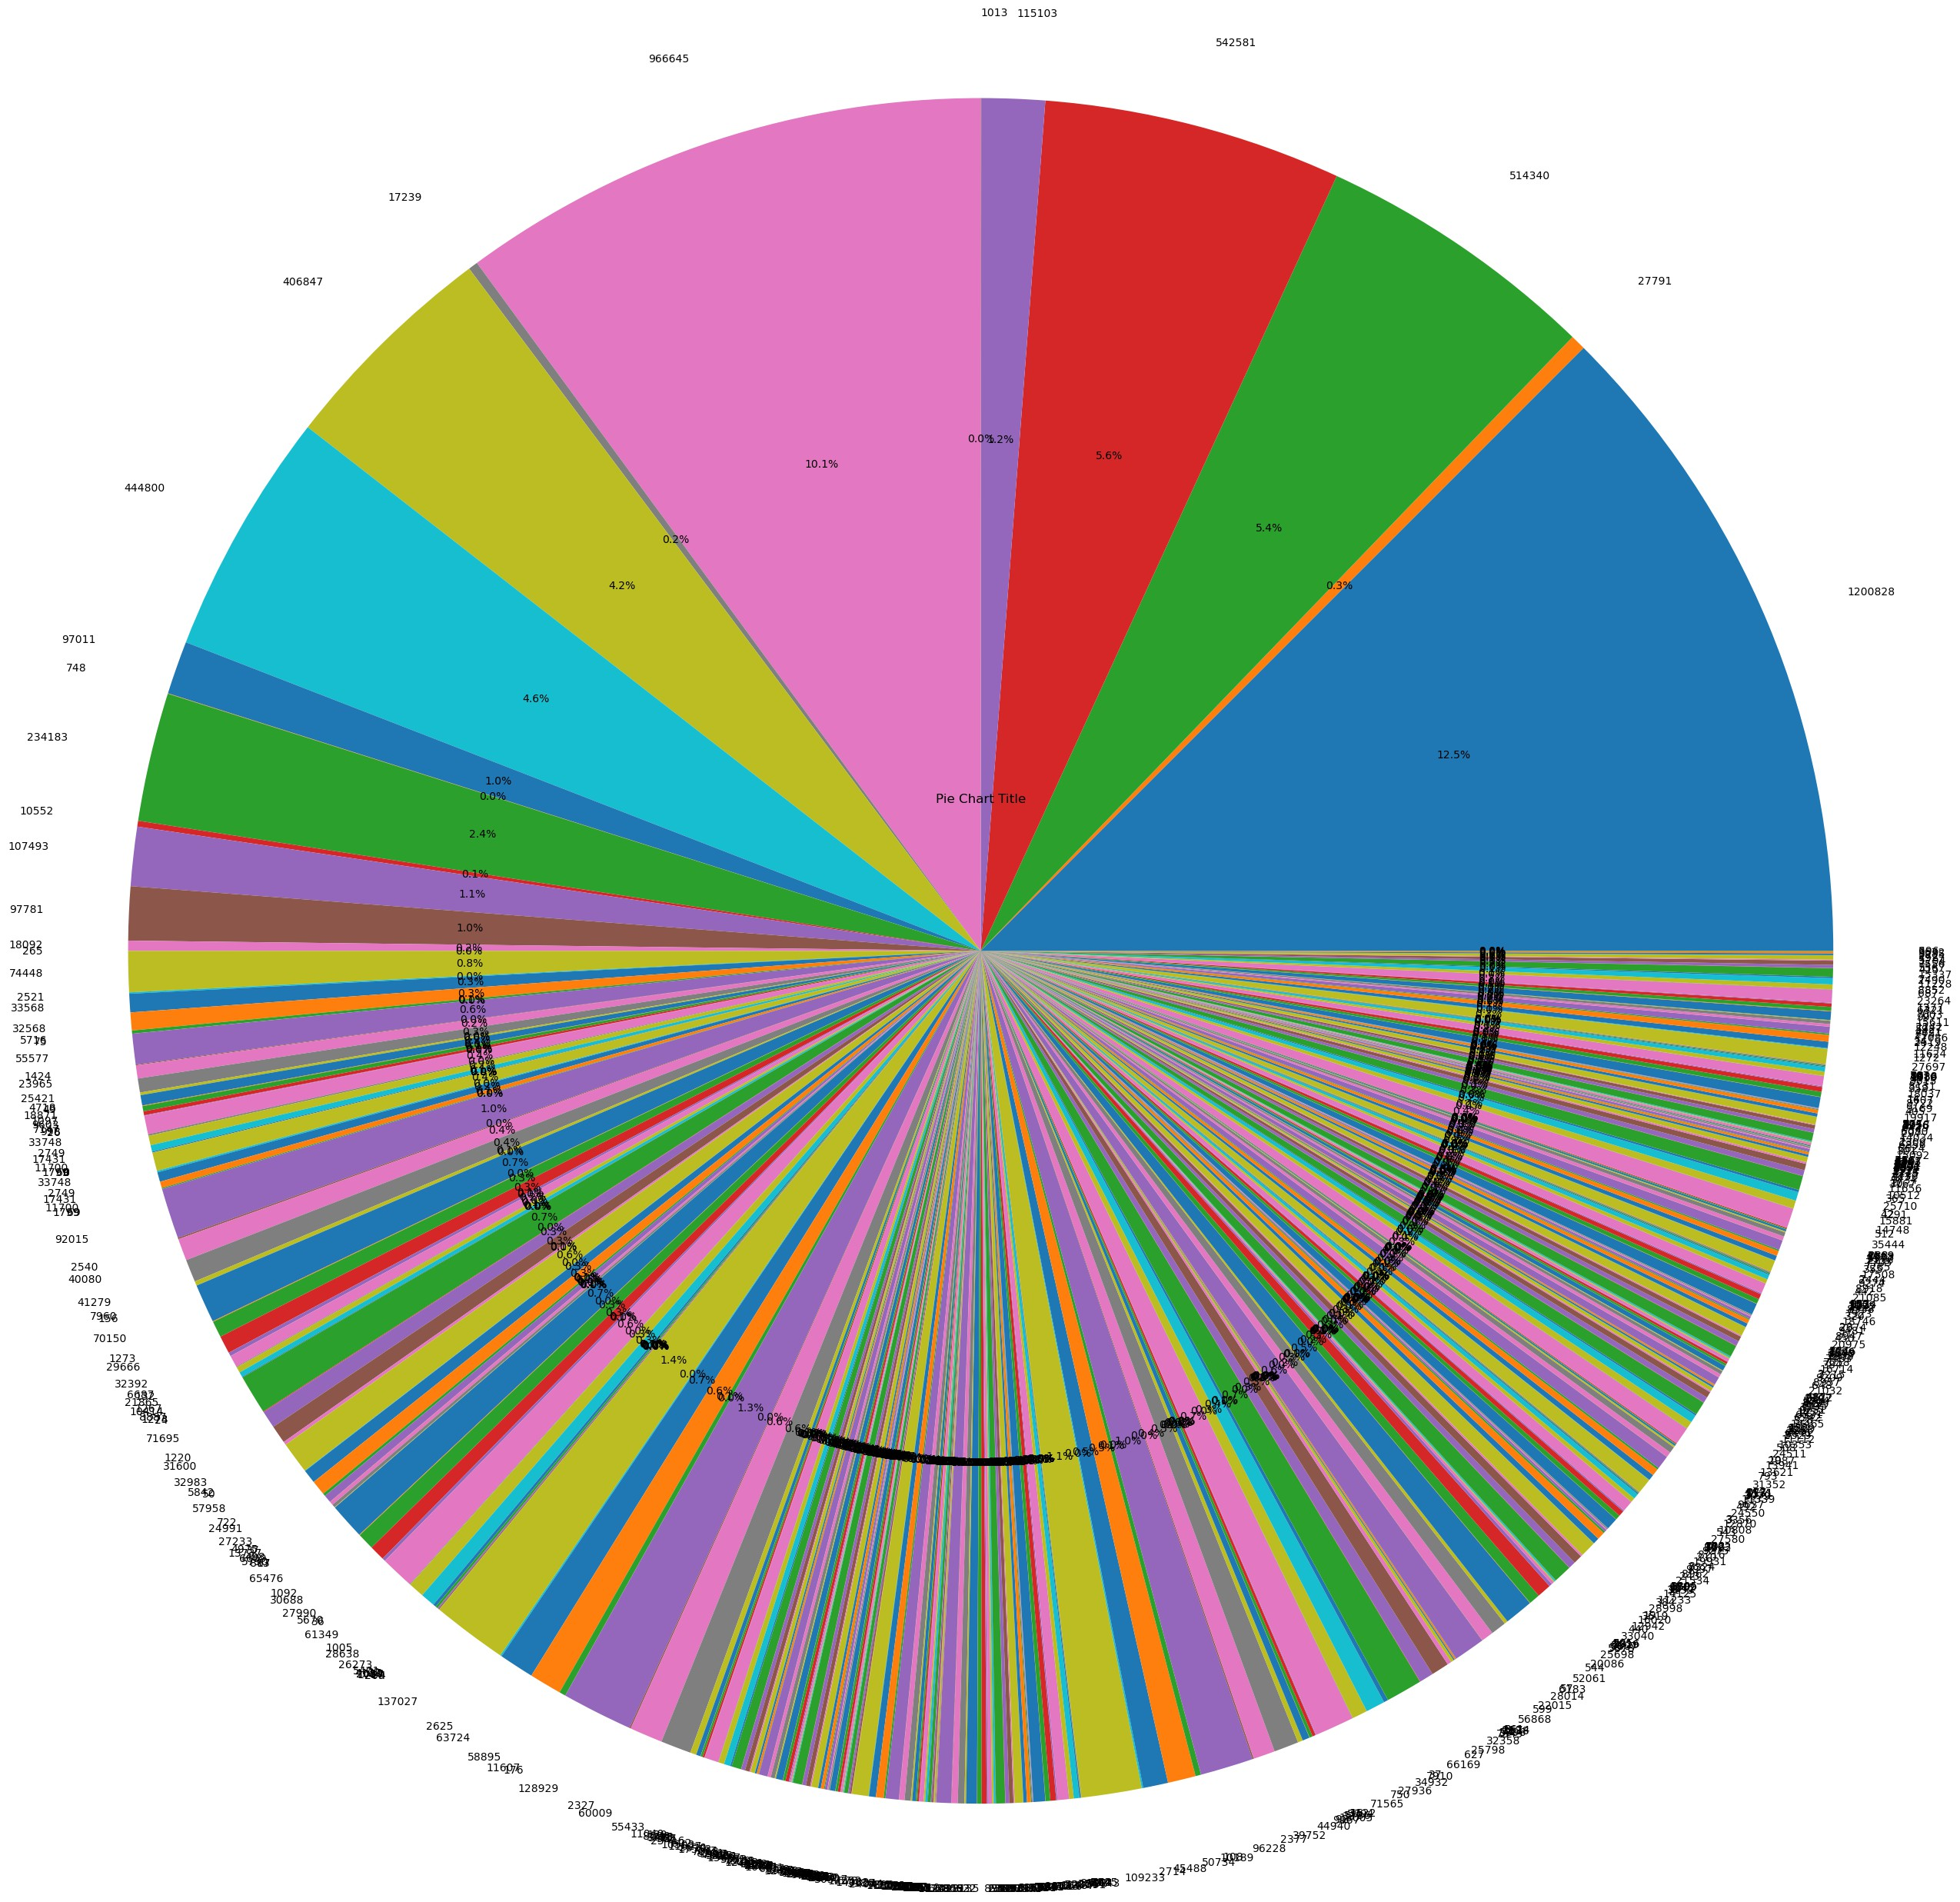
printing the pie chart using the given csv file data sets
In [10]:
price = df["Age group"]
visualizing the data sets column in the form of of histogram
In [11]:
plt.hist(price)
Out [11]: (array([99., 0., 99., 0., 99., 0., 99., 0., 99., 99.]),
array([0. , 0.5, 1. , 1.5, 2. , 2.5, 3. , 3.5, 4. , 4.5, 5. ]),
<BarContainer object of 10 artists>)

Slide 5
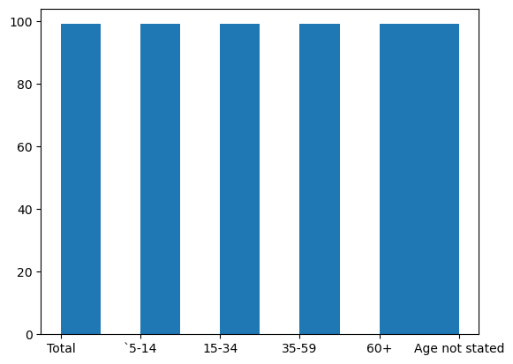
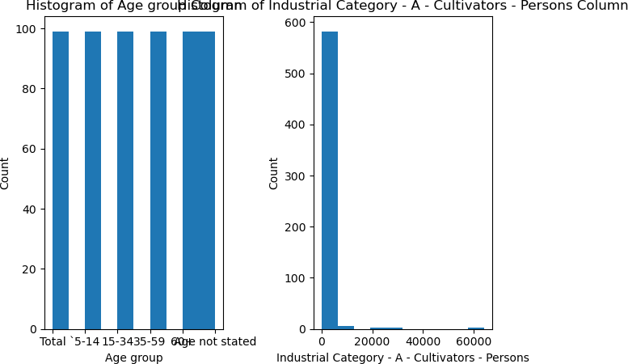
In [16]:
column_1 = df["Age group"]
column_2 = df["Industrial Category - A - Cultivators - Persons"]
# Create the histogram
fig, axs = plt.subplots(1, 2)
axs[0].hist(column_1) axs[1].hist(column_2)
# Add a title and axis labels for each subplot axs[0].set_title("Histogram of {} Column".format(column_1.name)) axs[1].set_title("Histogram of {} Column".format(column_2.name))
axs[0].set_xlabel(column_1.name) axs[1].set_xlabel(column_2.name)
axs[0].set_ylabel("Count") axs[1].set_ylabel("Count")
# Adjust the subplot layout plt.tight_layout()
# Show the plot plt.show()
visualizing three different columns by using scatter plot
^{In [26]:} x_column = df["Age group"]
y_column = df["Industrial Category - A - Plantation, Livestock, Forestry, Fishing, Hunting and allied activities - Perso z_column = df["Industrial Category - C - HHI - Persons"]
# Create the scatter plot

Slide 6
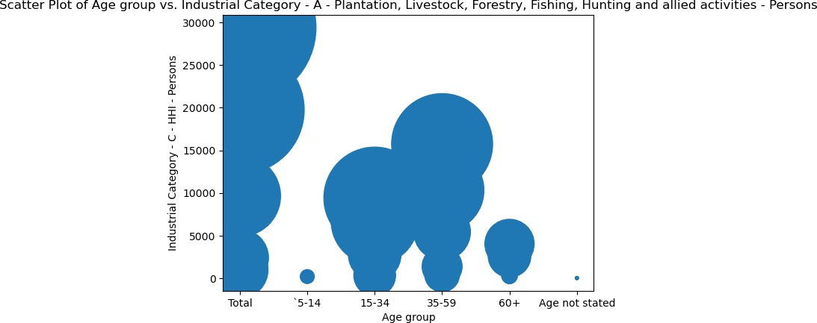
 | plt.scatter(x_column, y_column, z_column) # Add a title and axis labels plt.title("Scatter Plot of {} vs. {}".format(x_column.name, y_column.name, z_column.name)) plt.xlabel(x_column.name) plt.ylabel(y_column.name) plt.ylabel(z_column.name) # Show the plot plt.show()
output for the scatter plot for the gib=ven three columns

