Slide 1
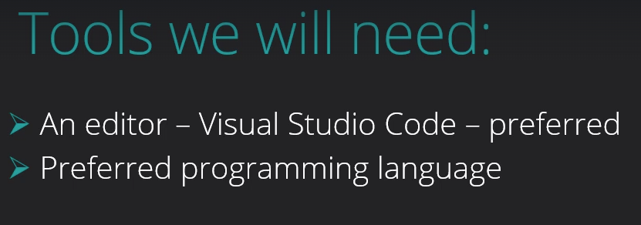

Slide 2
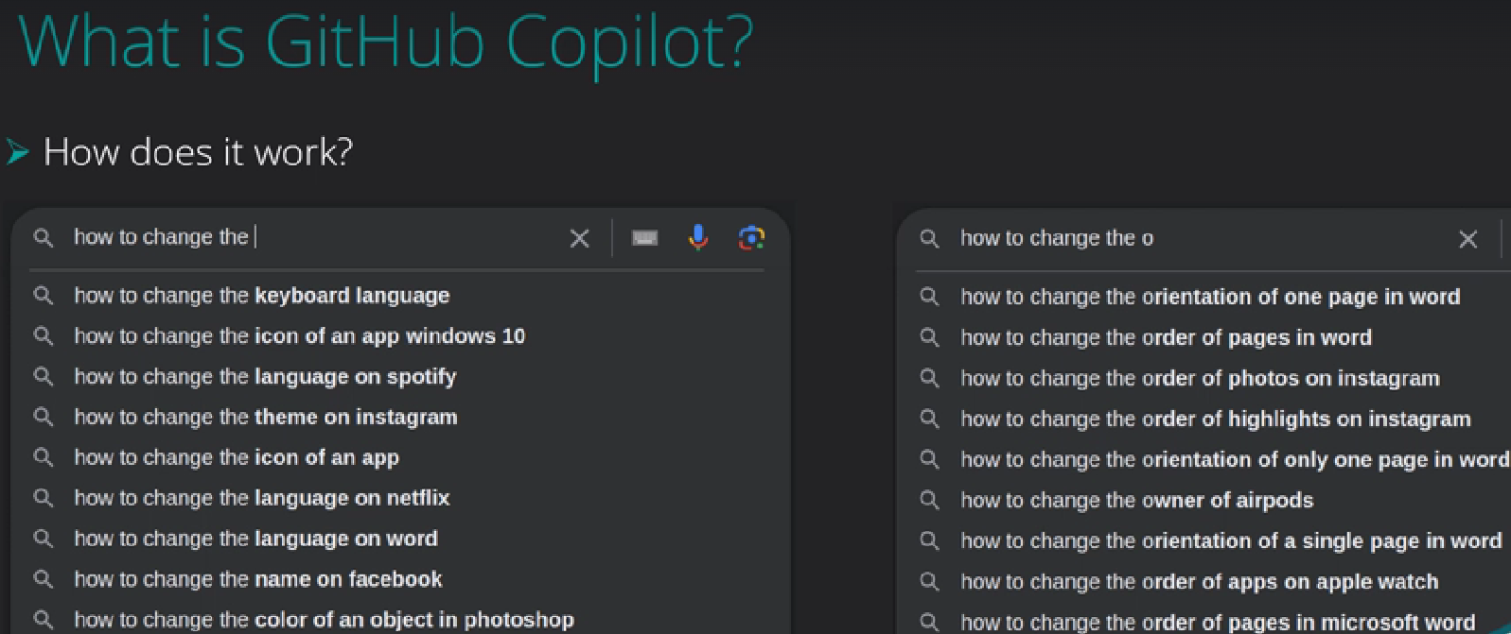

Slide 3
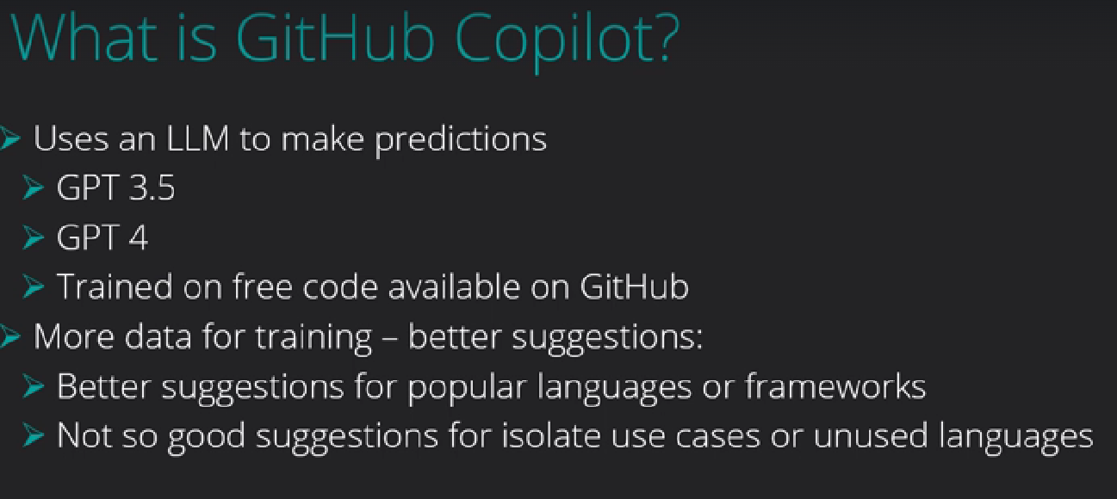

Slide 4
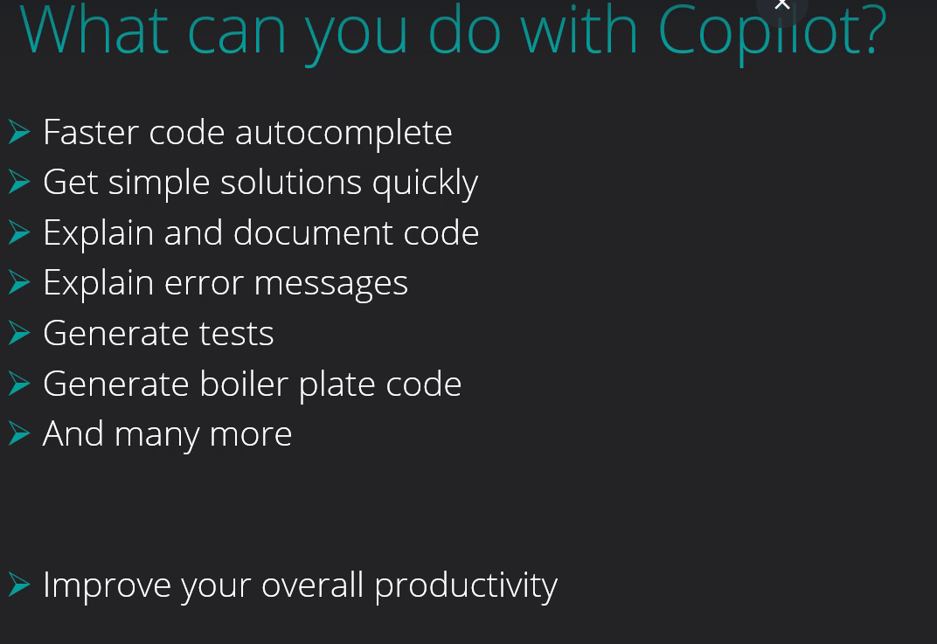

Slide 5
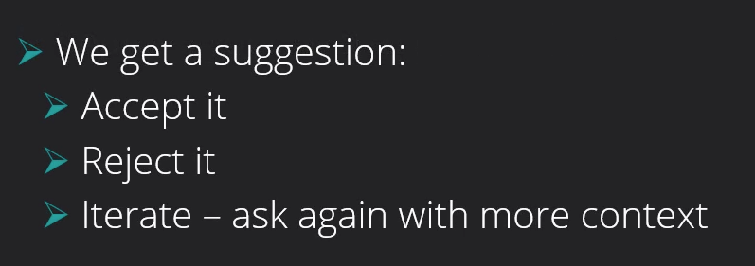

Slide 6
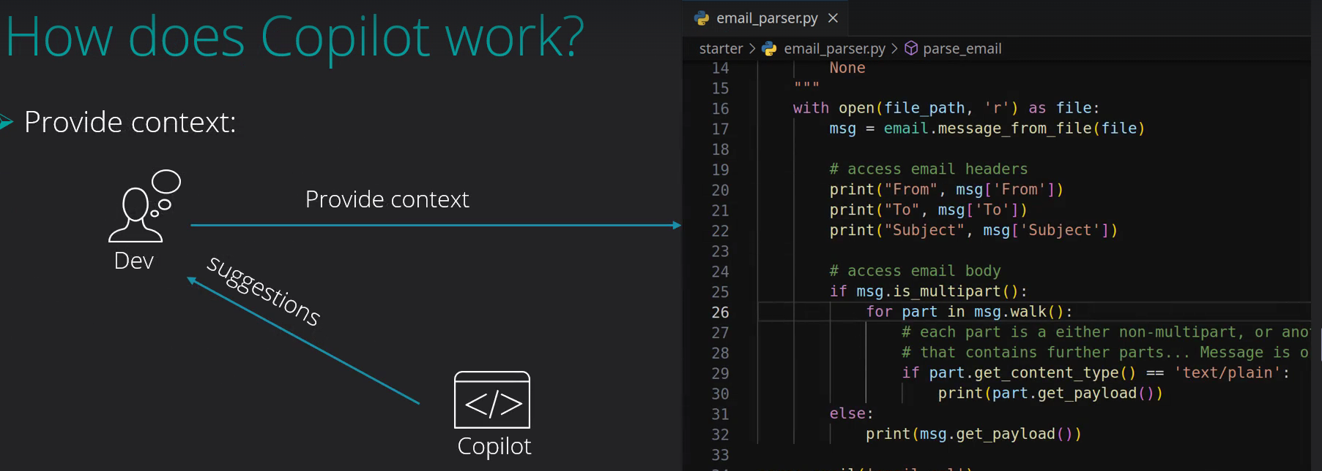

Slide 7
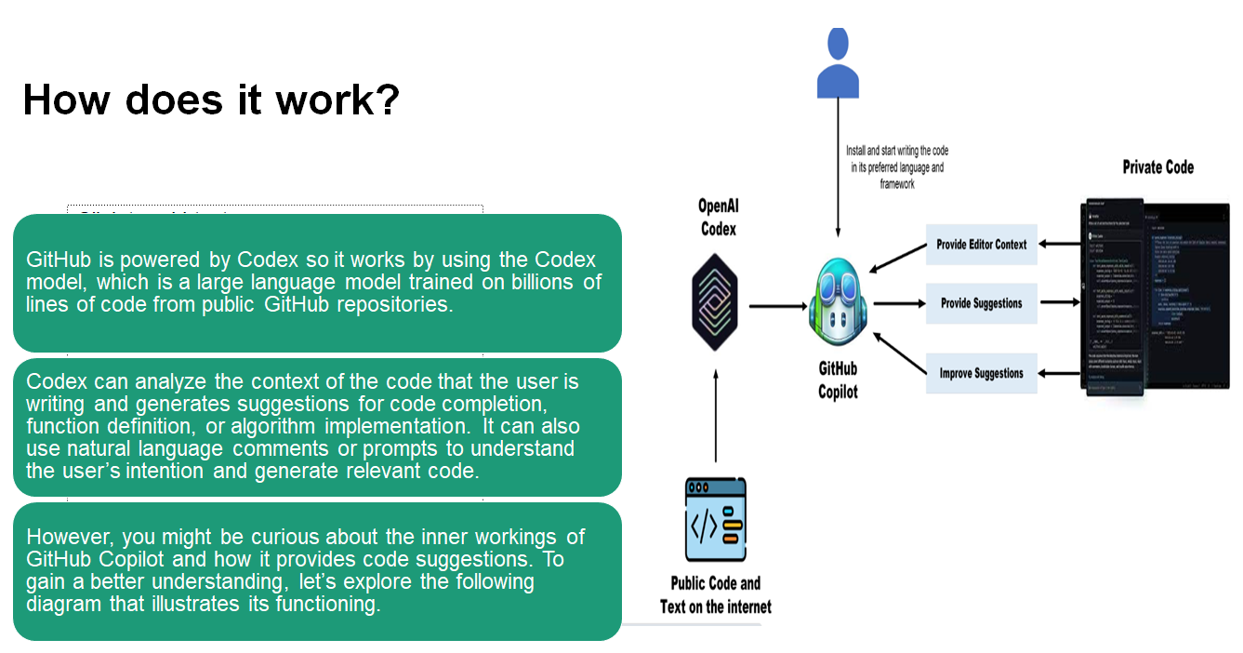

Slide 8
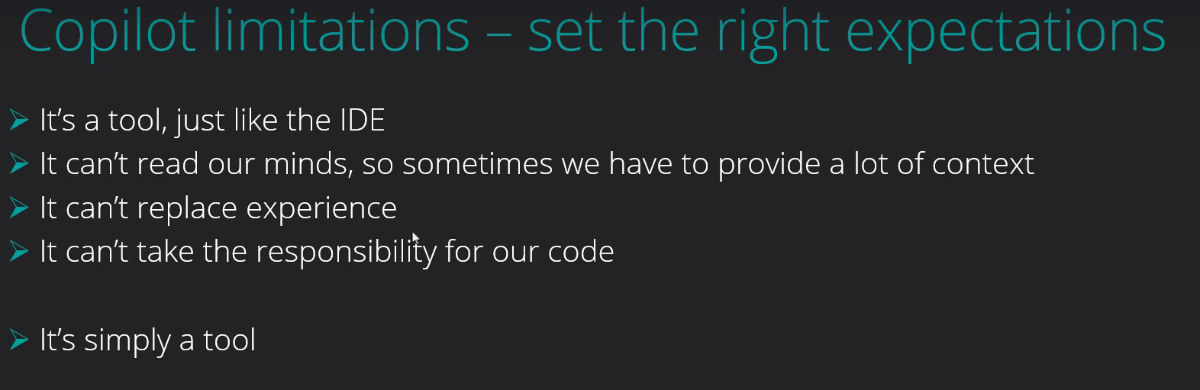

Slide 9
6 principles of responsible AI
Fairness: AI systems should treat all people fairly.
Reliability and safety: AI systems should perform reliably and safely.
Privacy and security: AI systems should be secure and respect privacy.
Inclusiveness: AI systems should empower everyone and engage people.
Transparency: AI systems should be understandable.
Accountability: People should be accountable for AI systems.

Slide 10
Prompt engineering
What is Prompt Engineering?
Prompt engineering principles
Best practices

Slide 11
What is prompt engineering?
Prompt engineering is the process of crafting clear instructions to guide AI systems, like GitHub Copilot, to generate context-appropriate code tailored to your project's specific needs.
This ensures the code is syntactically, functionally, and contextually correct.

Slide 12
Principles of prompt engineering
4 S rules of creating effective prompts
-Single
-Specific
-Short
-Surround

Slide 13
Best practices in prompt engineering
1)Provide enough clarity
2) Provide enough context with details
3) Provide examples for learning
4) Assert and iterate

Slide 14
How Copilot learns from your prompts
Zero-shot learning
One-shot learning
Few-shot learning

Slide 15
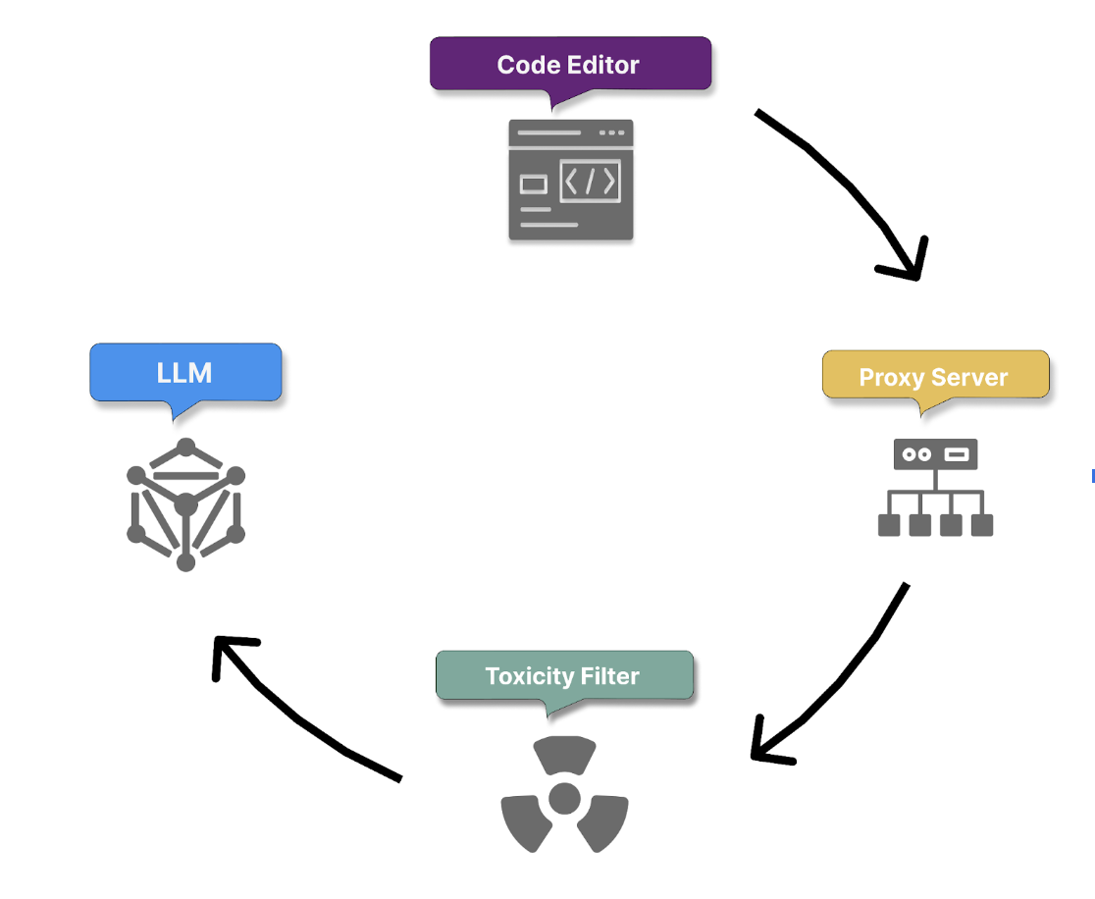
GitHub Copilot user prompt process flow - INBOUND

Slide 16
Proxy filter
Once the context is gathered and the prompt is built, it passes securely to a proxy server hosted in a GitHub-owned Microsoft Azure tenant.
The proxy filters traffic, blocking attempts to hack the prompt or manipulate the system into revealing details about how the model generates code suggestions.

Slide 17
Toxicity filtering
Hate speech and inappropriate content: Copilot employs algorithms to detect and prevent the intake of hate speech, offensive language, or inappropriate content that could be harmful or offensive.
Personal data: Copilot actively filters out any personal data, such as names, addresses, or identification numbers, to protect user privacy and data security.

Slide 18
Code generation with LLM
Finally, the filtered and analyzed prompt is passed to LLM Models, which generate appropriate code suggestions.

Slide 19
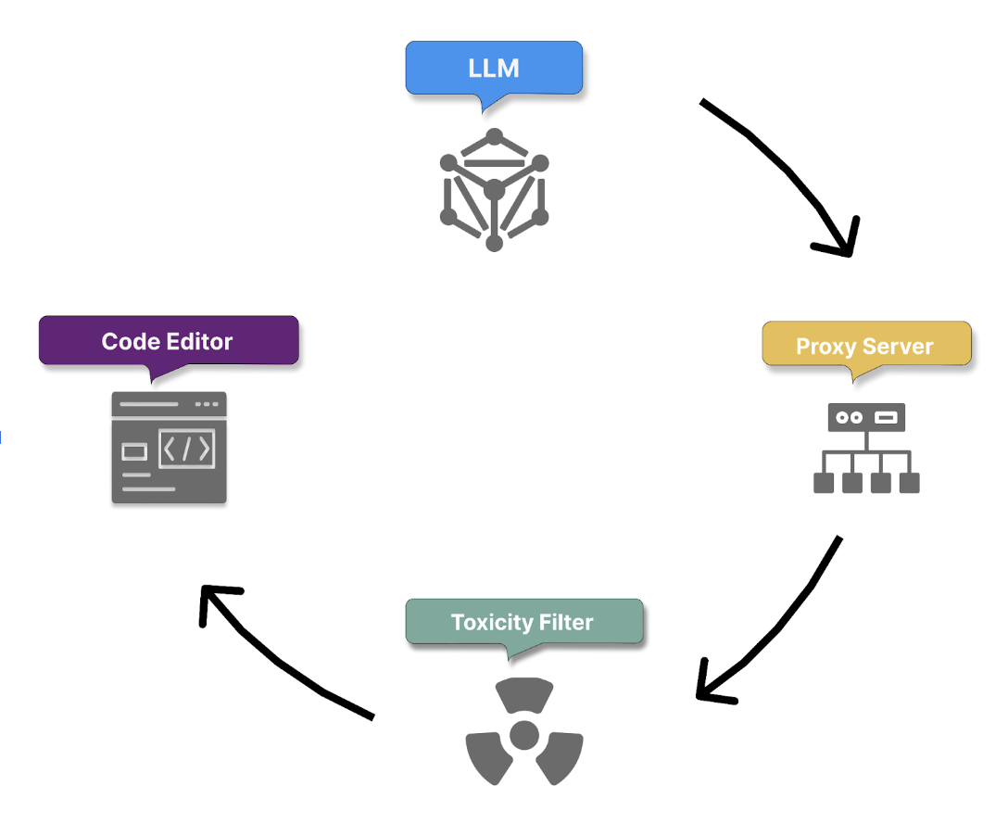
GitHub Copilot user prompt process flow - OUTBOUND

Slide 20
OUTBOUND
Once the model produces its responses, the toxicity filter removes any harmful or offensive generated content. The proxy server then applies a final layer of checks to ensure code quality, security, and ethical standards.

Slide 21
GitHub Copilot Support
GitHub Copilot offers a free tier with 2,000 code autocompletes and 50 chat messages per month.
Educators, Students and select open-source maintainers can receive Copilot Pro for free

Slide 22
Languages and Framework Support
GitHub Copilot provides robust support for a wide range of programming languages and frameworks
-Python
-JavaScript
-Java
-TypeScript
-Ruby
-Go
-C#
-C++ and so on

Slide 23
Copilot can work with various types of comments to inform its suggestions
-Inline comments: Short explanations next to specific lines of code.
-Block comments: Longer explanations that might describe a function or class.
-TODO comments: Notes about future implementations or improvements.
-API Documentation: Comments that describe the usage and parameters of functions or methods.

