Slide 1
DOCUMENTATION

Slide 2
Generate inline code documentation using GitHub Copilot
Ask mode:
Use the ask mode to suggest inline code documentation for a code file, class, or method. Review the suggested inline documentation in the Chat view.
Request updates as needed in the chat conversation. Once you're satisfied with the proposed documentation, you can insert the suggested documentation into the corresponding code file.
e.g. @workspace /doc Create inline code documentation for the ConsoleApp class.

Slide 3
Generate inline code documentation using GitHub Copilot
Agent mode:
Use the agent mode to autonomously generate inline code documentation for specified code projects, files, classes, or methods. Have the agent perform other tasks during or after the documentation process. Accept or reject the updates when the agent has completed the assigned tasks.
e.g. “Create inline code documentation for all C# class files in the specified context. Document the class, properties, and methods. Do not add documentation to JSON, markdown, or other file types. Do not document UnitTest project files in the Test folder. Ensure that the solution builds without errors after the documentation is added.”

Slide 4
Generate inline code documentation using GitHub Copilot
Inline chat mode:
Use an inline chat session to work directly in the code editor. The inline chat is useful when you want to document specific code (classes, methods, or code blocks) without leaving the editor. You can provide specific instructions in the prompt. Updates are displayed in the code editor and can be accepted or rejected. You can also choose the option to rerun the prompt with or without updates.
e.g. “Document the selected method. List currentState options”

Slide 5
Generate project documentation using GitHub Copilot
Project documentation describes the purpose, goals, and requirements of a project.
To create project documentation, you need to understand the project structure, its components, and how the components interact with each other.
Chat view is an ideal tool for generating project documentation, because it can analyze the entire project structure and provide high-level overviews of the project.
The Chat view can also be used to generate specific types of documentation, such as README files, API references, and other project-related documents.

Slide 6
For example, the README.md could include the following sections:
Project Title: The name of your project.
Description: A brief overview of what the project does and why it exists.
Table of Contents: Optional, but helpful for longer READMEs.
Installation: Instructions on how to install and set up the project.
Usage: Examples of how to use the project, including code snippets or screenshots.
Features: A list of key features or functionality.
Configuration: Details on any configuration options or environment variables.
License: Any licenses used by the distributed project.
Credits and acknowledgments: Recognition of contributors, libraries, or resources used.
Contact: How to reach the maintainers or project team.
Changelog: A history of changes and updates (sometimes linked to a separate file).

Slide 7
Generate project documentation using GitHub Copilot
Chat view in ask mode:
Use the ask mode to analyze the codebase and gain an understanding of the code projects, files, and classes.
Use ask mode to preview suggested project documentation.
Review suggestions and request updates or other details as needed.
Insert the suggested documentation into a project documentation file (README.md).

Slide 8
Ask mode example
“/explain I need help creating a README file that can be used in the GitHub repository for this workspace. The file should be formatted as markdown. The README file needs to include the following sections: Project Title, Description, Table of Contents, Installation, Usage, Features, Configuration, and License."

Slide 9
Generate project documentation using GitHub Copilot
Chat view in Agent mode:
Generate a project documentation file (README.md).
Agent mode is best for making changes to specific files in the project.
The Agent mode can be used to generate project documentation by adding context files to the chat and then creating or updating documentation files.

Slide 10
Agent mode example
"I need to create a README file that can be used for the GitHub repository. The file should be formatted as markdown. Create a README.md file in the root workspace folder. The README file needs to include the following sections: Project Title, Description, Table of Contents, Installation, Usage, Features, Configuration, and License."

Slide 11
Generate project documentation using GitHub Copilot
Chat view in agent mode: Generate a collection of project documentation files: create/update the README.md, create/update the UsageExamples.md, and create/update the ChangeLog.md.
Include links between the documentation files, cross-reference classes and methods, and ensure consistency across docs.

Slide 12
Agent mode example
"Generate a collection of project documentation files. Create or update the workspace README.md file for this repository. Create or update the UsageExamples.md file. Create or update the ChangeLog.md file. Include links between the documentation files, cross-reference classes and methods, and ensure consistency across the documents."

Slide 13
GitHub Copilot plans

Slide 14
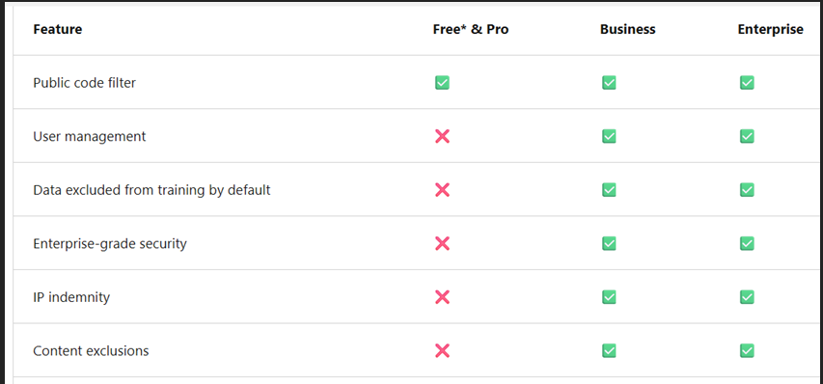
GitHub Copilot plans
Every developer and organization has specific needs. That's why GitHub Copilot has several pricing plans.
Available GitHub Copilot plans:

Slide 15
GitHub Copilot plans
When you're selecting a GitHub Copilot pricing plan, you and your organization should consider these key factors:
Data privacy and security
Policy management
Data collection and retention
IP indemnity and data privacy

Slide 16
Data privacy and security
The plans offer varying levels of data privacy and security measures.
For instance, GitHub Copilot Business and Enterprise are the only plans that provide more robust privacy controls.
These controls include the ability to exclude specific files from GitHub Copilot analysis, access detailed audit logs, and provide IP indemnity.

Slide 17
Policy management
The ability to manage Copilot policies at an organizational level is crucial.
Business and Enterprise plans allow for comprehensive policy management, to help ensure that sensitive data is handled according to the organization's privacy policies.

Slide 18
Data collection and retention
Understanding how data is collected and retained is essential for compliance with data privacy regulations.
Individual subscribers can choose whether GitHub collects and retains their prompts and Copilot suggestions.

Slide 19
IP indemnity and data privacy
For businesses and enterprises, IP indemnity and data privacy are critical to avoiding legal, security, and customer issues.
Evaluating the need for these features can help determine the most suitable pricing plan for your business.

Slide 20
IP indemnity
The GitHub Copilot Business and Enterprise plans include IP indemnity, which provides legal protection against intellectual property claims related to the use of Copilot suggestions.
With IP indemnity, if any suggestion from GitHub Copilot is challenged as infringing on third-party IP rights, GitHub assumes legal responsibility.
For GitHub to assume legal responsibility, the Matching public code setting must be blocked.

Slide 21
Filtering out matching public code
GitHub Copilot can help minimize potential code overlap by identifying and filtering out code suggestions that match publicly available code.
This feature is essential for maintaining the originality and security of your codebase.
It can reduce the risk of incorporating nonsecure or noncompliant code into your projects.

Slide 22
Manage content exclusions
The content exclusion feature in GitHub Copilot helps protect sensitive information by preventing the use of specific files, directories, or repositories to inform code-completion suggestions.
Configure content exclusions for repositories
Configure content exclusions for organizations

Slide 23
Impact of content exclusion on code suggestions
You can use content exclusions to configure GitHub Copilot to ignore certain files. When you exclude content from GitHub Copilot:
Code completion is no longer available in the affected files.
The content in affected files won't inform code completion suggestions in other files.
The content in affected files won't inform GitHub Copilot Chat responses.

Slide 24
Impact of content exclusion on code suggestions
Content exclusions can significantly affect the quality and relevance of code suggestions that GitHub Copilot generates.
When you exclude certain files or directories, GitHub Copilot won't use the content in those files to inform its suggestions.
This action can lead to more secure and compliant code suggestions, but it might also reduce the overall context available to GitHub Copilot.
This reduction could potentially affect the accuracy and usefulness of the suggestions.

Slide 25
Limitations of content exclusions
IDE limitations: In some integrated development environments (IDEs), content exclusions might not apply when you're using certain features, such as Copilot Chat.
Policy scope: Content exclusion settings apply only to members of the organization in which you configure the content exclusion. Anyone else who can access the specified files can still see code completion suggestions and Copilot Chat responses referencing the specified files.

