Slide 1
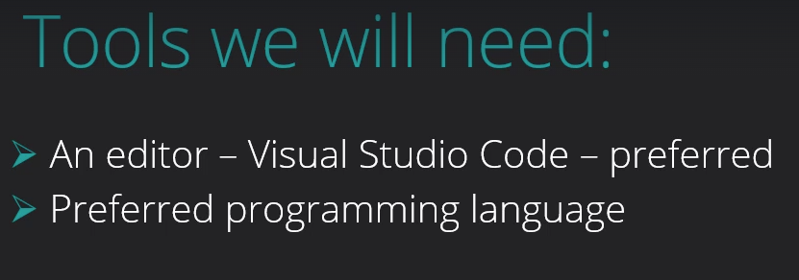

Slide 2
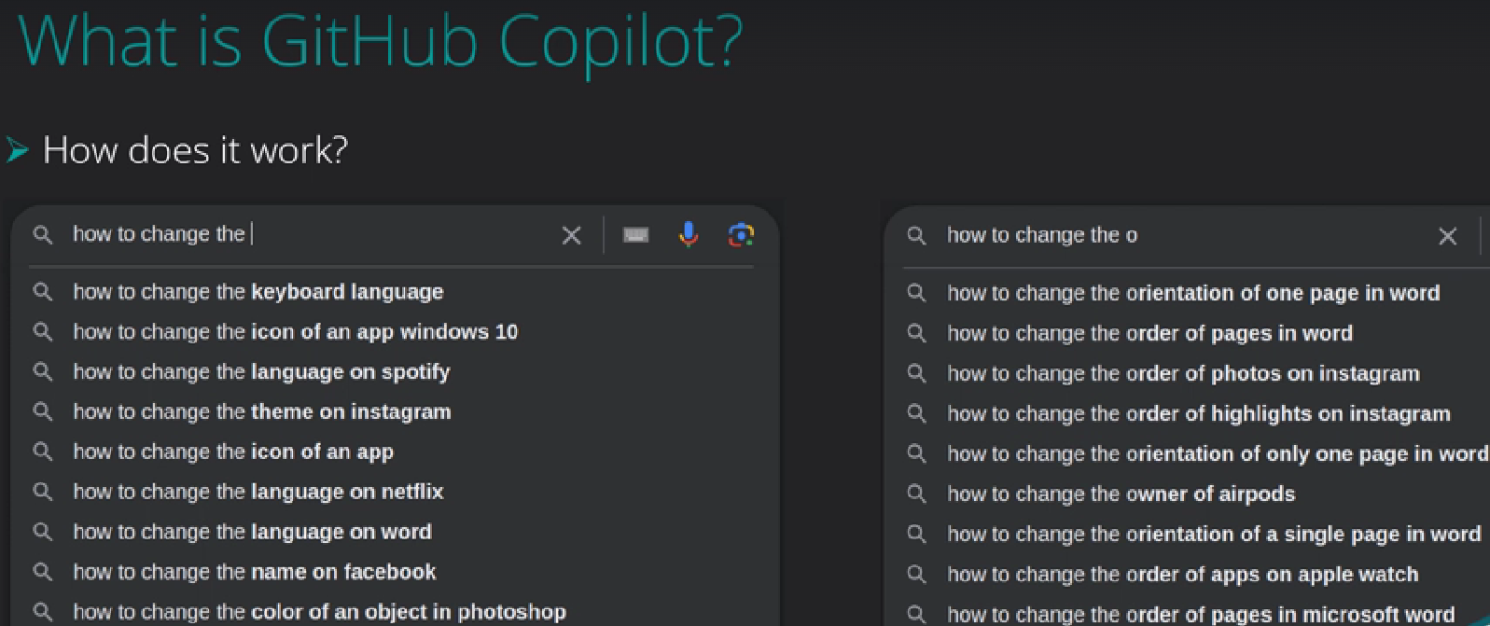

Slide 3
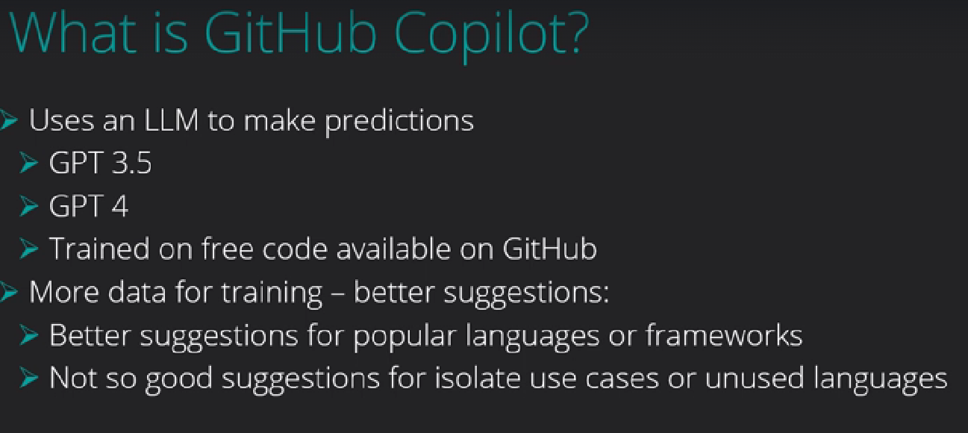

Slide 4
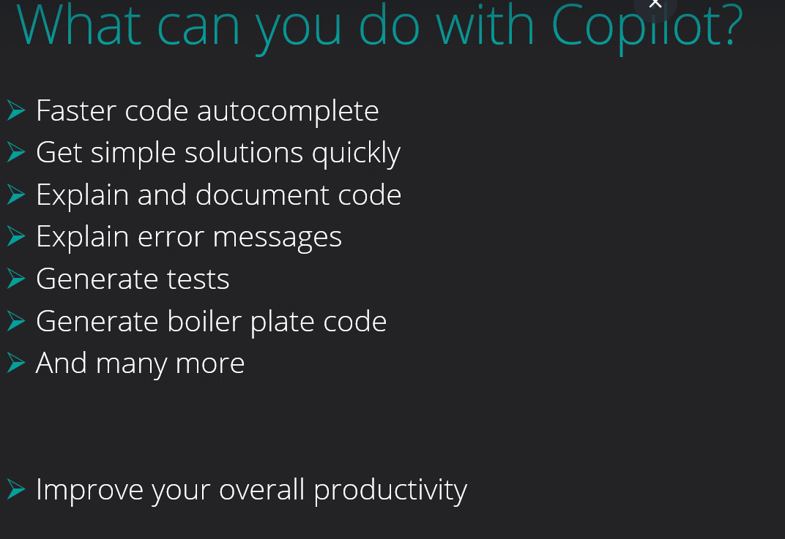

Slide 5
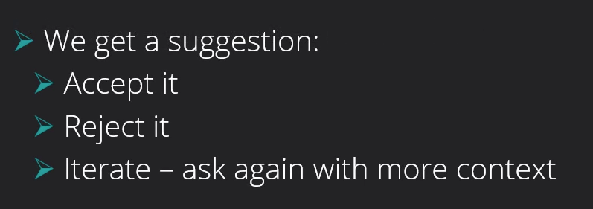

Slide 6
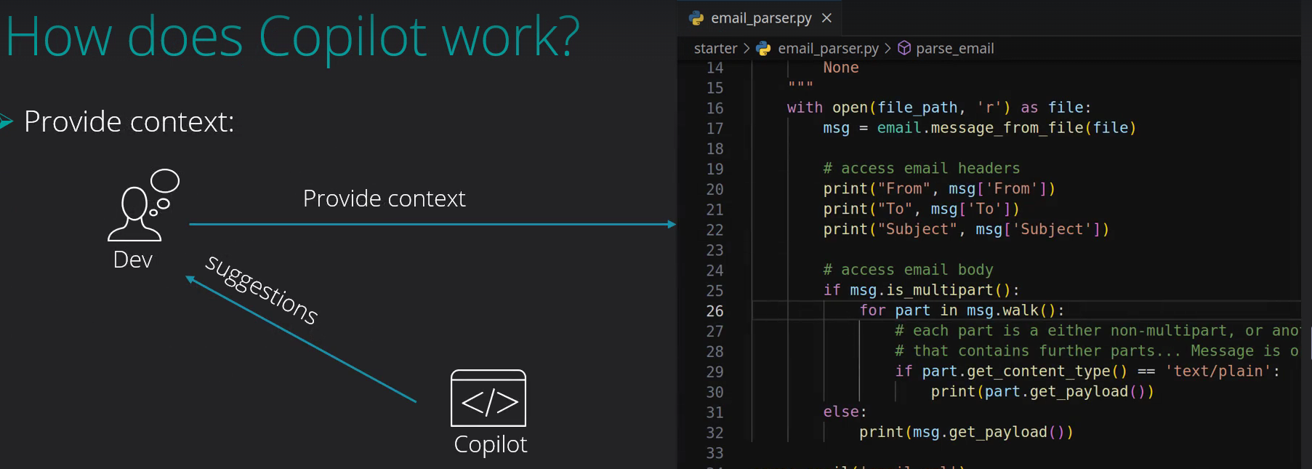

Slide 7
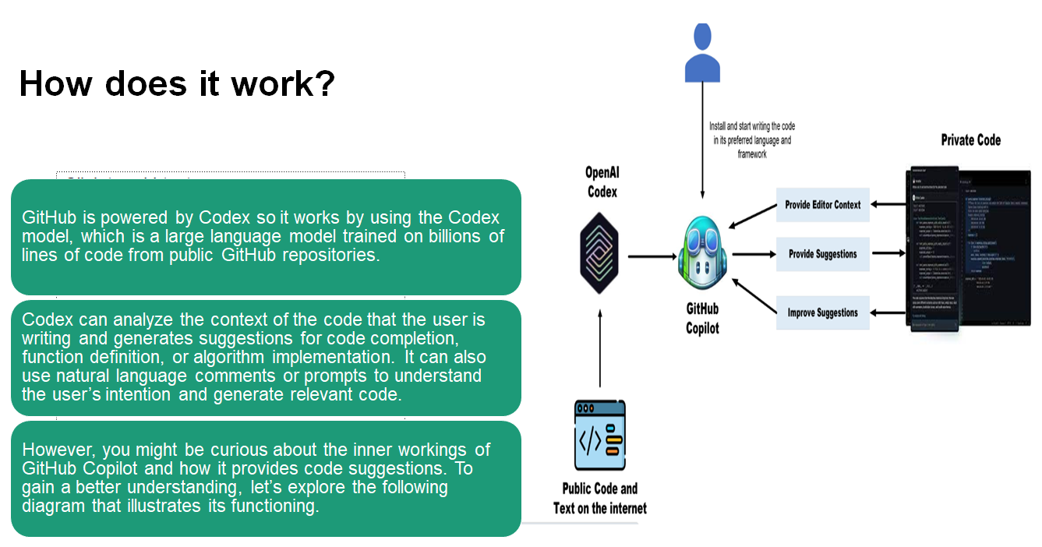

Slide 8
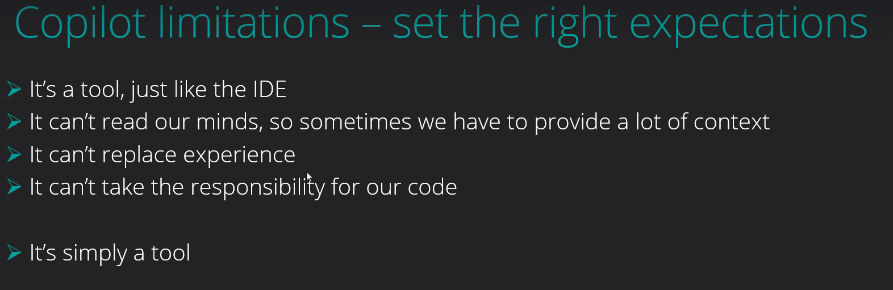

Slide 9
6 principles of responsible AI
Fairness: AI systems should treat all people fairly.
Reliability and safety: AI systems should perform reliably and safely.
Privacy and security: AI systems should be secure and respect privacy.
Inclusiveness: AI systems should empower everyone and engage people.
Transparency: AI systems should be understandable.
Accountability: People should be accountable for AI systems.

Slide 10
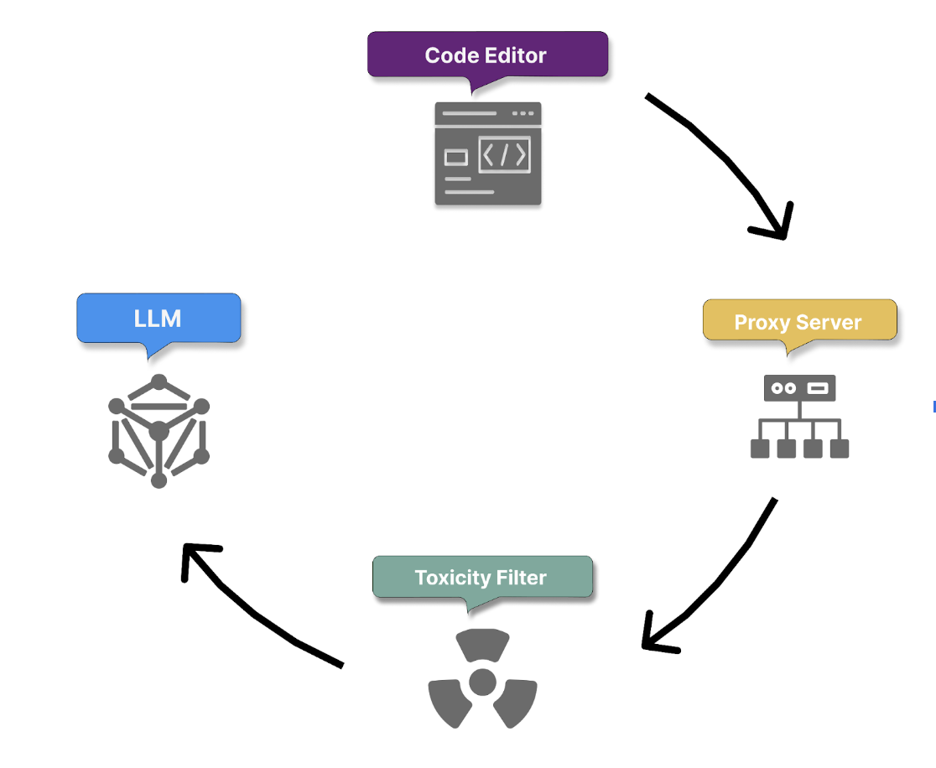
GitHub Copilot user prompt process flow - INBOUND

Slide 11
Proxy filter
Once the context is gathered and the prompt is built, it passes securely to a proxy server hosted in a GitHub-owned Microsoft Azure tenant.
The proxy filters traffic, blocking attempts to hack the prompt or manipulate the system into revealing details about how the model generates code suggestions.

Slide 12
Toxicity filtering
Hate speech and inappropriate content: Copilot employs algorithms to detect and prevent the intake of hate speech, offensive language, or inappropriate content that could be harmful or offensive.
Personal data: Copilot actively filters out any personal data, such as names, addresses, or identification numbers, to protect user privacy and data security.

Slide 13
Code generation with LLM
Finally, the filtered and analyzed prompt is passed to LLM Models, which generate appropriate code suggestions.

Slide 14
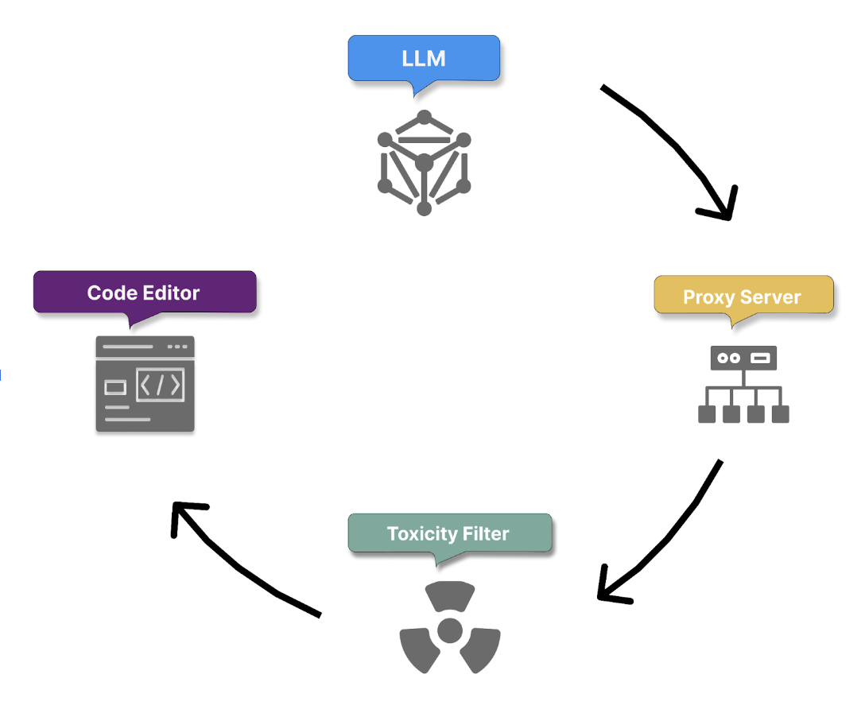
GitHub Copilot user prompt process flow - OUTBOUND

Slide 15
OUTBOUND
Once the model produces its responses, the toxicity filter removes any harmful or offensive generated content. The proxy server then applies a final layer of checks to ensure code quality, security, and ethical standards.

Slide 16
GitHub Copilot Support
GitHub Copilot offers a free tier with 2,000 code autocompletes and 50 chat messages per month.
Educators, Students and select open-source maintainers can receive Copilot Pro for free

Slide 17
Tokens in AI Tools
What are Tokens?
Tokens are pieces of text processed by AI systems.
Examples:
One word ≈ 1 token
Long sentences = more tokens
Large logs/errors = huge token consumption
Efficient token usage improves:
Faster responses
Better quality outputs
Lower AI confusion
Better contextual understanding
More accurate code generation

Slide 18
Copilot context limit
Copilot context limit - what it means for you?
It depicts the Copilot limitations.
It basically represents the data it can receive and return back in one request.
Poor performance on large requests
Refactoring -not possible
Better use the IDE refactoring capability
Error search inside workspace - not possible
Tasks for copilot should be as small as possible

Slide 19
Golden Rule
“Provide Context, Not Noise”
Good prompts:
Give structured information
Provide only relevant details
Focus on business objective
Bad prompts:
Dump entire codebase
Share full logs unnecessarily
Ask vague questions

Slide 20
Copilot context limit
Websites:
OpenAi Tokenizer
AI Analysis LLM Performance leaderboard

Slide 21
Languages and Framework Support
GitHub Copilot provides robust support for a wide range of programming languages and frameworks
-Python
-JavaScript
-Java
-TypeScript
-Ruby
-Go
-C#
-C++ and so on

Slide 22
Copilot can work with various types of comments to inform its suggestions
-Inline comments: Short explanations next to specific lines of code.
-Block comments: Longer explanations that might describe a function or class.
-TODO comments: Notes about future implementations or improvements.
-API Documentation: Comments that describe the usage and parameters of functions or methods.

Slide 23
Prompt engineering
What is Prompt Engineering?
Prompt engineering principles
Best practices

Slide 24
What is prompt engineering?
Prompt engineering is the process of crafting clear instructions to guide AI systems, like GitHub Copilot, to generate context-appropriate code tailored to your project's specific needs.
This ensures the code is syntactically, functionally, and contextually correct.

Slide 25
Principles of prompt engineering
4 S rules of creating effective prompts
-Single
-Specific
-Short
-Surround

Slide 26
Best practices in prompt engineering
1)Provide enough clarity
2) Provide enough context with details
3) Provide examples for learning
4) Assert and iterate

Slide 27
How Copilot learns from your prompts
Zero-shot learning
One-shot learning
Few-shot learning

Slide 28
General AI Prompting Best Practices
Good Practice | Why It Helps
Be specific | Reduces ambiguity
Mention technology stack | Improves code accuracy
Mention expected output | Gives direction
Provide sample input/output | Helps Copilot understand intent
Break large tasks into smaller prompts | Better quality responses
Use iterative prompting | Refine output gradually
Mention constraints | Avoids generic solutions
Mention coding standards | Produces production-ready code

Slide 29
Common Mistakes While Using Copilot
Mistake | Problem
Very large prompts | Context confusion
Dumping full stack traces | Wastes tokens
Asking multiple unrelated questions | Mixed output
No architecture context | Generic code
No validation requirements | Weak implementation
No security instructions | Vulnerable code
Blindly accepting suggestions | Risky implementation

Slide 30
Code Development features of GitHub Copilot
GitHub Copilot tools in Visual Studio Code
Code line completions: Use code line completions to write code more efficiently.
Inline chat: Start an inline chat conversation directly from the editor for help while you're coding.
Chat view: Open an AI assistant on the side that can help you at any time.

Slide 31
Examine GitHub Copilot best practices
GitHub Copilot is an AI pair programmer, it's not a programmer.
GitHub Copilot is a powerful tool that can help you write code faster and with fewer errors.
However, to get the most out of GitHub Copilot, you need to follow best practices.
By choosing the right Copilot tool for the job, providing context, and following good coding practices, you can optimize your experience with GitHub Copilot.

Slide 32
Best Practices
Code completions provide the most value when they're used to:
Complete code snippets, variable names, and functions as you write them.
Generate repetitive code.
Generate code from inline comments in natural language.
Generate tests for test-driven development.

Slide 33
Best Practices
GitHub Copilot's chat features provide the most value when they're used to:
Answer questions about code in natural language.
Generate large sections of code, then iterate on that code to meet your needs.
Accomplish specific tasks with keywords and skills. Different types of keywords and skills are available in different Copilot Chat platforms.
Complete a task as a specific persona.

Slide 34
Best Practices
Get the most out of Copilot inline suggestions
Provide context for GitHub Copilot
Open files
Top level comment
Appropriate includes and references
Meaningful function names
Prime Copilot with sample code
Be consistent and keep the quality bar high

Slide 35
Best Practices
Get the most out of GitHub Copilot Chat
Start general, then get specific
Give examples
Break complex tasks into simpler tasks
Avoid ambiguity
Indicate relevant code
Use chat participants, slash commands, and chat variables
Experiment and iterate
Keep history relevant
Follow good coding practices

Slide 36
AI is an Assistant
Not a replacement for:
Architecture thinking
Business understanding
Validation
Security review

Slide 37
Prompt Quality Determines Output Quality
Garbage in → Garbage out.
Human Review is Mandatory
Always validate:
Security
Logic
Compliance
Performance
Scalability

