Slide 1
Microservices

Slide 2
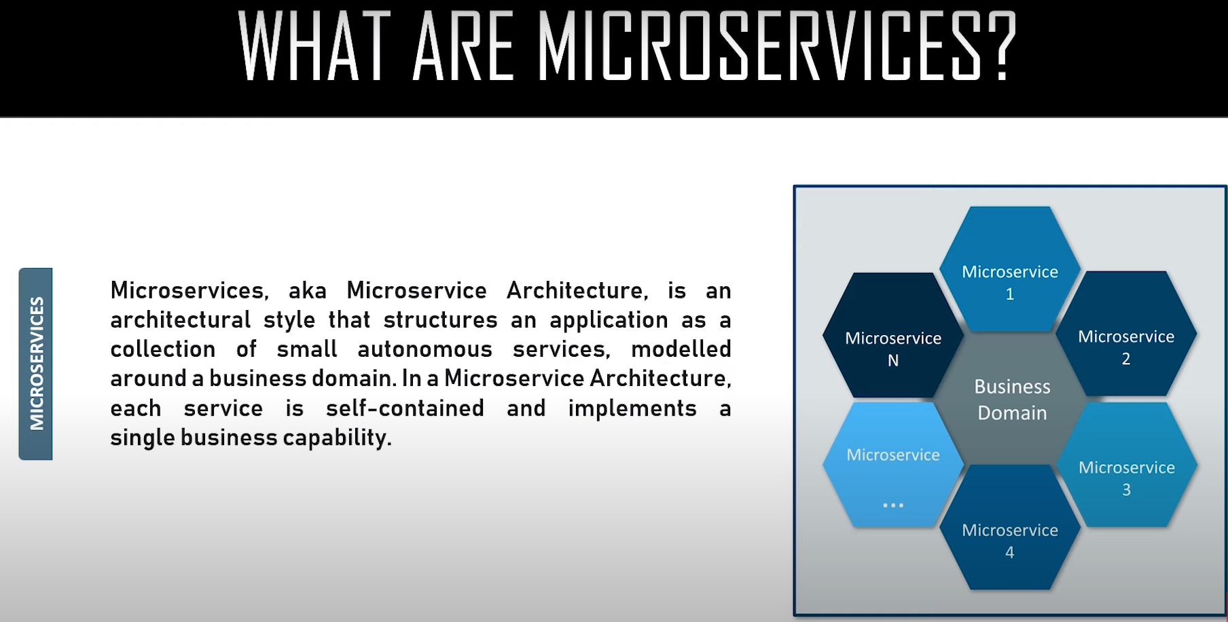

Slide 3
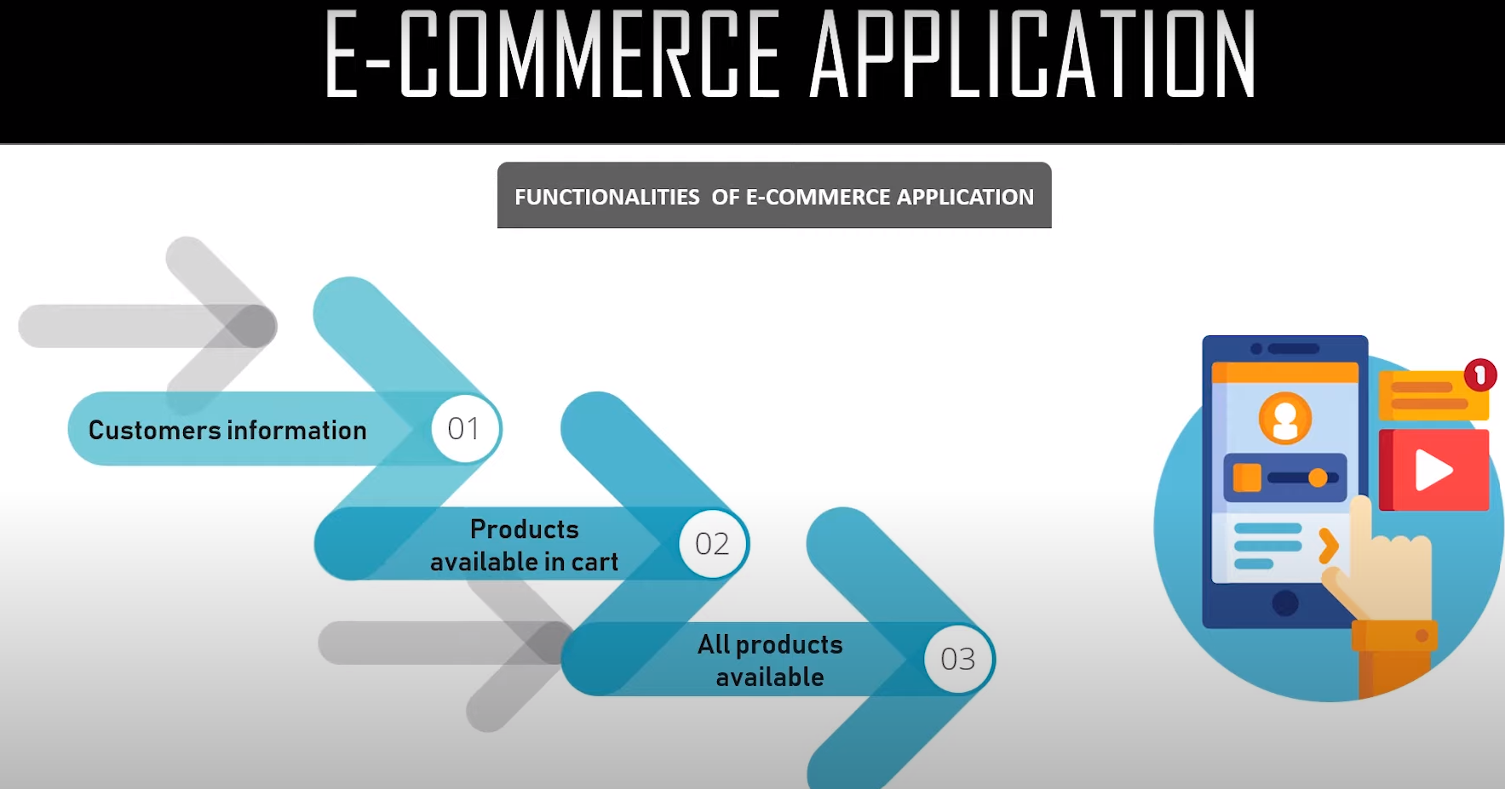

Slide 4
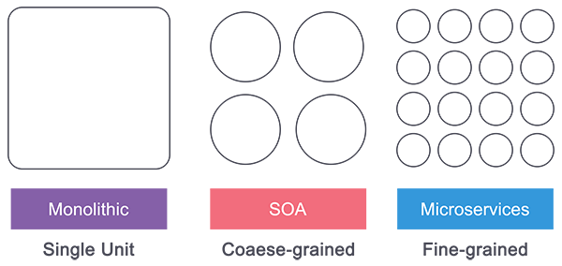
Monolithic vs. SOA vs. Microservices

Slide 5
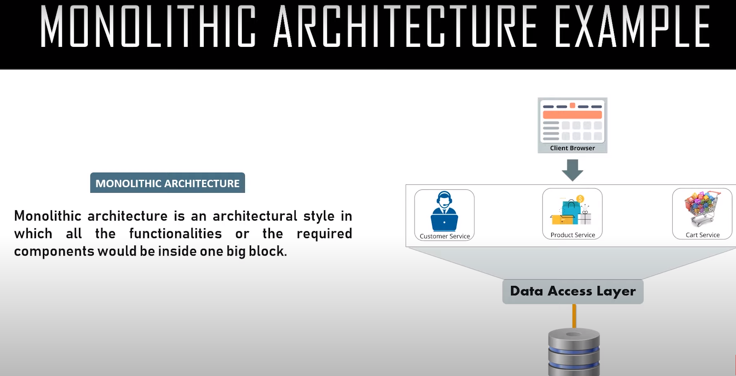

Slide 6
Monolithic
Monolithic architectures are the simplest form of architecture as it is having only one application layer that bundles together all the software components, and is hosted and delivered together.
This type has been widely used by many small and mid-sized companies.
The main challenge in this system is during scaling up as we need to duplicate the whole system including all the features of other machines which increases the cost.
Also, the failure of one feature will affect the whole system making it unreliable.

Slide 7
Service-Oriented Architecture (SOA)
Service-Oriented Architecture (SOA) follows a coarse-grained structure where the features of an application are broken down into smaller components as services comprised of some tasks.
This type of architecture allowed us to horizontally scale each service, and also more flexibility and performance at the cost of increasing the complexity of the architecture compared to the monolithic.
Each service can be written in different languages and the communication between them can be done with the help of a middleware

Slide 8
Microservices
Microservices have technically evolved out of SOA where those features are further broken down into tasks level services making it fine-grained architecture.
While Service Oriented Architecture followed a centrally governed architecture where each component is controlled by a central middleware, in microservices it’s a decentralized governing system where components talk directly to each other and can be written in different programming languages and communicate without the help of any broker and are done with the help of REST API.

Slide 9
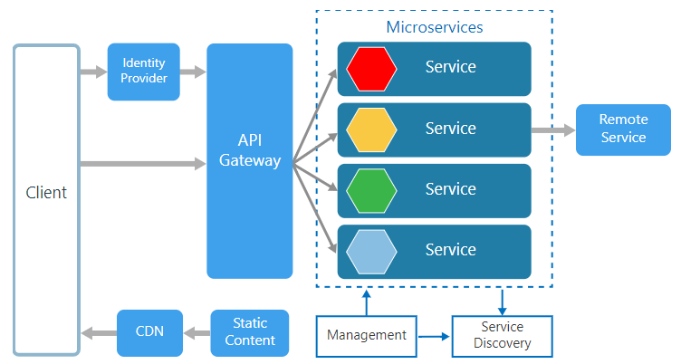
Microservices Architecture
An architectural style that structures an application as a collection of small self-contained processes, modeled around a business capability.
They don’t share the data structure and will be communicating through APIs.

Slide 10
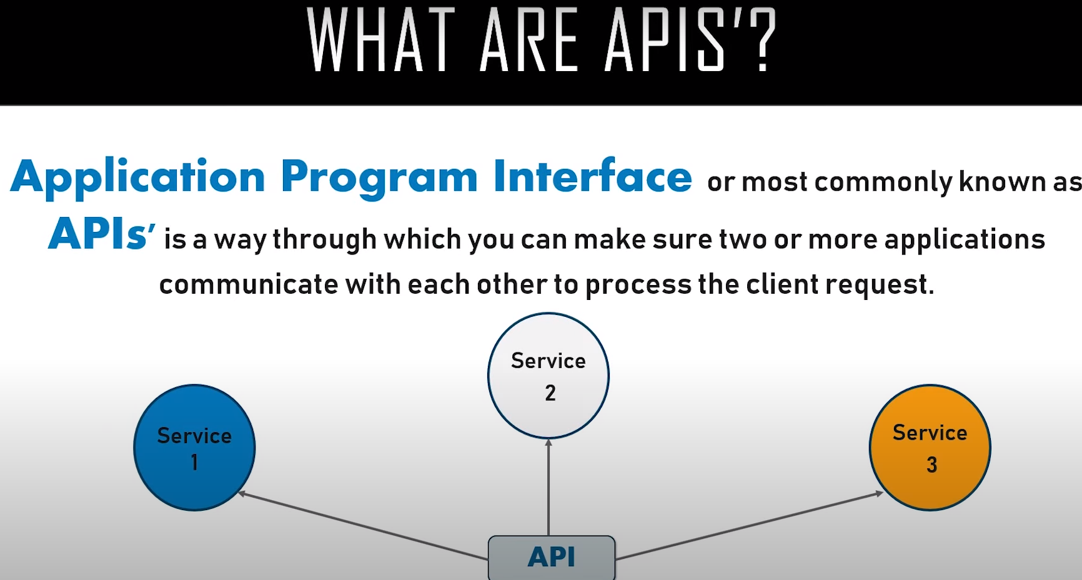

Slide 11
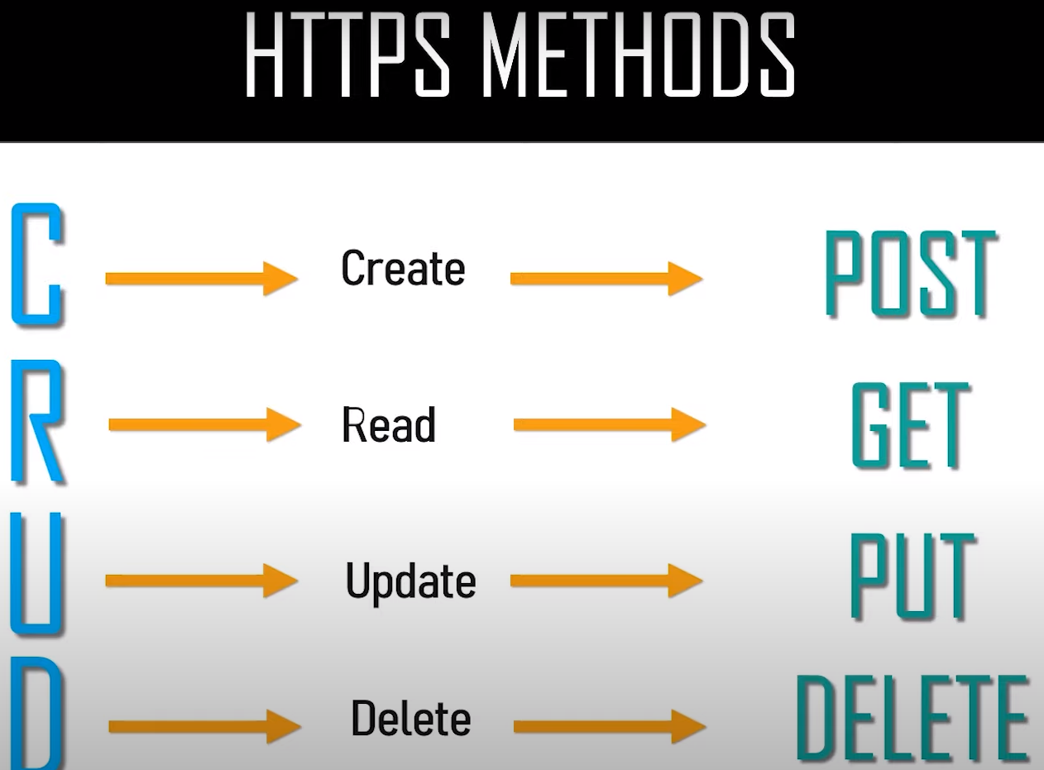

Slide 12
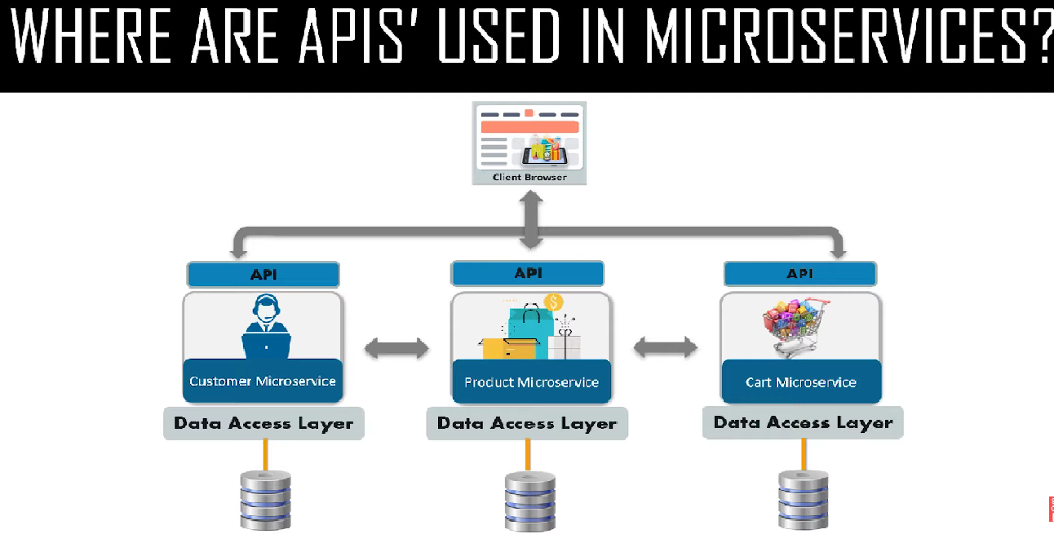

Slide 13
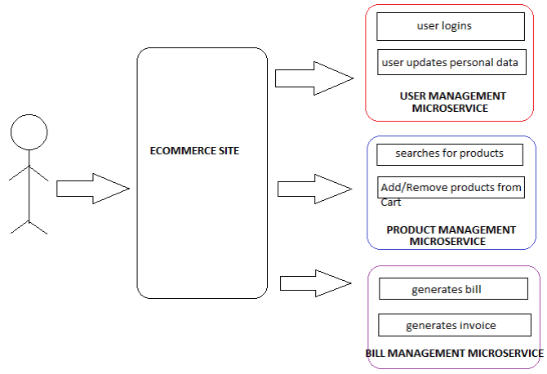
Microservices and APIs

Slide 14
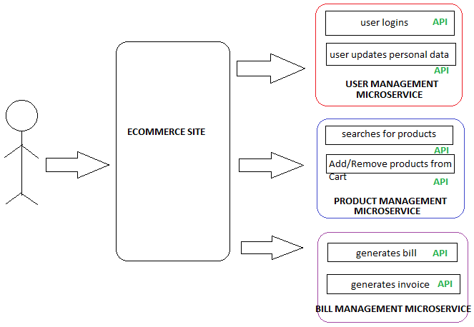
Microservices and APIs

Slide 15
Differences between Microservices and APIs
Microservices can be considered as ‘building block’ to segregate and define different services to have a clean and scalable Architecture whereas API can be considered as the ‘functional block’ to define the work a microservice is responsible to handle.
API is a part of Microservice.
Microservices can have one or more APIs.

Slide 16
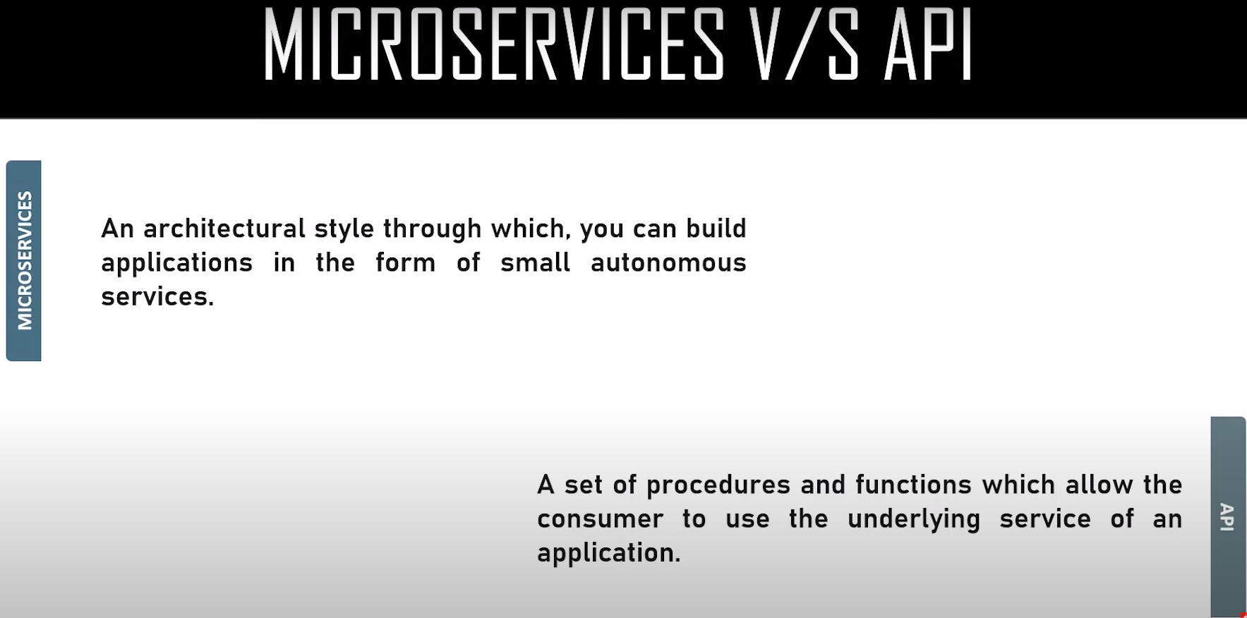

Slide 17
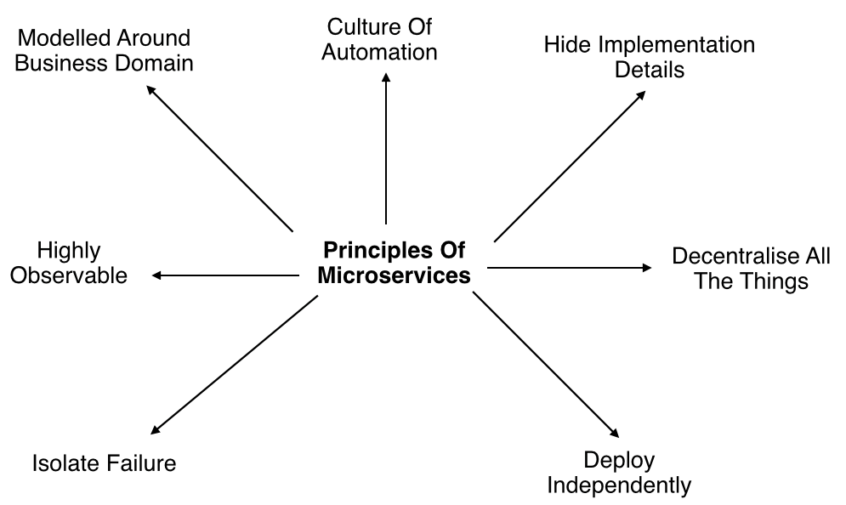
Microservices Principles

Slide 18
Microservices Architecture
Management: The Management takes care of the placement of services on nodes, checking for failures, and rebalancing services across nodes in case of any failures.
Service Discovery: Maintains a list of services and the nodes where each service is located, and also enables the service to look up to find the endpoint for a particular service.
API Gateway: The entry point for clients where all the calls from the client will be taken, analyze, and forward to appropriate services. In case some calls are needed from multiple services API Gateway will aggregate and will return the aggregated result.

Slide 19
Advantages of Microservices
Services can be written in different programming languages and can be accessed by using any framework.
Independently develop, deploy, redeploy, version, and scale component services in seconds without compromising the integrity of an application
Better fault isolation keeps other services working even though one got failed.
Zero downtime upgrades.
Services can be of from different servers or even different data centers.
Interaction with other services in a well-defined protocol
Monitor, capture, and report health diagnostics
Reliable and self-healing
Supports continuous integration and delivery
Easy to transfer knowledge to the new team member

Slide 20
Disadvantages of Microservices
The additional complexity for implementation of an inter-process communication mechanism between services.
Writing automated tests involving multiple services is challenging and It can be difficult to create consistent testing environments.
Requires a high level of automation to manage multiple instances of different types of services in production.
Managing multiple databases and their transactions is difficult.
Inter-process calls are slow.
Debugging will become difficult.
Complexity in DevOps.
Production monitoring cost is higher.
Formal documentation overhead.

Slide 21
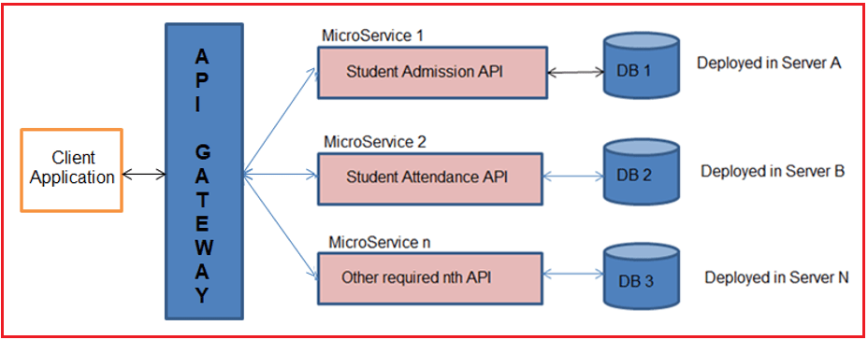
LAB-Implementing Microservices in .NET

