Slide 1
REEDBACK OPERATIONS PROJECT 7: “E WASTE BATTERY EXTRACTION ” PRESENTATION - FINAL INDIVIDUAL RETROSPECTIVE
STUDENT NAME: RAMNEEK SINGH BHANGU
STUDENT ID: S223927982
UNIT: SIT 374
TRIMESTER: T1-26

Slide 2
PROJECT OVERVIEW
The E-Waste Battery Extraction System aims to develop a robotic solution capable of safely identifying and extracting batteries from electronic waste. My contribution focused on the Systems and Simulations component, specifically implementing physics-based robotic simulation using MATLAB, Simulink, and Simscape Multibody.
The main goal of my work was to move from simple motion-based simulation toward realistic force-driven robotic behaviour using torque-based physics.

Slide 3
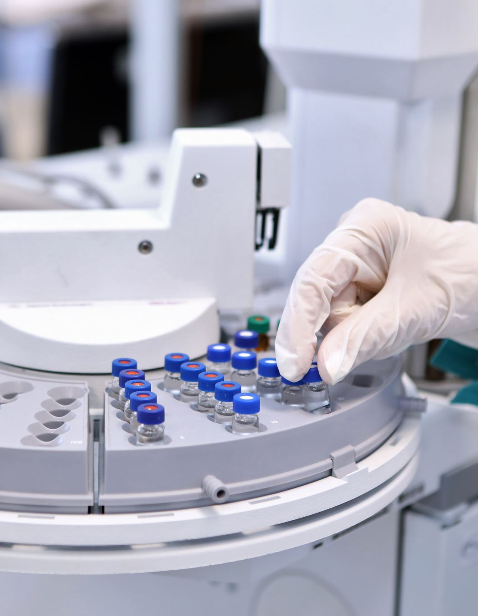
MY CONTRIBUTION
My responsibilities included:
Investigating simulation tool feasibility
Working with Kinova Gen3 simulation
Implementing physics replication
Testing torque-driven behaviour
Debugging simulation issues
Documenting results and demonstrations
I also contributed to discussions regarding Unity, MATLAB, and Isaac Sim feasibility for the Systems and Simulations workflow.

Slide 4
TOOLS AND TECHNOLOGIES USED
TOOL | PURPOSE
MATLAB | Robot Modelling
Simulink | Simulation Workflow
Simscape Multibody | Physics Engine
Robotics Toolbox | Robot Import
Scope Blocks | Output Visualisation

Slide 5
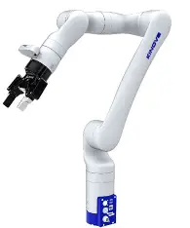
ROBOT IMPORT AND MODEL GENERATION
The Kinova Gen3 robot was imported using MATLAB’s Robotics Toolbox. A Simulink/Simscape Multibody model was generated to create a complete rigid body representation of the manipulator.
The generated model included:
7 revolute joints
rigid body links
actuator blocks
end-effector structure
The robot structure was verified using MATLAB functions before simulation testing began.

Slide 6
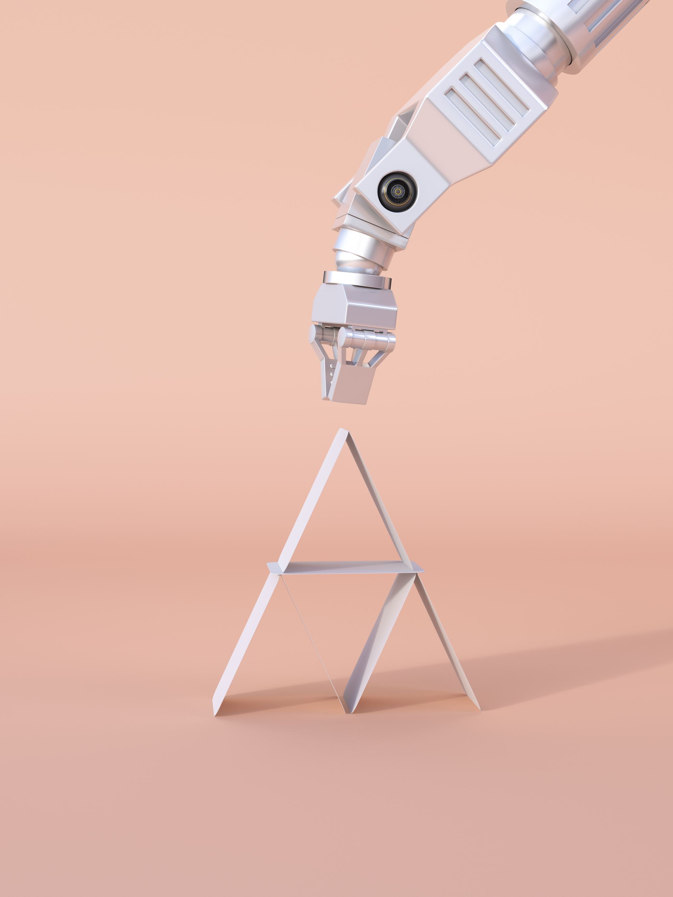
MOTION-BASED VALIDATION
Before implementing realistic physics, I first validated the system using motion-based input. A Step signal was connected to Actuator4 to confirm:
signal flow
actuator response
correct Simulink–Simscape interaction
Position outputs were measured using Scope blocks.
This stage confirmed that the robot model was functioning correctly before transitioning to force-driven simulation.

Slide 7
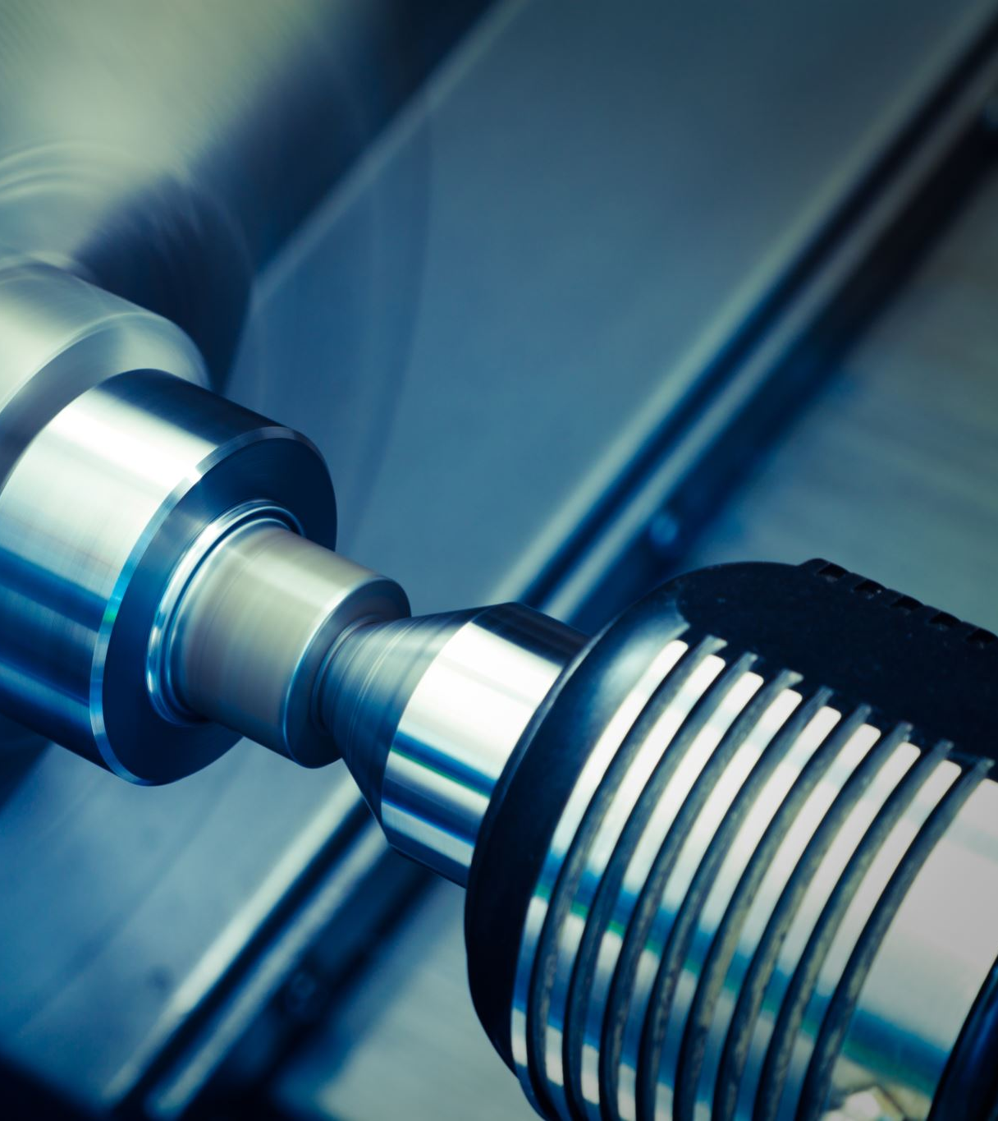
TORQUE-BASED PHYSICS IMPLEMENTATION
To make the simulation more realistic, I transitioned from motion-driven input to torque-based actuation.
The actuator was configured so that:
Torque = Provided by Input
Motion = Automatically Computed
Torque was applied through:
Constant → Simulink-PS Converter → Actuator
This allowed the system to compute motion based on physical forces rather than direct commands.

Slide 8
SYSTEM OUTPUTS AND DYNAMIC BEHAVIOUR
Position (q) and velocity (w) outputs were measured using:
PS-Simulink Converters
Scope blocks
The velocity response showed:
initial spike
oscillation
damping
stabilisation
This behaviour confirmed realistic dynamic system response under applied torque.

Slide 9

CHALLENGES AND SOLUTIONS
During implementation, several technical issues were encountered:
unit mismatch errors
red physical signal lines
solver derivative issues
unstable outputs
These were resolved by:
correcting units
adjusting actuator settings
modifying damping
configuring solver behaviour
tuning torque values
This process improved understanding of physical simulation and debugging.

Slide 10
KEY LEARNING OUTCOMES
Through this task, I learned:
difference between kinematic and dynamic simulation
how torque-driven systems behave
how Simscape models physical systems
practical debugging in simulation environments
importance of realistic physics in robotics
I also improved:
problem-solving
technical communication
independent learning
robotics simulation understanding

Slide 11
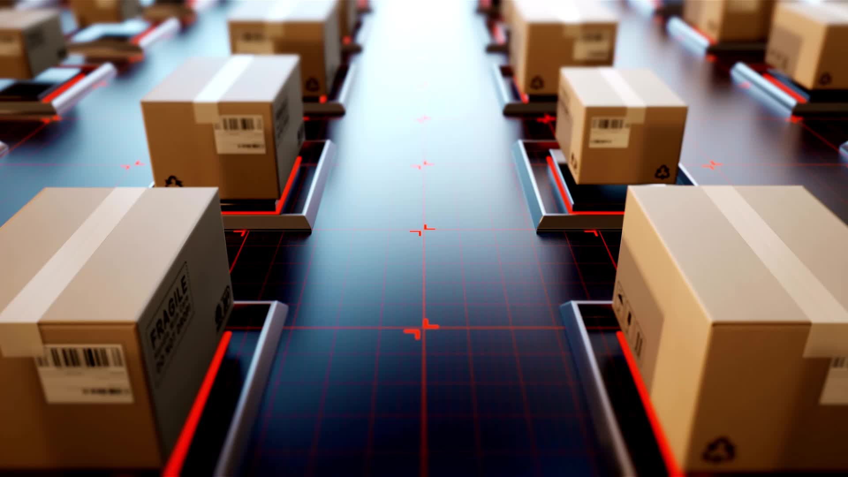
CONCLUSION
This trimester allowed me to significantly improve my understanding of robotics simulation, MATLAB/Simulink, and physics-based system behaviour. My main contribution focused on implementing the Kinova Gen3 physics replication using Simscape Multibody, where I progressed from motion-based validation to realistic torque-driven simulation. Through this process, I gained practical experience in robotic dynamics, actuator configuration, signal conversion, solver configuration, and simulation debugging.
The project also strengthened my problem-solving, independent learning, and technical communication skills. Overall, the work completed this trimester provided a strong foundation for future robotics control, simulation integration, and systems engineering development.

