Slide 1
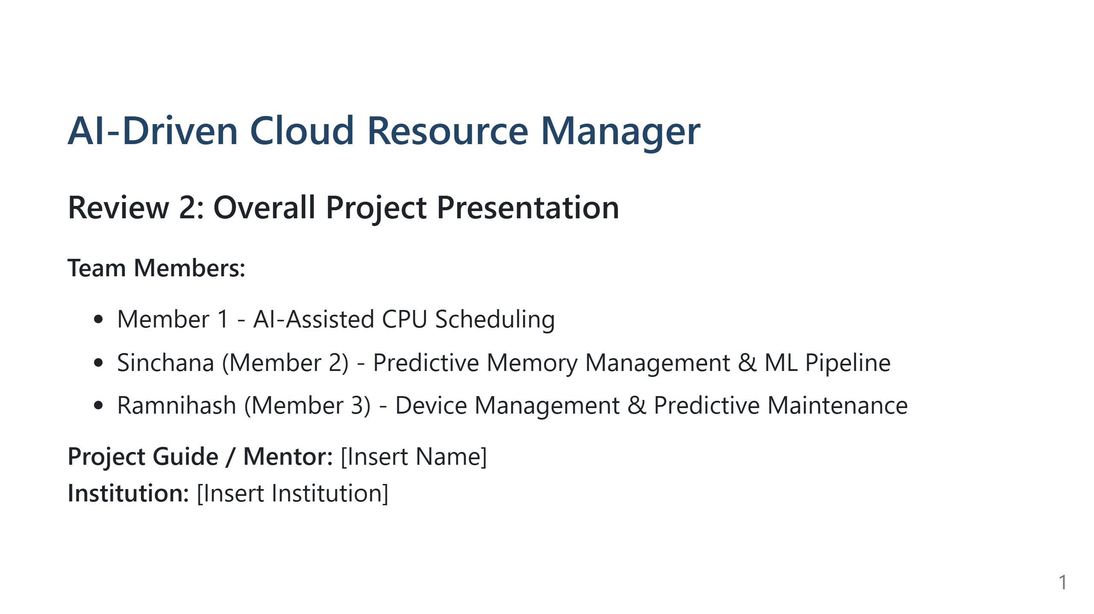
Notes:
Speaker Notes:
1. What we should say: "Welcome to our Review 2 presentation for the AI-Driven Cloud Resource Manager. Today we are presenting the overall progress of our entire project across all three modules."
2. Technical explanation: High-level overview of our cloud-hosted OS resource-manager simulator.
3. Important implementation details: We are presenting the unified state of the project, covering CPU, Memory, and Device management.
4. Likely professor questions: "Is this a real OS or a simulator?" -> "It is a highly accurate OS simulator where AI logic can be safely tested."
5. Repository files: README.md, DEVELOPMENT.md.

Slide 2
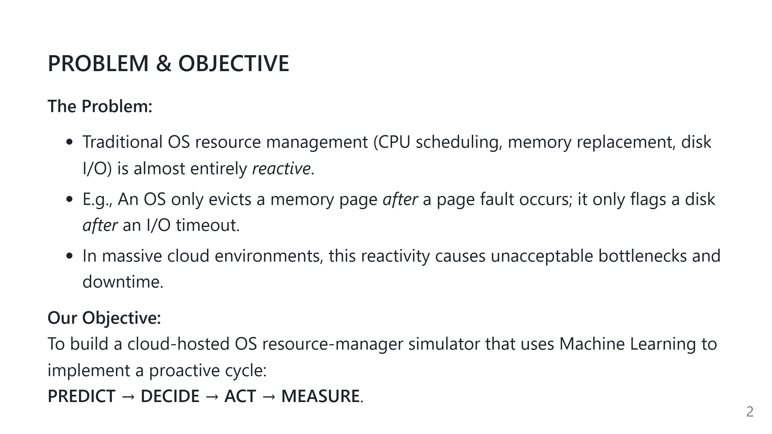
Notes:
Speaker Notes:
1. What we should say: "Traditional OS mechanisms are purely reactive. We wait for things to break, then we fix them. Our project introduces foresight through AI."
2. Technical explanation: Heuristics like LRU or FCFS don't learn from workload structures. We apply time-series and sequence models to learn patterns.
3. Important implementation details: The system acts before faults/anomalies occur.
4. Likely professor questions: "Why do we need this in the cloud?" -> "Cloud workloads are highly patterned; predicting scale-ups saves money and prevents cascading failures."
5. Repository files: DEVELOPMENT.md (Project Purpose).

Slide 3
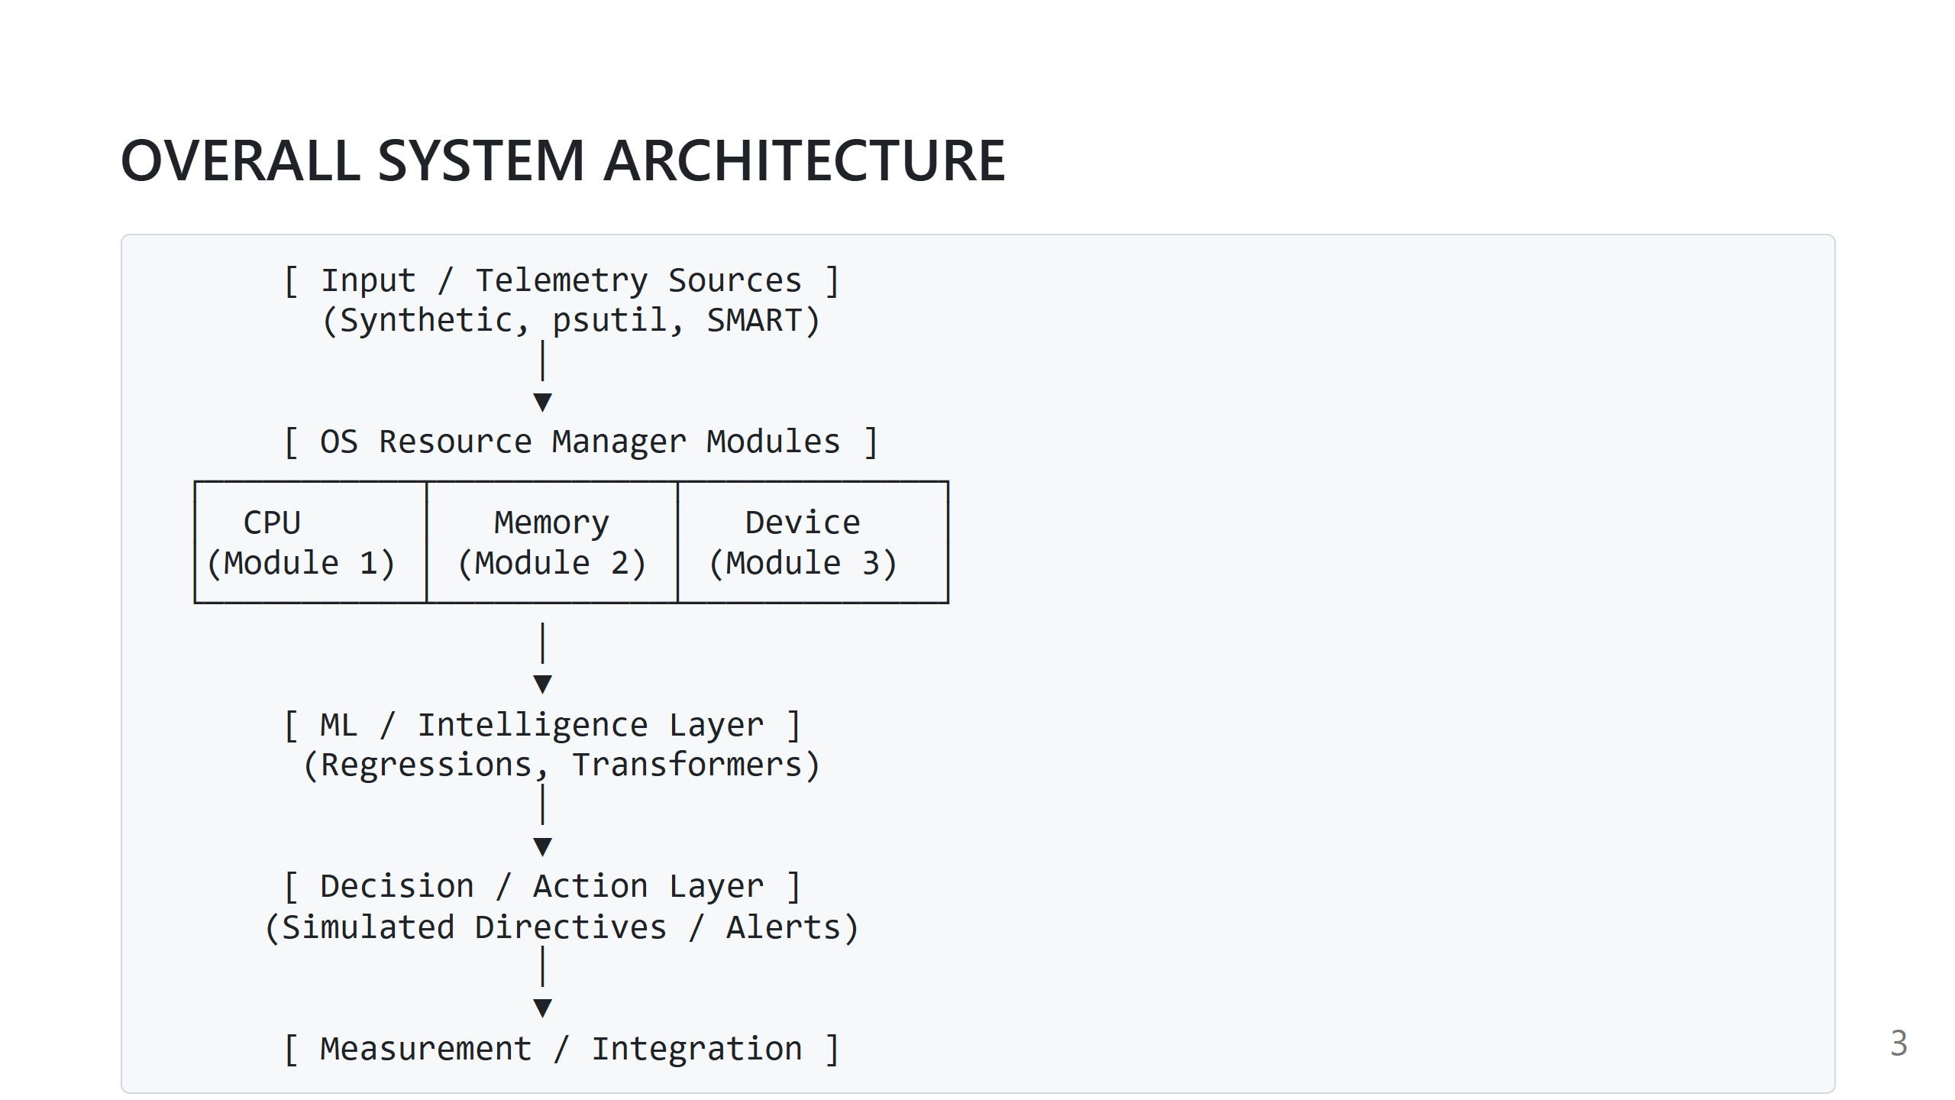
Notes:
Speaker Notes:
1. What we should say: "This is our actual implemented architecture. Telemetry flows into three independent resource modules. The data is fed into an Intelligence layer, which sends predictions to a Decision layer to generate actionable OS directives."
2. Technical explanation: The architecture decouples the classical OS simulation from the ML models.
3. Important implementation details: Modules run in an Action Loop. ML doesn't replace the OS; it orchestrates it.
4. Likely professor questions: "How do the ML models interact with the OS modules?" -> "Through the Action Layer, which translates a probability into a discrete directive (like PREFETCH)."
5. Repository files: DEVELOPMENT.md (High-Level Architecture).

Slide 4
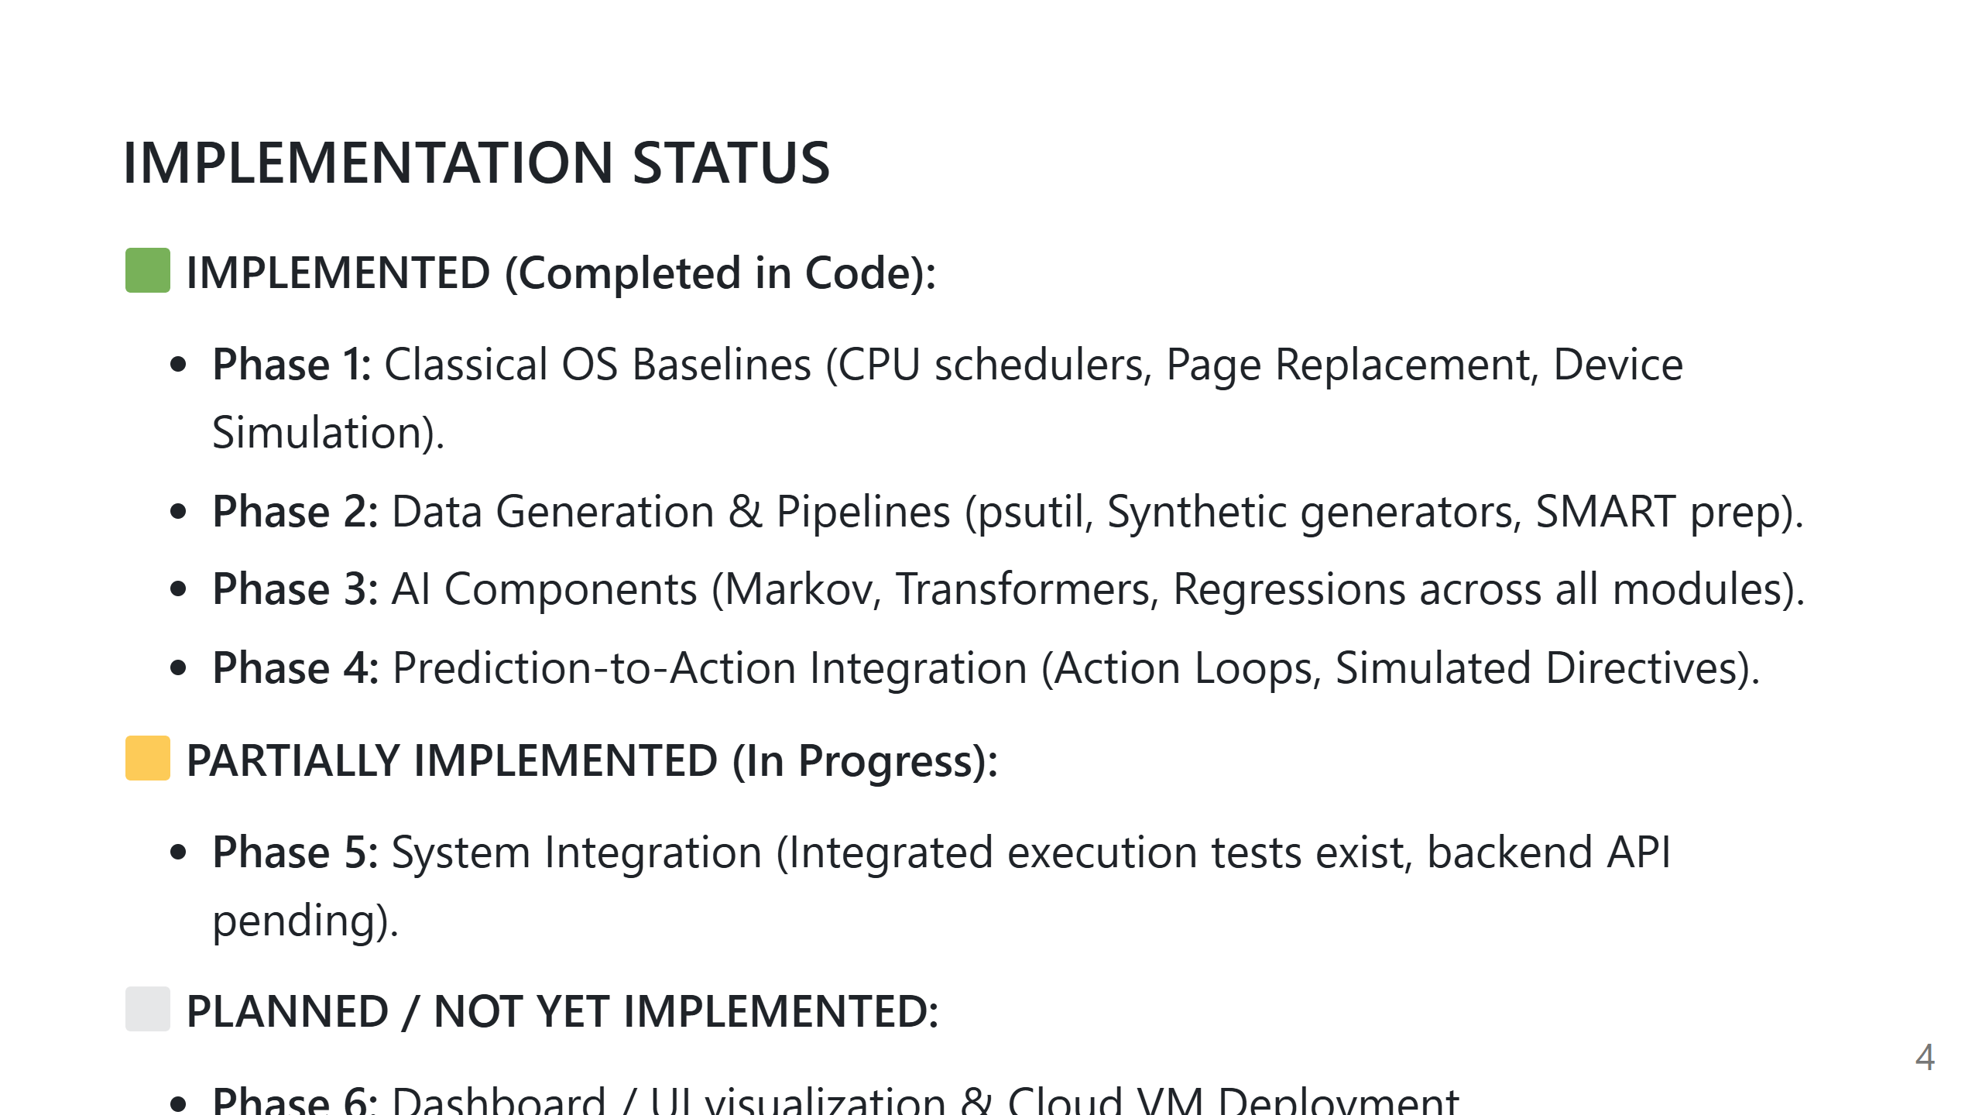
Notes:
Speaker Notes:
1. What we should say: "We have fully implemented Phases 1 through 4 across all three modules. The core logic, ML, and action layers are fully functional and tested."
2. Technical explanation: All checkpoints CP1.1 through CP4.5 in DEVELOPMENT.md are implemented in Python.
3. Important implementation details: We have not built the frontend UI or deployed to AWS/GCP yet; that is Phase 6.
4. Likely professor questions: "Is it connected to a web frontend yet?" -> "No, currently it runs as an integrated Python backend simulator."
5. Repository files: DEVELOPMENT.md, tests/ integration.

Slide 5
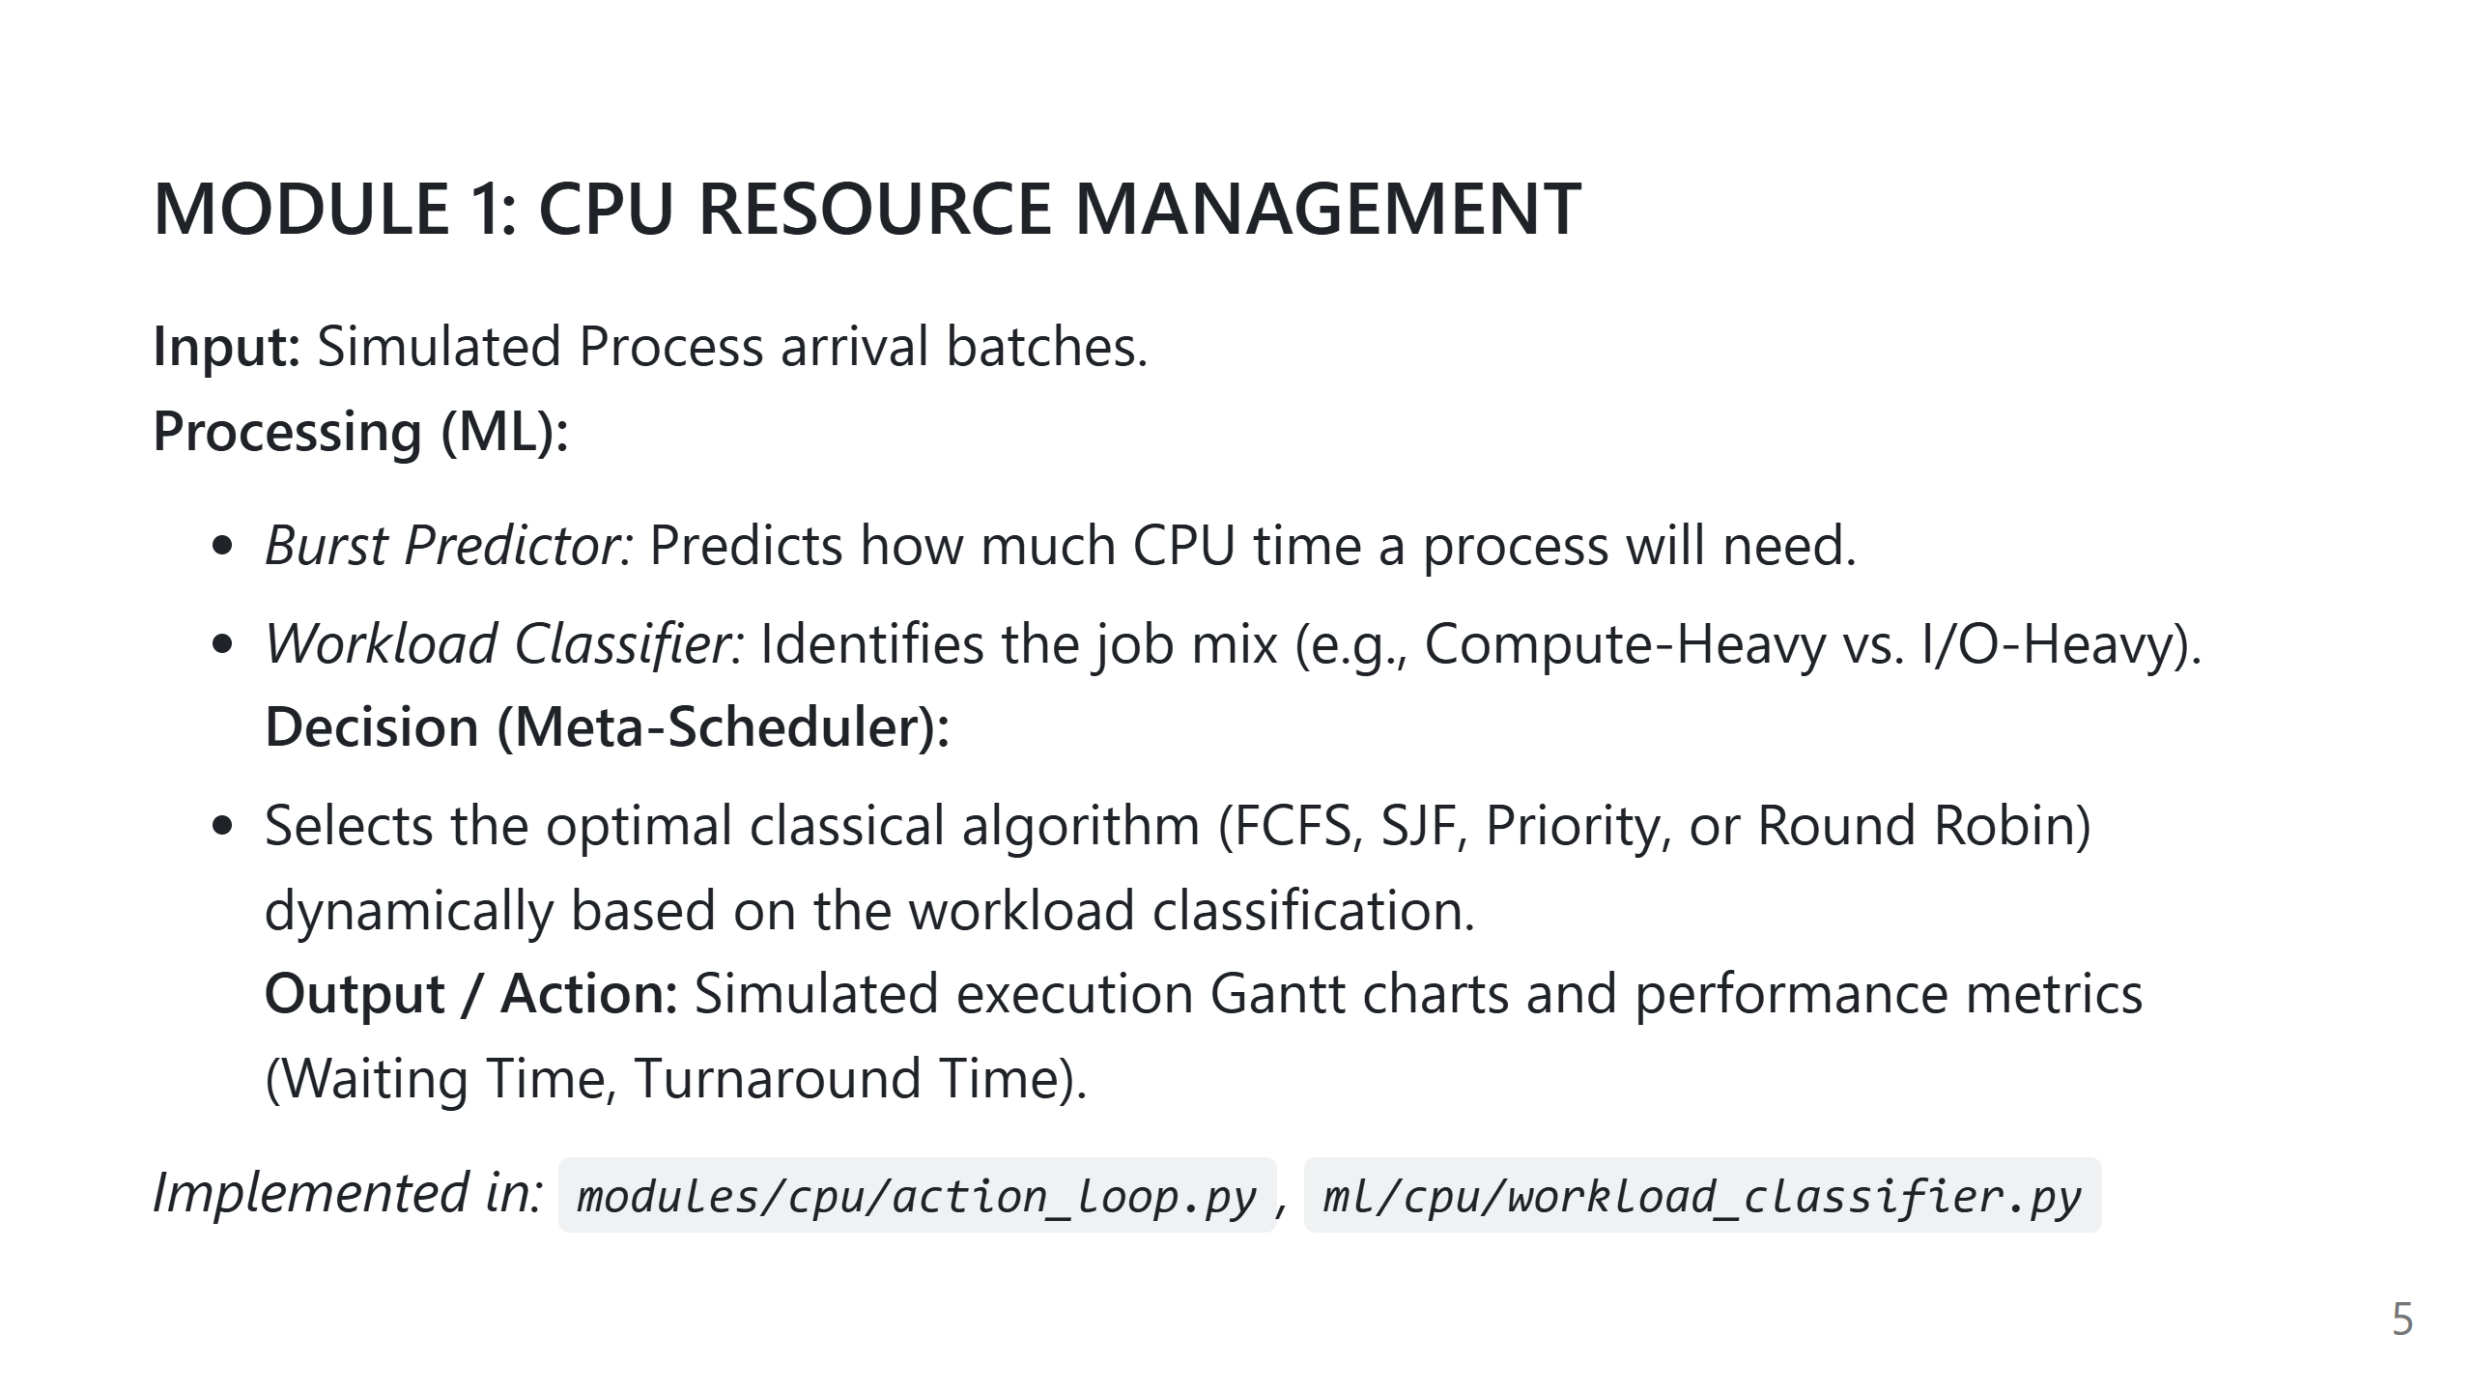
Notes:
Speaker Notes:
1. What we should say: "Module 1 tackles CPU scheduling. Instead of forcing one algorithm, our Meta-Scheduler uses ML to classify the workload and dynamically switches to the best classical scheduler for the job."
2. Technical explanation: Uses regression for burst times and classification for job mixes.
3. Important implementation details: The `CPUActionLoop` safely compares the AI's selection against a baseline FCFS scheduler.
4. Likely professor questions: "How do you know the AI chose correctly?" -> "The Action Loop compares AI performance metrics against a baseline."
5. Repository files: modules/cpu/action_loop.py.

Slide 6
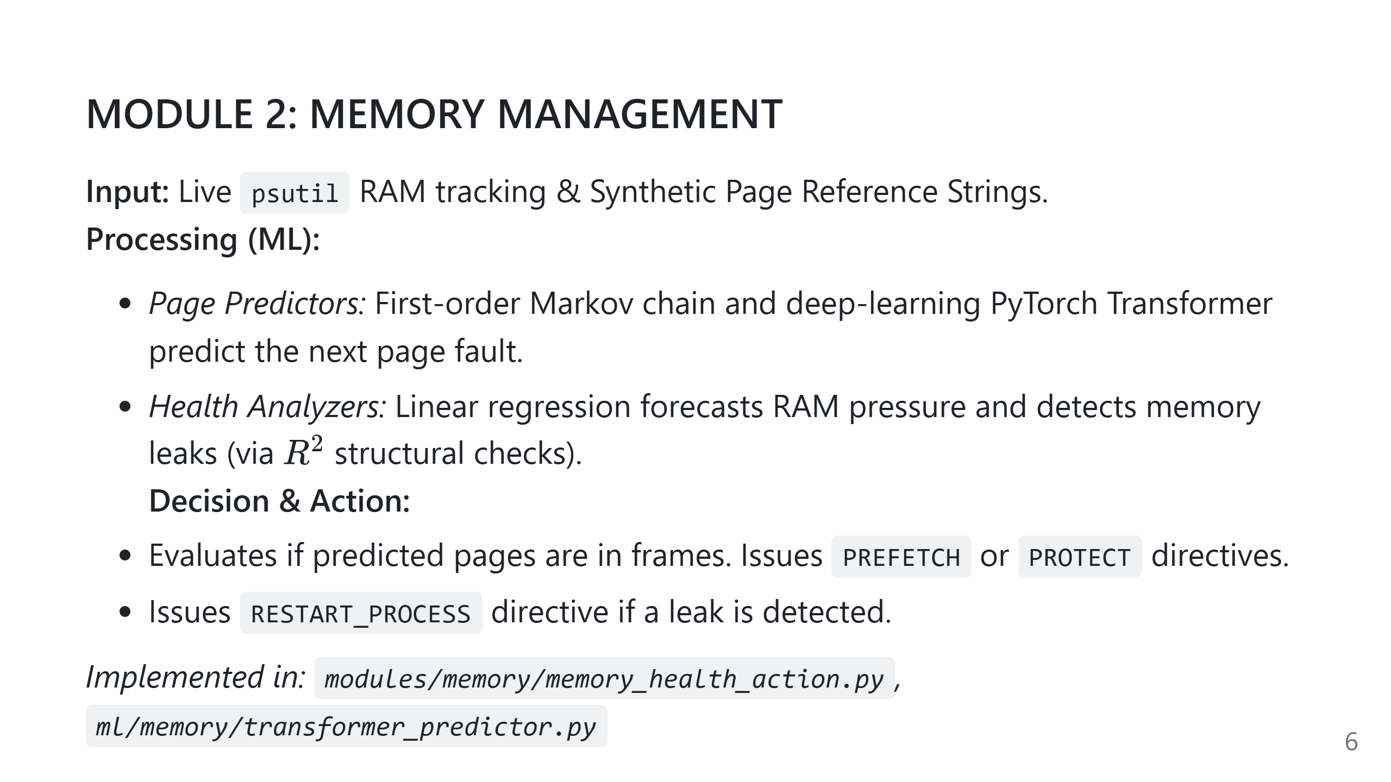
Notes:
Speaker Notes:
1. What we should say: "Module 2 handles Memory. It uses Transformers to learn long-term program behaviors and predict page faults, and time-series regression to spot structural memory leaks."
2. Technical explanation: Transformer autoencoders track context windows of pages. Regression R-squared filtering prevents false alarms on benign memory spikes.
3. Important implementation details: LRU is implemented in O(1) time using an OrderedDict.
4. Likely professor questions: "Are you really restarting processes?" -> "No, it's a simulated directive to prove the logic."
5. Repository files: modules/memory/page_replacement.py, ml/memory/memory_leak_detector.py.

Slide 7
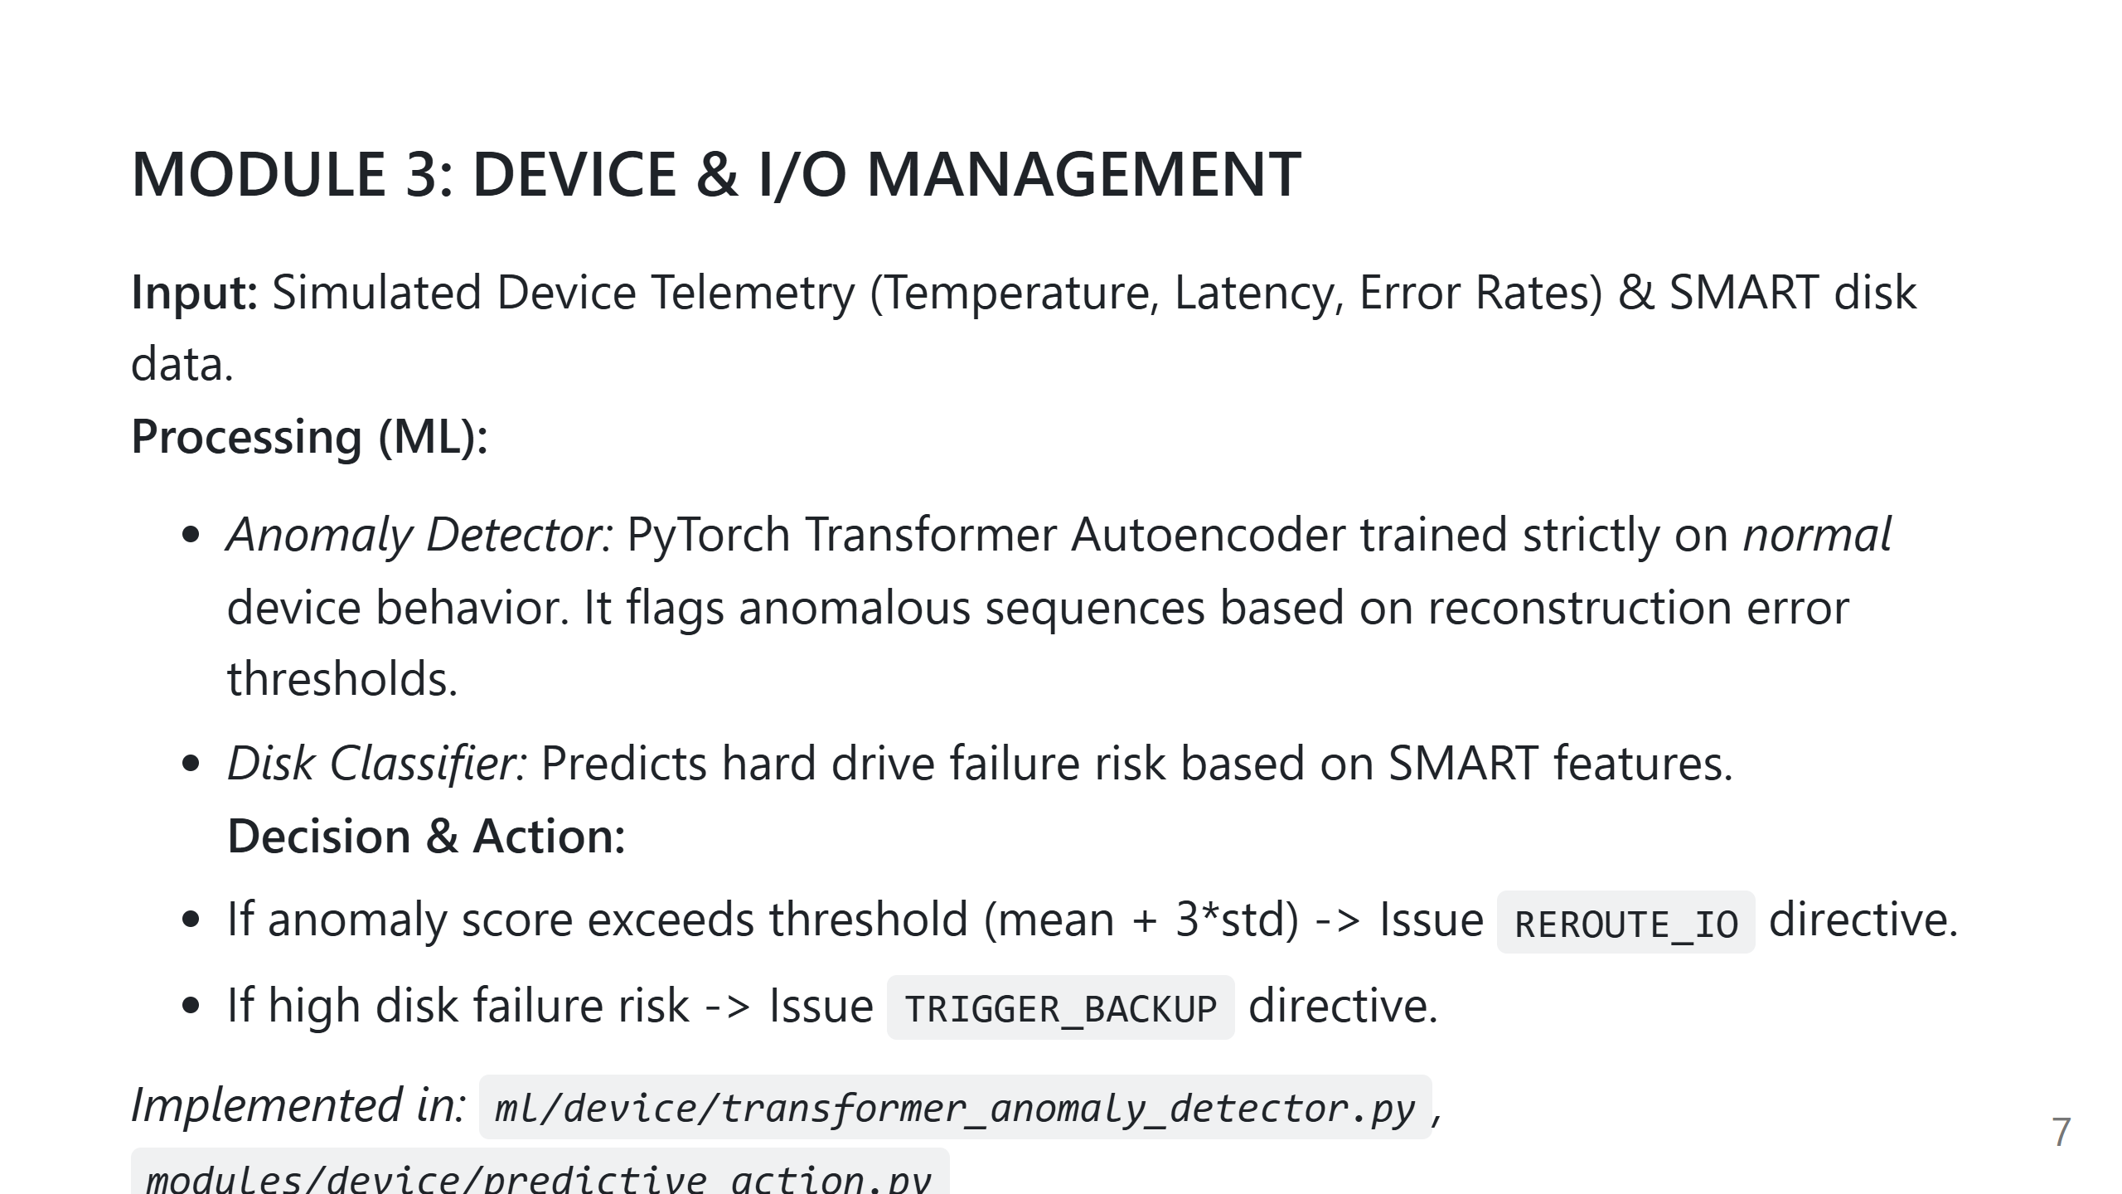
Notes:
Speaker Notes:
1. What we should say: "Module 3 monitors devices. Using a Transformer autoencoder trained only on healthy data, it calculates reconstruction errors. High errors mean the device is degrading."
2. Technical explanation: Semi-supervised anomaly detection. Normal sequences reconstruct well; abnormal sequences have high MSE loss.
3. Important implementation details: Thresholds are dynamically calculated during training.
4. Likely professor questions: "Why train only on normal data?" -> "Because hardware failures are rare. It's much easier to learn what 'healthy' looks like."
5. Repository files: ml/device/transformer_anomaly_detector.py, tests/device/test_predictive_action.py.

Slide 8
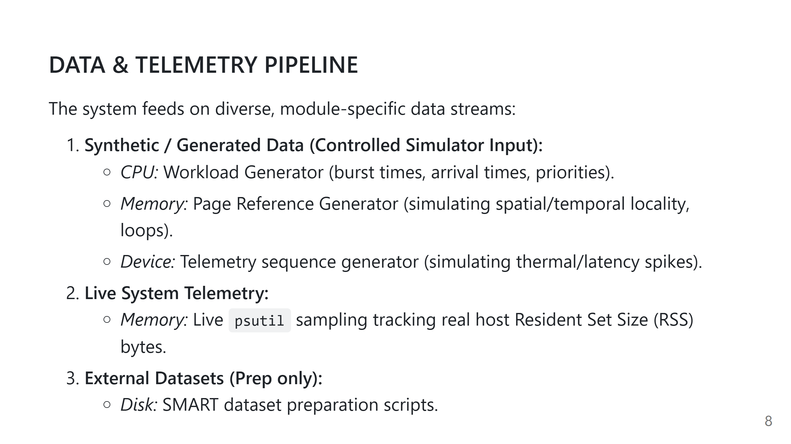
Notes:
Speaker Notes:
1. What we should say: "Because this is a simulator, robust data generation is crucial. We built sophisticated generators that mathematically mimic real OS behavior, such as spatial locality for memory."
2. Technical explanation: The page reference generator doesn't just spit out random numbers; it creates loops and contiguous blocks to accurately test LRU.
3. Important implementation details: We also collect live data using the `psutil` library to prove the leak detector works on real process metrics.
4. Likely professor questions: "Is your data real?" -> "The SMART and psutil data are real/derived from real systems. The process bursts and page sequences are mathematically simulated."
5. Repository files: ml/memory/page_reference_generator.py, modules/memory/memory_monitor.py.

Slide 9
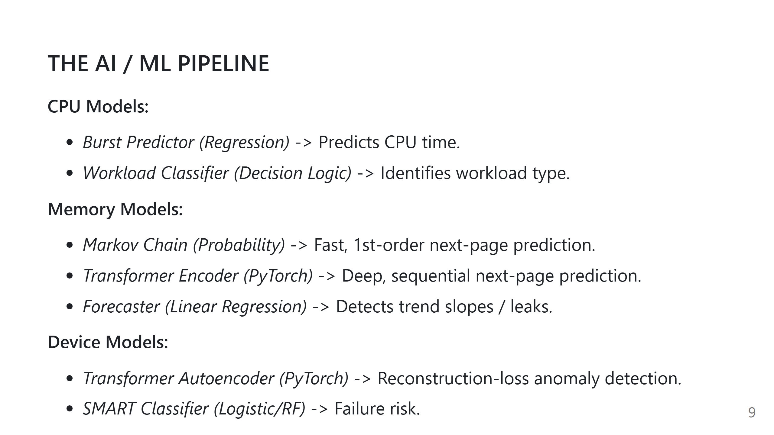
Notes:
Speaker Notes:
1. What we should say: "We use a spectrum of ML techniques. Simple tasks use fast linear regression or Markov chains. Complex sequence tasks, like device anomalies or page traces, use PyTorch Transformers."
2. Technical explanation: Transformers utilize self-attention, allowing them to contextually relate elements far apart in a sequence.
3. Important implementation details: Models share a consistent lifecycle API: train() -> predict()/evaluate().
4. Likely professor questions: "Why use PyTorch instead of just scikit-learn?" -> "For sequential data like device telemetry or memory pages, neural networks like Transformers significantly outperform simple statistical models."
5. Repository files: ml/device/transformer_anomaly_detector.py, ml/memory/markov_predictor.py.

Slide 10
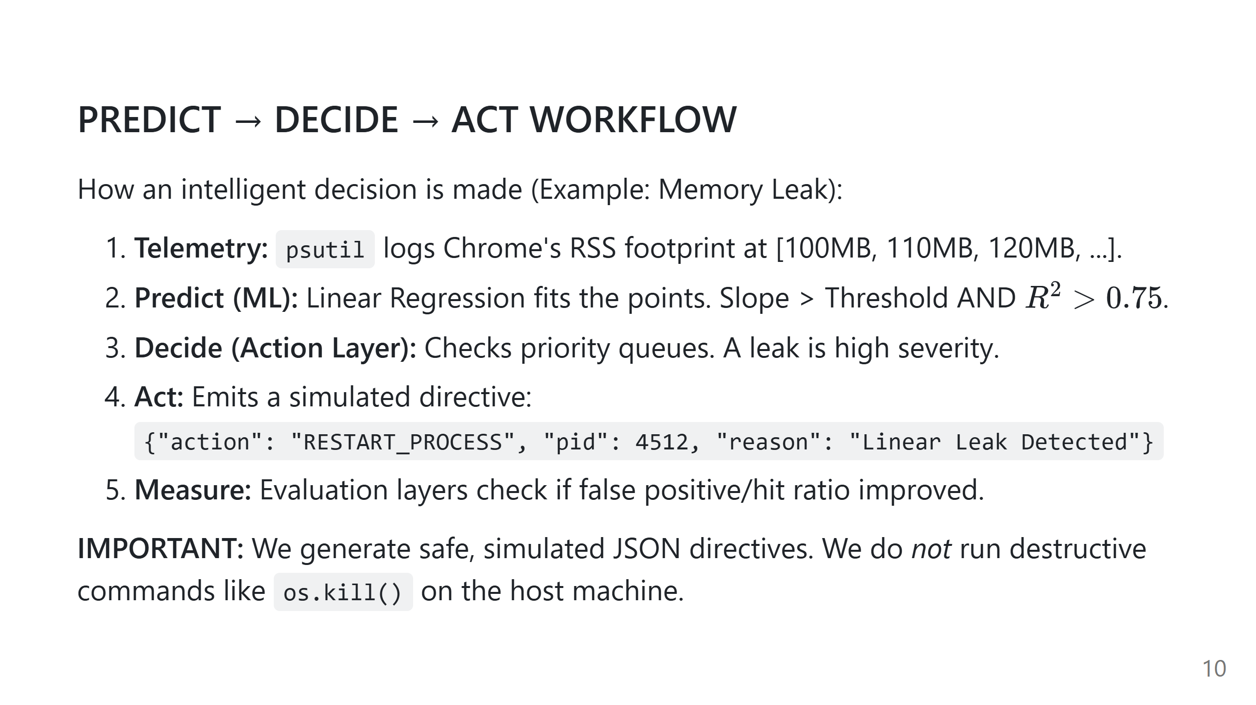
Notes:
Speaker Notes:
1. What we should say: "This is the core loop of our project. Data comes in, ML analyzes it, the Action Layer decides the severity, and a simulated directive is issued."
2. Technical explanation: The Action Layer prevents the ML model from directly interacting with the OS. It provides safety guarantees and threshold checks.
3. Important implementation details: The system is designed to be highly observable and safe.
4. Likely professor questions: "Will this crash my computer?" -> "No, the output is a simulated directive meant to demonstrate the decision logic, not a live kernel exploit."
5. Repository files: modules/memory/memory_health_action.py.

Slide 11
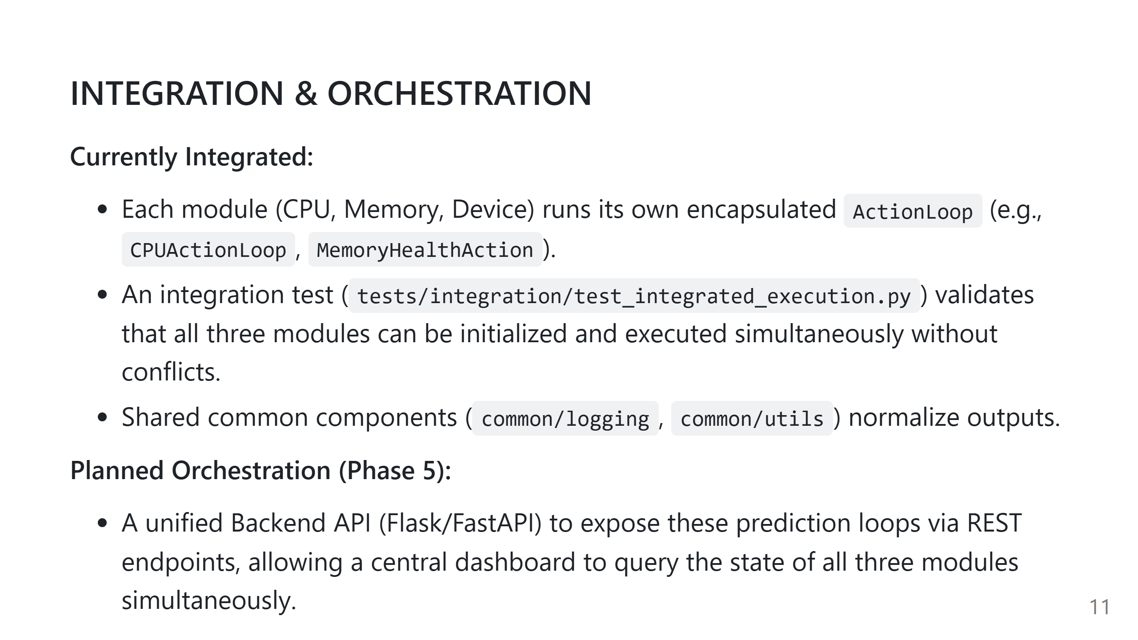
Notes:
Speaker Notes:
1. What we should say: "Currently, our modules are fully integrated at the Python package level. We have integration tests that run them side-by-side. The next step is exposing them over a web API."
2. Technical explanation: All modules share common logging and utilities to ensure data consistency.
3. Important implementation details: The architecture supports running the loops asynchronously in the future.
4. Likely professor questions: "Can these run concurrently?" -> "Yes, because they are decoupled, they can easily be mapped to separate threads or API endpoints."
5. Repository files: tests/integration/test_integrated_execution.py.

Slide 12
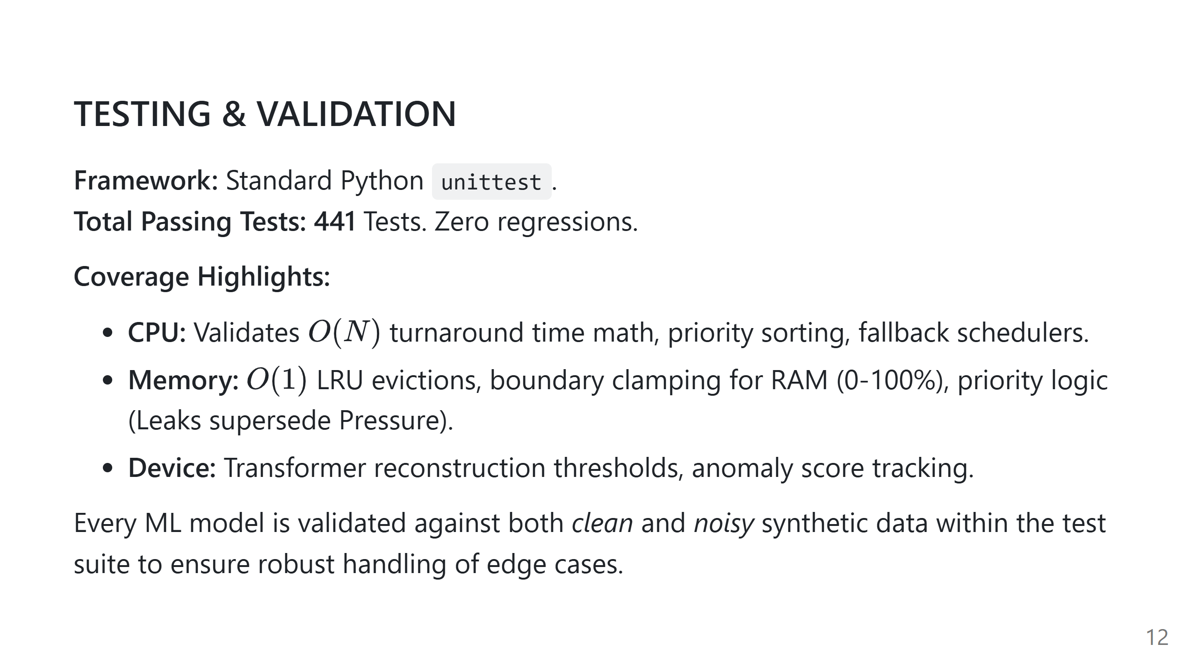
Notes:
Speaker Notes:
1. What we should say: "We take validation very seriously. We have 441 passing tests across the repository. This ensures our AI models do not break foundational OS math or data structures."
2. Technical explanation: ML tests evaluate model lifecycle (train->predict), while OS tests evaluate algorithm complexity and correctness.
3. Important implementation details: We test edge cases like clamped boundary percentages and fallback modes.
4. Likely professor questions: "How do you test a neural network in a unit test?" -> "We train it on a highly simplified, deterministic synthetic sequence and assert that the loss drops and the prediction matches the known label."
5. Repository files: tests/memory, tests/cpu, tests/device.

Slide 13
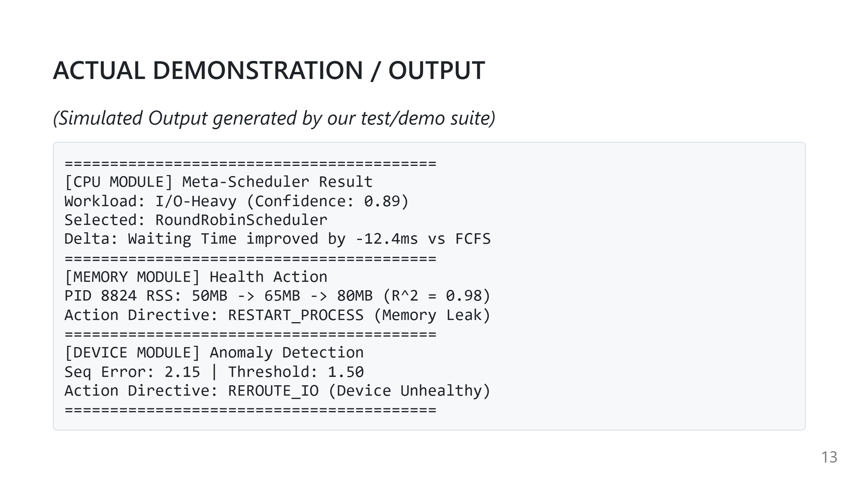
Notes:
Speaker Notes:
1. What we should say: "This is representative output from our simulation loops. It highlights the exact structured data our Action Layers emit."
2. Technical explanation: The delta shows how much the AI decision improved performance compared to a baseline.
3. Important implementation details: These outputs can be triggered live using our module demonstration scripts.
4. Likely professor questions: "Are these numbers hardcoded?" -> "No, they are the dynamic output of the simulated data passing through the trained ML models."
5. Repository files: scripts/demo_memory_module.py, modules/cpu/action_loop.py.

Slide 14
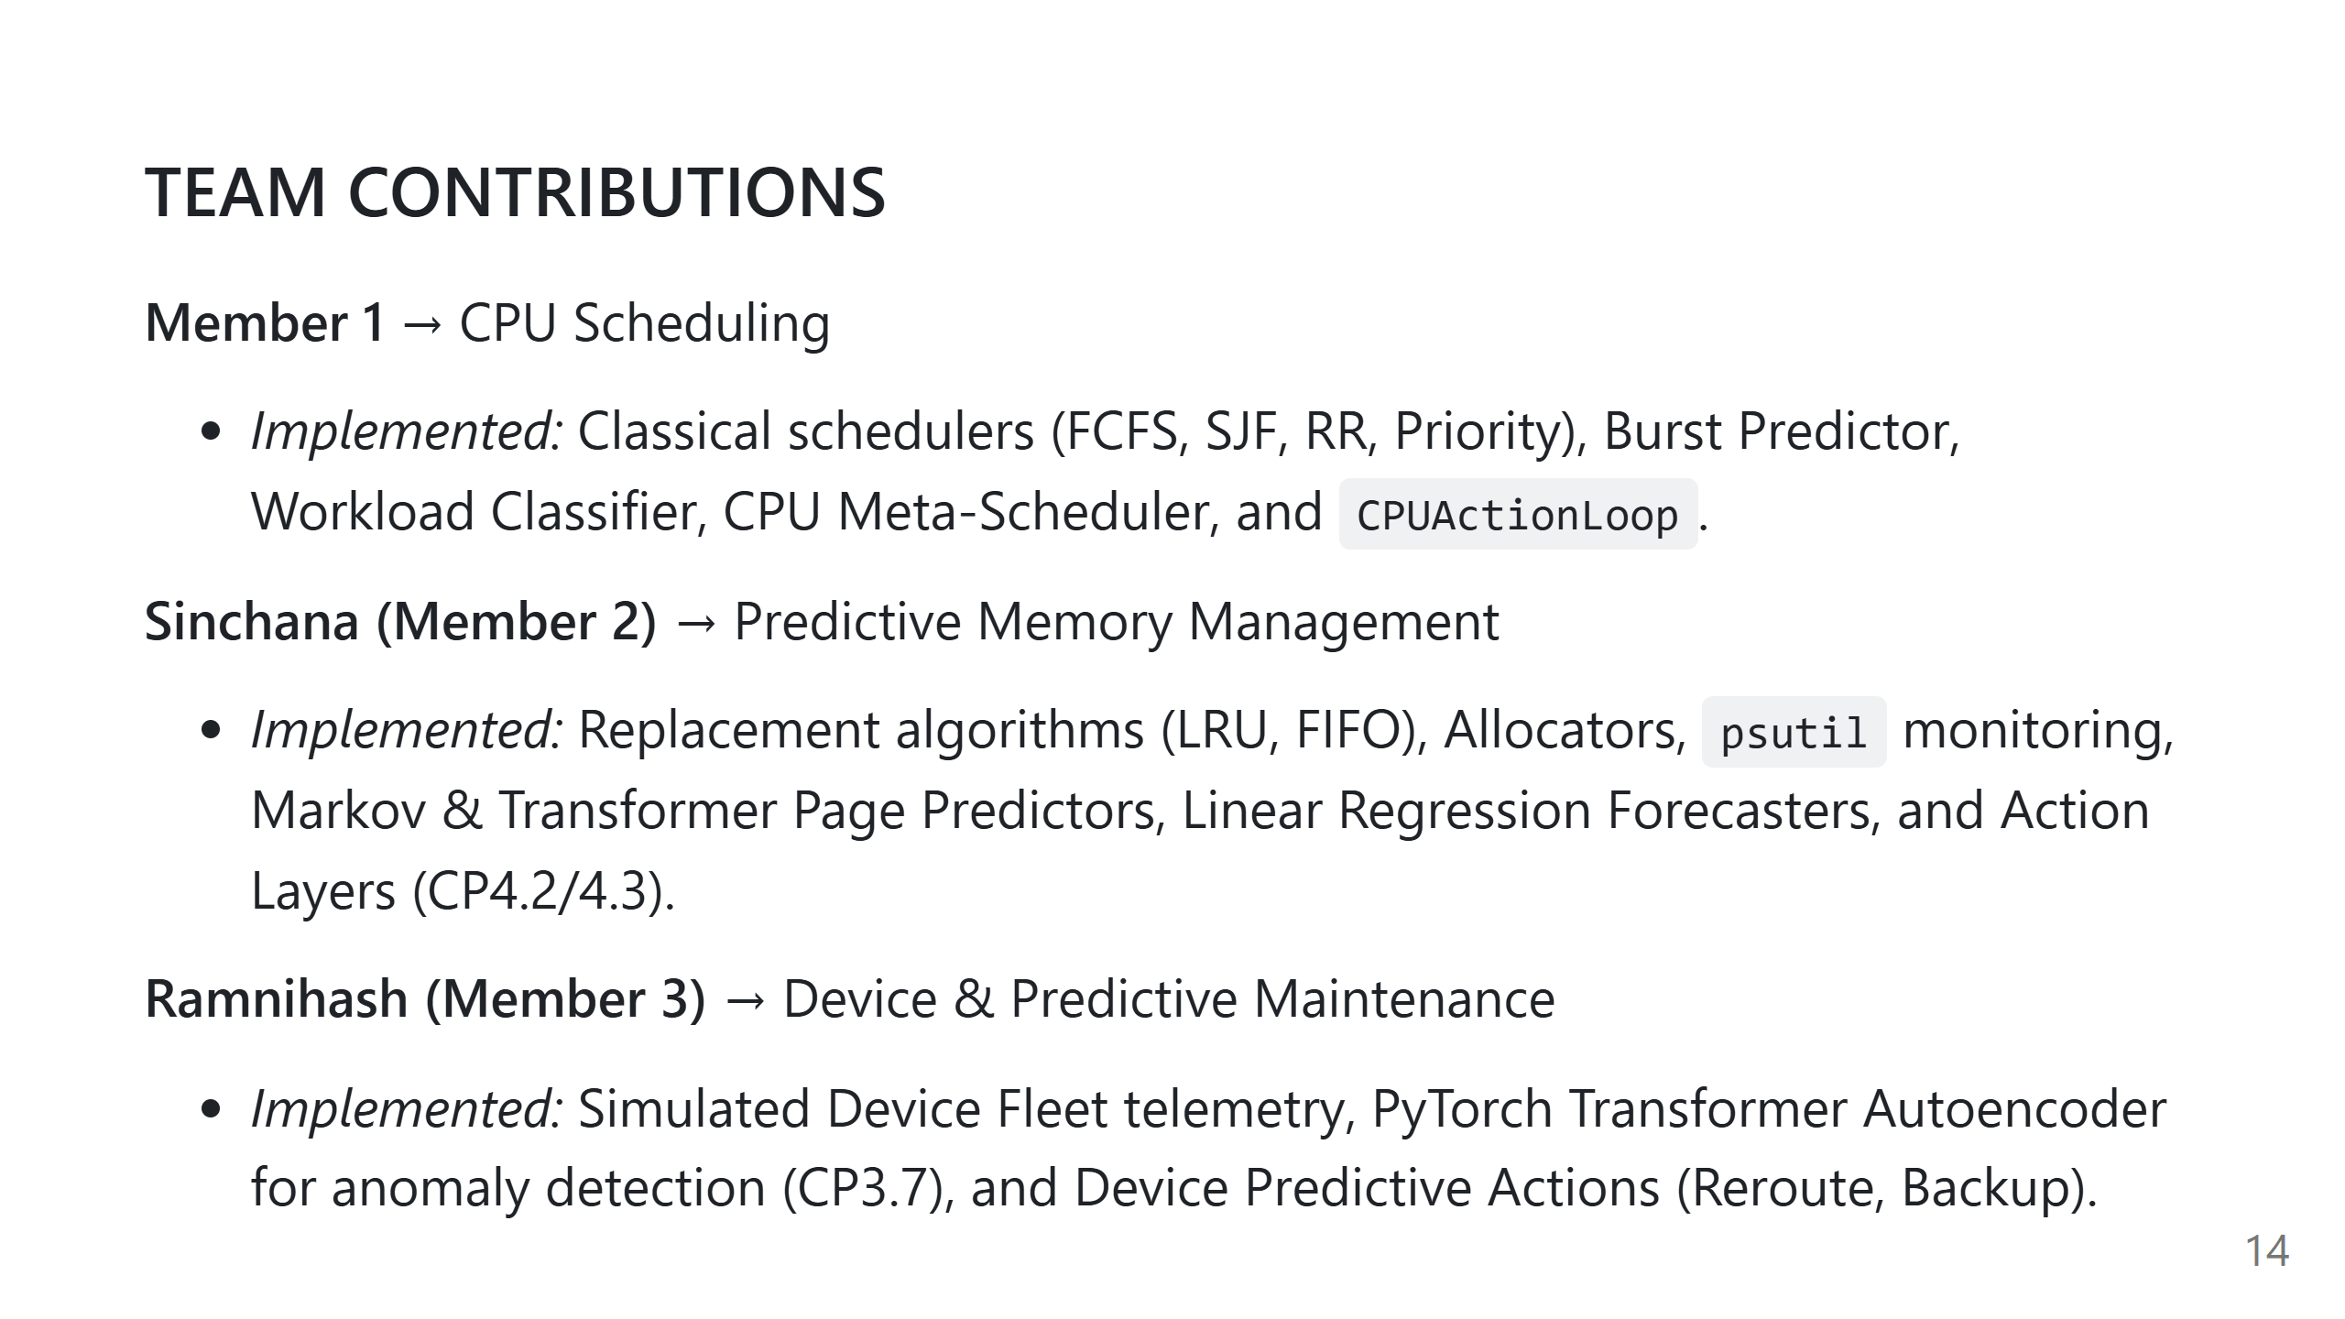
Notes:
Speaker Notes:
1. What we should say: "Every team member successfully delivered the core OS logic, ML models, and Action Layers for their respective modules."
2. Technical explanation: The work was evenly distributed across the 3 domains, but all followed the exact same architecture.
3. Important implementation details: We all utilized the common/utils and testing standards.
4. Likely professor questions: "Who integrates it?" -> "We all collaborate on the integration tests and the upcoming Phase 5 API."
5. Repository files: Git history reveals commits corresponding to these modules.

Slide 15
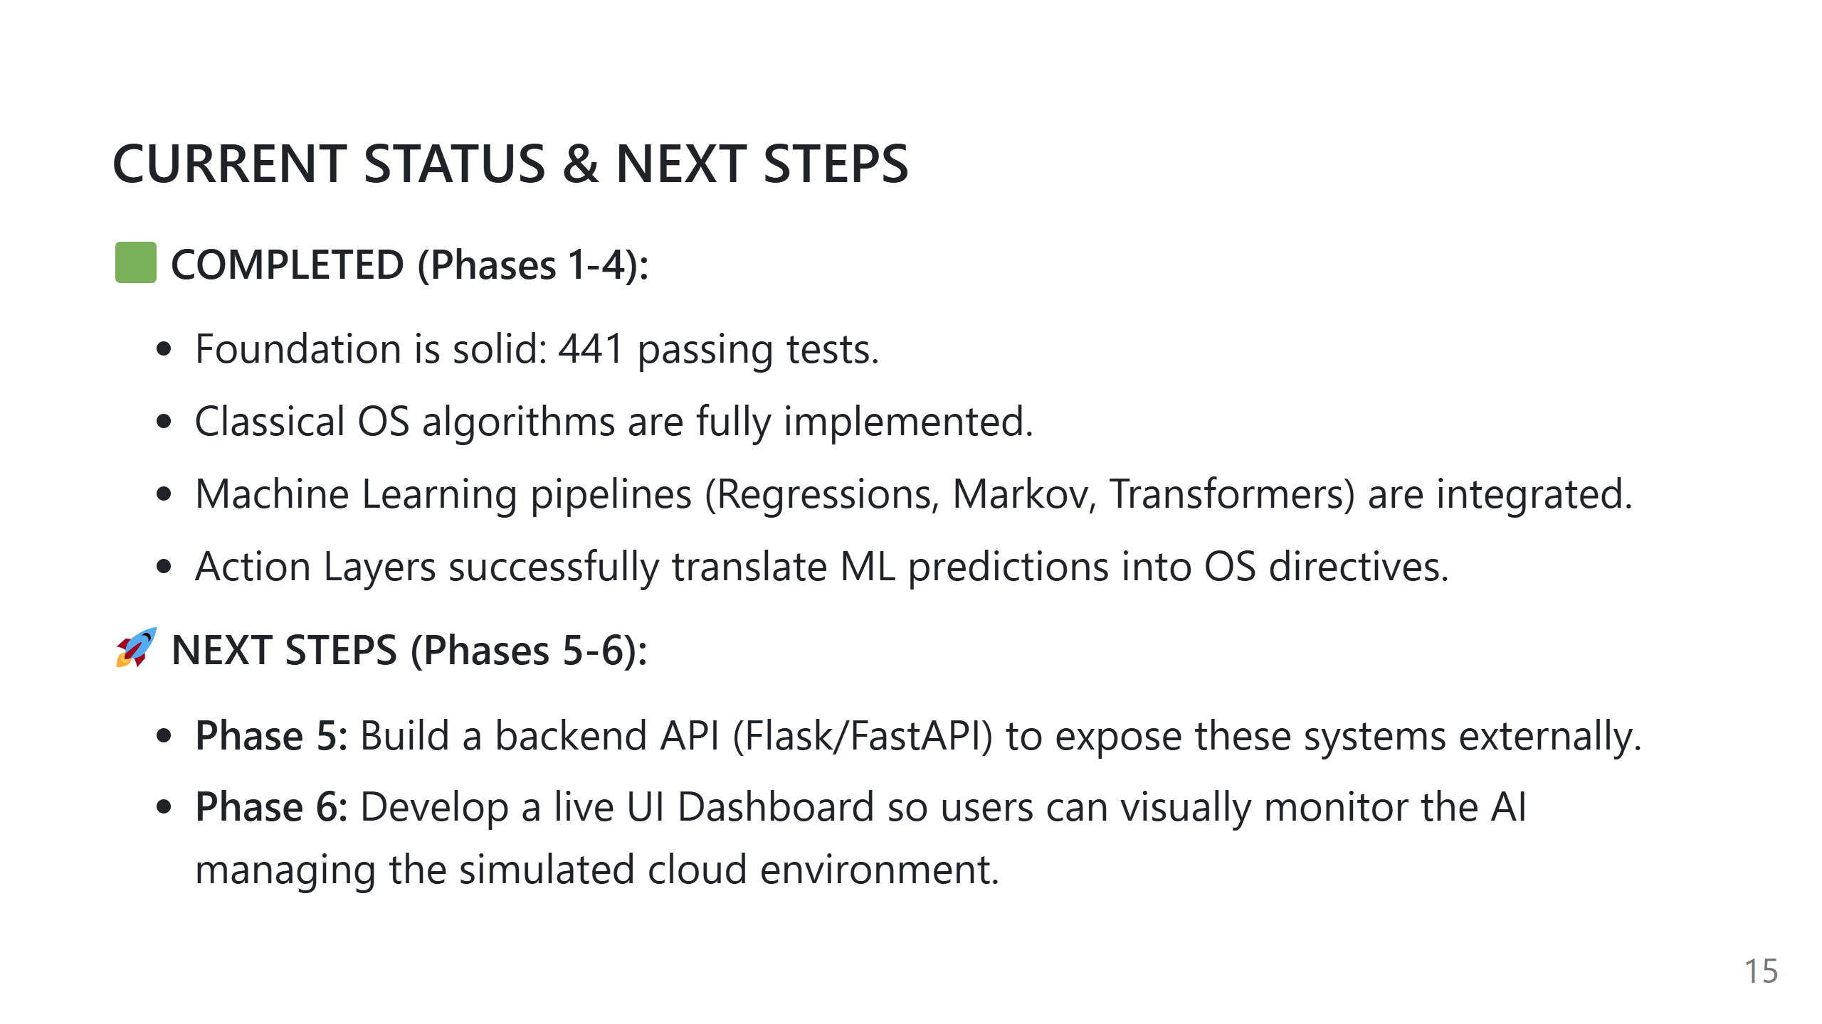
Notes:
Speaker Notes:
1. What we should say: "To conclude, our core intelligence and decision engines are complete. The remaining work for Review 3 is purely about exposing this incredible engine through a Backend API and a visual Dashboard."
2. Technical explanation: The heavy lifting of OS logic and ML model training is done.
3. Important implementation details: The API will just be a thin wrapper around our existing Action Loops.
4. Likely professor questions: "Are you on track?" -> "Yes, we are exactly where we planned to be according to DEVELOPMENT.md."
5. Repository files: DEVELOPMENT.md (Roadmap).

