Slide 1


GLOBAL INSTITUTE OF TECHNOLOGY
Department of
Computer Science & Engineering
Subject with code: 3CS4-23: Software Engineering Lab
Experiment-2: Software Requirement Analysis
Presented by:
Mr. Vivek Sharma
Assistant Professor
CSE, GIT, Jaipur

Slide 2

S/W Requirements Analysis
Requirements Analysis is the process of defining the expectations of the users for an application that is to be built or modified.
Requirements analysis involves all the tasks that are conducted to identify the needs of different stakeholders.
Therefore requirements analysis means to analyze, document, validate and manage software or system requirements.

Slide 3

Requirement Analysis Process
These steps are involved in requirement analysis:
1. Gathering requirements: The process of gathering requirements by communicating with the customers is known as eliciting requirements.
2. Analyzing requirements: This step helps to determine the quality of the requirements. It involves identifying whether the requirements are unclear, incomplete, ambiguous, and contradictory. These issues resolved before moving to the next step.

Slide 4

3. Requirements modeling: In Requirements modeling, the requirements are usually documented in different formats such as use cases, user stories, natural-language documents, or process specification.
4. Review and retrospective: This step is conducted to reflect on the previous iterations of requirements gathering in a bid to make improvements in the process going forward.

Slide 5
Requirements Analysis Techniques
There are different techniques used for Requirements Analysis.
In further slides we will discuss a number of different Requirements Analysis Techniques:

Slide 6
Business process modeling notation (BPMN)
This technique is similar to creating process flowcharts, although BPMN has its own symbols and elements. Business process modeling and notation is used to create graphs for the business process.
These graphs simplify understanding the business process. BPMN is widely popular as a process improvement methodology.

Slide 7
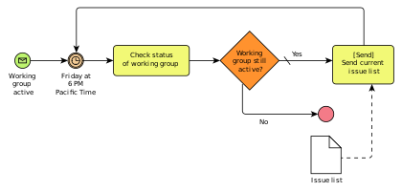
Business process modeling notation (BPMN)

Slide 8
UML (Unified Modeling Language)
UML consists of an integrated set of diagrams that are created to specify, visualize, construct and document the artifacts of a software system.
UML is a useful technique while creating object-oriented software and working with the software development process.
In UML, graphical notations are used to represent the design of a software project. UML also help in validating the architectural design of the software.

Slide 9
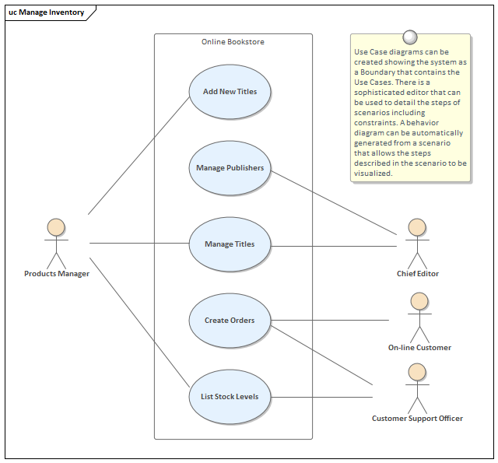
UML Diagram (Use-Case)

Slide 10
Flowchart technique
A flowchart depicts the sequential flow and control logic of a set of activities that are related. Flowcharts are in different formats such as linear, cross-functional, and top-down.
The flowchart can represent system interactions, data flows, etc. Flow charts are easy to understand and can be used by both the technical and non-technical team members. Flowchart technique helps in showcasing the critical attributes of a process.

Slide 11
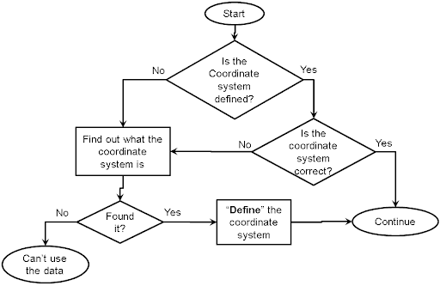
Flowchart technique

Slide 12
Data flow diagram
This technique is used to visually represent systems and processes difficult to describe in text.
Data flow diagrams represent the flow of information through a process or a system with the data inputs and outputs, data stores, and the various sub-processes through which the data moves.
DFD describes various entities and their relationships with the help of standardized notations and symbols. By visualizing all the elements of the system it is easier to identify any shortcomings.

Slide 13
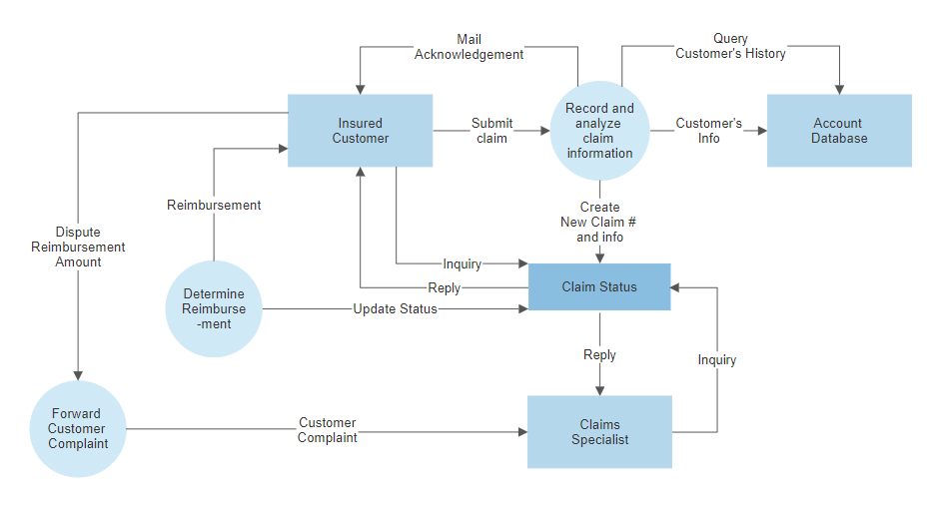
Data flow diagram

Slide 14
Role Activity Diagrams (RAD)
Role-activity diagram (RAD) is a role-oriented process model that represents role-activity diagrams.
Role activity diagrams are a high-level view that captures the dynamics and role structure of an organization.
Roles are used to grouping together activities into units of responsibilities.
Activities are the basic parts of a role. An activity may be either carried out in isolation or it may require coordination with other activities within the role.

Slide 15
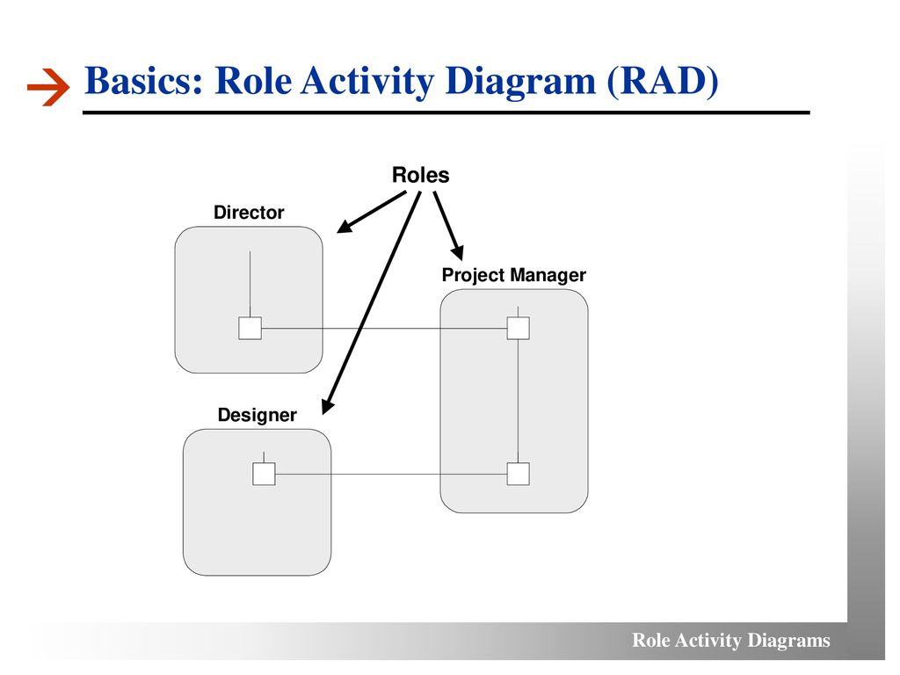

Slide 16
Gap Analysis
Gap analysis is a technique which helps to analyze the gaps in performance of a software application to determine whether the business requirements are met or not.
It also involves the steps that are to be taken to ensure that all the business requirements are met successfully.
Gap denotes the difference between the present state and the target state.
Gap analysis is also known as need analysis, need assessment or need-gap analysis.

Slide 17
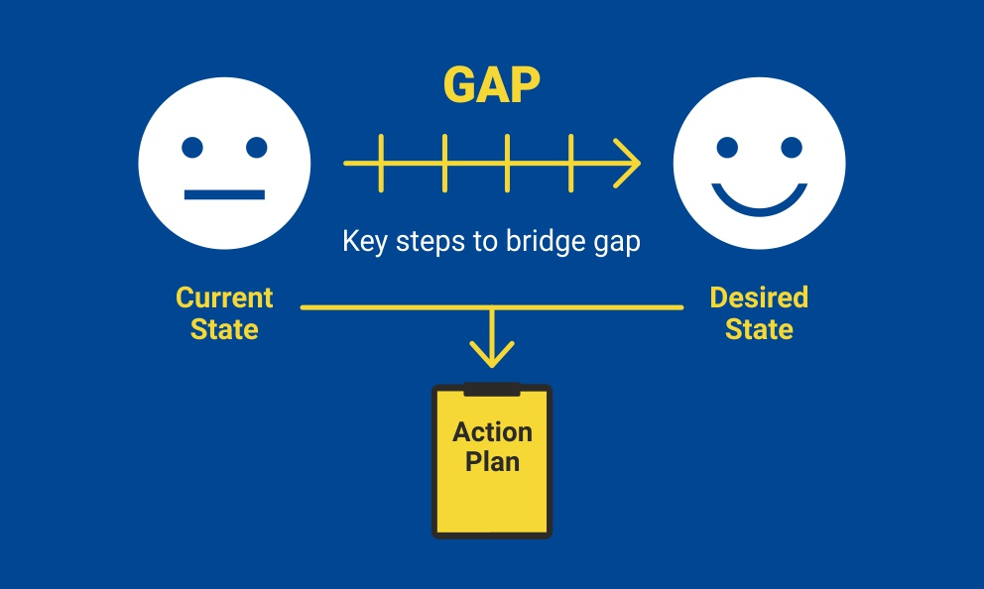

Slide 18
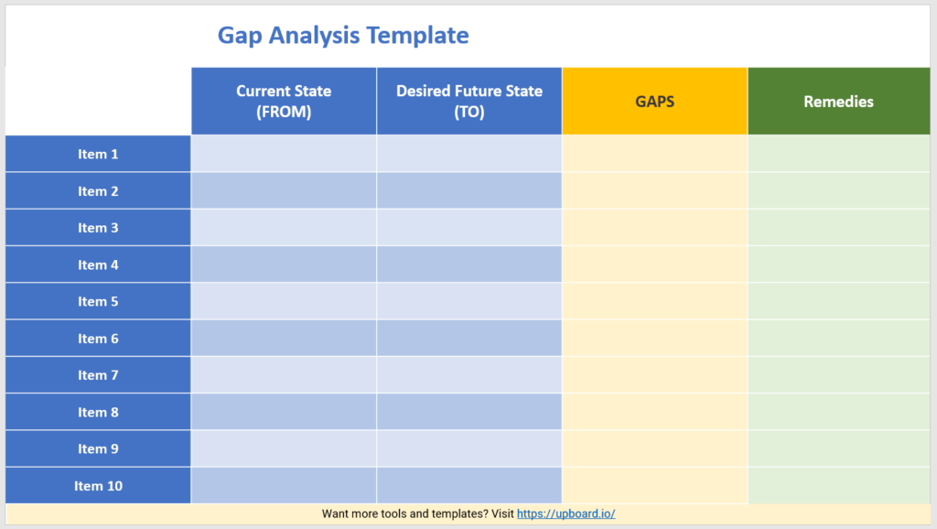

Slide 19
Instructions
Choose a project according to your choice, and gather the requirements of that project as per customer point of view and write them in document as per developer point of view.
You may use verbal, descriptive and graphical notation as per your convenience.

Slide 20
THANK YOU

