Slide 1
Definitions for chemical composition
Federico Ramognino

Slide 2

Air and EGR
Air (oxidizer) is defined at a fixed composition:
This is extracted from the mixture starting from the oxygen mass/mole fraction
EGR is everything but air and fuel, therefore its composition is the combustion products of stoichiometric combustion
$$Air=x_{O_{2}}O_{2}+x_{N_{2}}N_{2}+…$$
AIR
EGR
FUEL

Slide 3



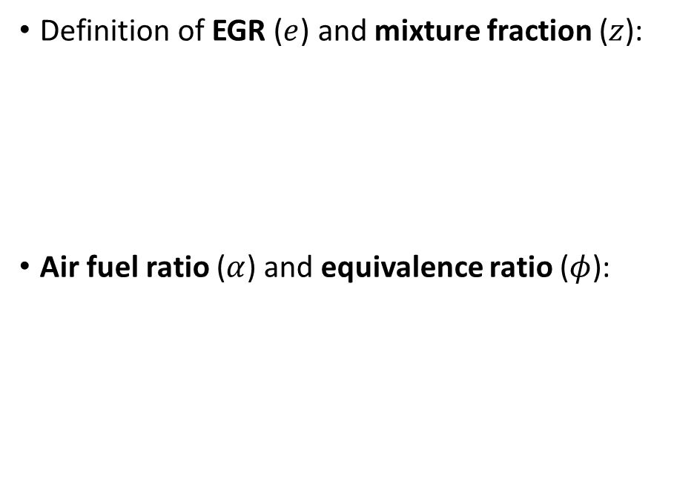



EGR and mixture fraction
Definition of EGR ($e$) and mixture fraction ($z$):
Air fuel ratio ($α$) and equivalence ratio ($φ$):
$$e=\frac{m_{e}}{m_{e}+m_{f}+m_{a}}=y_{e}$$
AIR
EGR
$$e^{∗}=\frac{m_{e}}{m_{e}+m_{a}}$$
$$z=\frac{m_{f}}{m_{e}+m_{f}+m_{a}}=y_{f}$$
$$z^{∗}=\frac{m_{f}}{m_{f}+m_{a}}$$
$$α=\frac{m_{a}}{m_{f}}$$
$$φ=\frac{α_{st}}{α}$$
FUEL

Slide 4






EGR and mixture fraction
Relationship between quantities:
Stoichiometric mixture fraction:
$$z^{∗}=\frac{z}{1−e}=\frac{1}{1+α}$$
$$e=\frac{e^{∗}(1−z^{∗})}{1−z^{∗}e^{∗}}$$
AIR
EGR
$$e^{∗}=\frac{e}{1−z}$$
$$z=\frac{z^{∗}(1−e^{∗})}{1−z^{∗}e^{∗}}$$
$$z_{st}=\frac{1−e}{1+α_{st}}=f\left(e\right)$$
FUEL
$$z_{st}\left( \right)>z_{st}\left( \right)$$

