Slide 1


University of Essex
Ramon Flores Arteaga
MSc Artificial Intelligence
Machine Learning · July 2026
Comparative
Intelligence & Ethics
Distracted Driver Classification in Machine Learning Systems
Ramon Flores Arteaga – MSC Artificial Intelligence – Machine Learning July 2026
Notes:
Introduce the investigation: evaluating machine learning architectures on distracted driver detection under rigorous driver-separated evaluation, examining both statistical performance and ethical deployment boundaries.

Slide 2
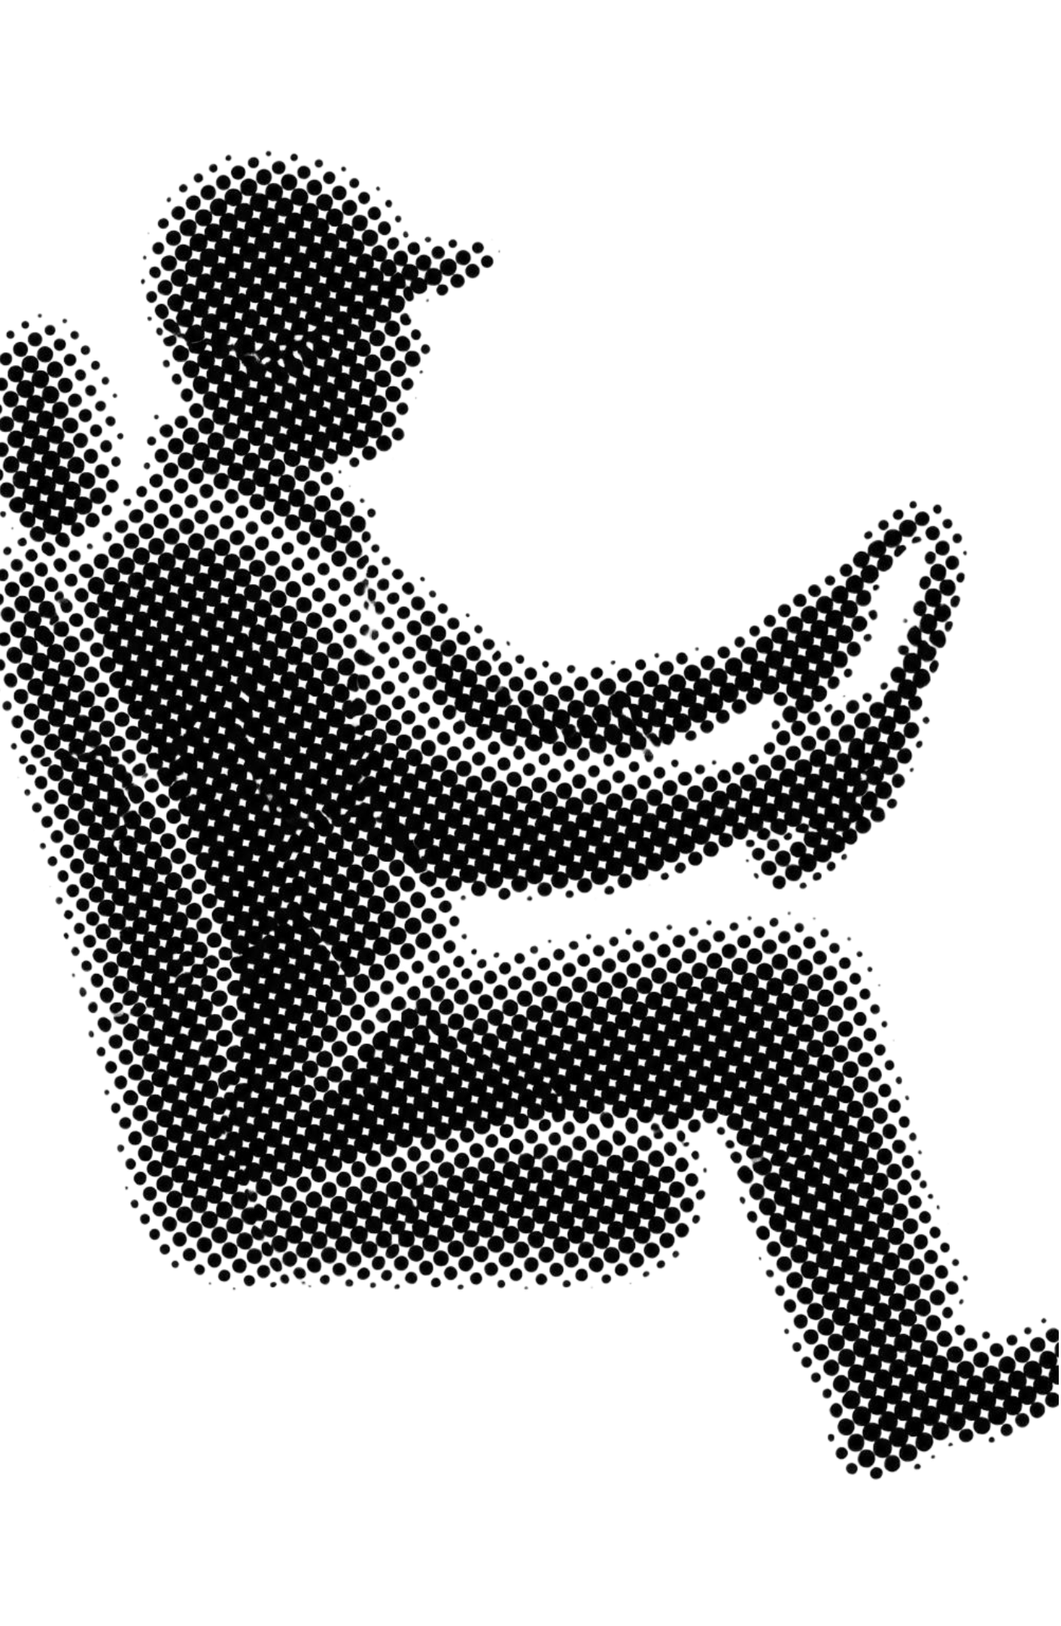
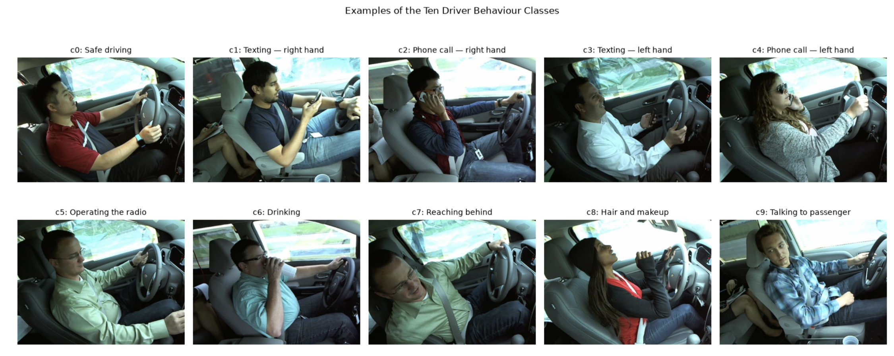
RESEARCH PROBLEM
Dataset and research question
DATASET SCALE
ARCHITECTURES
22,424 images
3 paradigms
State Farm benchmark across 26 distinct drivers and 10 posture classes.
Handcrafted HOG + SVM, a custom lightweight CNN, and pretrained MobileNetV3 + linear SVM.
CRITICAL_DISTINCTION.LOG
Ramon Flores Arteaga – MSC Artificial Intelligence – Machine Learning July 2026
Notes:
Frame the guiding question: models frequently overfit to specific cabin textures and individual driver morphology. Highlight that posture classification is not true safety assurance.

Slide 3
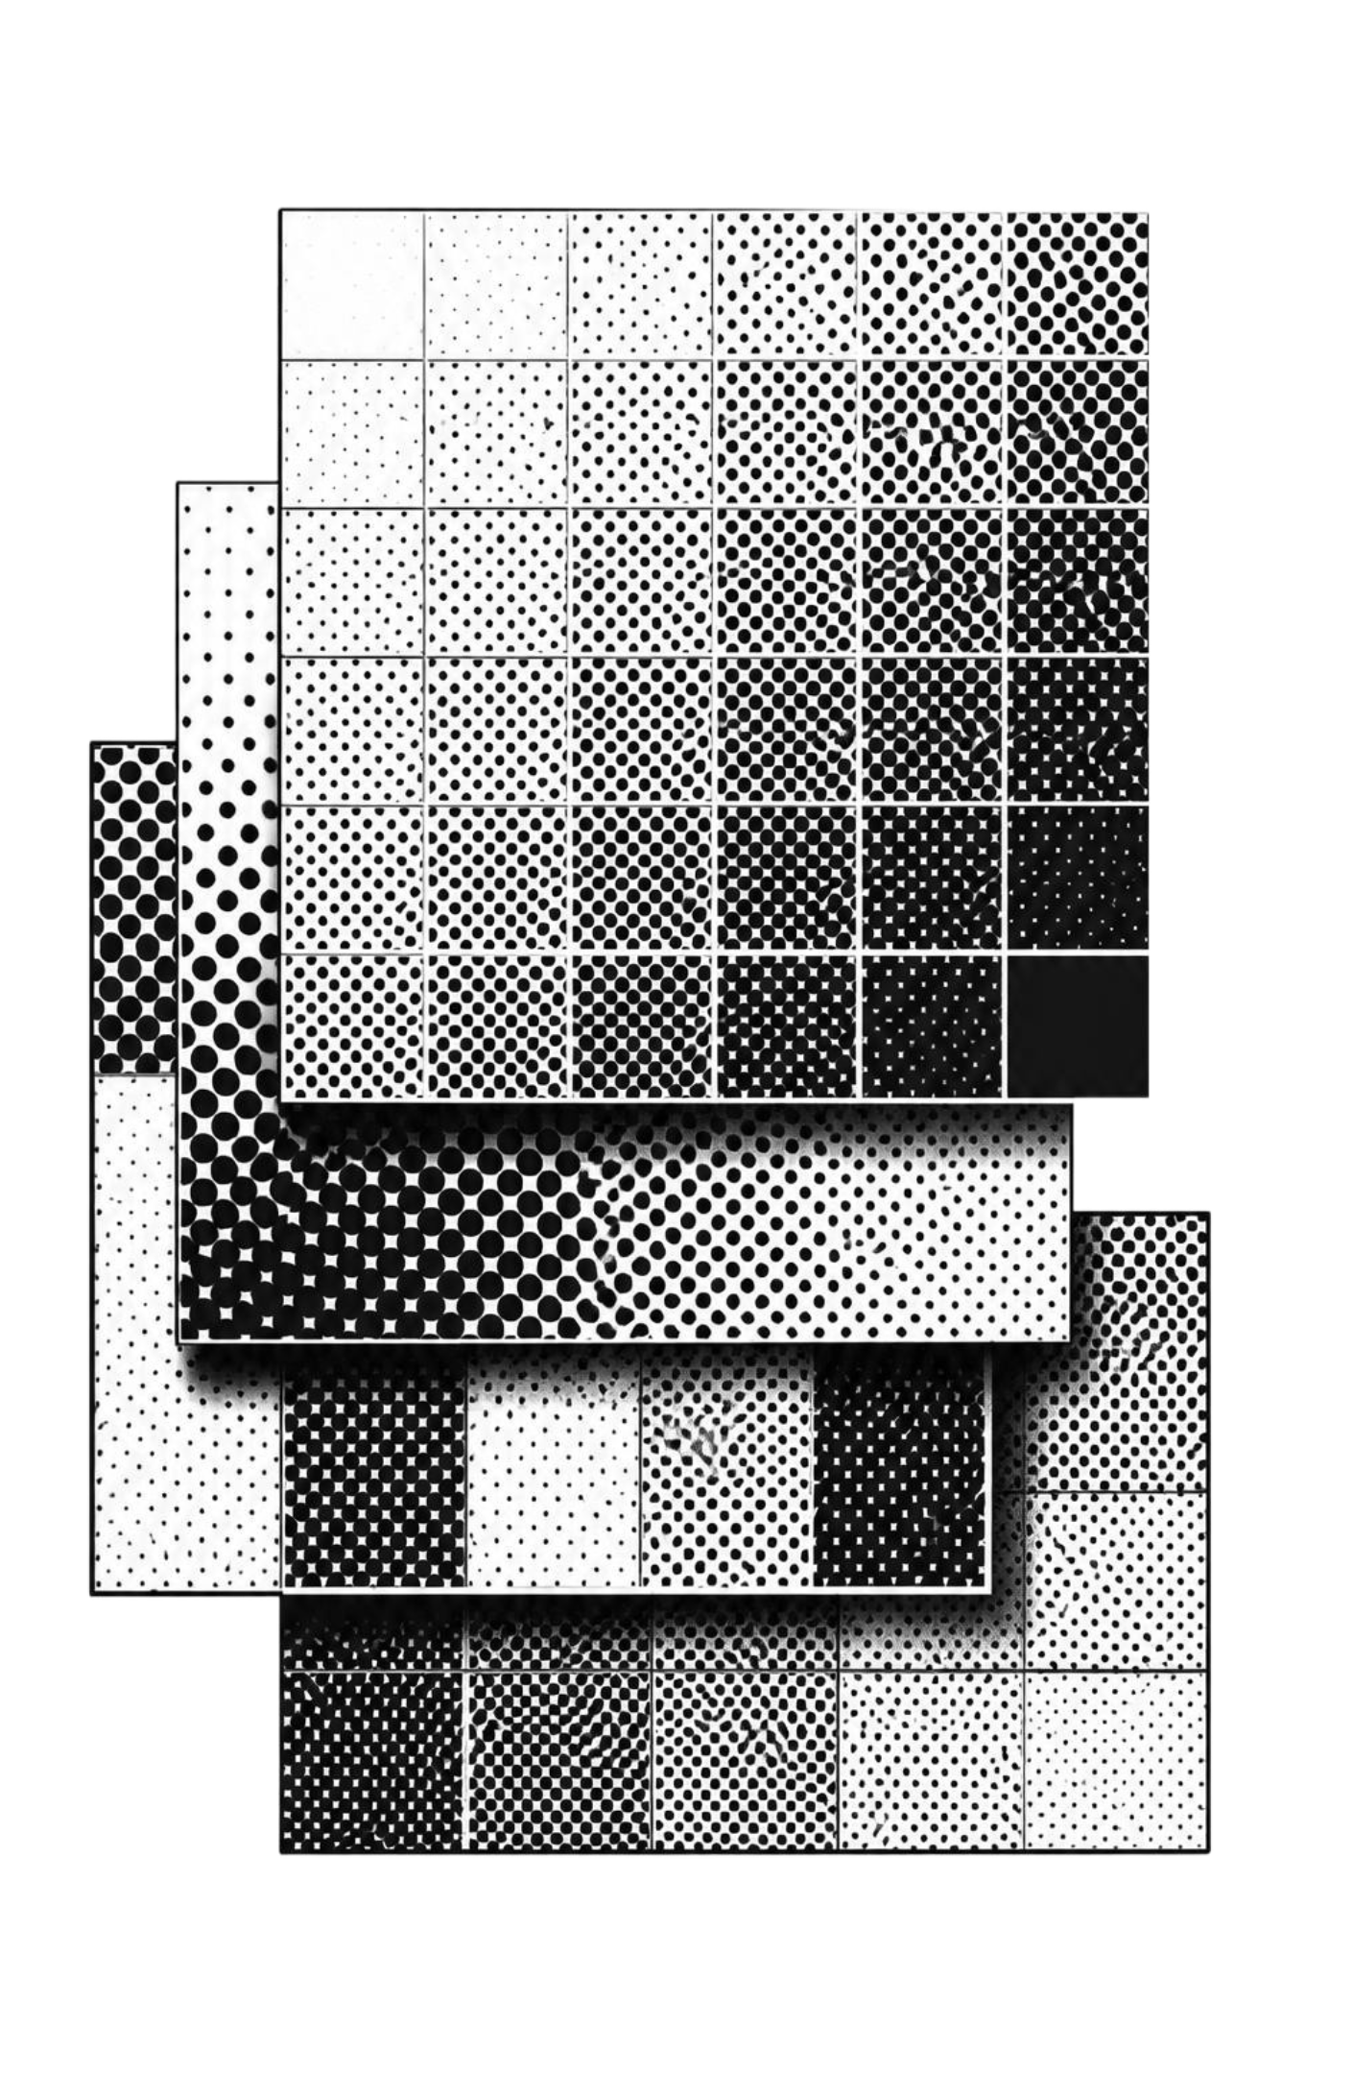
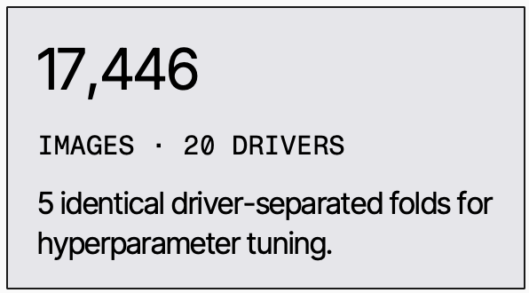
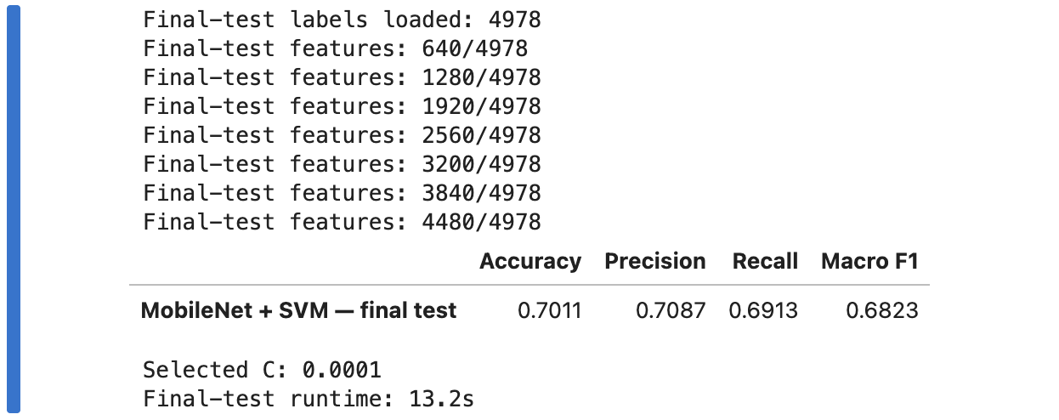
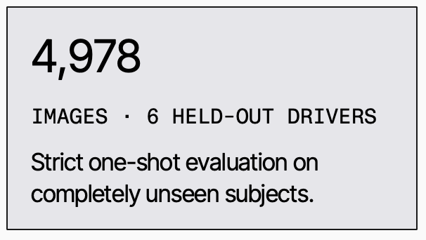
EXPERIMENTAL RIGOUR
Preprocessing and separation by driver
Random image-level splitting inflates benchmark accuracy by allowing identical drivers, clothing, and cabin backgrounds into both train and test splits.
DEV_SPLIT.CSV
Ramon Flores Arteaga – MSC Artificial Intelligence – Machine Learning July 2026
Notes:
Emphasize the partitioning protocol: keeping drivers segregated between training and testing is essential to prevent background and identity memorization.

Slide 4
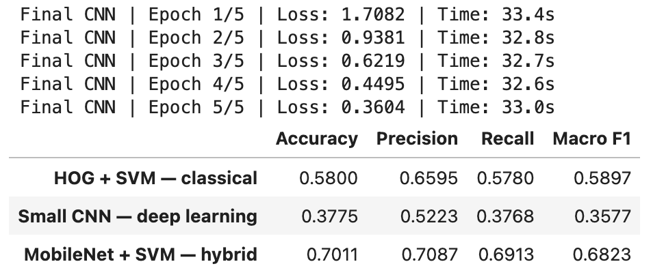
SYSTEM ARCHITECTURE
Three modelling approaches
CLASSICAL
DEEP BASELINE
HYBRID PIPELINE
HOG + Linear SVM
Lightweight CNN
MobileNetV3 + SVM
Handcrafted edge-direction histograms extracting coarse contour and boundary gradients without deep feature representation.
End-to-end convolutional network trained from scratch for five epochs, testing raw feature extraction under constrained capacity.
Frozen pretrained MobileNetV3 Small backbone yielding dense semantic feature vectors paired with a regularized linear classifier.
INPUT: 128 × 96 · SCIKIT-IMAGE
PYTORCH · SCRATCH TRAINING
TORCHVISION + LINEARSVC (C TUNED)
ALL ARCHITECTURES EVALUATED UNDER IDENTICAL DRIVER-SEPARATED FOLDS WITHOUT DATA LEAKAGE
Ramon Flores Arteaga – MSC Artificial Intelligence – Machine Learning July 2026
Notes:
Describe each modeling philosophy: handcrafted visual descriptors, uninitialized deep representation learning, and transfer learning leveraging pretrained representations.

Slide 5
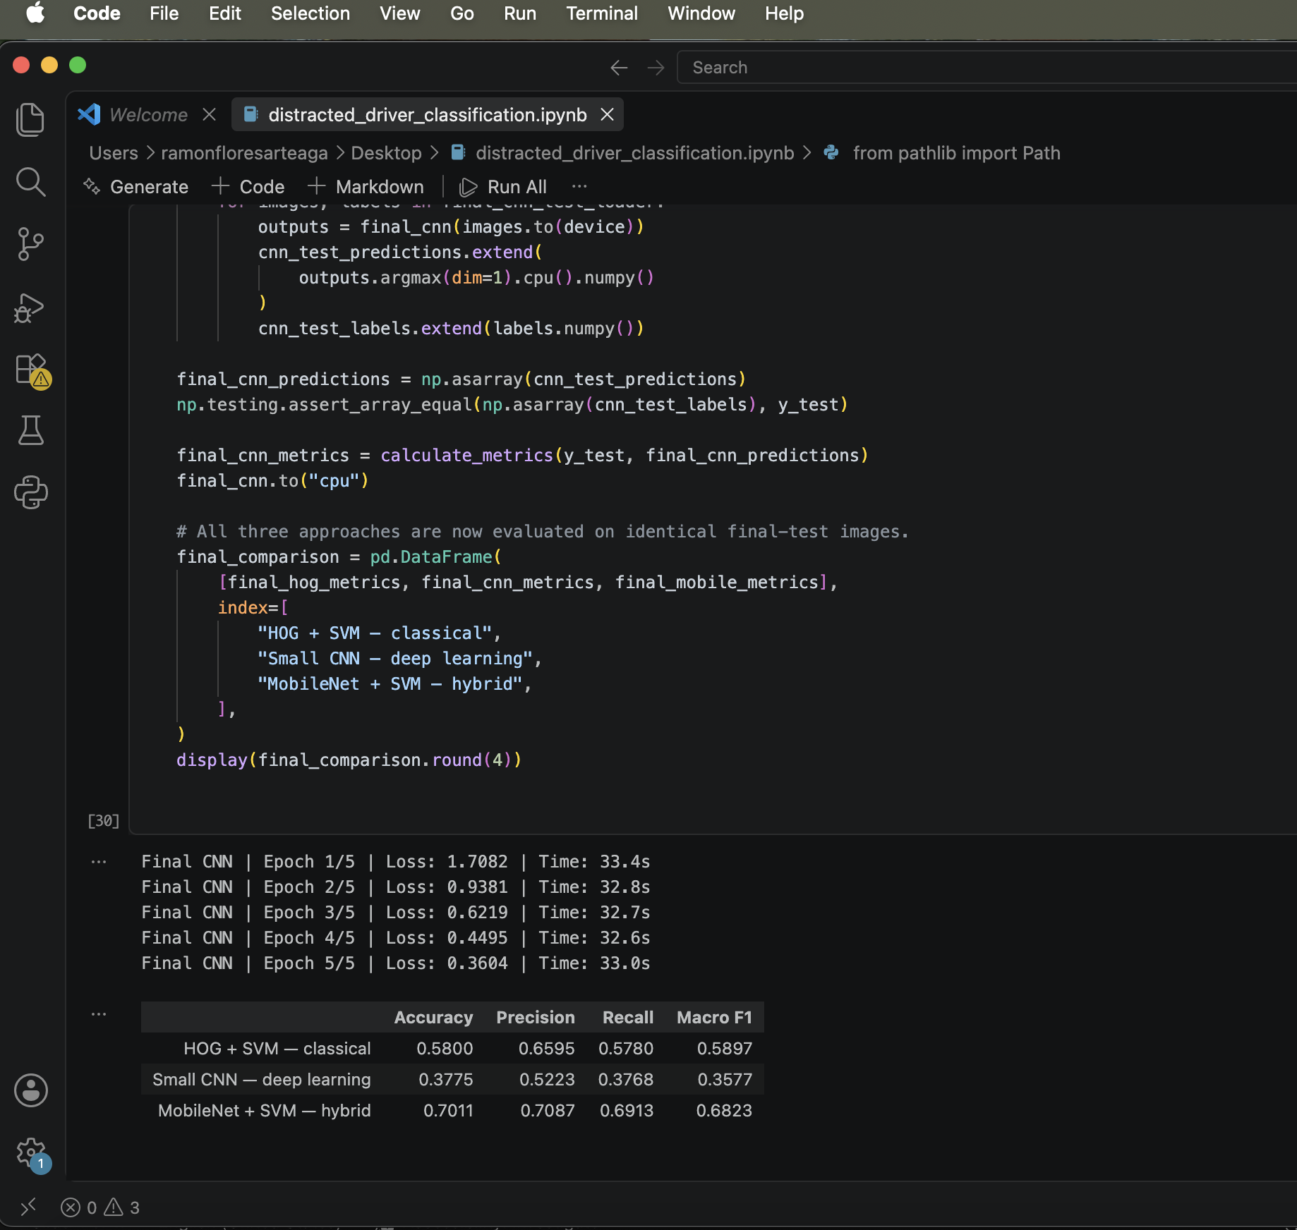
Three modelling approaches Results and Code Prerecorded

Slide 6




EVALUATION METHODOLOGY
Validation and performance measures
METRIC 01
METRIC 02
METRIC 03
METRIC 04
Overall Accuracy
Macro Precision
Macro Recall
Macro F1-Score
Aggregate percentage of correct predictions across all evaluation frames.
Unweighted mean of precision scores across all 10 distinct behaviour classes.
Unweighted average sensitivity detecting each specific driver distraction category.
Primary selection metric weighting minority and majority posture classes equally.
MODEL SELECTION PROTOCOL: TUNE HYPERPARAMETER C ON DEVELOPMENT FOLDS VIA MACRO F1 · EVALUATE EXACTLY ONCE ON 6 HELD-OUT TEST DRIVERS
Ramon Flores Arteaga – MSC Artificial Intelligence – Machine Learning July 2026
Notes:
Detail why macro metrics are mandatory: micro-averaging or raw accuracy lets high performance on frequent classes mask near-total failure on passenger interaction or texting.

Slide 7
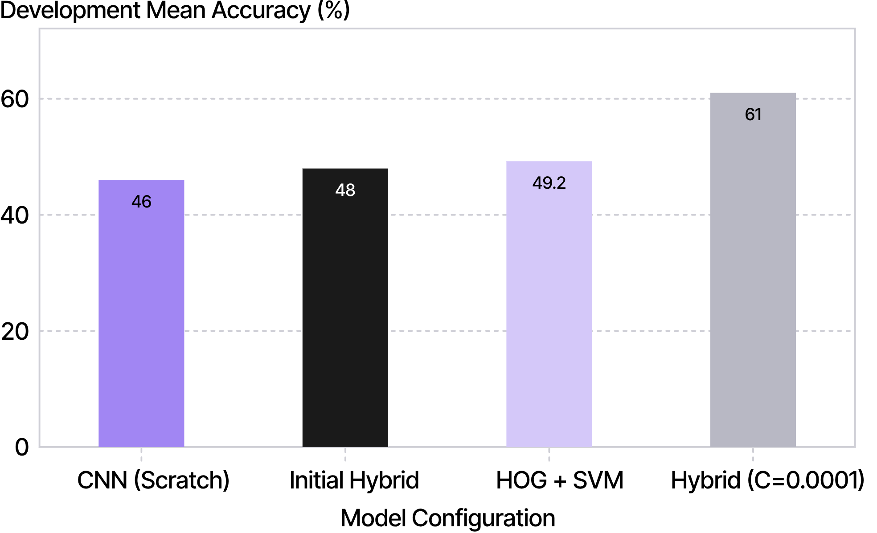
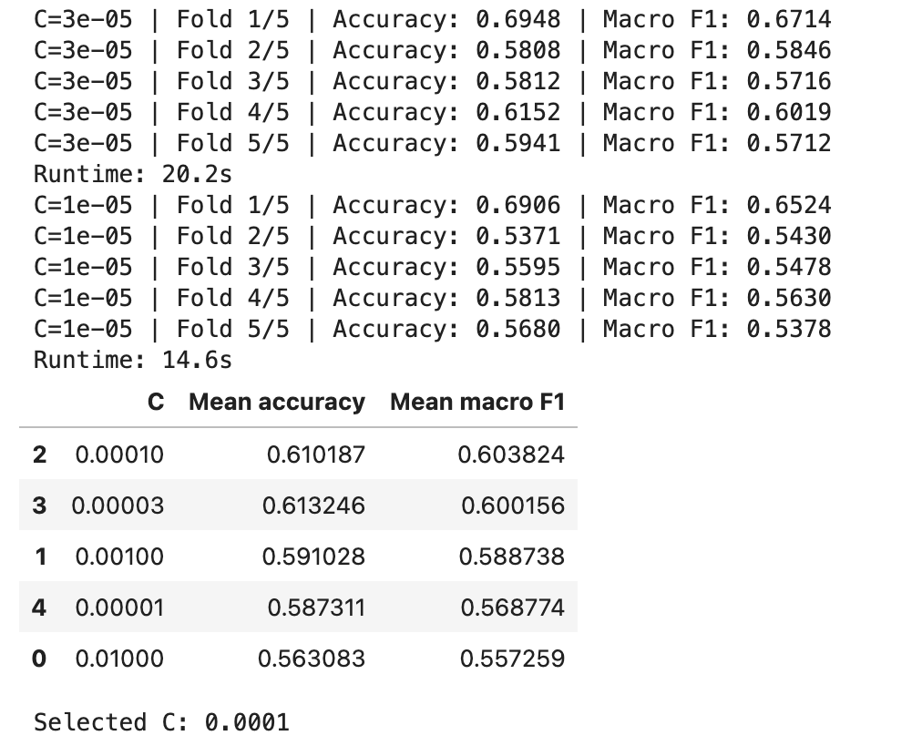
HYPERPARAMETER TUNING
Pretrained features and regularization
OPTIMIZATION
Severe regularization was decisive
Mean Accuracy between models
High-dimensional pretrained embeddings overfit training drivers under standard penalties. Sweeping down to C = 0.0001 raised mean CV accuracy to 61.02% and macro F1 to 0.6038.
FURTHER REDUCTION BELOW 1E-4 DID NOT YIELD GAINS; MACRO F1 ON VALIDATION FOLDS SERVED AS THE SOLE SELECTOR.
Ramon Flores Arteaga – MSC Artificial Intelligence – Machine Learning July 2026
Notes:
Walk through the cross-validation inflection: raw MobileNet features with default SVM regularization initially scored below classical HOG, until aggressive regularization restrained overfitting.

Slide 8
FINAL HELD-OUT TEST EVALUATION
Final Comparison on unseen drivers
Tested exactly once across 4,978 held-out images from 6 previously unseen drivers (p021, p022, p026, p035, p047, p050).
FINAL_BENCHMARK_RESULTS
Model Architecture | Test Accuracy | Macro F1-Score | Delta vs HOG
CNN (Scratch) | 37.75% | 0.3577 | −20.25 pts
HOG + Linear SVM | 58.00% | 0.5897 | Baseline
MobileNetV3 + SVM | 70.11% | 0.6823 | +12.11 pts
EVALUATED ON IDENTICAL UNSEEN DRIVERS · SCRATCH CNN COLLAPSED DUE TO CAPACITY LIMITS UNDER 5 EPOCHS
Ramon Flores Arteaga – MSC Artificial Intelligence – Machine Learning July 2026
Notes:
Present the primary empirical finding: MobileNetV3 + SVM outperforms classical HOG by 12.11 percentage points on unseen drivers, while the un-pretrained CNN struggles with limited training budget.

Slide 9
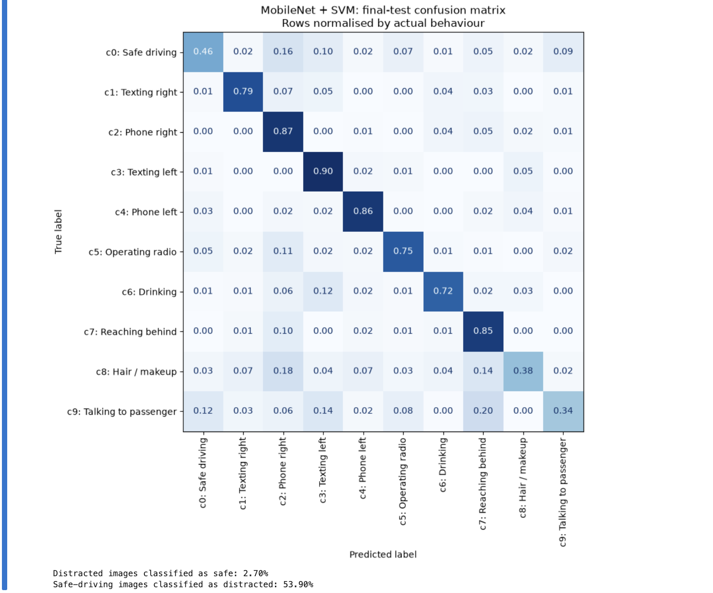
ERROR ASYMMETRY
Behavior errors and safety trade offs
Confusion Matrix
FALSE NEGATIVE RATE
2.70% of distracted images were classified as safe
FALSE ALARM RATE
53.90% of safe-driving images were classified as distracted
Best class: phone use, F1 0.8494; weakest: talking to a passenger, F1 0.4408. These are image-level rates, not real-time warning rates.
Ramon Flores Arteaga – MSC Artificial Intelligence – Machine Learning July 2026

Slide 10
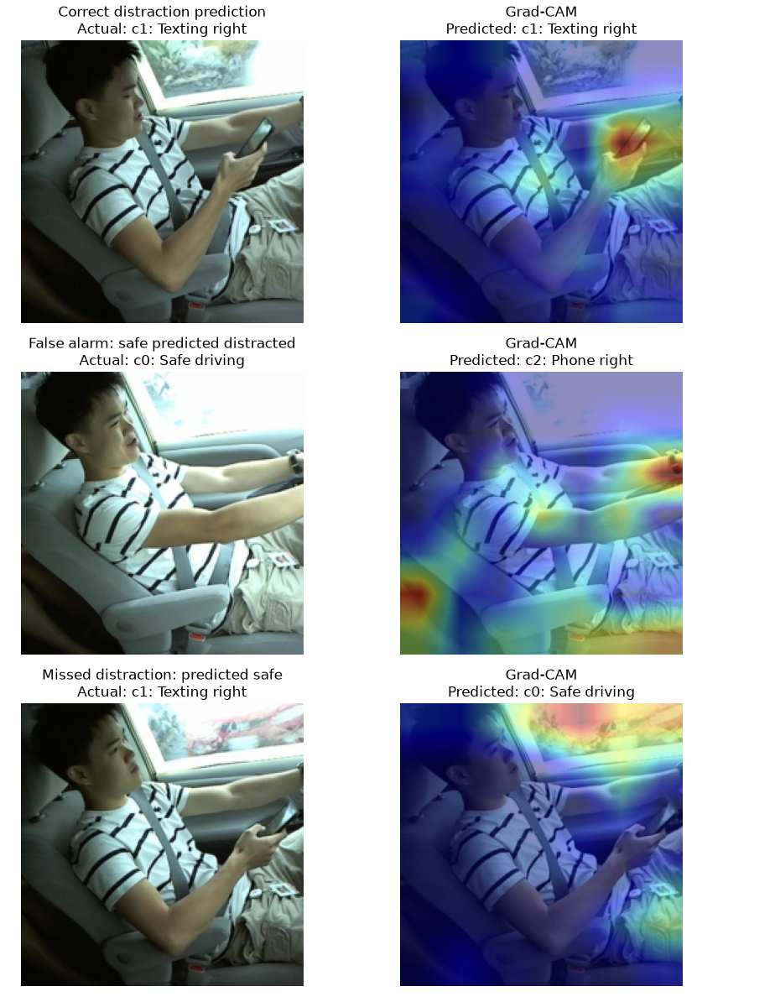
EXPLAINABILITY AUDIT
Grad-CAM Explanations
CASE_01_TRUE_POSITIVE
CASE_03_MISSED_TEXT
CORRECT PHONE CALL
MISSED TEXTING
Hand & Phone Cluster
Window Glare Distraction
Gradients strongly localized around the driver's hand, handset, and ear boundary.
High activation on the resting steering hand and high-contrast passenger window glare.
CASE_02_FALSE_ALARM
FALSE REACHING BEHIND
Seat & Lap Activation
Attribution fell onto the lower seat cushion and lap rather than shoulder rotation.
Ramon Flores Arteaga – MSC Artificial Intelligence – Machine Learning July 2026
Notes:
Walk through the Grad-CAM findings: when the model fails, attention frequently shifts away from hands to ambient lighting, cabin glare, or seat fabrics.

Slide 11
LIVE VERIFICATION
Notebook demonstration: inspect the evidence
Two-minute walkthrough verifying pre-executed outputs against published benchmark claims.
DEMONSTRATION_PROTOCOL.IPYNB
01
Held-out benchmark comparison table
Verify identical 4,978 test images across HOG (58.00%), CNN (37.75%), and Hybrid (70.11%).
02
Normalized confusion matrix inspection
Observe diagonal concentration alongside passenger conversation and reaching-behind leakage.
03
Three targeted Grad-CAM visual pairs
Inspect original cabin images against heatmaps for correct call, false alarm, and missed texting.
STRICT ACADEMIC PROTOCOL: EXECUTED OUTPUTS ONLY · ZERO TEST-SET RETRAINING OR ADAPTIVE PARAMETER TUNING
Ramon Flores Arteaga – MSC Artificial Intelligence – Machine Learning July 2026
Notes:
Provide the 2-minute notebook agenda: focus strictly on verified execution cells, demonstrating how reproducible code directly aligns with the slide claims.

Slide 12
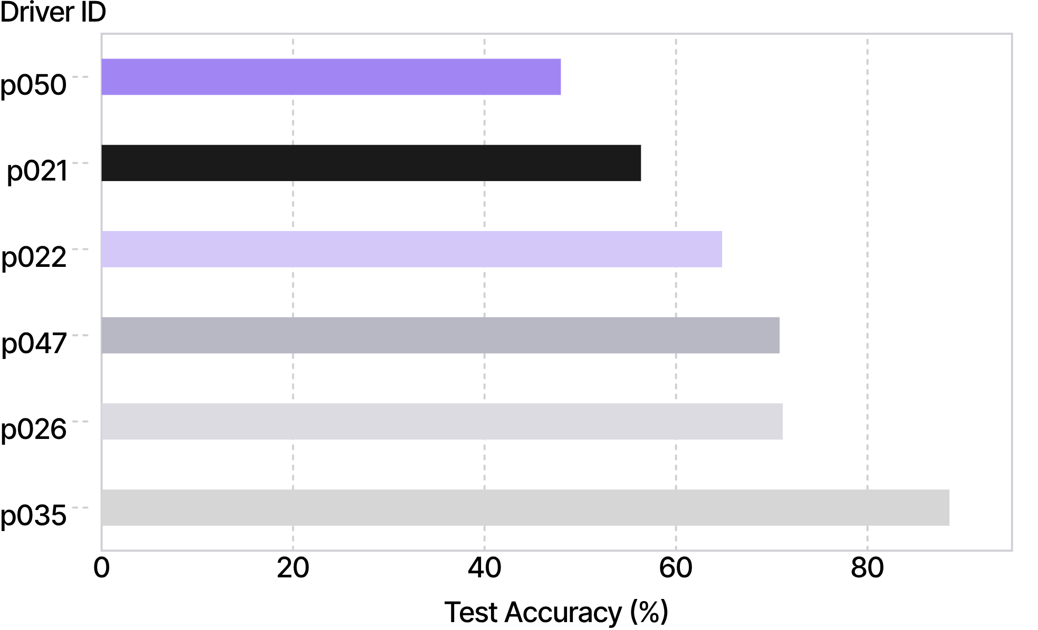
SUBGROUP DISPARITY
Performance Disparities Across Drivers
PER_DRIVER_ACCURACY.PLT
40.59
PERCENTAGE-POINT ACCURACY GAP
Performance collapsed to 47.97% on p050 while reaching 88.56% on p035. Meanwhile, p026 registered an extreme 96.15% false-alarm rate on safe-driving frames.
METHODOLOGICAL CAUTION: DRIVER IDS DENOTE PARTITIONED SUBJECTS ONLY; NEVER INFER AGE, GENDER, OR DEMOGRAPHICS WITHOUT EXPLICIT GROUND-TRUTH LABELS.
Ramon Flores Arteaga – MSC Artificial Intelligence – Machine Learning July 2026
Notes:
Point out the stark 40.59 percentage point spread between drivers. High aggregate accuracy hides unacceptable individualized failure rates.

Slide 13
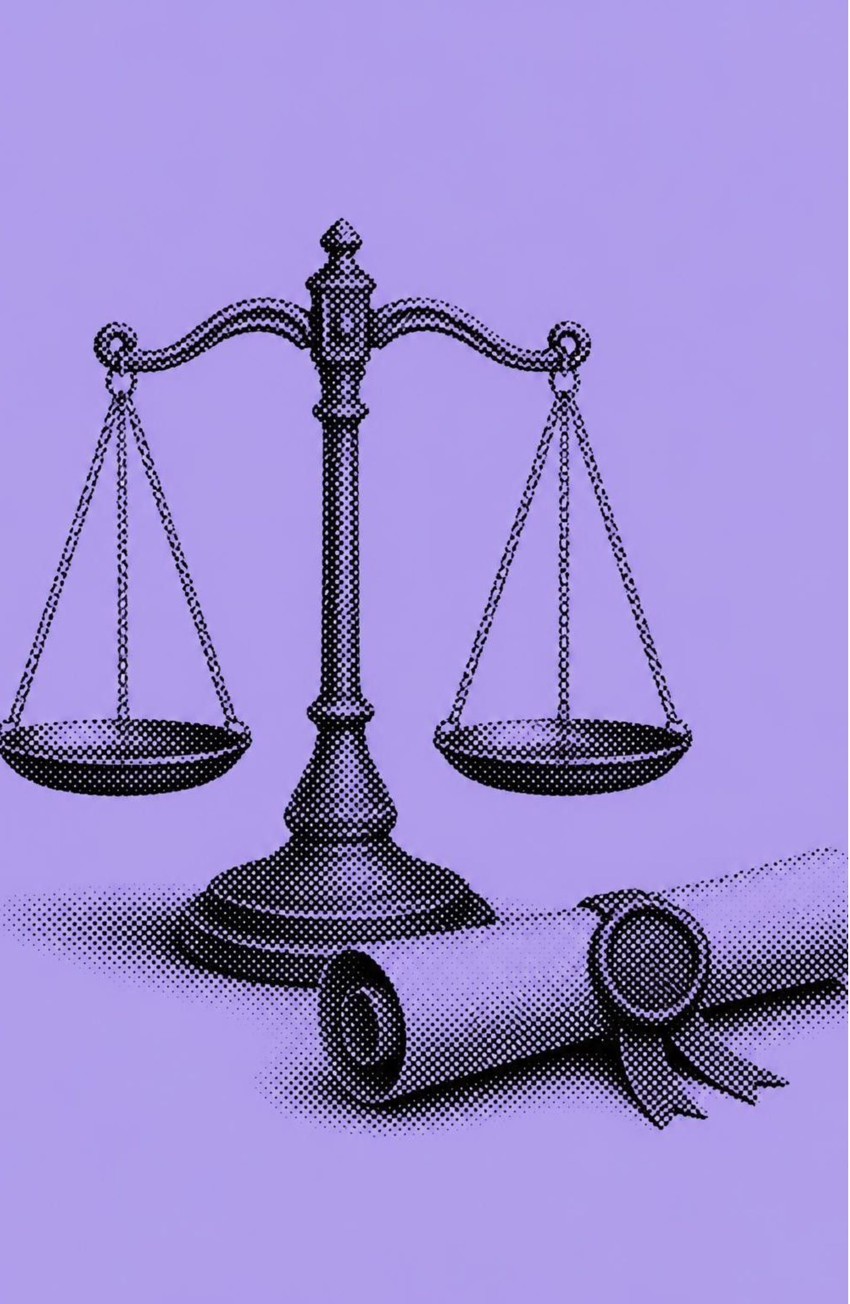
ETHICAL & GOVERNANCE AUDIT
Ethical Considerations and model recommendation
DATASET PROVENANCE & CONSENT
Verify data licensing, permitted downstream reuse, and participant consent terms before any operational pipeline integration.
BIOMETRIC PRIVACY PROTECTION
Driver faces and vehicle interior geometry require end-to-end encryption, strict role-based access, retention limits, and verifiable deletion.
OPERATIONAL FAILURE STAKES
False negatives create dangerous complacency; false positives trigger driver distraction, alarm fatigue, and unfair commercial penalties.
Final Recommendation: Deploy exclusively as an offline academic benchmark—never for autonomous actuation, insurance underwriting, or driver termination.
Kaggle Data Set: https://www.kaggle.com/competitions/state-farm-distracted-driver-detection/data
Ramon Flores Arteaga – MSC Artificial Intelligence – Machine Learning July 2026
Notes:
Deliver the governance imperative: dataset provenance, facial privacy, and severe operational asymmetry preclude immediate commercial or industrial deployment.

Slide 14




PROPOSED INFERENCE DESIGN
Proposed Deployment and Interference API
Hypothetical edge and cloud serving architecture (conceptual design, distinct from notebook implementation).
STEP 01
STEP 02
STEP 03
STEP 04
Camera
Preprocessing
MobileNet
Scaler/SVM → advisory application
Proposed flow begins at the camera.
Prepare input for MobileNet.
Feature extraction.
Return class, model version, and an uncalibrated decision score.
Kaggle Data Set: https://www.kaggle.com/competitions/state-farm-distracted-driver-detection/data
PROPOSED OPTIONS
Prefer local vehicle inference where feasible; a controlled pilot could use authenticated HTTPS and FastAPI. SageMaker, Vertex AI, and Azure ML are options, not implemented deployments.
Ramon Flores Arteaga – MSC Artificial Intelligence – Machine Learning July 2026
Notes:
Describe the proposed runtime pipeline: explain why edge processing protects passenger privacy by discarding raw video frames immediately after tensor extraction.

Slide 15
POST-DEPLOYMENT OVERSIGHT
Scalability Monitoring and Retraining
Telemetry & Operational Reliability
01
Continuous telemetry tracking inference latency, request error rates, frame degradation, and distributional feature drift.
Human-in-the-Loop Disparity Auditing
02
Connecting telemetry logs to secondary human reviews to quantify real-world false alarms and per-driver accuracy variance.
Controlled Retraining Pipelines
03
Enforcing strict driver-separated validation gates and verified consent protocols on all candidate retraining batches.
Canary Staging & Instant Rollback
04
Canary release rollouts with automated fallback switches to prevent catastrophic behavioral drift in production fleets.
GOVERNANCE REQUIREMENT: PREDICTION LOGS WITHOUT HUMAN VERIFICATION ARE INSUFFICIENT TO DETECT DEMOGRAPHIC OR ENVIRONMENTAL DEGRADATION.
Ramon Flores Arteaga – MSC Artificial Intelligence – Machine Learning July 2026
Notes:
Detail the continuous governance lifecycle: monitoring operational latency is trivial, but detecting safety drift requires human auditing of false-positive clusters.

Slide 16
SYSTEM BOUNDARIES
Tools libraries and deployment units
Distinguishing executed academic artifacts from conceptual commercial architectures.
IMPLEMENTED_NOTEBOOK.PY
PROPOSED_CLOUD_SPEC.YAML
EXECUTED ARTIFACTS
HYPOTHETICAL SYSTEMS
PyTorch & Torchvision backbones
Scikit-learn (LinearSVC, cross-validation)
Scikit-image (HOG feature extraction)
NumPy, Pandas, & Matplotlib analysis
FastAPI serving containers
Docker runtime environments
Managed endpoints (SageMaker / Vertex AI)
In-vehicle hardware acceleration
TECHNICAL CONSTRAINTS: STATIC SINGLE-CAMERA FRAMES · SMALL 26-DRIVER SAMPLE · CROPPING LOSS · SCRATCH CNN CAPPED AT 5 TRAINING EPOCHS
Ramon Flores Arteaga – MSC Artificial Intelligence – Machine Learning July 2026
Notes:
Explicitly separate the implemented Python/PyTorch codebase from enterprise concepts like AWS SageMaker or edge Docker containers to maintain academic honesty.

Slide 17
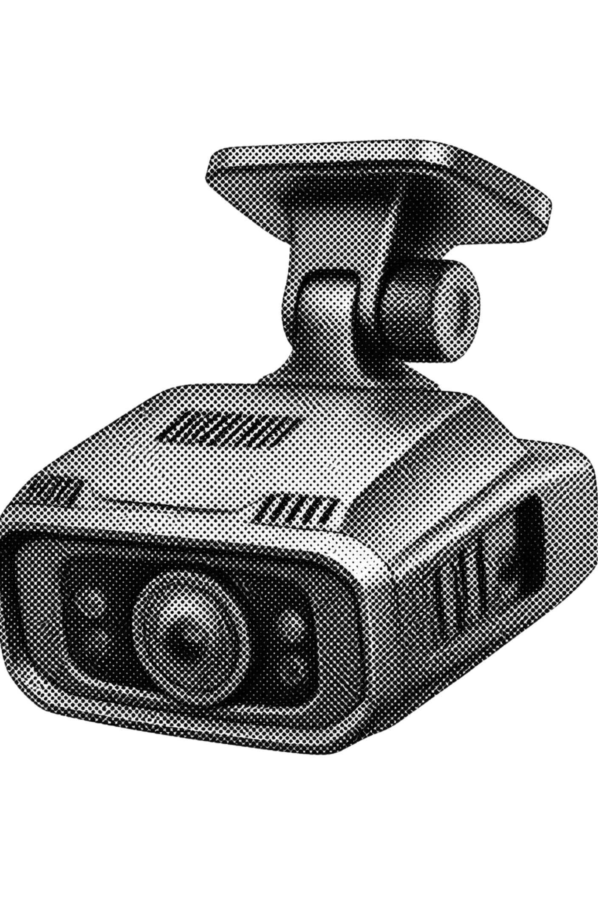
SYNTHESIS & FUTURE WORK
Conclusion
Empirical confirmation: Pretrained MobileNetV3 features paired with a heavily regularized SVM achieved 70.11% accuracy and 0.6823 macro F1 on unseen drivers.
However, rigorous driver separation, macro averaging, Grad-CAM audits, and subgroup testing revealed a 53.90% safe-driver false-alarm rate and a 40.59-point gap between individual drivers.
FUTURE RESEARCH ROADMAP
Fine-tuning deep trunk layers with temporal video sequence models
Expanding cabin diversity across vehicle models and environmental lighting
Privacy-preserving federated training and strict fairness auditing
Ramon Flores Arteaga – MSC Artificial Intelligence – Machine Learning July 2026
Notes:
Conclude with balanced perspective: celebrate the 70.11% technical win while re-iterating that real-world deployment requires temporal context, privacy safeguards, and bias mitigation.

Slide 18
ACADEMIC CITATIONS
References
Amazon Web Services (n.d.a) Data and model quality monitoring with Amazon SageMaker Model Monitor. Available at: https://docs.aws.amazon.com/sagemaker/latest/dg/model-monitor.html (Accessed: 12 October 2026). Amazon SageMaker AI
Amazon Web Services (n.d.b) Real-time inference. Available at: https://docs.aws.amazon.com/sagemaker/latest/dg/realtime-endpoints.html (Accessed: 12 October 2026). Amazon SageMaker AI
FastAPI (n.d.) FastAPI in containers – Docker. Available at: https://fastapi.tiangolo.com/deployment/docker/ (Accessed: 12 October 2026). FastAPI
Howard, A., Sandler, M., Chu, G., Chen, L.-C., Chen, B., Tan, M., Wang, W., Zhu, Y., Pang, R., Vasudevan, V., Le, Q.V. and Adam, H. (2019) ‘Searching for MobileNetV3’, Proceedings of the IEEE/CVF International Conference on Computer Vision, pp. 1314–1324. Available at: https://openaccess.thecvf.com/content_ICCV_2019/html/Howard_Searching_for_MobileNetV3_ICCV_2019_paper.html (Accessed: 12 October 2026). openaccess.thecvf.com
PyTorch (n.d.) mobilenet_v3_small. Available at: https://docs.pytorch.org/vision/main/models/generated/torchvision.models.mobilenet_v3_small.html (Accessed: 12 October 2026). Torchvision main documentation
Scikit-image (n.d.) skimage.feature.hog. Available at: https://scikit-image.org/docs/stable/api/skimage.feature.html#skimage.feature.hog (Accessed: 12 October 2026). skimage 0.26.0 documentation
Scikit-learn (n.d.a) LinearSVC. Available at: https://scikit-learn.org/stable/modules/generated/sklearn.svm.LinearSVC.html (Accessed: 12 October 2026). scikit-learn 1.9.1 documentation
Scikit-learn (n.d.b) StandardScaler. Available at: https://scikit-learn.org/stable/modules/generated/sklearn.preprocessing.StandardScaler.html (Accessed: 12 October 2026). scikit-learn 1.9.1 documentation
Selvaraju, R.R., Cogswell, M., Das, A., Vedantam, R., Parikh, D. and Batra, D. (2017) ‘Grad-CAM: Visual explanations from deep networks via gradient-based localization’, Proceedings of the IEEE International Conference on Computer Vision, pp. 618–626. Available at: https://openaccess.thecvf.com/content_iccv_2017/html/Selvaraju_Grad-CAM_Visual_Explanations_ICCV_2017_paper.html (Accessed: 12 October 2026). openaccess.thecvf.com
State Farm (n.d.) State Farm distracted driver detection. Kaggle. Available at: https://www.kaggle.com/competitions/state-farm-distracted-driver-detection (Accessed: 12 October 2026). Kaggle
Gamma was used for some help with colors and text design.
Ramon Flores Arteaga – MSC Artificial Intelligence – Machine Learning July 2026
Notes:
Provide formal academic references across foundational machine learning literature, benchmark sources, and API documentation.

