Slide 1
Evolution of Terrorist Attacks

Slide 2
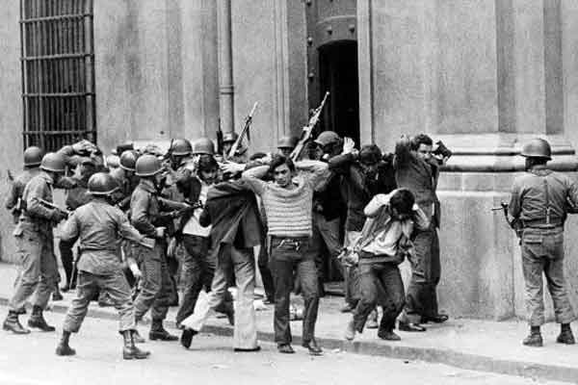
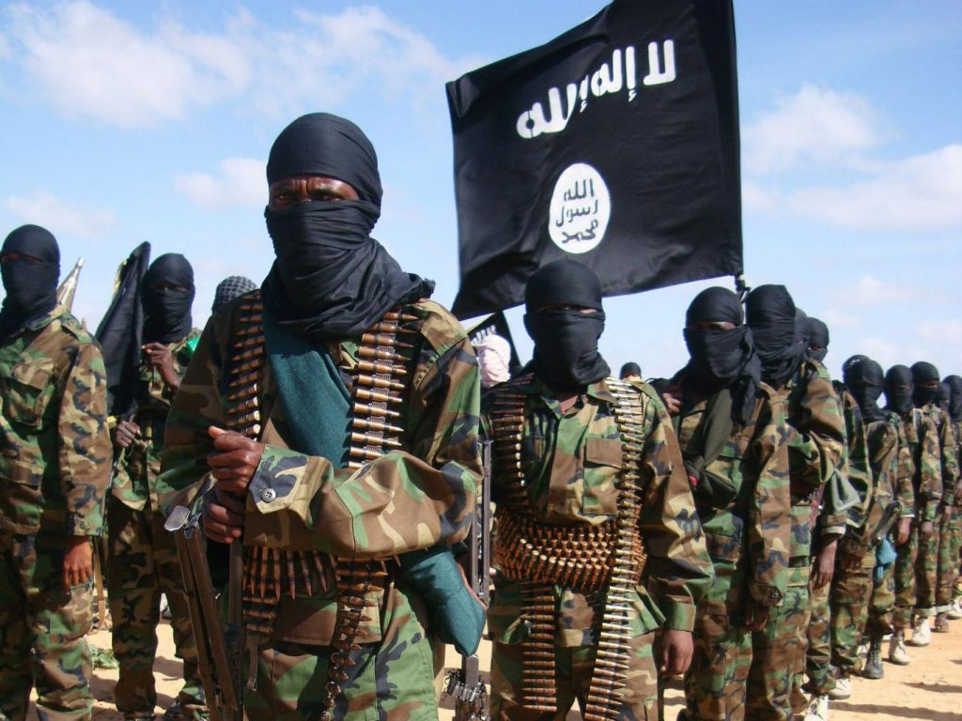
Trends and Tactics
THEN
NOW

Slide 3
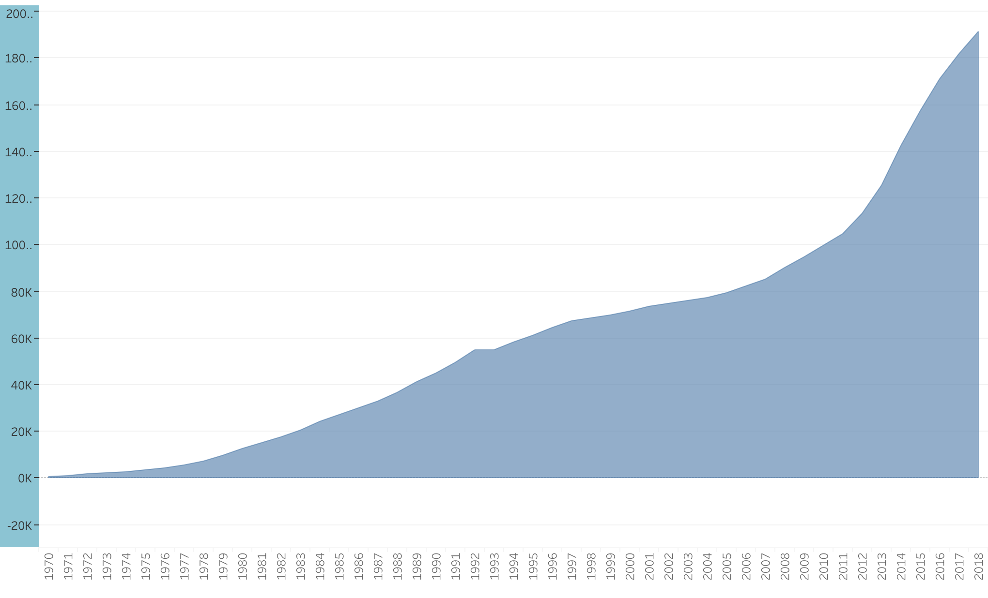
Growth Rate

Slide 4
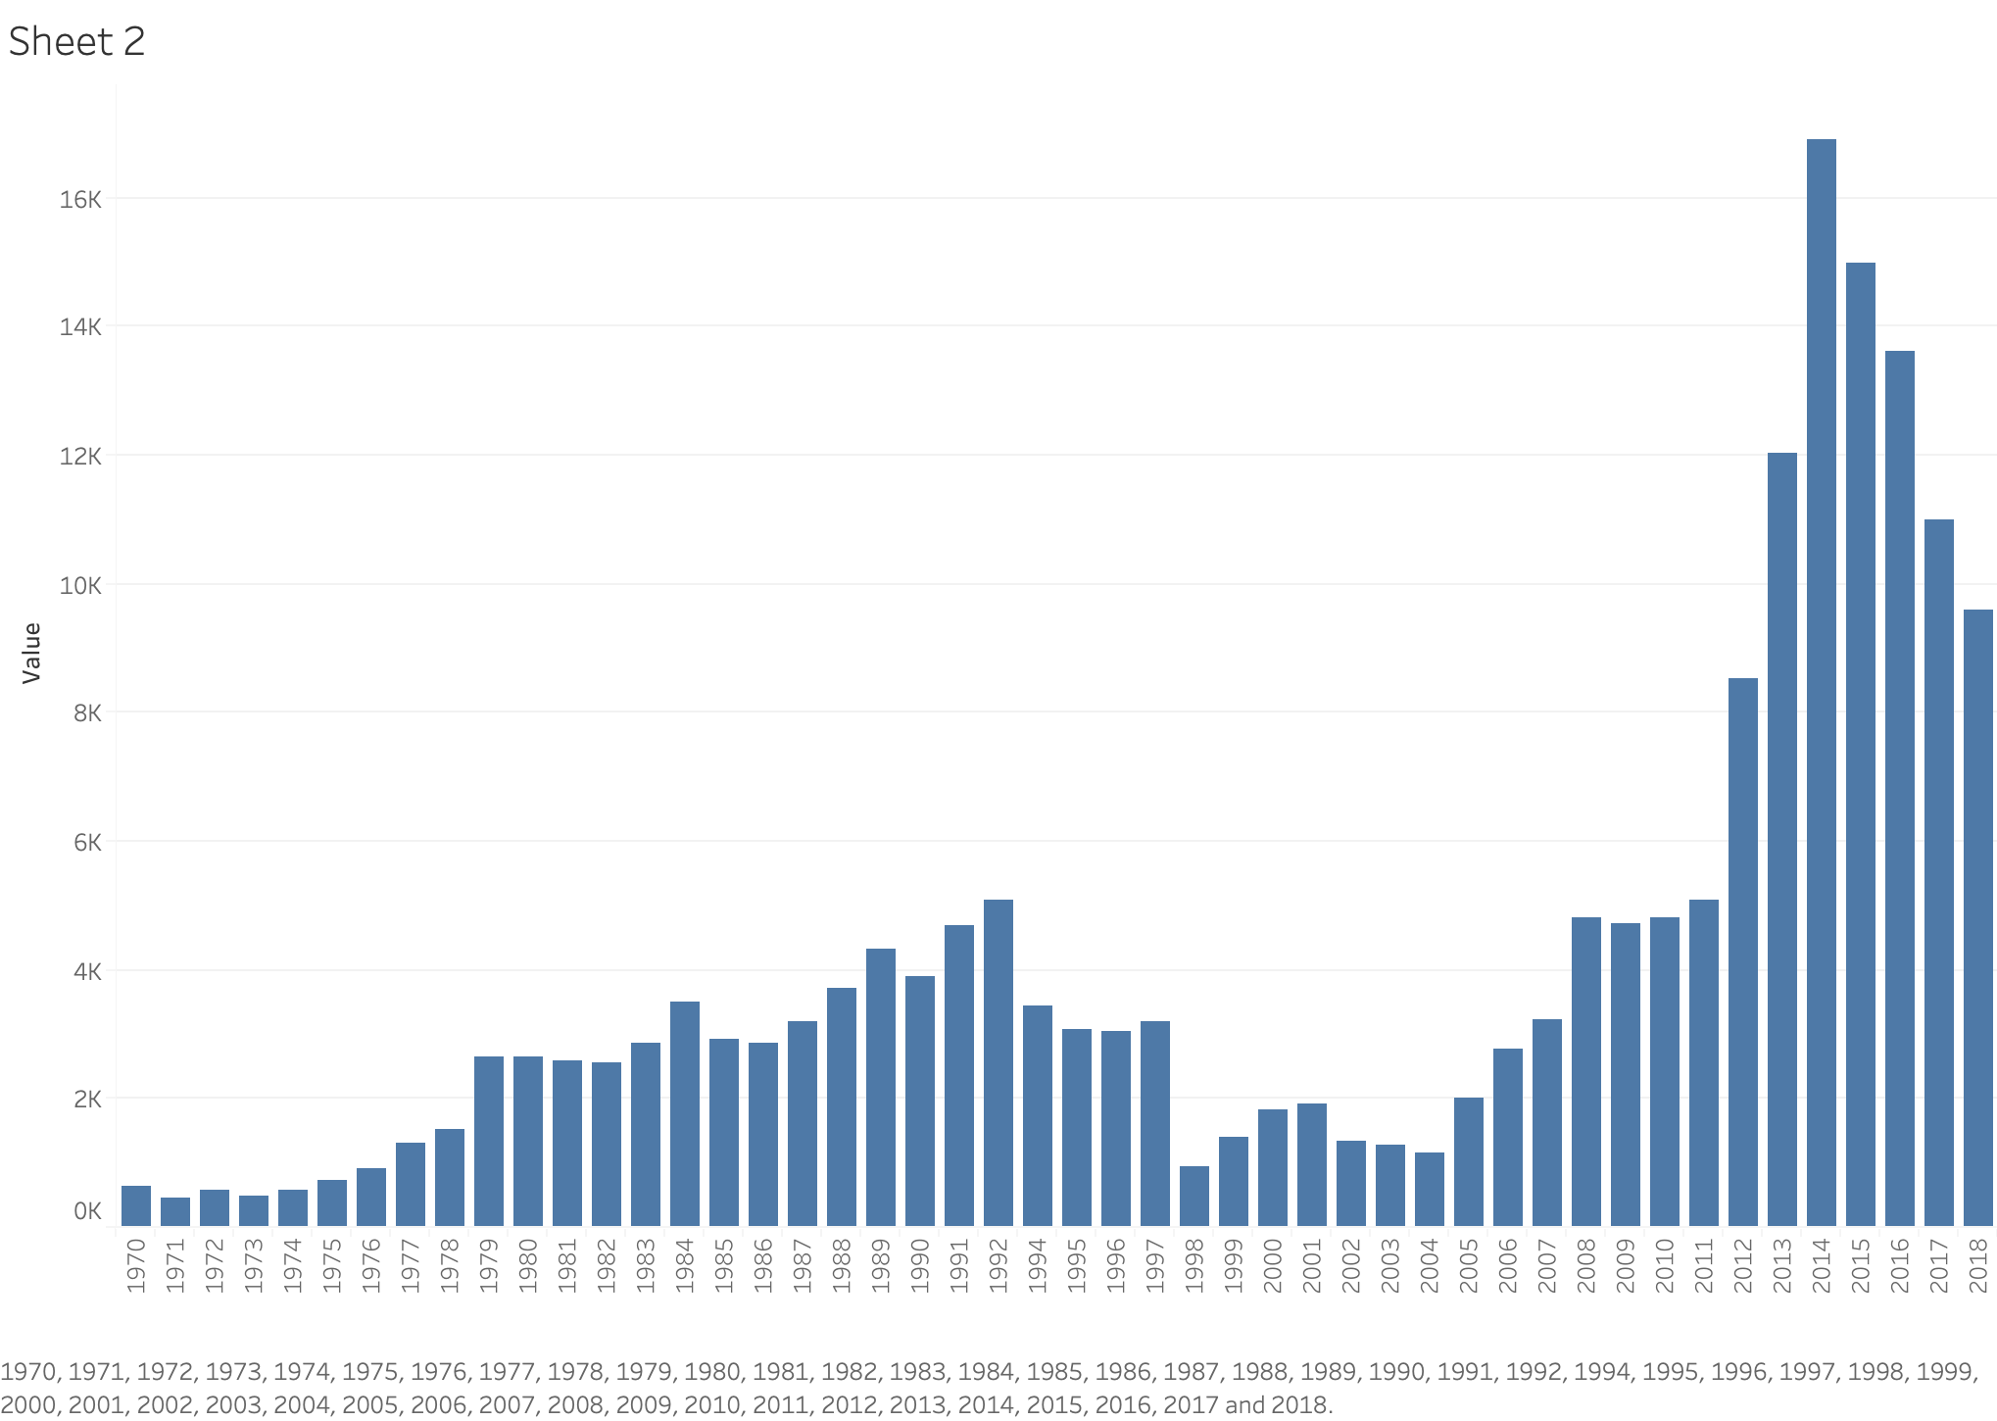
Frequency Histogram

Slide 5
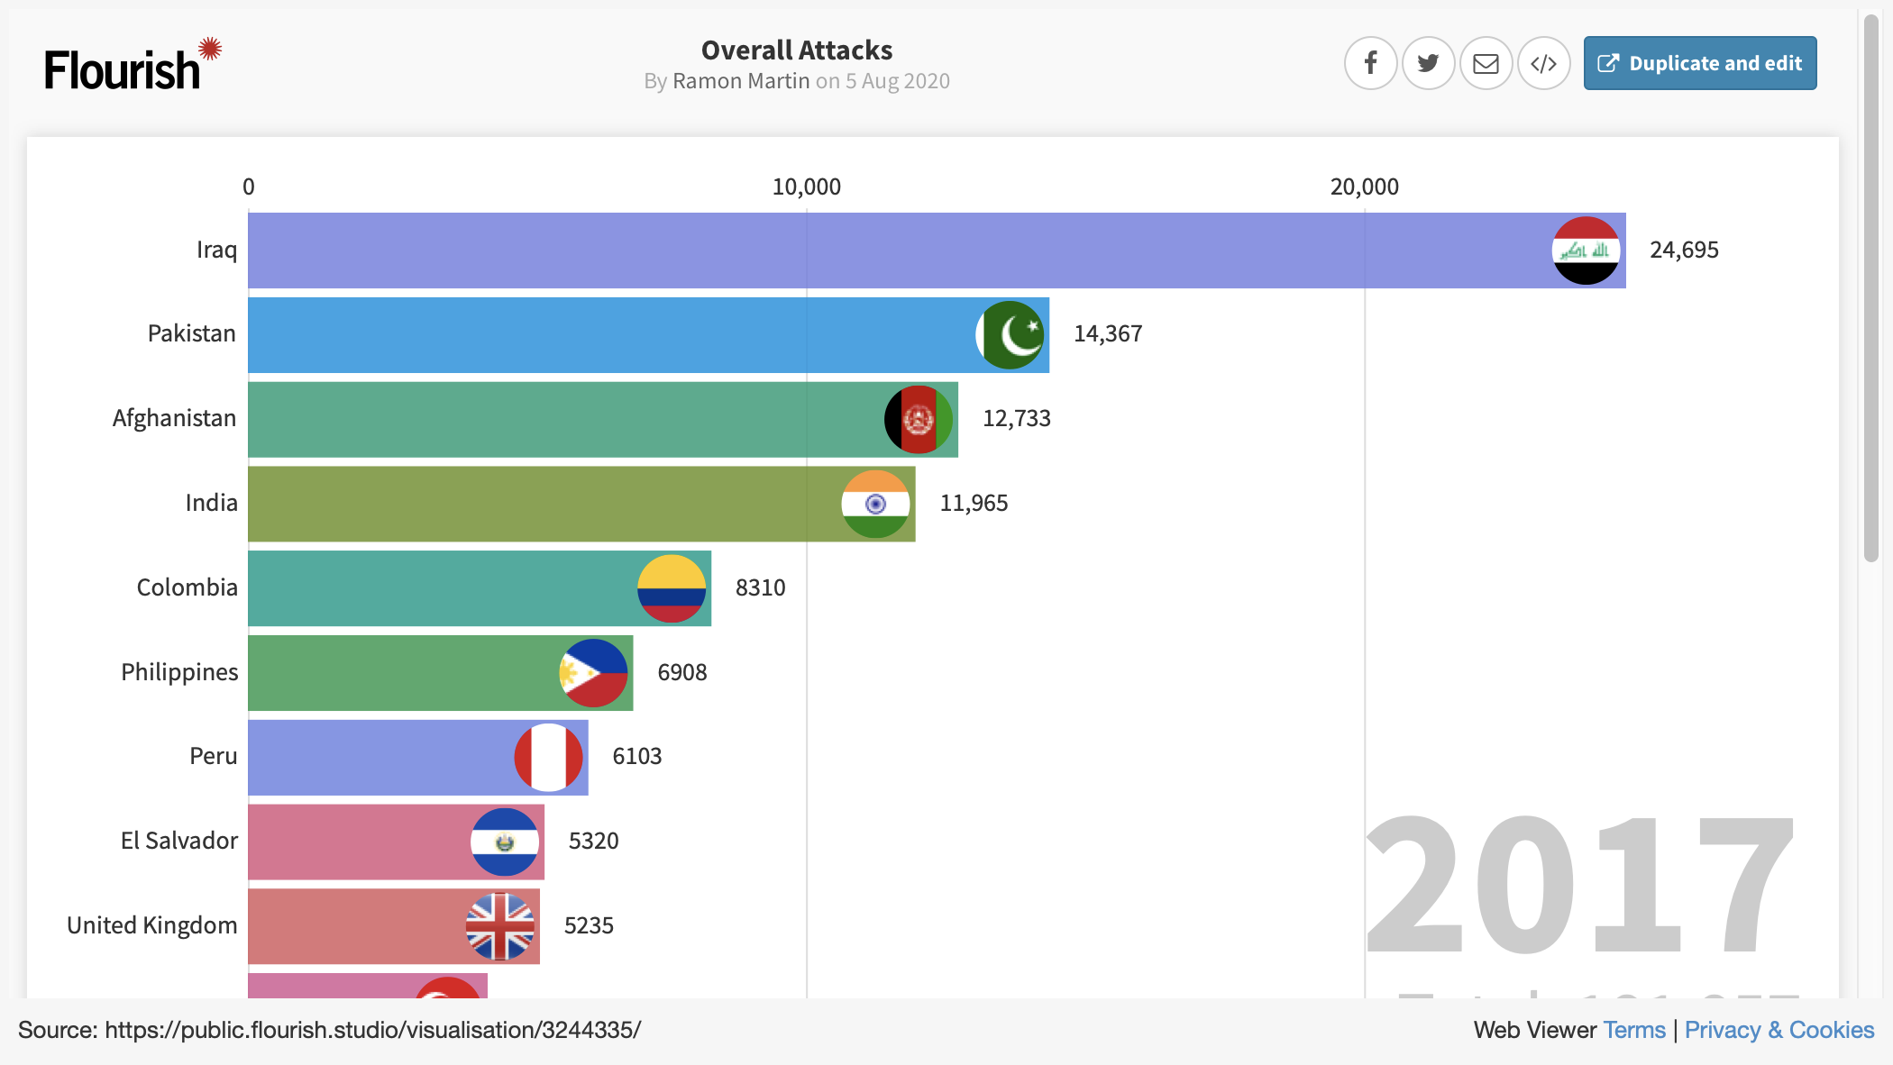

Slide 6
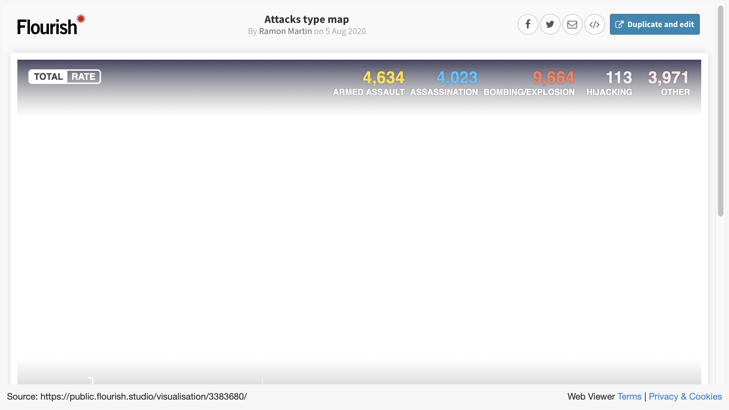

Slide 7
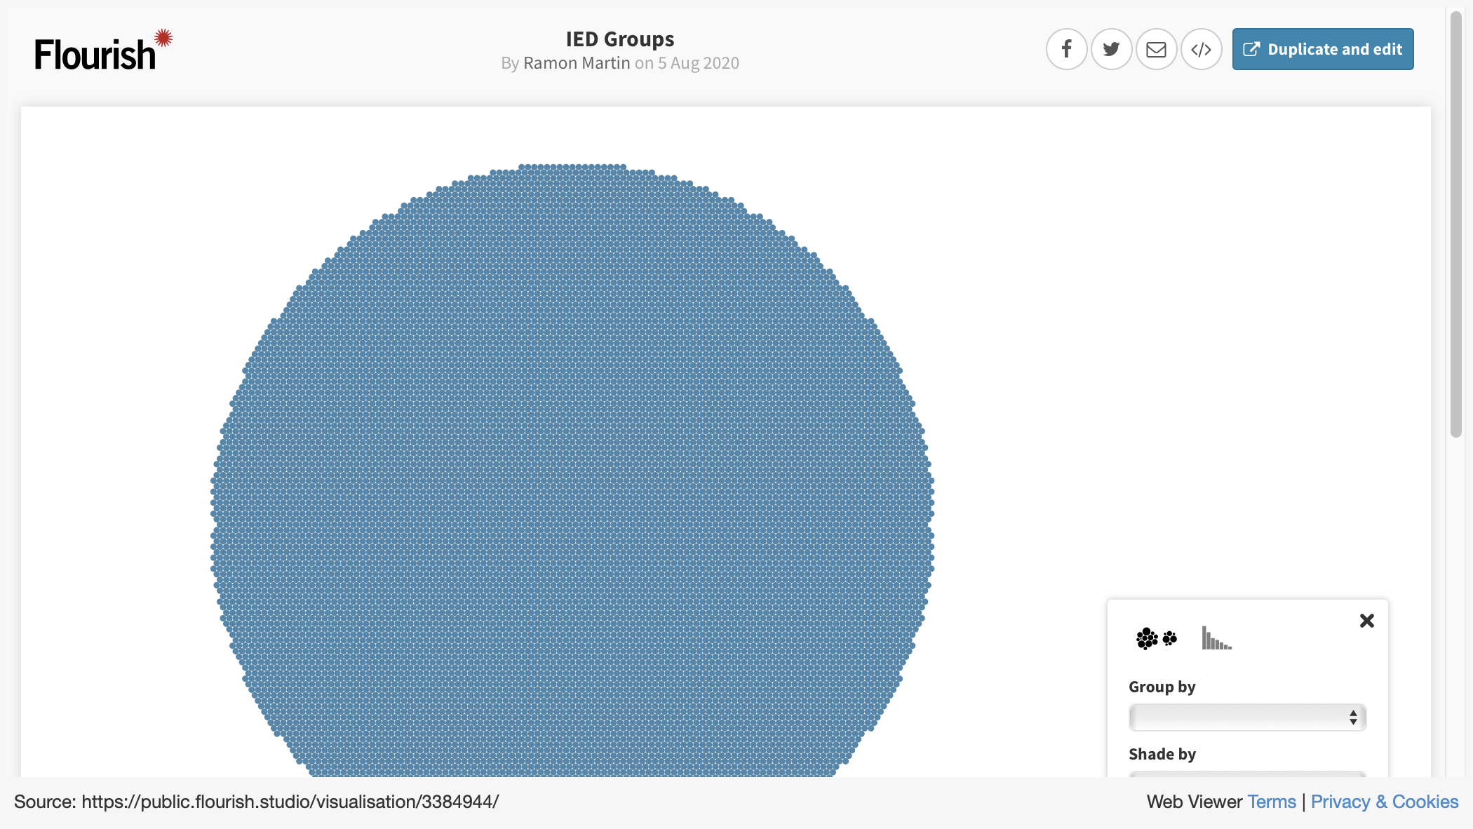

Slide 8
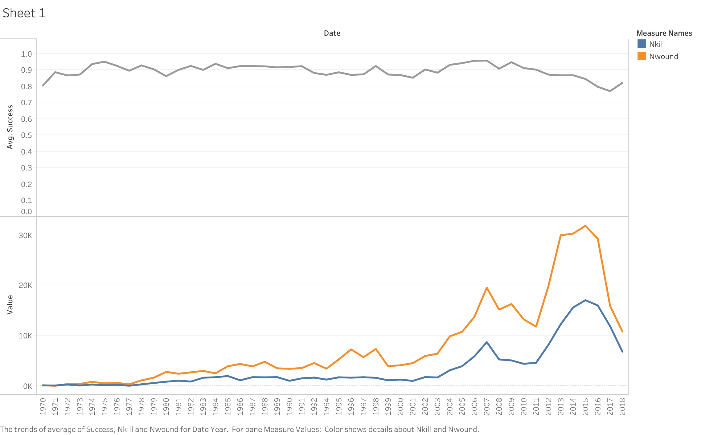
SUCCESS RATE AND CASUALTIES
WOUNDED
DEAD

Slide 9
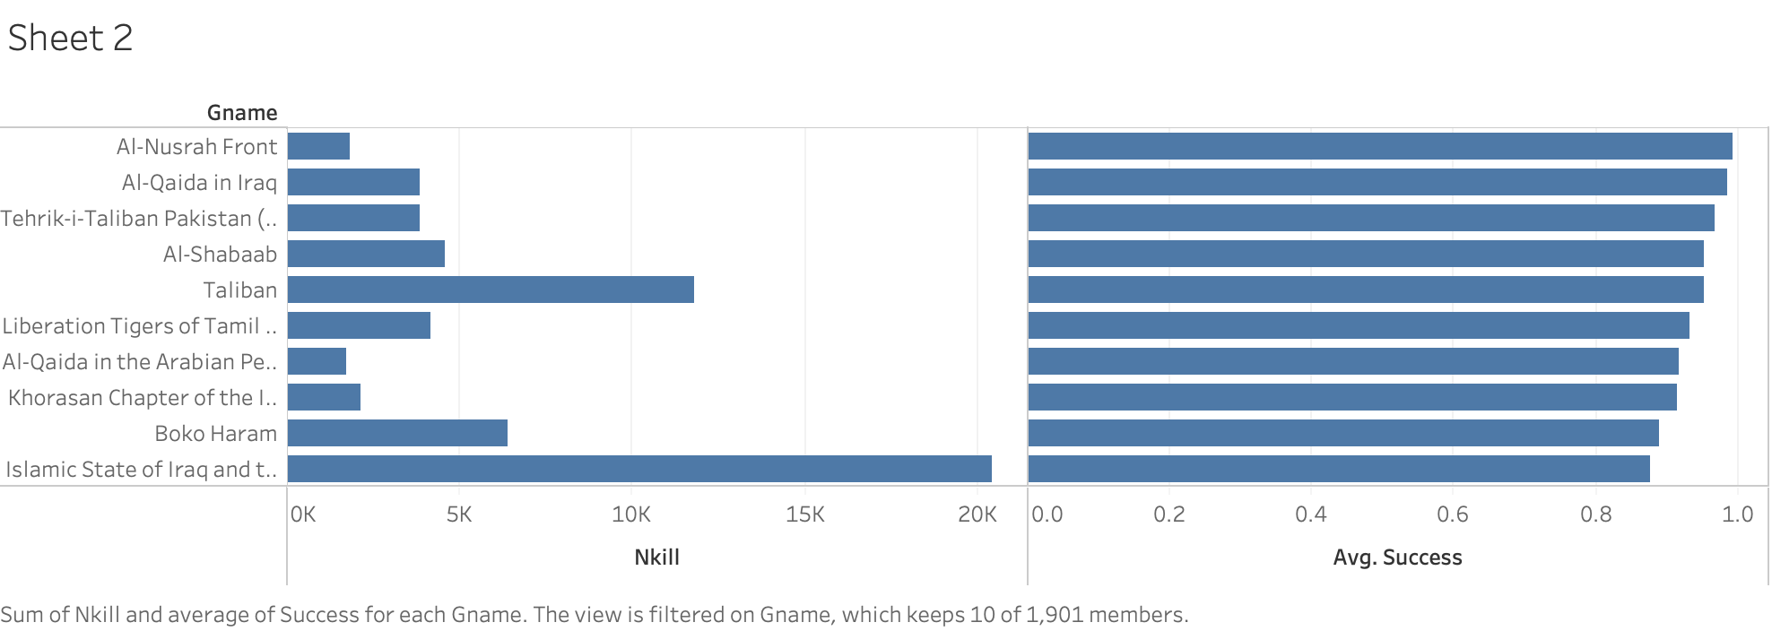
KEY PLAYERS AND THEIR PERFORMANCE

Slide 10
FINAL REMARKS
FUTURE CONSIDERATION:
DETAILED TACTIC EXAMINATION
PRESENCE OF US FORCES
FOREIGN SUPPORT
REPORT SUMMARY NLP

Slide 11

THANKS!
Any questions?
Project GitHub repo:
git@github.com:RamonMartin1/ Ter_Atk_Analysis.git
https://github.com/RamonMartin1/Ter_Atk_Analysis/
Email for additional information at:
martin.ramon.f@gmail.com

