Slide 1
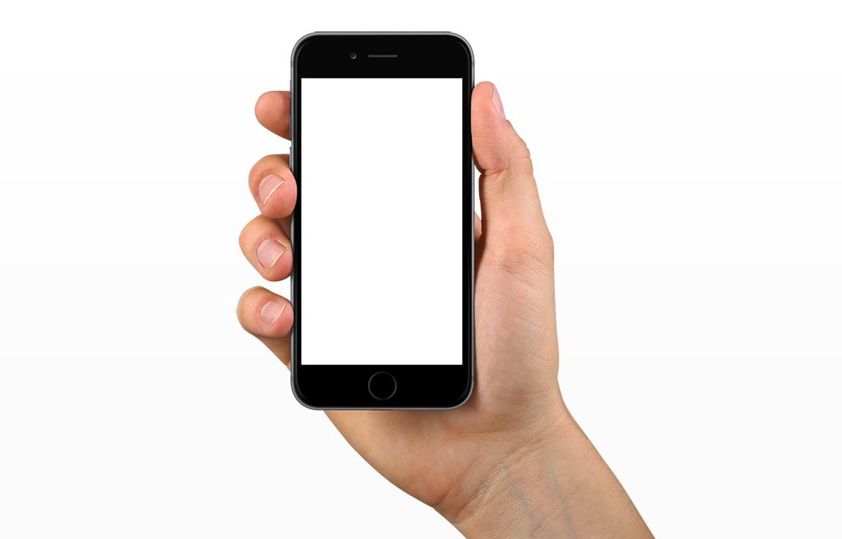
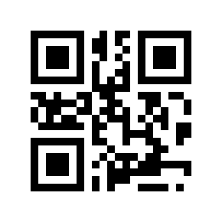
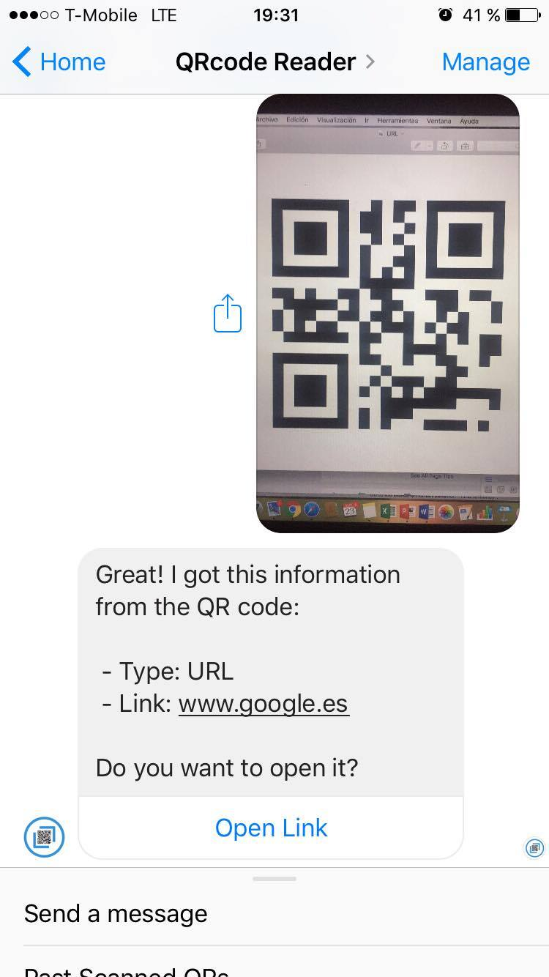
Tired of annoying apps to scan QR codes?
Finally a useful QR bot on Messenger.
Send a picture. Get the info in nanoseconds.

Slide 2

