Slide 1
TC3022
COMPUTER GRAPHICS
Introduction

Slide 2
Lecturer
Dr Andras Takacs – atakacsx@itesm.mx

Slide 3
What is Computer Graphics?
“Computer graphics is the science and art of communicating visually via a computer’s display and its interaction devices.”
Imaging = representing 2D images
Modelling = representing 3D objects
Rendering = constructing 2D images from 3D models
Animation = simulating changes over time

Slide 4
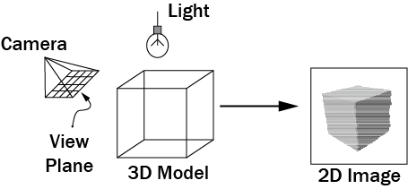
What is Computer Graphics?

Slide 5

What can I do with graphics?
<number>/44

Slide 6
Hollywood Visual Effects
One often cannot film various real-world situations required in order to tell a story
  Some times the situation is too dangerous, impractical, expensive, or rare
  Other times the situation doesn’t actually exist,
except in an alternative reality
<number>/44

Slide 7

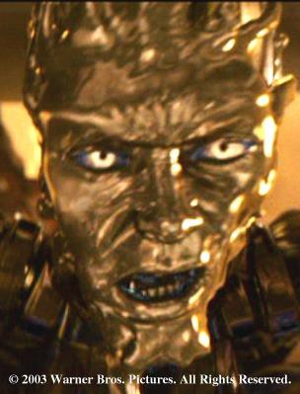
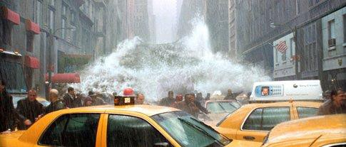
Visual Effects: Liquids
Battleship
Terminator 2
The Day After Tomorrow
<number>/44

Slide 8

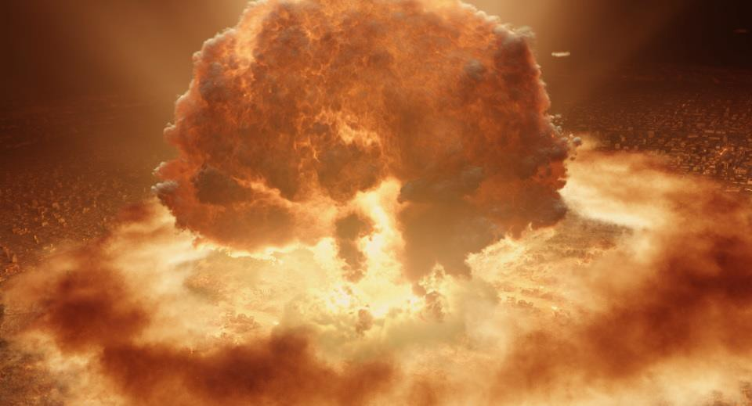
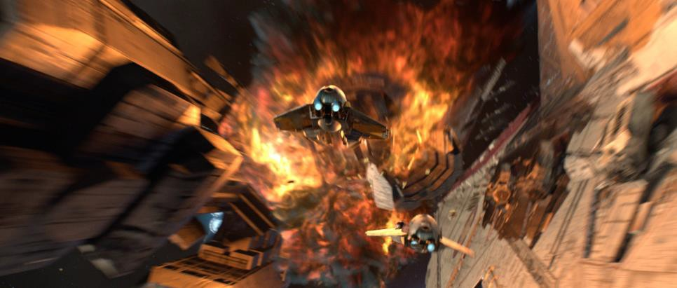
Visual Effects: Gases
Harry Potter and the Order of the Phoenix
Terminator 3
Star Wars Episode III
<number>/44

Slide 9
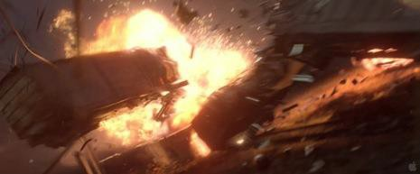
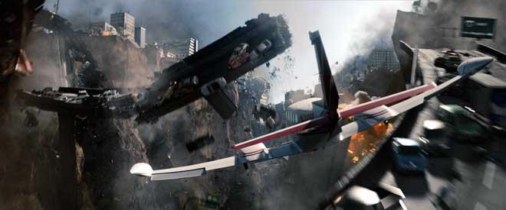
Visual Effects: Solids
Destruction: fracture, explosions,
etc.
Super 8
2012
<number>/44

Slide 10
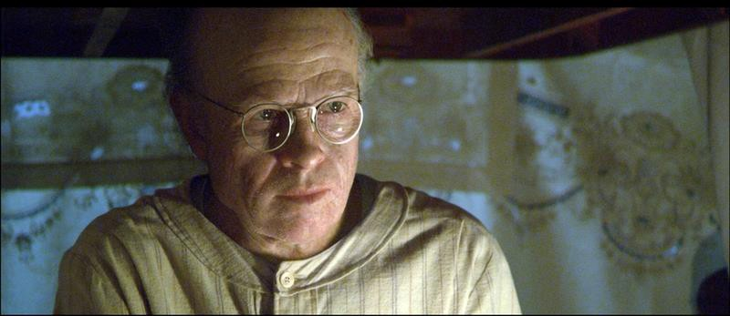
Visual Effects: Digital Doubles
The Curious Case of Benjamin Button

Slide 11
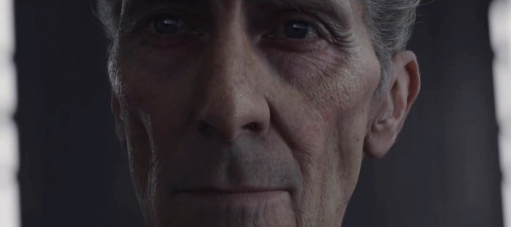
Visual Effects: Digital Doubles
Rogue One: A Star Wars Story

Slide 12


Visual Effects: CG Creatures
Sméagol/Gollum, The Lord of the Rings
Yoda, Star Wars Episode II
<number>/44

Slide 13
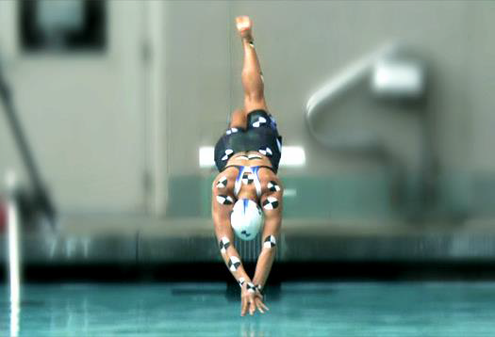
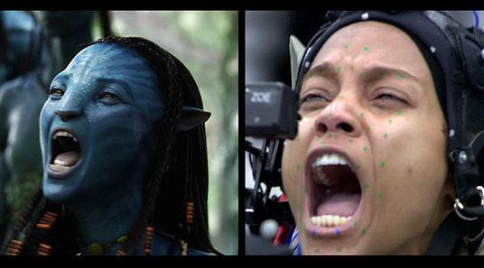
Motion Capture
Facial capture in Avatar
Motion capture of Olympic swimmer Dana Vollmer by Manhattan Mocap (technology transition)
9/44

Slide 14
Animated Films & Video Games
Not just adding computer generated elements to real world film footage, but creating a whole new digital world
– often with its own set of rules
Can be quite immersive
10/44

Slide 15

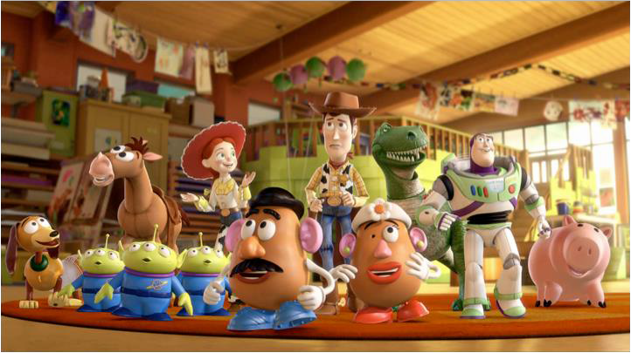
Animated Films
Toy Story 3
Monsters, Inc.
11/44

Slide 16
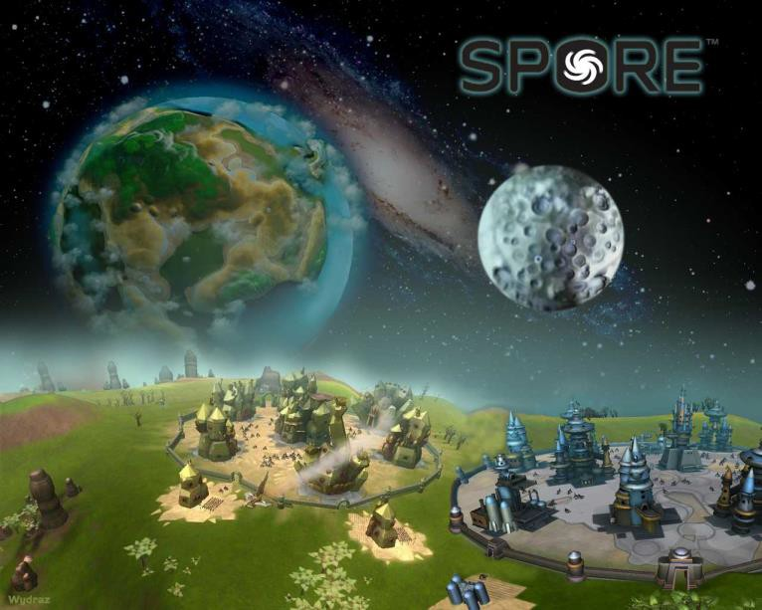
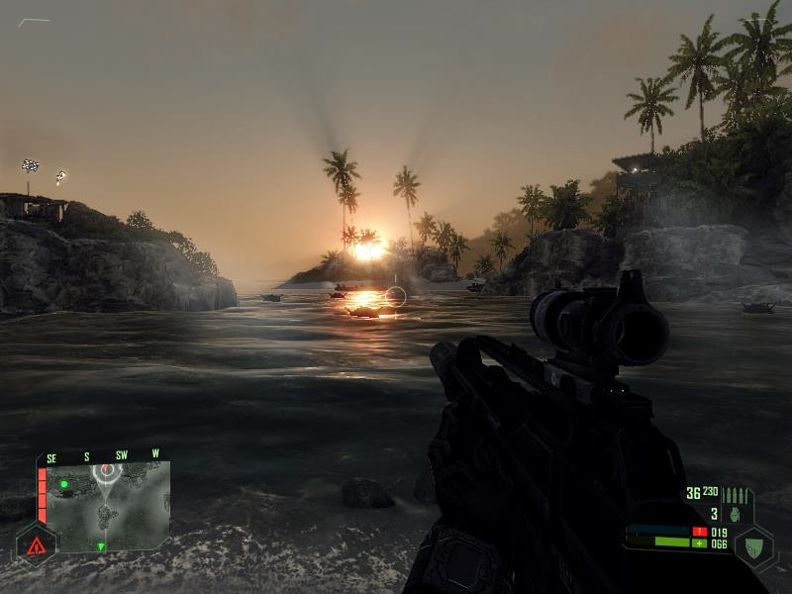
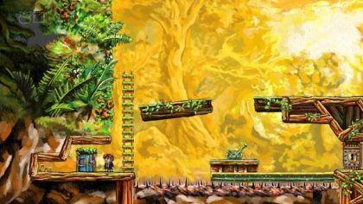
Video Games
Spore
Crysis
Braid
12/44

Slide 17
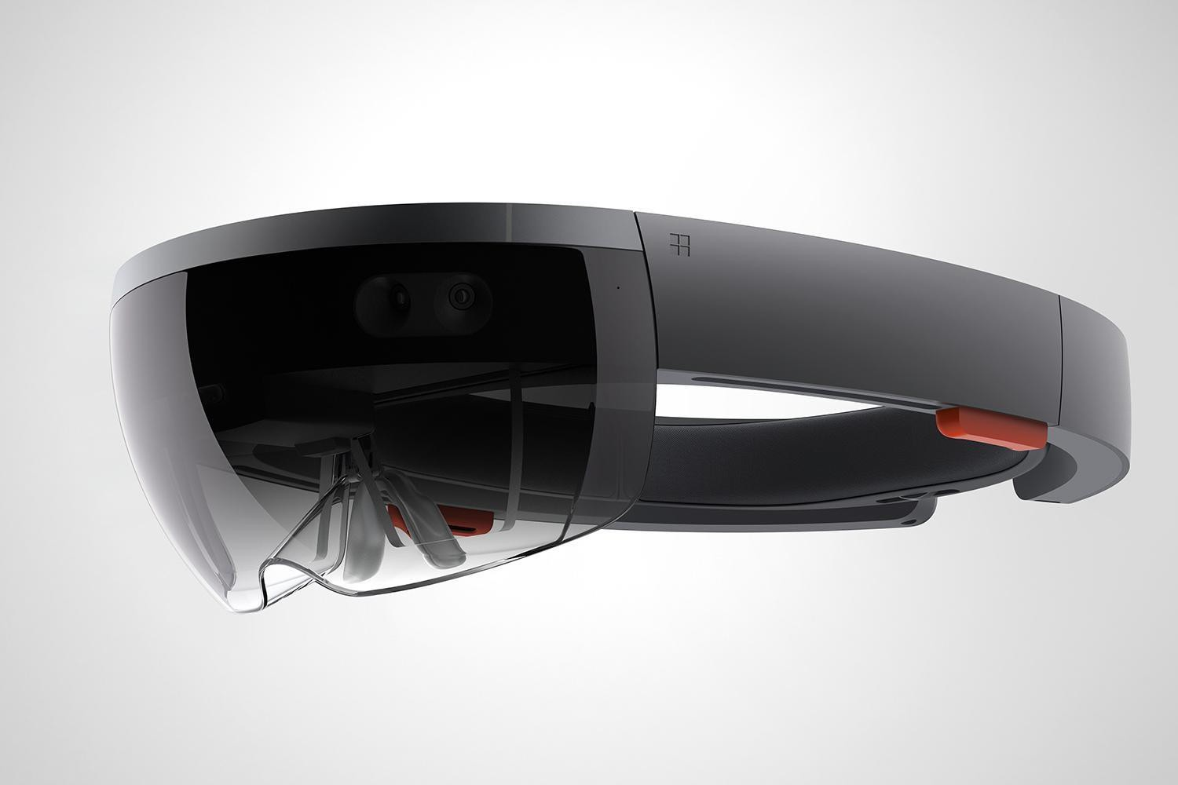
What can I do with graphics?
<number>/44

Slide 18
Graphics is Pervasive
Computer graphics is already all around us!
How many people actually want to interact with their computer, cell phone, DVD player, ATM, or car by entering text?
– Ntm, even the text is visualized via graphics based fonts
Learning at least a little bit about a graphics
is highly useful for all computer scientists…
<number>/44

Slide 19
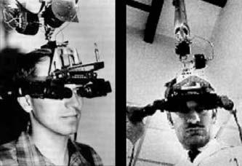
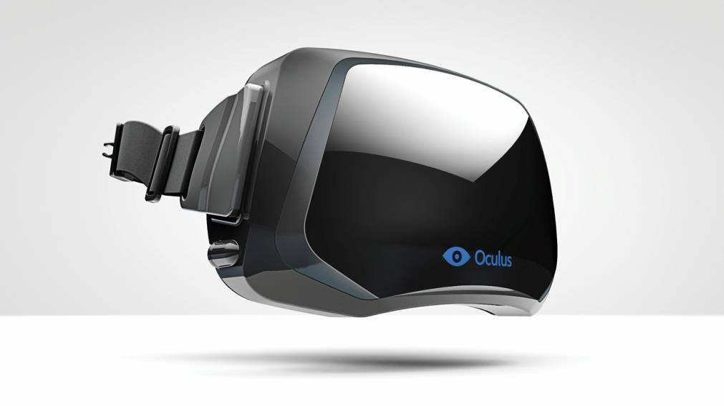
Virtual (and Augmented) Reality
Oculus Rift
Ivan Sutherland: Head- mounted displays, with mechanical tracker
<number>/44

Slide 20
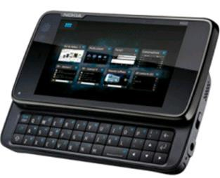
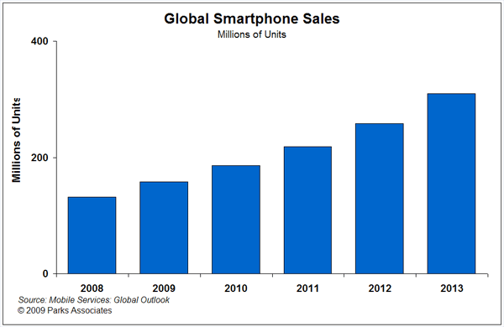
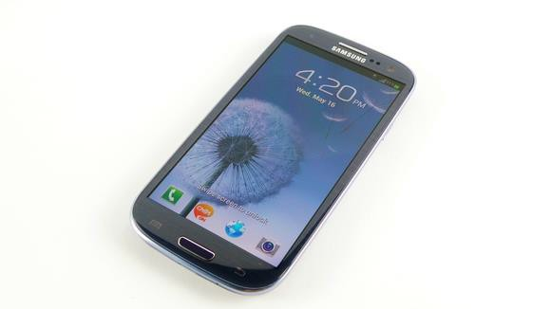
Smartphones (& Cameras)
Sales of smartphones outweigh sales of cameras by a factor of 3
Most smartphones have cameras
5 billion mobile phones are in use worldwide
  4.4 billion camera phones and 1.2 billion smartphones
World population is 7 billion
<number>/44

Slide 21

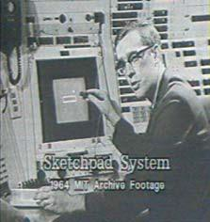
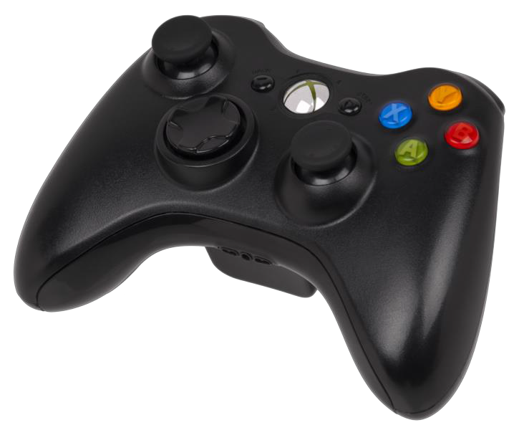
User Interfaces
Apple iPad
Ivan Sutherland, Sketchpad, Light-pen, vector display
Console
Controller
<number>/44

Slide 22

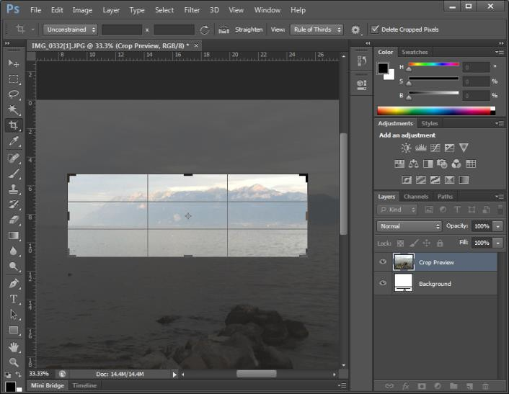



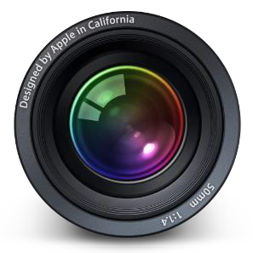
2D Image Processing
<number>/44

Slide 23
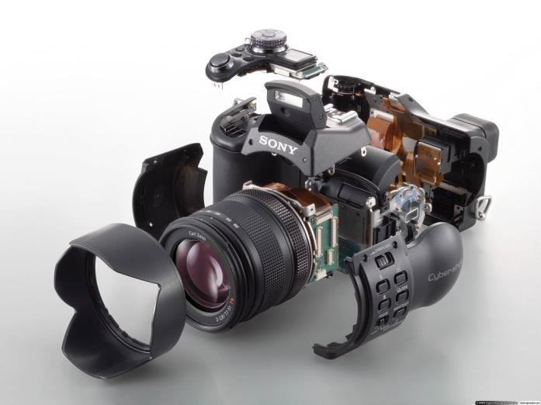
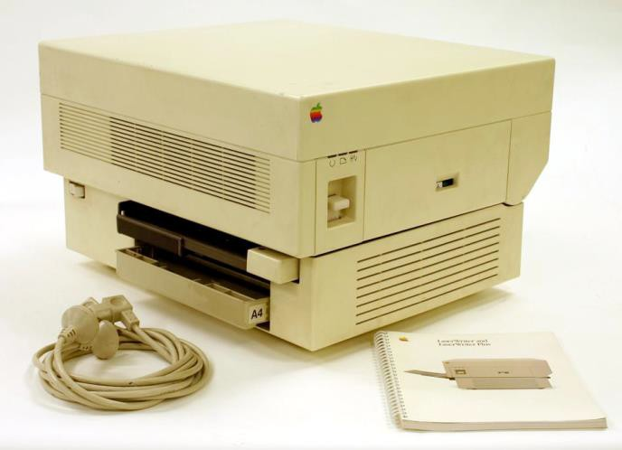
Digital Media Technologies
Digital photography
Inkjet and laser printers
Digital video and HDTV
Electronic books
Graphics on the web:
Sony Video Camera
Photos (flickr)
Videos (youtube)
Apple Laserwriter
<number>/44

Slide 24
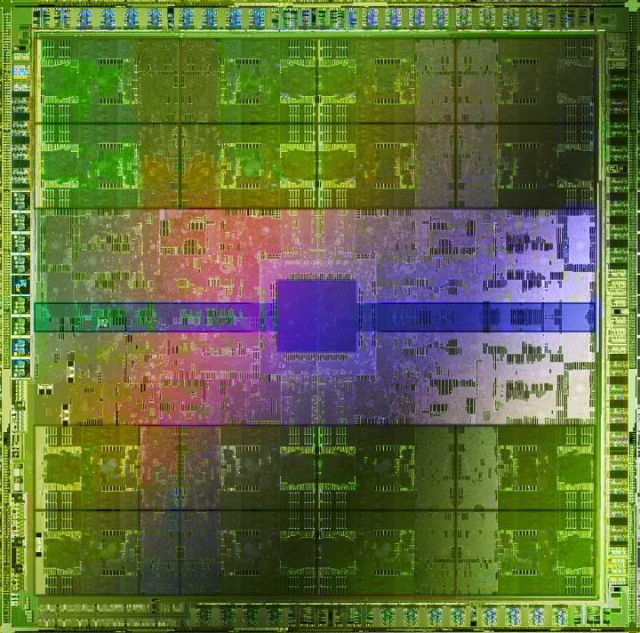
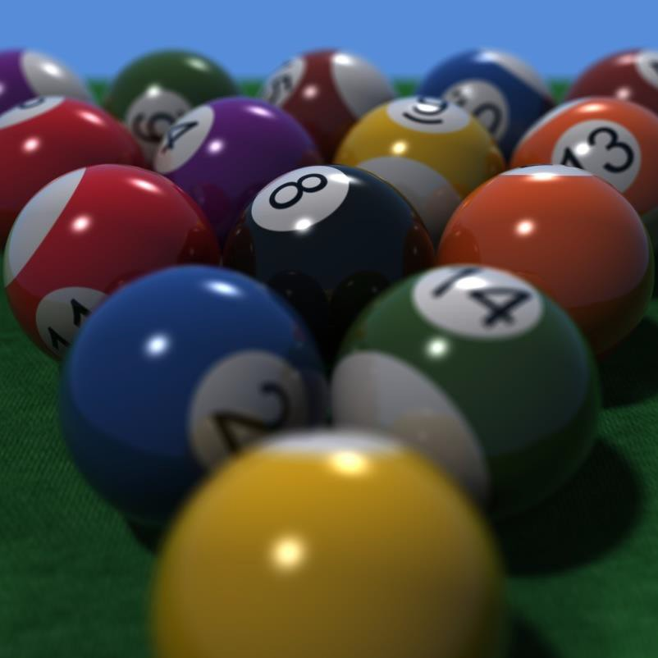
Graphics Hardware
NVIDIA Fermi
NVIDIA OptiX
20/44

Slide 25
Scientists/Engineers need graphics too
Visualization of various phenomena, computer aided design, virtual prototyping, simulation, etc.
Learning at least a little bit about a graphics is highly useful for most scientists and engineers as well…
<number>/44

Slide 26
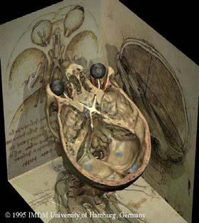
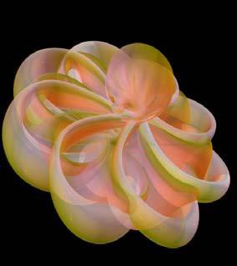
Scientific Visualization
The Virtual Human Karl-Heinz Hoehne
Outside-In
The Geometry Center
<number>/44

Slide 27
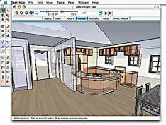
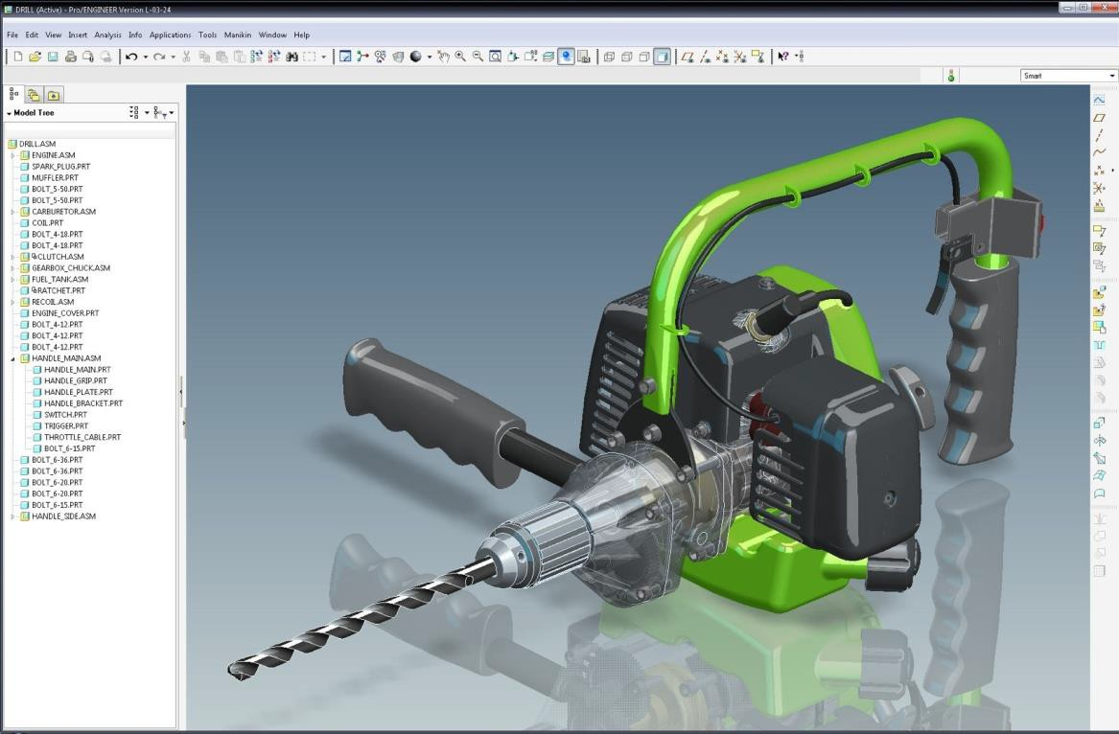
Computer-Aided Design
Sketchup
ProEngineer
<number>/44

Slide 28
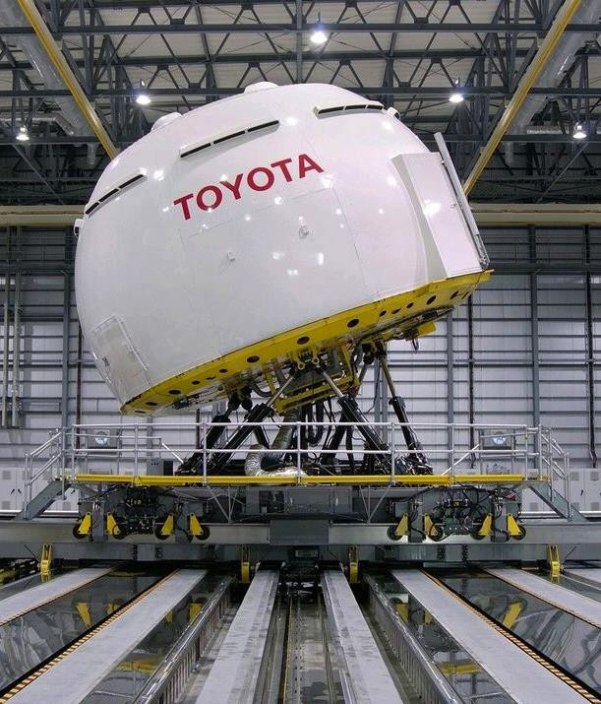
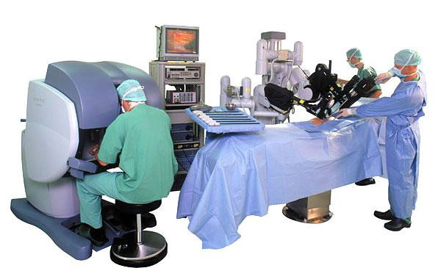
Visual Simulation and Training
Apollo spacecraft
Flight simulators
Driving simulators
Surgical simulation
Driving simulator
Toyota Higashifuji Technical Center
Davinci surgical robot Intuitive Surgical

Slide 29
Class Overview
1. Introduction to Computer Graphics and Graphics library
2. Base Math (Points, Vectors, Matrices, Transformations…etc.)
3. The drawing process (graphics pipeline)
4. Shaders
5. Curves and Surfaces
6. Models
7. Animation
8. Advanced Image Synthesis
<number>/44

Slide 30
Evaluation
Partial Evaluation
  20% Partial Exam
  30% Project Development
  50% Exercises
1st Partial Exam : 19th February
2nd Partial Exam: 2nd April
Final Evaluation
  50% Average of Partials
  10% Last Weeks exercises
  10% Final Exam
  30% Final Project

