Slide 1
TRANSFORMATION

Slide 2
Modeling Transformations
Specify transformations for objects
  Allows definitions of objects in own coordinate systems
  Allows use of object definition multiple times in a scene

Slide 3
Overview
2D Transformations
  Basic 2D transformations
  Matrix representation
  Matrix composition
3D Transformations
  Basic 3D transformations
  Same as 2D
Transformation Hierarchies
  Scene graphs
  Ray casting

Slide 4


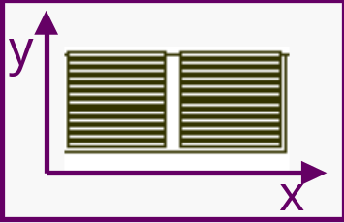

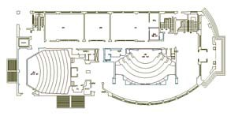

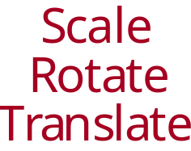

2D Modeling Transformations

Slide 5
2D Modeling Transformations
See in details

Slide 6
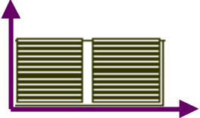
2D Modeling Transformations

Slide 7

2D Modeling Transformations
Scale 0.3, 0.3

Slide 8

2D Modeling Transformations
Scale 0.3, 0.3
Rotate -90º

Slide 9
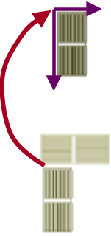
2D Modeling Transformations
Scale 0.3, 0.3
Rotate -90º
Translate 5,3

Slide 10
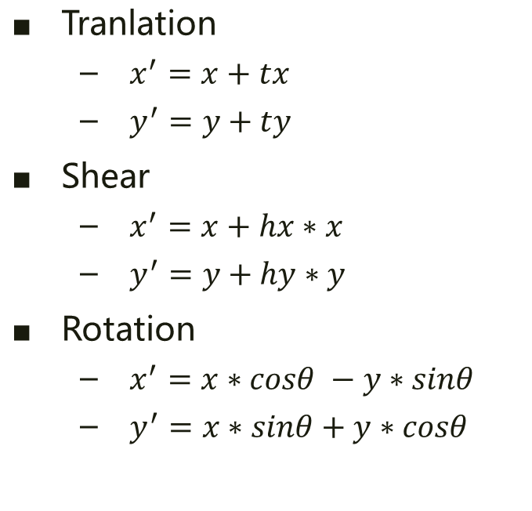
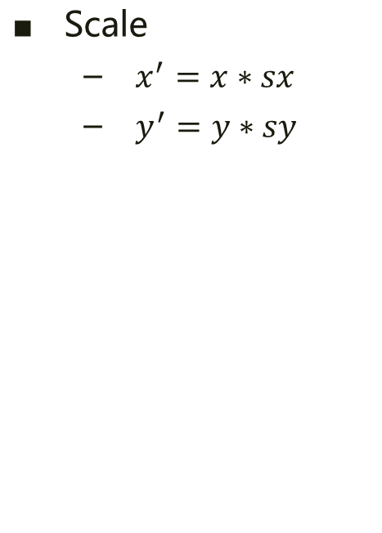
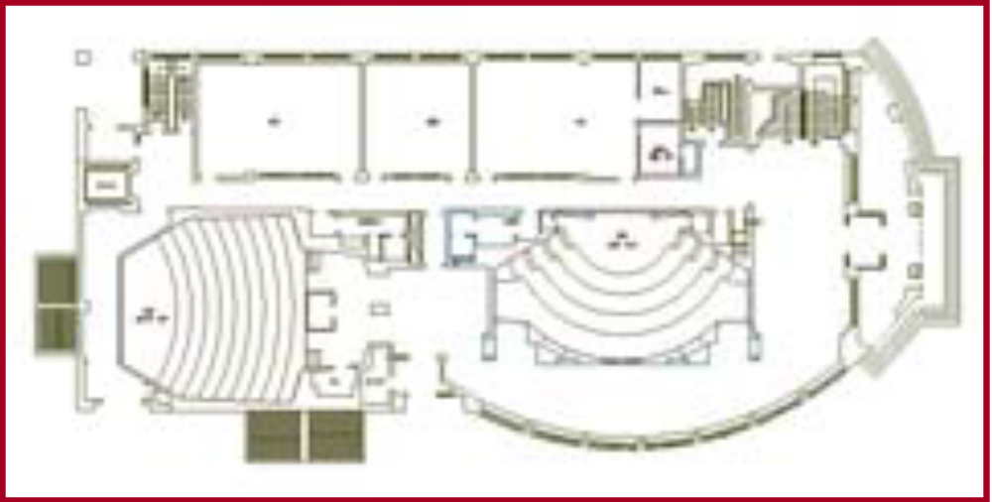
Basic 2D Transformations
Transformations can be combined

Slide 11
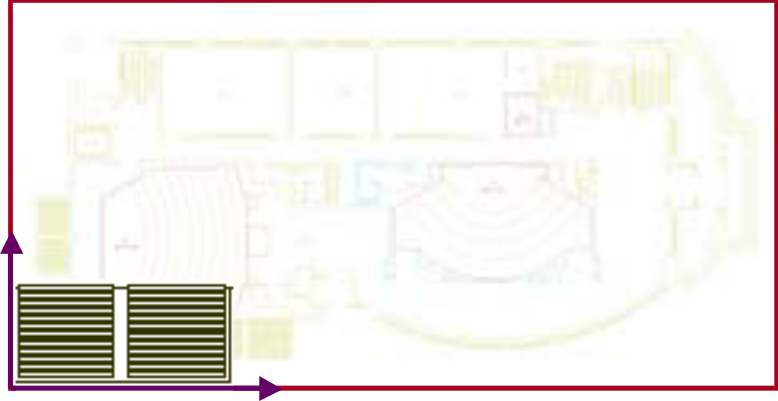
Basic 2D Transformations

Slide 12
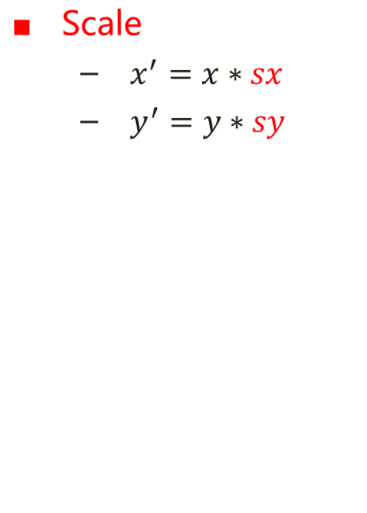
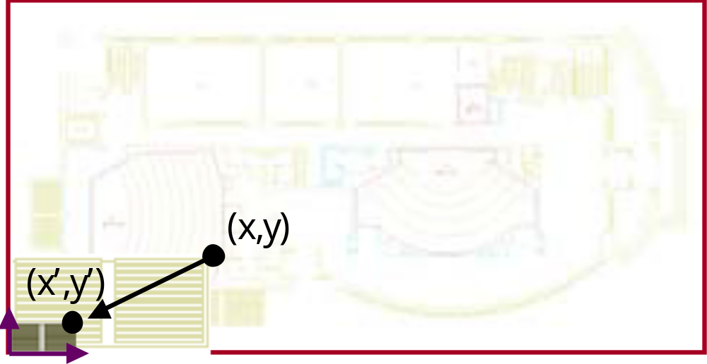

Basic 2D Transformations

Slide 13
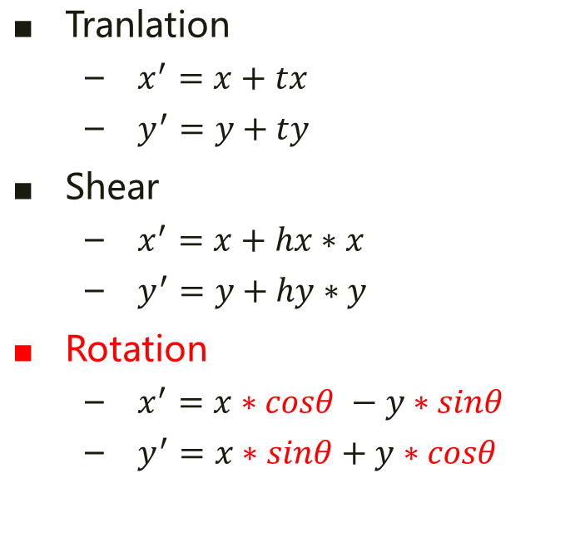
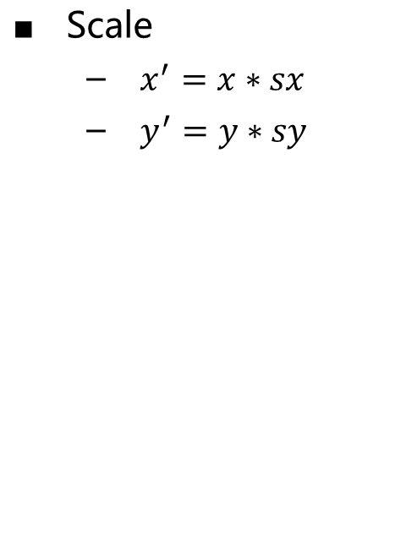
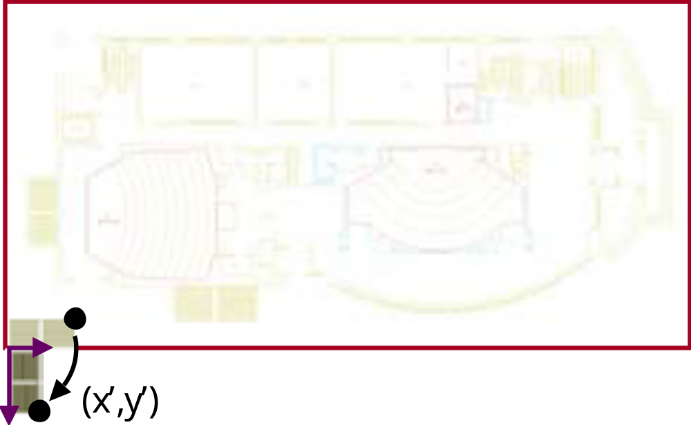

Basic 2D Transformations

Slide 14
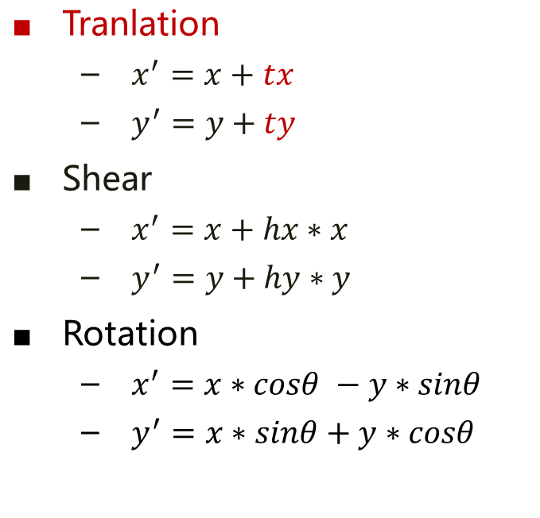
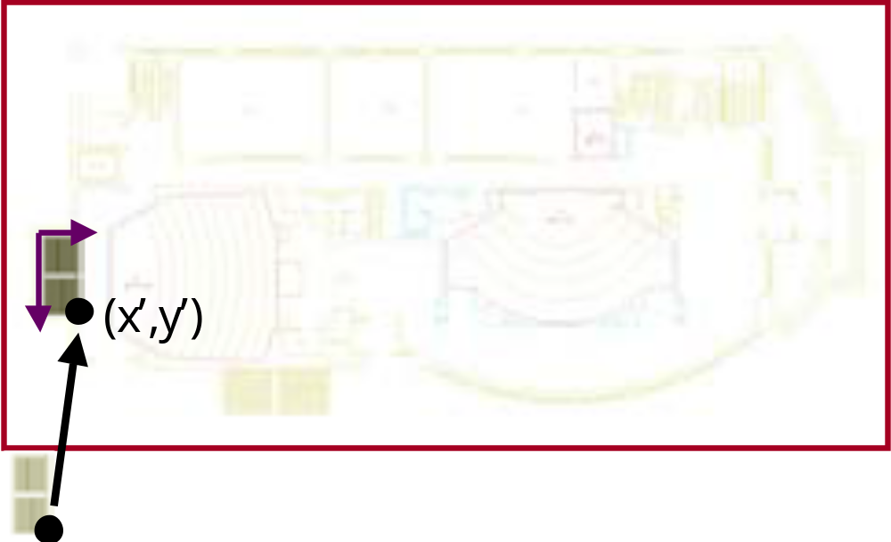
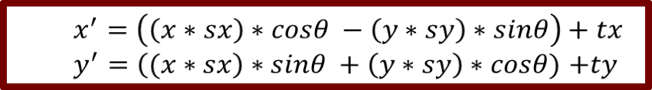
Basic 2D Transformations

Slide 15
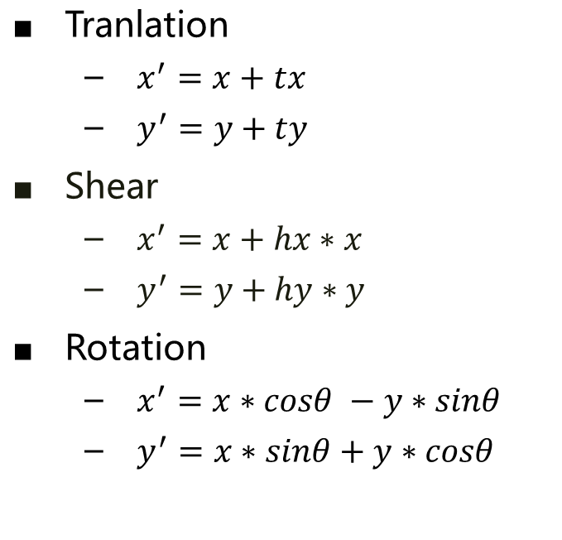
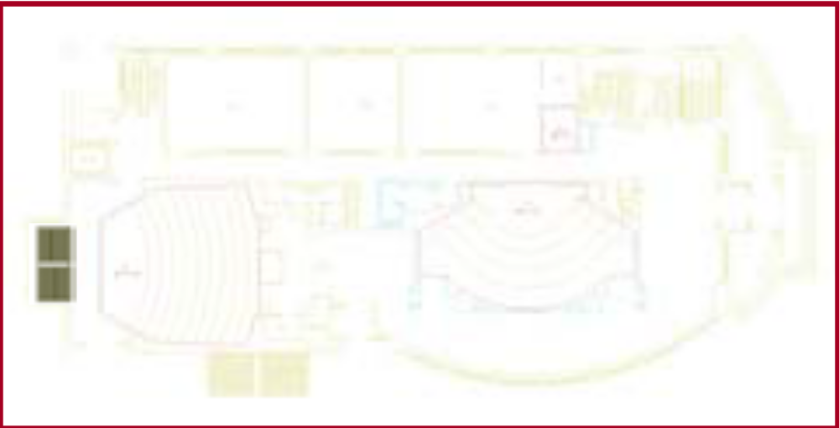
Basic 2D Transformations

Slide 16
Overview
2D Transformations
  Basic 2D transformations
  Matrix representation
  Matrix composition
3D Transformations
  Basic 3D transformations
  Same as 2D
Transformation Hierarchies
  Scene graphs
  Ray casting

Slide 17
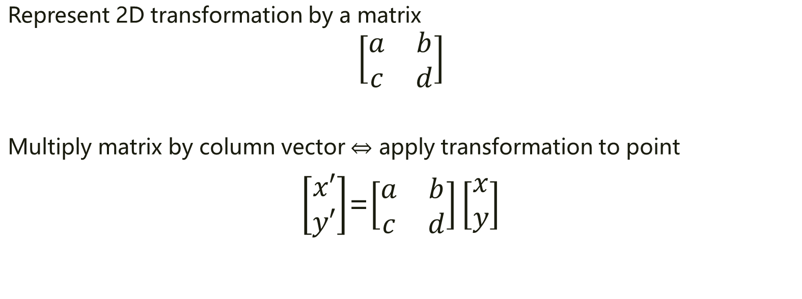

Matrix Representation

Slide 18
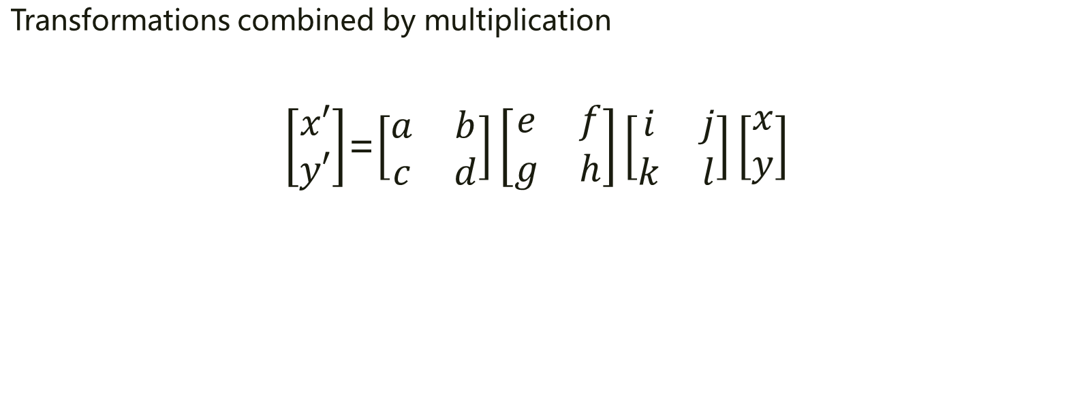
Matrix Representation
Matrices are a convenient and efficient way
to represent a sequence of transformations!

Slide 19
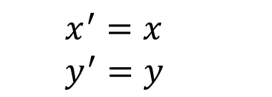
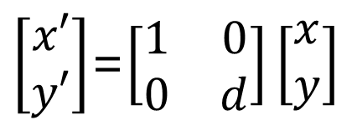
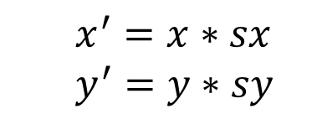
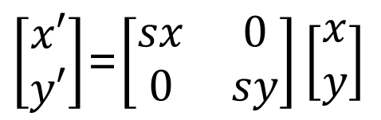
2x2 Matrices
What types of transformations can be represented with a 2x2 matrix?
2D Identity?
2D Scale around (0,0)

Slide 20
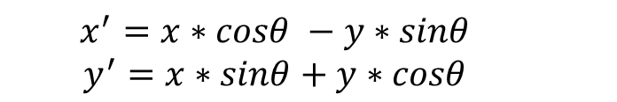
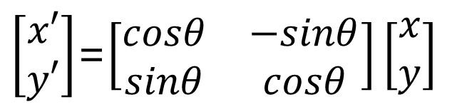

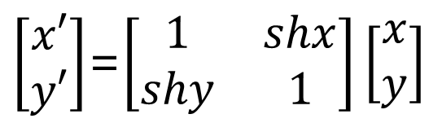
2x2 Matrices
What types of transformations can be represented with a 2x2 matrix?
2D Rotate around (0,0)?
2D Share?

Slide 21
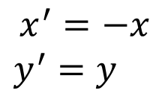
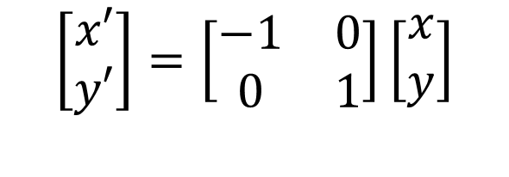
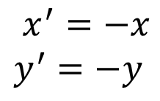
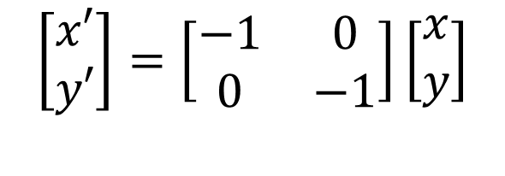
2x2 Matrices
What types of transformations can be represented with a 2x2 matrix?
2D Mirror over Y axis?
2D Mirror over (0,0)?

Slide 22
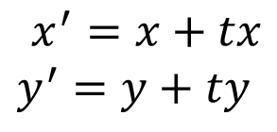
2x2 Matrices
What types of transformations can be represented with a 2x2 matrix?
2D Translation?
NO

Slide 23
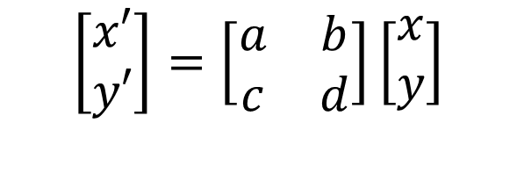
Linear Transformations
Linear transformations are combinations of …
Scale,
Rotation,
Shear, and
Mirror
Properties of linear transformations:
Origin maps to origin
Lines map to lines
Parallel lines remain parallel
Ratios are preserved
Closed under composition

Slide 24
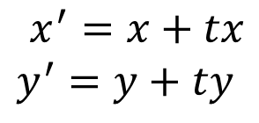
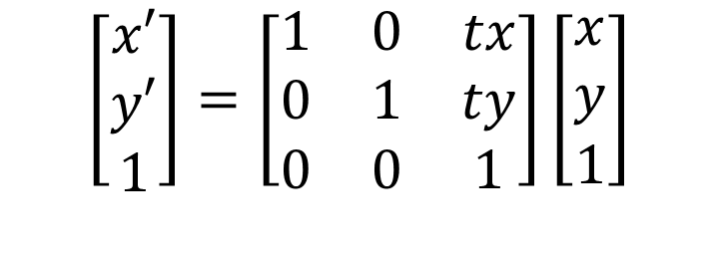
2D Translation
2D translation represented by a 3x3 matrix
  Point represented with homogeneous coordinates

Slide 25
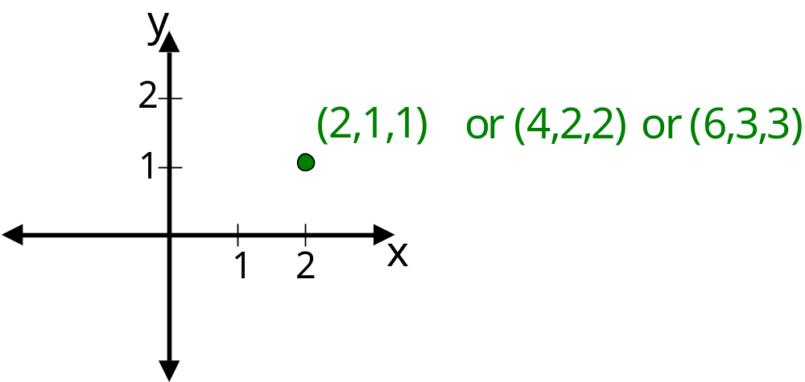
Homogeneous Coordinates
Add a 3rd coordinate to every 2D point
  (x, y, w) represents a point at location (x/w, y/w)
  (x, y, 0) represents a point at infinity
  (0, 0, 0) is not allowed
Convenient coordinate system to
represent many useful transformations

Slide 26
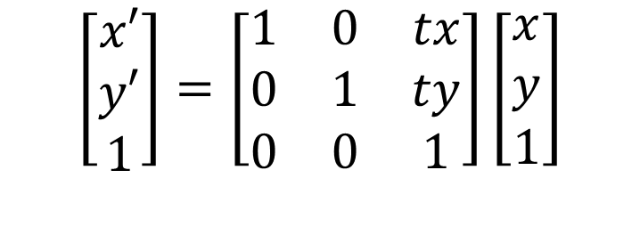
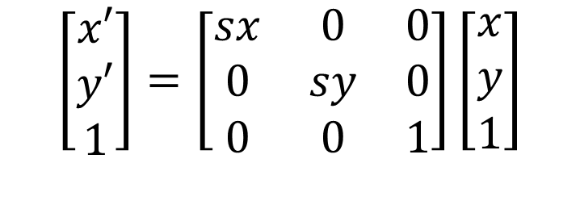
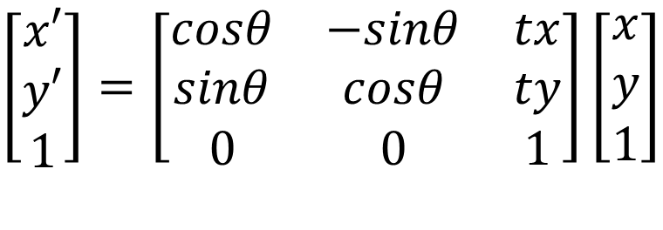
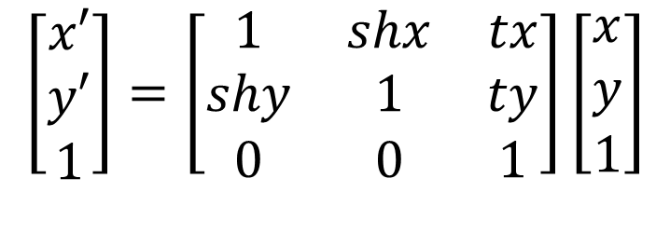
Basic 2D Transformations
Basic 2D transformations as 3x3 matrices
Translate
Scale
Rotate
Shear

Slide 27
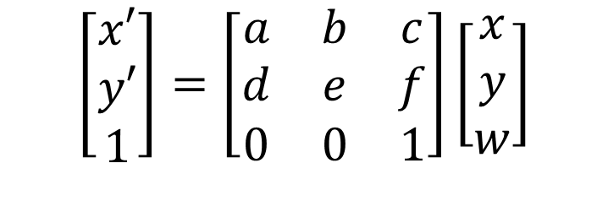
Affine Transformations
Affine transformations are combinations of …
  Linear transformations, and
  Translations
Properties of affine transformations:
  Origin does not necessarily map to origin
  Lines map to lines
  Parallel lines remain parallel
  Ratios are preserved
  Closed under composition

Slide 28
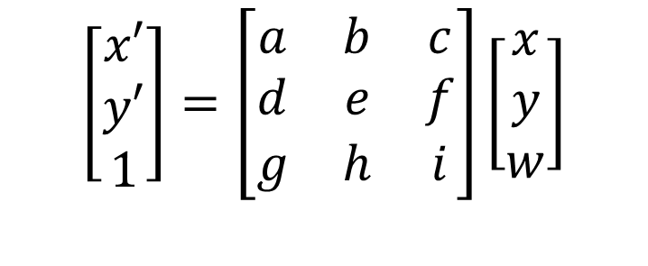
Projective Transformations
Projective transformations …
  Affine transformations, and
  Projective warps
Properties of projective transformations:
  Origin does not necessarily map to origin
  Lines map to lines
  Parallel lines do not necessarily remain parallel
  Ratios are not preserved (but “cross-ratios” are)
  Closed under composition

Slide 29
Overview
2D Transformations
  Basic 2D transformations
  Matrix representation
  Matrix composition
3D Transformations
  Basic 3D transformations
  Same as 2D
Transformation Hierarchies
  Scene graphs
  Ray casting

Slide 30
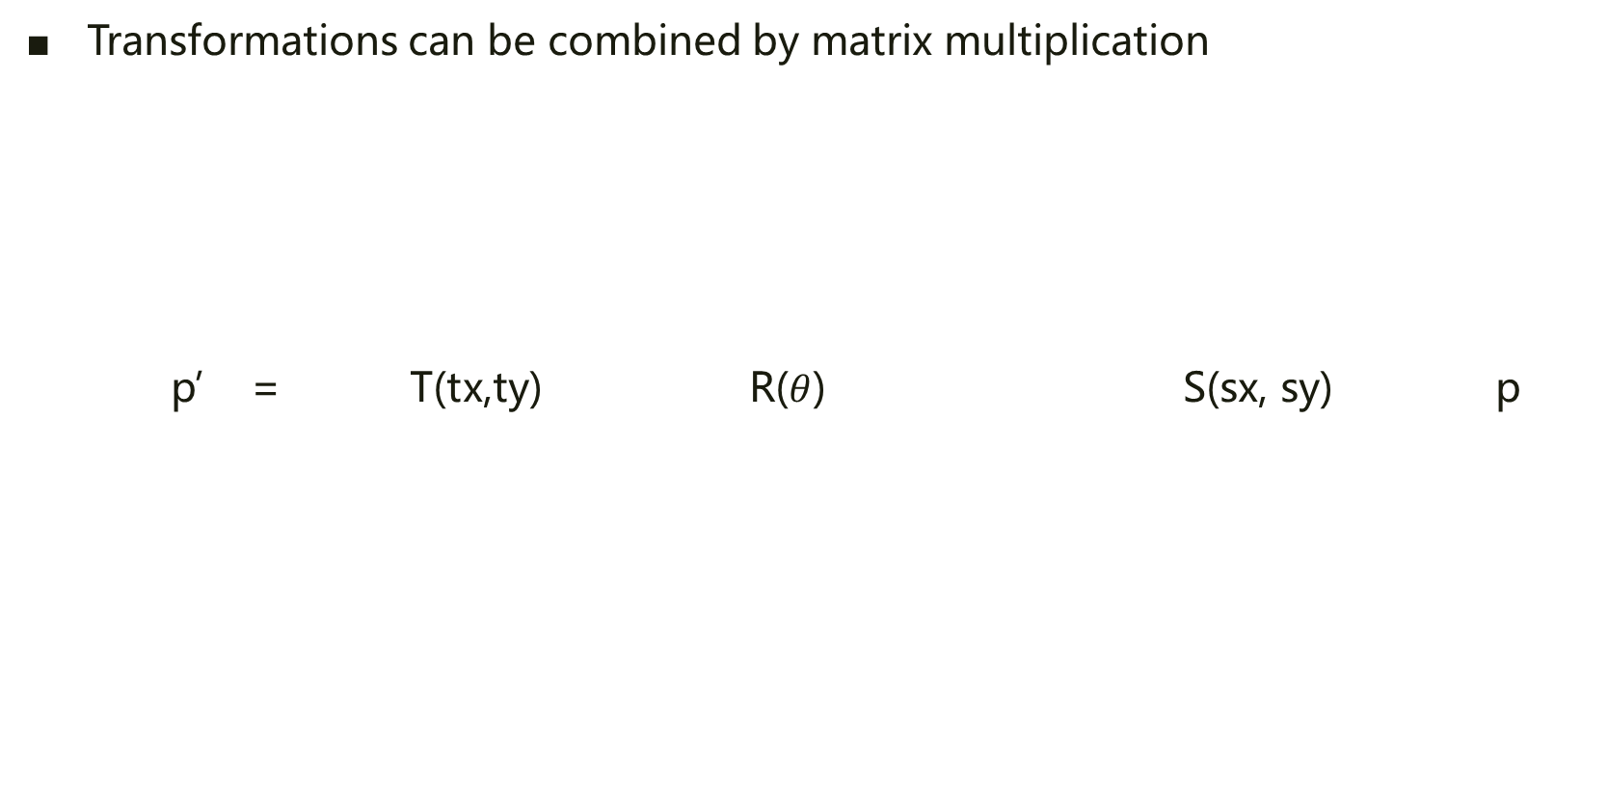
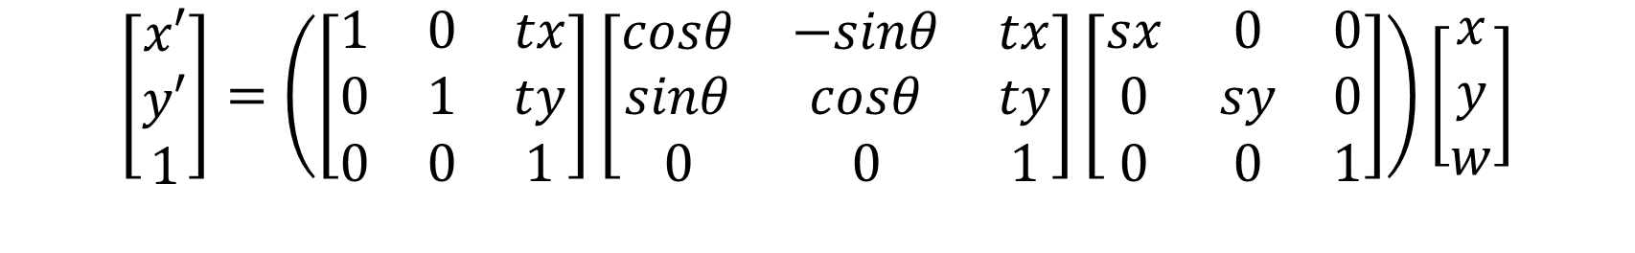
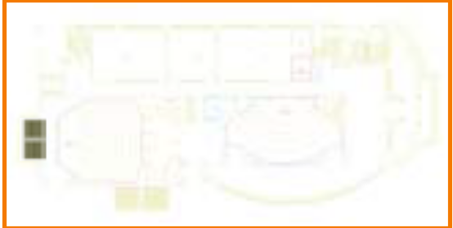
Matrix Composition

Slide 31
Matrix Composition
Matrices are a convenient and efficient way to represent a sequence of transformations
  General purpose representation
  Hardware matrix multiply
  Efficiency with premultiplication
    Matrix multiplication is associative
p’ = (T* (R* (S*p) ) )
p’ = (T*R*S*p)

Slide 32

Matrix Composition
Be aware: order of transformations matters
  Matrix multiplication is not commutative
p’ = T* R* S*p

Slide 33
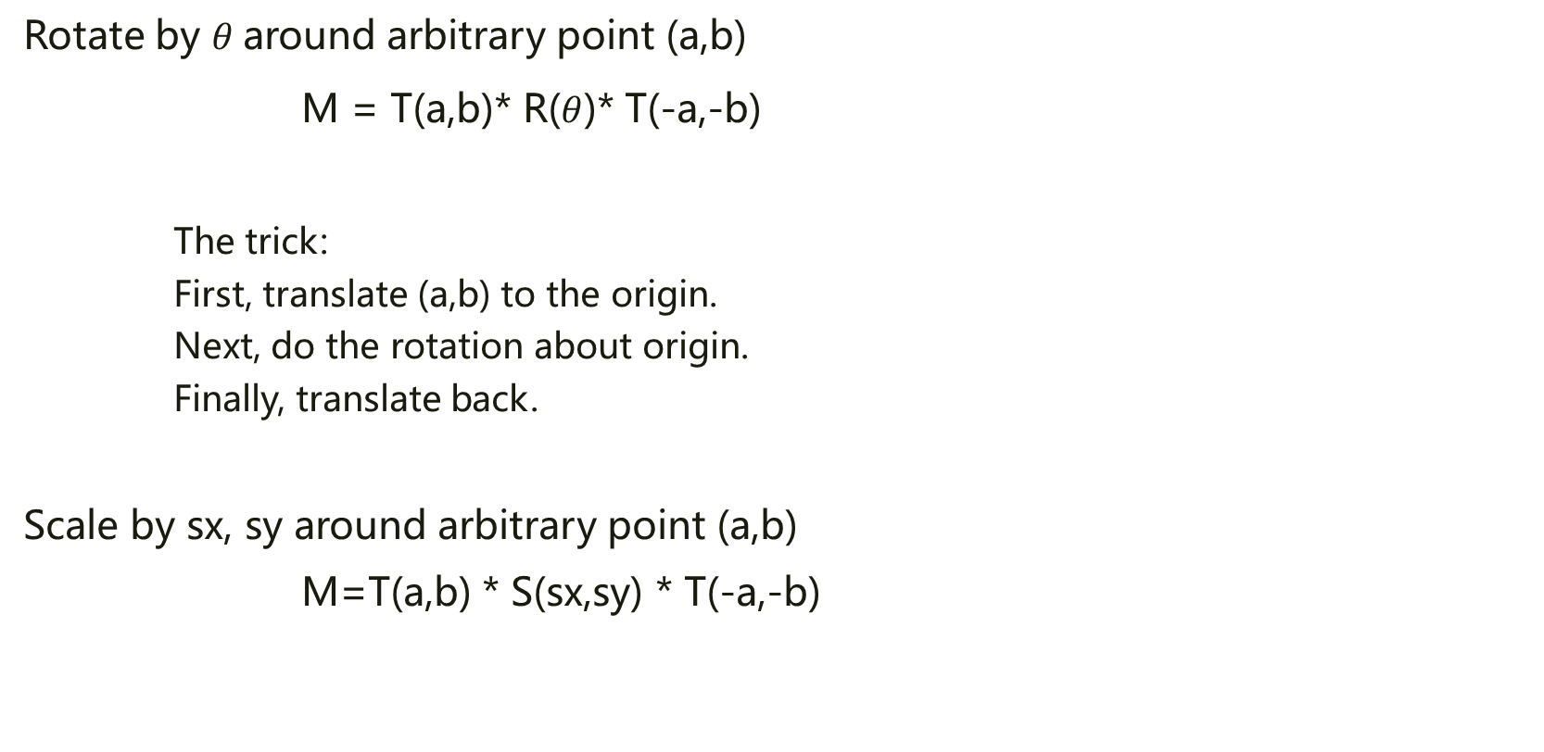
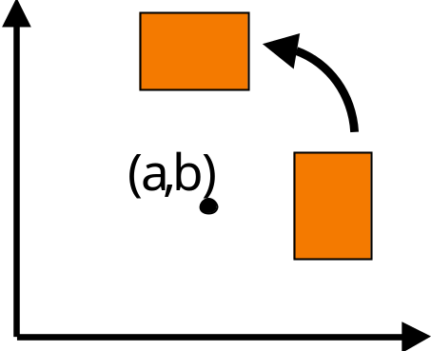
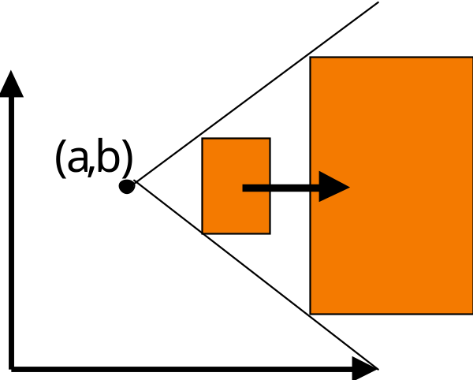
Matrix Composition

Slide 34
Overview
2D Transformations
  Basic 2D transformations
  Matrix representation
  Matrix composition
3D Transformations
  Basic 3D transformations
  Same as 2D
Transformation Hierarchies
  Scene graphs
  Ray casting

Slide 35
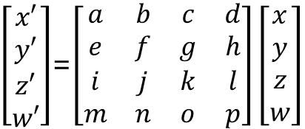
3D Transformations
Same idea as 2D transformations
  Homogeneous coordinates: (x,y,z,w)
  4x4 transformation matrices

Slide 36




Basic 3D Transformations
Identity
Scale
Translate
Mirror over the x axis

Slide 37



Basic 3D Transformations
Rotate around Z axis
Rotate around Y axis
Rotate around X axis

Slide 38
Overview
2D Transformations
  Basic 2D transformations
  Matrix representation
  Matrix composition
3D Transformations
  Basic 3D transformations
  Same as 2D
Transformation Hierarchies
  Scene graphs
  Ray casting

Slide 39


Transformation Hierarchies
Scene may have hierarchy of coordinate systems
  Each level stores matrix representing transformation from parent’s coordinate system

Slide 40


Transformation Example 1
Well-suited for humanoid characters

