Slide 1
3D Polygon Rendering Pipeline
Acknowledgment: slides by Misha Kazhdan, Allison Klein, Tom Funkhouser, Adam Finkelstein and David Dobkin

Slide 2
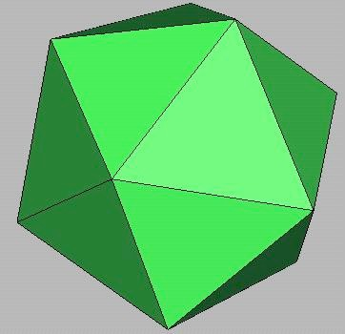
3D Polygon Rendering
Many applications use rendering of 3D polygons with direct illumination

Slide 3

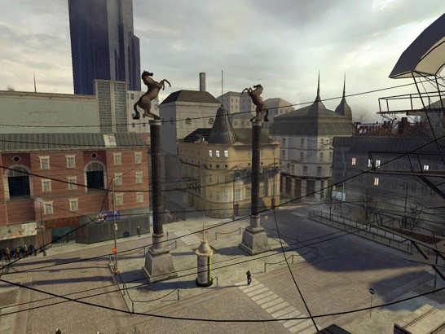
3D Polygon Rendering
Many applications use rendering of 3D polygons with direct illumination
Half-Life 2
(Valve Software)

Slide 4

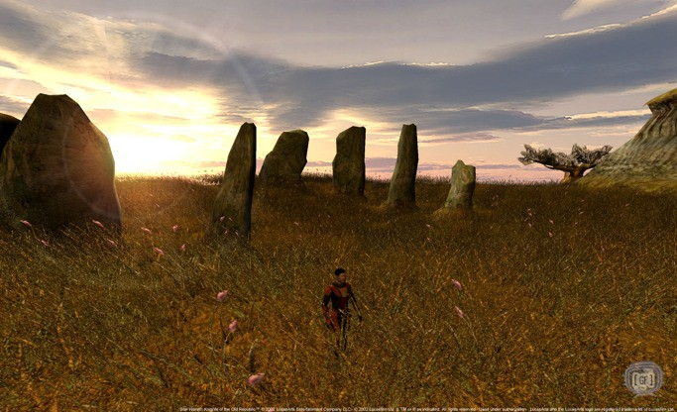
3D Polygon Rendering
Many applications use rendering of 3D polygons with direct illumination
Star Wars: Knights of the Old Republic
(BioWare)

Slide 5

Ray Casting Revisited
For each sample …
Construct ray from eye position through view plane
Find first surface intersected by ray through pixel
Compute color of sample based on surface radiance
More efficient algorithms utilize spatial coherence!

Slide 6
3D Polygon Rendering
Logical inverse of ray casting
Idea: Instead of sending rays from the camera into the scene, send rays from the scene into the camera.

Slide 7
3D Polygon Rendering
Ray casting: pick pixel and figure out what color it should be based on what object its ray hits
Polygon rendering: pick polygon and figure out what pixels it should affect

Slide 8





3D Rendering Pipeline
(direct illumination)
3D Geometric Primitives
Modeling Transformation
Camera Transformation
This is a pipelined sequence of operations to draw a 3D primitive into a 2D image
Lighting
Projection
Transformation
Clipping
Scan
Conversion
Image

Slide 9
3D Rendering Pipeline
(direct illumination)
3D Geometric Primitives
Modeling Transformation
Transform from current (local) coordinate system into 3D world coordinate system
Camera Transformation
Lighting
Projection
Transformation
Clipping
Scan
Conversion
Image

Slide 10
3D Rendering Pipeline
(direct illumination)
3D Geometric Primitives
Modeling Transformation
Transform into 3D world coordinate system
Camera Transformation
Transform into 3D camera coordinate system
Lighting
Projection
Transformation
Clipping
Scan
Conversion
Image

Slide 11
3D Rendering Pipeline
(direct illumination)
3D Geometric Primitives
Modeling Transformation
Transform into 3D world coordinate system
Camera Transformation
Transform into 3D camera coordinate system
Lighting
Projection
Transformation
Clipping
Scan
Conversion
Image

Slide 12
3D Rendering Pipeline
(direct illumination)
3D Geometric Primitives
Modeling Transformation
Transform into 3D world coordinate system
Camera Transformation
Transform into 3D camera coordinate system
Lighting
Illuminate according to lighting and reflectance
Projection
Transformation
Clipping
Scan
Conversion
Image

Slide 13
3D Rendering Pipeline
(direct illumination)
3D Geometric Primitives
Modeling Transformation
Transform into 3D world coordinate system
Camera Transformation
Transform into 3D camera coordinate system
Lighting
Illuminate according to lighting and reflectance
Projection
Transformation
Transform into 2D camera coordinate system
Clipping
Scan
Conversion
Image

Slide 14
3D Rendering Pipeline
(direct illumination)
3D Geometric Primitives
Modeling Transformation
Transform into 3D world coordinate system
Camera Transformation
Transform into 3D camera coordinate system
Lighting
Illuminate according to lighting and reflectance
Projection
Transformation
Transform into 2D camera coordinate system
Clipping
Clip (parts of) primitives outside camera’s view
Scan
Conversion
Image

Slide 15
3D Rendering Pipeline
(direct illumination)
3D Geometric Primitives
Transformations map points from one coordinate system to another
Modeling Transformation
Transform into 3D world coordinate system
Camera Transformation
Transform into 3D camera coordinate system
Lighting
Illuminate according to lighting and reflectance
Projection
Transformation
Transform into 2D camera coordinate system
Clipping
Clip (parts of) primitives outside camera’s view
Scan
Conversion
Draw pixels (includes texturing, hidden surface, ...)
Image

Slide 16
Transformations
3D Geometric Primitives
Modeling Transformation
Transform into 3D world coordinate system
Camera Transformation
Transform into 3D camera coordinate system
Lighting
Illuminate according to lighting and reflectance
Projection
Transformation
Transform into 2D camera coordinate system
Clipping
Clip primitives outside camera’s view
Scan
Conversion
Draw pixels (includes texturing, hidden surface, etc.)
Image

Slide 17


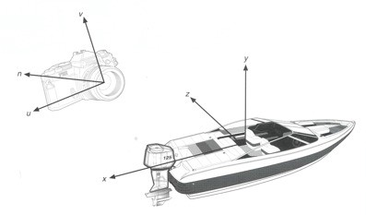


Transformations
p(x,y,z)
3D Object Coordinates
Transformations map points from one coordinate system to another
Modeling
Transformation
3D World Coordinates
Camera
Transformation
3D Camera Coordinates
3D Object Coordinates
y
3D Camera Coordinates
z
Projection
Transformation
x
2D Screen Coordinates
Window-to-Viewport
Transformation
2D Image Coordinates
3D World Coordinates
p’(x’,y’)

Slide 18
Viewing Transformations
p(x,y,z)
3D Object Coordinates
Modeling
Transformation
3D World Coordinates
Camera
Transformation
3D Camera Coordinates
Viewing Transformations
Projection
Transformation
2D Screen Coordinates
Window-to-Viewport
Transformation
2D Image Coordinates
p’(x’,y’)

Slide 19
Viewing Transformation
Mapping from world to camera coordinates
Eye position maps to origin
Right vector maps to X axis
Up vector maps to Y axis
back
Back vector maps to Z axis
up
right
y
View plane
Camera
-z
x
World

Slide 20
Camera Coordinates
Canonical coordinate system
Convention is right-handed (looking down -z axis)
Convenient for projection, clipping, etc.
Camera up vector maps to Y axis
y
Camera right vector maps to X axis
Camera back vector maps to Z axis (pointing out of page)
z
x

Slide 21
Finding the Viewing Transformation
We have the camera (in world coordinates)
We want T taking objects from world to camera
Trick: find T⁻¹ taking objects in camera to world
?

Slide 22
Finding the Viewing Transformation
Trick: map from camera coordinates to world
oOrigin maps to eye position
oZ axis maps to Back vector
oY axis maps to Up vector
oX axis maps to Right vector
This matrix is T⁻¹ so we invert it to get T … easy!

Slide 23
Finding the Viewing Transformation
Trick: map from camera coordinates to world
oRemember, with homogeneous coordinates, we divide through by w values…
oSo if we know actual point in 3D, w = 1
oEasy to find code to invert a matrix
This matrix is T⁻¹ so we invert it to get T … easy!

Slide 24
Viewing Transformations
p(x,y,z)
3D Object Coordinates
Modeling
Transformation
3D World Coordinates
Camera
Transformation
3D Camera Coordinates
Viewing Transformations
Projection
Transformation
2D Screen Coordinates
Window-to-Viewport
Transformation
2D Image Coordinates
p’(x’,y’)

Slide 25
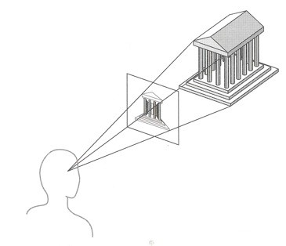
Projection
General definition:
oA linear transformation of points in n-space to
m-space (m<n)
In computer graphics:
oMap 3D camera coordinates to 2D screen coordinates

Slide 26
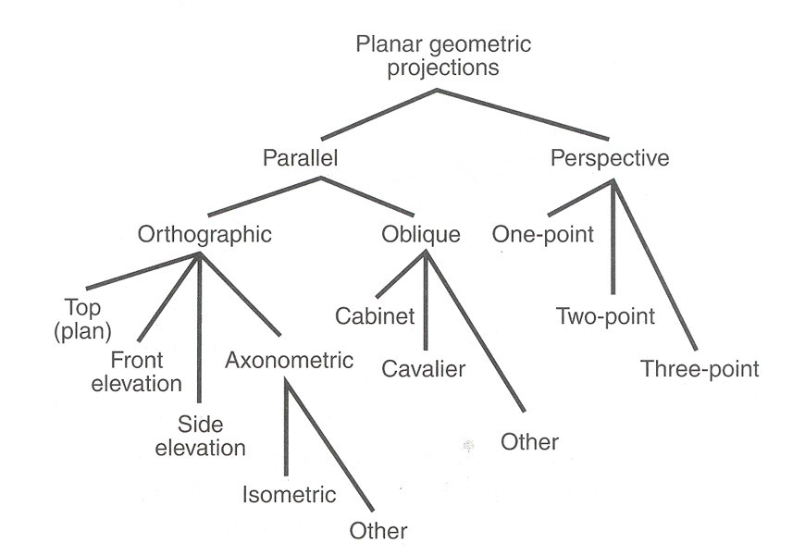
Taxonomy of Projections
FvDFH Figure 6.13

Slide 27
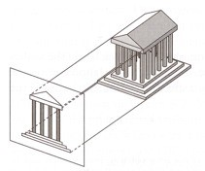

Projection
Two general classes of projections, both of which shoot rays from the scene, through the view plane: oParallel Projection:
»Rays converge at a point at infinity and are parallel
oPerspective “Projection”:
»Rays converge at a finite point, giving rise to perspective distortion
View Plane
View Plane

Slide 28
Taxonomy of Projections
FvDFH Figure 6.13

Slide 29
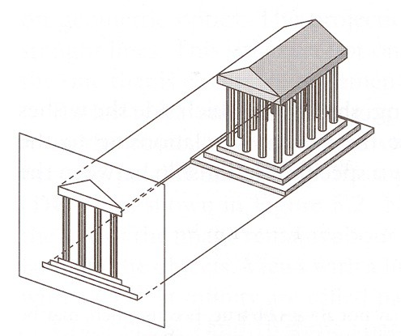
Parallel Projection
Center of projection is at infinity
oDirection of projection (DOP) same for all points
DOP
View Plane
Angel Figure 5.4

Slide 30

Parallel Projection
Parallel lines remain parallel
Relative proportions of objects preserved
Angles are not preserved
Less realistic looking
oFar away objects don’t get smaller

Slide 31
Taxonomy of Projections
FvDFH Figure 6.13

Slide 32
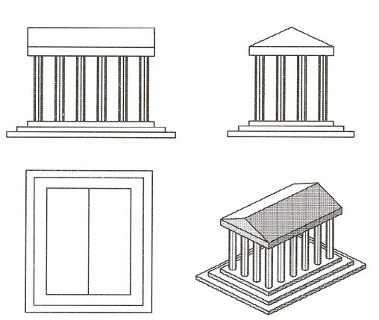
Orthographic Projections
DOP perpendicular to view plane
Side
Front
Top
Isometric
Angel Figure 5.5

Slide 33
Orthographic Projections
DOP perpendicular to view plane
Side Front
Lines perpendicular to the view plane vanish
Faces parallel to the view plane are un-distorted.
Top
Isometric
Angel Figure 5.5

Slide 34
Taxonomy of Projections
FvDFH Figure 6.13

Slide 35
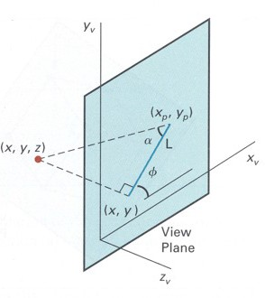
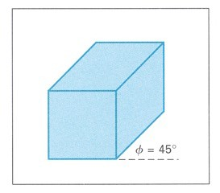
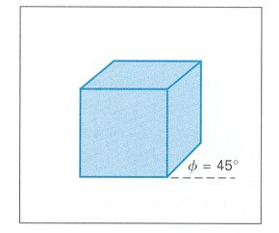
Oblique Projections
DOP not perpendicular to view plane
1
1
1
1/2
1
1
Cavalier (DOP α = 45º)
Cabinet (DOP α = 63.4º)
φ describes the angle of the projection of the view plane’s normal
L represents the scale factor applied to the view plane’s normal
H&B Figure 12.21

Slide 36
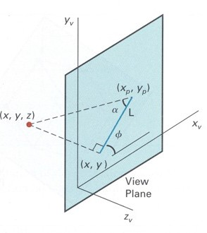
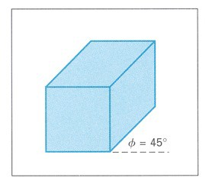
Parallel Projection Matrix
General parallel projection transformation:
1
1
1
1/2
1
1
Cavalier (DOP α = 45º)
Cabinet (DOP α = 63.4º)
2 _{x}
y
 _{xp} l ₌ 
y_{p}
1 | 0 | L cos </
0 | 1 | L sin </
l
4 5
z
H&B Figure 12.21

Slide 37
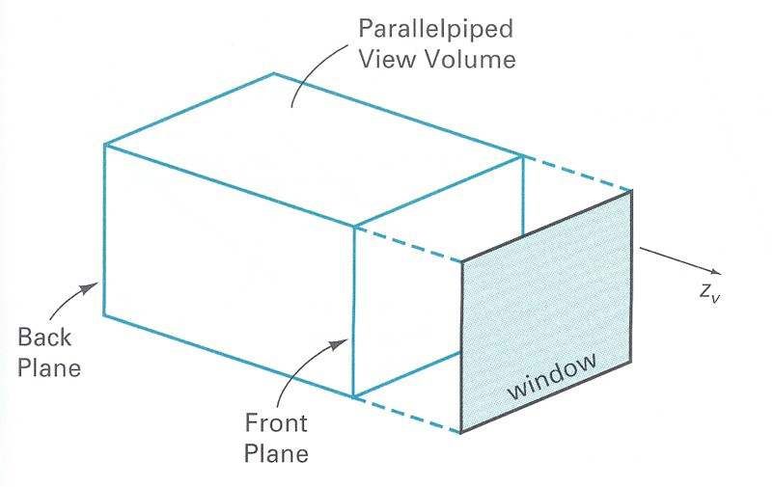
Parallel Projection View Volume
H&B Figure 12.30

Slide 38
Taxonomy of Projections
FVFHP Figure 6.10

Slide 39
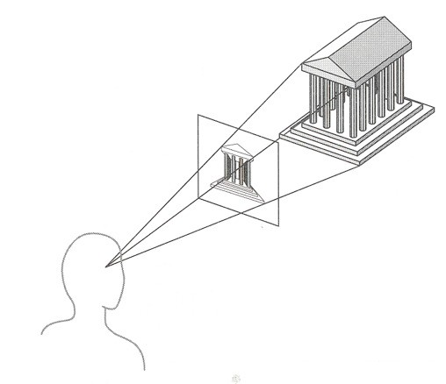
Perspective “Projection”
Map points onto “view plane” along “projectors” emanating from “center of projection” (COP)
Projectors
Center of Projection
View
Plane
Angel Figure 5.9

Slide 40
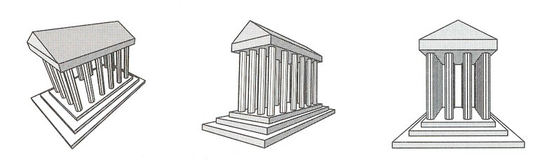
Perspective Projection
How many vanishing points?
y
y
y
z
z
x
3-Point Perspective
x
2-Point
Perspective
x
z
1-Point Perspective
Number of vanishing points determined by number of axes parallel to the view plane
Angel Figure 5.10

Slide 41
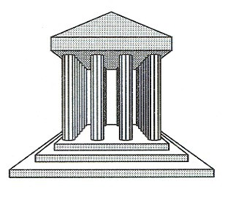
Perspective Projection
Perspective “projection” is not really a projection because it is not a linear map from 3D to 2D. oParallel lines do not remain parallel!

Slide 42
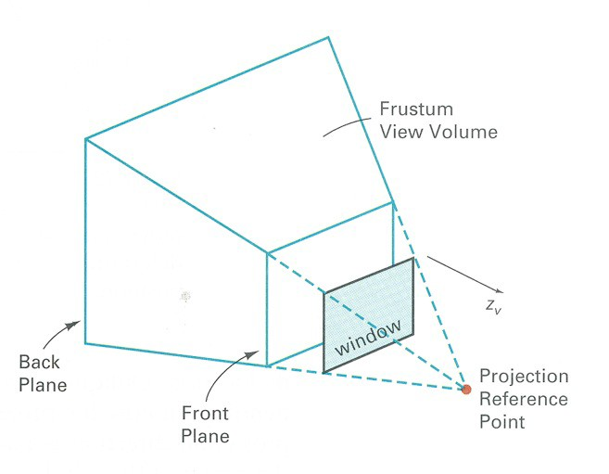
Perspective Projection View Volume
View Plane
H&B Figure 12.30

Slide 43
Perspective Projection
What are the coordinates of the point resulting from projection of (x₀,y₀,z₀) onto the view plane at a distance of D along the z-axis?
y
(x₀,y₀,z₀)
D
-z
(0,0,0)
z
View Plane
-y

Slide 44
Perspective Projection
Use the fact that for any point (x₀,y₀,z₀) and any scalar α, the points (x₀,y₀,z₀) and (αx₀, αy₀, αz₀) map to the same location:
(2x₀,2y₀,2z₀)
y
(x₀,y₀,z₀)
D
-z
(0,0,0)
z
View Plane
-y

Slide 45
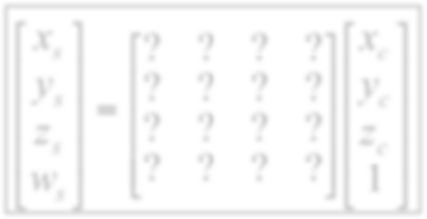
Perspective Projection Matrix
4x4 matrix representation?

Slide 46
Perspective Projection Matrix
4x4 matrix representation?
We want to divide by the z coordinate. How do we do that with a 4x4 matrix?

Slide 47
Perspective Projection Matrix
4x4 matrix representation?
We want to divide by the z coordinate. How do we do that with a 4x4 matrix?
Recall that in homogenous coordinates:
(x, y, z, w) = (x/w, y/w, z/w, 1)

Slide 48
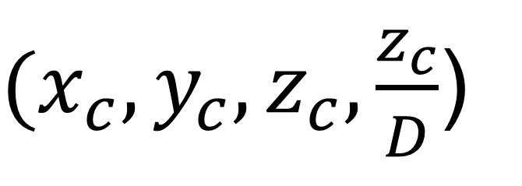
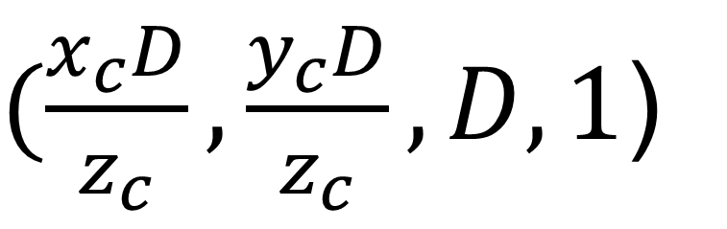
Perspective Projection Matrix
4x4 matrix representation?
We want to divide by the z coordinate. How do we do that with a 4x4 matrix?
Recall that in homogenous coordinates:
(x, y, z, w) = (x/w, y/w, z/w, 1)
$(\frac{x_{c}D}{z_{c}},\frac{y_{c}D}{z_{c}},D,1$)
$(x_{c},y_{c},z_{c},\frac{z_{c}}{D}$)

Slide 49
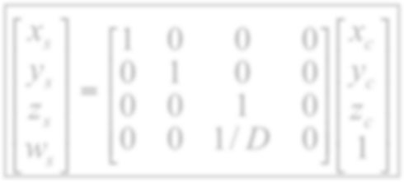
Perspective Projection Matrix
4x4 matrix representation?
We want to divide by the z coordinate. How do we do that with a 4x4 matrix?
Recall that in homogenous coordinates:
(x, y, z, w) = (x/w, y/w, z/w, 1)
$(\frac{x_{c}D}{z_{c}},\frac{y_{c}D}{z_{c}},D,1$)
$(x_{c},y_{c},z_{c},\frac{z_{c}}{D}$)

Slide 50
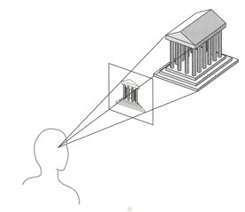

Perspective vs. Parallel
Perspective projection
+Size varies inversely with distance - looks realistic
– Distance and angles are not preserved
– Only parallel lines that are parallel to the view plane remain parallel
Parallel projection
+Good for exact measurements
+Parallel lines remain parallel
+Angles are preserved on faces parallel to the view plane
– Less realistic looking

