Slide 1
PSE – Requirements Ramona Christen

Slide 2
Inhalt
Unser Team
Unser Projekt
Requirements
Scrum Poker
Fazit
Fragen

Slide 3
Unser Team
Raphael (Key Account Manager)
Dario (Quality Evangelist)
Renato
Julien
Ramona (Chief Deliverable Officer)
(Master Tracker)

Slide 4

Unser Projekt
Puzzle
Cryptopus
Passwort Manager
Open Source

Slide 5
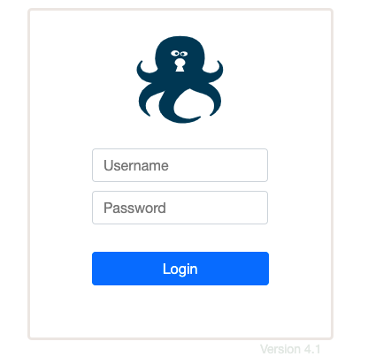
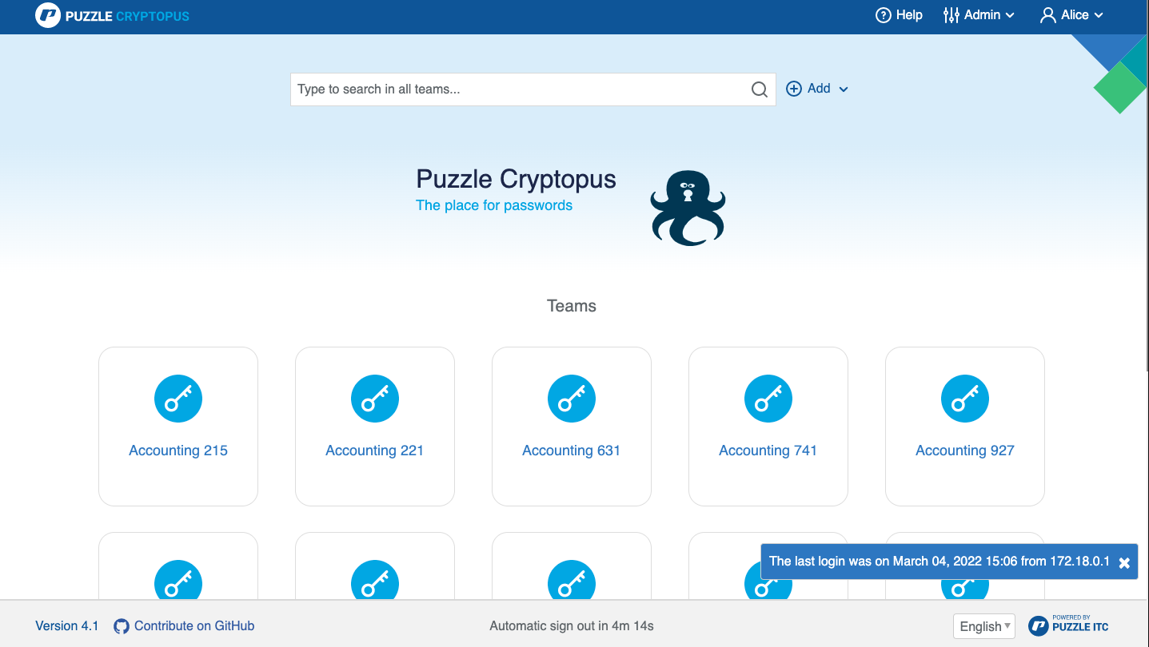

Slide 6
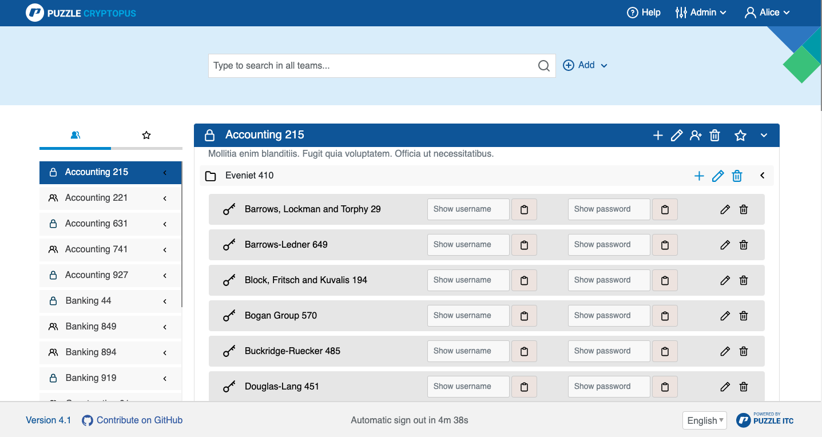

Slide 7
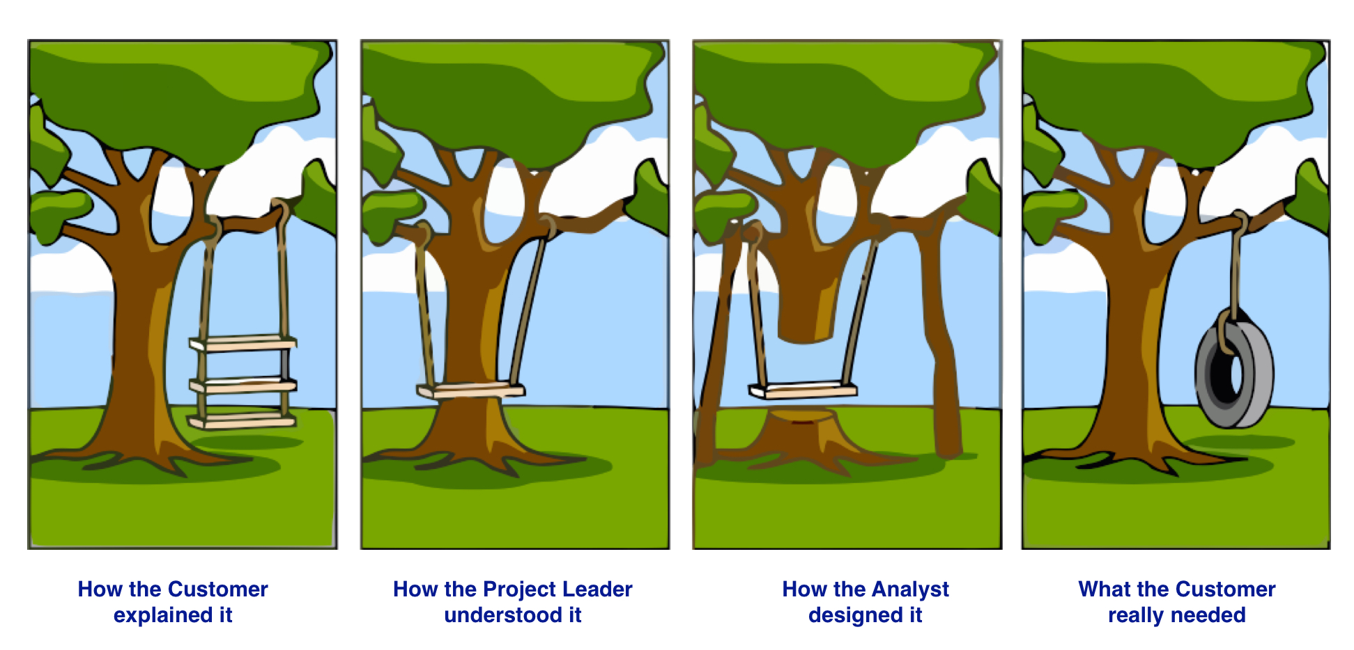
Requirements

Slide 8
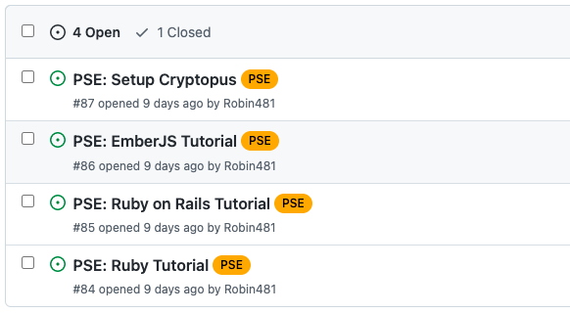
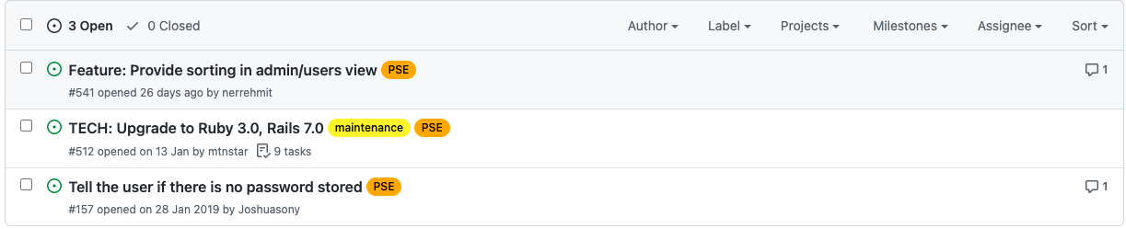
Requirements

Slide 9
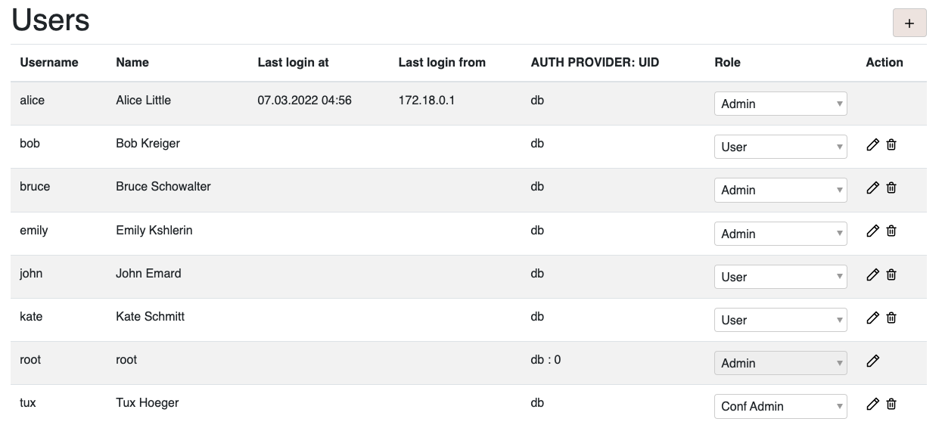
Provide sorting in admin/users view

Slide 10
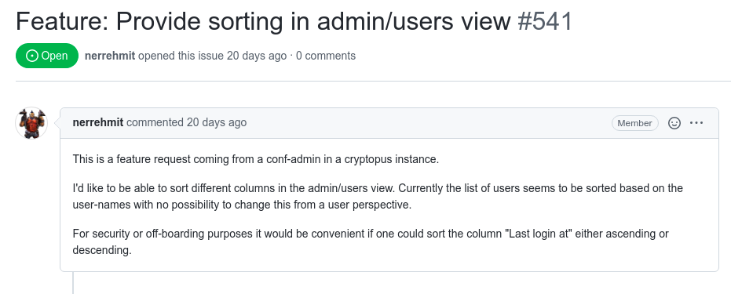
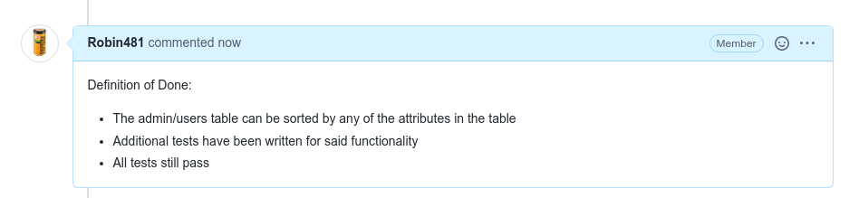

Slide 11
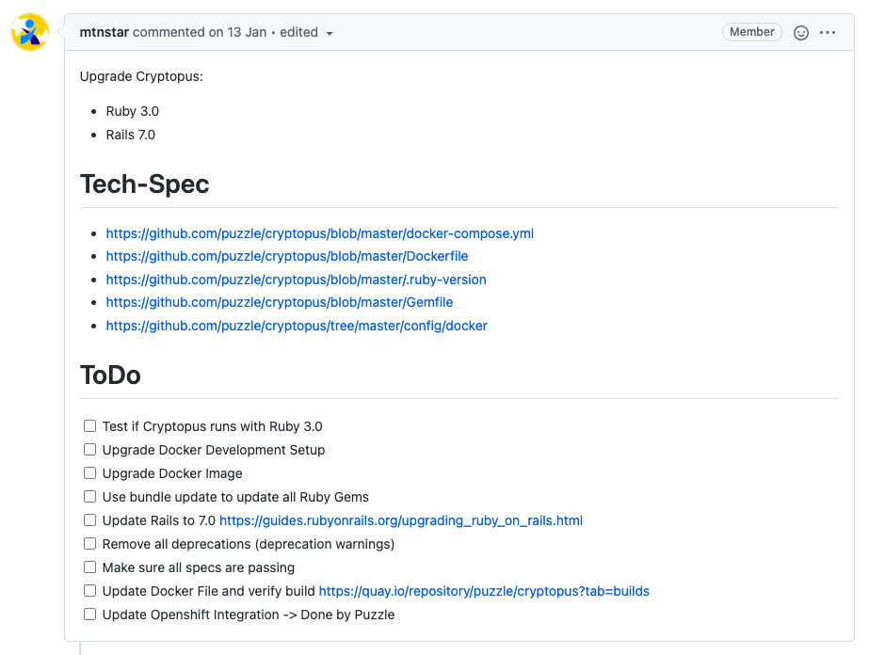
Upgrade to Ruby 3.0, Rails 7.0

Slide 12
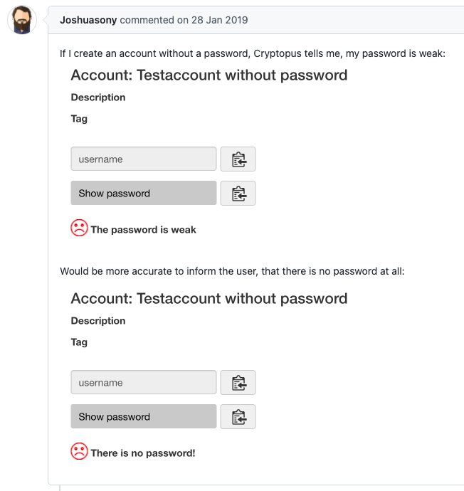
Tell the user if there is no password stored

Slide 13
Scrum Poker
(Master Tracker)

Slide 14
Scrum Poker
(Master Tracker)

Slide 15
Fazit
Klare Vorgaben helfen bei der Umsetzung
Schwierigkeiten beim Einschätzen des Aufwands

Slide 16
Links
https://github.com/puzzle/cryptopus
https://github.com/RamonaChristen/PSE-Documents

Slide 17

Fragen?

