Slide 1
London Street Crime Analyses 2011-2017
by Blae Quayle
Springboard Foundations of Data Science
April-June 2017

Slide 2
Problem Definition
Metropolitan Police operate across 32 boroughs and aim to make London the ‘safest global city’
No accessible method allowing residents and tourists to check for crime hotspots
Allow for informed decisions and encourage preventative action

Slide 3
Project Aims
Investigate temporal and geographical patterns of street crime occurrences
Annual variations
Seasonal variations
Identify crime hot spots
Create visualisation allowing identification of risk level for specific crimes
Can a model be built to predict the expected number of crimes in a borough?

Slide 4
Data Extraction
Street level crime for London is available from data.police.uk
Reported monthly and available from Dec 2010 to Mar 2017
Associated API implemented as standard JSON web service:
https://data.police.uk/api/crimes-street/all-crime?poly=52.268,0.543:52.794,0.238:52.130,0.478&date=2013-01

Slide 5
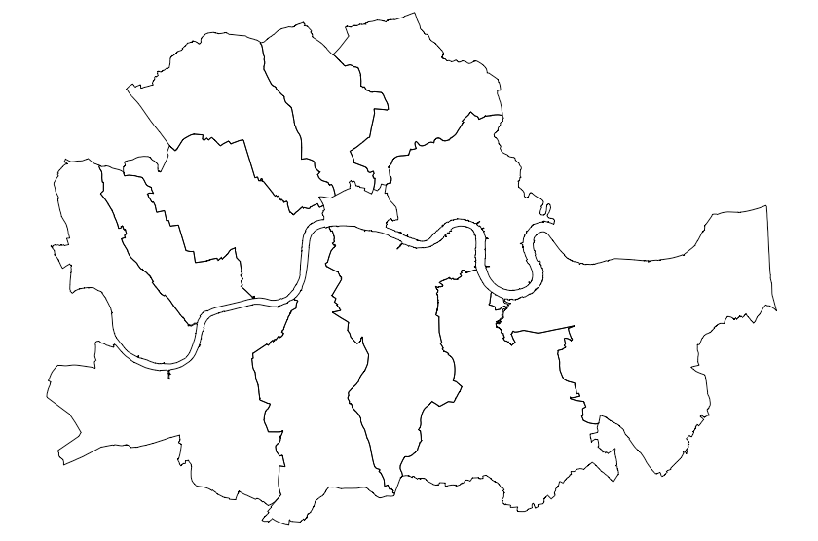
Geographic and temporal extents
2
12 “inner” London boroughs for 2016
2011-2017
1

Slide 6
Data Exploration
Data are stored at a crime incident level i.e. one observation for each incident with unique identifier
Almost 500,000 observations for central London polygon for full time period
11 variables returned by API – 4 are of primary interest: category, month, longitude, latitude

Slide 7
Data Limitations
Anonymisation – no day/time provided and no specific location to protect victim confidentiality
Integration with other datasets – using initial polygon returned dataset over arbitrary area, not at borough level
City of London not included in dataset as not policed by the Met

Slide 8
Data Wrangling 1
Loaded dplyr, tidyr and readr
Removed variables with no useful civilian data using select()
Rename() category as crime_type and location_type as service
Set category and location_type to factor variables using as.factor()
Check for missing values using is.na()
Lubridate package used to set month() and year() as separate variables

Slide 9
Data Wrangling 2
Create additional data frames for analysis using mutate(), case_when(), group_by(), summarize()
Monthly crime
Annual crime
Abbreviation of crime_type for clearer visualisation e.g Anti-social behaviour = ASB
Seasonal crime – addition of ‘season’ variable
Load rgdal, rgeos and sp. Filter borough shapefile using subset() and convert 2016 data to spatial points dataframe, remove all crimes outside of 12 boroughs

Slide 10
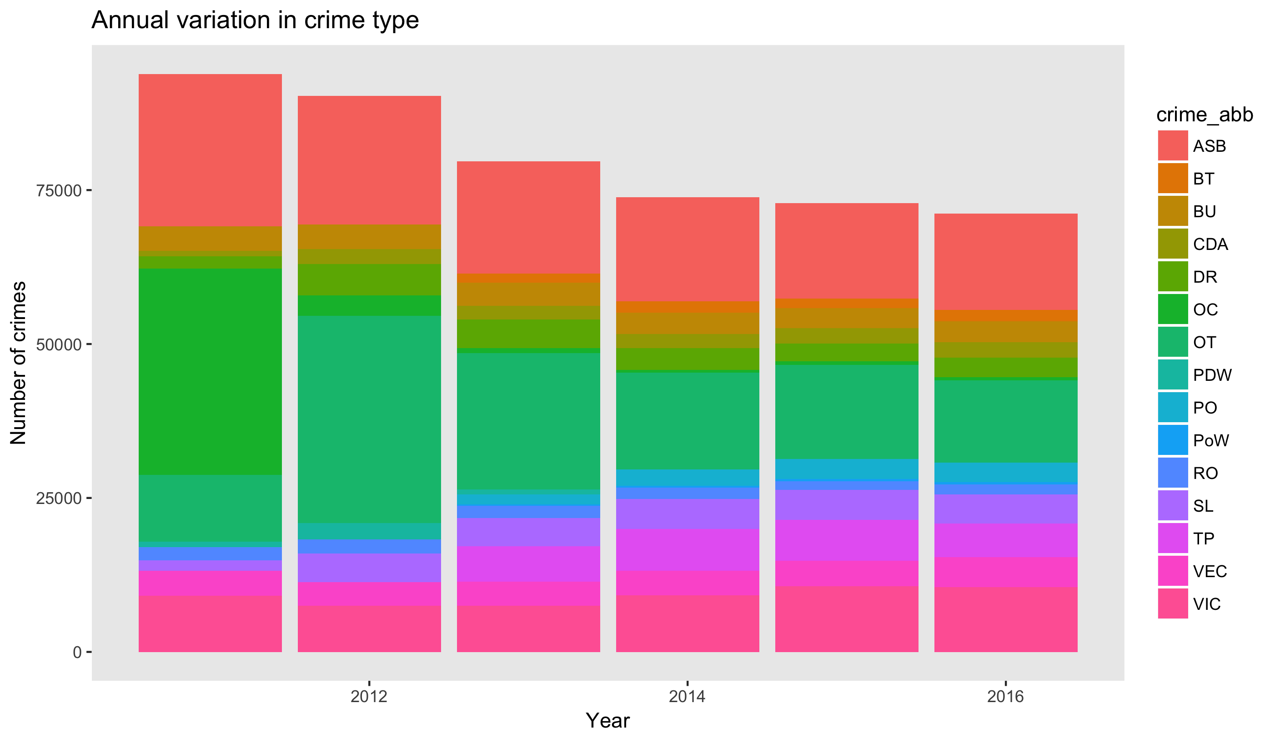
Data Visualisation 1: geom_col()
2011-2017
“Central”
Decreasing since 2011, largest drop of 12% between 2012 and 2013
Other crime, other theft and anti-social behaviour largest decrease

Slide 11
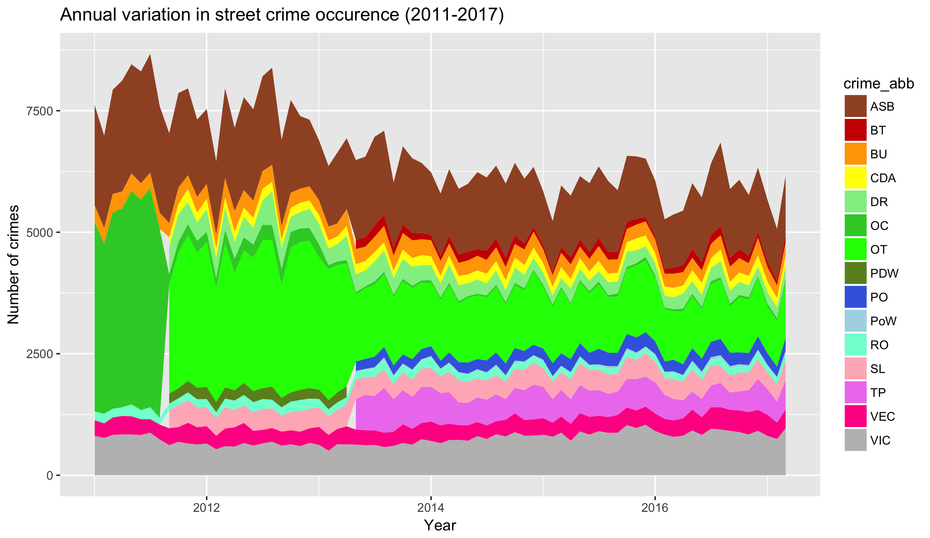
Data Visualisation 2: geom_area()
2011-2017
“Central”
Identifying seasonal trends is difficult when all crimes are combined
Anti-social behaviour appears to show peaks most summers

Slide 12
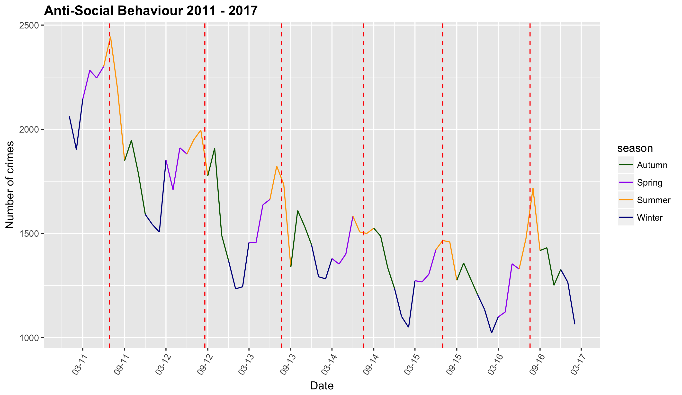
Data Visualisation 3: geom_line()
2011-2017
“Central”
Decrease in anti-social behaviour from 2011 until 2016
Clear peaks visible usually coinciding with school summer holidays

Slide 13
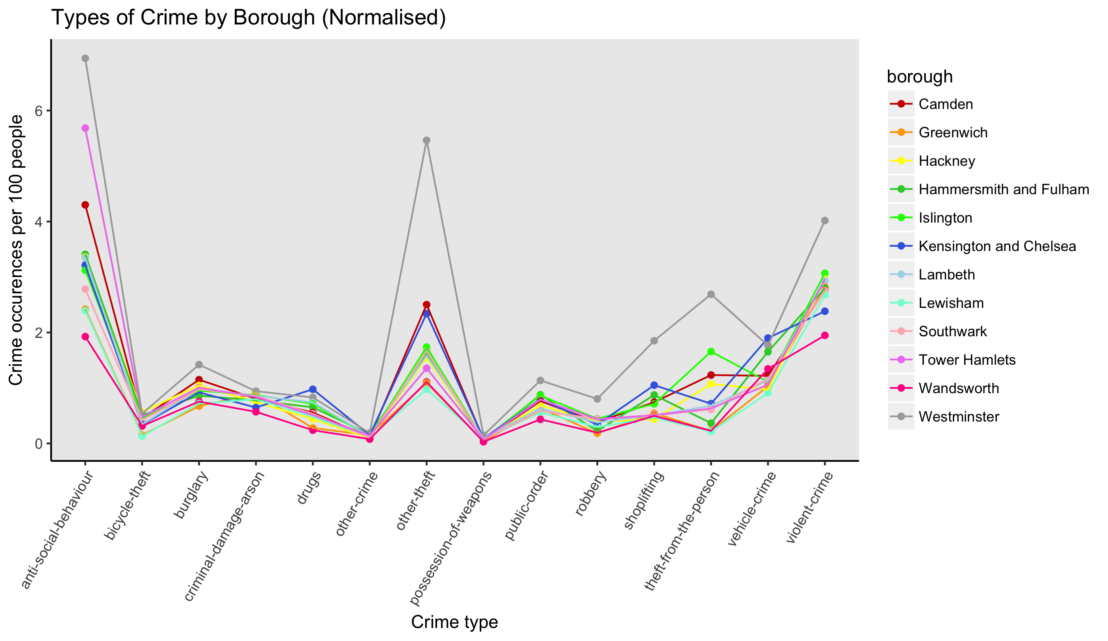
Data Visualisation 4
2016
“Inner Boroughs”
Westminster highest rate 28.7 crimes/100 people, however also borough with most tourists
Wandsworth lowest rate 9.7 crimes/100 people

Slide 14
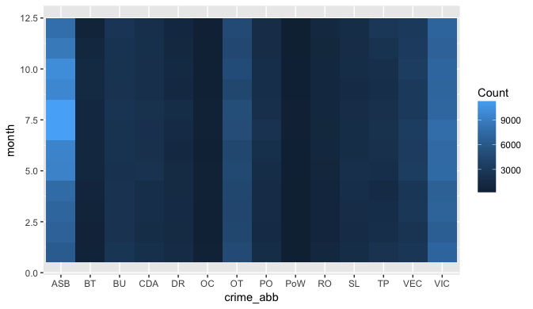
Data Visualisation 4
2016
“Inner Boroughs”
Heatmaps can be used to get an overview of seasonal variation across all crimes. Summer peaks in anti-social behaviour clear, but also violent crime and other theft more prevalent

Slide 15
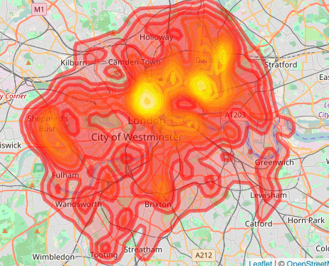
Crime hotspots 1
2016
“Inner Boroughs”
Using KernSmooth, sp and Leaflet to create Kernel Density Estimation maps for bicycle thefts - high density around Russel Square (SOAS, UCL and Birkbeck Universities), Shoreditch and Dalston

Slide 16
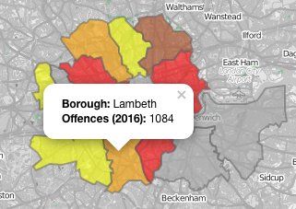
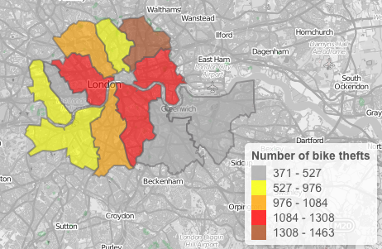
Crime hotspots 2
2016
“Inner Boroughs”
Using maptools, classInt and Leaflet to create interactive chloropleth maps for bicycle thefts – highlights Westminster, Southwark and Tower Hamlets as boroughs with highest number of bike thefts

Slide 17
Machine Learning
Place holder

Slide 18
Conclusions 1
Crime rates have been dropping consistently from 2011, with a high decrease between 2012 and 2013 noted. However, certain crimes have shown an increase over that time e.g. violent crime.
Seasonal patterns in crime present
Peaks of anti-social behaviour correlating to the highest temperature peaks in the summer
Bicycle theft cyclical with peaks in the summer and troughs in the winter, against a background of fairly constant thefts
Burglary broadly decreasing since 2012 but peak often visible in the run up to Christmas followed by a sharp drop in the New Year.

Slide 19
Conclusions 2
KDE is a valuable method for visualising the density of crimes when displaying a very large dataset
Particular due to the location anonymisation meaning many crime observations lie immediately on top of each other.
Russel Square and Shoreditch were identified as bicycle theft hotspots, with Soho and Fitzrovia as burglary hotspots, and Covent Garden and Soho for theft from the person.
Westminster, with one of the lowest populations, displays the largest number of crimes at 28.7 per 100 people.

Slide 20
Recommendations
1. Combination of interactive chloropleth and KDE maps could be used to populate a Shiny App for easy access on a smartphone or tablet by the general public. Support Met Police’s aim of making London the safest global city.
2. For tourists, always be on high alert for pickpockets when visiting tourist attractions in Westminster, especially the areas around Soho and Covent Garden, and when visiting Shoreditch.
3. For local residents, be extra cautious and vigilant if locking your bike up in the area around the universities in Russell Square or Shoreditch and for the 'safest' inner London borough move to Wandsworth

Slide 21
Further Work
A potential feature which could be added to the KDE maps would be location services so user could identify current position automatically and return a risk rating from 1 to 5 for example.
Chloropleth maps should be adjusted to display data normalised by population, so the effect of population is removed from the records.
If data download constraints were removed, a larger dataset covering all of the London boroughs for the full period from 2011-2017 could be used. This would provide a more thorough overview of crime patterns across London.

