Slide 1
Chapter 1:
The Database Environment
Modern Database Management
9th Edition
Jeffrey A. Hoffer, Mary B. Prescott,
Heikki Topi
© 2009 Pearson Education, Inc. Publishing as Prentice Hall

Slide 2
Objectives
Definition of terms
Explain growth and importance of databases
Name limitations of conventional file processing
Identify five categories of databases
Explain advantages of databases
Identify costs and risks of databases
List components of database environment
Describe evolution of database systems

Slide 3
Definitions
Database: organized collection of logically related data
Data: stored representations of meaningful objects and events
  Structured: numbers, text, dates
  Unstructured: images, video, documents
Information: data processed to increase knowledge in the person using the data
Metadata: data that describes the properties and context of user data

Slide 4
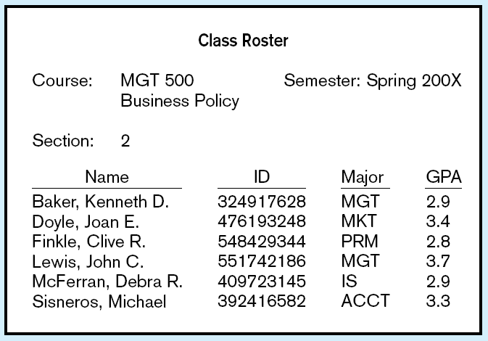
Figure 1-1a Data in context
Context helps users understand data

Slide 5
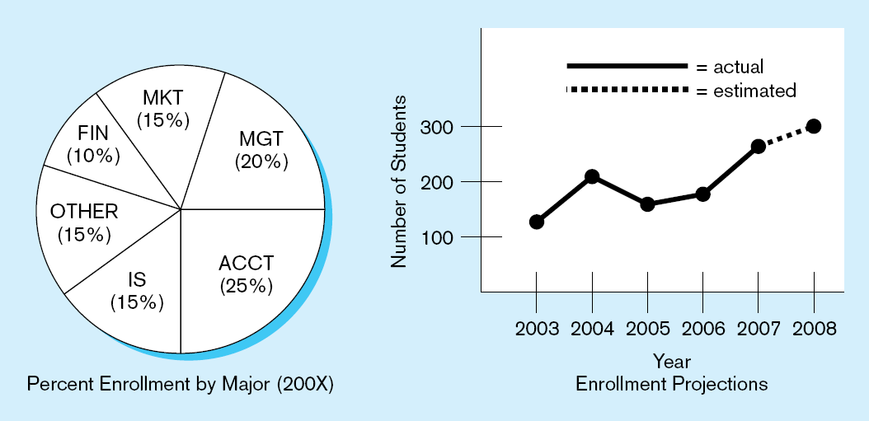
Figure 1-1b Summarized data
Graphical displays turn data into useful information that managers can use for decision making and interpretation

Slide 6
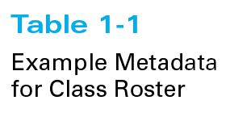
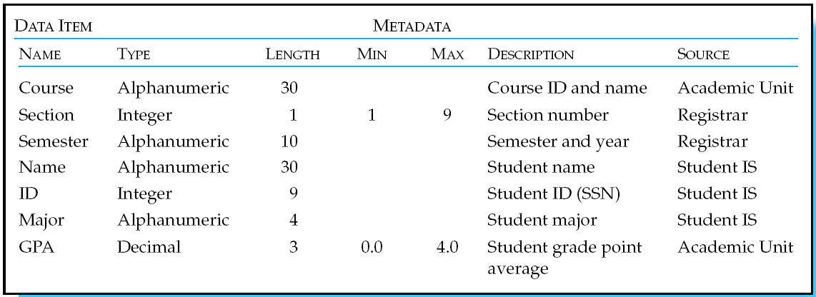
Descriptions of the properties or characteristics of the data, including data types, field sizes, allowable values, and data context

Slide 7
Disadvantages of File Processing
Program-Data Dependence
  All programs maintain metadata for each file they use
Duplication of Data
  Different systems/programs have separate copies of the same data
Limited Data Sharing
  No centralized control of data
Lengthy Development Times
  Programmers must design their own file formats
Excessive Program Maintenance
  80% of information systems budget

Slide 8
Problems with Data Dependency
Each application programmer must maintain his/her own data
Each application program needs to include code for the metadata of each file
Each application program must have its own processing routines for reading, inserting, updating, and deleting data
Lack of coordination and central control
Non-standard file formats

Slide 9
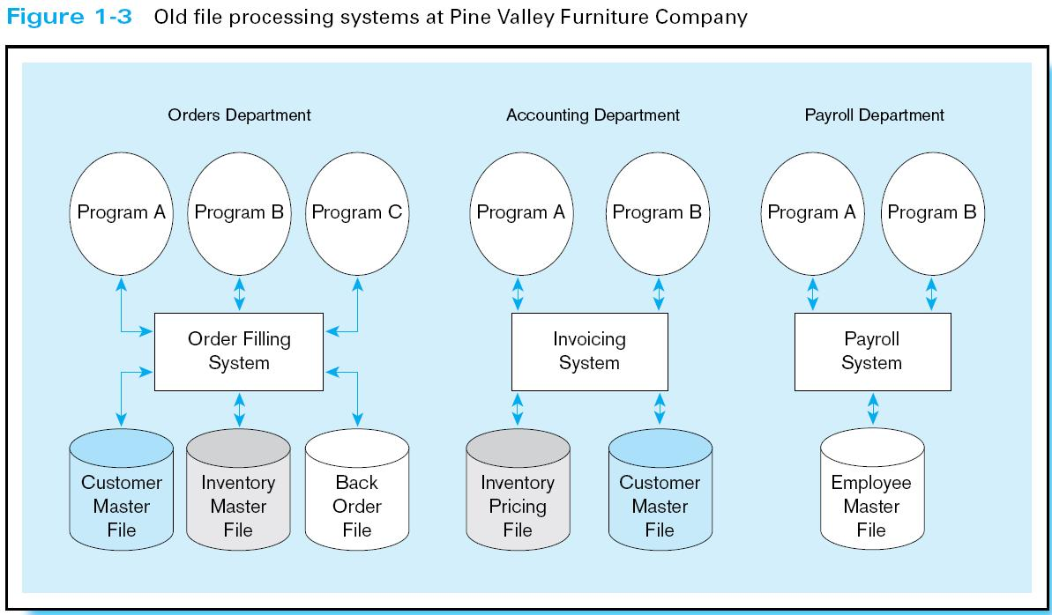
Duplicate Data

Slide 10
Problems with Data Redundancy
Waste of space to have duplicate data
Causes more maintenance headaches
The biggest problem:
  Data changes in one file could cause inconsistencies
  Compromises in data integrity

Slide 11
SOLUTION:
The DATABASE Approach
Central repository of shared data
Data is managed by a controlling agent
Stored in a standardized, convenient form
Requires a Database Management System (DBMS)

Slide 12
Database Management System
A software system that is used to create, maintain, and provide controlled access to user databases
Order Filing
System
Central database
Contains employee,
order, inventory,
pricing, and
customer data
Invoicing
System
DBMS
Payroll
System
DBMS manages data resources like an operating system manages hardware resources

Slide 13
Advantages of the Database Approach
Program-data independence
Planned data redundancy
Improved data consistency
Improved data sharing
Increased application development productivity
Enforcement of standards
Improved data quality
Improved data accessibility and responsiveness
Reduced program maintenance
Improved decision support

Slide 14
Costs and Risks of the Database Approach
New, specialized personnel
Installation and management cost and complexity
Conversion costs
Need for explicit backup and recovery
Organizational conflict

Slide 15
Elements of the Database Approach
Data models
  Graphical system capturing nature and relationship of data
  Enterprise Data Model–high-level entities and relationships for the organization
  Project Data Model–more detailed view, matching data structure in database or data warehouse
Relational Databases
  Database technology involving tables (relations) representing entities and primary/foreign keys representing relationships
Use of Internet Technology
  Networks and telecommunications, distributed databases, client-server, and 3-tier architectures
Database Applications
  Application programs used to perform database activities (create, read, update, and delete) for database users

Slide 16
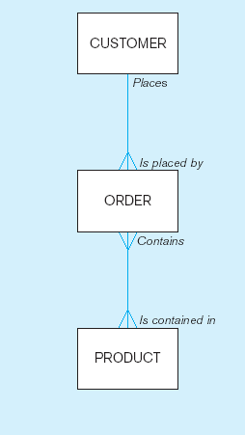
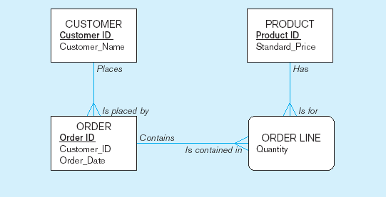
Figure 1-2 Comparison of enterprise and project level data models
Segment of an enterprise data model
Segment of a project-level data model

Slide 17
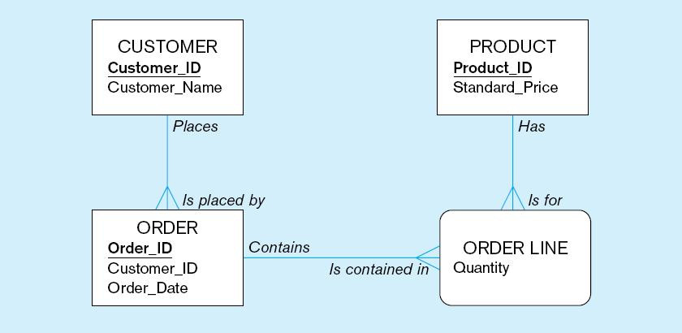
One customer may place many orders, but each order is placed by a single customer
→ One-to-many relationship

Slide 18
One order has many order lines; each order line is associated with a single order
→ One-to-many relationship

Slide 19
One product can be in many order lines, each order line refers to a single product
→ One-to-many relationship

Slide 20
Therefore, one order involves many products and one product is involved in many orders
→ Many-to-many relationship

Slide 21
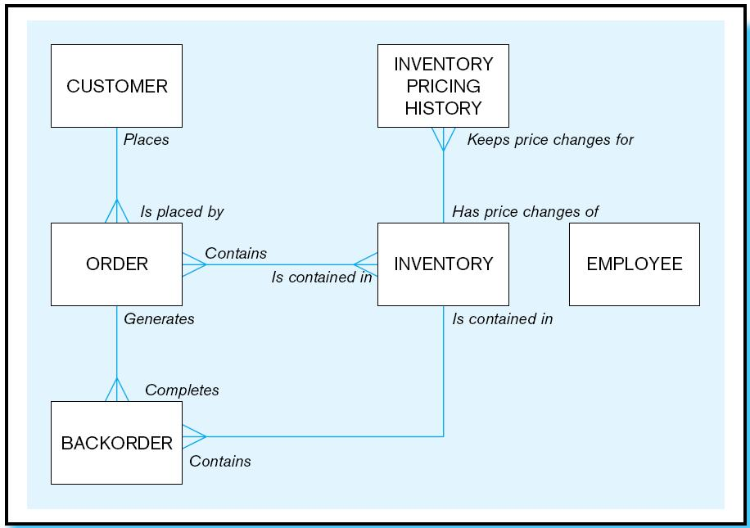
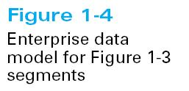

Slide 22
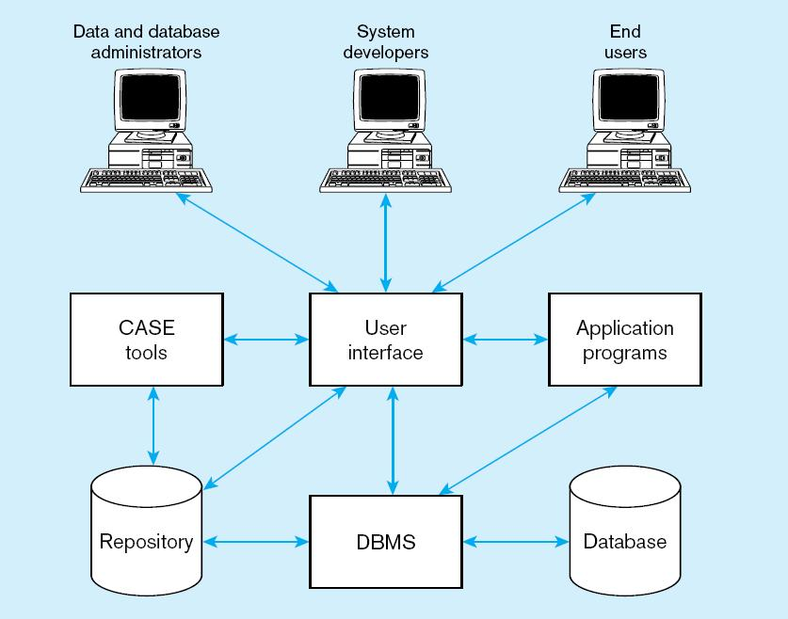
Figure 1-5 Components of the Database Environment

Slide 23
Components of the
Database Environment
CASE Tools–computer-aided software engineering
Repository–centralized storehouse of metadata
Database Management System (DBMS) –software for managing the database
Database–storehouse of the data
Application Programs–software using the data
User Interface–text and graphical displays to users
Data/Database Administrators–personnel responsible for maintaining the database
System Developers–personnel responsible for designing databases and software
End Users–people who use the applications and databases

Slide 24
The Range of Database Applications
Personal databases
Workgroup databases
Departmental/divisional databases
Enterprise database
  Enterprise resource planning (ERP) systems
  Data warehousing implementations

Slide 25
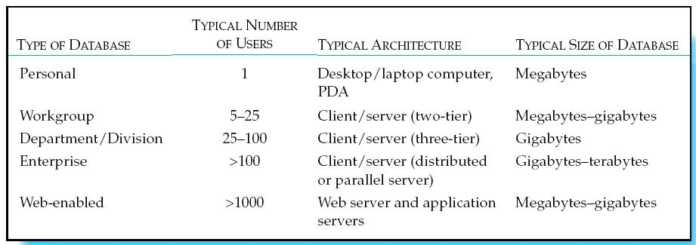
Table 1-6 Summary of Database Applications

Slide 26
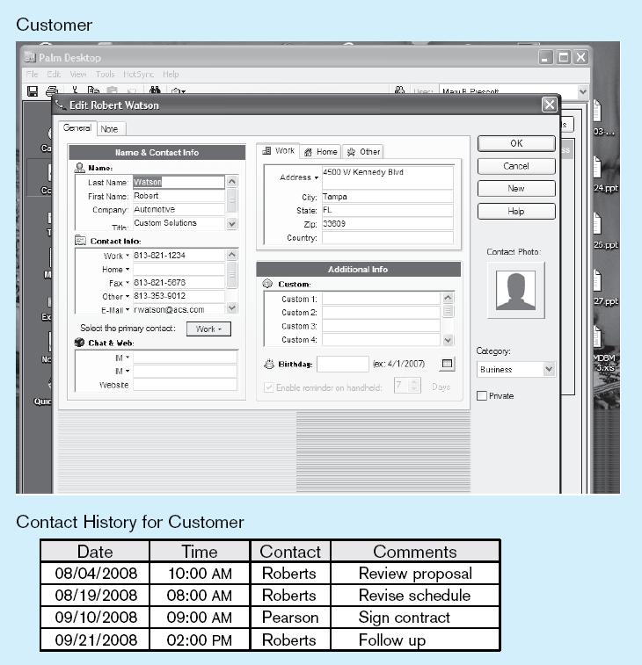
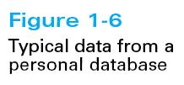

Slide 27
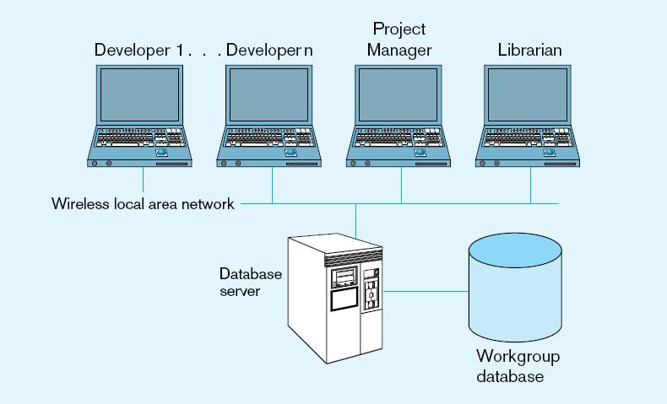
Figure 1-7 Workgroup database with wireless
local area network

Slide 28
Enterprise Database Applications
Enterprise Resource Planning (ERP)
  Integrate all enterprise functions (manufacturing, finance, sales, marketing, inventory, accounting, human resources)
Data Warehouse
  Integrated decision support system derived from various operational databases

Slide 29
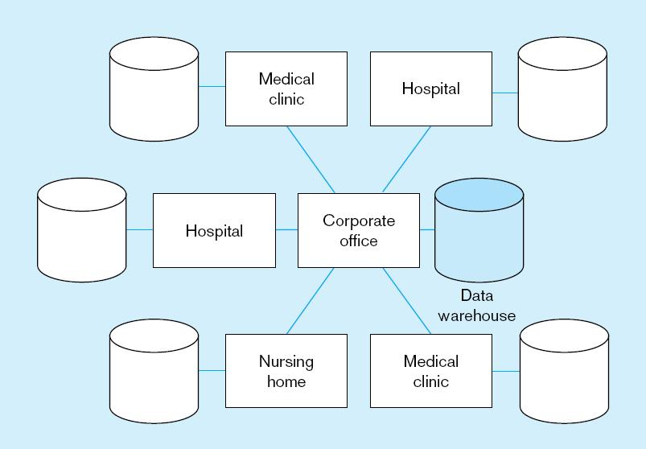
Figure 1-8 An enterprise data warehouse

Slide 30
Web-Enabled Databases
Web applications requiring databases
  Customer relationship management (CRM)
  Business-to-consumer (B2C)
  Electronic data interchange (EDI)
  Private intranets
  XML-defined Web services

Slide 31
Web-Enabled Databases (cont.)
Issues to consider
  Which technologies to use?
  Security/privacy protection
  Managing huge volumes of data from Internet transactions
  Maintaining data quality

Slide 32
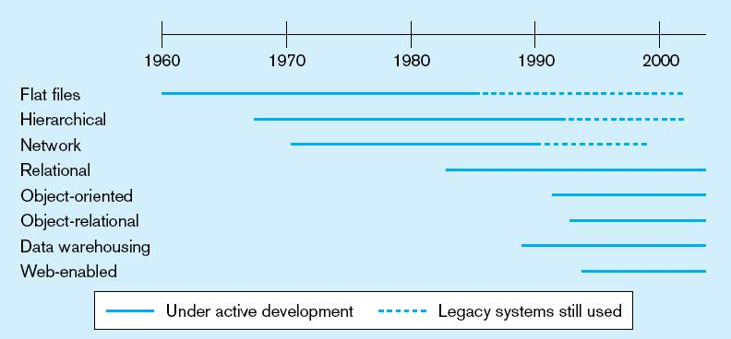
Figure 1-9 Evolution of database technologies

Slide 33

All rights reserved. No part of this publication may be reproduced, stored in a retrieval system, or transmitted, in any form or by any means, electronic, mechanical, photocopying, recording, or otherwise, without the prior written permission of the publisher. Printed in the United States of America.
Copyright © 2009 Pearson Education, Inc. Publishing as Prentice Hall

