Slide 1
Chapter 2:
The Database Development Process
Modern Database Management
9th Edition
Jeffrey A. Hoffer, Mary B. Prescott,
Heikki Topi
© 2009 Pearson Education, Inc. Publishing as Prentice Hall

Slide 2
Objectives
Definition of terms
Describe system development life cycle
Explain prototyping approach
Explain agile software development approach
Explain roles of individuals
Explain three-schema approach
Explain role of packaged data models
Explain three-tiered architectures
Explain scope of database design projects
Draw simple data models

Slide 3
Enterprise Data Model
First step in database development
Specifies scope and general content
Overall picture of organizational data at high level of abstraction
Entity-relationship diagram
Descriptions of entity types
Relationships between entities
Business rules

Slide 4
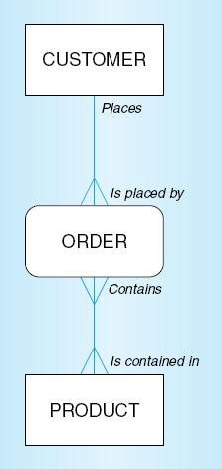
Figure 2-1 Segment from enterprise data model
Enterprise data model describes the high-level entities in an organization and the relationship between these entities

Slide 5
Information Systems Architecture
(ISA)
Conceptual blueprint for organization’s desired information systems structure
Consists of:
  Data (e.g. Enterprise Data Model–simplified ER Diagram)
  Processes–data flow diagrams, process decomposition, etc.
  Data Network–topology diagram (like Fig 1-7)
  People–people management using project management tools (Gantt charts, etc.)
  Events and points in time (when processes are performed)
  Reasons for events and rules (e.g., decision tables)

Slide 6
Information Engineering
A data-oriented methodology to create and maintain information systems
Top-down planning–a generic IS planning methodology for obtaining a broad understanding of the IS needed by the entire organization
Four steps to Top-Down planning:
  Planning
  Analysis
  Design
  Implementation

Slide 7
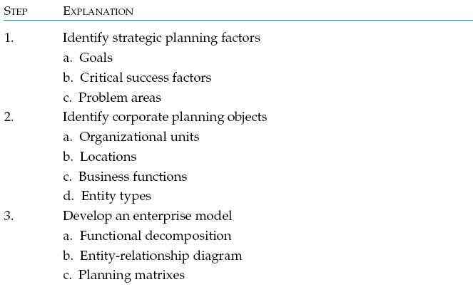
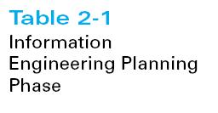

Slide 8
Identify Strategic Planning Factors (Table 2-2)
Organization goals–what we hope to accomplish
Critical success factors–what MUST work in order for us to survive
Problem areas–weaknesses we now have

Slide 9
Identify Corporate Planning Objects (Table 2-3)
Organizational units–departments
Organizational locations
Business functions–groups of business processes
Entity types–the things we are trying to model for the database
Information systems–application programs

Slide 10
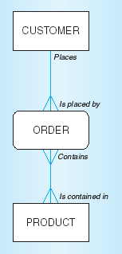
Develop Enterprise Model
Functional decomposition
  Iterative process breaking system description into finer and finer detail
Enterprise data model
Planning matrixes
  Describe interrelationships
  between planning objects

Slide 11
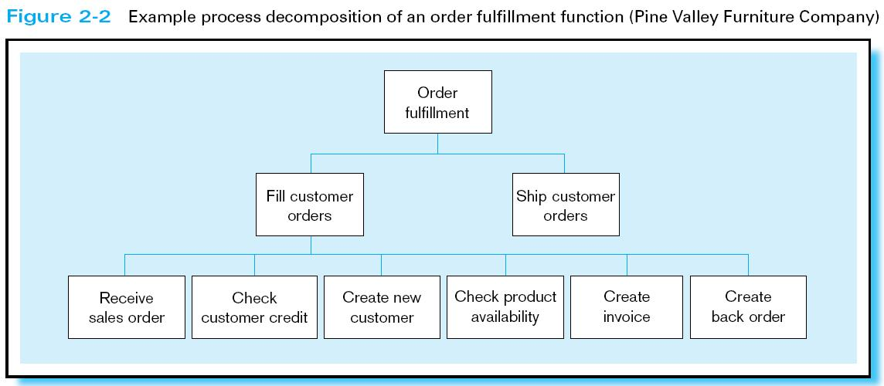

Slide 12
Planning Matrixes
Describe relationships between planning objects in the organization
Types of matrixes:
  Location-to-function
  Unit-to-function
  IS-to-data entity
  Supporting function-to-data entity
  IS-to-business objective

Slide 13
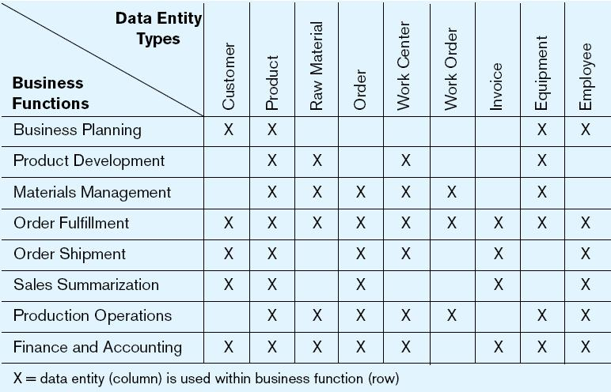
Example Business Function-to-Data Entity Matrix (Fig. 2-3)

Slide 14
Two Approaches to Database and IS Development
SDLC
  System Development Life Cycle
  Detailed, well-planned development process
  Time-consuming, but comprehensive
  Long development cycle
Prototyping
  Rapid application development (RAD)
  Cursory attempt at conceptual data modeling
  Define database during development of initial prototype
  Repeat implementation and maintenance activities with new prototype versions

Slide 15
Systems Development Life Cycle
(see also Figures 2.4, 2.5)
Planning
Analysis
Logical Design
Physical Design
Implementation
Maintenance

Slide 16
Systems Development Life Cycle
(see also Figures 2.4, 2.5) (cont.)
Planning
Purpose–preliminary understanding
Deliverable–request for study
Planning
Analysis
Logical Design
Physical Design
Database activity–
enterprise modeling and early conceptual data modeling
Implementation
Maintenance

Slide 17
Systems Development Life Cycle
(see also Figures 2.4, 2.5) (cont.)
Purpose–thorough requirements analysis and structuring
Deliverable–functional system specifications
Planning
Analysis
Analysis
Logical Design
Physical Design
Database activity–thorough and integrated conceptual data modeling
Implementation
Maintenance

Slide 18
Systems Development Life Cycle
(see also Figures 2.4, 2.5) (cont.)
Purpose–information requirements elicitation and structure
Deliverable–detailed design specifications
Planning
Analysis
Logical Design
Logical Design
Physical Design
Database activity–
logical database design (transactions, forms, displays, views, data integrity and security)
Implementation
Maintenance

Slide 19
Systems Development Life Cycle
(see also Figures 2.4, 2.5) (cont.)
Purpose–develop technology and organizational specifications
Deliverable–program/data structures, technology purchases, organization redesigns
Planning
Analysis
Logical Design
Physical Design
Physical Design
Database activity–
physical database design (define database to DBMS, physical data organization, database processing programs)
Implementation
Maintenance

Slide 20
Systems Development Life Cycle
(see also Figures 2.4, 2.5) (cont.)
Purpose–programming, testing, training, installation, documenting
Deliverable–operational programs, documentation, training materials
Planning
Analysis
Logical Design
Physical Design
Database activity–
database implementation, including coded programs, documentation, installation and conversion
Implementation
Implementation
Maintenance

Slide 21
Systems Development Life Cycle
(see also Figures 2.4, 2.5) (cont.)
Planning
Purpose–monitor, repair, enhance
Deliverable–periodic audits
Analysis
Logical Design
Physical Design
Database activity–
database maintenance, performance analysis and tuning, error corrections
Implementation
Maintenance
Maintenance

Slide 22
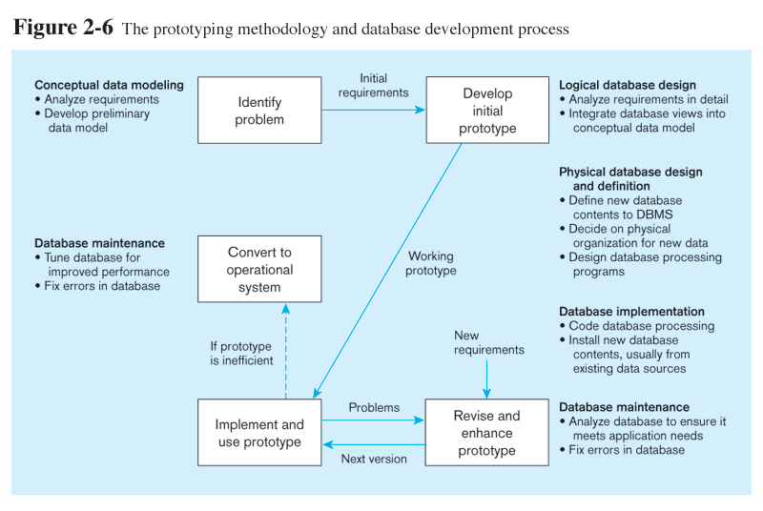
Prototyping Database Methodology
(Figure 2.6)

Slide 23
Prototyping Database Methodology
(Figure 2.6) (cont.)

Slide 24
Prototyping Database Methodology
(Figure 2.6) (cont.)

Slide 25
Prototyping Database Methodology
(Figure 2.6) (cont.)

Slide 26
Prototyping Database Methodology
(Figure 2.6) (cont.)

Slide 27
CASE
Computer-Aided Software Engineering (CASE)–software tools providing automated support for systems development
Three database features:
  Data modeling–drawing entity-relationship diagrams
  Code generation–SQL code for table creation
  Repositories–knowledge base of enterprise information

Slide 28
Packaged Data Models
Model components that can be purchased, customized, and assembled into full-scale data models
Advantages
  Reduced development time
  Higher model quality and reliability
Two types:
  Universal data models
  Industry-specific data models

Slide 29
Managing Projects
Project–a planned undertaking of related activities to reach an objective that has a beginning and an end
Involves use of review points for:
  Validation of satisfactory progress
  Step back from detail to overall view
  Renew commitment of stakeholders
Incremental commitment–review of systems development project after each development phase with rejustification after each phase

Slide 30
Managing Projects: People Involved
Business analysts
Systems analysts
Database analysts and data modelers
Users
Programmers
Database architects
Data administrators
Project managers
Other technical experts

Slide 31
Database Schema
External Schema
  User Views
  Subsets of Conceptual Schema
  Can be determined from business-function/data entity matrices
  DBA determines schema for different users
Conceptual Schema
  E-R models–covered in Chapters 3 and 4
Internal Schema
  Logical structures–covered in Chapter 5
  Physical structures–covered in Chapter 6

Slide 32
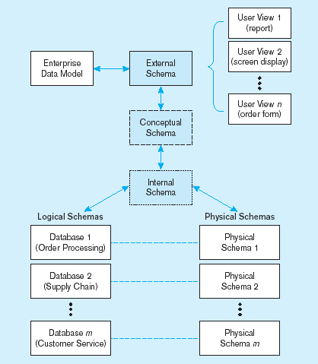
Figure 2-7 Three-schema architecture
Different people have different views of the database…these are the external schema
The internal schema is the underlying design and implementation

Slide 33
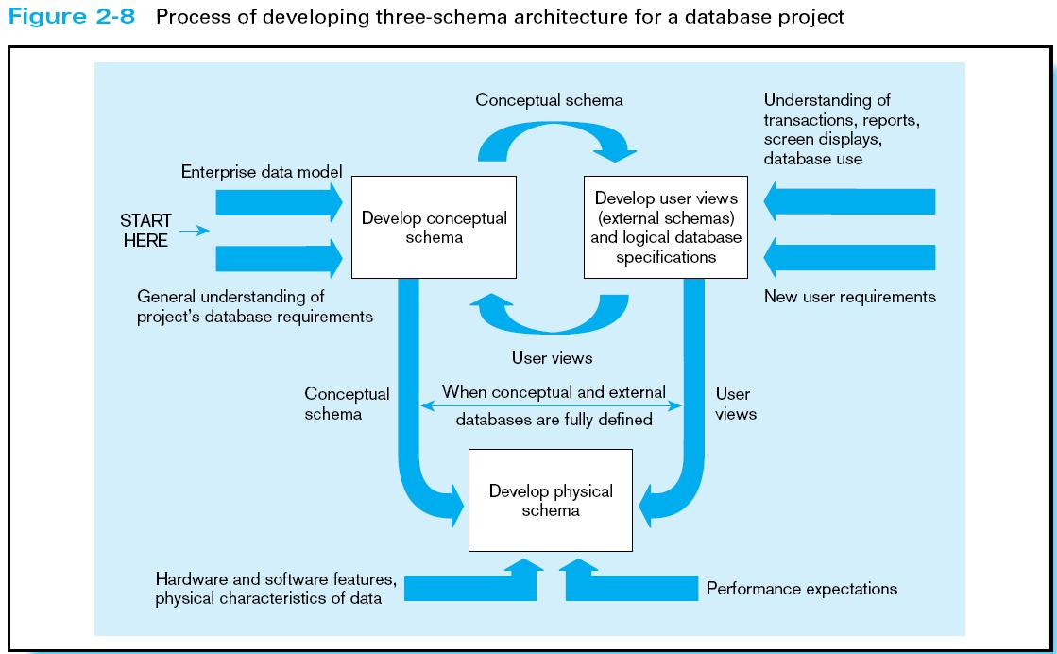

Slide 34
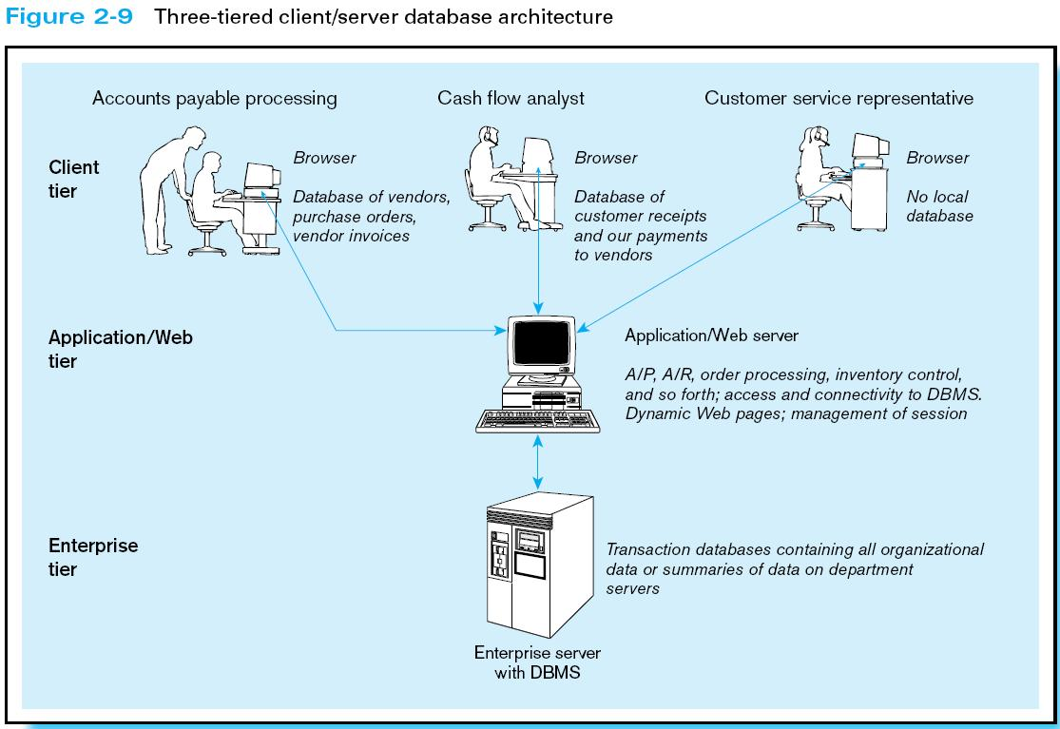

Slide 35
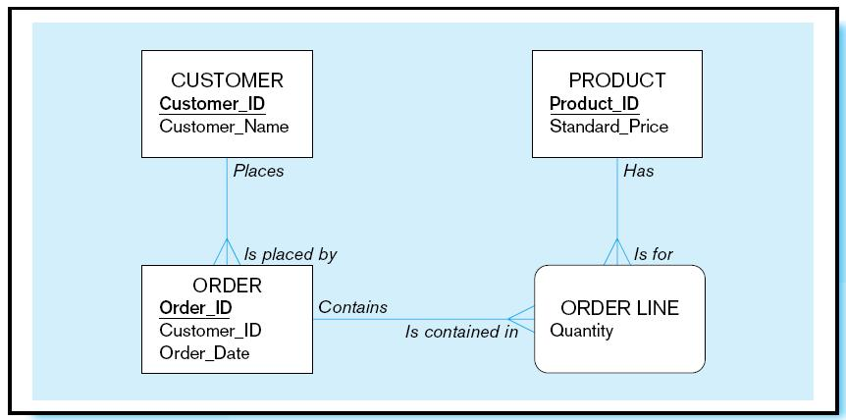
Pine Valley Furniture
Segment of project data model (Figure 2-11)

Slide 36
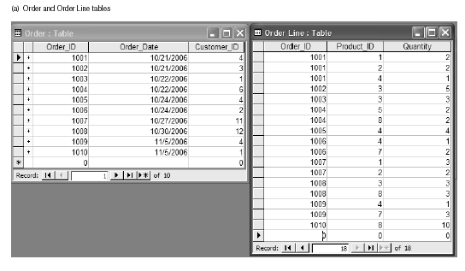
Figure 2-12 Four relations (Pine Valley Furniture)

Slide 37
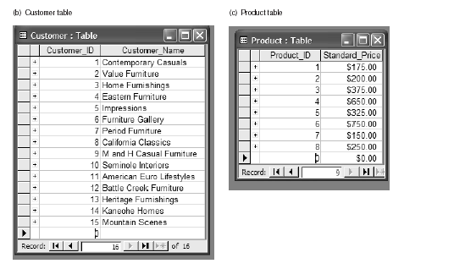
Figure 2-12 Four relations (Pine Valley Furniture) (cont.)

Slide 38

All rights reserved. No part of this publication may be reproduced, stored in a retrieval system, or transmitted, in any form or by any means, electronic, mechanical, photocopying, recording, or otherwise, without the prior written permission of the publisher. Printed in the United States of America.
Copyright © 2009 Pearson Education, Inc. Publishing as Prentice Hall

