Slide 1
Chapter 6:
Physical Database Design and Performance
Modern Database Management
9th Edition
Jeffrey A. Hoffer, Mary B. Prescott,
Heikki Topi
© 2009 Pearson Education, Inc. Publishing as Prentice Hall

Slide 2
Objectives
Definition of terms
Describe the physical database design process
Choose storage formats for attributes
Select appropriate file organizations
Describe three types of file organization
Describe indexes and their appropriate use
Translate a database model into efficient structures
Know when and how to use denormalization

Slide 3
Physical Database Design
Purpose–translate the logical description of data into the technical specifications for storing and retrieving data
Goal–create a design for storing data that will provide adequate performance and insure database integrity, security, and recoverability

Slide 4
Physical Design Process
Inputs
Decisions
Normalized relations
Volume estimates
Attribute definitions
Response time expectations
Data security needs
Backup/recovery needs
Integrity expectations
DBMS technology used
Attribute data types
Physical record descriptions (doesn’t always match logical design)
File organizations
Indexes and database architectures
Query optimization
Leads to

Slide 5
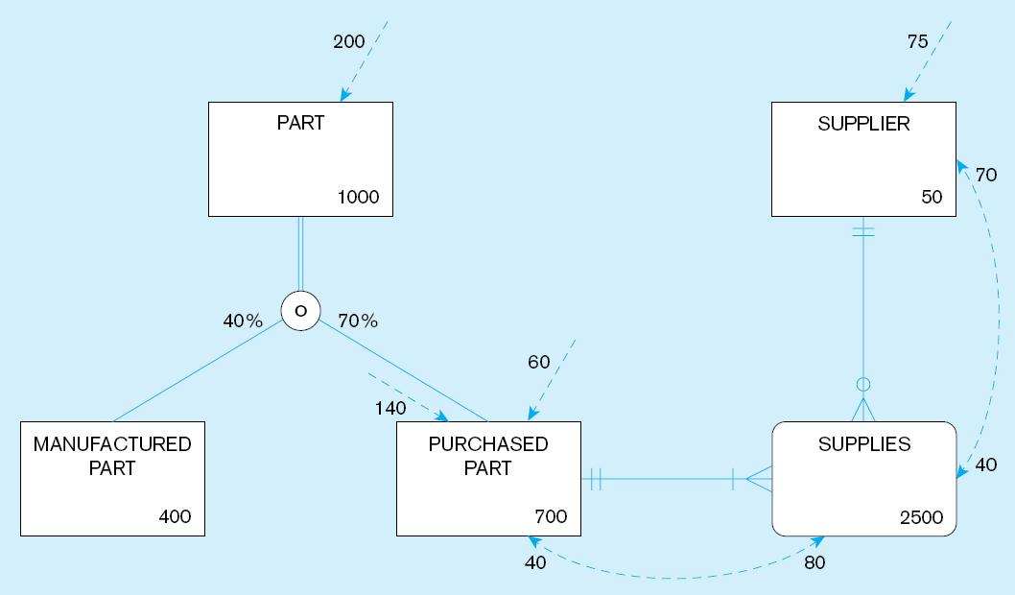
Figure 6-1 Composite usage map
(Pine Valley Furniture Company)

Slide 6
Figure 6-1 Composite usage map
(Pine Valley Furniture Company) (cont.)
Data volumes

Slide 7
Figure 6-1 Composite usage map
(Pine Valley Furniture Company) (cont.)
Access Frequencies (per hour)

Slide 8
Figure 6-1 Composite usage map
(Pine Valley Furniture Company) (cont.)
Usage analysis:
140 purchased parts accessed per hour ➔
80 quotations accessed from these 140 purchased part accesses ➔
70 suppliers accessed from these 80 quotation accesses

Slide 9
Figure 6-1 Composite usage map
(Pine Valley Furniture Company) (cont.)
Usage analysis:
75 suppliers accessed per hour ➔
40 quotations accessed from these 75 supplier accesses ➔
40 purchased parts accessed from these 40 quotation accesses

Slide 10
Designing Fields
Field: smallest unit of data in database
Field design
  Choosing data type
  Coding, compression, encryption
  Controlling data integrity

Slide 11
Choosing Data Types
CHAR–fixed-length character
VARCHAR2–variable-length character (memo)
LONG–large number
NUMBER–positive/negative number
INEGER–positive/negative whole number
DATE–actual date
BLOB–binary large object (good for graphics, sound clips, etc.)

Slide 12
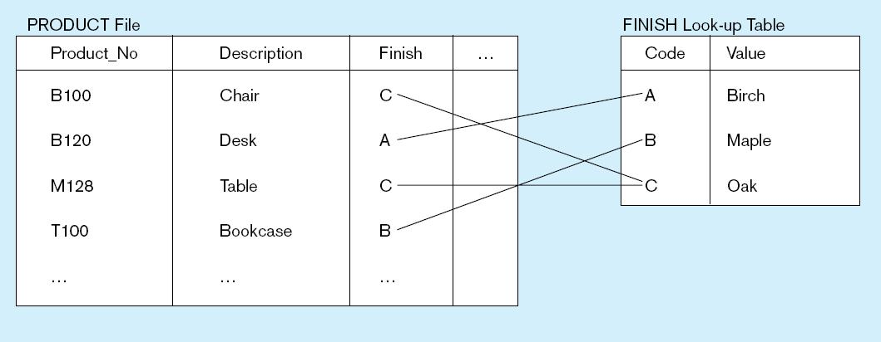
Figure 6-2 Example code look-up table
(Pine Valley Furniture Company)
Code saves space, but costs an additional lookup to obtain actual value

Slide 13
Field Data Integrity
Default value–assumed value if no explicit value
Range control–allowable value limitations (constraints or validation rules)
Null value control–allowing or prohibiting empty fields
Referential integrity–range control (and null value allowances) for foreign-key to primary-key match-ups
Sarbanes-Oxley Act (SOX) legislates importance of financial data integrity

Slide 14
Handling Missing Data
Substitute an estimate of the missing value (e.g., using a formula)
Construct a report listing missing values
In programs, ignore missing data unless the value is significant (sensitivity testing)
Triggers can be used to perform these operations

Slide 15
Physical Records
Physical Record: A group of fields stored in adjacent memory locations and retrieved together as a unit
Page: The amount of data read or written in one I/O operation
Blocking Factor: The number of physical records per page

Slide 16
Denormalization
Transforming normalized relations into unnormalized physical record specifications
Benefits:
  Can improve performance (speed) by reducing number of table lookups (i.e. reduce number of necessary join queries)
Costs (due to data duplication)
  Wasted storage space
  Data integrity/consistency threats
Common denormalization opportunities
  One-to-one relationship (Fig. 6-3)
  Many-to-many relationship with attributes (Fig. 6-4)
  Reference data (1:N relationship where 1-side has data not used in any other relationship) (Fig. 6-5)

Slide 17
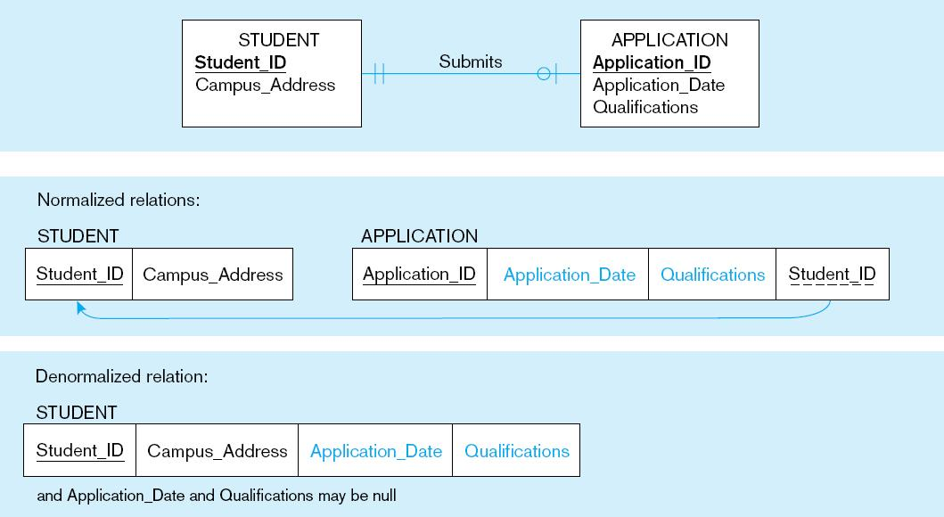
Figure 6-3 A possible denormalization situation: two entities with one-to-one relationship

Slide 18
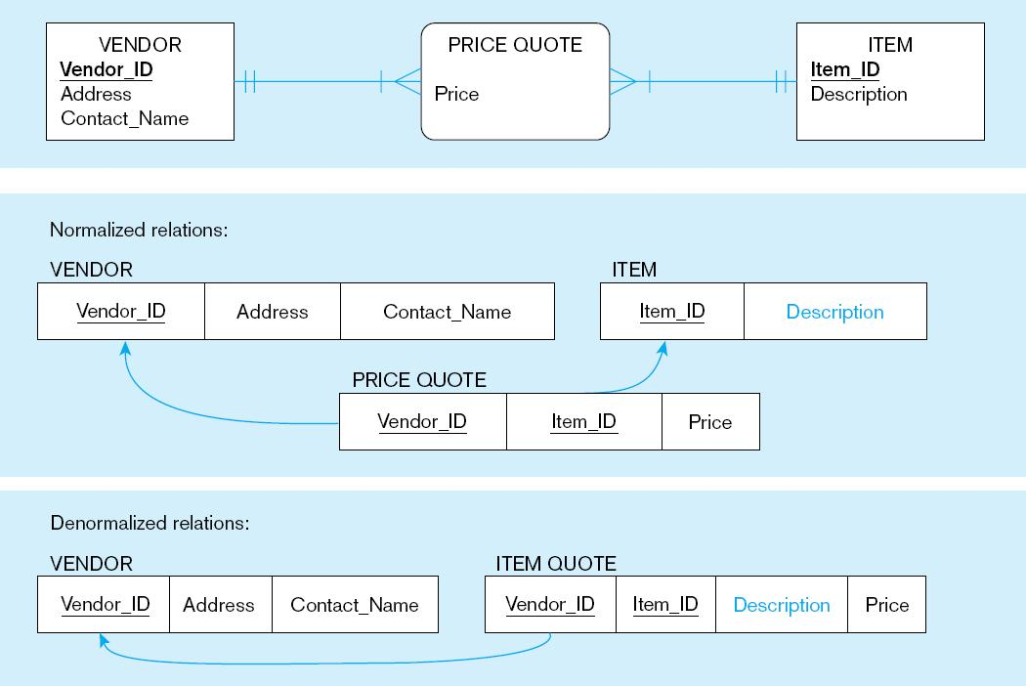
Figure 6-4 A possible denormalization situation: a many-to-many relationship with nonkey attributes
Extra table access required
Null description possible

Slide 19
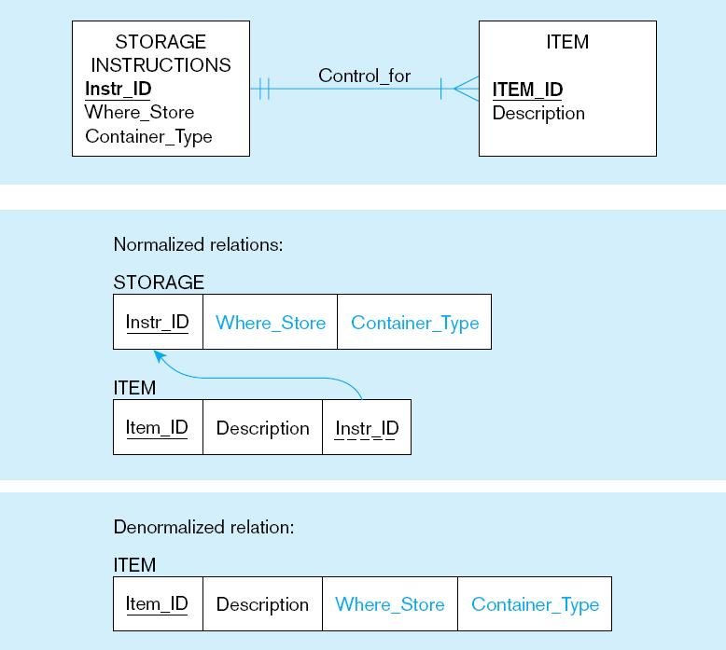
Figure 6-5
A possible denormalization situation:
reference data
Extra table access required
Data duplication

Slide 20
Partitioning
Horizontal Partitioning: Distributing the rows of a table into several separate files
  Useful for situations where different users need access to different rows
  Three types: Key Range Partitioning, Hash Partitioning, or Composite Partitioning
Vertical Partitioning: Distributing the columns of a table into several separate relations
  Useful for situations where different users need access to different columns
  The primary key must be repeated in each file
Combinations of Horizontal and Vertical
Partitions often correspond with User Schemas (user views)

Slide 21
Partitioning (cont.)
Advantages of Partitioning:
  Efficiency: Records used together are grouped together
  Local optimization: Each partition can be optimized for performance
  Security, recovery
  Load balancing: Partitions stored on different disks, reduces contention
  Take advantage of parallel processing capability
Disadvantages of Partitioning:
  Inconsistent access speed: Slow retrievals across partitions
  Complexity: Non-transparent partitioning
  Extra space or update time: Duplicate data; access from multiple partitions

Slide 22
Oracle 10i Horizontal Partitioning Methods
Key range partitioning
  Partitions defined by range of field values
  Could result in unbalanced distribution of rows
  Like-valued fields share partitions
Hash partitioning
  Partitions defined via hash functions
  Will guarantee balanced distribution of rows
  Partition could contain widely varying valued fields
Composite partitioning
  Combines key range and hash

Slide 23
Data Replication
Purposely storing the same data in multiple locations of the database
Improves performance by allowing multiple users to access the same data at the same time with minimum contention
Sacrifices data integrity due to data duplication
Best for data that is not updated often

Slide 24
Designing Physical Files
Physical File:
  A named portion of secondary memory allocated for the purpose of storing physical records
  Tablespace–named set of disk storage elements in which physical files for database tables can be stored
  Extent–contiguous section of disk space
Constructs to link two pieces of data:
  Sequential storage
  Pointers–field of data that can be used to locate related fields or records

Slide 25
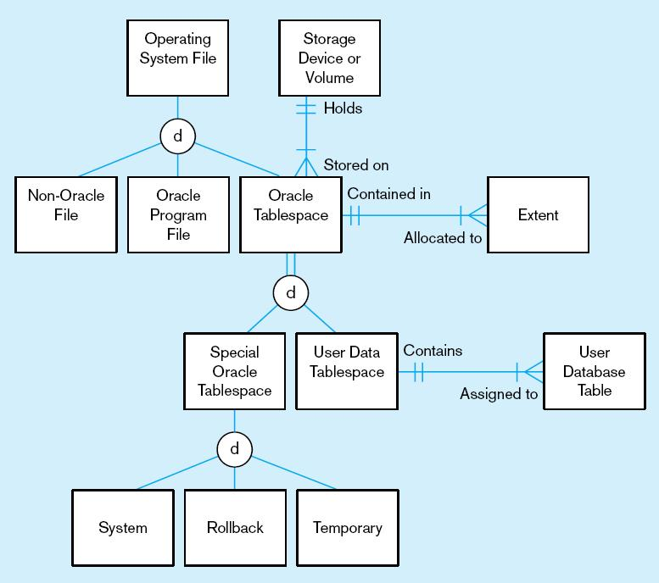
Figure 6-6 Physical file terminology in an Oracle environment

Slide 26
File Organizations
Technique for physically arranging records of a file on secondary storage
Factors for selecting file organization:
  Fast data retrieval and throughput
  Efficient storage space utilization
  Protection from failure and data loss
  Minimizing need for reorganization
  Accommodating growth
  Security from unauthorized use
Types of file organizations
  Sequential
  Indexed
  Hashed

Slide 27
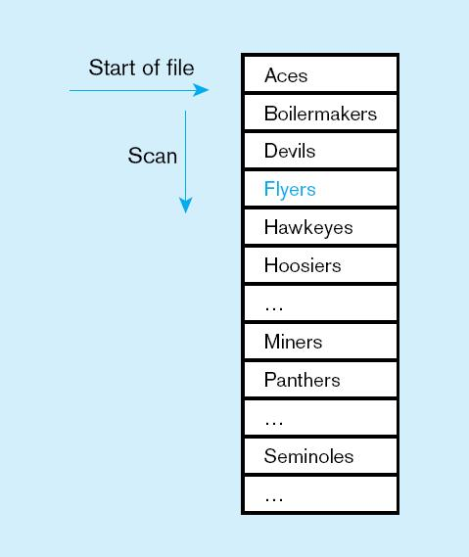
Figure 6-7a Sequential file organization
1
2
Records of the file are stored in sequence by the primary key field values
If sorted – every insert or delete requires resort
If not sorted
Average time to find desired record = n/2
n

Slide 28
Indexed File Organizations
Index–a separate table that contains organization of records for quick retrieval
Primary keys are automatically indexed
Oracle has a CREATE INDEX operation, and MS ACCESS allows indexes to be created for most field types
Indexing approaches:
  B-tree index, Fig. 6-7b
  Bitmap index, Fig. 6-8
  Hash Index, Fig. 6-7c
  Join Index, Fig 6-9

Slide 29
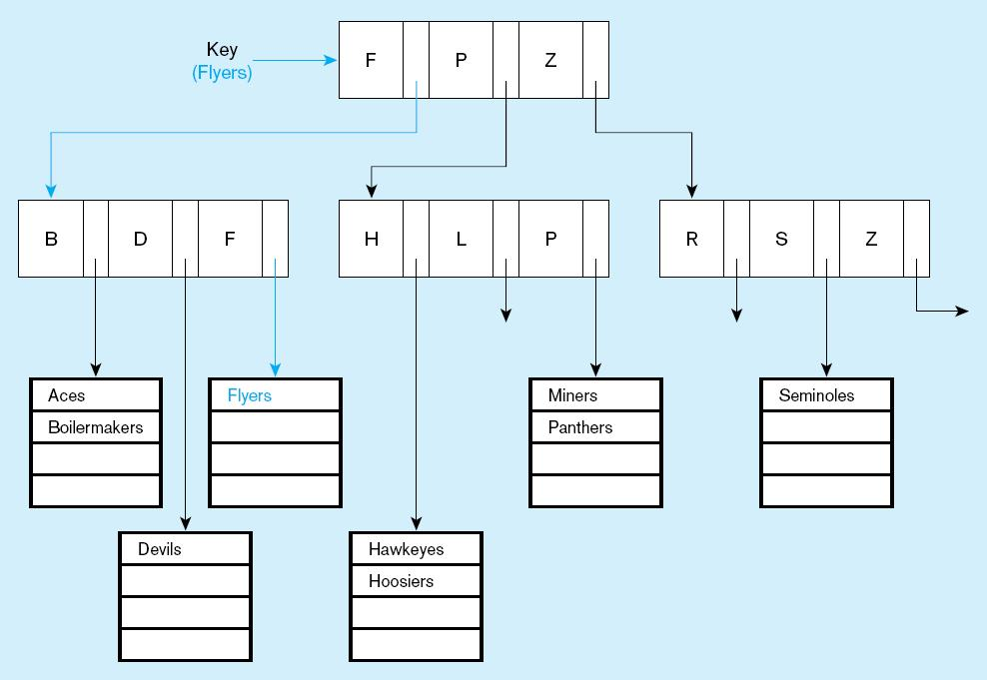
Figure 6-7b B-tree index
Leaves of the tree are all at same level →
consistent access time
uses a tree search
Average time to find desired record = depth of the tree

Slide 30
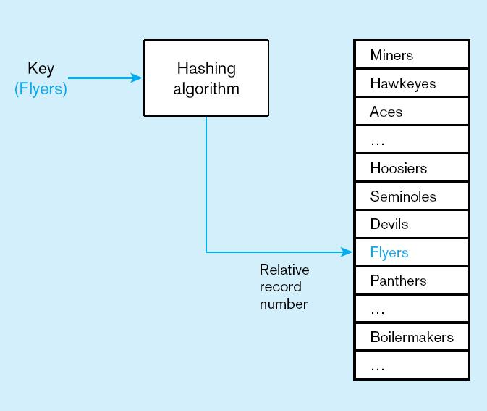
Figure 6-7c
Hashed file or index organization
Hash algorithm
Usually uses division-remainder to determine record position. Records with same position are grouped in lists

Slide 31
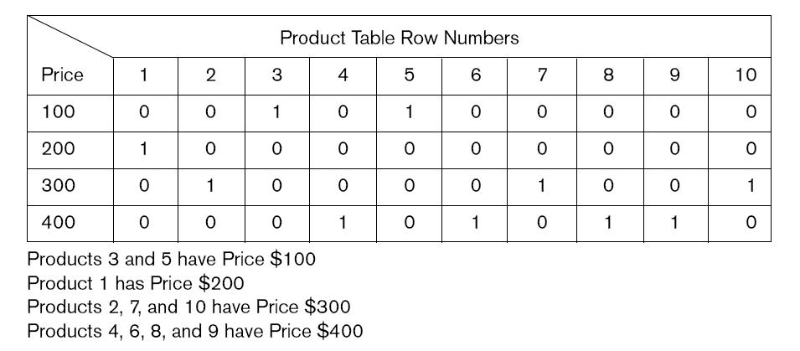
Figure 6-8
Bitmap index organization
Bitmap saves on space requirements
Rows - possible values of the attribute
Columns - table rows
Bit indicates whether the attribute of a row has the values

Slide 32
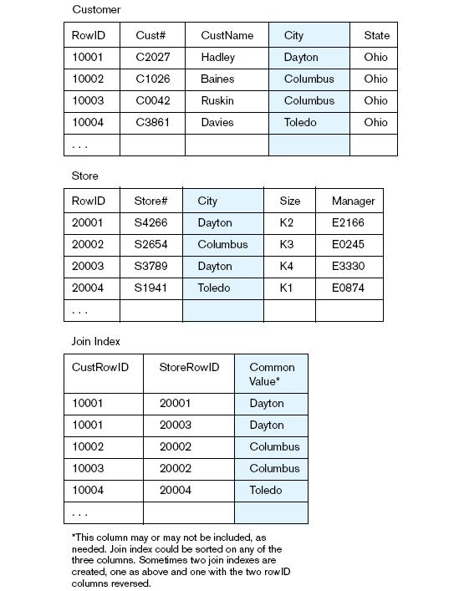
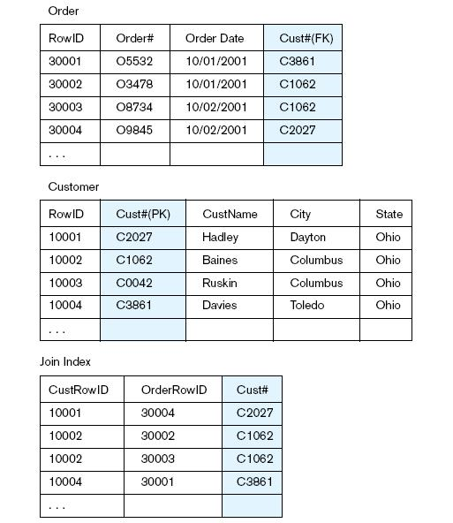
Figure 6-9 Join Indexes–speeds up join operations

Slide 33
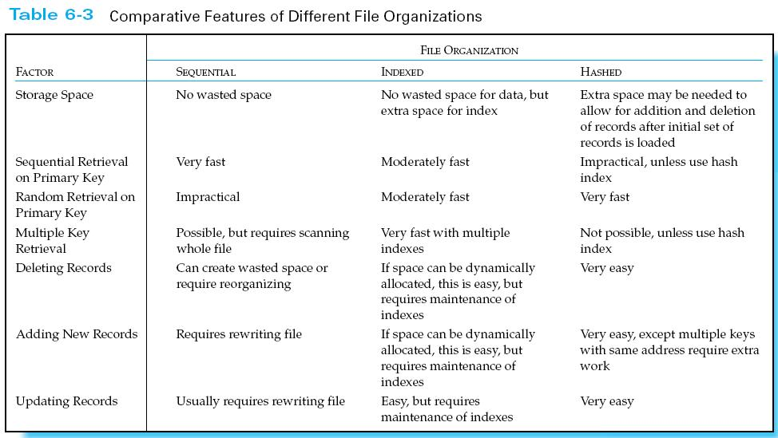

Slide 34
Clustering Files
In some relational DBMSs, related records from different tables can be stored together in the same disk area
Useful for improving performance of join operations
Primary key records of the main table are stored adjacent to associated foreign key records of the dependent table
e.g. Oracle has a CREATE CLUSTER command

Slide 35
Rules for Using Indexes
Use on larger tables
Index the primary key of each table
Index search fields (fields frequently in WHERE clause)
Fields in SQL ORDER BY and GROUP BY commands
When there are >100 values but not when there are <30 values

Slide 36
Rules for Using Indexes (cont.)
Avoid use of indexes for fields with long values; perhaps compress values first
DBMS may have limit on number of indexes per table and number of bytes per indexed field(s)
Null values will not be referenced from an index
Use indexes heavily for non-volatile databases; limit the use of indexes for volatile databases
  Why? Because modifications (e.g. inserts, deletes) require updates to occur in index files

Slide 37
RAID
Redundant Array of Inexpensive Disks
A set of disk drives that appear to the user to be a single disk drive
Allows parallel access to data (improves access speed)
Pages are arranged in stripes

Slide 38
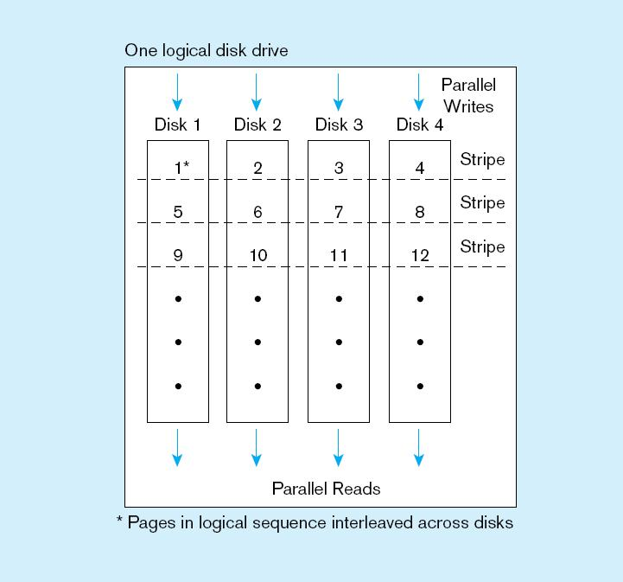
Figure 6-10
  RAID with four disks and striping
Here, pages 1-4 can be read/written simultaneously

Slide 39
Raid Types (Figure 6-10)
Raid 0
  Maximized parallelism
  No redundancy
  No error correction
  no fault-tolerance
Raid 1
  Redundant data–fault tolerant
  Most common form
Raid 2
  No redundancy
  One record spans across data disks
  Error correction in multiple disks–reconstruct damaged data
Raid 3
  Error correction in one disk
  Record spans multiple data disks (more than RAID2)
  Not good for multi-user environments,
Raid 4
  Error correction in one disk
  Multiple records per stripe
  Parallelism, but slow updates due to error correction contention
Raid 5
  Rotating parity array
  Error correction takes place in same disks as data storage
  Parallelism, better performance than Raid4

Slide 40
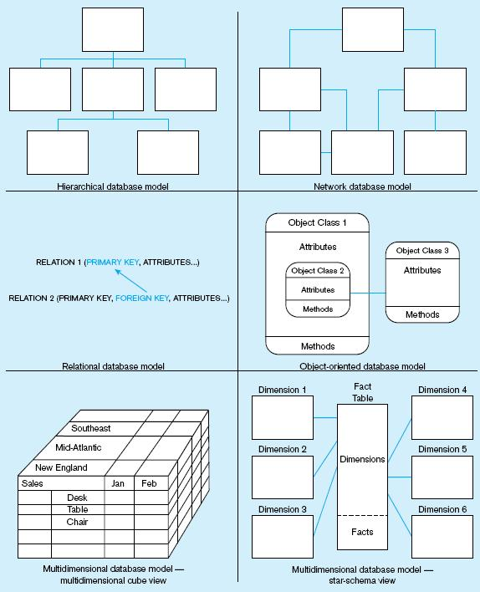
Database Architectures (Figure 6-11)
Legacy
Systems
Current
Technology
Data
Warehouses

Slide 41
Query Optimization
Parallel query processing – possible when working in multiprocessor systems
Overriding automatic query optimization – allows for query writers to preempt the automated optimization
Picking data block size – factors to consider include:
  Block contention, random and sequential row access speed, row size
Balancing I/O across disk controllers

Slide 42
Query Design Guidelines
Understand how indexes are used
Keep optimization statistics up-to-date
Use compatible data types for fields and literals
Write simple queries
Break complex queries into multiple, simple parts
Don’t use one query inside another
Don’t combine a table with itself

Slide 43
Query Design Guidelines (cont.)
Create temporary tables for groups of queries
Combine update operations
Retrieve only the data you need
Don’t have the DBMS sort without an index
Learn!
Consider the total query processing time for ad hoc queries

Slide 44

All rights reserved. No part of this publication may be reproduced, stored in a retrieval system, or transmitted, in any form or by any means, electronic, mechanical, photocopying, recording, or otherwise, without the prior written permission of the publisher. Printed in the United States of America.
Copyright © 2009 Pearson Education, Inc. Publishing as Prentice Hall

