Slide 1
Chapter 8:
Advanced SQL
Modern Database Management
9th Edition
Jeffrey A. Hoffer, Mary B. Prescott,
Heikki Topi
© 2009 Pearson Education, Inc. Publishing as Prentice Hall

Slide 2
Objectives
Definition of terms
Write single and multiple table SQL queries
Define and use three types of joins
Write noncorrelated and correlated subqueries
Establish referential integrity in SQL
Understand triggers and stored procedures
Discuss SQL:200n standard and its extension of SQL-92
Understand SQL use for OLTP and OLAP

Slide 3
Processing Multiple Tables–Joins
Join–a relational operation that causes two or more tables with a common domain to be combined into a single table or view
Equi-join–a join in which the joining condition is based on equality between values in the common columns; common columns appear redundantly in the result table
Natural join–an equi-join in which one of the duplicate columns is eliminated in the result table
Outer join–a join in which rows that do not have matching values in common columns are nonetheless included in the result table (as opposed to inner join, in which rows must have matching values in order to appear in the result table)
Union join–includes all columns from each table in the join, and an instance for each row of each table
The common columns in joined tables are usually the primary key of the dominant table and the foreign key of the dependent table in 1:M relationships

Slide 4
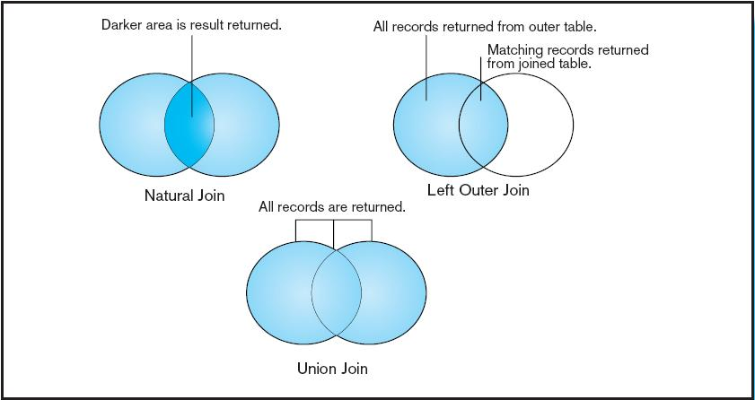
Figure 8-2
Visualization of different join types with results returned in shaded area

Slide 5
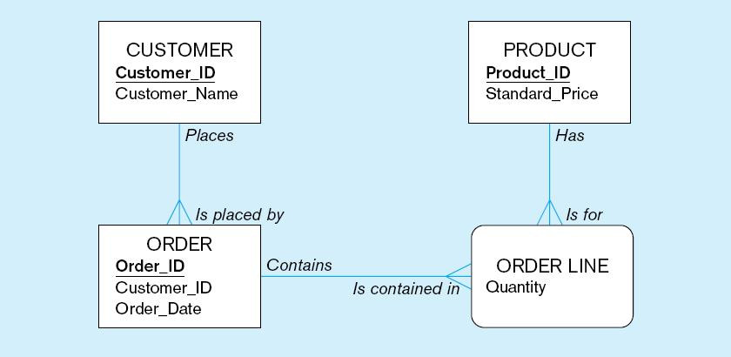
The following slides create tables for this enterprise data model

Slide 6
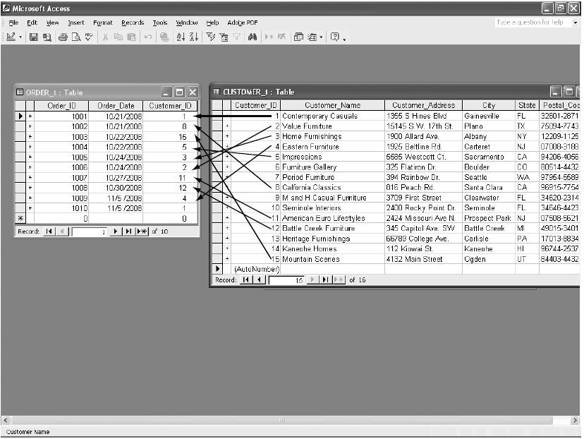
Figure 8-1 Pine Valley Furniture Company Customer and Order tables with pointers from customers to their orders
These tables are used in queries that follow

Slide 7
Natural Join Example
For each customer who placed an order, what is the customer’s name and order number?
  SELECT CUSTOMER_T.CUSTOMER_ID, CUSTOMER_NAME, ORDER_ID
  FROM CUSTOMER_T NATURAL JOIN ORDER_T ON
  CUSTOMER_T.CUSTOMER_ID = ORDER_T.CUSTOMER_ID;
Join involves multiple tables in FROM clause
Note: from Fig. 1, you see that only 10 Customers have links with orders
➔ Only 10 rows will be returned from this INNER join
ON clause performs the equality check for common columns of the two tables

Slide 8
Outer Join Example
(Microsoft Syntax)
List the customer name, ID number, and order number for all customers. Include customer information even for customers that do have an order
  SELECT CUSTOMER_T.CUSTOMER_ID, CUSTOMER_NAME, ORDER_ID
  FROM CUSTOMER_T, LEFT OUTER JOIN ORDER_T
  ON CUSTOMER_T.CUSTOMER_ID = ORDER_T.CUSTOMER_ID;
LEFT OUTER JOIN syntax with ON causes customer data to appear even if there is no corresponding order data
Unlike INNER join, this will include customer rows with no matching order rows

Slide 9
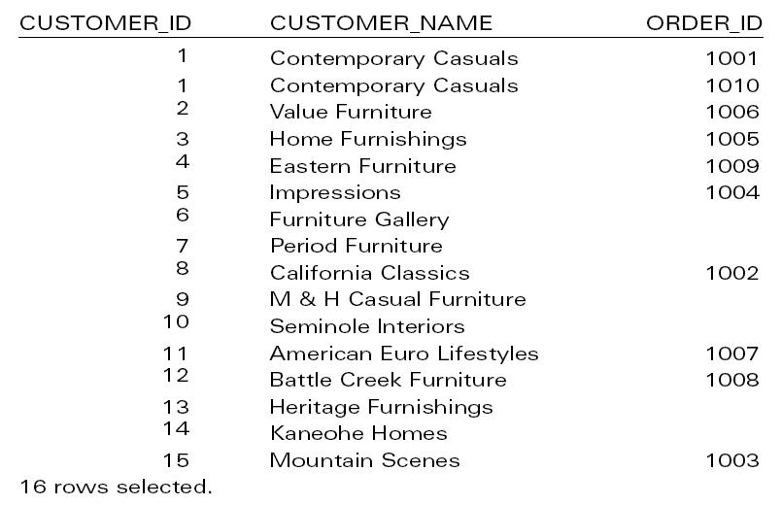
Results
Unlike INNER join, this will include customer rows with no matching order rows

Slide 10
Multiple Table Join Example
Assemble all information necessary to create an invoice for order number 1006
  SELECT CUSTOMER_T.CUSTOMER_ID, CUSTOMER_NAME, CUSTOMER_ADDRESS, CITY, SATE, POSTAL_CODE, ORDER_T.ORDER_ID, ORDER_DATE, QUANTITY, PRODUCT_DESCRIPTION, STANDARD_PRICE, (QUANTITY * UNIT_PRICE)
  FROM CUSTOMER_T, ORDER_T, ORDER_LINE_T, PRODUCT_T
  WHERE CUSTOMER_T.CUSTOMER_ID = ORDER_LINE.CUSTOMER_ID AND ORDER_T.ORDER_ID = ORDER_LINE_T.ORDER_ID
    AND ORDER_LINE_T.PRODUCT_ID = PRODUCT_PRODUCT_ID
    AND ORDER_T.ORDER_ID = 1006;
Four tables involved in this join
Each pair of tables requires an equality-check condition in the WHERE clause, matching primary keys against foreign keys

Slide 11
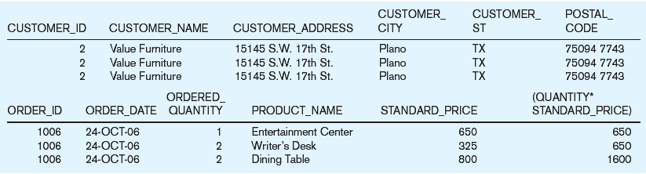
Figure 8-4 Results from a four-table join
From CUSTOMER_T table
From ORDER_T table
From PRODUCT_T table

Slide 12
Processing Multiple Tables
Using Subqueries
Subquery–placing an inner query (SELECT statement) inside an outer query
Options:
  In a condition of the WHERE clause
  As a “table” of the FROM clause
  Within the HAVING clause
Subqueries can be:
  Noncorrelated–executed once for the entire outer query
  Correlated–executed once for each row returned by the outer query

Slide 13
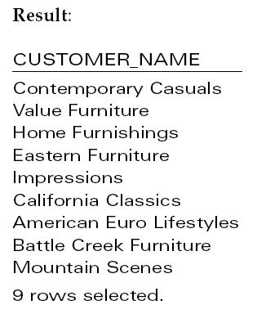
Subquery Example
Show all customers who have placed an order
  SELECT CUSTOMER_NAME FROM CUSTOMER_T
  WHERE CUSTOMER_ID IN
  (SELECT DISTINCT CUSTOMER_ID FROM ORDER_T);
The IN operator will test to see if the CUSTOMER_ID value of a row is included in the list returned from the subquery
Subquery is embedded in parentheses. In this case it returns a list that will be used in the WHERE clause of the outer query

Slide 14
Correlated vs. Noncorrelated Subqueries
Noncorrelated subqueries:
  Do not depend on data from the outer query
  Execute once for the entire outer query
Correlated subqueries:
  Make use of data from the outer query
  Execute once for each row of the outer query
  Can use the EXISTS operator

Slide 15
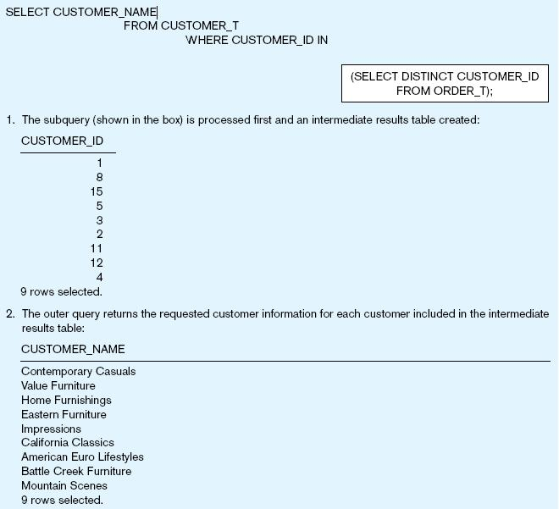
Figure 8-6a Processing a noncorrelated subquery
No reference to data in outer query, so subquery executes once only
The subquery executes and returns the customer IDs from the ORDER_T table
The outer query on the results of the subquery
These are the only customers that have IDs in the ORDER_T table

Slide 16
Correlated Subquery Example
Show all orders that include furniture finished in natural ash
  SELECT DISTINCT ORDER_ID FROM ORDER_LINE_T
  WHERE EXISTS
  (SELECT * FROM PRODUCT_T
  WHERE PRODUCT_ID = ORDER_LINE_T.PRODUCT_ID
  AND PRODUCT_FINISH = ‘Natural ash’);
The EXISTS operator will return a TRUE value if the subquery resulted in a non-empty set, otherwise it returns a FALSE
The subquery is testing for a value that comes from the outer query

Slide 17
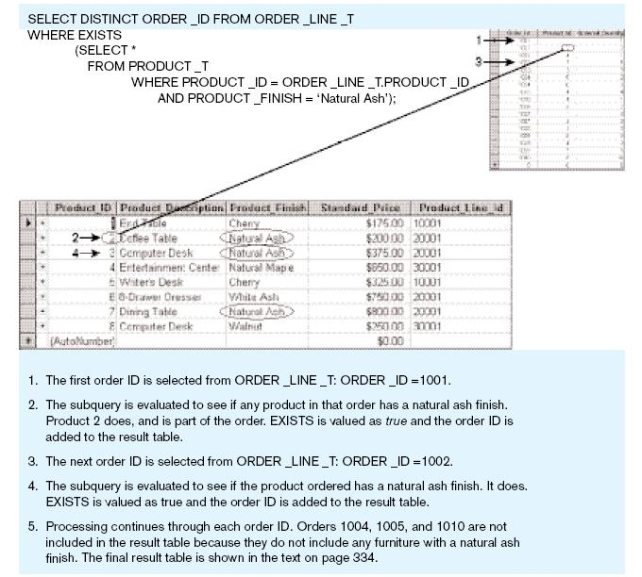
Figure 8-6b Processing a correlated subquery
Subquery refers to outer-query data, so executes once for each row of outer query
Note: only the orders that involve products with Natural Ash will be included in the final results

Slide 18
Another Subquery Example
Show all products whose standard price is higher than the average price
  SELECT PRODUCT_DESCRIPTION, STANDARD_PRICE, AVGPRICE
  FROM
    (SELECT AVG(STANDARD_PRICE) AVGPRICE FROM PRODUCT_T),
    PRODUCT_T
    WHERE STANDARD_PRICE > AVG_PRICE;
One column of the subquery is an aggregate function that has an alias name. That alias can then be referred to in the outer query
Subquery forms the derived table used in the FROM clause of the outer query
The WHERE clause normally cannot include aggregate functions, but because the aggregate is performed in the subquery its result can be used in the outer query’s WHERE clause

Slide 19
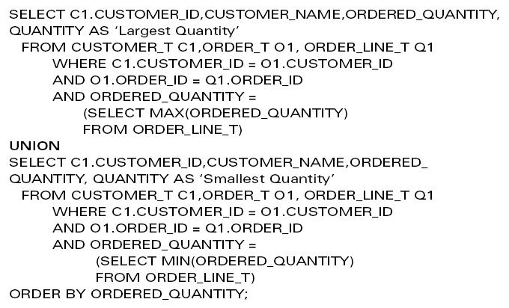
Union Queries
Combine the output (union of multiple queries) together into a single result table
First query
Combine
Second query

Slide 20
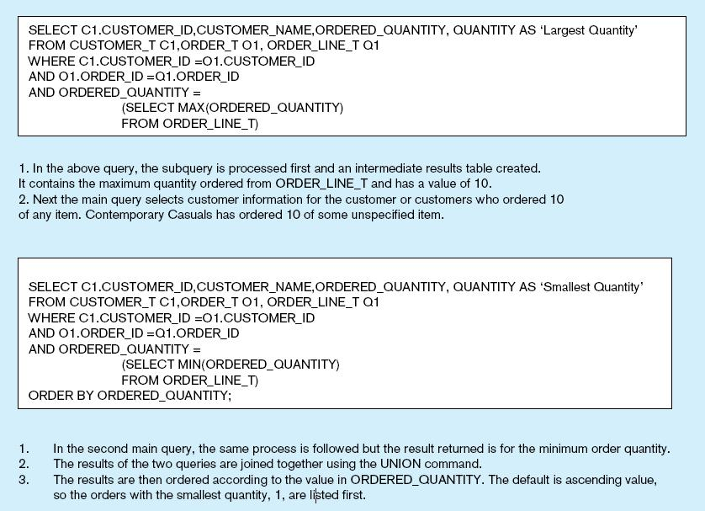
Figure 8-7 Combining queries using UNION

Slide 21
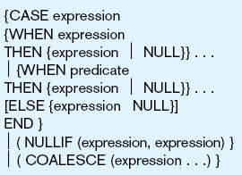
Conditional Expressions Using Case Syntax
This is available with newer versions of SQL, previously not part of the standard
Figure 8-8

Slide 22
Tips for Developing Queries
Be familiar with the data model (entities and relationships)
Understand the desired results
Know the attributes desired in result
Identify the entities that contain desired attributes
Review ERD
Construct a WHERE for each link
Fine tune with GROUP BY and HAING clauses if needed
Consider the effect on unusual data

Slide 23
Ensuring Transaction Integrity
Transaction = A discrete unit of work that must be completely processed or not processed at all
  May involve multiple updates
  If any update fails, then all other updates must be cancelled
SQL commands for transactions
  BEGIN TRANSACTION/END TRANSACTION
    Marks boundaries of a transaction
  COMMIT
    Makes all updates permanent
  ROLLBACK
    Cancels updates since the last COMMIT

Slide 24
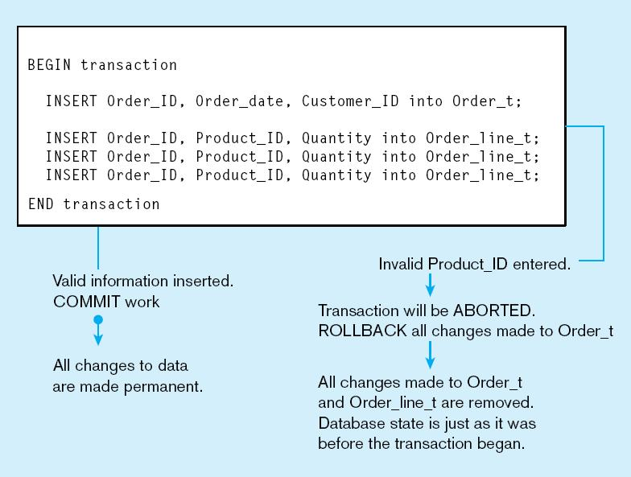
Figure 8-9 An SQL Transaction sequence (in pseudocode)

Slide 25
Data Dictionary Facilities
System tables that store metadata
Users usually can view some of these tables
Users are restricted from updating them
Some examples in Oracle 10g
  DBA_TABLES–descriptions of tables
  DBA_CONSTRAINTS–description of constraints
  DBA_USERS–information about the users of the system
Examples in Microsoft SQL Server 2000
  SYSCOLUMNS–table and column definitions
  SYSDEPENDS–object dependencies based on foreign keys
  SYSPERMISSIONS–access permissions granted to users

Slide 26
SQL:1999 and SQL:200N Enhancements/Extensions
User-defined data types (UDT)
  Subclasses of standard types or an object type
Analytical functions (for OLAP)
  CEILING, FLOOR, SQRT, RANK, DENSE_RANK
  WINDOW–improved numerical analysis capabilities
New Data Types
  BIGINT, MULTISET (collection), XML
CREATE TABLE LIKE–create a new table similar to an existing one
MERGE

Slide 27
SQL:1999 and SQL:200N Enhancements/Extensions (cont.)
Persistent Stored Modules (SQL/PSM)
  Capability to create and drop code modules
  New statements:
    CASE, IF, LOOP, FOR, WHILE, etc.
    Makes SQL into a procedural language
Oracle has propriety version called PL/SQL, and Microsoft SQL Server has Transact/SQL

Slide 28
Routines and Triggers
Routines
  Program modules that execute on demand
  Functions–routines that return values and take input parameters
  Procedures–routines that do not return values and can take input or output parameters
Triggers
  Routines that execute in response to a database event (INSERT, UPDATE, or DELETE)

Slide 29
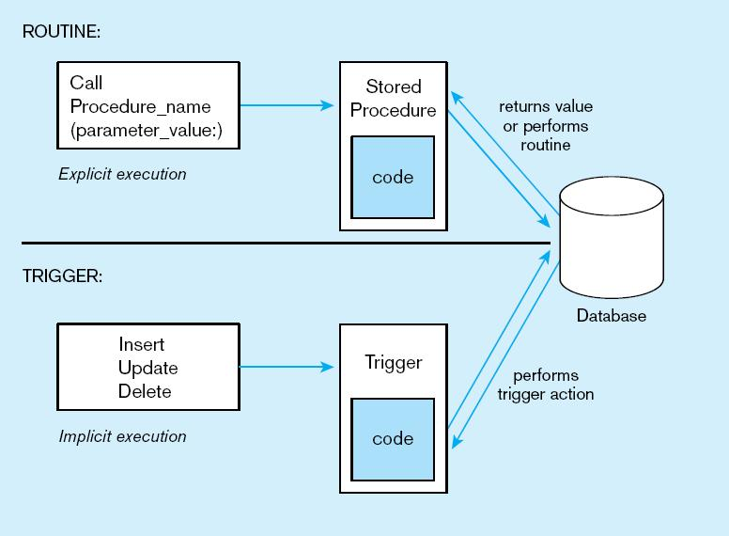
Figure 8-10 Triggers contrasted with stored procedures
Procedures are called explicitly
Triggers are event-driven
Source: adapted from Mullins, 1995.

Slide 30
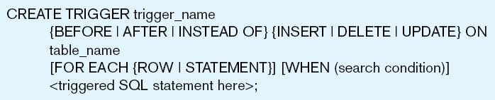
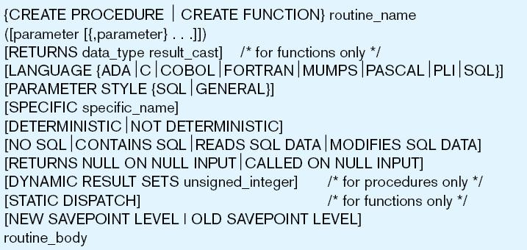
Figure 8-11 Simplified trigger syntax, SQL:200n
Figure 8-12 Create routine syntax, SQL:200n

Slide 31
Embedded and Dynamic SQL
Embedded SQL
  Including hard-coded SQL statements in a program written in another language such as C or Java
Dynamic SQL
  Ability for an application program to generate SQL code on the fly, as the application is running

Slide 32
OLAP SQL
Online Transaction Processing (OLTP)
  Real-time processing of SQL transactions, characterized by fast data entry and retrieval in multi-user environments
  Smaller size, less data sources, many users, simpler queries, more normalized, standard SQL
Online Analytical Processing (OLAP)
  Use of graphical tools providing users with multidimensional views of data for analysis purposes
  Larger size, more data sources, fewer users, complex queries, less normalized, OLAP SQL and statistical packages (SPSS/SAS)

Slide 33

All rights reserved. No part of this publication may be reproduced, stored in a retrieval system, or transmitted, in any form or by any means, electronic, mechanical, photocopying, recording, or otherwise, without the prior written permission of the publisher. Printed in the United States of America.
Copyright © 2009 Pearson Education, Inc. Publishing as Prentice Hall

