Slide 1
Chapter 9:
The Client/Server Database Environment
Modern Database Management
9th Edition
Jeffrey A. Hoffer, Mary B. Prescott,
Heikki Topi
© 2009 Pearson Education, Inc. Publishing as Prentice Hall

Slide 2
Objectives
Definition of terms
List advantages of client/server architecture
Explain three application components: presentation, processing, and storage
Suggest partitioning possibilities
Distinguish between file server, database server, three-tier, and n-tier approaches
Describe and discuss middleware
Explain database linking via ODBC and JDBC

Slide 3
Client/Server Systems
Networked computing model
Processes distributed between clients and servers
Client–Workstation (usually a PC) that requests and uses a service
Server–Computer (PC/mini/mainframe) that provides a service
For DBMS, server is a database server

Slide 4
Application Logic in C/S Systems
Presentation Logic
  Input–keyboard/mouse
  Output–monitor/printer
GUI Interface
Processing Logic
  I/O processing
  Business rules
  Data management
Procedures, functions,
programs
Storage Logic
  Data storage/retrieval
DBMS activities

Slide 5
Client/Server Architectures
Client does extensive processing
File Server Architecture
Database Server Architecture
Three-tier Architecture
Client does little processing

Slide 6
File Server Architecture
All processing is done at the PC that requested the data
Entire files are transferred from the server to the client for processing
Problems:
  Huge amount of data transfer on the network
  Each client must contain full DBMS
    Heavy resource demand on clients
    Client DBMSs must recognize shared locks, integrity checks, etc.
FAT CLIENT

Slide 7
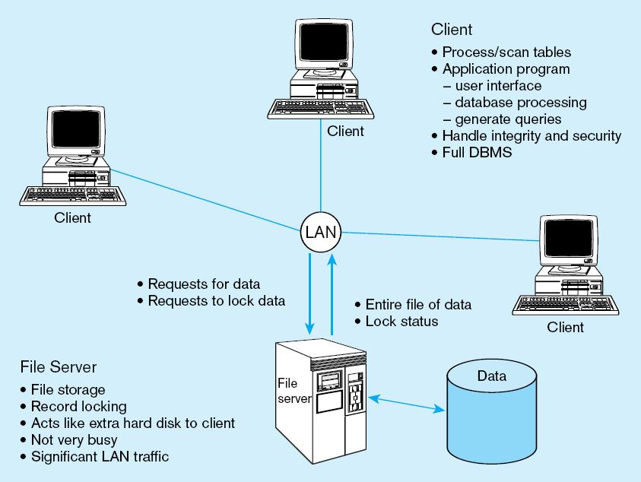
Figure 9-2 File server model
FAT CLIENT

Slide 8
Two-Tier Database Server Architectures
Client is responsible for
  I/O processing logic
  Some business rules logic
Server performs all data storage and access processing
  ➔ DBMS is only on server

Slide 9
Advantages of Two-Tier Approach
Clients do not have to be as powerful
Greatly reduces data traffic on the network
Improved data integrity since it is all processed centrally
Stored procedures ➔ DBMS code that performs some business rules done on server

Slide 10
Advantages of
Stored Procedures
Compiled SQL statements
Reduced network traffic
Improved security
Improved data integrity
Thinner clients

Slide 11
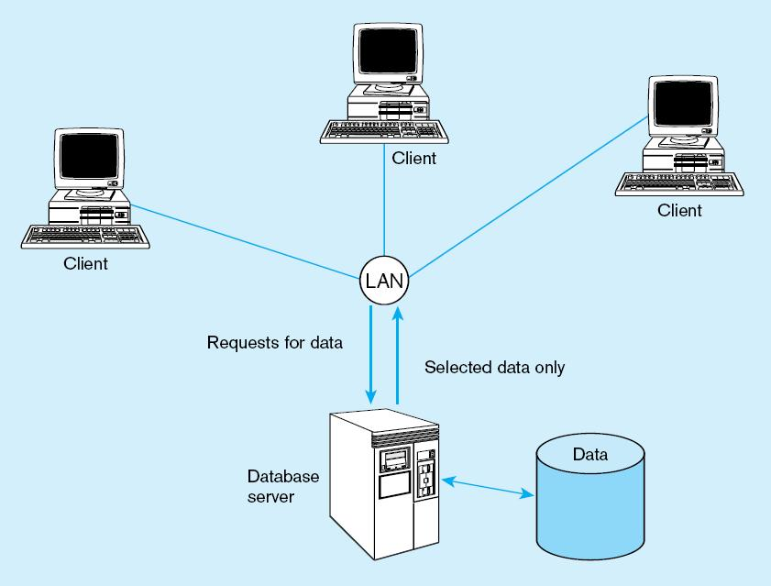
Figure 9-3 Database server architecture (two-tier)
Thinner clients
DBMS only on server

Slide 12
Three-Tier Architectures
Client
GUI interface
(I/O processing)
Browser
  Application server
Web Server
Business rules
  Database server
Data storage
DBMS
Thin Client
  PC just for user interface and a little application processing. Limited or no data storage (sometimes no hard drive)

Slide 13
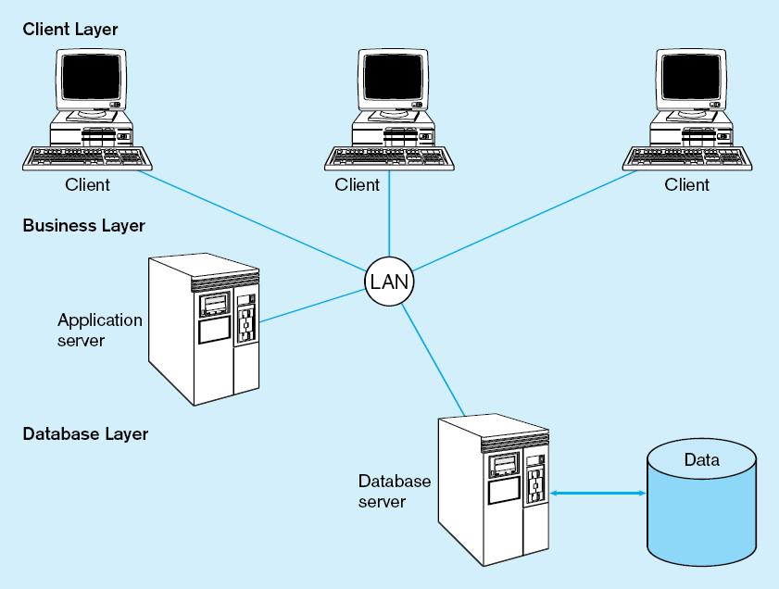
Figure 9-4a Generic three-tier architecture
Thinnest clients
Business rules on separate server
DBMS only on DB server

Slide 14
Advantages of Three-Tier Architectures
Scalability
Technological flexibility
Long-term cost reduction
Better match of systems to business needs
Improved customer service
Competitive advantage
Reduced risk

Slide 15
Application Partitioning
Placing portions of the application code in different locations (client vs. server) AFTER it is written
Advantages
  Improved performance
  Improved interoperability
  Balanced workloads

Slide 16
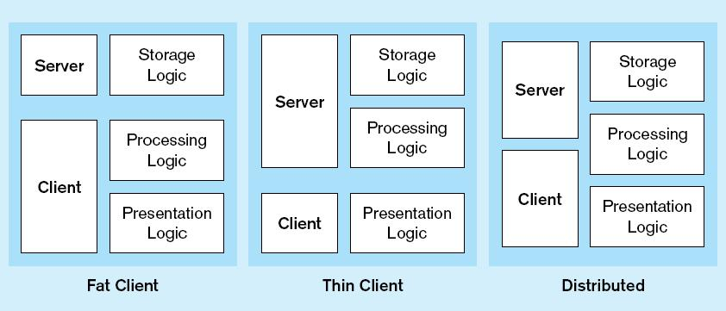
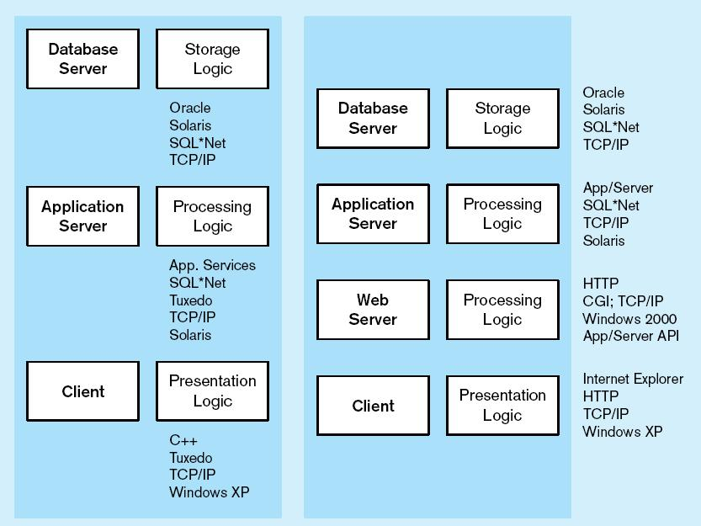
Common Logic Distributions
Figure 9-5a Two-tier client-server environments
Processing logic could be at client, server, or both
Figure 9-5b n-tier client-server environment
Processing logic will be at application server or Web server

Slide 17
Role of the Mainframe
Mission-critical legacy systems have tended to remain on mainframes
Distributed client/server systems tend to be used for smaller, workgroup systems
Difficulties in moving mission critical systems from mainframe to distributed
  Determining which code belongs on server vs. client
  Identifying potential conflicts with code from other applications
  Ensuring sufficient resources exist for anticipated load
Rule of thumb
  Mainframe for centralized data that does not need to be moved
  Client for data requiring frequent user access, complex graphics, and user interface

Slide 18
Middleware
Software that allows an application to interoperate with other software
No need for programmer/user to understand internal processing
Accomplished via Application Program Interface (API)
The “glue” that holds client/server applications together

Slide 19
Types of Middleware
Remote Procedure Calls (RPC)
  client makes calls to procedures running on remote computers
  synchronous and asynchronous
Message-Oriented Middleware (MOM)
  asynchronous calls between the client via message queues
Publish/Subscribe
  push technology → server sends information to client when available
Object Request Broker (ORB)
  object-oriented management of communications between clients and servers
SQL-oriented Data Access
  middleware between applications and database servers

Slide 20
Database Middleware
ODBC–Open Database Connectivity
  Most DB vendors support this
OLE-DB
  Microsoft enhancement of ODBC
JDBC–Java Database Connectivity
  Special Java classes that allow Java applications/applets to connect to databases

Slide 21
Client/Server Security
Network environment ➔ complex security issues
Security levels:
  System-level password security
    for allowing access to the system
  Database-level password security
    for determining access privileges to tables; read/update/insert/delete privileges
  Secure client/server communication
    via encryption

Slide 22
Keys to Successful Client-Server Implementation
Accurate business problem analysis
Detailed architecture analysis
Architecture analysis before choosing tools
Appropriate scalability
Appropriate placement of services
Network analysis
Awareness of hidden costs
Establish client/server security

Slide 23
Benefits of Moving to Client/Server Architecture
Staged delivery of functionality speeds deployment
GUI interfaces ease application use
Flexibility and scalability facilitates business process reengineering
Reduced network traffic due to increased processing at data source
Facilitation of Web-enabled applications

Slide 24
Using ODBC to Link External Databases Stored on a Database Server
Open Database Connectivity (ODBC)
  API provides a common language for application programs to access and process SQL databases independent of the particular RDBMS that is accessed
Required parameters:
  ODBC driver
  Back-end server name
  Database name
  User id and password
Additional information:
  Data source name (DSN)
  Windows client computer name
  Client application program’s executable name

Slide 25
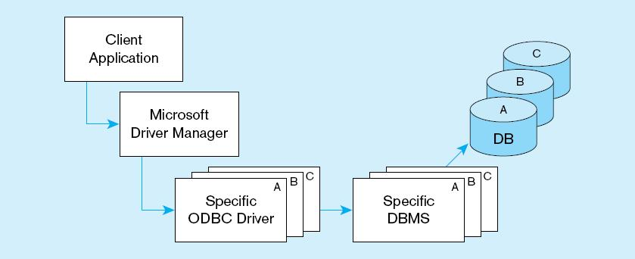
ODBC Architecture
(Figure 9-6)
Client does not need to know anything about the DBMS
Application Program Interface (API) provides common interface to all DBMSs
Each DBMS has its own ODBC-compliant driver

Slide 26
Using JDBC to Link External Databases Stored on a Database Server
Java Database Connectivity (JDBC)
  API that Enables Java programs to execute SQL statements and connect to database servers
  Whereas ODBC is language independent, JDBC is specific to Java
  Based on X/Open SQL Call Level Interface
Two layers:
  JDBC API for communication from application to JDBC driver manager
  JDBC Driver API for communication from driver manager to drivers
SQLJ (SQL-Java):
  Embedded SQL in Java
  SQL routines using Java
  SQL types using Java

Slide 27

All rights reserved. No part of this publication may be reproduced, stored in a retrieval system, or transmitted, in any form or by any means, electronic, mechanical, photocopying, recording, or otherwise, without the prior written permission of the publisher. Printed in the United States of America.
Copyright © 2009 Pearson Education, Inc. Publishing as Prentice Hall

