Slide 1
Chapter 10:
The Internet Database Environment
Modern Database Management
9th Edition
Jeffrey A. Hoffer, Mary B. Prescott,
Heikki Topi
© 2009 Pearson Education, Inc. Publishing as Prentice Hall

Slide 2
Objectives
Definition of terms
Explain the importance of attaching a database to a Web page
Describe necessary environment for Internet and Intranet database connectivity
Use Internet terminology appropriately
Explain the purpose of WWW Consortium
Explain purpose of XML for standardized data interpretation
Explain XPath and XQuery
Explain the purpose of server-side extensions
Describe Web services
Compare Web server interfaces (CGI, API, Java servlets)
Describe Web load balancing methods
Explain plug-ins

Slide 3
Web Characteristics that Support Web-Based Database Applications
Web browsers are simple to use
Information transfer can take place across different platforms
Development time and cost have been reduced
Sites can be static (no database) or dynamic/interactive (with database)
Potential e-business advantages (improved customer service, faster market time, better supply chain management)

Slide 4
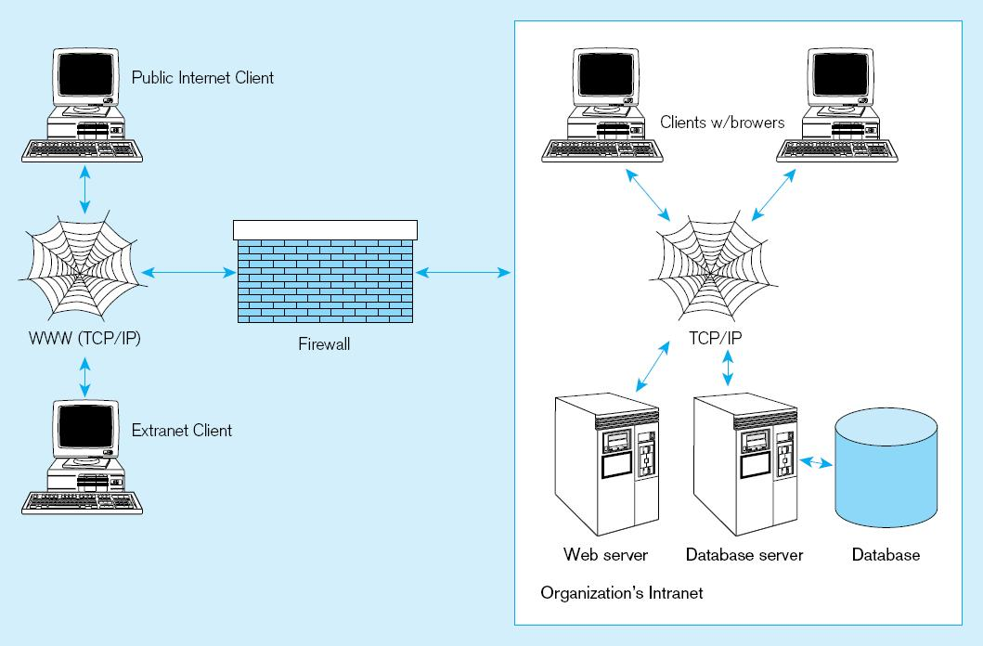
Figure 10-1 Database-enabled intranet/internet environment

Slide 5
Internet and Intranet Services
Web server
Database-enabled services
Directory, security, authentication
E-mail
File Transfer Protocol (FTP)
Firewalls and proxy servers
News or discussion groups
Document search
Load balancing and caching

Slide 6
World Wide Web Consortium (W3C)
An international consortium of companies working to develop open standards that foster the development of Web conventions so that Web documents can be consistently displayed on all platforms
See www.w3c.org

Slide 7
Web-Related Terms
World Wide Web (WWW)
  The total set of interlinked hypertext documents residing on Web servers worldwide
Browser
  Software that displays HTML documents and allows users to access files and software related to HTML documents
Web Server
  Software that responds to requests from browsers and transmits HTML documents to browsers
Web pages–HTML documents
  Static Web pages–content established at development time
  Dynamic Web pages–content dynamically generated, usually by obtaining data from database

Slide 8
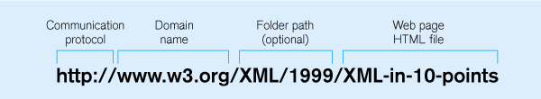
Communications Technology
IP Address
  Four numbers that identify a node on the Internet
  e.g. 131.247.152.18
Hypertext Transfer Protocol (HTTP)
  Communication protocol used to transfer pages from Web server to browser
  HTTPS is a more secure version
Uniform Resource Locator (URL)
  Mnemonic Web address corresponding with IP address
  Also includes folder location and html file name
Typical URL

Slide 9
Internet-Related Languages
Hypertext Markup Language (HTML)
  Markup language specifically for Web pages
Standard Generalized Markup Language (SGML)
  Markup language standard
Extensible Markup Language (XML)
  Markup language allowing customized tags
XHTML
  XML-compliant extension of HTML
Java
  Object-oriented programming language for applets
JavaScript/VBScript
  Scripting languages that enable interactivity in HTML documents
Cascading Style Sheets (CSS)
  Control appearance of Web elements in an HML document
XSL and XSLT
  XMS style sheet and transformation to HTML
Standards and Web conventions established by
World Wide Web Consortium (W3C)

Slide 10
XML Overview
Becoming the standard for E-Commerce data exchange
A markup language (like HTML)
  Uses elements, tags, attributes
  Includes document type declarations (DTDs), XML schemas, comments, and entity references
XML Schema (XSD) replacing DTDs
Relax NG–ISO standard XML database definition
Document Structure Description (DSD)– expressive, easy to use XML database definition

Slide 11
XML Overview (cont.)
Xpath
  One of a set of XML technologies supporting XQuery development, locating data in XML documents
XLink
  XML markup language for creating hypertext links
XPointer
  Used along with Xlink for establishing hypertext links to URI references
XQuery
  XML transformation language allowing applications to query relational databases and XML data

Slide 12
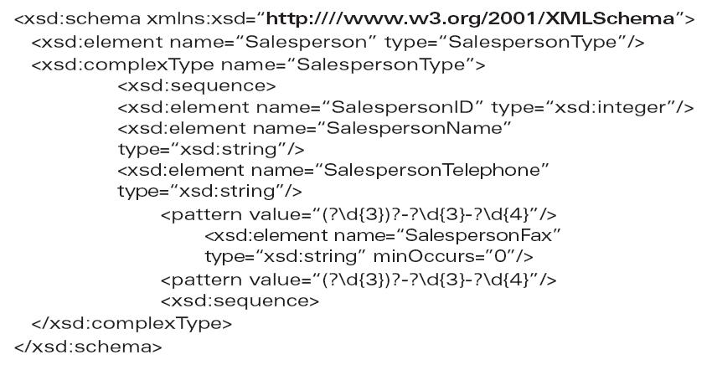
Sample XML Schema
Schema is a record definition, analogous to the Create SQL statement, and therefore provides metadata

Slide 13
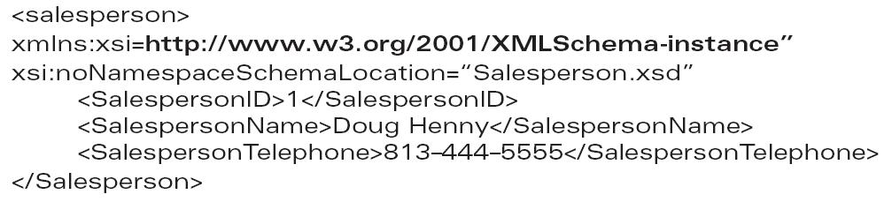
Sample XML Document Data
XML data involves elements and attributes defined in the schema, and is analogous to inserting a record into a database

Slide 14
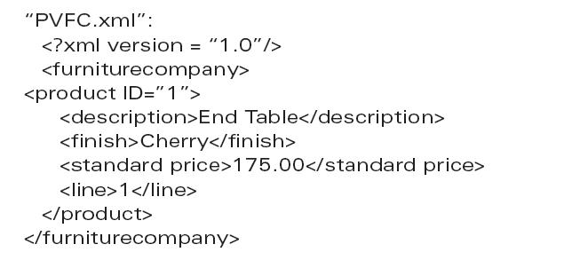
Another Sample XML Document

Slide 15
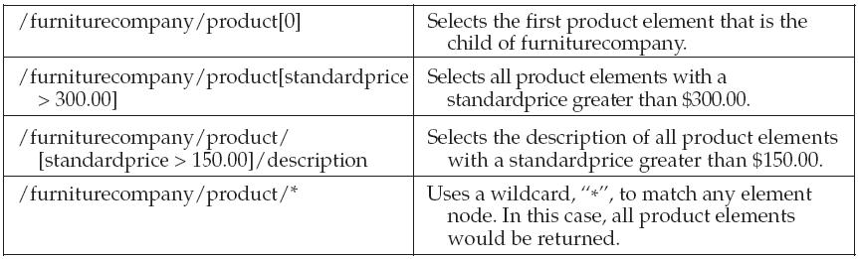
Sample XPath Expressions for PVFC.xml

Slide 16
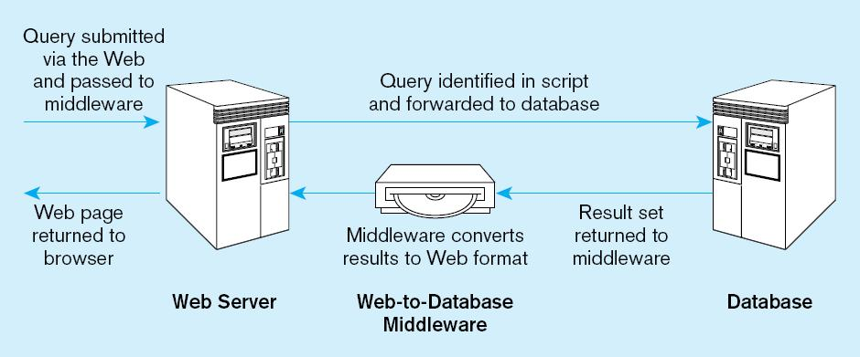
Server-Side Extensions
Programs that interact directly with Web servers to handle requests
e.g. database-request handling middleware
Figure 10-2 Web-to-database middleware

Slide 17
Web Server Interfaces
Common Gateway Interface (CGI)
  Specify transfer of information between Web server and CGI program
  Performance not very good
  Security risks
Application Program Interface (API)
  More efficient than CGI
  Shared as dynamic link libraries (DLLs)
Java Servlets
  Like applets, but stored at server
  Cross-platform compatible
  More efficient than CGI

Slide 18
Web Servers
Provide HTTP service
Passing plain text via TCP connection
Serve many clients at once
  Therefore, multithreaded and multiprocessed
Load balancing approaches:
  Domain Name Server (DNS) balancing
    One DNS = multiple IP addresses
  Software/hardware balancing
    Request at one IP address is distributed to multiple servers
  Reverse proxy
    Intercept client request and cache response

Slide 19
Client-Side Extensions
Add functionality to the browser
Plug-ins
  Hardware/software modules that extend browser capabilities by adding features (e.g. encryption, animation, wireless access)
ActiveX
  Microsoft COM/OLE components that allow data manipulation inside the browser
Cookies
  Block of data stored at client by Web server for later use

Slide 20
Components for Dynamic Web Sites
DBMS–Oracle, Microsoft SQL Server, Informix, Sybase, DB2, Microsoft Access, MySQL
Web server–Apache, Microsoft IIS
Programming languages/development technologies–ASP .NET, PHP, ColdFusion, Coral Web Builder, Macromedia’s Dreamweaver
Web browser–Microsoft Internet Explorer, Netscape Navigator, Mozilla Firefox, Apple’s Safari, Opera
Text editor–Notepad, BBEdit, vi, or an IDE
FTP capabilities–SmartFTP, WS_FTP

Slide 21
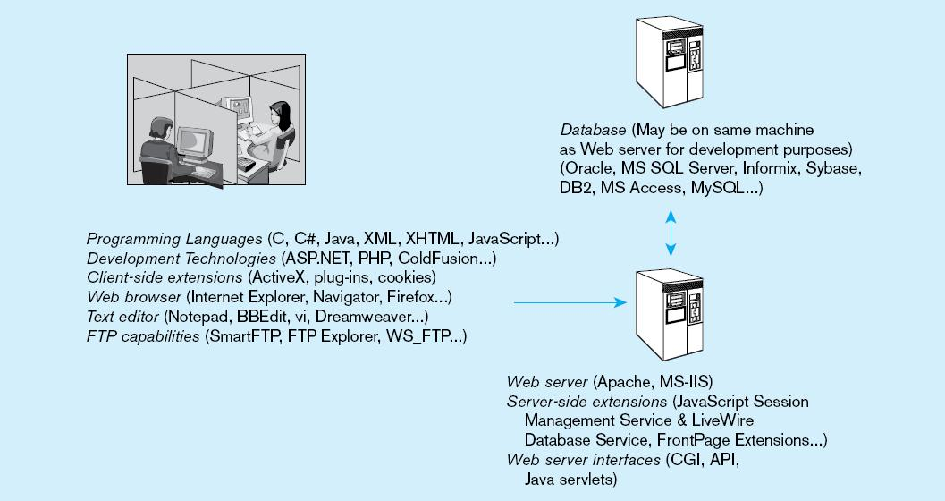
Figure 10-3 Dynamic Web development environment

Slide 22
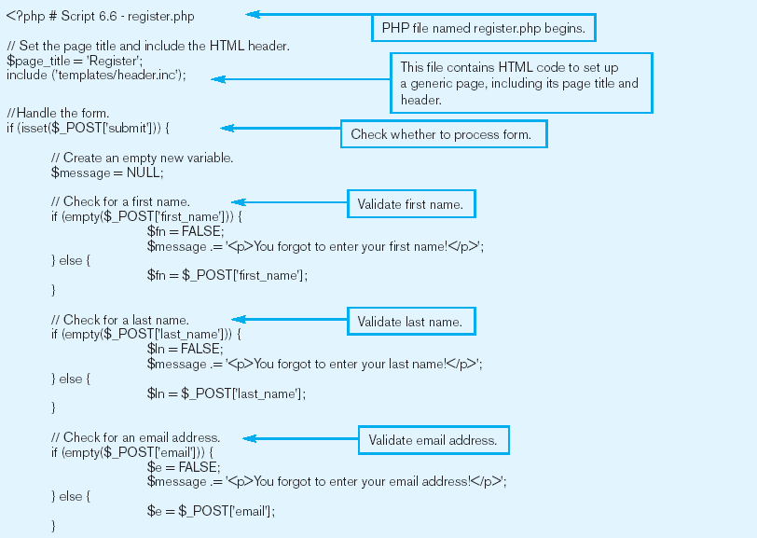
Figure 10-4 Sample PHP script that accepts user registration input
a) PHP script initiation and input validation
(Ullman, PHP and MySql for Dynamic Web Sites, 2003, Script 6.6)

Slide 23
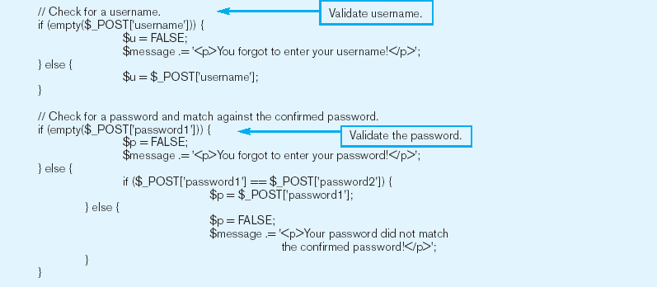
Figure 10-4a (cont.)

Slide 24
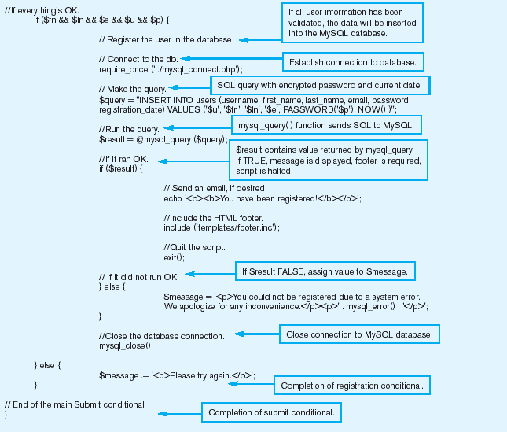
Figure 10-4 Sample PHP script that accepts user registration input
b) Adding user information to the database

Slide 25
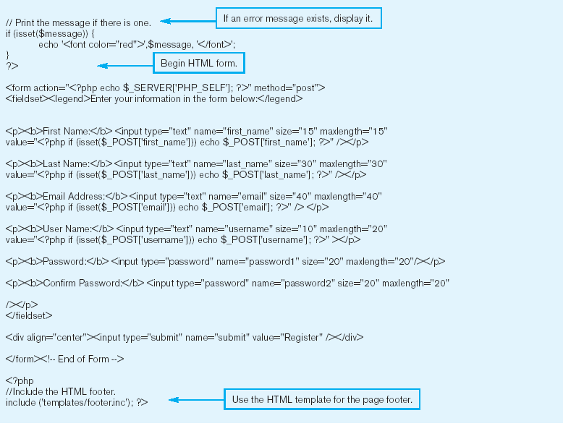
Figure 10-4 Sample PHP script that accepts user registration input
c) Close PHP script and display HTML form

Slide 26
Web Services
XML-based standards that define protocols for automatic communication between applications over the Web
Web Service Components:
  Universal Description, Discovery, and Integration (UDDI)
    Technical specification for distributed registries of Web services and businesses open to communication on these services
  Web Services Description Language (WSDL)
    XML-based grammar for describing Web services and providing public interfaces for these services
  Simple Object Access Protocol (SOAP)
    XML-based communication protocol for sending messages between applications via the Internet
Challenges for Web Services
  Lack of mature standards
  Lack of security

Slide 27
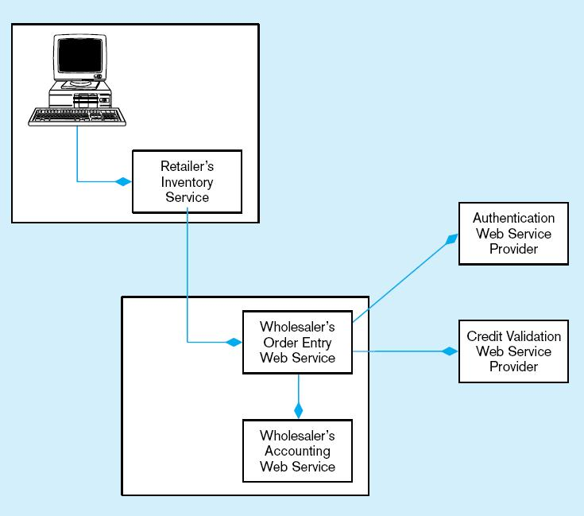
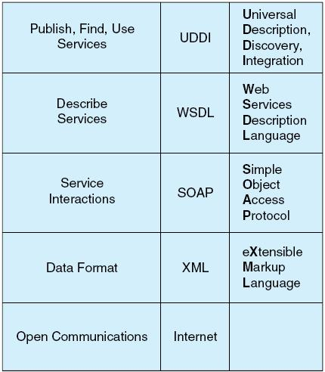
Figure 10-5 A typical order entry system that uses Web services
(adapted from Newcomer 2002, Figure 1-3)
Figure 10-6 Web services protocol stack

Slide 28
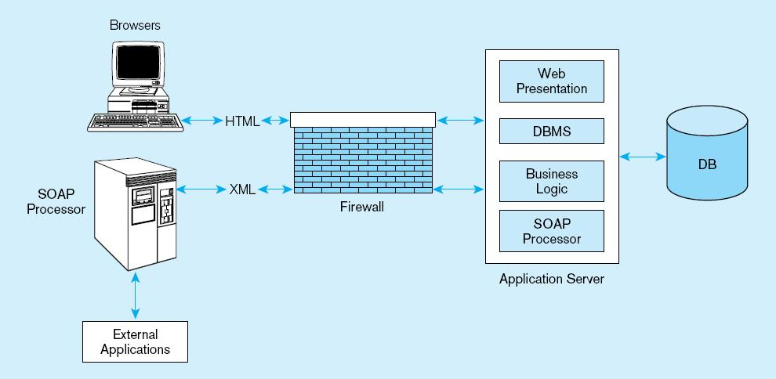
Figure 10-7 Web services deployment
(adapted from Newcomer, 2002)

Slide 29
Service Oriented Architectures
Collection of services that communicate with each other by passing data
Web services, CORBA, Java, XML, SOAP, WSDL
Loosely coupled
Interoperable
Using SOA results in increased software development efficiency (up to 40%)

Slide 30
Semantic Web
W3C project using Web metadata to automate collection of knowledge and storing in easily understood format
Structuring based on:
  XML
  Resource Description Framework (RDF)
  Web Ontology Language (OWL)

Slide 31
Rapidly Accelerating Internet Changes
Integrated database environments
Use of cell phones and PDAs
Changes in organizational relationships
Globalization
Challenges to IT personnel require:
  Business and technology infrastructure understanding
  Leadership and communication skills
  Upward influence techniques
  Employee management techniques

Slide 32

All rights reserved. No part of this publication may be reproduced, stored in a retrieval system, or transmitted, in any form or by any means, electronic, mechanical, photocopying, recording, or otherwise, without the prior written permission of the publisher. Printed in the United States of America.
Copyright © 2009 Pearson Education, Inc. Publishing as Prentice Hall

