Slide 1
Chapter 12:
Data Quality and Integration
Modern Database Management
9th Edition
Jeffrey A. Hoffer, Mary B. Prescott,
Heikki Topi
© 2009 Pearson Education, Inc. Publishing as Prentice Hall

Slide 2
Objectives
Definition of terms
Describe importance and measures of data quality
Define characteristics of quality data
Describe reasons for poor data quality in organizations
Describe a program for improving data quality
Describe three types of data integration approaches
Describe the purpose and role of master data management
Describe four steps and activities of ETL for data integration for a data warehouse
Explain various forms of data transformation for data warehouses

Slide 3
Importance of Data Quality
Minimize IT project risk
Make timely business decisions
Ensure regulatory compliance
Expand customer base

Slide 4
Characteristics of Quality Data
Uniqueness
Accuracy
Consistency
Completeness
Timeliness
Currency
Conformance
Referential integrity

Slide 5
Causes of poor data quality
External data sources
  Lack of control over data quality
Redundant data storage and inconsistent metadata
  Proliferation of databases with uncontrolled redundancy and metadata
Data entry
  Poor data capture controls
Lack of organizational commitment
  Do not recognize poor data quality as an organizational issue

Slide 6
Data quality improvement
Perform data quality audit
Improve data capture processes
Establish data stewardship program
Apply total quality management (TQM) practices
Apply modern DBMS technology
Estimate return on investment
Start with a high-quality data model

Slide 7
Improving Data Capture Processes
Automate data entry as much as possible
Manual data entry should be selected from preset options
Use trained operators when possible
Follow good user interface design principles
Immediate data validation for entered data

Slide 8
Data Stewardship Program
Data steward
  A person responsible for ensuring that organizational applications properly support the organization’s data quality goals
Data governance
  High-level organizational groups and processes overseeing data stewardship across the organization

Slide 9
Principles for High Quality Data Models
Entity types represent underlying nature of an object
Entity types part of subtype/supertype hierarchy for universal context
Activities and associations represented by (event) entity types, not relationships
Relationships used to represent only involvement of entity types with activities or associations
Candidate attributes suspected of representing relationships to other entity types
Entity types should have a single attribute as the primary unique identifier

Slide 10
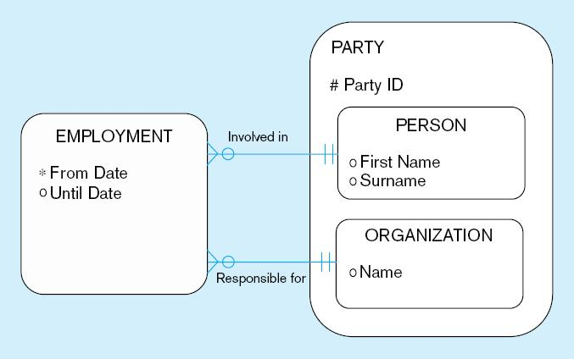
Figure 12-1 Example of a many-to-many relationship as an entity type

Slide 11
Data Integration
Data integration creates a unified view of business data
Other possibilities:
  Application integration
  Business process integration
  User interaction integration
Any approach required changed data capture (CDC)
  Indicates which data have changed since previous data integration activity

Slide 12
Techniques for Data Integration
Consolidation (ETL)
  Consolidating all data into a centralized database (like a data warehouse)
Data federation (EII)
  Provides a virtual view of data without actually creating one centralized database
Data propagation (EAI and ERD)
  Duplicate data across databases, with near real-time delay

Slide 13
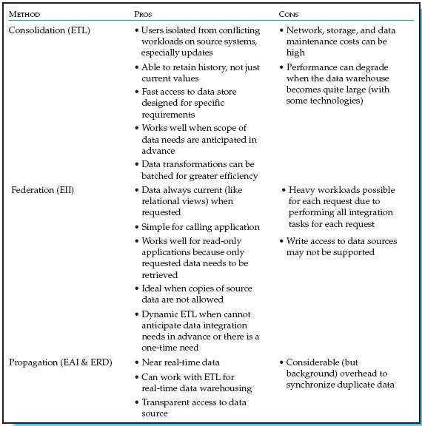
Table 12-3 Comparison of Consolidation, Federation, and Propagation Forms of Data Integration

Slide 14
Master Data Management (MDM)
The disciplines, technologies, and methods to ensure the currency, meaning, and quality of reference data within and across various subject areas
Three main approaches
  Identity registry
  Integration hub
  Persistent

Slide 15
The Reconciled Data Layer
Typical operational data is:
  Transient–not historical
  Not normalized (perhaps due to denormalization for performance)
  Restricted in scope–not comprehensive
  Sometimes poor quality–inconsistencies and errors
After ETL, data should be:
  Detailed–not summarized yet
  Historical–periodic
  Normalized–3rd normal form or higher
  Comprehensive–enterprise-wide perspective
  Timely–data should be current enough to assist decision-making
  Quality controlled–accurate with full integrity

Slide 16
The ETL Process
Capture/Extract
Scrub or data cleansing
Transform
Load and Index
ETL = Extract, transform, and load

Slide 17
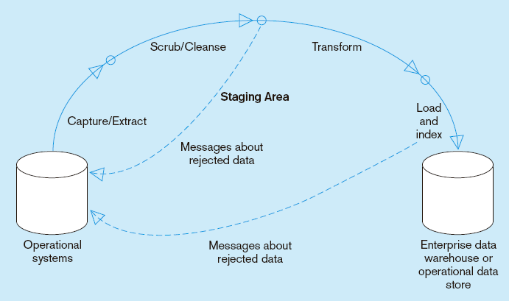
Capture/Extract…obtaining a snapshot of a chosen subset of the source data for loading into the data warehouse
Figure 12-2 Steps in data reconciliation
Static extract = capturing a snapshot of the source data at a point in time
Incremental extract = capturing changes that have occurred since the last static extract

Slide 18
Scrub/Cleanse…uses pattern recognition and AI techniques to upgrade data quality
Figure 12-2 Steps in data reconciliation
(cont.)
Fixing errors: misspellings, erroneous dates, incorrect field usage, mismatched addresses, missing data, duplicate data, inconsistencies
Also: decoding, reformatting, time stamping, conversion, key generation, merging, error detection/logging, locating missing data

Slide 19
Transform = convert data from format of operational system to format of data warehouse
Figure 12-2 Steps in data reconciliation
(cont.)
Record-level:
Selection–data partitioning
Joining–data combining
Aggregation–data summarization
Field-level:
single-field–from one field to one field
multi-field–from many fields to one, or one field to many

Slide 20
Load/Index= place transformed data into the warehouse and create indexes
Figure 12-2 Steps in data reconciliation
(cont.)
Refresh mode: bulk rewriting of target data at periodic intervals
Update mode: only changes in source data are written to data warehouse

Slide 21
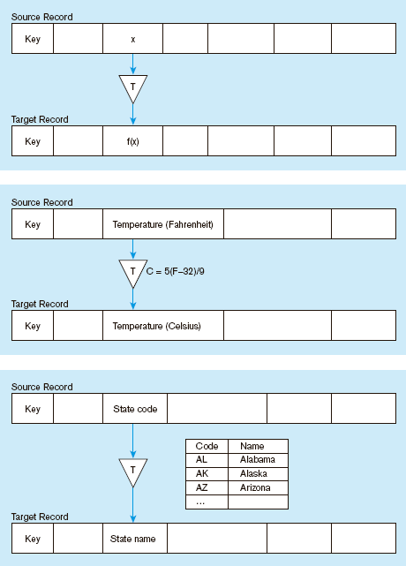
Figure 12-3 Single-field transformation
In general–some transformation function translates data from old form to new form
Algorithmic transformation uses a formula or logical expression
Table lookup–another approach, uses a separate table keyed by source record code

Slide 22
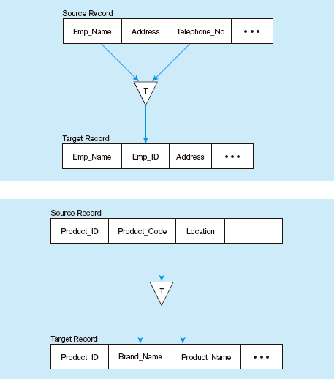
Figure 12-4 Multi-field transformation
M:1–from many source fields to one target field
1:M–from one source field to many target fields

Slide 23
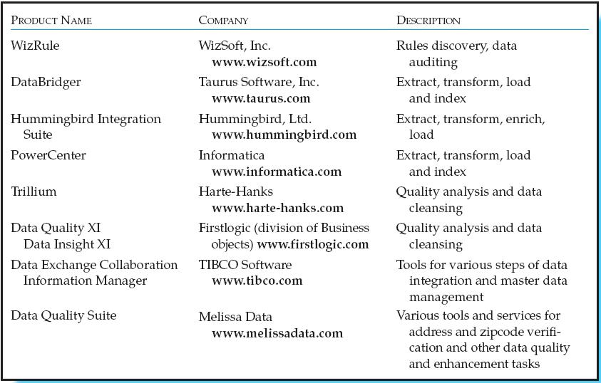
Table12-4 Samples of Tools to Support Data Reconciliation and Integration

Slide 24

All rights reserved. No part of this publication may be reproduced, stored in a retrieval system, or transmitted, in any form or by any means, electronic, mechanical, photocopying, recording, or otherwise, without the prior written permission of the publisher. Printed in the United States of America.
Copyright © 2009 Pearson Education, Inc. Publishing as Prentice Hall

