Slide 1
Chapter 13:
Data and Database Administration
Modern Database Management
9th Edition
Jeffrey A. Hoffer, Mary B. Prescott,
Heikki Topi
© 2009 Pearson Education, Inc. Publishing as Prentice Hall

Slide 2
Objectives
Definition of terms
List functions and roles of data/database administration
Describe role of data dictionaries and information repositories
Compare optimistic and pessimistic concurrency control
Describe problems and techniques for data security
Describe problems and techniques for data recovery
Describe database tuning issues and list areas where changes can be done to tune the database
Describe importance and measures of data availability

Slide 3
Traditional Administration Definitions
Data Administration: A high-level function that is responsible for the overall management of data resources in an organization, including maintaining corporate-wide definitions and standards
Database Administration: A technical function that is responsible for physical database design and for dealing with technical issues such as security enforcement, database performance, and backup and recovery

Slide 4
Traditional Data Administration Functions
Data policies, procedures, standards
Planning
Data conflict (ownership) resolution
Managing the information repository
Internal marketing of DA concepts

Slide 5
Traditional Database Administration Functions
Selection of DBMS and software tools
Installing/upgrading DBMS
Tuning database performance
Improving query processing performance
Managing data security, privacy, and integrity
Data backup and recovery

Slide 6
Evolving Approaches to Data Administration
Blend data and database administration into one role
Fast-track development–monitoring development process (planning, analysis, design, implementation, maintenance)
Procedural DBAs–managing quality of triggers and stored procedures
eDBA–managing Internet-enabled database applications
PDA DBA–data synchronization and personal database management
Data warehouse administration

Slide 7
Data Warehouse Administration
New role, coming with the growth in data warehouses
Similar to DA/DBA roles
Emphasis on integration and coordination of metadata/data across many data sources
Specific roles:
  Support DSS applications
  Manage data warehouse growth
  Establish service level agreements regarding data warehouses and data marts

Slide 8
Open Source DBMSs
An alternative to proprietary packages such as Oracle, Microsoft SQL Server, or Microsoft Access
mySQL is an example of an open-source DBMS
Less expensive than proprietary packages
Source code available, for modification
Absence of complete documentation
Ambiguous licensing concerns
Not as feature-rich as proprietary DBMSs
Vendors may not have certification programs

Slide 9
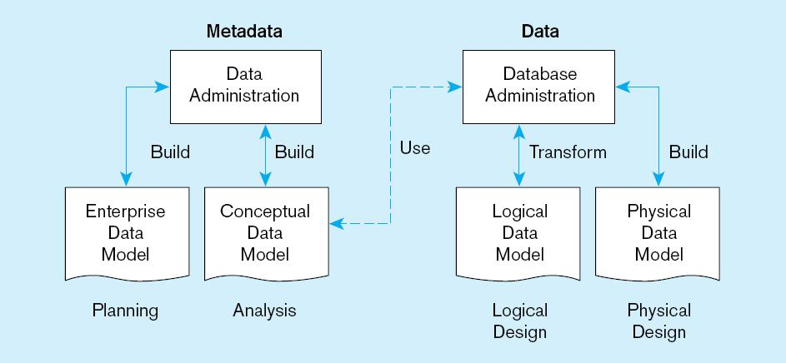
Figure 13-2 Data modeling responsibilities

Slide 10
Database Security
Database Security: Protection of the data against accidental or intentional loss, destruction, or misuse
Increased difficulty due to Internet access and client/server technologies

Slide 11
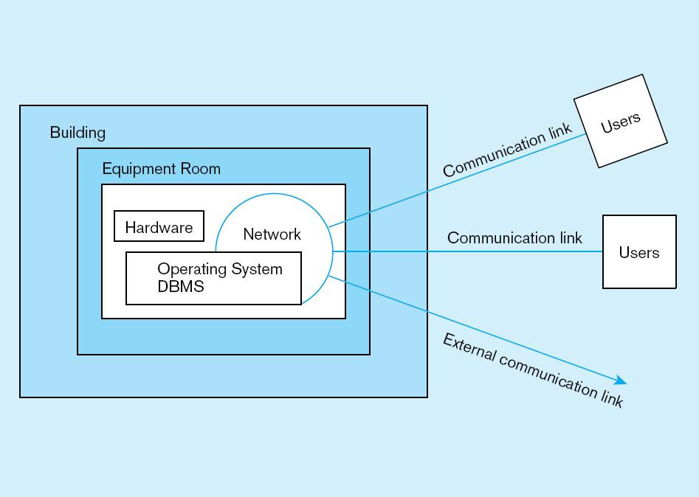
Figure 13-3 Possible locations of data security threats

Slide 12
Threats to Data Security
Accidental losses attributable to:
  Human error
  Software failure
  Hardware failure
Theft and fraud
Improper data access:
  Loss of privacy (personal data)
  Loss of confidentiality (corporate data)
Loss of data integrity
Loss of availability (through, e.g. sabotage)

Slide 13
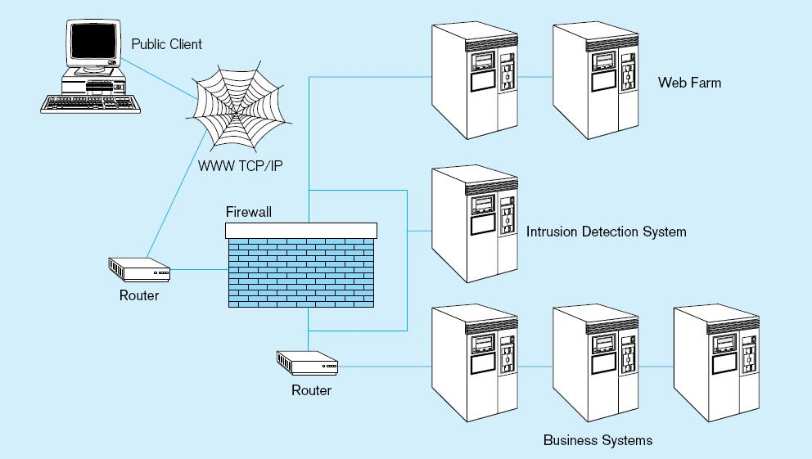
Figure 13-4 Establishing Internet Security

Slide 14
Web Security
Static HTML files are easy to secure
  Standard database access controls
  Place Web files in protected directories on server
Dynamic pages are harder
  Control of CGI scripts
  User authentication
  Session security
  SSL for encryption
  Restrict number of users and open ports
  Remove unnecessary programs

Slide 15
W3C Web Privacy Standard
Platform for Privacy Protection (P3P)
Addresses the following:
  Who collects data
  What data is collected and for what purpose
  Who is data shared with
  Can users control access to their data
  How are disputes resolved
  Policies for retaining data
  Where are policies kept and how can they be accessed

Slide 16
Database Software Security Features
Views or subschemas
Integrity controls
Authorization rules
User-defined procedures
Encryption
Authentication schemes
Backup, journalizing, and checkpointing

Slide 17
Views and Integrity Controls
Views
  Subset of the database that is presented to one or more users
  User can be given access privilege to view without allowing access privilege to underlying tables
Integrity Controls
  Protect data from unauthorized use
  Domains–set allowable values
  Assertions–enforce database conditions

Slide 18
Authorization Rules
Controls incorporated in the data management system
➔Restrict:
  access to data
  actions that people can take on data
➔Authorization matrix for:
  Subjects
  Objects
  Actions
  Constraints

Slide 19
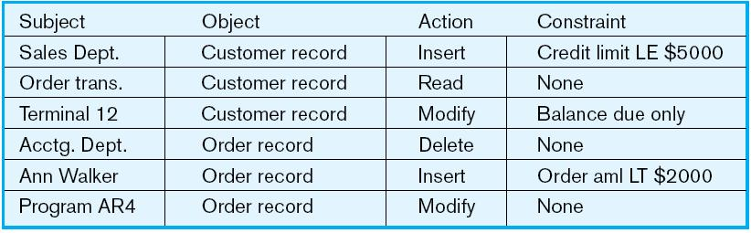
Figure 13-5 Authorization matrix

Slide 20
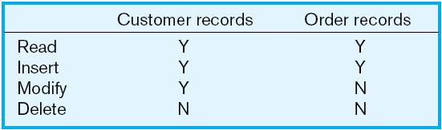
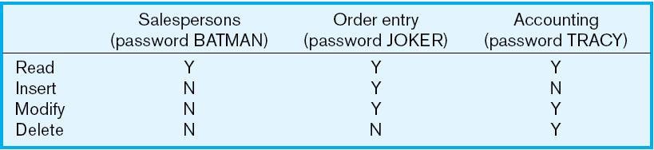
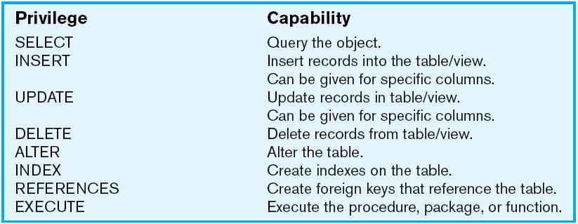
Figure 13-6a Authorization table for subjects (salespeople)
Implementing authorization rules
Figure 13-6b Authorization table for objects (orders)
Figure 13-7 Oracle privileges
Some DBMSs also provide capabilities for user-defined procedures to customize the authorization process

Slide 21
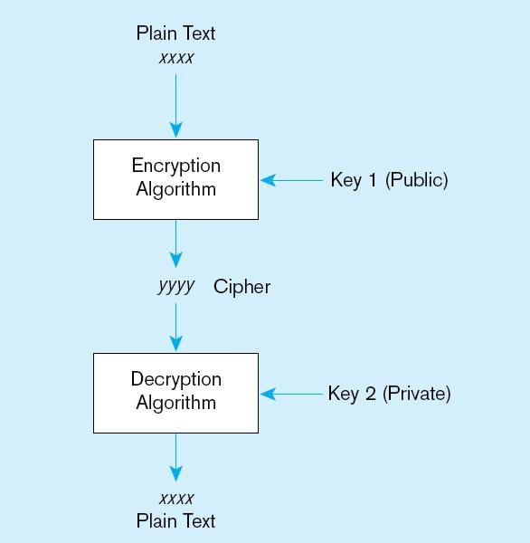
Figure 13-8 Basic two-key encryption
Encryption – the coding or scrambling of data so that humans cannot read them
Secure Sockets Layer (SSL) is a popular encryption scheme for TCP/IP connections

Slide 22
Authentication Schemes
Goal – obtain a positive identification of the user
Passwords: First line of defense
  Should be at least 8 characters long
  Should combine alphabetic and numeric data
  Should not be complete words or personal information
  Should be changed frequently

Slide 23
Authentication Schemes (cont.)
Strong Authentication
  Passwords are flawed:
    Users share them with each other
    They get written down, could be copied
    Automatic logon scripts remove need to explicitly type them in
    Unencrypted passwords travel the Internet
Possible solutions:
  Two factor–e.g. smart card plus PIN
  Three factor–e.g. smart card, biometric, PIN
  Biometric devices–use of fingerprints, retinal scans, etc. for positive ID
  Third-party mediated authentication–using secret keys, digital certificates

Slide 24
Security Policies and Procedures
Personnel controls
  Hiring practices, employee monitoring, security training
Physical access controls
  Equipment locking, check-out procedures, screen placement
Maintenance controls
  Maintenance agreements, access to source code, quality and availability standards
Data privacy controls
  Adherence to privacy legislation, access rules

Slide 25
Database Recovery
Mechanism for restoring a database quickly and accurately after loss or damage
Recovery facilities:
  Backup Facilities
  Journalizing Facilities
  Checkpoint Facility
  Recovery Manager

Slide 26
Back-up Facilities
Automatic dump facility that produces backup copy of the entire database
Periodic backup (e.g. nightly, weekly)
Cold backup–database is shut down during backup
Hot backup–selected portion is shut down and backed up at a given time
Backups stored in secure, off-site location

Slide 27
Journalizing Facilities
Audit trail of transactions and database updates
Transaction log–record of essential data for each transaction processed against the database
Database change log–images of updated data
  Before-image–copy before modification
  After-image–copy after modification
Produces an audit trail

Slide 28
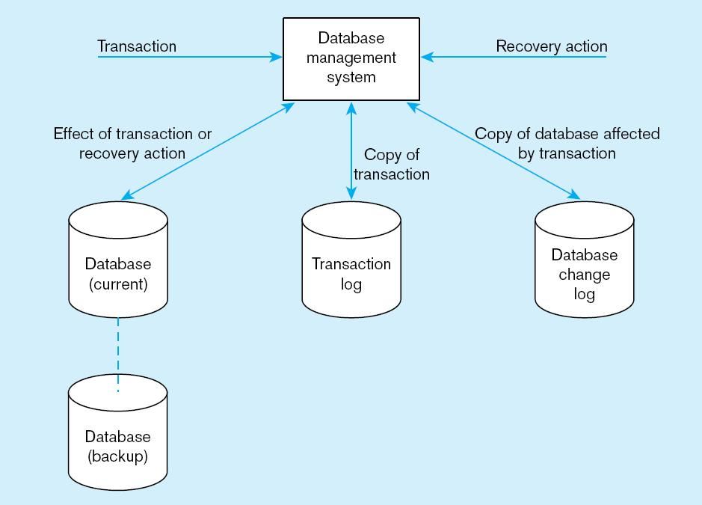
Figure 13-9 Database audit trail
From the backup and logs, databases can be restored in case of damage or loss

Slide 29
Checkpoint Facilities
DBMS periodically refuses to accept new transactions
➔ system is in a quiet state
Database and transaction logs are synchronized
This allows recovery manager to resume processing from short period, instead of repeating entire day

Slide 30
Recovery and Restart Procedures
Disk Mirroring–switch between identical copies of databases
Restore/Rerun–reprocess transactions against the backup
Transaction Integrity–commit or abort all transaction changes
Backward Recovery (Rollback)–apply before images
Forward Recovery (Roll Forward)–apply after images (preferable to restore/rerun)

Slide 31
Transaction ACID Properties
Atomic
  Transaction cannot be subdivided
Consistent
  Constraints don’t change from before transaction to after transaction
Isolated
  Database changes not revealed to users until after transaction has completed
Durable
  Database changes are permanent

Slide 32
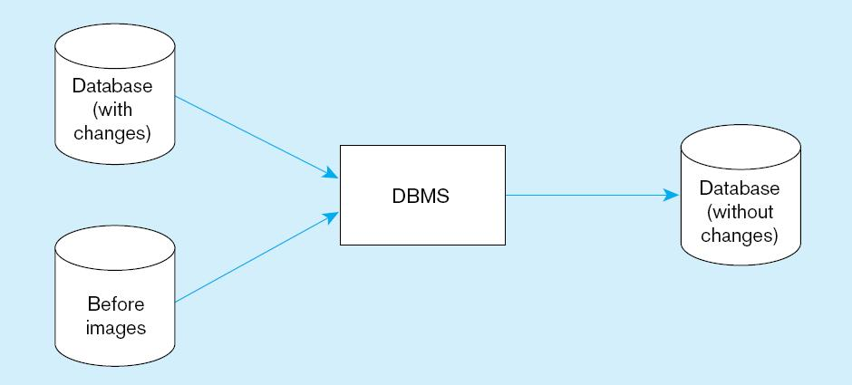
Figure 13-10 Basic recovery techniques
a) Rollback

Slide 33
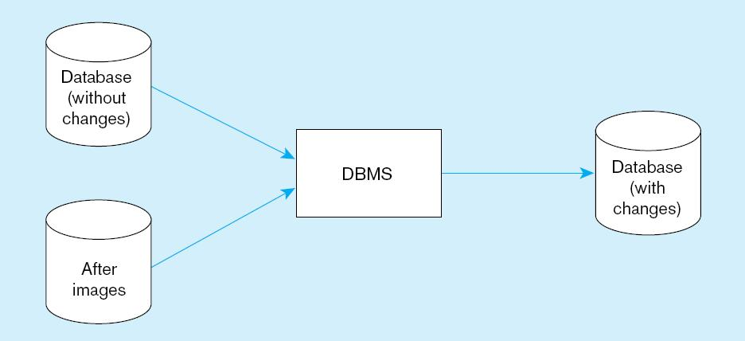
Figure 13-10 Basic recovery techniques (cont.)
b) Rollforward

Slide 34
Database Failure Responses
Aborted transactions
  Preferred recovery: rollback
  Alternative: Rollforward to state just prior to abort
Incorrect data
  Preferred recovery: rollback
  Alternative 1: rerun transactions not including inaccurate data updates
  Alternative 2: compensating transactions
System failure (database intact)
  Preferred recovery: switch to duplicate database
  Alternative 1: rollback
  Alternative 2: restart from checkpoint
Database destruction
  Preferred recovery: switch to duplicate database
  Alternative 1: rollforward
  Alternative 2: reprocess transactions

Slide 35
Concurrency Control
Problem–in a multi-user environment, simultaneous access to data can result in interference and data loss
Solution–Concurrency Control
  The process of managing simultaneous operations against a database so that data integrity is maintained and the operations do not interfere with each other in a multi-user environment

Slide 36
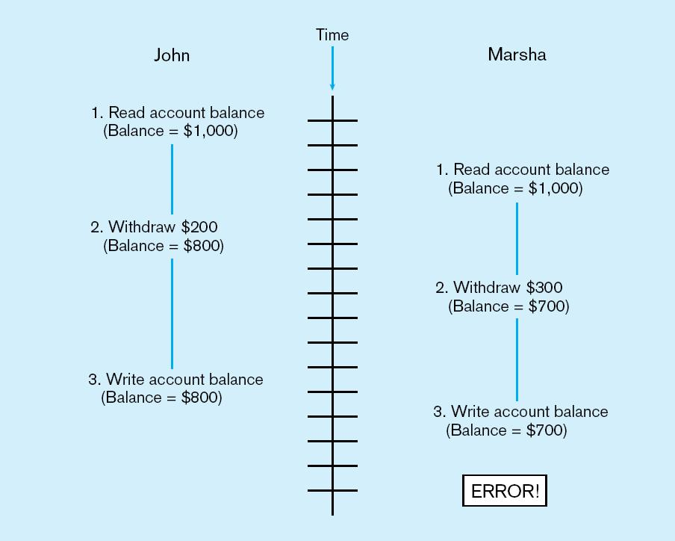
Figure 13-11 Lost update (no concurrency control in effect)
Simultaneous access causes updates to cancel each other
A similar problem is the inconsistent read problem

Slide 37
Concurrency Control Techniques
Serializability
  Finish one transaction before starting another
Locking Mechanisms
  The most common way of achieving serialization
  Data that is retrieved for the purpose of updating is locked for the updater
  No other user can perform update until unlocked

Slide 38
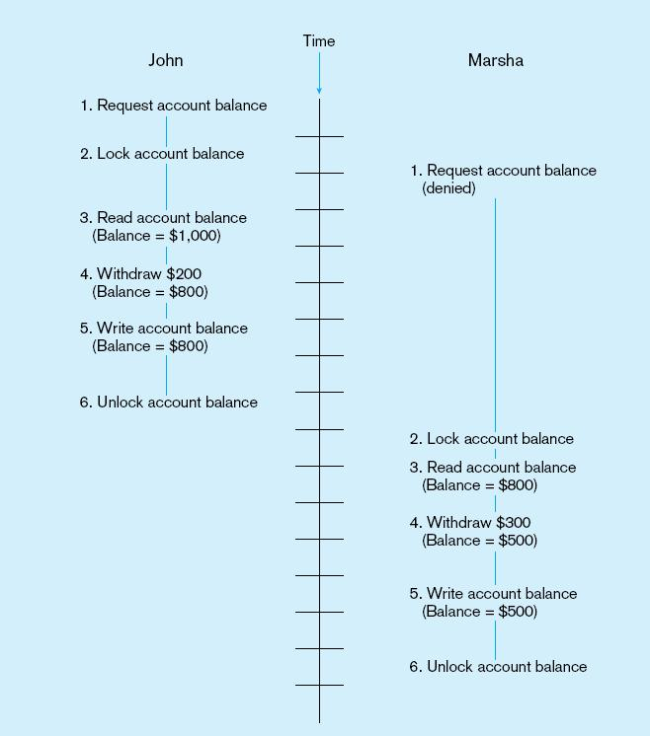
Figure 13-12: Updates with locking (concurrency control)
This prevents the lost update problem

Slide 39
Locking Mechanisms
Locking level:
  Database–used during database updates
  Table–used for bulk updates
  Block or page–very commonly used
  Record–only requested row; fairly commonly used
  Field–requires significant overhead; impractical
Types of locks:
  Shared lock–Read but no update permitted. Used when just reading to prevent another user from placing an exclusive lock on the record
  Exclusive lock–No access permitted. Used when preparing to update

Slide 40
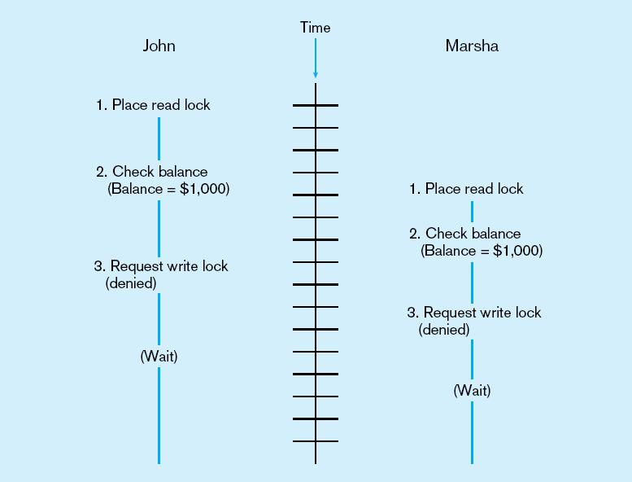
Deadlock
An impasse that results when two or more transactions have locked common resources, and each waits for the other to unlock their resources
Figure 13-13
The problem of deadlock
John and Marsha will wait forever for each other to release their locked resources!

Slide 41
Managing Deadlock
Deadlock prevention:
  Lock all records required at the beginning of a transaction
  Two-phase locking protocol
    Growing phase
    Shrinking phase
  May be difficult to determine all needed resources in advance
Deadlock Resolution:
  Allow deadlocks to occur
  Mechanisms for detecting and breaking them
    Resource usage matrix

Slide 42
Versioning
Optimistic approach to concurrency control
Instead of locking
Assumption is that simultaneous updates will be infrequent
Each transaction can attempt an update as it wishes
The system will reject an update when it senses a conflict
Use of rollback and commit for this

Slide 43
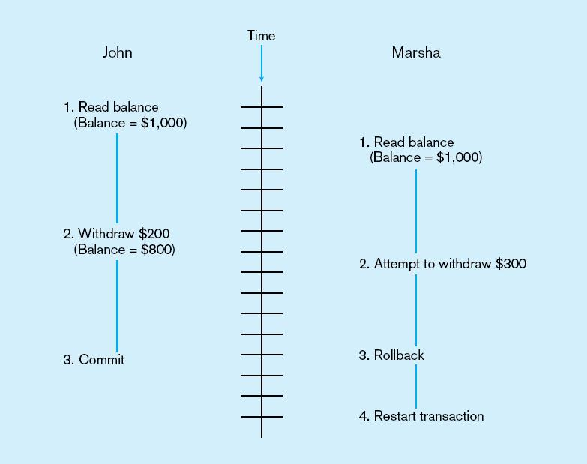
Figure 13-15 The use of versioning
Better performance than locking

Slide 44
Data Dictionaries and Repositories
Data dictionary
  Documents data elements of a database
System catalog
  System-created database that describes all database objects
Information Repository
  Stores metadata describing data and data processing resources
Information Repository Dictionary System (IRDS)
  Software tool managing/controlling access to information repository

Slide 45
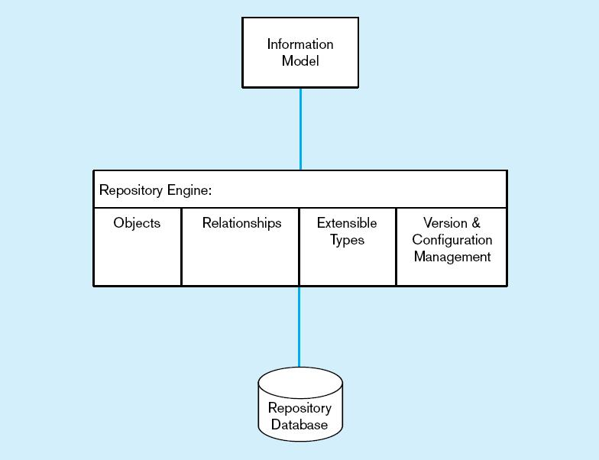
Figure 13-16 Three components of the repository system architecture
A schema of the repository information
Software that manages the repository objects
Where repository objects are stored
Source: adapted from Bernstein, 1996.

Slide 46
Database Performance Tuning
DBMS Installation
  Setting installation parameters
Memory Usage
  Set cache levels
  Choose background processes
Input/Output (I/O) Contention
  Use striping
  Distribution of heavily accessed files
CPU Usage
  Monitor CPU load
Application tuning
  Modification of SQL code in applications

Slide 47
Data Availability
Downtime is expensive
How to ensure availability
  Hardware failures–provide redundancy for fault tolerance
  Loss of data–database mirroring
  Maintenance downtime–automated and non-disruptive maintenance utilities
  Network problems–careful traffic monitoring, firewalls, and routers

Slide 48

All rights reserved. No part of this publication may be reproduced, stored in a retrieval system, or transmitted, in any form or by any means, electronic, mechanical, photocopying, recording, or otherwise, without the prior written permission of the publisher. Printed in the United States of America.
Copyright © 2009 Pearson Education, Inc. Publishing as Prentice Hall

