Slide 1
Chapter 15 (Web):
Object-Oriented Data Modeling
Modern Database Management
9th Edition
Jeffrey A. Hoffer, Mary B. Prescott,
Heikki Topi
© 2009 Pearson Education, Inc. Publishing as Prentice Hall

Slide 2
Objectives
Definition of terms
Describe phases of object-oriented development life cycle
State advantages of object-oriented modeling
Compare object-oriented model with E-R and EER models
Model real-world application using UML class diagram
Provide UML snapshot of a system state
Recognize when to use generalization, aggregation, and composition
Specify types of business rules in a class diagram

Slide 3
What Is Object-Oriented Data Modeling?
Centers around objects and classes
Involves inheritance
Encapsulates both data and behavior
Benefits of Object-Oriented Modeling
  Ability to tackle challenging problems
  Improved communication between users, analysts, designers, and programmers
  Increased consistency in analysis, design, and programming
  Explicit representation of commonality among system components
  System robustness
  Reusability of analysis, design, and programming results

Slide 4
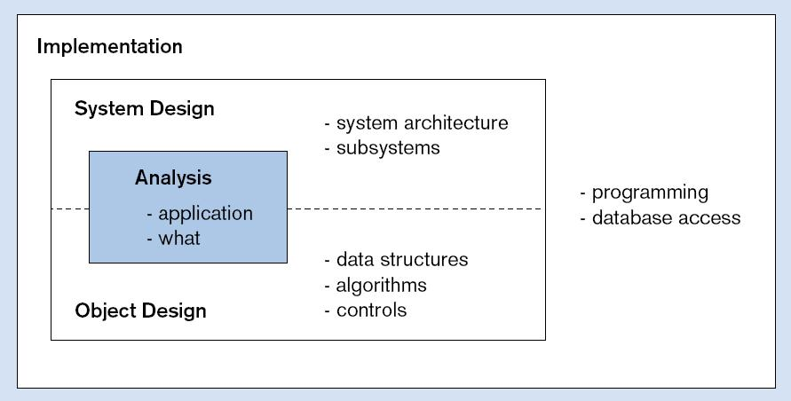
Figure 15-1 Phases of object-oriented systems development cycle
Progressive and iterative development process

Slide 5
OO vs. EER Data Modeling
Object Oriented
EER
Class
Entity type
Object
Entity instance
Association
Relationship
Inheritance of attributes
Inheritance of attributes
Inheritance of behavior
No representation of behavior
Object-oriented modeling is typically represented using the Unified Modeling Language (UML)

Slide 6
Classes and Objects
Class: An entity that has a well-defined role in the application domain, as well as state, behavior, and identity
  Tangible: person, place or thing
  Concept or Event: department, performance, marriage, registration
  Artifact of the Design Process: user interface, controller, scheduler
Object: a particular instance of a class
Objects exhibit BEHAVIOR as well as attributes
➔ Different from entities

Slide 7
State, Behavior, Identity
State: attribute types and values
Behavior: how an object acts and reacts
  Behavior is expressed through operations that can be performed on it
Identity: every object has a unique identity, even if all of its attribute values are the same

Slide 8
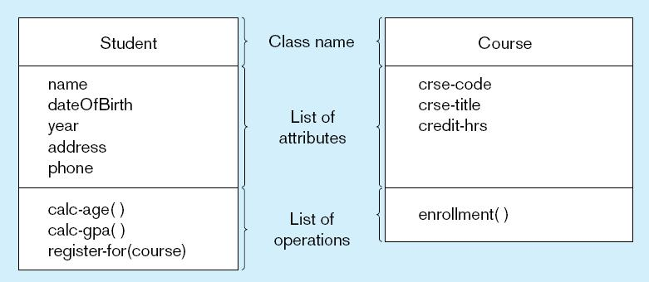
Figure 15-2 UML class and object diagram
a) Class diagram showing two classes
Class diagram shows the static structure of an object-oriented model: object classes, internal structure, relationships

Slide 9
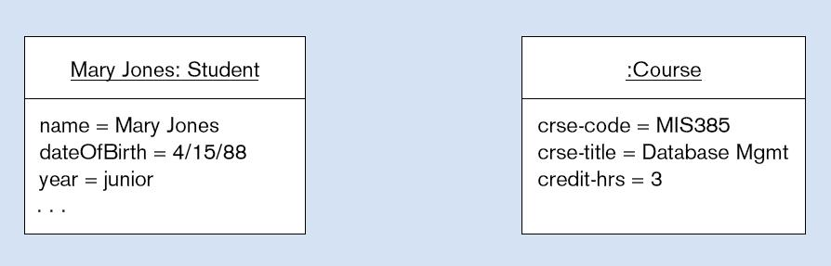
Figure 15-2 UML class and object diagram (cont.)
b) Object diagram with two instances
Object diagram shows instances that are compatible with a given class diagram

Slide 10
Operation
A function or service that is provided by all instances of a class
Types of operations:
  Constructor: creates a new instance of a class
  Query: accesses the state of an object but does not alter its state
  Update: alters the state of an object
  Scope: operation applying to the class instead of an instance
Operations implement the object’s behavior

Slide 11
Associations
Association:
  Named relationship among object classes
Association Role:
  Role of an object in an association
  The end of an association where it connects to a class
Multiplicity:
  How many objects participate in an association. Lower-bound...Upper-bound (cardinality)

Slide 12
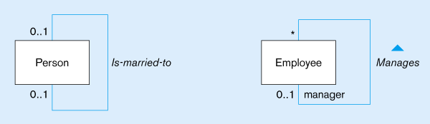
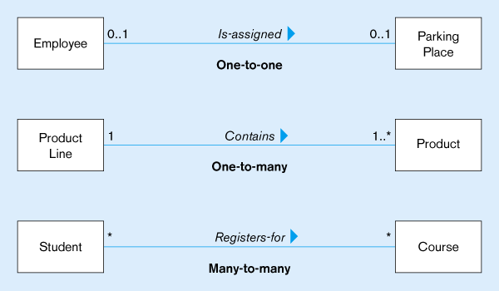
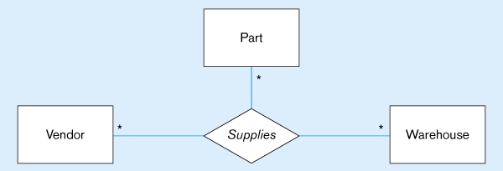
Figure 15-3
Examples of association relationships of different degrees
Unary
Lower-bound – upper-bound
Represented as:
0..1, 0..*, 1..1, 1..*
Similar to minimum/maximum cardinality rules in EER
Binary
Ternary

Slide 13
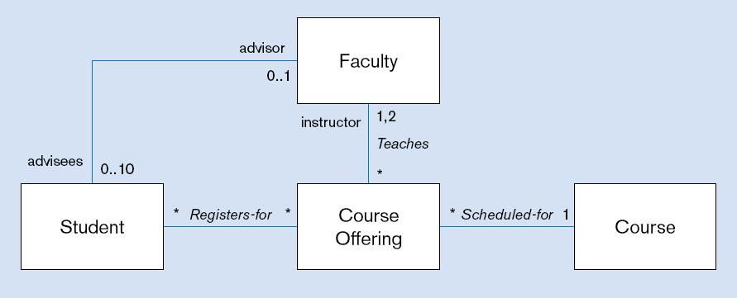
Figure 15-4 Examples of binary association relationships
a) University example
Alternative multiplicity representation: specifying the two possible values in a list instead of a range

Slide 14
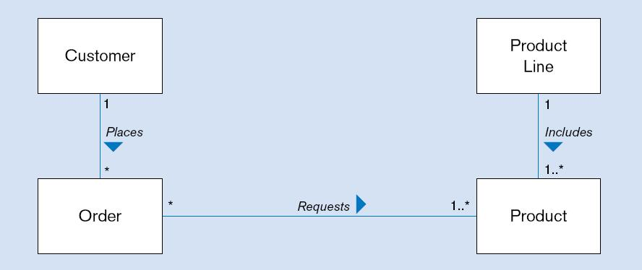
Figure 15-4 Examples of binary association relationships (cont.)
b) Customer order example

Slide 15
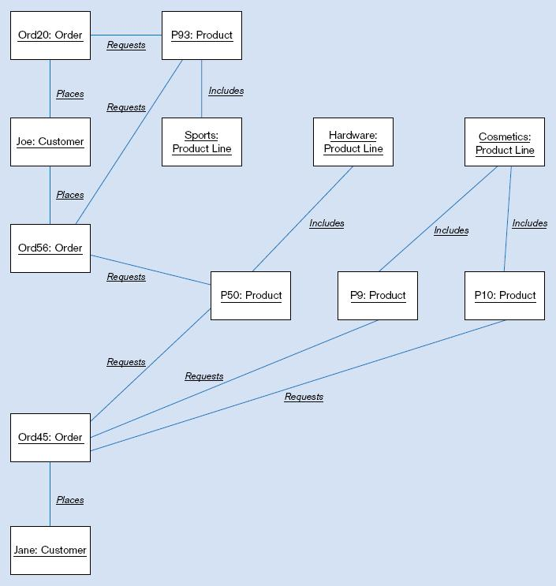
Figure 15-5
Object diagram for customer order example

Slide 16
Association Class
An association that has attributes or operations of its own or that participates in relationships with other classes
Like an associative entity in E-R model

Slide 17
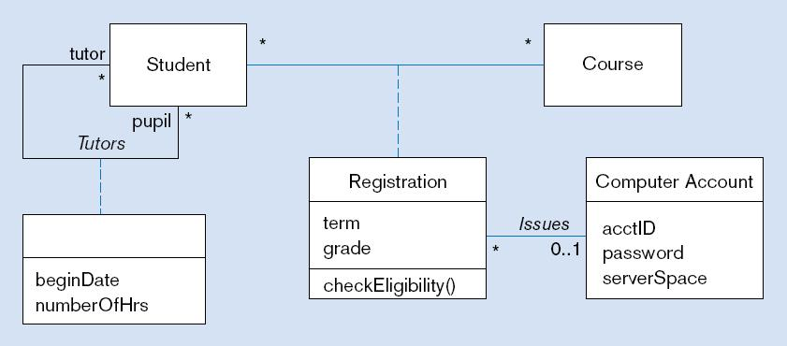
Figure 15-6 Association class and link object
a) Class diagram showing association classes
Binary association class with behavior
Unary association with only attributes and no behavior

Slide 18
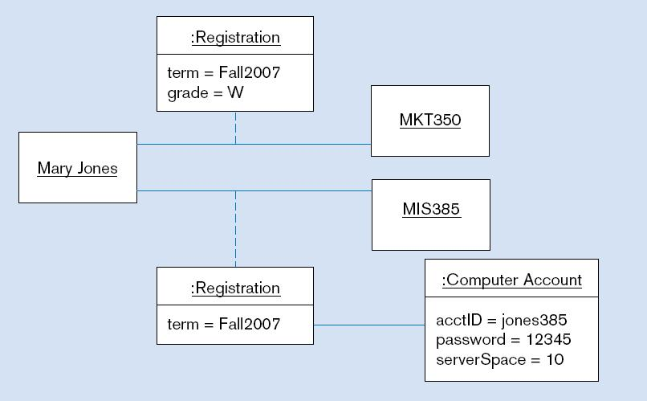
Figure 15-6 Association class and link object (cont.)
b) Object diagram showing link objects
Association class
instances

Slide 19
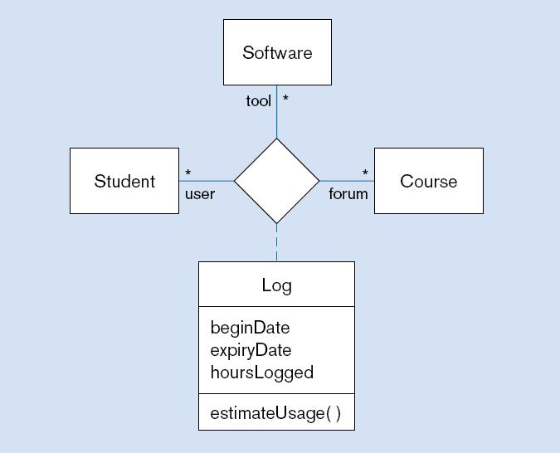
Figure 15-7 Ternary relationship with association class

Slide 20
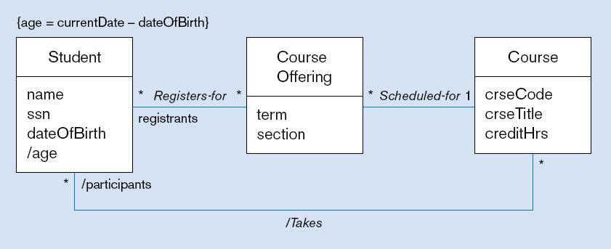
Figure 15-8 Derived attribute, association, and role
Constraint expression for derived attribute
Derived attribute
Derived relationship (from Registers-for and Scheduled-for)
Derived attributes and relationships shown with / in front of the name

Slide 21
Generalization/Specialization
Subclass, superclass
  similar to subtype/supertype in EER
Common attributes, relationships, and operations
Disjoint vs. Overlapping
Complete (total specialization) vs. incomplete (partial specialization)
Abstract Class: no direct instances possible, but subclasses may have direct instances
Concrete Class: direct instances possible

Slide 22
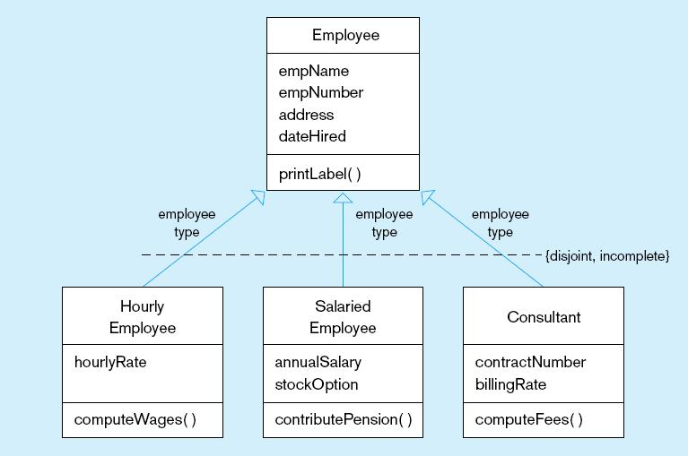
Figure 15-9 Examples of generalization, inheritance, and constraints
a) Employee superclass with three subclasses
An employee can only be one of these subclasses
Shared attributes and operations
An employee may be none of them
Specialized attributes and operations

Slide 23
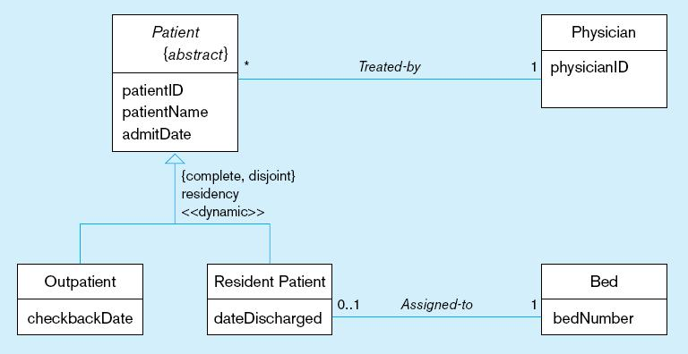
Figure 15-9 Examples of generalization, inheritance, and constraints (cont.)
b) Abstract Patient class with two concrete subclasses
Abstract indicated by italics
A patient MUST be EXACTLY one of the subtypes
Dynamic means a
patient can change from one subclass to another over time

Slide 24
Class-Scope Attribute
Specifies a value common to an entire class, rather than a specific value for an instance
Represented by underlining
“=“ is initial, default value

Slide 25
Polymorphism
Abstract Operation: Defines the form or protocol of the operation, but not its implementation
Method: The implementation of an operation
Polymorphism: The same operation may apply to two or more different classes in different ways

Slide 26
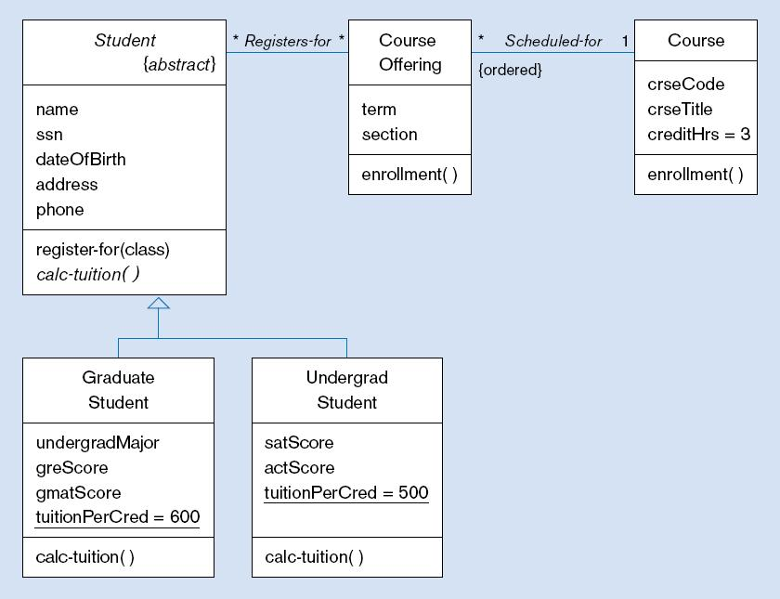
Figure 15-11 Polymorphism, abstract operation, class-scope attribute, and ordering
This operation is abstract…it has no method at Student level
Class-scope attributes–only one value common to all instances of these classes (includes default values)
Methods are defined at subclass level

Slide 27
Overriding Inheritance
Overriding: The process of replacing a method inherited from a superclass by a more specific implementation of that method in a subclass
  For Extension: add code
  For Restriction: limit the method
  For Optimization: improve code by exploiting restrictions imposed by the subclass

Slide 28
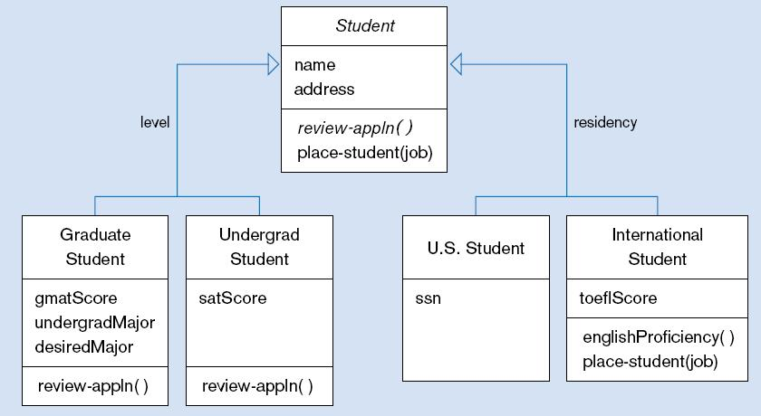
Figure 15-12 Overriding inheritance
Subclasses that do not override place-student use the default behavior
Restrict job placement

Slide 29
Multiple Inheritance
Multiple Classification: An object is an instance of more than one class
Multiple Inheritance: A class inherits features from more than one superclass

Slide 30
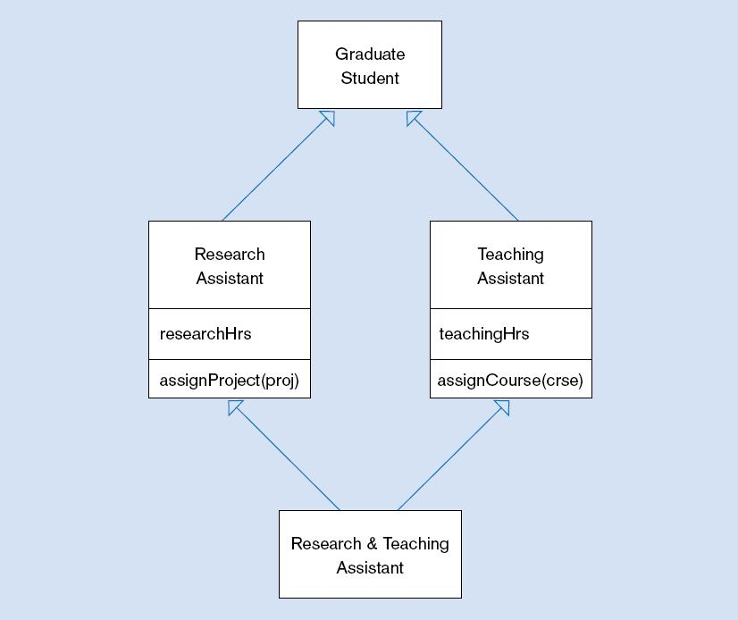
Figure 15-13 Multiple inheritance

Slide 31
Aggregation
Aggregation: A part-of relationship between a component object and an aggregate object
Composition: A stronger form of aggregation in which a part object belongs to only one whole object and exists only as part of the whole object
Recursive Aggregation: Composition where component object is an instance of the same class as the aggregate object

Slide 32
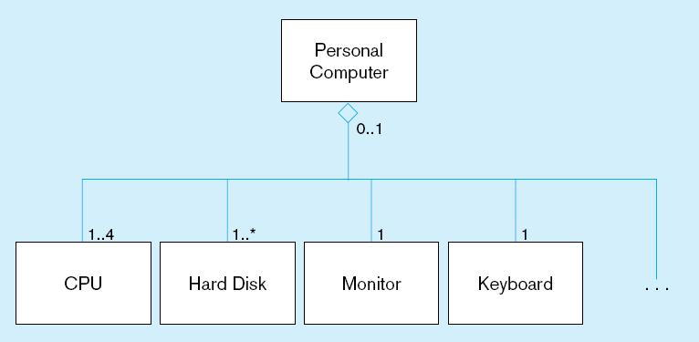
Figure 15-14 Example of aggregation
A Personal Computer includes CPU, Hard Disk, Monitor, and Keyboard as parts. But, these parts can exist without being installed into a computer. The open diamond indicates aggregation, but not composition

Slide 33
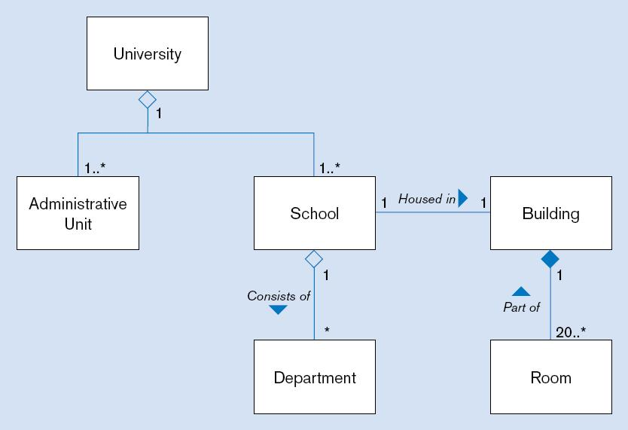
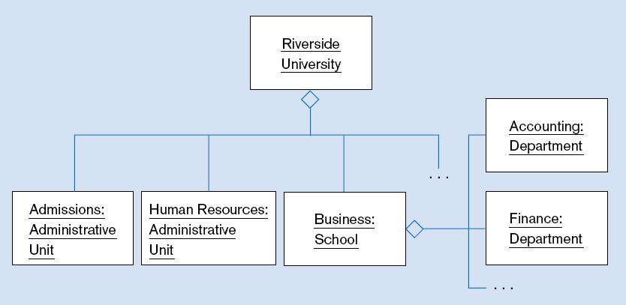
Figure 15-15 Aggregation and Composition
(a) Class diagram
Closed diamond indicates composition. The room cannot exist without the building
(b) Object diagram

Slide 34
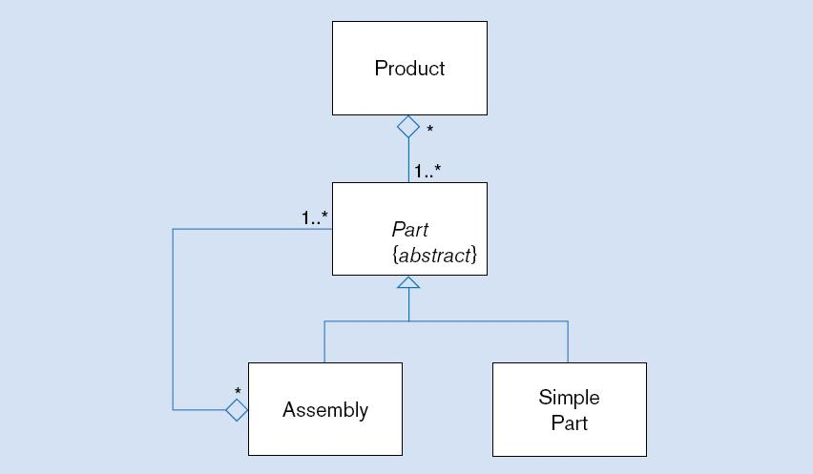
Figure 15-16 Recursive aggregation

Slide 35
Business Rules
See Chapters 3 and 4
Implicit and explicit constraints on objects – for example:
  cardinality constraints on association roles
  ordering constraints on association roles
Business rules involving two graphical symbols:
  labeled dashed arrow from one to the other
Business rules involving three or more graphical symbols:
  note with dashed lines to each symbol

Slide 36
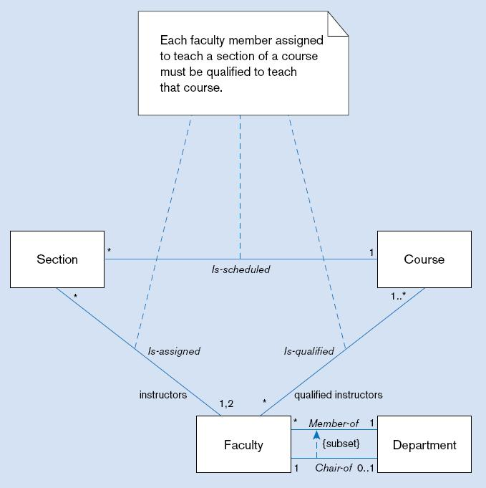
Figure 15-17 Representing business rules
Three-symbol constraint
Two-symbol constraint

Slide 37
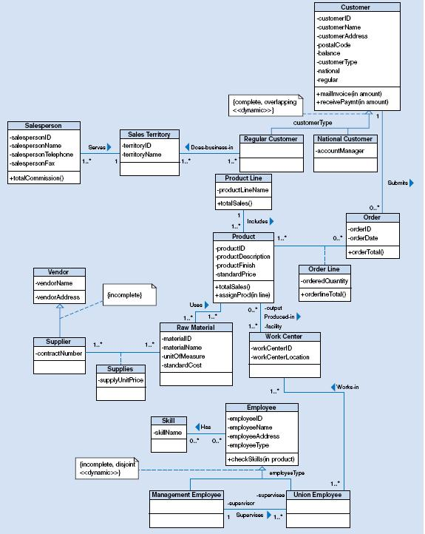
Figure 15-18 Class diagram for Pine Valley Furniture Company

Slide 38

All rights reserved. No part of this publication may be reproduced, stored in a retrieval system, or transmitted, in any form or by any means, electronic, mechanical, photocopying, recording, or otherwise, without the prior written permission of the publisher. Printed in the United States of America.
Copyright © 2009 Pearson Education, Inc. Publishing as Prentice Hall

