Slide 1
Chapter 16
Using Relational Databases to Provide Object Persistence
Modern Database Management
9th Edition
Jeffrey A. Hoffer, Mary B. Prescott,
Heikki Topi
© 2009 Pearson Education, Inc. Publishing as Prentice Hall

Slide 2
Objectives
Definition of terms
Understand mismatch between object-oriented and relational paradigms and its consequences
Understand similarities and differences between approaches used to address object-relational mismatch
Create mapping between OO structures and relational structures using Hibernate
Identify appropriate contexts for the different approaches of addressing the object-relational mismatch
Understand performance, concurrency, and security effects of object-relational mapping
Use HQL to formulate queries

Slide 3
Storage in OO systems
Persistence
  An object’s capacity to maintain its state between application execution sessions
Object-relational mapping (ORM)
  Defining structural relationships between object-oriented and relational representations of data, typically to enable the use of a relational database to provide persistence for objects

Slide 4
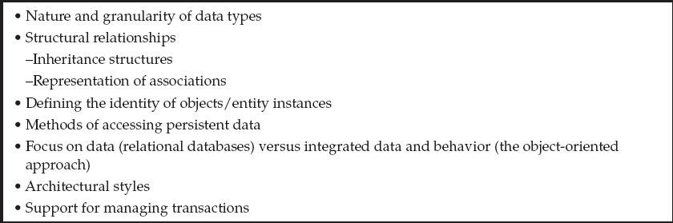
OO – Relational Mismatch
Conceptual differences between the object-oriented approach to application design and the relational model for database design/implementation
Table 16-1 – Elements of the object-relational mismatch

Slide 5
Providing Object Persistence Using Relational Databases
Call-level Application Program Interface (API)
SQL Mapping Frameworks
Object-Relational Mapping Frameworks
Proprietary Approaches

Slide 6
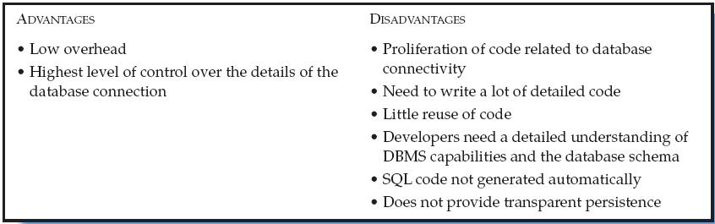
Call-Level APIs
SQL query hand-coded by programmer passed as parameter to driver
Examples:
  Java Database Connectivity (JDBC)
  ADO .NET
  Open Database Connectivity (ODBC)

Slide 7
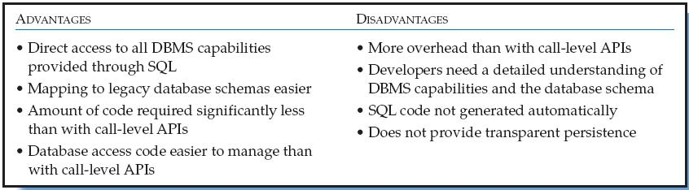
SQL Query Mapping Frameworks
Examples:
  iBATIS and iBATIS .NET
Components:
  iBATIS Data Mapper/SQL Maps
  iBATIS Data Access Objects

Slide 8
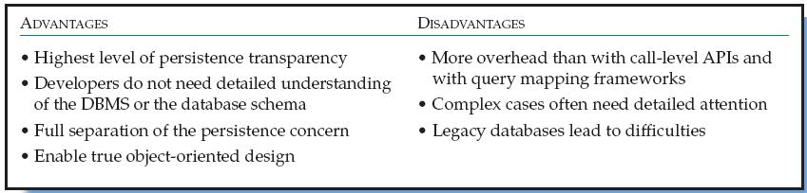
ORM Mapping Frameworks
Examples:
  (N)Hibernate, JDO, Java Persistence API (JPA), Toplink
Transparent persistence
  Hides underlying storage technology
Declarative Mapping Schema
  Defines relationship between OO classes and database relations/tables

Slide 9
Proprietary Frameworks
Example:
  Microsoft’s Language Integrated Query (LINQ)
Goal:
  very closely integrate data access queries into programming languages, not limiting the access to relational databases or XML but any type of data store

Slide 10
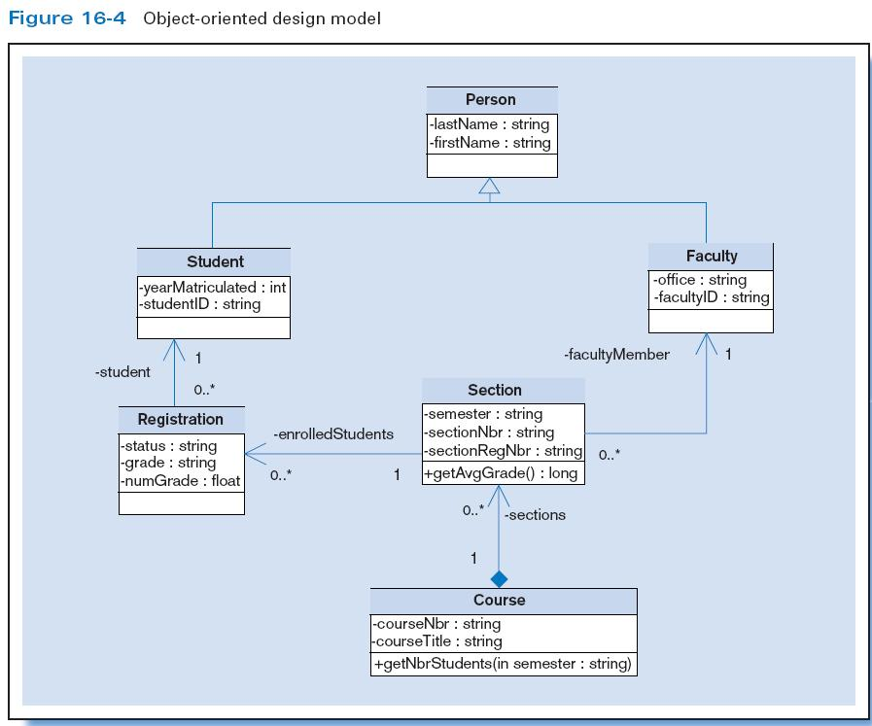

Slide 11
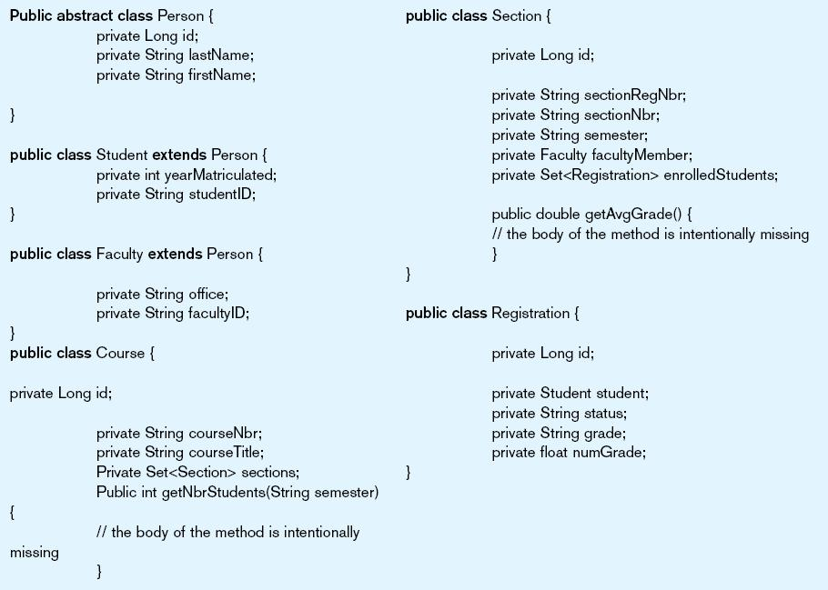
Example Hibernate Mapping
Figure 16-5 Java implementation of OO model

Slide 12
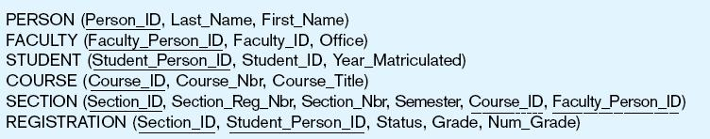
Example Hibernate Mapping
Figure 16-6 Relational database implementation

Slide 13

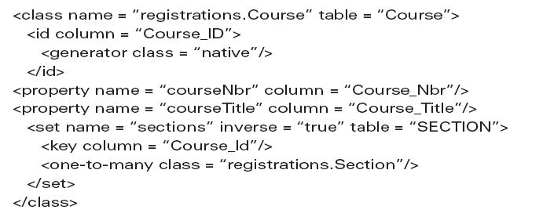

Example Hibernate Mapping
An ORM mapping

Slide 14
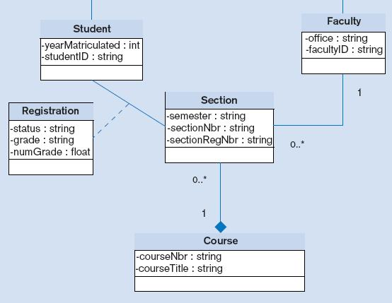
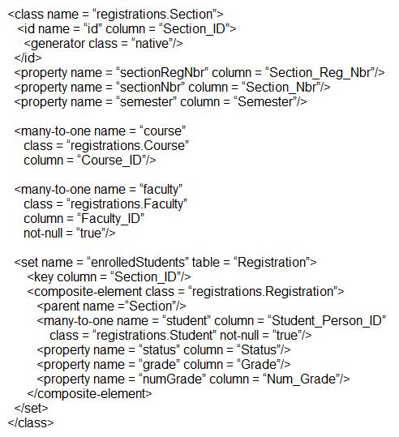
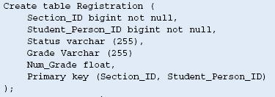
Example Hibernate Mapping
Another ORM mapping

Slide 15
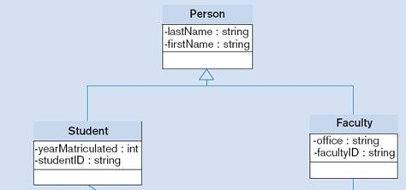
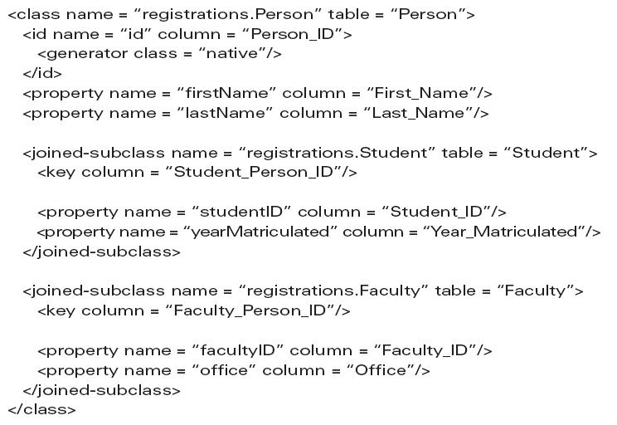

Example Hibernate Mapping
Another ORM mapping

Slide 16
Responsibilities of ORM Mapping Frameworks
Providing a layer of abstraction between OO applications and a database schema implemented with a DBMS ➝ transparent persistence
Generating SQL code for database access
Centralizing code related to database access
Support for transaction integrity and management
Services for concurrency control
Query language (e.g. Hibernate’s HQL)

Slide 17

All rights reserved. No part of this publication may be reproduced, stored in a retrieval system, or transmitted, in any form or by any means, electronic, mechanical, photocopying, recording, or otherwise, without the prior written permission of the publisher. Printed in the United States of America.
Copyright © 2009 Pearson Education, Inc. Publishing as Prentice Hall

