Slide 1
House Sales Management System EDS6397 – Database Management Tools Group - 1

Slide 2
Our Team
Anudeep Bathina
Shashank Arjun Dandu
Abhinandhan Reddy Gangula
Pravallika Kilari
Ananya Kura
Chandana Obulampalli
Bhanu Prakash Ramineni
Greeshma Geethika Rampam
Adi Karthikeya S B
Shanmukha Sai Vemulapalli

Slide 3
Introduction
Simplified way to interact with Real Estate properties
Seamless experience for
Property Listings
Rentals
Purchases
Payments
Chatbot
A system designed to ensure security, traceability and User-friendliness at every step of real estate journey.

Slide 4
Business Rules
1. User
Each user must have a unique email address for identification and login purposes.
Passwords must be securely stored using a strong hashing algorithm
The role field must clearly define user access (Buyer, Seller, Agent, Admin), and user roles control permissions across the system.
2. Property Listings Table (Property Management)
Only users with Seller or Agent role can Create , Modify and Delete property listings.
Each property must have a valid user_id from the user table, ensuring ownership is traceable.
Each Property must have a valid property_status (Available, Hold and Sold)
3. Property Image Table (Property Images)
Each property should have at least one associated image (image_url).
The propertyimage_id must link to an existing entry in property_listings.

Slide 5
4. Appointment Table (Appointments Scheduling)
Only registered users can schedule appointments (linked via user_id).
Appointments can be scheduled only for properties with status = 'available'.
Seller/Agent can Accept or Reject the appointments
5. Offer Table (Offer Management)
Only users with Buyer and Agent roles can submit offers on properties.
A Buyer/Agent can submit only one active offer per property.
When an offer is accepted, all other offers on that property must be automatically rejected.
6. Payment Table (Payments and Transaction Flow)
Payments are allowed only for offers with status = ‘Hold'.
Upon successful payment, the property status must update to 'Sold'.
The amount_paid should be validated to match the Seller accepted offer_price
7. Favorite Table (Favorites Functionality)
Only registered users can mark properties as favorites.
A property can be favorited only once by the same user.

Slide 6
8. Tickets Table (Support System / Help Center)
Each ticket must be linked to a valid user_id.
Ticket status must be either 'Open' or 'Resolved’.
Once a ticket is resolved, a resolution message must be recorded in the resolution field.
9. Audit Log Table (Action Tracking and Monitoring)
Every action performed by a user must be recorded with action_type, action_date, and a description.
Linked via user_id to identify which user performed the action.
The description field must clearly explain the action taken (e.g., 'Offer submitted', 'Payment processed’).
10. Rental Contracts Table (Rental Management)
Each rental contract must reference a valid property_id.
Only one active rental contract is allowed per property at any given time.
Security deposit and available_date must be valid.
11. Rental Interest Table (Rental Interest and Payment Status)
Each rental interest must be associated with a valid buyer and property.
The status should be managed between 'Pending', 'Accepted', or 'Rejected'.
If payment is completed (payment_status = 'Paid’) and (property_status=‘Sold’) and the property
will get displayed under his properties.

Slide 7
ERD DIAGRAM

Slide 8
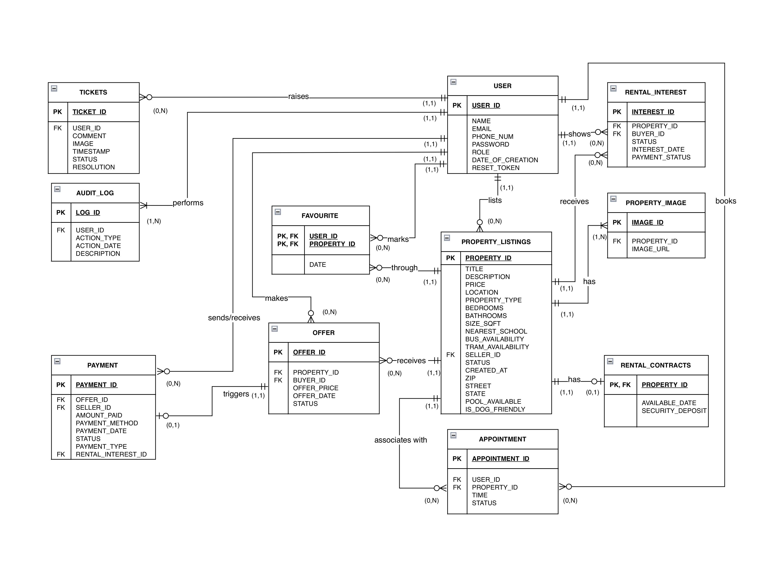

Slide 9
Data Dictionary

Slide 10
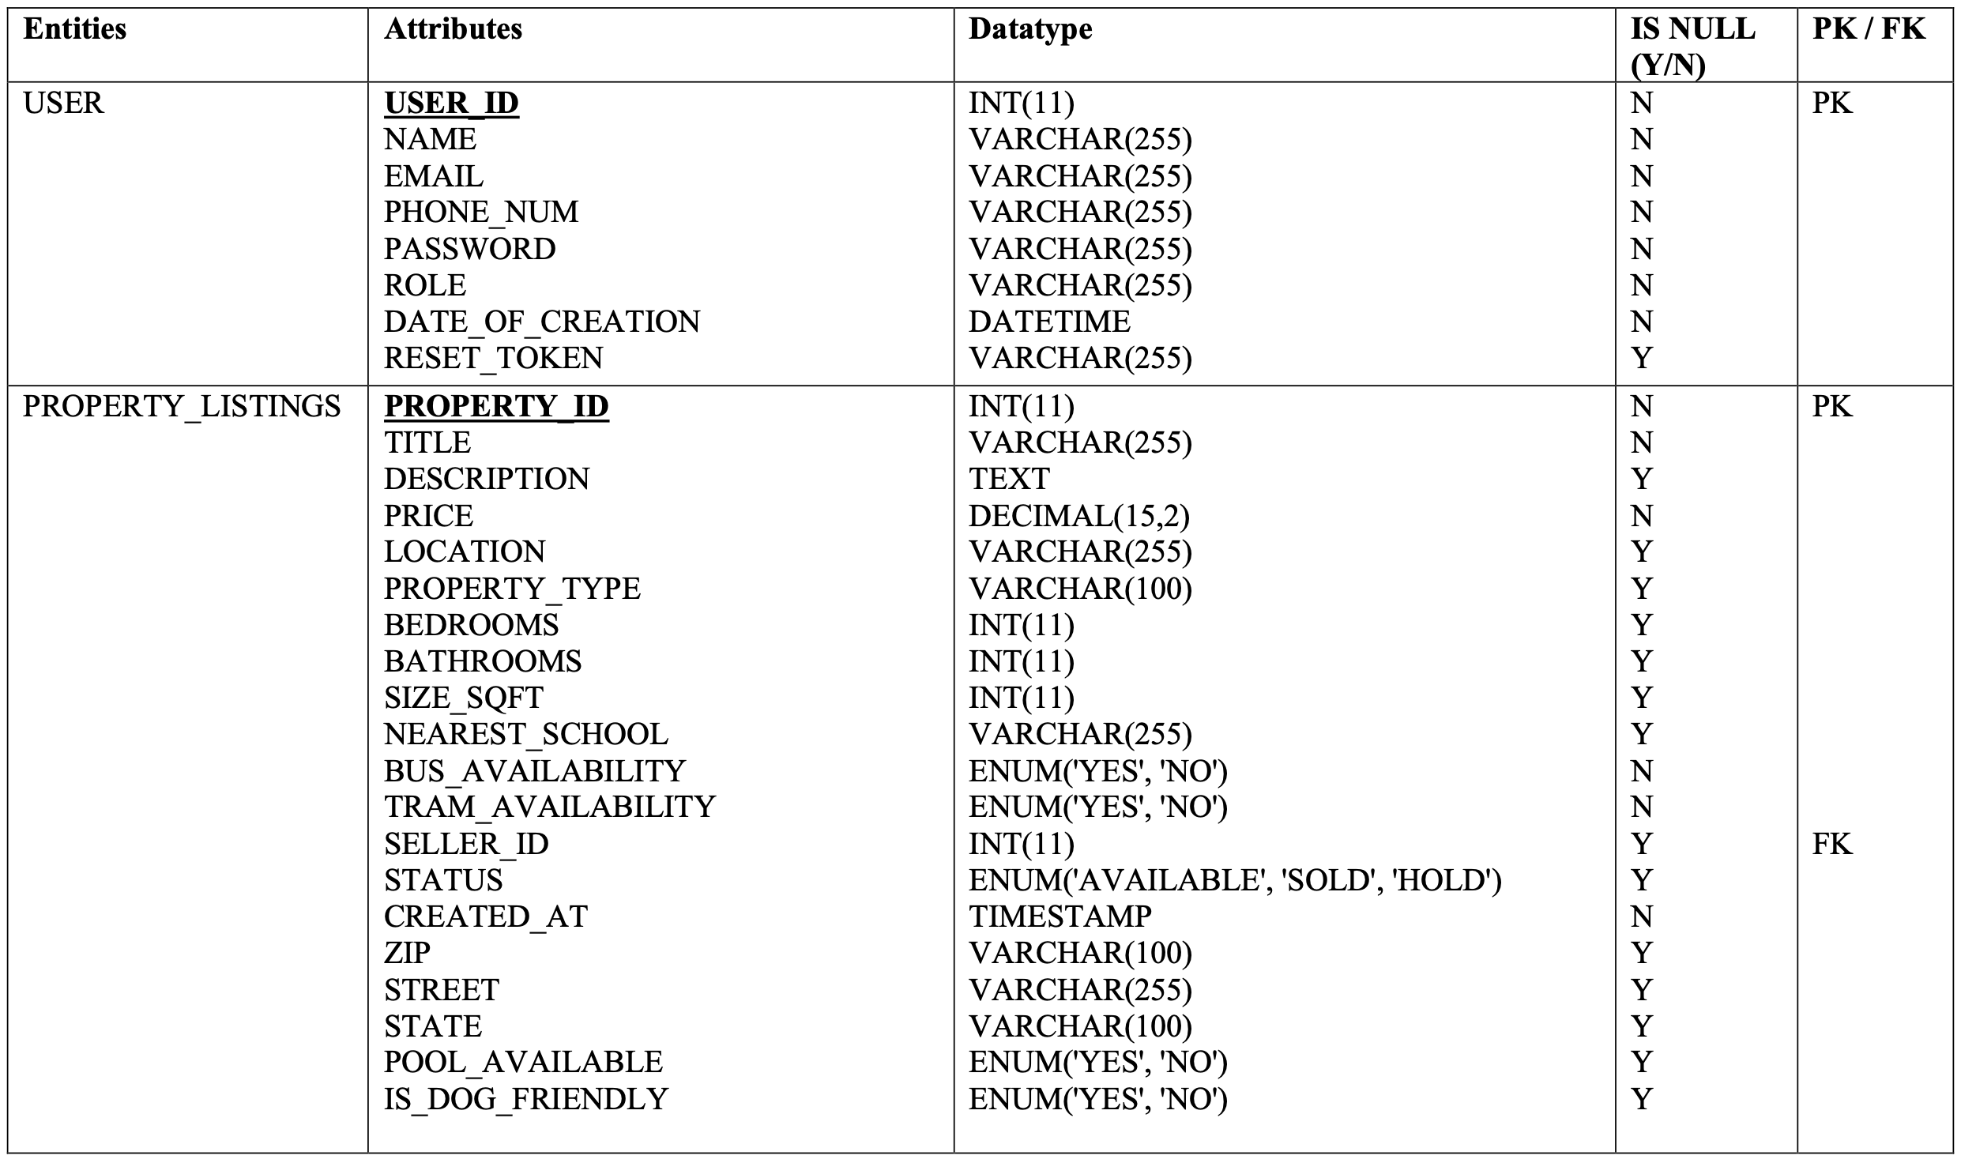

Slide 11
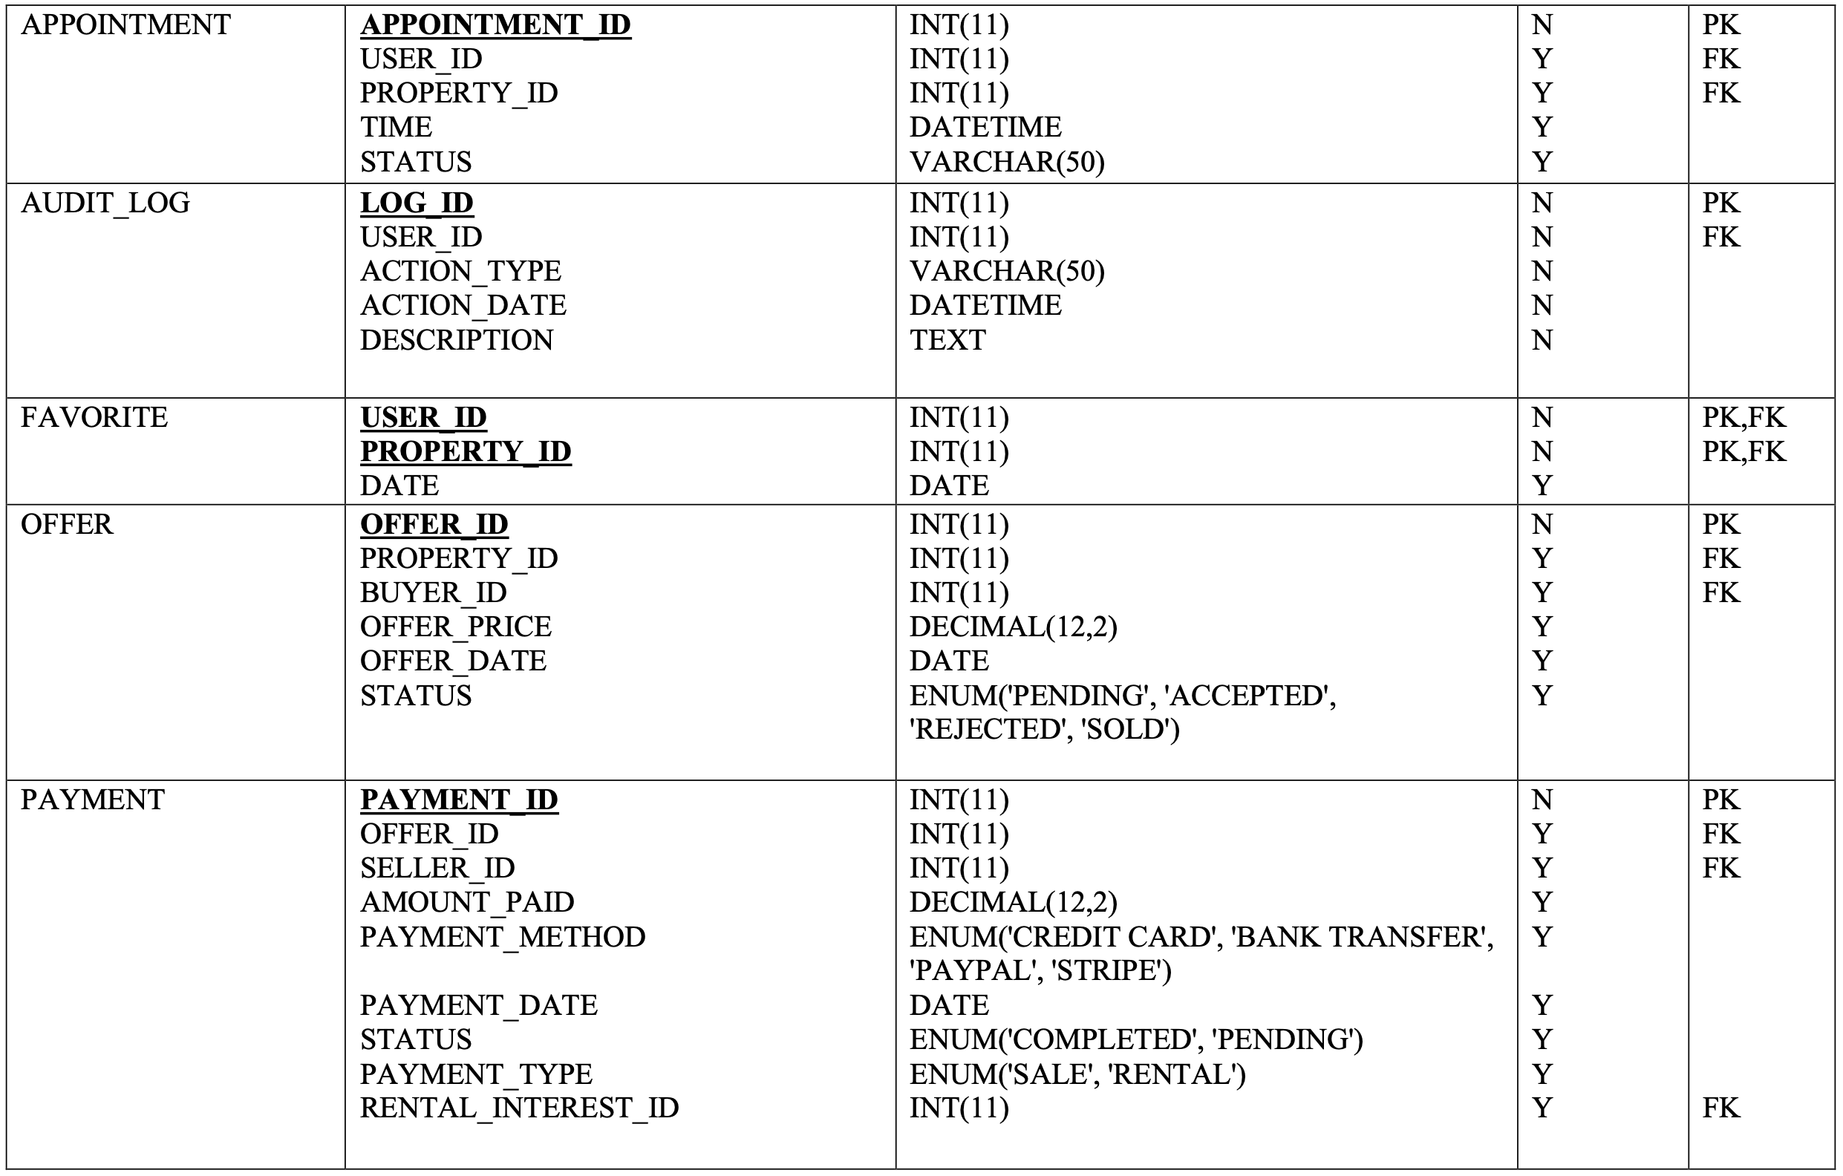

Slide 12
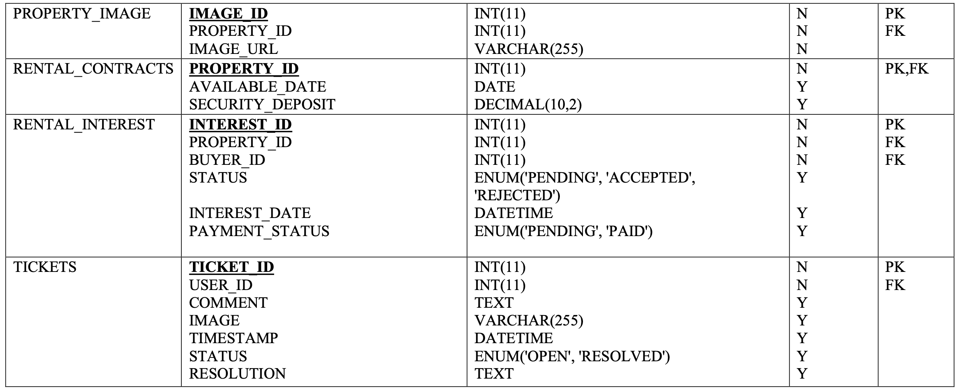

Slide 13

THANK YOU

