Slide 1
Informing a Discord channel of GitHub commits with an Azure Cloud Function
Rami Pasanen

Slide 2



Idea
User pushes commit(s) to GitHub
GitHub
GitHub webhook call -> sends information
about pushed commits
to our Azure cloud function
Azure Cloud function
uses Discord Webhook API
to post commit details to
a Discord channel

Slide 3
Implementation process
1. Create Azure account
2. Create a new Azure Function App on the Azure website
3. Install Azure SDK for Visual Studio 2017, included in VS2017 installer
4. Create a new Azure Functions project in VS2017
5. Write function code
Create a webhook for the Discord server
Parse JSON data sent from GitHub webhook
Use the URL address generated for the Discord webhook to post a message to the channel
6. Publish function to Azure by right-clicking the project in Visual Studio
7. Make GitHub call our Azure function through a webhook each time commits are pushed to the repository

Slide 4
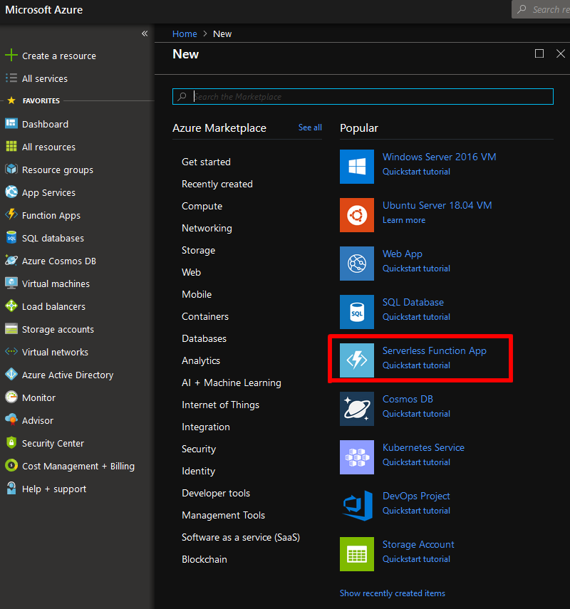
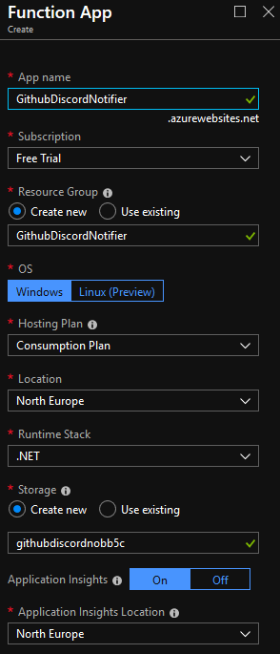
Azure function app creation

Slide 5
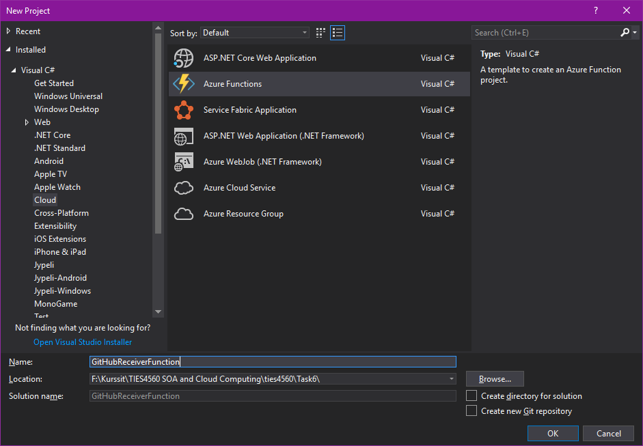
Creating an Azure Functions project in VS2017

Slide 6
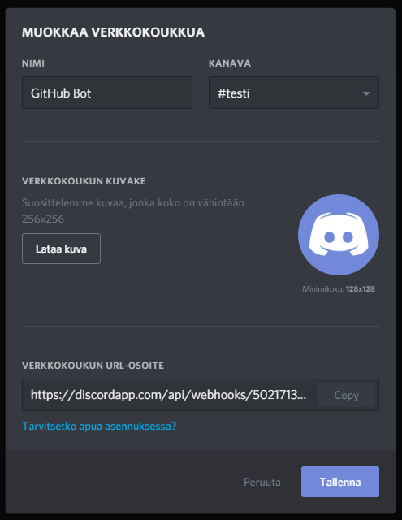
Create webhook for Discord channel, use URL in function code to push message to Discord channel

Slide 7
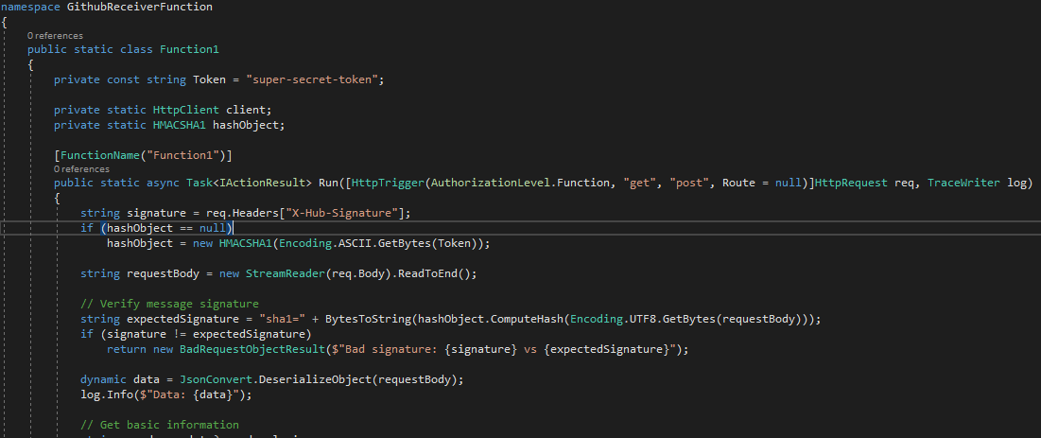
Write function code

Slide 8
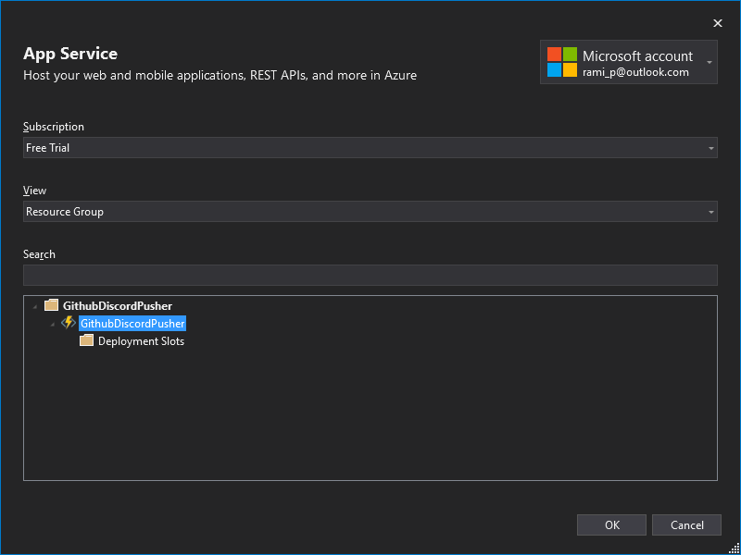
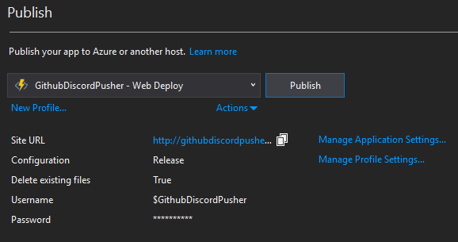
Publish function to Azure, right-click on VS project -> Publish

Slide 9
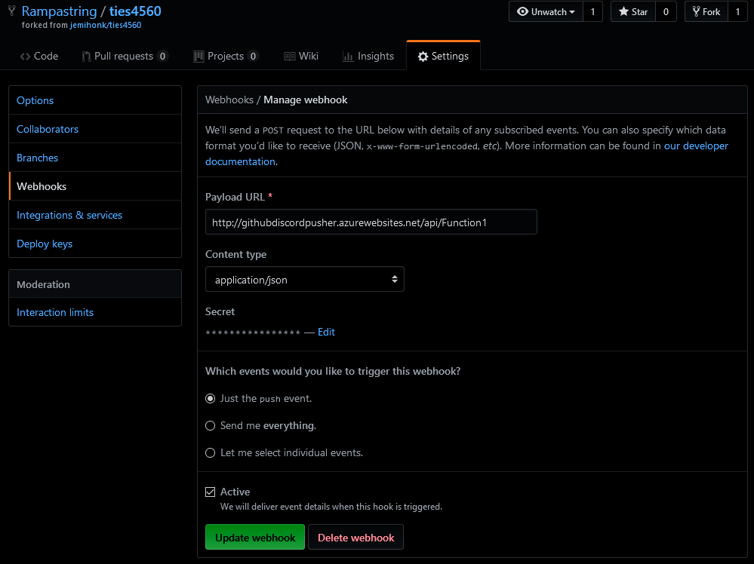
Set up GitHub webhook to call our function when repository is pushed to

Slide 10
Demonstration

Slide 11
Security
Discord requires you to use a token in the URL to prevent unauthorized use of the webhook
You get the token when creating the webhook and use it when sending the message. Other people can’t know the token unless you give it to them – meaning they can’t directly utilize the webhook to deliver messages to the channel.
GitHub can optionally be configured to send a hashed authentication token with the push notification
Token can be used in the cloud function to verify that GitHub really is the source of the push notification – prevents someone from manually sending false push notifications to our Discord channel with our cloud function.
Azure URL token adds another layer of security

Slide 12
Challenges
Almost everything went smoothly
Microsoft Azure, GitHub and Discord all have well-written documentation with examples
Most complex thing was figuring out the format of GitHub’s JSON response and parsing it in C# as well as figuring out how the GitHub and Discord APIs work

Slide 13
Challenges
One surprise – published Azure cloud function needs authorization code in the URL, while when run locally it doesn’t
Function worked perfectly when debugged on local system with VS2017
After publishing it returned 401 Unauthorized to both GitHub and my own browser despite not configuring any authorization mechanism
By navigating the Azure Cloud Functions App website I found a ”Get function URL” link that had an additional authorization code in the URL – I had to use this URL in GitHub to succesfully call the published cloud function

Slide 14
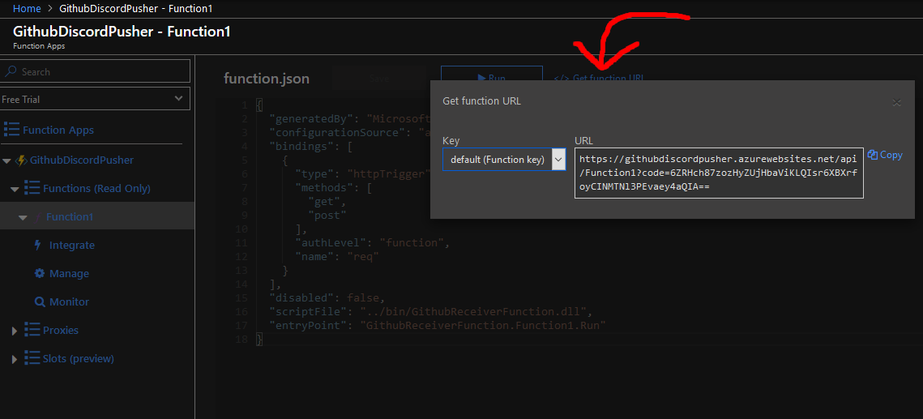
Function URL with authorization code

Slide 15
Questions, comments, etc.?

