Slide 1
TASK 5.1 - APPLICATION DEPLOYMENT TO A CLOUD
JERE HONKA
RAMI PASANEN
JANITA SALLANKO
JARO VÄISÄNEN

Slide 2
USED CLOUD PLATFORMS
Azure
Google Cloud Platform
IBM
Heroku

Slide 3
AZURE
Deployed Task1 to Azure
https://ties4560demo1.azurewebsites.net/
Easy to deploy Java based web applications to Azure
https://docs.microsoft.com/en-gb/azure/app-service/app-service-web-get-started-java
Prerequisites
The free Eclipse IDE for Java EE Developers
The Azure Toolkit for Eclipse (for other IDEs also?)

Slide 4
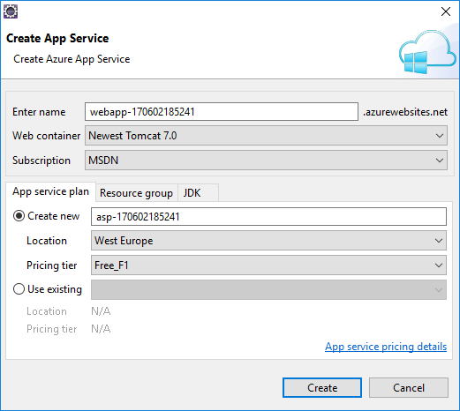
AZURE
Right click your project
Publish as Azure Web App…
Create a new App service
Create a new App service plan if one doesn’t exist already
Select Web container
Select an Azure subscription
An App Service plan specifies the location, size, and features of the web server farm that hosts your app
You can save money when hosting multiple apps by configuring the web apps to share a single App Service plan
A resource group is a logical container into which Azure resources like web apps, databases, and storage accounts are deployed and managed
In the Deploy Web App dialog box, select Deploy to root
DEPLOY

Slide 5
Google Cloud Platform
Deployed Task 2.1
http://soaprojectid.appspot.com/

Slide 6
Google Cloud Platform
Google AppEngine hosts web applications
Google Compute Engine hosts virtual machines (that can also be used to host web applications)
Lots of documentation and examples, can be confusing at first

Slide 7
Google Cloud Platform
Publishing applications can be done directly through Eclipse with the Google Cloud Tools for Eclipse plugin, or through command line
Projects can be standard AppEngine projects or Flexible AppEngine projects
Flexible AppEngine projects are built into JARs that are run on the server – no web server provided automatically
Standard AppEngine projects host a welcome page and servlets defined in web.xml – custom servlets need to be defined there
<web-app …>
<servlet>
<servlet-name>FirstNameGenerator</servlet-name>
<servlet-class>servlet.FirstNameGenerator</servlet-name>
</servlet>
<servlet-mapping>
<servlet-name>FirstNameGenerator</servlet-name>
<url-pattern>getFirstName</url-pattern>
</servlet-mapping>
</web-app>

Slide 8
Google Cloud Platform - SOAP
No direct support or documentation on how to host SOAP web services – there was documentation on running servlets and REST APIs, but nothing for SOAP WSs
A SOAP web service could be ran by directly deploying a JAR file to AppEngine Flexible
While troubleshooting unrelated issues with the SOAP service we decided to set up a Google Cloud Compute virtual machine to host our SOAP web service
Jetty-based web service runs on AppEngine flexible and communicates with the SOAP web service that is run on the virtual machine
Browser
(User)
Jetty-based web service
(AppEngine Flexible)
SOAP WS
(Google Compute Engine VM)

Slide 9
IBM
Deployed Task 1 to IBM Cloud
https://ties4560task1.eu-gb.mybluemix.net/
Although couldn’t get the application running on cloud due to issues with heap memory…
Straightforward documentation, supports both Tomcat and Java web apps
Prequisities
Free Eclipse IDE for Java Developers
Free IBM Cloud support tools or support for IBM Cloud CLI

Slide 10
bluemix api https://api.eu-de.bluemix.net
bluemix api https://api.eu-de.bluemix.net
Register to IBM Cloud and create new resource
Choose the type of application to run on the server
Give a name to the application
Choose domain and region
Users are offered memory up to 256 MB for free
Open command prompt and connect to the IBM Cloud
You can access the cloud with either bluemix (i.e. bluemix api https://api.eu-de.bluemix.net ) or cf commands
Login with your username and password (i.e. bluemix login –u username)
Specify the region, organization and space on your account
Give the app push command with using either bluemix app push app.war or cf push –p app.war if you are pushing with a war file

Slide 11
Task 4 to Heroku
Task-4 was deployed with Basic authentication to https://ties4560-task4.herokuapp.com/
Deployment steps:
An account was created to heroku, then a login from heroku CLI using ”heroku login”
New app called ”ties4560-task4” was created with ”heroku create ties4560-task4
CLI deploy plugin was installed
Authentication user & password (tomcat:tomcat) were defined using WEBAPP_RUNNER_OPTS -environment variable like so: heroku:set WEBAPP_RUNNER_OPTS=”--enable_basic_auth --basic_auth_user tomcat --basic_auth_pw tomcat”
Webapp runner, which is responsible for running tomcat uses WEBAPP_RUNNER_OPTS as command line parameters for configuration purposes
Deployment was finished using ”heroku deploy”

Slide 12
Main resources used for task 4
Lecture notes
https://github.com/jsimone/webapp-runner
https://devcenter.heroku.com/articles/java-webapp-runner
https://devcenter.heroku.com/articles/war-deployment

Slide 13
Problems with task 4
Couldn't get authentication to work with tomcat-users.xml; parsing the xml-file failed during deployment for unknown reason
Instead, authentication is now done by giving ”basic-auth-user” and ”basic-auth-pw” CLI parameters

