Slide 1
Task 5.1 - Application deployment to a Cloud
Jere honka
Rami pasanen
Janita sallanko
Jaro Väisänen

Slide 2
Used cloud platforms
Azure
Google Cloud Platform
IBM
Heroku

Slide 3
Azure
Deployed Task1 to Azure
https://ties4560demo1.azurewebsites.net/
Easy to deploy Java based web applications to Azure
https://docs.microsoft.com/en-gb/azure/app-service/app-service-web-get-started-java
Prerequisites
The free Eclipse IDE for Java EE Developers
The Azure Toolkit for Eclipse (for other IDEs also?)

Slide 4
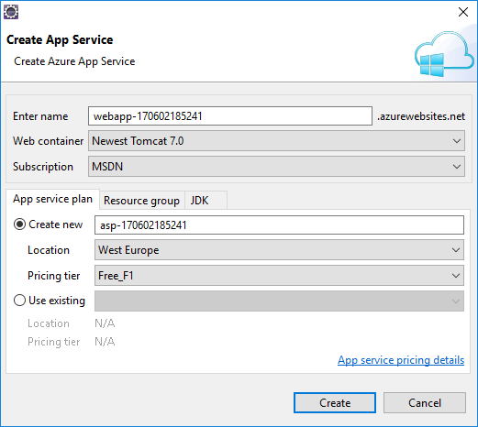
Azure
Right click your project
Publish as Azure Web App…
Create a new App service
Create a new App service plan if one doesn’t exist already
Select Web container
Select an Azure subscription
An App Service plan specifies the location, size, and features of the web server farm that hosts your app
You can save money when hosting multiple apps by configuring the web apps to share a single App Service plan
A resource group is a logical container into which Azure resources like web apps, databases, and storage accounts are deployed and managed
In the Deploy Web App dialog box, select Deploy to root
DEPLOY

