Slide 1


NASA Space Apps Hackers
Title Page
Project Title :-Smart Planet Selector
Theme:- Space Technology
PS category :- web page
Team Name :- Insane Yodha

Slide 2
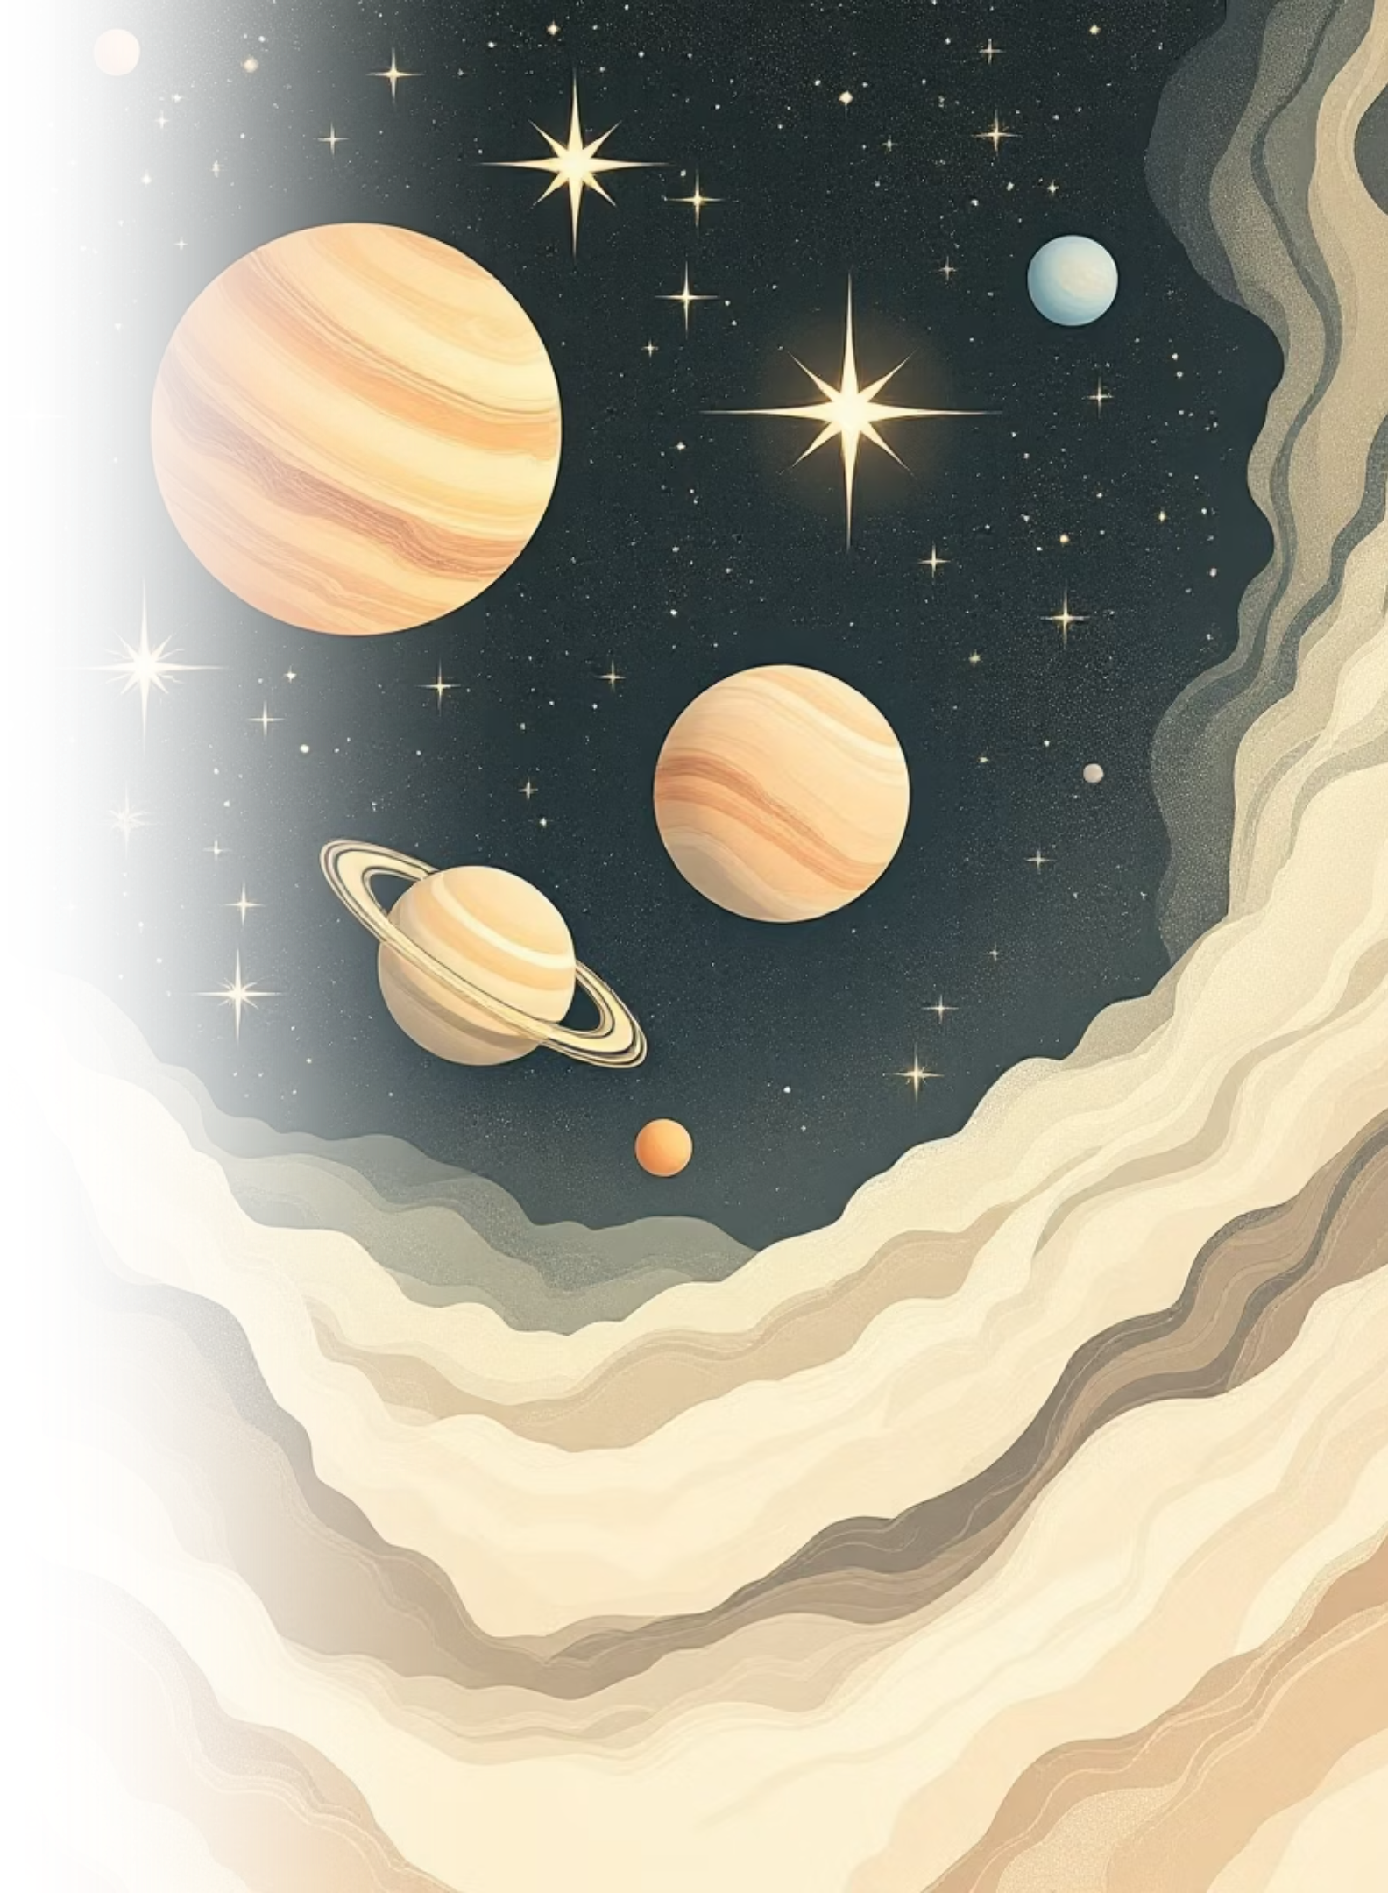
Smart Planet Selector
Hello! We are Team Insane Yodha from Sandip Foundation Polytechnic, and we're excited to present our interactive solar system explorer. Experience space exploration reimagined through cutting-edge web technology, where all 8 planets come alive with stunning visuals and fascinating facts.

Slide 3

The Journey Begins
Welcoming Portal
Our start page sets the cosmic stage with an immersive space background that instantly transports users beyond Earth. The glowing red title "NASA Space Apps Hackers" commands attention, while Team Insane Yodha's identity shines through clean typography.
The interactive "Begin" button features neon colors, dynamic shadows, and hover animations that respond to user interaction. CSS orchestrates the layout, fonts, colors, and responsive spacing to create a futuristic and professional entry point for the entire experience.

Slide 4
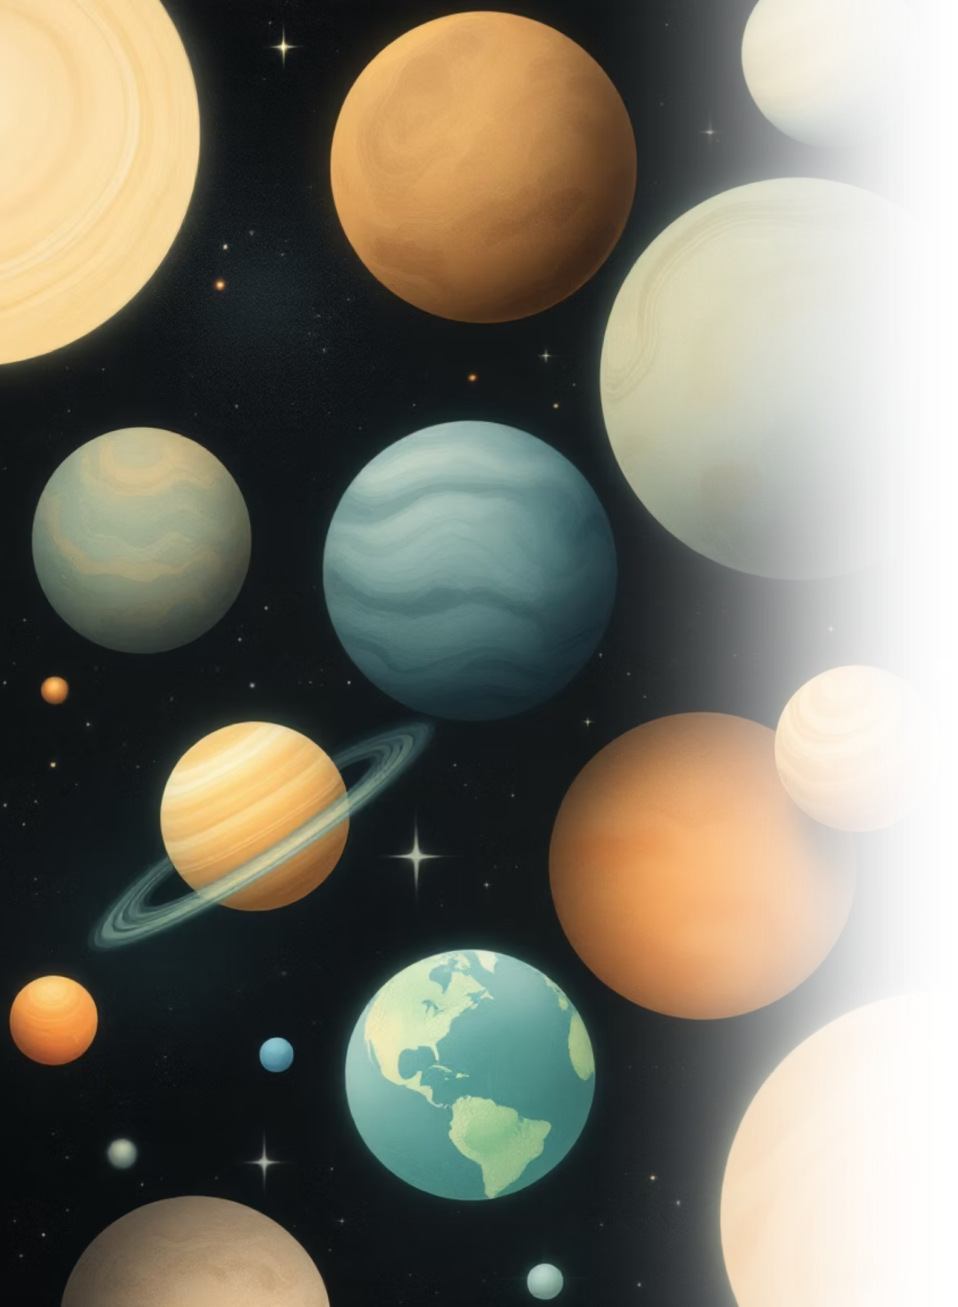



Interactive Planet Gallery
Scrollable Design
Interactive Cards
All 8 planets displayed in a smooth horizontal gallery with intuitive navigation arrows
Planet cards enlarge on hover with 3D shadow effects and clickable links to detailed pages
Visual Polish
Futuristic fonts with glowing effects, cosmic backgrounds, and seamless animations
The Smart Planet Selector showcases all 8 planets in an elegant, horizontally scrollable interface. Each planet card features high-quality imagery and clear labeling. JavaScript dynamically generates the cards and powers the smooth scrolling functionality, while CSS creates depth through shadows, spacing, and hover animations.

Slide 5
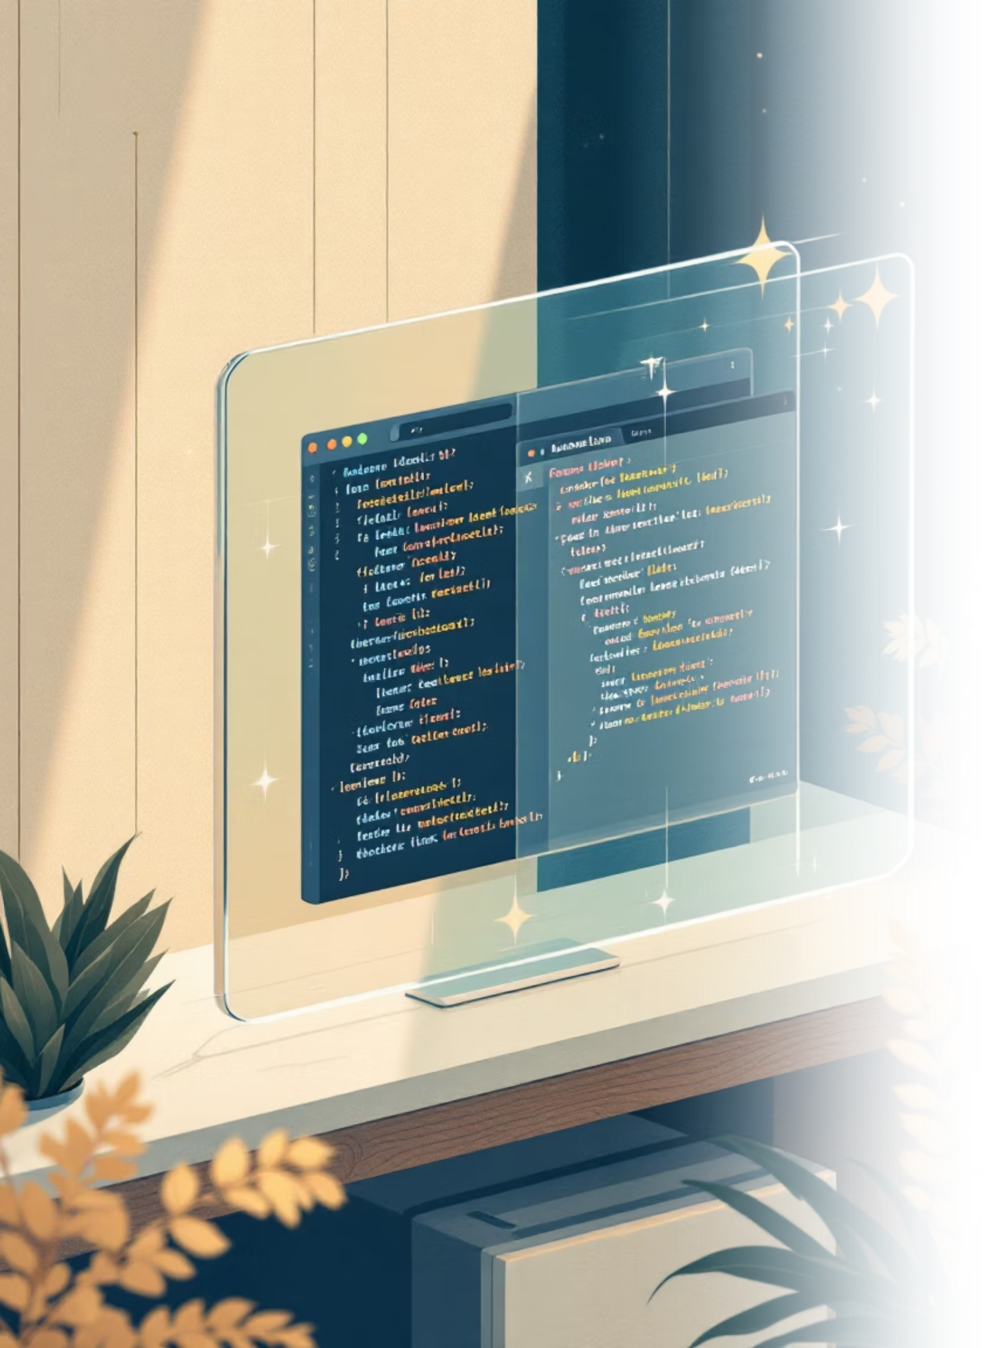



Technical Architecture
Start Page Layer
Cosmic background with glowing typography, team branding, and an animated "Begin" button featuring neon styling and hover effects that link to the main selector
Gallery Engine
8-planet horizontal gallery with dynamic card generation, smooth arrow-based scrolling, and click handlers that navigate to individual planet detail pages
Style & Interaction
CSS manages fonts, shadows, spacing, colors, and animations while JavaScript handles dynamic rendering, scroll behavior, and navigation logic

Slide 6
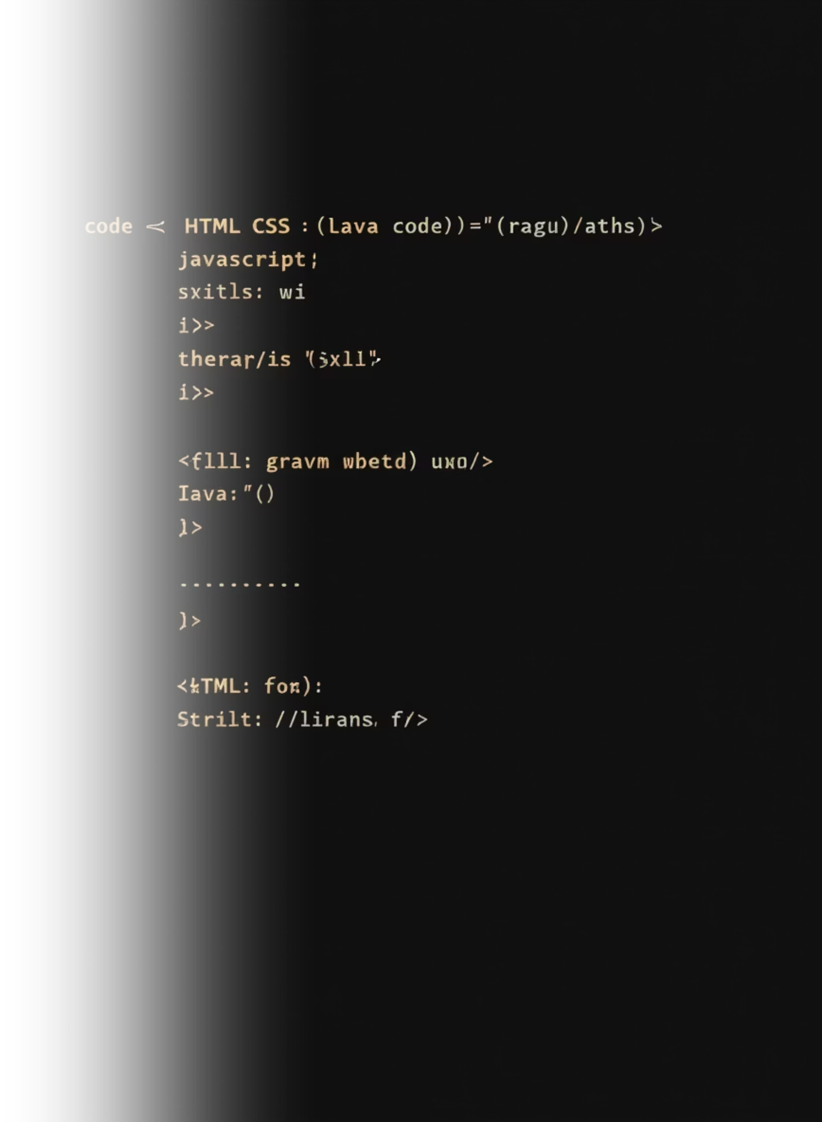
Code Foundation
HTML Syntax
CSS Syntax
JavaScript Syntax
<html> – document root
font-family – typography
const – variable declaration
<head> – metadata container
background – image styling
getElementById – element selection
<body> – visible content
text-shadow – glow effects
createElement – DOM generation
<h1>, <p> – text elements
box-shadow – depth creation
addEventListener – event handling
<button> – interactive control
border-radius – corner rounding
forEach – array iteration
<div> – content grouping
display: flex – layout system
window.open – navigation
<img> – image display
transition – smooth animations
scrollBy – smooth scrolling
<script> – JavaScript embed
cursor – interaction feedback

Slide 7
Immersive User Experience
Intuitive Navigation
Visual Feedback
Rich Content
Smooth scrolling through all 8 planets with responsive arrow controls makes exploration effortless and natural
Hover effects create glowing highlights and 3D depth, providing immediate responsive feedback to user actions
Click any planet to access detailed information pages filled with fascinating facts and stunning imagery
The Smart Planet Selector delivers a fun, immersive, and interactive journey through our solar system. Vivid imagery, futuristic fonts, glowing animations, and thoughtful interaction design combine to create an experience that's engaging for all ages while maintaining a modern, space-themed aesthetic that transforms learning into an adventure.

Slide 8

Thank You
We're Team Insane Yodha from Sandip Foundation Polytechnic, and we hope you enjoyed exploring our Smart Planet Selector. This project represents our passion for combining education with engaging technology to inspire curiosity about our incredible solar system.

