Slide 1
Clearance
Software compliance,
with evidence you can review.
PRODUCT & ENGINEERING / OCTOBER 2026
01
Notes:
Clearance product and engineering presentation. Application built in this repository. Status as verified on 13 October 2026. The product supports readiness review, not legal certification.

Slide 2
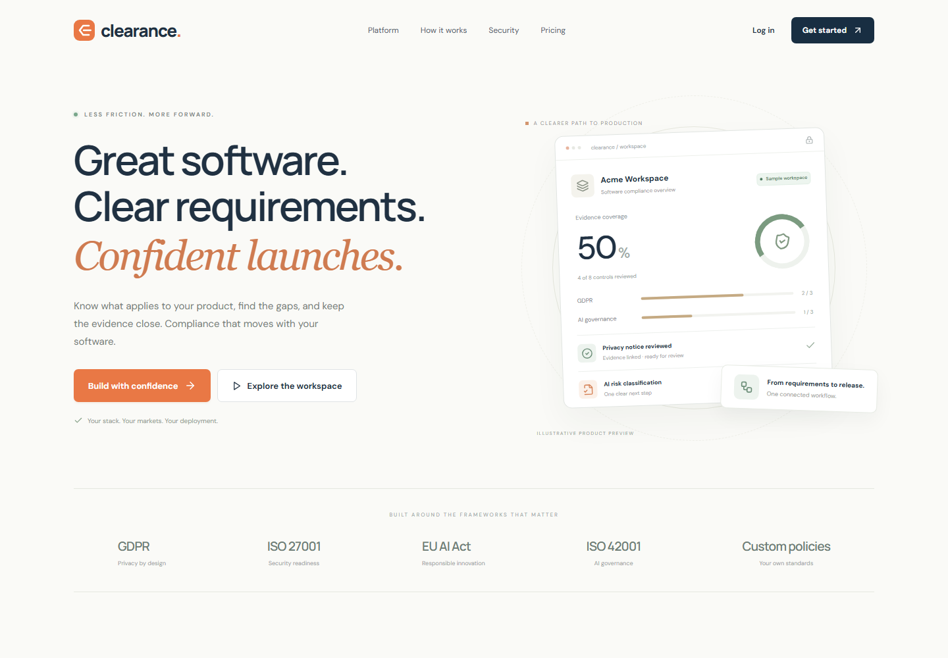
A workspace for compliance readiness
Product context
Industry, markets, software type, audience and data practices.
A reviewable result
Candidate requirements, evidence gaps and a release gate.
02
Notes:
Sources: src/Landing.tsx, src/Workspace.tsx. Screenshot captured from local application using isolated sample data. Pricing is proposed preview pricing, not enabled billing.

Slide 3
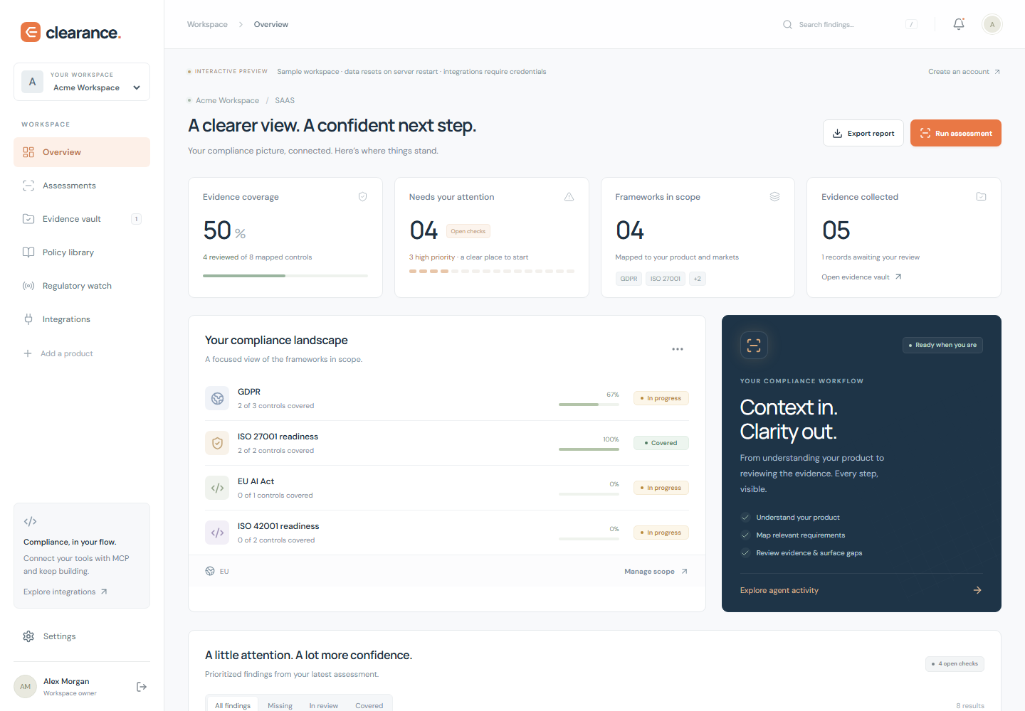
The product at a glance
03
Notes:
Source: src/Workspace.tsx. Screenshot is the sample workspace. Readiness percentage reflects approved evidence for selected starter controls, not legal compliance certification.

Slide 4
Requirements start with product context
Declared context
Candidate controls
SaaS, mobile and embedded software
Industry and target markets
Consumer or business customers
Personal data and AI use
Privacy and consumer obligations
Mobile disclosures and permissions
AI governance and ISO/IEC 42001
Custom internal policies
Applicability needs qualified review before a production launch.
04
Notes:
Sources: src/Onboarding.tsx and server/catalog.ts. The starter catalog includes candidate/readiness controls, not full standards text or an exhaustive statutory mapping. ISO/IEC 42001 is the AI management system standard referenced by the application.

Slide 5
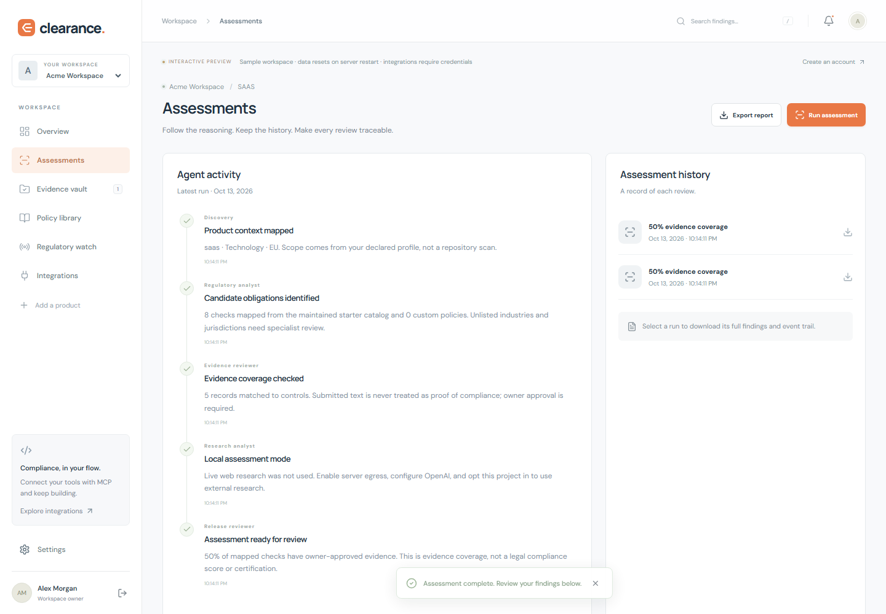
A visible assessment workflow
Discovery
Regulatory analysis
Evidence review
Optional research
Release review
Timestamped events preserve
what happened during each run.
05
Notes:
Sources: server/engine.ts and agents/AGENTS.md. The implementation uses deterministic workflow roles plus optional OpenAI Responses research. It does not represent five independent model agents. Research requires both deployment-level permission and project opt-in.

Slide 6
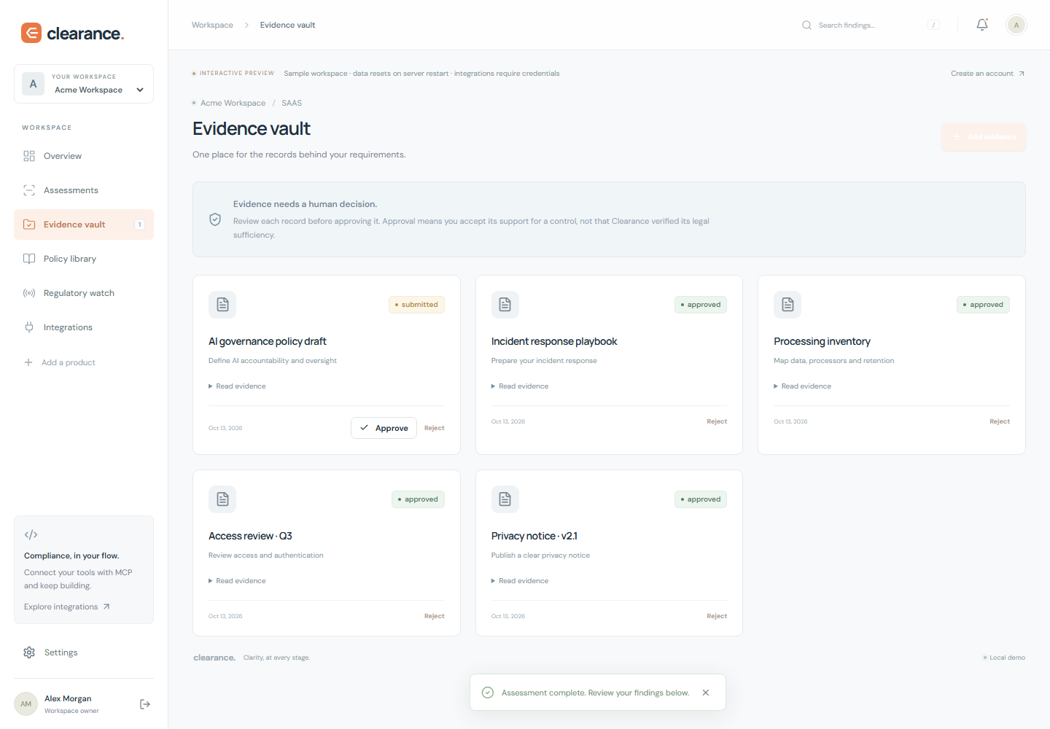
Evidence remains under human control
Submit
Attach a record to the
requirement it supports.
Review
Approve or reject explicitly.
Changes invalidate prior gates.
Approval is a human decision.
06
Notes:
Sources: server/app.ts, server/engine.ts and src/Workspace.tsx. Evidence is submitted and explicitly approved by the owner. Model output cannot approve evidence. Sample screenshot only.

Slide 7
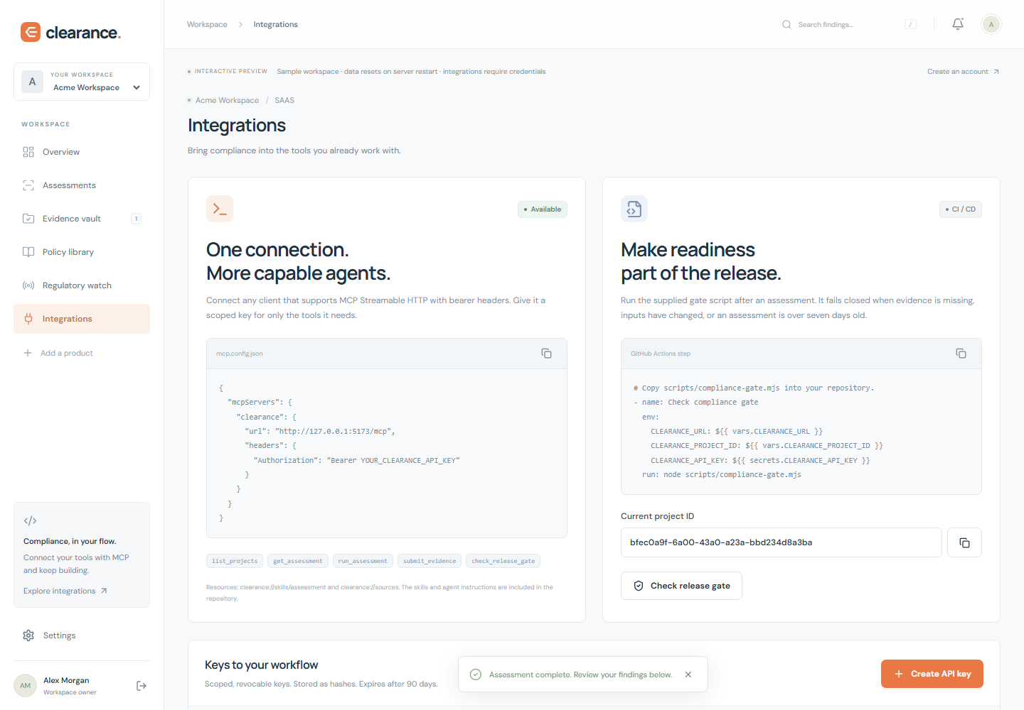
MCP and CI use the same evidence
MCP tools
List projects, run assessments,
submit evidence and read gates.
CI release checks
Block missing, stale or changed
assessments and unresolved
high-priority evidence gaps.
07
Notes:
Sources: server/mcp.ts, scripts/compliance-gate.mjs, skills/compliance-assessment/SKILL.md and examples/compliance-gate.yml. MCP uses Streamable HTTP with scoped bearer keys. API keys cannot approve evidence. Screenshot from sample workspace, without credentials.

Slide 8
Deployment architecture
01
React frontend
Responsive workspace and landing page, served with the Node.js application.
02
Node.js API and PostgreSQL
Authentication, projects, evidence, assessment history, audit events and scoped MCP.
03
Optional external services
Google sign-in, Brevo email, Twilio Verify and OpenAI research. On-prem deployment supported.
08
Notes:
Sources: Dockerfile, compose.yaml, server/config.ts, server/providers.ts and README.md. Docker configuration is supplied but actual image/container execution was not verified because the local engine was unresponsive. Offline/on-prem core works without model or messaging providers, with availability boundaries described in README.

Slide 9
Security boundaries
01
Identity and access
Scrypt passwords, hashed tokens, secure production cookies, tenant isolation and rate limits.
02
Explicit external processing
Research is opt-in. Evidence text stays local. Provider availability is visible in the interface.
03
Controlled deployment
Production requires PostgreSQL and HTTPS URLs. Demo access is disabled in production.
09
Notes:
Sources: server/auth.ts, server/app.ts, server/config.ts and README.md. Security features are implementation facts, not a penetration-test or certification claim. External model research receives the declared profile rather than evidence text.

Slide 10
Verified behavior
36
4
SQL
Automated tests
Browser flows
Real PostgreSQL
API, auth, isolation, MCP,
gates and provider contracts.
Desktop workflow, mobile
layout and authentication UI.
Full test suite and a compiled
production server smoke test.
Live provider delivery and Docker execution still need operational verification.
10
Notes:
Source: docs/VERIFICATION.md. Final checks on 13 October 2026: build and 36 Vitest tests passed, same suite passed with PostgreSQL 18.4, four Playwright flows passed, compiled production smoke passed with PostgreSQL, npm audit --omit=dev reported zero known vulnerabilities. Provider tests use mocks. Docker engine was unavailable.

Slide 11
Production launch requirements
01
Configure deployment and credentials
HTTPS ingress, database backups, Google OAuth, verified Brevo sender and Twilio Verify.
02
Verify the operational environment
Run Docker checks and real provider flows with controlled accounts and recipients.
03
Complete the release review
Validate legal applicability and operating procedures. Billing and team roles remain future work.
11
Notes:
Sources: README.md and docs/VERIFICATION.md. No live Google OAuth, Brevo email, Twilio SMS/WhatsApp or billable OpenAI request was made. Pricing is illustrative, billing is not implemented. Team RBAC, SAML, MFA recovery codes and deletion automation are outside this first implementation.

