Slide 1


Note: The data and information in this document is reflective of a hypothetical situation and client. This document is to be used for KPMG Virtual Internship purposes only.
KPMG AU Data Analytics : EDA
Lighthouse & Innovation Team
Organised by : Ramprakash tripathi(Data Analyst)

Slide 2
Note: The data and information in this document is reflective of a hypothetical situation and client. This document is to be used for KPMG Virtual Internship purposes only.
Agenda
1. Introduction
2. Data Exploration
3. Model Development
4. Interpretation

Slide 3

Note: The data and information in this document is reflective of a hypothetical situation and client. This document is to be used for KPMG Virtual Internship purposes only.
Introduction
Sprocket Central Pty Ltd :
A medium size bikes & cycling accessories organisation.
Sprocket Central Pty Ltd is a long-standing KPMG client whom specializes
in high-quality bikes and accessible cycling accessories to riders.
Data Set:
Consist 3 sheets:
Customer Demographic
Customer Addresses
Transactions data in the past 3 Years.

Slide 4
Note: The data and information in this document is reflective of a hypothetical situation and client. This document is to be used for KPMG Virtual Internship purposes only.
Problem Statement
1. We need to Analyze dataset to determine customer trends and behaviors.
2. On the Analysis basis recommend which of these 1000 new customers should be targeted by company to drive the most value for the organization.

Slide 5
Note: The data and information in this document is reflective of a hypothetical situation and client. This document is to be used for KPMG Virtual Internship purposes only.
Data Exploration
Insights:
Total No of Bicycle Sole was approx. 3 lac and Got Total profit of approx. 17 cr in that particular year.
Gender wise more Bicycle Purchased by male i.e. 155189 out of total bicycle sold.
Age Group of 30-45 years Preferred more to use bicycle.
Month wise Highest sales recorded in month of October followed by July and least in June.
People who belongs to manufacturing Sector was highest buyer , followed by people of finance sector.
Highest sold brand was solex although the highest profit generated by the brand was WeareA2B
Mode of buying bicycle doesn't have so much difference so we can say almost same.
Max Profit recorded from the state of New South Wales and over all in term of wealth by mass Customer .

Slide 6
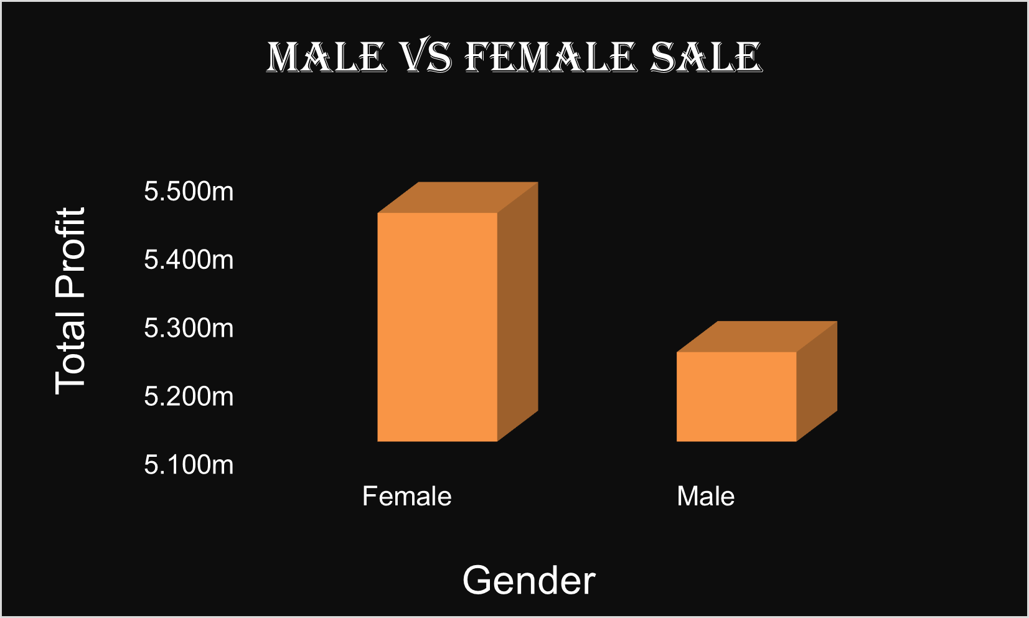
Note: The data and information in this document is reflective of a hypothetical situation and client. This document is to be used for KPMG Virtual Internship purposes only.
Model Development
Below Graph Indicates profit earned by company gender wise. Accessories of bike or bicycle that has been sold to people who were living there, Buyer from most of them was Female. Accordingly use of vehicle is more by female so company can focus into this.

Slide 7
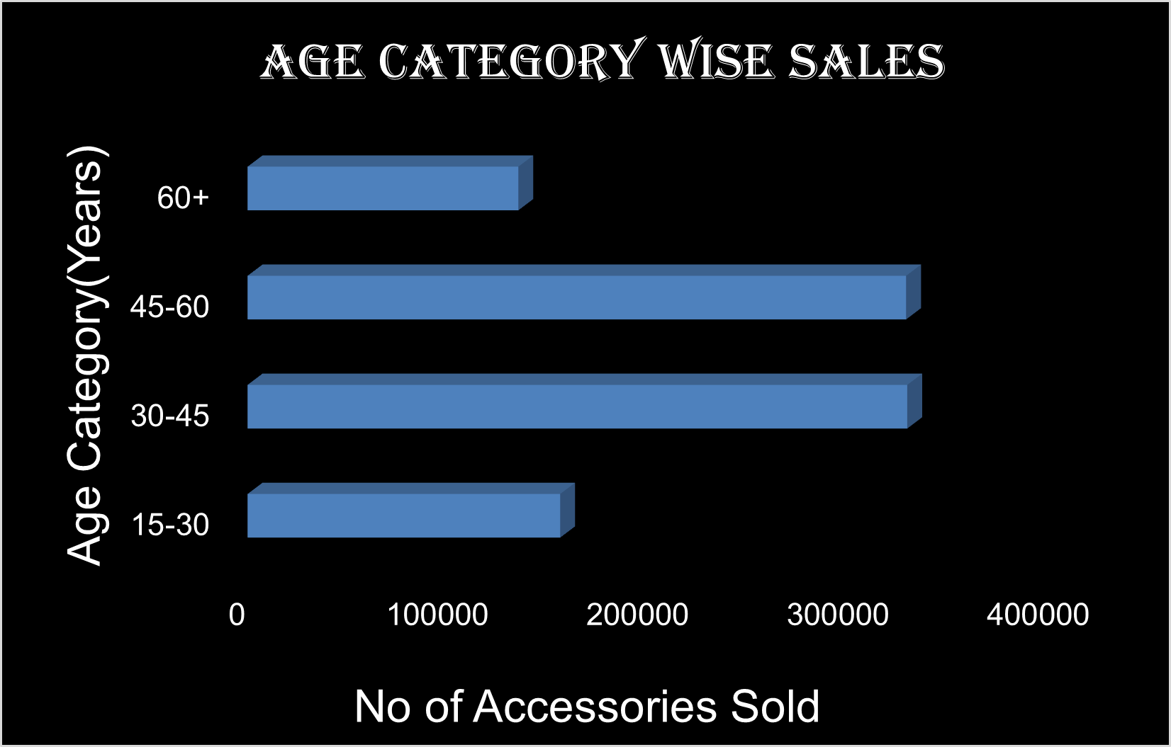
Note: The data and information in this document is reflective of a hypothetical situation and client. This document is to be used for KPMG Virtual Internship purposes only.
Model Development
Below Graph Indicates that group wise no of accessories sold by company as per given data. Accessories of bike or bicycle that has been sold to people who were living there, Buyer from most of them were belong to age category of 30-45. Accordingly it shows that Mid age people or can say occupational prefer more to use these accessories. So company can target them as well.

Slide 8
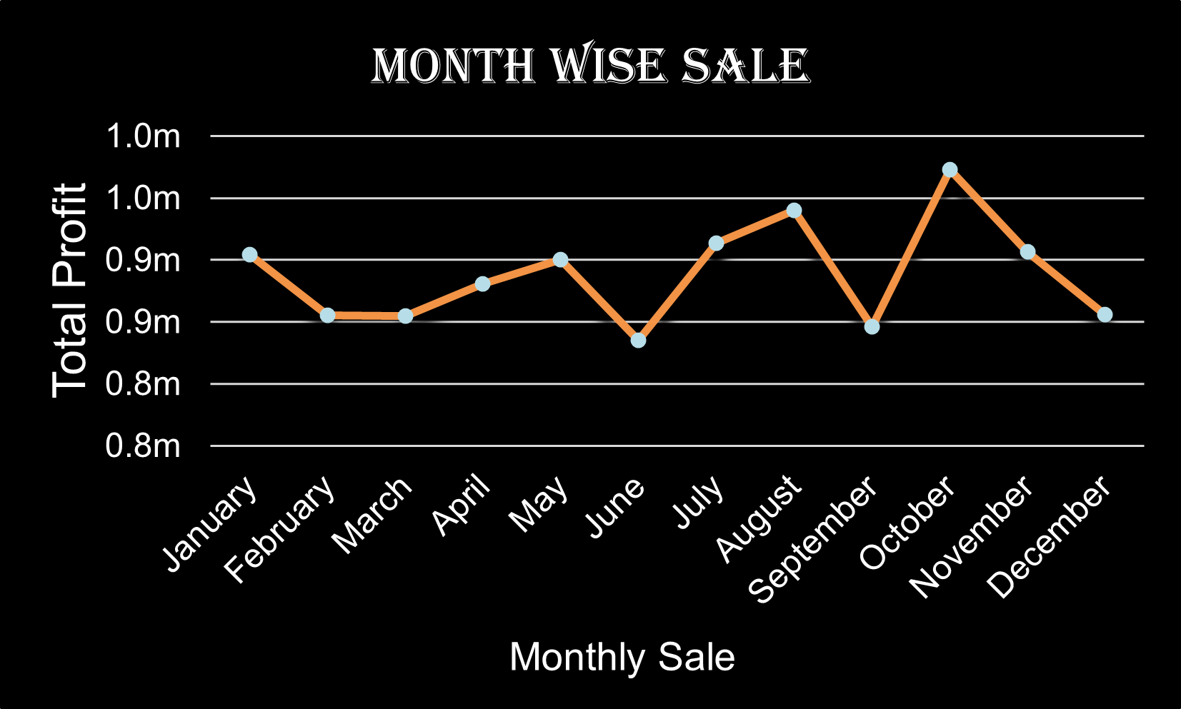
Note: The data and information in this document is reflective of a hypothetical situation and client. This document is to be used for KPMG Virtual Internship purposes only.
Model Development
Below Graph Indicates profit earned by company on monthly basis in 2017. Mostly profit has made in month of October followed by July and least in June.
It shows that people prefer to use more vehicle while winter and least in summer. This is also be a factor for company to prepare well before and enhance their business accordingly.

Slide 9
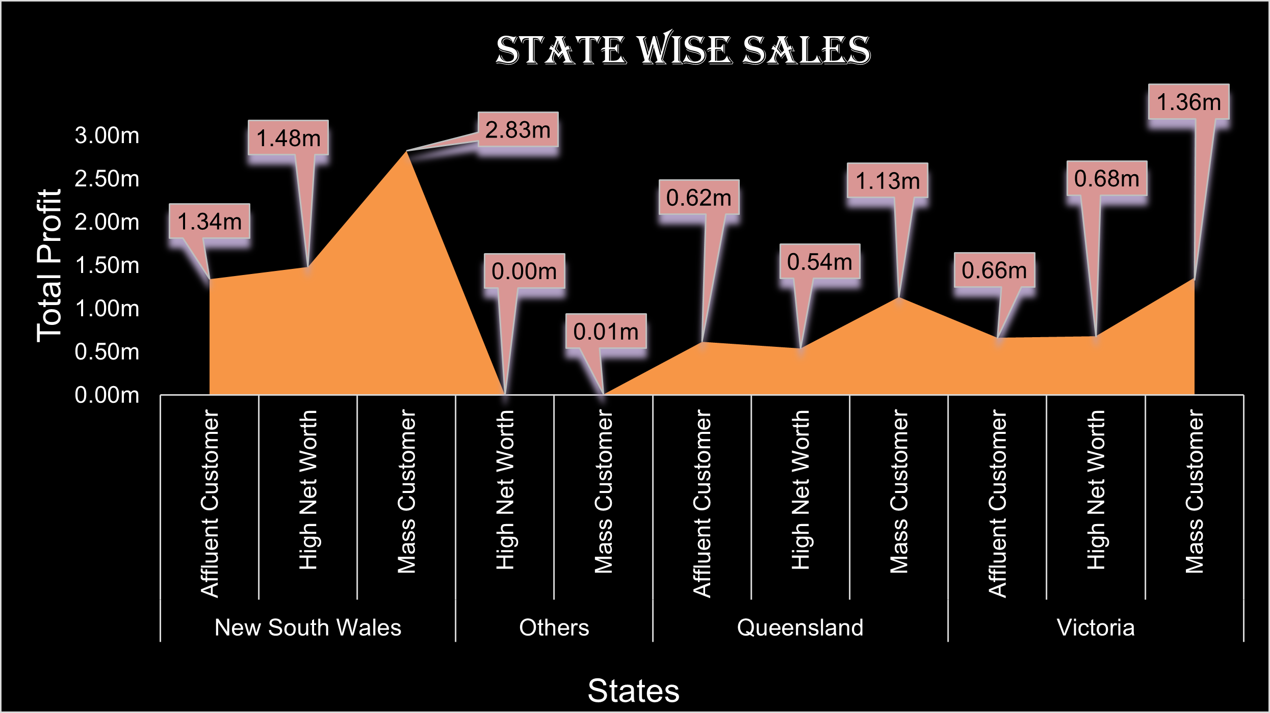
Note: The data and information in this document is reflective of a hypothetical situation and client. This document is to be used for KPMG Virtual Internship purposes only.
Model Development
This Chart indicates state wise sale. Here we can clearly see that most of the profit has been recorded from New South Wales. And If we talk about particular wealth category then mass customer is leading in contribution of profit in all states. Hence company should focus more on mass customer category among 1000 new customer.

Slide 10
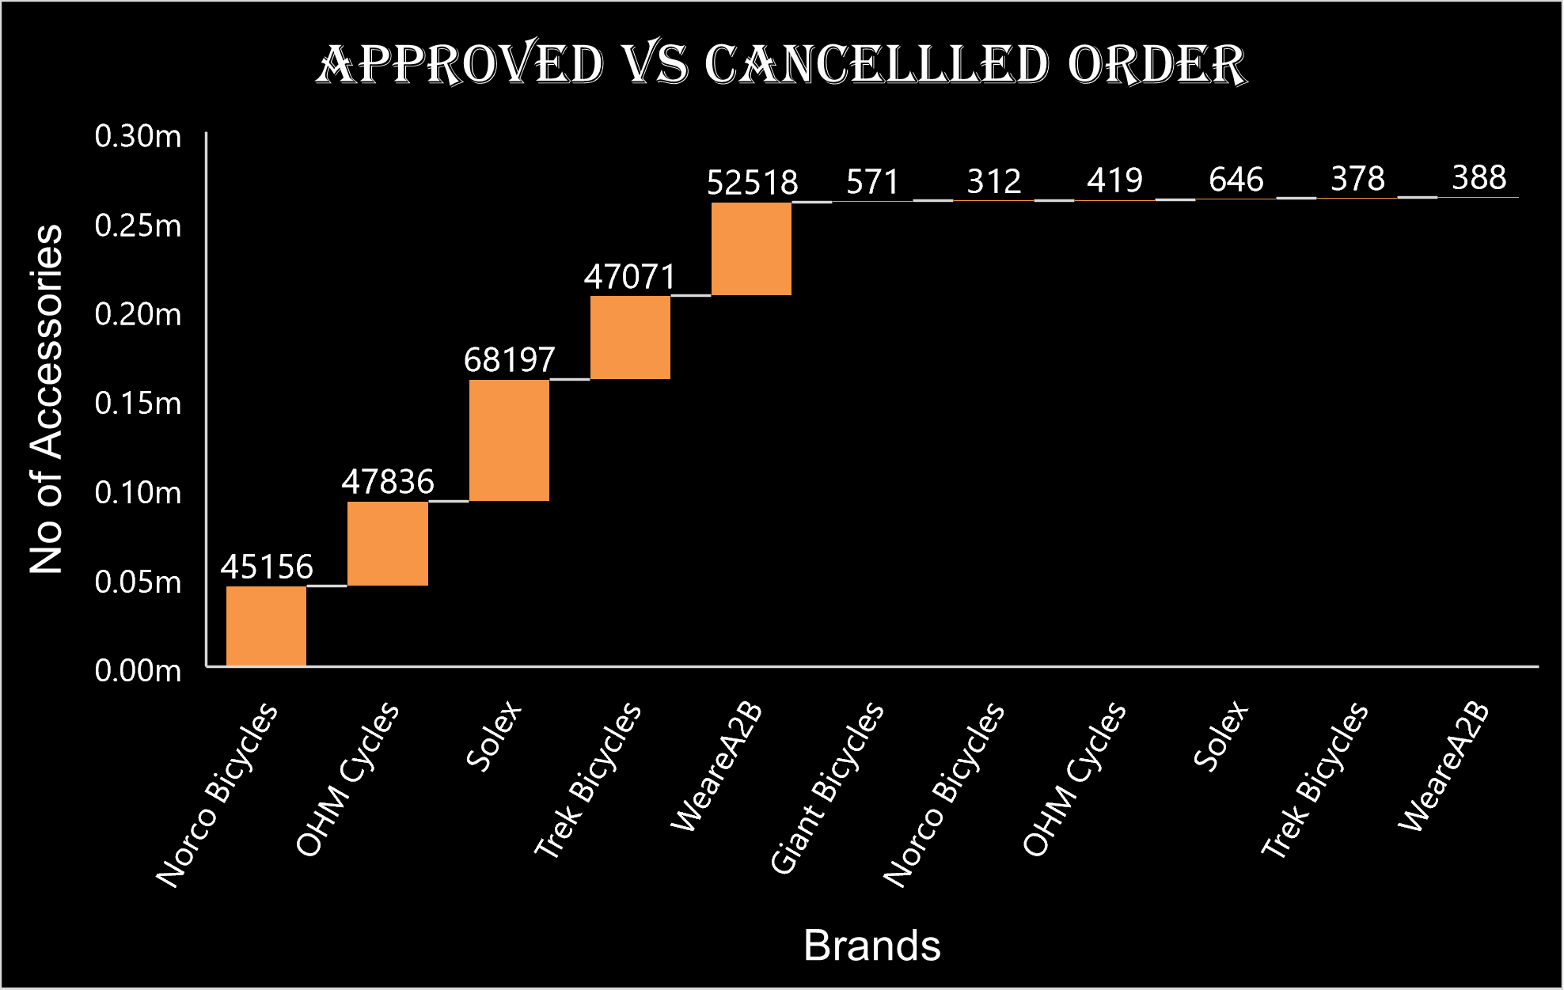
Note: The data and information in this document is reflective of a hypothetical situation and client. This document is to be used for KPMG Virtual Internship purposes only.
Model Development
This Chart indicates that which brand had is demand and sold mostly. Here we can see Solex has most no of accessories sold but still in profit contribution, weareA2B is leading. Similarly if we talk about most cancelled order by customer then still Solex is leading into this. So company can focus more here to improve on brands which is main factor of their business.

Slide 11
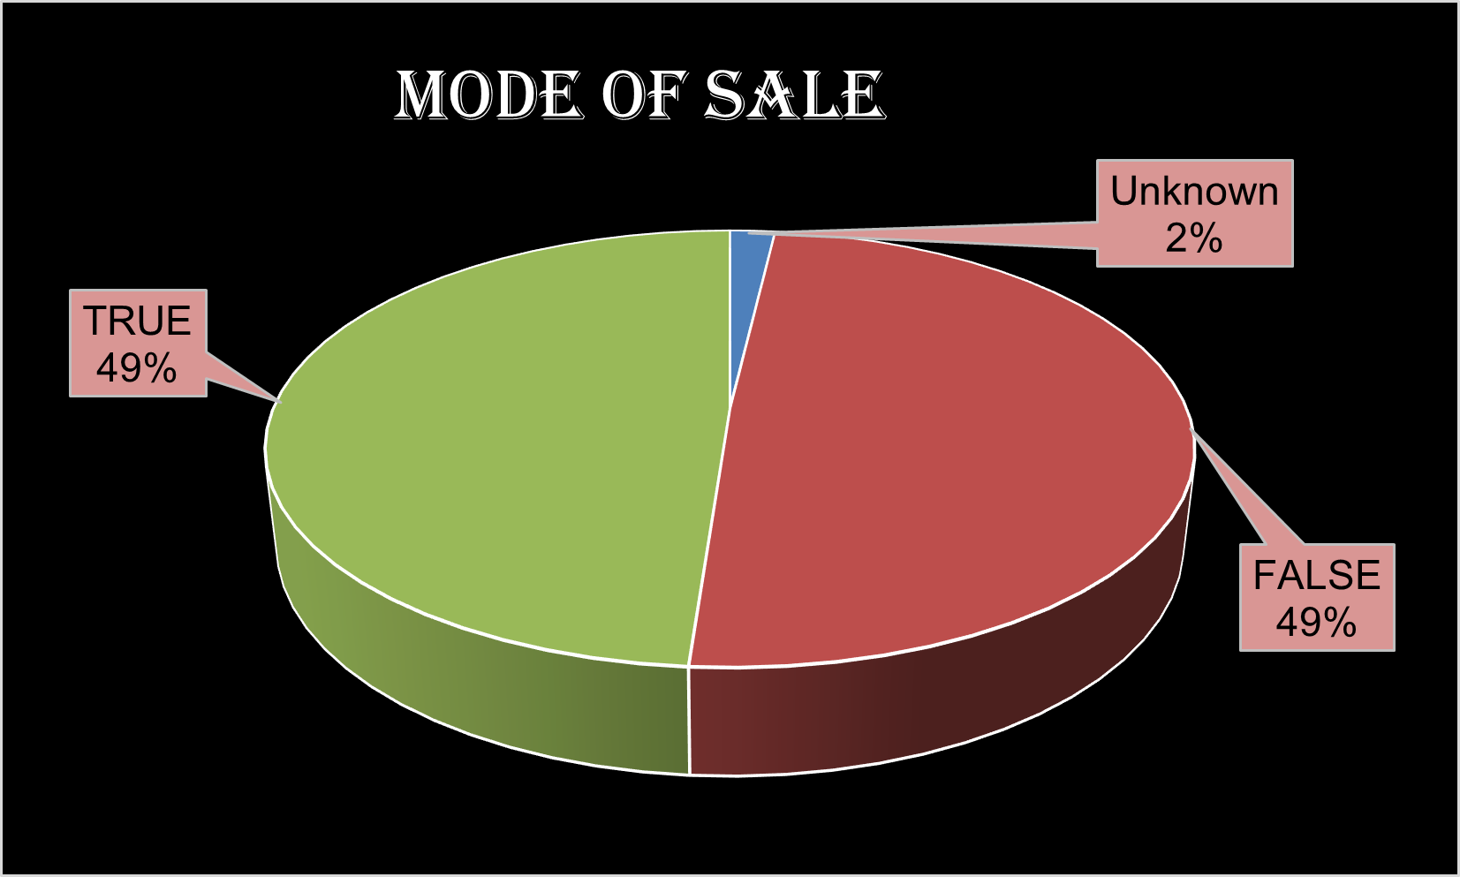
Note: The data and information in this document is reflective of a hypothetical situation and client. This document is to be used for KPMG Virtual Internship purposes only.
Model Development
This Chart indicates whether the mode of purchasing was online or offline. According to visual we can predict that mode of purchasing is same in both condition and people equally prefer to buy from both mode. This is also a main factor where company need to focus more to enhance their profit.

Slide 12
Note: The data and information in this document is reflective of a hypothetical situation and client. This document is to be used for KPMG Virtual Internship purposes only.
Interpretation
Conclusion :
Company need to work on improvement of their brands which is a main factor.
Company can target more to female as mostly accessories used by them only.
Company should focus more on people who belong to their mid age(30-45 years)
Company can plan their stocks capacity according to session wise demand and can reduce or enhance on monthly basis.
Company should focus more on people belongs to New South Wales and Specially on mass customer wealth category.
Company should be more focus on both mode of selling equally i.e. online and offline.

Slide 13
Note: The data and information in this document is reflective of a hypothetical situation and client. This document is to be used for KPMG Virtual Internship purposes only.
Thank you
For Any Query:
contact : Email – ramprakashtripathi108@gmail.com
LinkedIn - https://www.linkedin.com/in/ramprakash-tripathi-aa86771a7/

