Slide 1
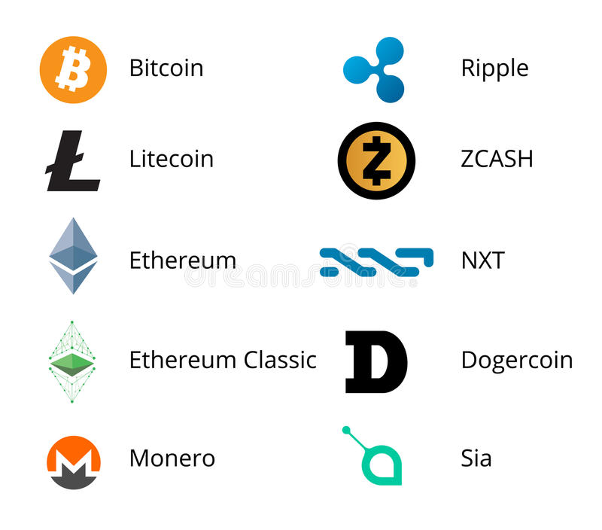

Slide 2
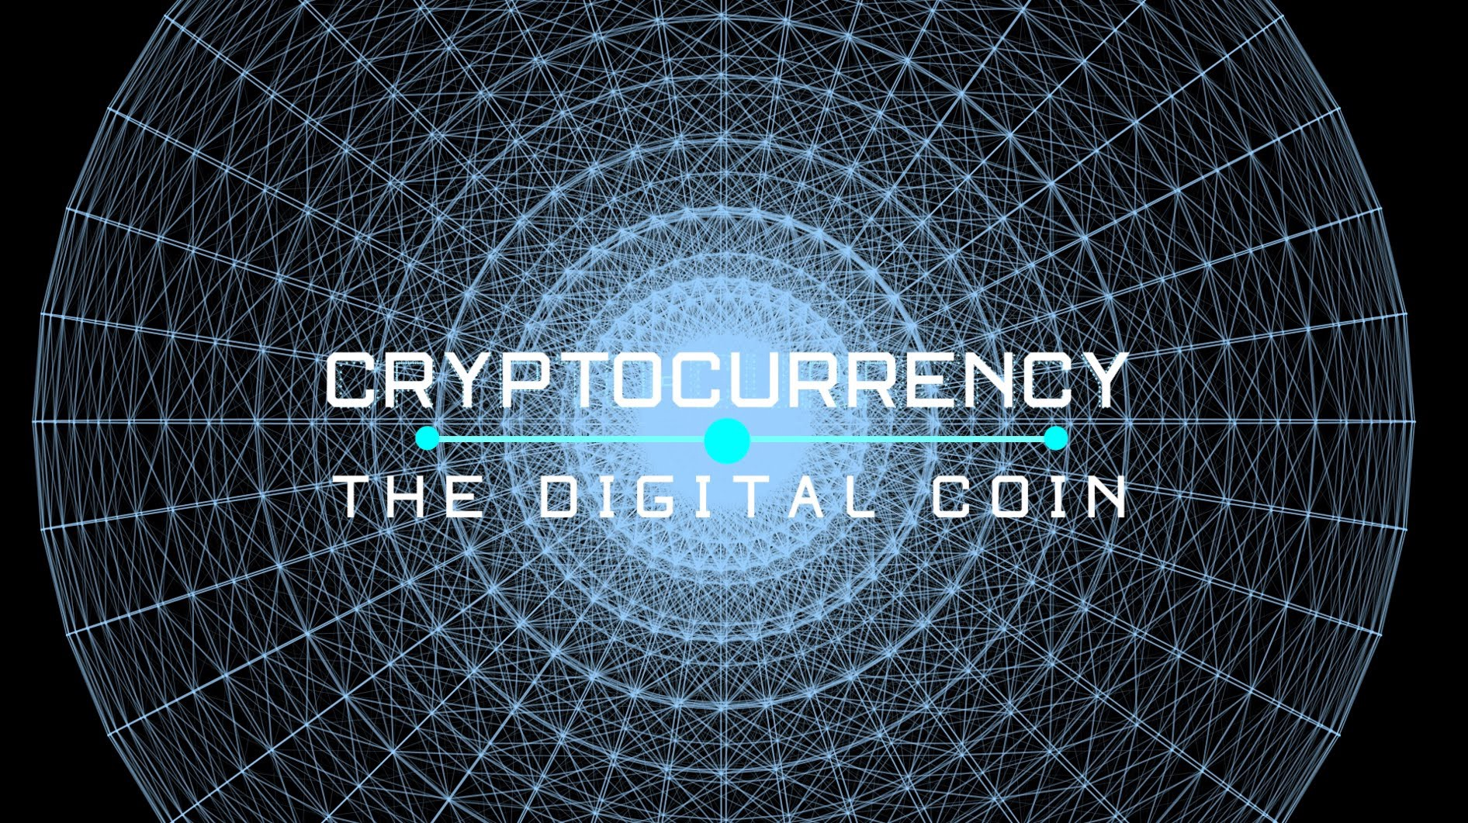

Slide 3
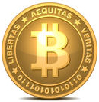
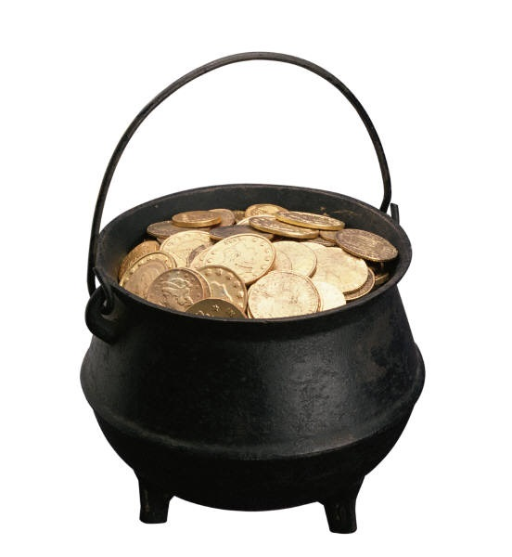
CryptoCurrency
How did it get started?
How is the currency created?
Why does it have value?
Who controls the value?
Who Accepts Bitcoin?
How Would I buy some Bitcoins?
Why would I want some Bitcoins?
Problems with Bitcoin currency.

Slide 4
What is the Vision of Cryptocurrency?
Intended to be digital currency to replace the fiat currency
Secure, Stable, Decentralized and Un-Breakable.
Buyers and sellers will use them and eliminate all the middlemen such as credit cards, ATM machines, etc.
Will be safer than carrying a plastic card.
Will be an international currency with no exchange transaction fees.
No central regulatory body to impose restrictions and track transactions

Slide 5
How Did It Start?
In 2009 A technical paper was posted on the internet by Satoshi Nakamoto titled Bitcoin: A Peer-to-Peer Electronic Cash System
It described a sytem of cryptocurrency that was not backed by any government or any form of existing currency.
Interestingly, there is no such person. It’s a pseudonymn.

Slide 6
Where Do Cryptocurrencies(Bitcoins) Come From?
Bitcoin is based on solving an encryption formula which requires extreme amounts of computing power.
  Each time you solve a portion of the formula you earn a “BitCoin.”
  Websites like Deepbit.net help you set up the mining formula.
  Companies began to sell hardware called gate array miners to enhance the processing speed.
  Only 21 million BitCoins will ever exist
Nearly all Bitcoins have been mined and are now in circulation.

Slide 7
What is Mining
Mining is the process whereby value is created through transaction processing that occurs on nodes of the network.
In 2009, one could mine 200 Bitcoins with a personal, home computer. In 2015, it would take about 98 years to mine just 1 Bitcoin.
Today there is almost no money to be made through traditional home mining.
ASIC (Application Specific Integrated Circuit) has been designed strictly for mining Bitcoins.
Groups of miners have formed mining pools, with each being paid their relative share for their contribution to the work performed.
BitMinter
CK Pool
Eligius
Slush Pool

Slide 8
The Process-Mining
Collects transactions from the network
Validates them, and doesn't allow conflicting ones
Puts them into large bundles called blocks
Computes cryptographic hashes over and over until if finds one "good enough to count"
Then submits the block to the network, adding it to the block chain and earning a reward in return in the corresponding Cryptocurrency

Slide 9
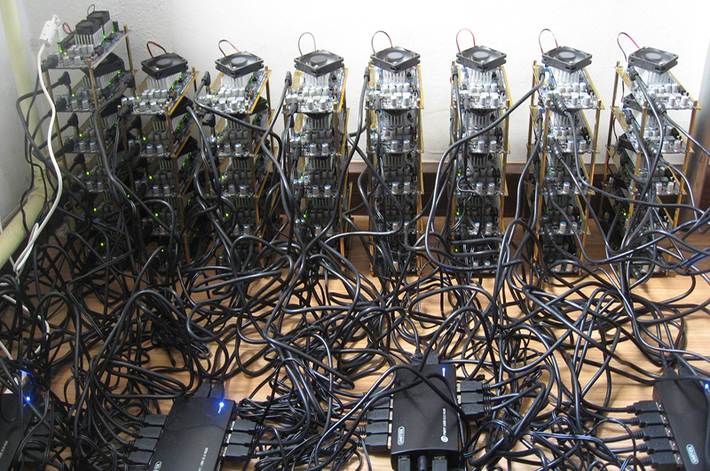
KVL Anyone!!?

Slide 10
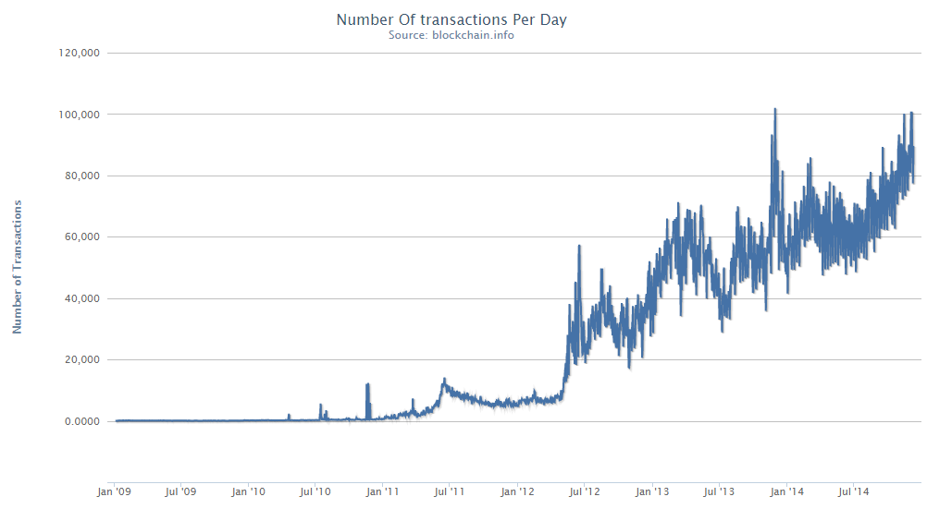
Number of Transactions per Day

Slide 11
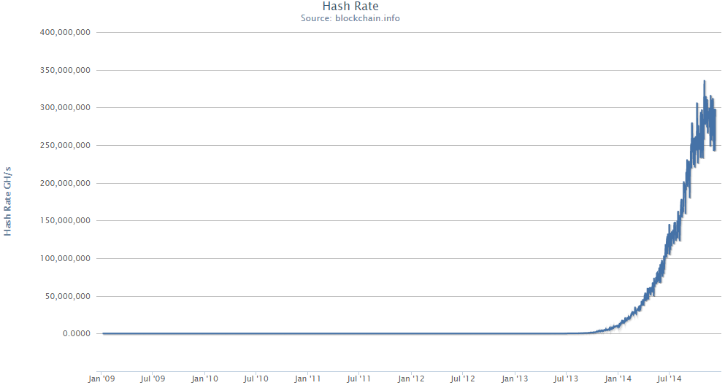
Hash Rate

Slide 12
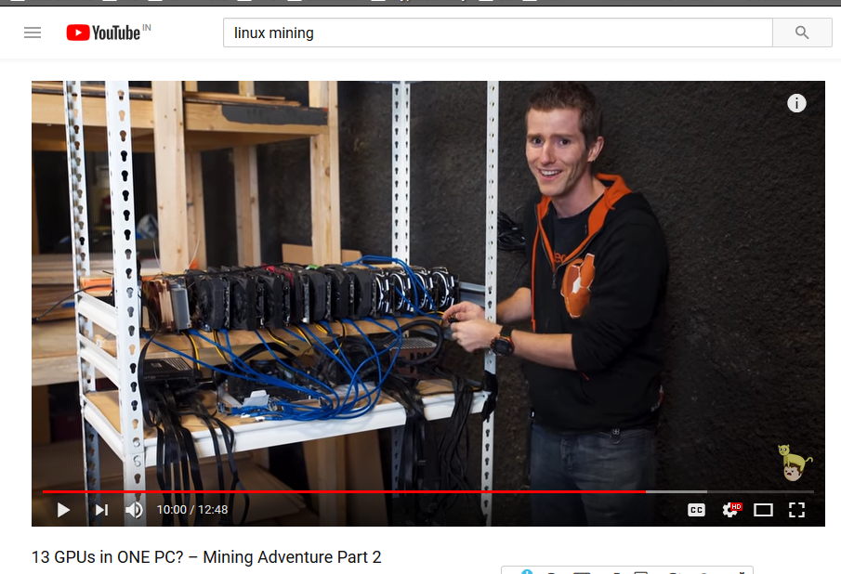

Slide 13
Is Mining Feasible on a PC?
ROI(Return on Investment) for a low investment is too late.
For 13 Powerful GPU is 4 months.
Maintenance of GPU’s is costly includes storage, cooling, etc.
Grants for high power usage is being cut down with the current cryptocurrency development.

Slide 14
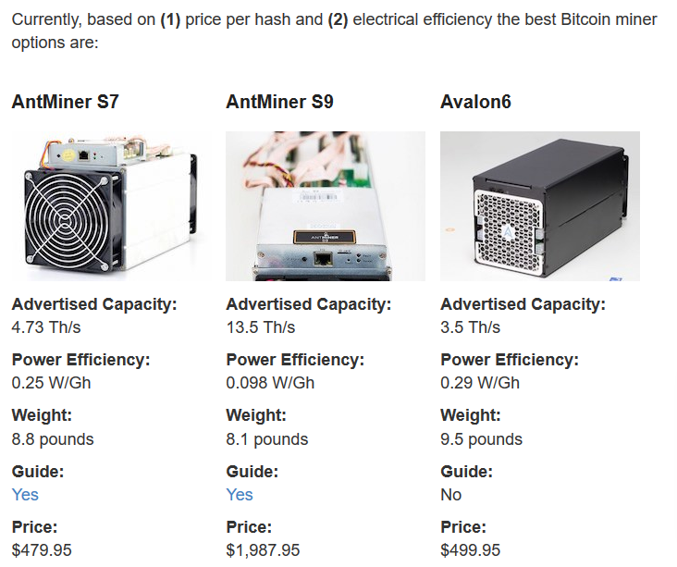
How do we calculate estimated earnings and ROI

Slide 15
Open Source Cryptocurrencies
Litecoin -- https://github.com/litecoin-project/litecoin
Market value of $7.13 billion and is the world’s fifth most valuable cryptocurrency by market capitalization.
Launched in 2011 as an alternative to Bitcoin
However, it has been designed to be faster and lighter (hence the name) than its predecessor.
Open source network and is not controlled by any one entity.
Zcash -- https://github.com/zcash/zcash

Slide 16
Making your own Cryptocurrencies
Litecoin -- https://github.com/litecoin-project/litecoin
Fork an existing Open source Cryptocurrency from github.
The subreddit r/coindev and sites like CodementorX will connect you with crypto developers for your project.
Create a token—what is essentially a smart contract—with or without a public ICO.
The token contract process is free, but CoinLaunch takes a commission from each ICO (4-10% depending on much money is raised).
The real work is in giving your coin or token value,
Building the infrastructure
Maintaining it
Convincing others to buy in—even memecoins, such as Garlicoin, Dogecoin, and PepeCoin, have developers and user-facing teams to keep the technology stable and the community engaged

Slide 17
Ethereum (ETH)
Ethereum (ETH)
Launched in 2015
Decentralized software platform that enables Smart Contracts and Distributed Applications (ĐApps) to be built and run without any downtime, fraud, control or interference from a third party.
Platform-specific cryptographic token, ether.
It can be used to “codify, decentralize, secure and trade just about anything

Slide 18
Ripple (XRP)
Real-time global settlement network that offers instant, certain and low-cost international payments.
  Account ledger
  transactions in 2-5 sec
Ripple’s structure doesn't require mining, it reduces the usage of computing power, and minimizes network latency.

Slide 19
Alternative Cryptocurrencies
DarkCoin (DRK)
  Uses different hash functions
NameCoin (NMC)
  Decentralized DNS
  .bit domain
Auroracoin (AUR)
Quarkcoin (QRK)
Feathercoin (FTC)
Vertcoin (VTC)
Novacoin (NVC)

Slide 20
Who Sells Cryptocurrency?
Larger Buyers go to Exchanges
An Exchange is a website with significant software and funding.
Exchanges act as a clearing house to match buyers and sellers similar to Stock Exchanges. They keep a very small transaction fee for each trade.
There are at least 21 Bitcoin Exchanges in the U.S. alone
Mt Gox was one of the largest exchanges and was located in Japan

Slide 21
Using an Exchange
To Buy Bitcoins on an Exchange:
  Create an account at an exchange like Coinbase.com
  Wire them some money (no credit cards allowed)
  Funds will show up in your account
  Purchase or sell Bitcoins whenever you wish from your account.
  You can have all or some sent to your Bitcoin wallet on your computer

Slide 22
Buying Cryptos Locally
Many small Dealers want to make money selling Bitcoin to individuals who use them for e-commerce.
The Dealer will withdraw Bitcoins from their account at an Exchange and sell them to you.
You can buy any fraction of a coin you wish. There is no “round amount.” (i.e. $100 my buy .4567 of a Bitcoin)
Search for local Bitcoin sellers and you will get the current prices from each.

Slide 23
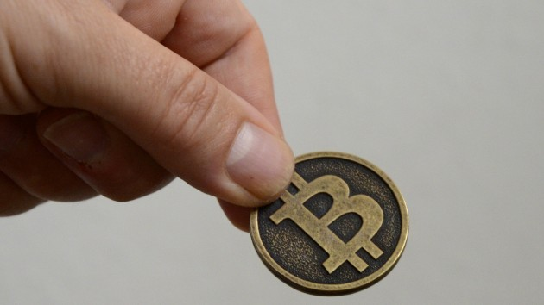
Buy Cryptos Locally
Buying small amounts of Bitcoins is popular.
  Find a dealer with an acceptable price (price is posted on the internet.)
  Arrange a meeting place that is safe.
  Bring cash since he/she doesn’t accept any form of credit.
  You pay him and he initiates a transfer from his account in a Bitcoin Exchange.
  He gives you a secure code which deposits them in your “wallet.”

Slide 24
Buy Bitcoins from ATM
ATM’s that sell Bitcoin are in a very few locations.
First one was in Texas in a gun store.
Bitcoin ATM’s only take cash.
They only sell Bitcoin, you can’t convert Bitcoin to cash.

Slide 25
Actvity Level
Currently there are 60,000 to 70,000 Bitcoin transactions each day
The level hasn’t changed significantly in the last year.
Log into Blockchain.info to see the transaction activity.

Slide 26
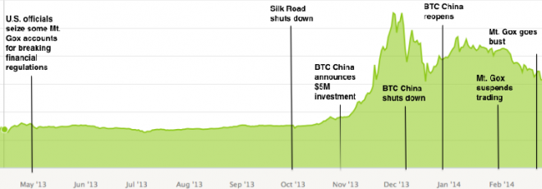
Chinese Speculators Drive the Price

Slide 27
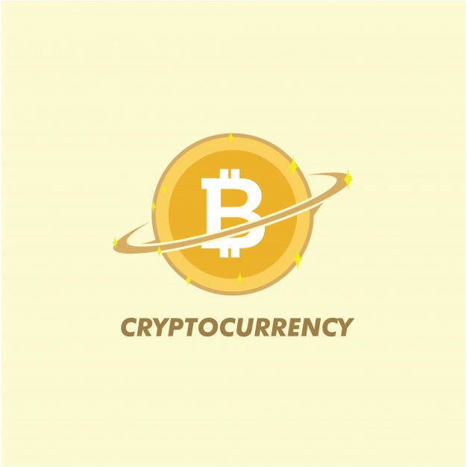
Cryptocurrencies Value – 1 Year History

Slide 28
Why is all the Money Flowing into Bitcoins?
Trading in Bitcoin can make you very rich! (or very poor.)
90% of Bitcoin buyers are speculators.
If people only bought Bitcoins to be used for e-commerce, the price would likely be much lower.

Slide 29
Wall Street wants in on the Action
Wall Street just opened the “Bitcoin Investment Trust” to speculate in Bitcoin prices without owning the currency. Minimum investment is $25,000.
  Currently has $70 Million in assets.
Expect Wall Street to develop leveraging instruments such as calls, shorts, straddles, etc.

Slide 30
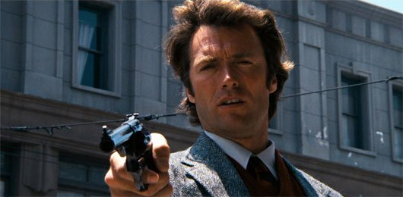
Bitcoin – The New Gold Rush
If you want to invest in Bitcoins ……..
To Quote Dirty Harry:
You've gotta ask yourself a question: "Do I feel lucky?" Well, do ya?

Slide 31
Why Would You Want Some Bitcoin?
It’s a novelty and would be fun to try.
Show your friends that you are a true groundbreaker.
You like to gamble.
You don’t trust Credit Cards and want to buy stuff online.
You want to buy something on the internet that is “unconventional.”
You want to sell something that is “unconventional”

Slide 32
Cryptocurrency Issues - Legality
Transactions are untraceable.
  Seller doesn’t tell the IRS
  Buyer can be anonymous
U.S. Treasury and IRS wants it stopped.
First big user of Bitcoin was Silk Road
  Drug trade proliferated
  No money laundering necessary
It’s very hard to stop Cryptocurrency– it’s an international scheme.

Slide 33
Bitcoin Outlawed in Some Countries
Russia was first to outlaw Bitcoin transactions
  They have enough corruption without Bitcoin
China is restricting it use
  Too much speculation
Korea outlaws it’s use – claims it’s not a legitimate currency
Thailand shutdown the Bitcoin exchange in their country.

Slide 34
Bitcoin Issues - Safety
Largest Exchange, Mt Gox in Japan just went bankrupt
  Hackers were siphoning off their Bitcoins
  They lost $450 million dollars
  Account holders are the real losers
Electronic Wallets
  Many websites have created “secure” electronic wallets for you.
  There are Wallets for Windows, Mac, iPhone, and Android
  Some “Wallets” deduct a small fee for every transaction
Wallets have proven to be safe, but no guarantees.

Slide 35
Bitcoin Issues - Safety
Bitcoin addresses are RACE Integrity Primitives Evaluation Message Digest RIPEMD-160 of SHA-256 of an Elliptic Curve Digital Signature Algorithm public key any vulnerabilities in the algorithms would constitute a vulnerability in bitcoin itself
An attacker with > 50% of hash power can
Double spend: Reverse transactions that he sends while he's in control
Prevent some or all transactions from gaining any confirmations
Prevent some or all other generators from getting any generations

Slide 36
Who Accepts Cryptocurrencies?
Thousands of online merchants such as:
  Pirate Bay – Online sharing site for questionable materials.
  OKCupid – Online dating site
  Overstock.com – Sells clearance merchandise
  TigerDirect.com – Major electronics retailer
  Wikileaks – non-profit organisation that publishes secret information, news leaks, and classified media provided by anonymous sources.
50,000 Retail stores (and counting) accept Bitcoin
  Hotels in Las Vegas
  Gift Cards for GAP, Lowes, Burger King, etc.
  Mostly small merchants who want to increase traffic

Slide 37
Will Bitcoin Survive?
JP Morgan Chase filed a patent to address the issues of a cryptocurrency like Bitcoin.
Since most owners are speculators the true price for owning Bitcoin only to use as a currency is unknown.
Hedge Funds and Banks will likely start trading Bitcoins similar to international currencies and gold.
Bank of America announced that Bitcoin could be a major means of payment for commerce.

Slide 38
Bitcoin in a Perfect World
There are many promises to be fulfilled by a universal digital currency.
Lowers the cost of processing.
  Credit cards charge ~5% to the supplier.
  Bitcoin transactions would cost almost nothing.
Reduces Fraud
  Credit card fraud costs billions of dollars each year
  Don’t need to carry plastic in your wallet
  Smartphone Apps can work with Bitcoin

Slide 39
The future of Cryptocurrency
Digital currency makes a lot of sense.
  It could eliminate a lot of middle man costs (credit cards, wire fees, etc.)
  It could be extremely easy to use
  It could eliminate billions of dollars in credit card fraud and identity theft.
Bitcoin may utterly fail but some form of digital currency will probably emerge.
  It must be safe
  It must be traceable by government entities
  It must be easy to use.
  People must have trust in it’s value

Slide 40
THANK YOU

