Slide 1


Slide 2
INTRODUCTION
WHY Git?
Version control
Collaboration

Slide 3
Version control systems
Version control (or revision control, or source control) is all about managing multiple versions of documents, programs, web sites, etc.
  Almost all “real” projects use some kind of version control
  Essential for team projects, but also very useful for individual projects
Some well-known version control systems are CVS, Subversion, Mercurial, and Git
  CVS and Subversion use a “central” repository; users “check out” files, work on them, and “check them in”
  Mercurial and Git treat all repositories as equal
Distributed systems like Mercurial and Git are newer and are gradually replacing centralized systems like CVS and Subversion

Slide 4

Version Control in Git

Slide 5
Why version control?
For working by yourself:
  Gives you a “time machine” for going back to earlier versions
  Gives you great support for different versions (standalone, web app, etc.) of the same basic project
For working with others:
  Greatly simplifies concurrent work, merging changes
For getting an internship or job:
  Any company with a clue uses some kind of version control
  Companies without a clue are bad places to work

Slide 6


Slide 7
Why Git?
Git has many advantages over earlier systems such as CVS and Subversion
  More efficient, better workflow, etc.
  See the literature for an extensive list of reasons
  Of course, there are always those who disagree
Best competitor: Mercurial
  I like Mercurial better
  Same concepts, slightly simpler to use
  In my (very limited) experience, the Eclipse plugin is easier to install and use
  Much less popular than Git

Slide 8
Multiple versions
Initial commit
Second commit
Third commit
Bob gets a copy
Fourth commit
Bob’s commit
Merge

Slide 9
What is a DVCS?
Centralized VCS
One central repository
Must be capable of connecting to repo
Need to solve issues with group members making different changes on the same files
Distributed VCS
Everyone has a working repo
FasterConnectionless
Still need to resolve issues, but it's not an argument against DVCS﻿

Slide 10
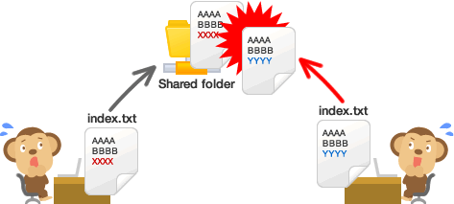
Collaboration in Git

Slide 11
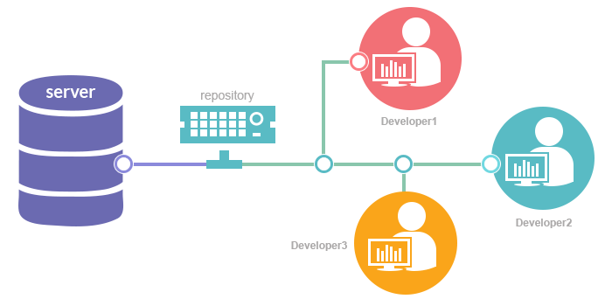

Slide 12
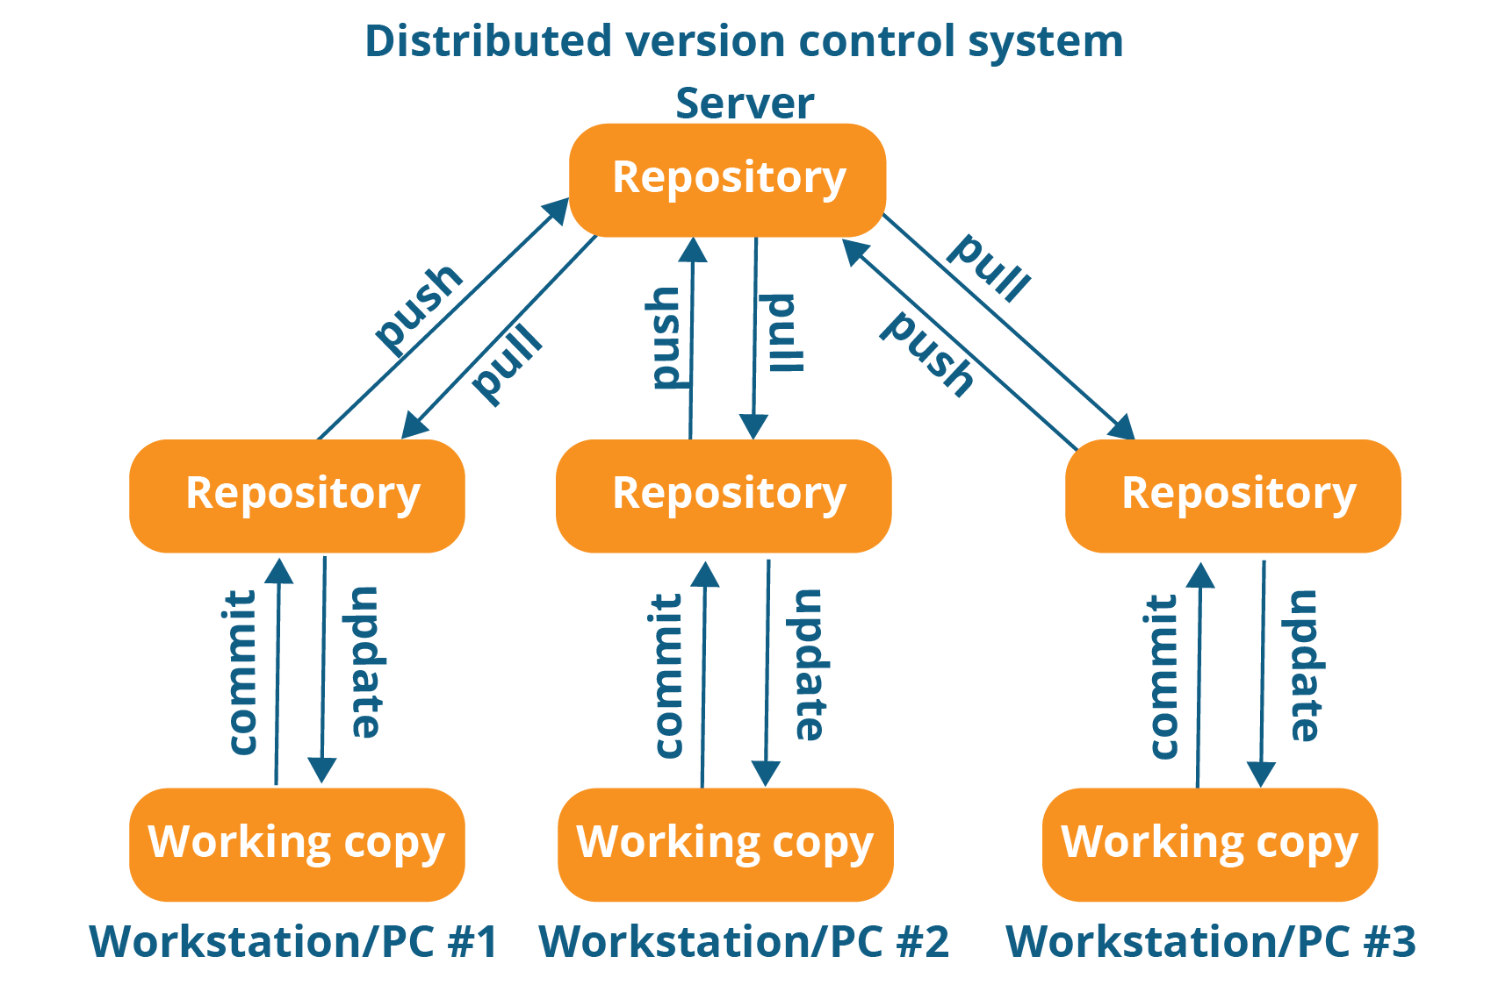

Slide 13
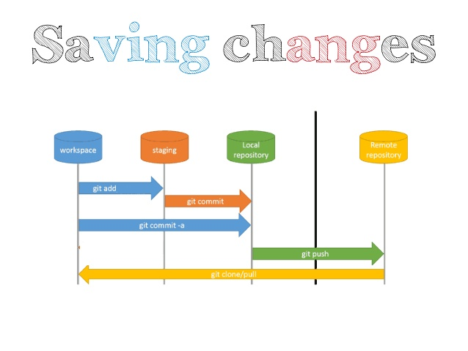

Slide 14
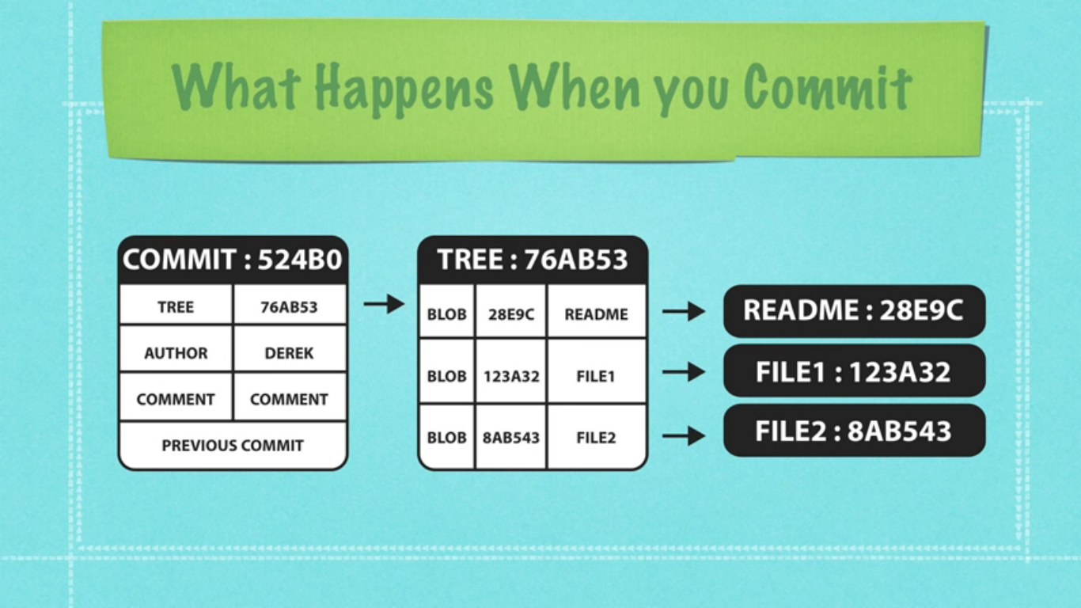

Slide 15
Configuration
ramprasad@enigma:~/Documents$ git config --global user.name "Ramprasade10"
ramprasad@enigma:~/Documents$ git config --global user.email "ramprasade10@gmail.com"
ramprasad@enigma:~/Documents$ git config --global core.editor "vim"
You only need to do this once
If you want to use a different name/email address for a particular project, you can change it for just that project
cd to the project directory
Use the above commands, but leave out the --global

Slide 16
Choose an editor
When you “commit,” git will require you to type in a commit message
For longer commit messages, you will use an editor
The default editor is probably vim

Slide 17
The repository
Your top-level working directory contains everything about your project
  The working directory probably contains many subdirectories—source code, binaries, documentation, data files, etc.
  One of these subdirectories, named .git, is your repository
At any time, you can take a “snapshot” of everything (or selected things) in your project directory, and put it in your repository
  This “snapshot” is called a commit object
  The commit object contains (1) a set of files, (2) references to the “parents” of the commit object, and (3) a unique “SHA1” name
  Commit objects do not require huge amounts of memory
You can work as much as you like in your working directory, but the repository isn’t updated until you commit something

Slide 18
Initialization
C:\> mkdir CoolProject
C:\> cd CoolProject
C:\CoolProject > git init
Initialized empty Git repository in C:/CoolProject/.git
C:\CoolProject > vi README.txt
C:\CoolProject > git add *
C:\CoolProject > git commit -m 'my first commit'
[master (root-commit) 7106a52] my first commit
1 file changed, 1 insertion(+)
create mode 100644 README.txt

Slide 19
Adding remote repository
a. git init
b. git add . # Stages all new and modified files and directories
c. git commit -m 'Initial Project Version'
d. git remote add origin https://github.com/Ramprasade10/test.git
e. git pull https://github.com/Ramprasade10/test.git
f. git push origin master
git remote -v # Lists all remotes and their URLs
git fetch origin # Gets data from the remote, but it doesn't merge changes with your work
7.

Slide 20

Best practices for code collaboration
When to commit?
  Source of major arguments (big changes vs small change)
  Never put broken code on the master branch (test first!)
  Try not to break things (don't do two weeks worth of work in one commit)
  Always use a clear, concise commit message
    Put more details in lines below, but always make the first line short
    Describe the why; the what is clear in the change log
  When making giant changes, consider branches (we'll talk about these in a few slides)
  Make sure your name and email are right

Slide 21
Branches Illustrated
master
A
> git commit –m ‘my first commit’
Notes:
Now lets see what this visually looks like.
On my first commit I have A.
The default branch that gets created with git is a branch names Master.
This is just a default name. As I mentioned before, most everything in git is done by convention. Master does not mean anything special to git.

Slide 22
Branches Illustrated
master
A
B
C
> git commit (x2)
Notes:
We make a set of commits, moving master and our current pointer (*) along

Slide 23
Branches Illustrated
master
A
B
C
bug123
> git checkout –b bug123
Notes:
Suppose we want to work on a bug. We start by creating a local “story branch” for this work.
Notice that the new branch is really just a pointer to the same commit (C) but our current pointer (*) is moved.

Slide 24
Branches Illustrated
master
A
B
C
D
E
bug123
> git commit (x2)
Notes:
Now we make commits and they move along, with the branch and current pointer following along.

Slide 25
Branches Illustrated
master
A
B
C
D
E
bug123
> git checkout master
Notes:
We can “checkout” to go back to the master branch.
This is where I was freaked out the first time I did this. My IDE removed the changes I just made. It can be pretty startling, but don’t worry you didn’t lose anything.

Slide 26
Branches Illustrated
master
A
B
C
D
E
bug123
> git merge bug123
Notes:
And then merge from the story branch, bringing those change histories together.

Slide 27
Branches Illustrated
master
A
B
C
D
E
> git branch -d bug123
Notes:
And since we’re done with the story branch, we can delete it. This all happened locally, without affecting anyone upstream.

Slide 28
Branches Illustrated
master
A
B
C
D
E
F
G
bug456
Notes:
Let’s consider another scenario. Here we created our bug story branch back off of (C). But some changes have happened in master (bug 123 which we just merged) since then.
And we made a couple of commits in bug 456.

Slide 29
Branches Illustrated
master
A
B
C
D
E
F
G
bug456
> git checkout master
Notes:
Again, to merge, we checkout back to master which moves our (*) pointer.

Slide 30
Branches Illustrated
master
A
B
C
D
E
H
F
G
bug456
> git merge bug456
Notes:
And now we merge, connecting the new (H) to both (E) and (G). Note that this merge, especially if there are conflicts, can be unpleasant to perform.

Slide 31
Branches Illustrated
master
A
B
C
D
E
H
F
G
> git branch -d bug456
Notes:
Now we delete the branch pointer.
But notice the structure we have now. This is very non-linear. That will make it challenging to see the changes independently. And it can get very messy over time.

Slide 32
Branches Illustrated
master
A
B
C
D
E
F
G
bug456
Notes:
Rebase flow - Let’s go back in time and look at another approach that git enables. So here we are ready to merge.

Slide 33
Branches Illustrated
master
A
B
C
D
E
F’
G’
bug456
> git rebase master
Notes:
Instead of merging, we “rebase”.
What this means is something like this:
1. Take the changes we had made against (C) and undo them, but remember what they were
2. Re-apply them on (E) instead

Slide 34
Branches Illustrated
master
A
B
C
D
E
F’
G’
bug456
> git checkout master
> git merge bug456
Notes:
Now when we merge them, we get a nice linear flow.
Also, the actual changeset ordering in the repository mirrors what actually happened. (F’) and (G’) come after E rather than in parallel to it. Also, there is one fewer snapshots in the repository.

Slide 35

Git vs GitHub

Slide 36
Thank you!

