Slide 1


Version Control System

Slide 2
Version control systems
Version control (or revision control, or source control) is all about managing multiple versions of documents, programs, web sites, etc.
  Almost all “real” projects use some kind of version control
  Essential for team projects, but also very useful for individual projects
Some well-known version control systems are CVS, Subversion, Mercurial, and Git
  CVS and Subversion use a “central” repository; users “check out” files, work on them, and “check them in”
  Mercurial and Git treat all repositories as equal
Distributed systems like Mercurial and Git are newer and are gradually replacing centralized systems like CVS and Subversion

Slide 3
How we try to maintain, share different versions
Copying (Coursework_working.java, Coursework_tmp.java) – different feature versions
Copy & Paste code snippets - if its working
Renaming- Final 1,Final 2 by Copying entire directories
Distribution - Emailing code to people

Slide 4
Why version control?
For working by yourself:
  Gives you a “time machine” for going back to earlier versions
  Gives you great support for different versions (standalone, web app, etc.) of the same basic project
For working with others:
  Greatly simplifies concurrent work, merging changes

Slide 5
Version control is not just useful for collaborative working, essential for quality source code development
Often want to undo changes to a file,you start working, realize it's the wrong approach, want to get back to starting point
Keep the whole history of every file and a changelog
Also want to be able to see who changed what, when
The best way to find out how something works is often to ask the person who wrote it

Slide 6
Version control for teams
Scenario:
  You change one part of a program--it works
  Your co-worker changes another part--it works
  You put them together--it doesn’t work
  Some change in one part must have broken something in the other part
  What were all the changes?

Slide 7
Teams (part 2)
Scenario:
  You make a number of improvements to a class
  Your co-worker makes a number of different improvements to the same class
How can you merge these changes?

Slide 8
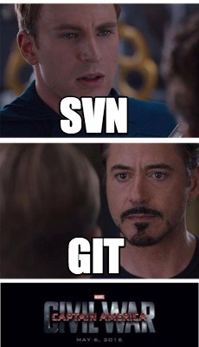

Slide 9
What is a DVCS?
Centralized VCS
One central repository
Must be capable of connecting to repo
Need to solve issues with group members making different changes on the same files
Distributed VCS
Everyone has a working repo
FasterConnectionless
Still need to resolve issues, but it's not an argument against DVCS﻿

Slide 10
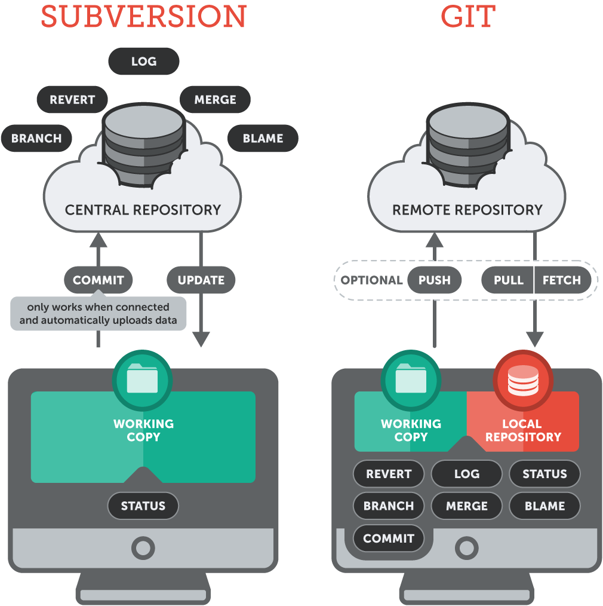

Slide 11
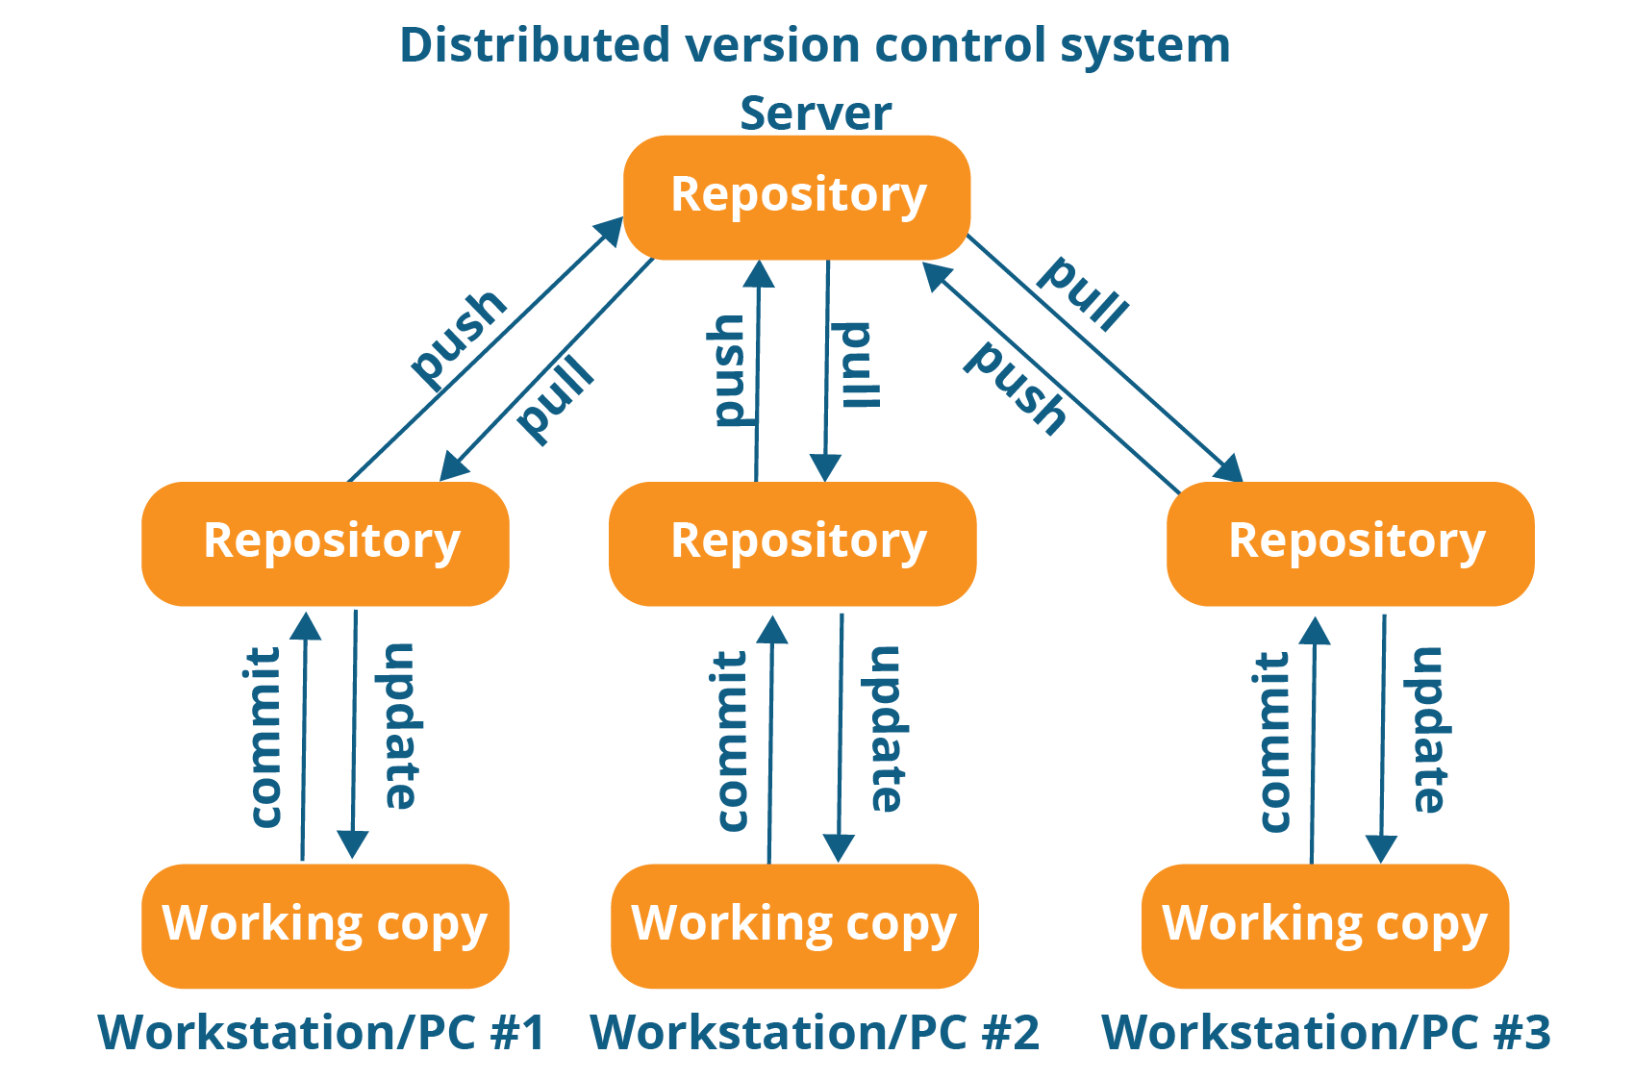

Slide 12
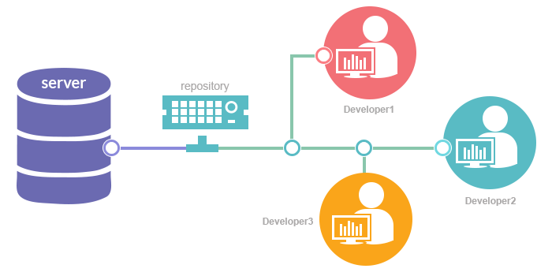

Slide 13
Why Git?
Git has many advantages over earlier systems such as CVS and Subversion

Slide 14
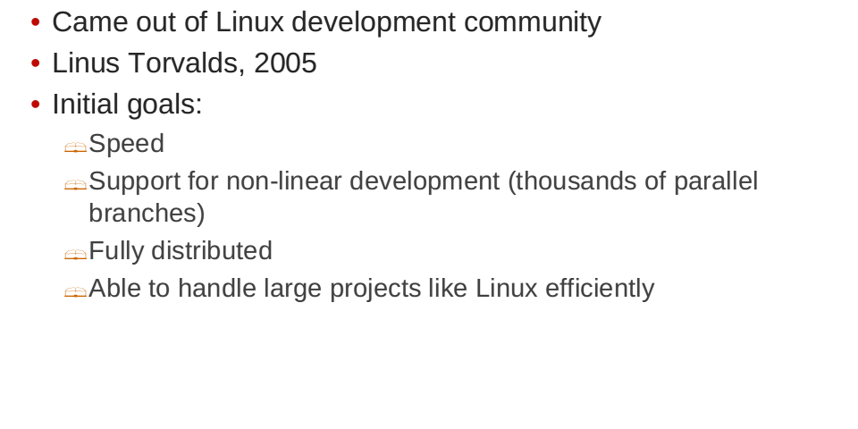
Git History

Slide 15
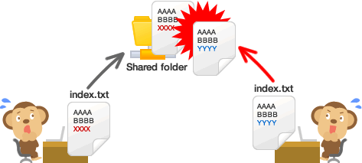
Collaboration in Git

Slide 16
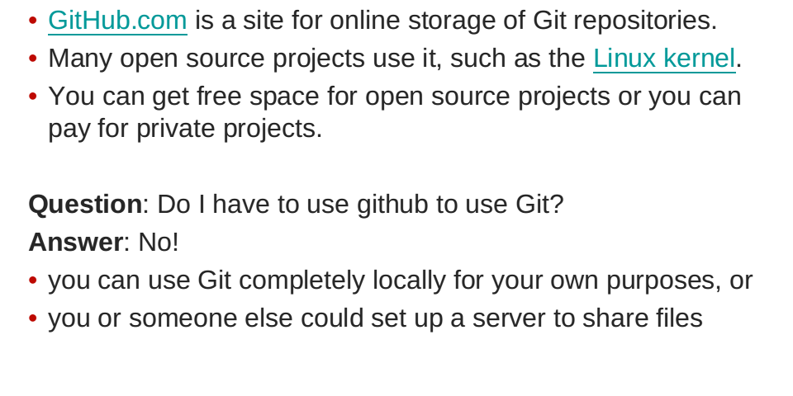
What is Github

Slide 17
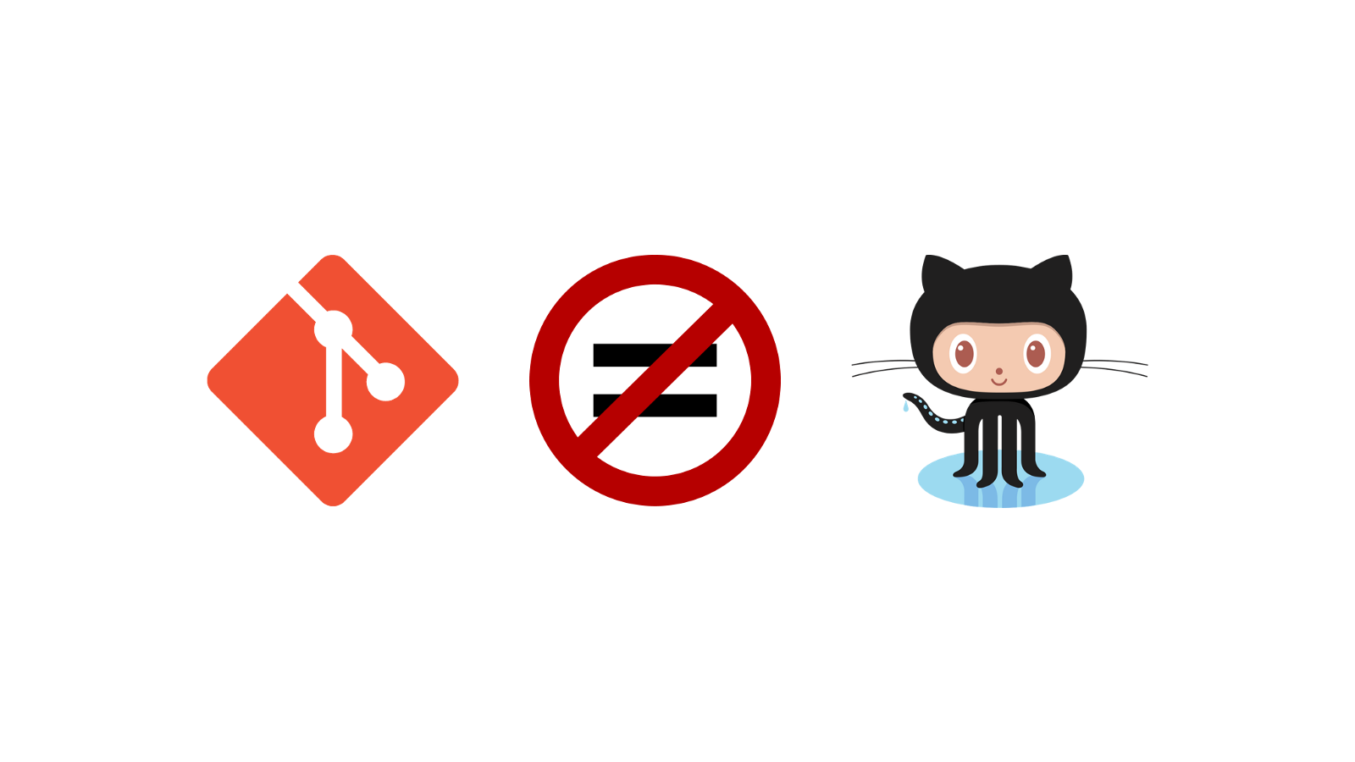
Github Vs Git

Slide 18

Version Control in Git

Slide 19


Slide 21
Working with Git
C:\> mkdir CoolProject
C:\> cd CoolProject
C:\CoolProject > git init
Initialized empty Git repository in C:/CoolProject/.git
C:\CoolProject > vi README.txt
C:\CoolProject > git add *
C:\CoolProject > git commit -m 'my first commit'
[master (root-commit) 7106a52] my first commit
1 file changed, 1 insertion(+)
create mode 100644 README.txt

Slide 22
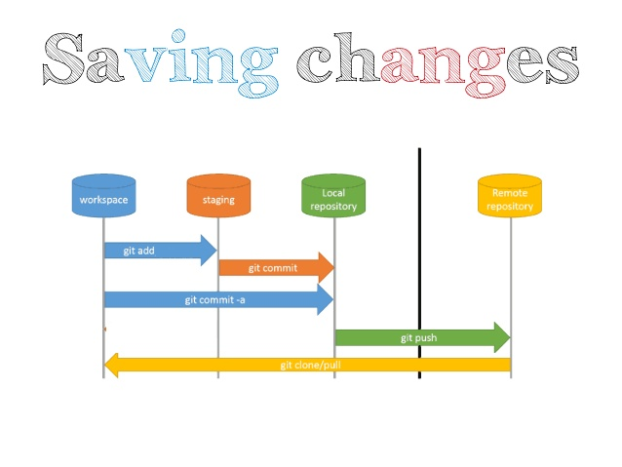

Slide 23
The repository
Your top-level working directory contains everything about your project
  The working directory probably contains many subdirectories—source code, binaries, documentation, data files, etc.
  One of these subdirectories, named .git, is your repository
At any time, you can take a “snapshot” of everything (or selected things) in your project directory, and put it in your repository
  This “snapshot” is called a commit object
  The commit object contains (1) a set of files, (2) references to the “parents” of the commit object, and (3) a unique “SHA1” name
  Commit objects do not require huge amounts of memory
You can work as much as you like in your working directory, but the repository isn’t updated until you commit something

Slide 24
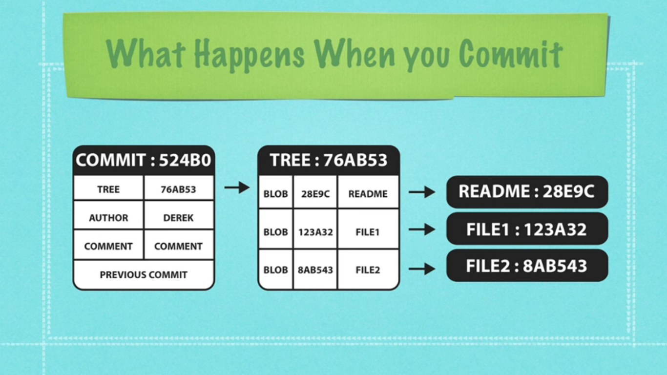

Slide 25
Configuration
ramprasad@enigma:~/Documents$ git config --global user.name "Ramprasade10"
ramprasad@enigma:~/Documents$ git config --global user.email "ramprasade10@gmail.com"
ramprasad@enigma:~/Documents$ git config --global core.editor "vim"
You only need to do this once
If you want to use a different name/email address for a particular project, you can change it for just that project
cd to the project directory
Use the above commands, but leave out the --global

Slide 26
Choose an editor
When you “commit,” git will require you to type in a commit message
For longer commit messages, you will use an editor
The default editor is probably vim

Slide 27
Initialization
C:\> mkdir CoolProject
C:\> cd CoolProject
C:\CoolProject > git init
Initialized empty Git repository in C:/CoolProject/.git
C:\CoolProject > vi README.txt
C:\CoolProject > git add *
C:\CoolProject > git commit -m 'my first commit'
[master (root-commit) 7106a52] my first commit
1 file changed, 1 insertion(+)
create mode 100644 README.txt

Slide 28
Adding remote repository
a. git init
b. git add . # Stages all new and modified files and directories
c. git commit -m 'Initial Project Version'
d. git remote add origin https://github.com/Ramprasade10/test.git
e. git pull https://github.com/Ramprasade10/test.git
f. git push origin master
g. git remote -v # Lists all remotes and their URLs
h. git fetch origin # Gets data from the remote, but it doesn't merge changes with your work
7.

Slide 29

Best practices for code collaboration
When to commit?
  Source of major arguments (big changes vs small change)
  Never put broken code on the master branch (test first!)
  Try not to break things (don't do two weeks worth of work in one commit)
  Always use a clear, concise commit message
    Put more details in lines below, but always make the first line short
    Describe the why; the what is clear in the change log
  When making giant changes, consider branches (we'll talk about these in a few slides)
  Make sure your name and email are right

Slide 30
Branching
Branches allows multiple copies to implement multiple features of the code base within a single repository.
  Customer 1 wants features A,B, C
  Customer 2 wants features A & C but not B because his computer is old and it slows down too much.
  Customer 3 wants only feature A due to costs
  Each customer has their own branch.
Want to add a particular feature and test its feasibility without affecting the main project(master branch)

Slide 31
Multiple versions
Initial commit
Second commit
Third commit
Bob gets a copy
Fourth commit
Bob’s commit
Merge

Slide 32
Branches Illustrated
master
A
> git commit –m ‘my first commit’
Notes:
Now lets see what this visually looks like.
On my first commit I have A.
The default branch that gets created with git is a branch names Master.
This is just a default name. As I mentioned before, most everything in git is done by convention. Master does not mean anything special to git.

Slide 33
Branches Illustrated
master
A
B
C
> git commit (x2)
Notes:
We make a set of commits, moving master and our current pointer (*) along

Slide 34
Branches Illustrated
master
A
B
C
bug123
> git checkout –b bug123
Notes:
Suppose we want to work on a bug. We start by creating a local “story branch” for this work.
Notice that the new branch is really just a pointer to the same commit (C) but our current pointer (*) is moved.

Slide 35
Branches Illustrated
master
A
B
C
D
E
bug123
> git commit (x2)
Notes:
Now we make commits and they move along, with the branch and current pointer following along.

Slide 36
Branches Illustrated
master
A
B
C
D
E
bug123
> git checkout master
Notes:
We can “checkout” to go back to the master branch.
This is where I was freaked out the first time I did this. My IDE removed the changes I just made. It can be pretty startling, but don’t worry you didn’t lose anything.

Slide 37
Branches Illustrated
master
A
B
C
D
E
bug123
> git merge bug123
Notes:
And then merge from the story branch, bringing those change histories together.

Slide 38
Branches Illustrated
master
A
B
C
D
E
> git branch -d bug123
Notes:
And since we’re done with the story branch, we can delete it. This all happened locally, without affecting anyone upstream.

Slide 39
Branches Illustrated
master
A
B
C
D
E
F
G
bug456
Notes:
Let’s consider another scenario. Here we created our bug story branch back off of (C). But some changes have happened in master (bug 123 which we just merged) since then.
And we made a couple of commits in bug 456.

Slide 40
Branches Illustrated
master
A
B
C
D
E
F
G
bug456
> git checkout master
Notes:
Again, to merge, we checkout back to master which moves our (*) pointer.

Slide 41
Branches Illustrated
master
A
B
C
D
E
H
F
G
bug456
> git merge bug456
Notes:
And now we merge, connecting the new (H) to both (E) and (G). Note that this merge, especially if there are conflicts, can be unpleasant to perform.

Slide 42
Branches Illustrated
master
A
B
C
D
E
H
F
G
> git branch -d bug456
Notes:
Now we delete the branch pointer.
But notice the structure we have now. This is very non-linear. That will make it challenging to see the changes independently. And it can get very messy over time.

Slide 43
Branches Illustrated
master
A
B
C
D
E
F
G
bug456
Notes:
Rebase flow - Let’s go back in time and look at another approach that git enables. So here we are ready to merge.

Slide 44
Branches Illustrated
master
A
B
C
D
E
F’
G’
bug456
> git rebase master
Notes:
Instead of merging, we “rebase”.
What this means is something like this:
1. Take the changes we had made against (C) and undo them, but remember what they were
2. Re-apply them on (E) instead

Slide 45
Branches Illustrated
master
A
B
C
D
E
F’
G’
bug456
> git checkout master
> git merge bug456
Notes:
Now when we merge them, we get a nice linear flow.
Also, the actual changeset ordering in the repository mirrors what actually happened. (F’) and (G’) come after E rather than in parallel to it. Also, there is one fewer snapshots in the repository.

Slide 46


Slide 47
Thank you!

