Slide 1

Divvy-Bike trip
Case study
01/04/2022

Slide 2
Contents
Introduction
.Data and its source
Purpose of analysis
.Data cleaning
.Data Analysis
.Insights (Data visualization)
.Findings and recommendation.

Slide 3

Introduction
In 2016, Cyclists launched a successful bike-share offering. Since then, the program has grown to a fleet of 5,824 bicycles that are tracked and locked into a network of 692 stations across Chicago. The bikes can be unlocked from one station and returned to any other station in the system anytime
*Pricing plans: single-ride passes,
A)full-day passes,
B)annual memberships.
*Types of Riders
A) Single-ride or full-day passes - Casual riders.
B) Annual memberships are - Members.

Slide 4

Purpose of Analysis
How do annual members and casual riders use Cyclistic bikes differently?
Why would casual riders buy Cyclistic annual memberships?
How can Cyclistic use digital media to influence casual riders to become members?

Slide 5
Data Cleaning
* I used the last 12 months of Divvy bike trip data.
* All 12 different files are checked for empty rows and columns.
* All file column names have been checked and renamed in a consistently
* A data frame has been created to merge all the 12 different files.
* Checking the types of observation in each column.
* Recode four observations in a member-casual column into two :
“subscriber=member” and “Customer=Casual”
* Creating separate column named :
Ride length, month, year, day.

Slide 6

Data Analysis
* A descriptive analysis of ride length (all figures in seconds)
longest ride, shortest ride, average(total ride length / rides)
* The four lines to one line using summary() on the specific attribute summary
* Compare members and casual users
* Notice that the days of the week are out of order.
* Analyse ridership data by type and weekday

Slide 7
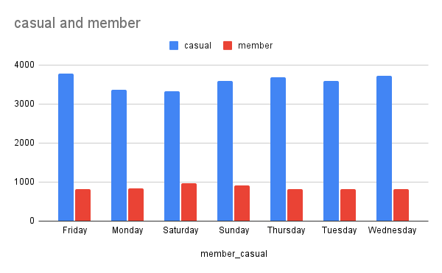
Insights- Ride length
Duration of Ride length between casual and membership riders.

Slide 8
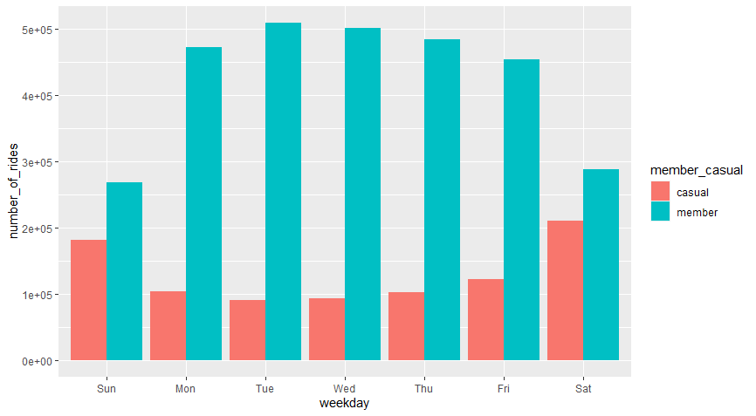
Number OF RIDEs (Casual vs member)
Here, we can see the members initiate a maximum number of rides, compared to casual riders.

Slide 9

Findings
* Casual riders
A) are the ones, who initiate lengthy rides.
B) But they take only less number of rides.
C) They are busy on weekdays only.
*Members
A) They are doing only a consistent length (short) of rides.
B) And also, members scores low on no. of. rides category as well.
C) They look slightly more busy on weekends than casual riders.

Slide 10
RECOMMENDATION & Further analysis
* Casual riders need to be concentrated on weekdays.
* We need to approach casual riders in terms of more ride length.
* They buy membership only when we offer more facilities to help casual riders to complete long rides easily.
* We would need to limit the length of rides for casual riders in weekdays.
* Trend clearly show they must need a bike for lengthy rides. So they go for membership
* We need to do use public transport as digital media for ad, because they are busy in weekdays.

