Slide 1


CGC Jhanjeri Present By Balmiki kumar
Uni-Roll : 2235548

Slide 2

CSS
Introduction of CSS
Why need CSS
Syntax and Property
Selector
Types of CSS
Advantage
Browser support
Reference:

Slide 3
Introduction:
Cascading Style Sheets.
Cascading : refers to the procedure that determines which style will apply to a certain section, if you have more than one style rull.
Style : How you want a certain part of your pages to look.you can set things like color, margins, font, etc for things like tables, paragraphs, and headings.
Sheets: Sheets are templates, or a set of rules, for determining how the webpage will looks.
The first version of CSS was invented 1996 by Hakon Wium Lie.

Slide 4

Why css need:
Design pages.
Makes webpage Beautifull and
user interfaces.
control the layout of multiple web pages all at once.
layout and variations in display for different devices and screen sizes.
you can control the color of the text.
style of fonts, spacing between paragraphs, background images or colors.

Slide 5
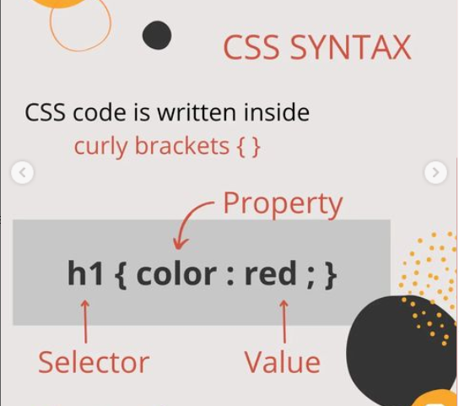
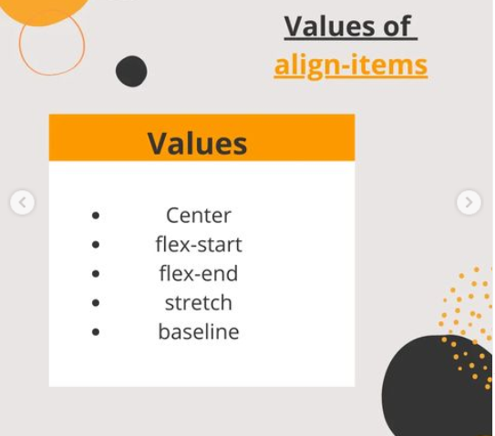

CSS Syntax and Property:
Left
Right
Center

Slide 6
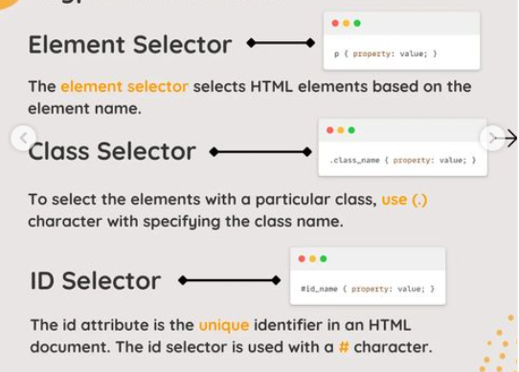
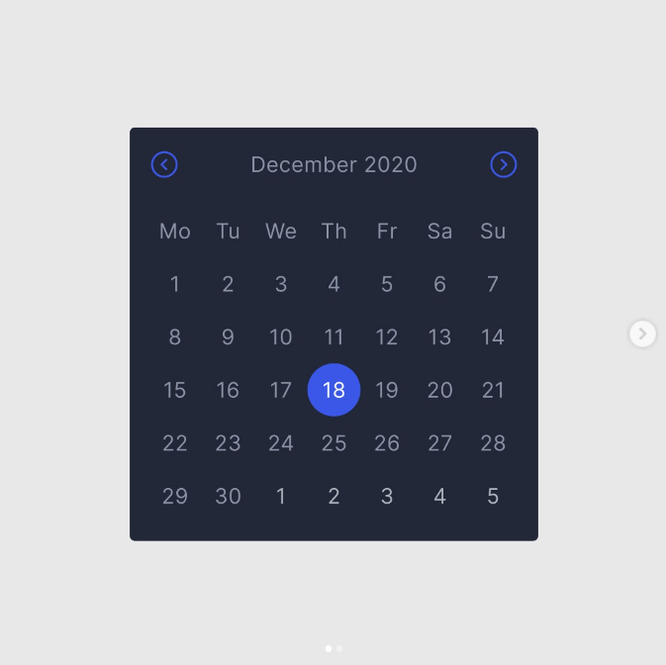
Type of selector:

Slide 7
CSS Property:
Margin Property
margin-top
margin-right
margin-bottom
margin-left
p { margin-top: 100px; margin-bottom: 100px; margin-right: 150px; margin-left: 80px; }
p { margin: 25px 50px 75px 100px; }

Slide 8
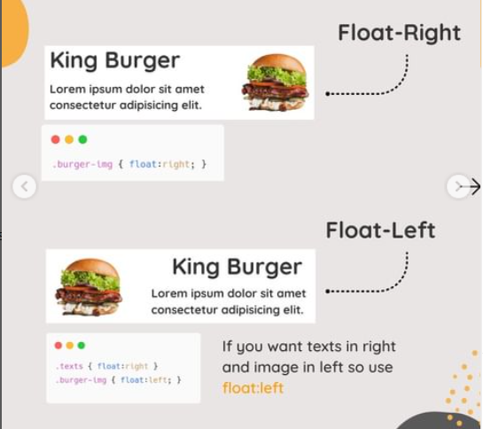
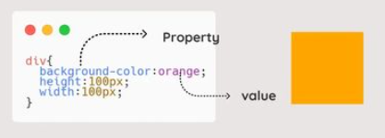
CSS Property:

Slide 9
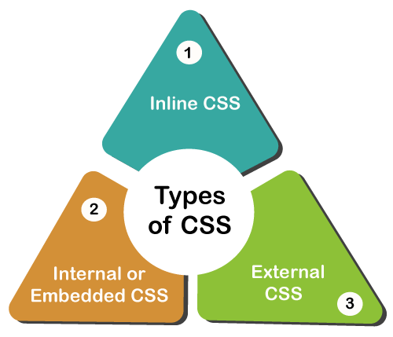
Type of css:
Inline CSS
<!DOCTYPE html>
<html>
<body>
<h1 style="color:blue;text-align:center;">This is a heading</h1>
<p style="color:red;">This is a paragraph.</p>
</body>
</html>

Slide 10
Type of css:
Internal CSS
<!DOCTYPE html>
<html>
<head>
<style>
body {
background-color: linen;
}
h1 {
color: maroon;
margin-left: 40px;
}
</style>
</head>
<body>
<p>This is a paragraph.</p>
</body>
</html>
External CSS
<!DOCTYPE html>
<html>
<head>
<link rel="stylesheet" href="mystyle.css">
</head>
<body>
<h1>This is a heading</h1>
<p>This is a paragraph.</p>
</body>
</html>
mystyle.css
body {
background-color: lightblue;
}
h1 {
color: navy;
margin-left: 20px;
}

Slide 11
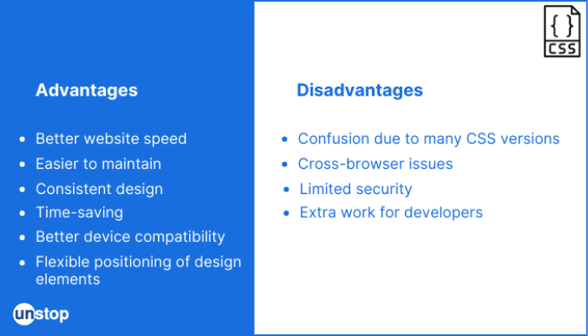
Advantage and disadvantage:

Slide 12
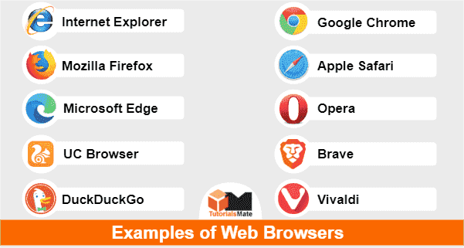
Browser support:

Slide 13
Reference:
https://www.w3schools.com/css/default.asp
https://www.javatpoint.com/css-tutorial
https://www.geeksforgeeks.org/css/
https://www.tutorialspoint.com/css/index.htm

Slide 14


