Slide 1
Digital Portfolio
STUDENT NAME: RAM PRATHAP K
REGISTER NO AND NMID: 45E3A1512CFBDE8B91B40D79 A7C30851
DEPARTMENT: COMPUTER SCIENCE
COLLEGE: KPR COLLEGE OF ATRS SCIENCE AND RESEARCH

Slide 2
PROJECT TITLE
Online & Digital Learning
"Click to Learn: The Digital Classroom Experience"
"Beyond Borders: Global Learning Online"
"EvolveEd: Education in the Digital Age"

Slide 3


AGENDA
Problem Statement
Project Overview
End Users
Tools and Technologies
Portfolio design and Layout
Features and Functionality
Results and Screenshots
Conclusion
Github Link
3/21/2024 Annual Review

Slide 4

PROBLEM STATEMENT
Despite the rapid expansion of online and digital learning platforms, many learners continue to face significant barriers to effective engagement, retention, and success. These challenges include limited access to reliable internet and devices, lack of personalized learning experiences, reduced motivation and accountability in virtual environments, and insufficient digital literacy among both students and educators. Additionally, the absence of real-time interaction and community-building often leads to feelings of isolation, which can negatively impact learning outcomes.
To ensure equitable and impactful education in the digital age, it is essential to address these systemic gaps by designing inclusive, interactive, and adaptive learning ecosystems that cater to diverse learner needs and contexts.

Slide 5

PROJECT OVERVIEW
With the global shift toward digital education, traditional learning models face challenges in accessibility, flexibility, and learner engagement. This project aims to bridge the gap by leveraging technology to create dynamic, learner-centered environments that support academic growth, skill development, and lifelong learning.
🛠️ Key Components
Curriculum Digitization: Converting traditional content into interactive, multimedia-rich formats
Learning Management System (LMS): A centralized platform for course delivery, tracking, and feedback
Adaptive Learning Tools: AI-driven personalization based on learner performance and preferences
Mobile Accessibility: Ensuring seamless access across devices and low-bandwidth environments
Teacher Training: Equipping educators with digital pedagogy and tech integration skills
Community & Collaboration: Forums, peer review, and group

Slide 6

WHO ARE THE END USERS?
Sure! Here's a short version:
👥 End Users of Online and Digital Learning
Students – from school kids to university learners
Professionals – for career growth and skill development
Educators – teaching and managing digital classrooms
Lifelong Learners – anyone learning for personal interest
Organizations – schools, companies, and governments using eLearning tools

Slide 7

TOOLS AND TECHNIQUES
Sure! Here's a short version:
🛠️ X
Tools
LMS (e.g., Google Classroom, Moodle)
Zoom, Teams (video classes)
Digital whiteboards (Jamboard, Miro)
Quiz tools (Kahoot, Quizizz)
MOOC platforms (Coursera, Udemy)
🎯 Techniques
Blended learning
Flipped classroom
Gamification
Microlearning
Adaptive learning

Slide 8
POTFOLIO DESIGN AND LAYOUT
🧩 Portfolio Design & Layout
Simple & clean design
Sections:
About Me
Projects
Tools Used
Results/Feedback
Contact Info
Use visuals: Screenshots, videos, icons
Keep branding consistent: Fonts, colors, style
8

Slide 9
FEATURES AND FUNCTIONALITY
🔮 Futures
AI personalization
VR/AR immersive learning
Hybrid models
Global access
Digital certificates
⚙️ Functionalities
Live classes & quizzes
Progress tracking
Mobile access
Multimedia content
Collaboration tools

Slide 10

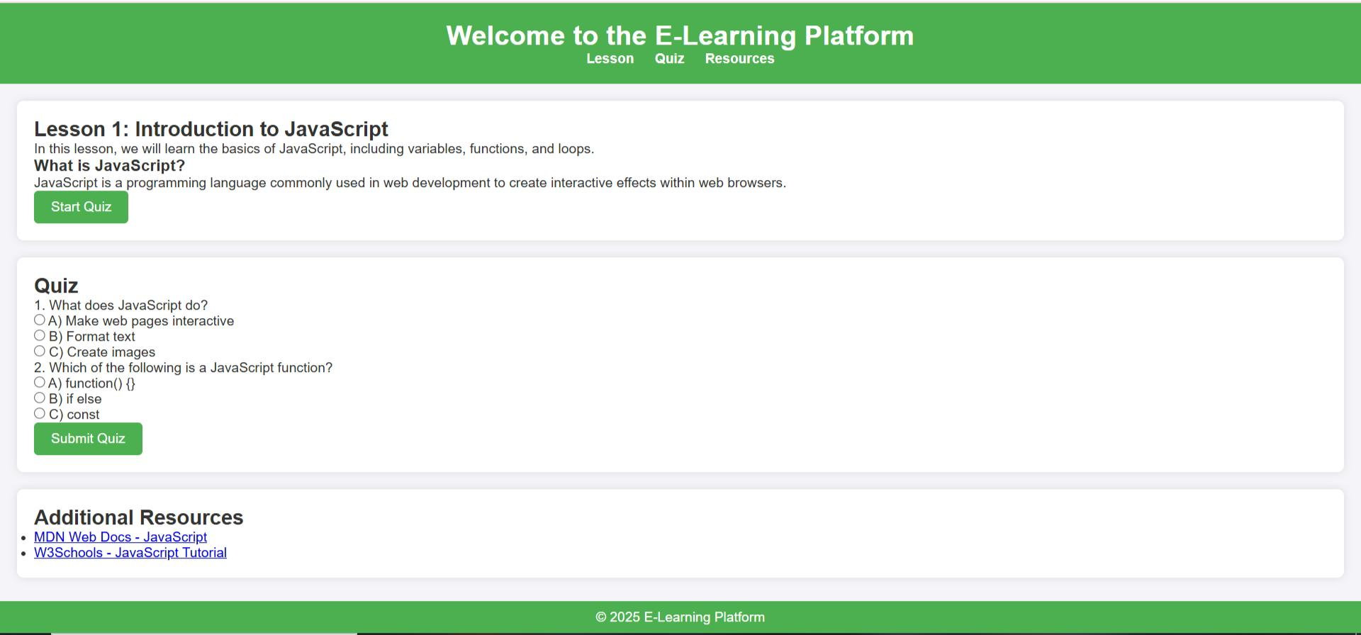
RESULTS AND SCREENSHOTS
Here are some visuals and examples showcasing the results and screenshots from online and digital learning projects. These include interactive course designs, learner dashboards, and platform interfaces that highlight engagement, progress tracking, and creative layouts.
📸 The image card below displays a selection of screenshots and project outcomes from real-world e-learning platforms and instructional design portfolios.
Let me know if you'd like help designing your own project layout or showcasing results in a portfolio!
3/21/2024 Annual Review
10

Slide 11
CONCLUSION
✅ Conclusion
The online and digital learning project successfully demonstrated how technology can transform education by making it more accessible, flexible, and engaging. Through the use of interactive tools, multimedia content, and personalized learning techniques, learners were able to gain knowledge at their own pace and convenience. The project highlights the importance of innovation in education and sets the foundation for future improvements in digital learning environments.
11

