Slide 1
Simulation Based Methodology of Trojan Detection
Supervisor - Dr. Binod Kumar
Team Members
Ramresh Meena (B19EE070)
Himanshu Raj (B19EE038)
Presentation Date- 09/07/2022
2022-23, Semester - Summer [EEN3010]
IIT Jodhpur

Slide 2
Motivation
Increasing complexity of ICs, Leads to increase in outsourcing the design and fabrication make it vulnerable to malicious activities and alteration(H.T).
H.T , as a backdoor in design.
Backdoors can leak private information as well as enable chance for other possible attack.
Threat to Security and Sovereignty of Nation
It can leak the information so it is a serious threat to military and intelligence agencies, even for every government functionaries that have sensitive information also leaking some sensitive information can lead internal tension or make any nation unstable.
Indian government Initiative: C2S, involving more youth intelligentsia in this field.
IIT Jodhpur

Slide 3
Deliverables
Development of simulation-based methodology for trojan detection & Documentation.
Taking different some original circuitries and write test bench and simulate it .
Insert Trojan in Original circuitries write test bench and simulate it for detecting trojan .
In both cases Analyse code coverage and Effect of Trojan on Original circuitries performance and make documentation .
IIT Jodhpur

Slide 4
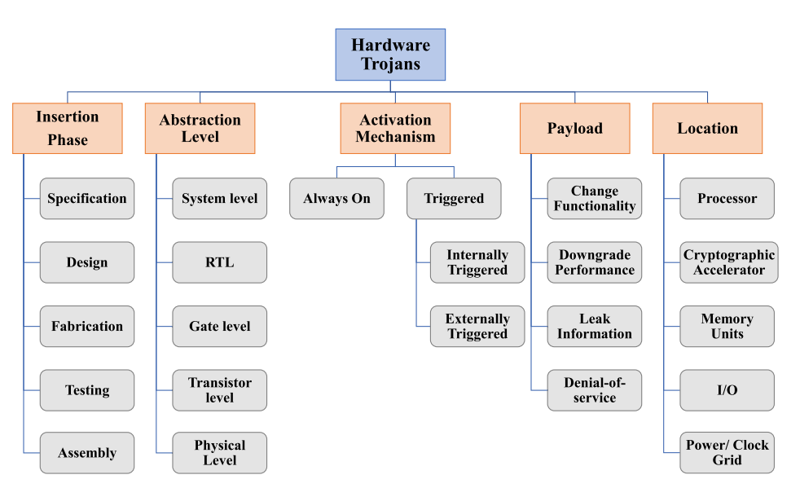
Hardware Trojan Insertion and Its impact on Circuit
IIT Jodhpur
Hardware Trojans come in a wide range of forms and sizes, as well as a wide range of usefulness.

Slide 5
Work Done And Results
Design | Code Coverage (Trojan Free) | Code Coverage (TIn but not Triggered) | Code Coverage (TIn but Triggered)
RS232-T100 | 94.45% | 93.57% | 94.06%
RS232-T200 | 94.45% | 88.55%
RS232-T300 | 94.45% | 92.35%
RS232-T400 | 94.45% | 81.36%
RS232-T500 | 94.45% | 79.99%
RS232-T600 | 94.45% | 72.53%
RS232-T700 | 94.45% | 51.58%
RS232-T800 | 94.45% | 43.05%
RS232-900 | 94.45% | 43.05%
RC6 | 100% | 99.80% | 99.99%
Spi_master | 66.68% | 58.50%
syncRAM | 79.27% | 73.80% | 78.57%
Det_1011 | 95.18% | 94.55%
IIT Jodhpur

Slide 6
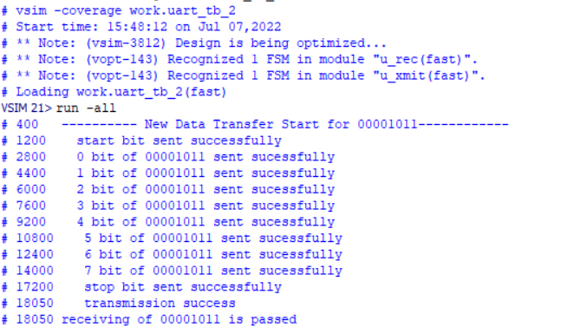
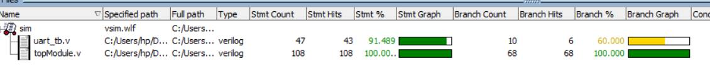
Result (RS232 Trojan Free)
IIT Jodhpur

Slide 7
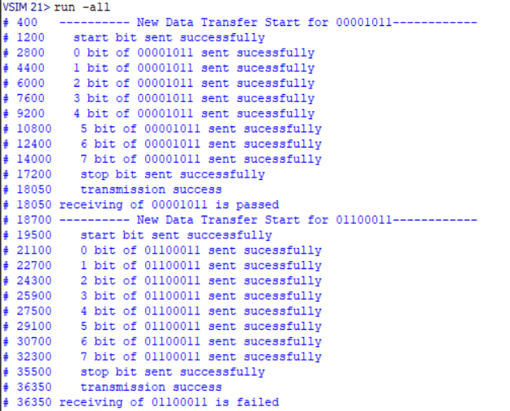
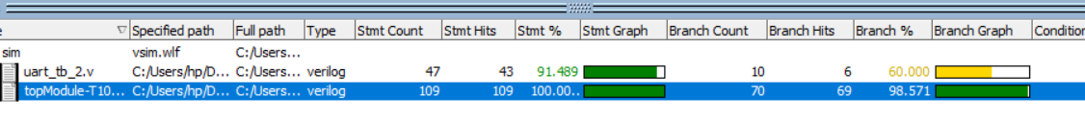
When HT was not triggered
Results (RS232 Trojan Inserted Design)
IIT Jodhpur

Slide 8
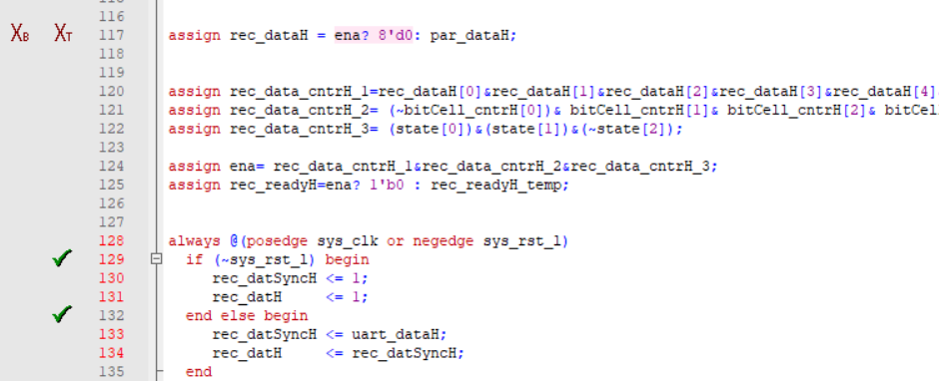
When HT was not triggered
Results
IIT Jodhpur
Code coverage = 93.57%

Slide 9
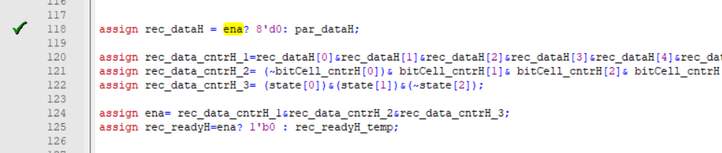
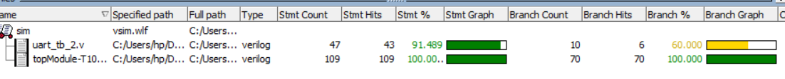
When HT was triggered
Results
IIT Jodhpur
code coverage = 94.06%

Slide 10
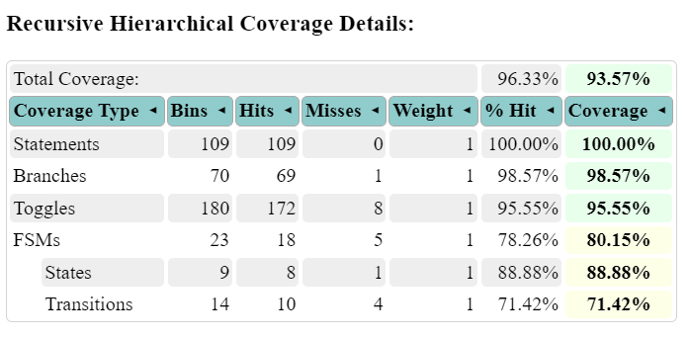
Code Coverage Report when the trojan was not triggered(RS232)
IIT Jodhpur

Slide 11
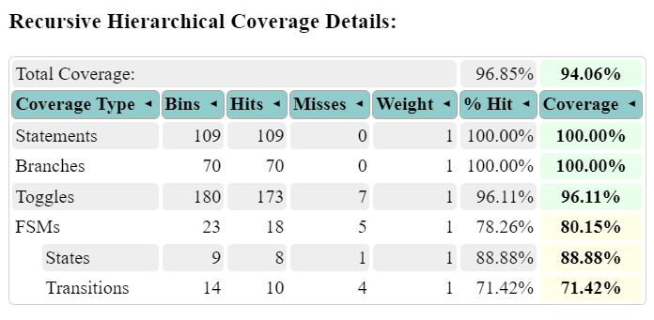
Code Coverage Report when the trojan was triggered(RS232)
IIT Jodhpur

Slide 12
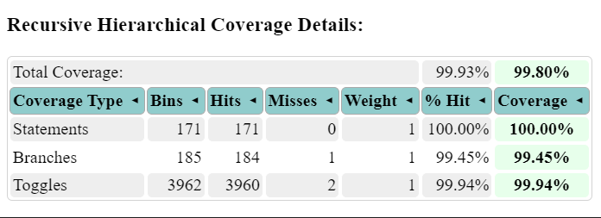
RC6 Code Coverage Report (RC6) - Not triggered
IIT Jodhpur

Slide 13
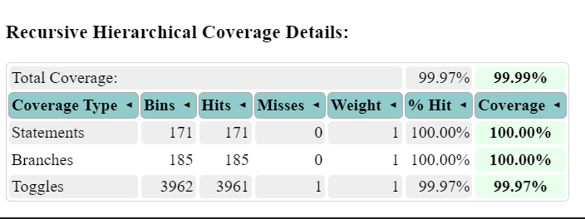
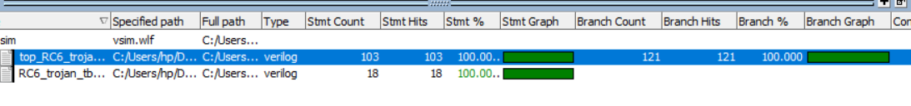
RC6 Code Coverage Report (RC6) - Triggered
IIT Jodhpur

Slide 14
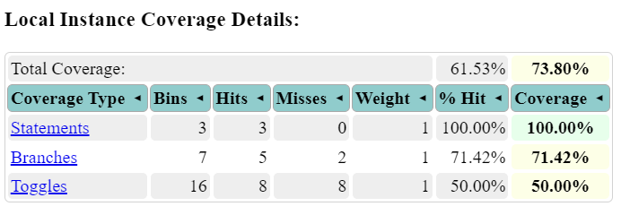
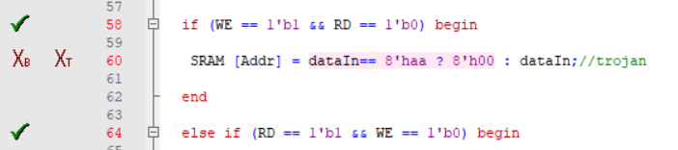
Code Coverage Report (synRAM) – Self Triggered
IIT Jodhpur

Slide 15
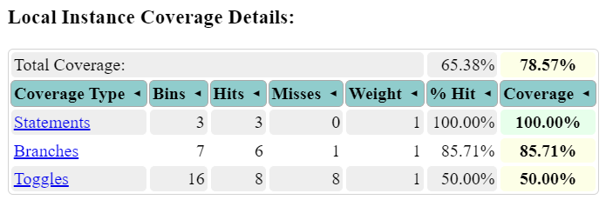
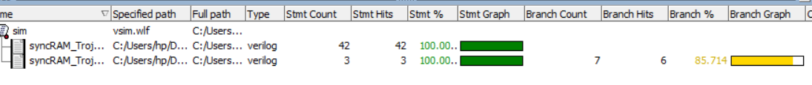
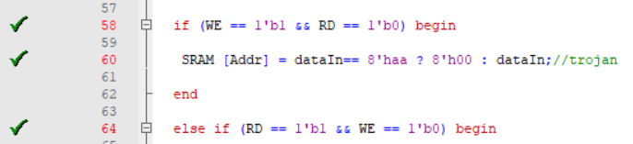
Code Coverage Report (synRAM) – Self Triggered
IIT Jodhpur

Slide 16
Conclusión
Code Coverage is more when HT was triggered as compared to when it was not triggered.
But when HT is triggered it affects some functionality of circuit.
The numbers on both the reports are very close and so the detection of more advanced HT will become difficult.
We can’t only rely on Code Coverage Analysis and FSM for detection of trojan detection, because of increase in complexity in design of circuits and trojans .
IIT Jodhpur

Slide 17

Thanks!

