Slide 1
ZIDIS NODE: RTOS-DRIVEN MANUAL ALARM SYSTEM ON THE STM32H533RETX
Phase 1: Firmware Foundation and Hardware Abstraction Layer
Platform: MT-Kernel (Micro T-Kernel) | Tools: STM32CubeMX, STM32CubeIDE

Slide 2
OBJECTIVE
Establish and validate the foundational firmware architecture and hardware abstraction layer (HAL) on the STM32H533RETX.
PRIMARY DELIVERABLE
A highly responsive, RTOS-driven manual alarm system triggered by a physical user button.
EXCLUDED FROM PHASE 1
Seismic data acquisition, P-wave analysis (DSP) and Multi-Layer Perceptron (MLP) neural networks were deferred on purpose, to isolate and verify core system stability.
SIGNIFICANCE
Proves the RTOS scheduler, memory management and basic I/O are solid before computationally heavy tasks are added.

Slide 3
SOFTWARE ARCHITECTURE
Operating system: MT-Kernel (Micro T-Kernel), configured for real-time task scheduling.
Init Task: boots the system, configures clocks, spawns the other tasks, then terminates.
Idle Task: keeps the system in a low-power state while waiting for events.
Alarm Manager Task: high priority; stays blocked until signaled by the button interrupt.
IPC: RTOS semaphores signal the Alarm Manager Task instantly from the interrupt context.

Slide 4
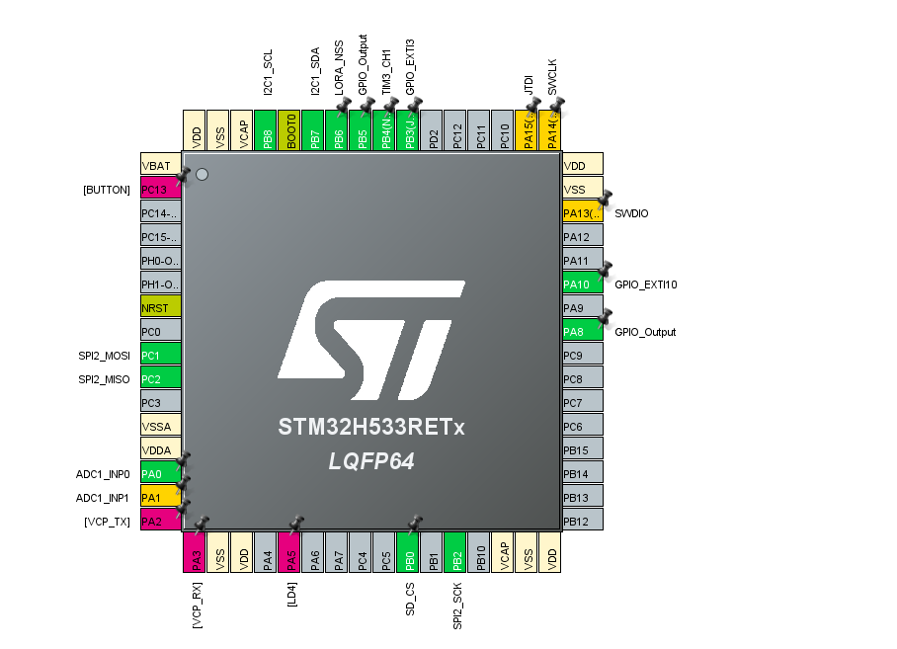
HARDWARE INTERFACE
PC13 (user button): input with internal pull resistors, mapped to the EXTI controller.
PA5 (alarm output): push-pull output that drives the alarm.
Future-proofing: SPI2, I2C1 and ADC1 pins already mapped, so adding sensors causes no conflicts.
Pinout in STM32CubeMX

Slide 5
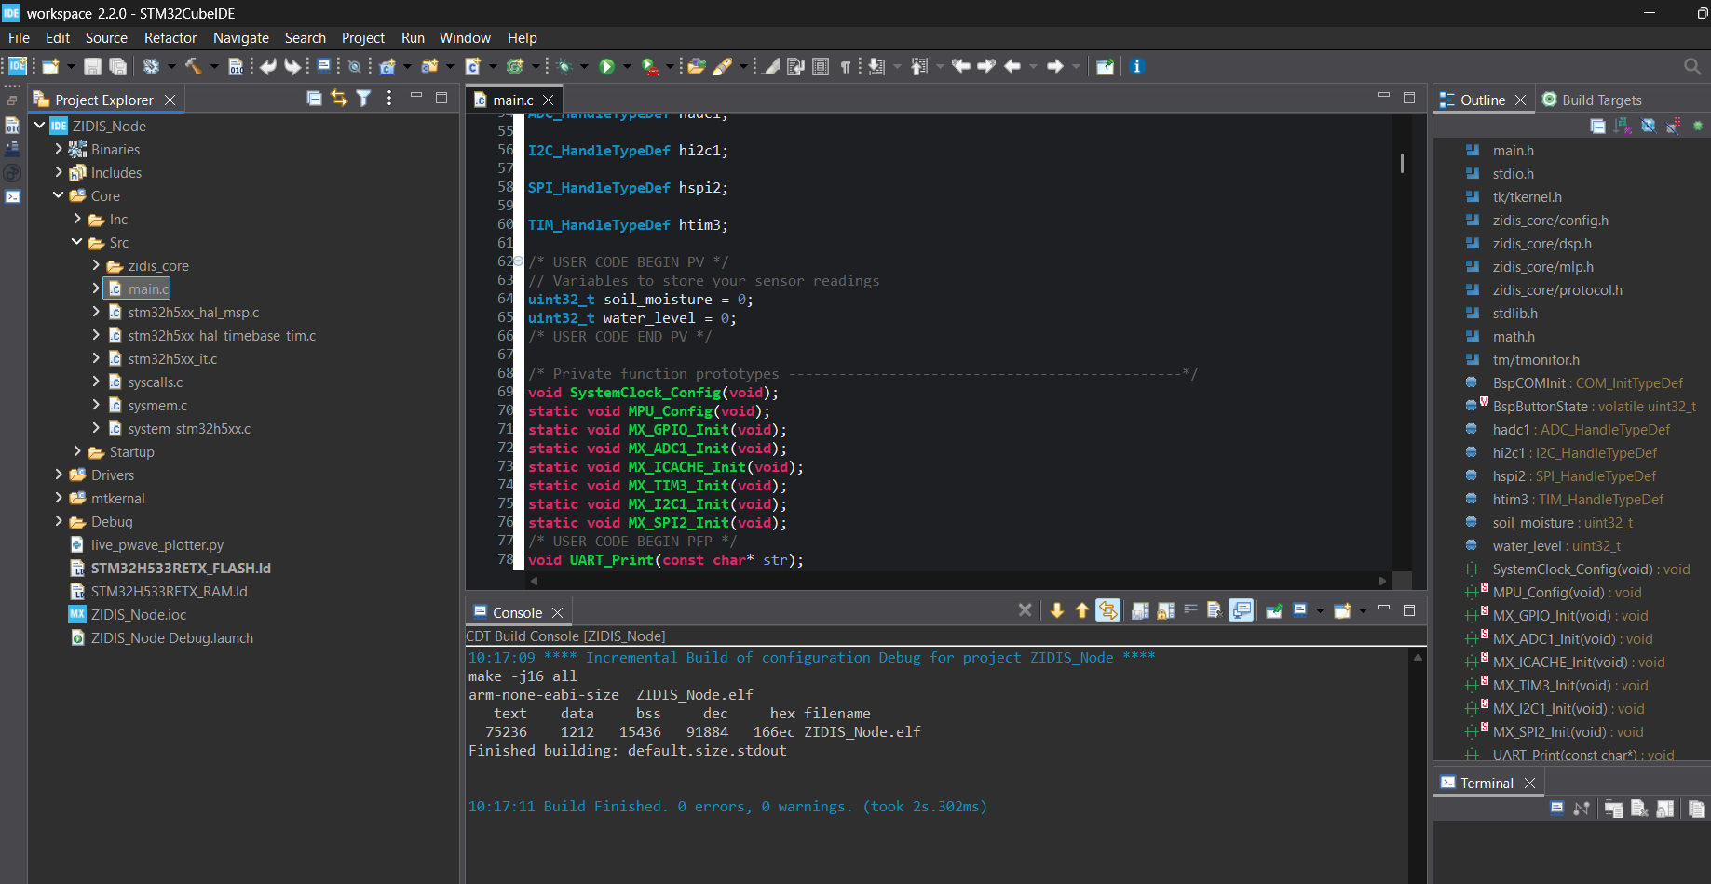
FIRMWARE AND BUILD
Written: MX_GPIO_Init and SystemClock_Config, tuning SYSCLK for reliable interrupts without excess power draw.
Result: clean build of ZIDIS_Node.elf with 0 errors and 0 warnings.
Footprint: small binary, leaving Flash and SRAM free for later phases.
STM32CubeIDE workspace and build console

Slide 6
ISR AND DEBOUNCE LOGIC
EXTI handler: the interrupt fires the moment the button on PC13 is pressed.
Debounce strategy: software debouncing ignores further interrupts for a short window, so switch bounce cannot cause false alarms.
Context switching: the ISR clears the interrupt flag, gives the RTOS semaphore and yields to the high-priority Alarm Manager Task, with no CPU polling loops.

Slide 7
SYSTEM WORKFLOW
Power on / reset: hardware bootstrap sequence runs.
HAL and RTOS init: clocks, GPIOs and MT-Kernel are initialized.
Standby: system idles; Alarm Manager is blocked on the button semaphore.
Trigger event: user presses the button and the EXTI interrupt fires.
ISR execution: debounce verified, semaphore given, context switch requested.
Alarm execution: Alarm Manager wakes immediately and drives PA5 HIGH.

Slide 8
VALIDATION AND ACCEPTANCE
System stability: runs continuously with no MT-Kernel faults, stack overflows or memory leaks.
Latency: delay from button press to alarm output is deterministic, measured in microseconds.
Stress testing: rapid, repeated presses are handled correctly, confirming the debounce logic and ISR.
Resource baseline: CPU idle time, RAM footprint and Flash usage recorded, to measure the impact of DSP/MLP algorithms in Phase 2.

Slide 9
THANK YOU

