Slide 1
MOBILE APPLICATION DEVELOPMENT FOR PAINTING
BALA VARDHINI.MANNAVA
RAMYA SRI.V
HARSHITHA.C

Slide 2
OBJECTIVE
The best way of making use of these colours is through Painting.
Painting is a mode of creative expression.
It's an art form which gives us the freedom of expressing our
thoughts on a canvas with the help of colours and a brush.
Paintings can be naturalistic and representational (as in a still life or
landscape painting), photographic, abstract, be loaded with narrative
content, symbolism, emotion or be political in nature.

Slide 3
ABSTRACT
Abstract painting usually utilizes form and colours in a non-figurative
way and do not portray any entity or object in the natural world.
It is usually used to portray realistic forms in a simplified manner,
leaving only a reference of the original subject.
Colours play an important part in our lives.
They add fun and life to it and make it beautiful and enjoyable for us.
We see different shades of colours all around us in everything from nature to the place we live and work.

Slide 4
INTRODUCTION
The best way of making use of these colours is through Painting.
Painting is a mode of creative expression.
It's an art form which gives us the freedom of expressing our thoughts on a canvas with the help of colour sand a brush.
Paintings can be naturalistic and representational photographic, abstract, be loaded with narrative content, symbolism, emotion or be political in nature.

Slide 5
PROPOSED SYSTEM
The penalty for specifying and engineering an inefficient paint application process is severe for any business and is a price that is paid every day during the lifetime of the system.
For even mid-sized systems, it can easily run into the millions of dollars each year.
Quality issues can easily strain existing customer relationships and discourage new accounts.
The most efficient application technology will often result in the need for additional applicators and equipment, larger booths, and much more pollution and waste.

Slide 6
HISTORY OF PAINTING
The history of painting reaches back in time to artifacts from pre-historic humans, and spans all cultures.
It represents a continuous, though periodically disrupted tradition from ancient times.
The oldest known paintings are at the Grotte Chauvet in France, claimed by some historians to be about 32,000 years old.
They are engraved and painted using red ochre and black pigment and show horses, rhinoceros, lions, buffalo, mammoth or humans often hunting.

Slide 7
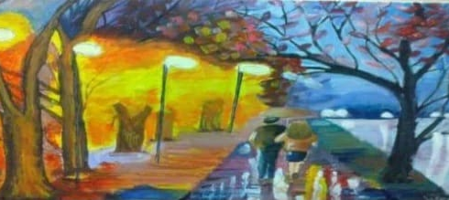
Indian painting has a very long tradition and history in Indian art.
The earliest Indian times, the as found in places like Bhimbetka, but the paintings of the Ajanta Caves are the most significant of the few survivals.

Slide 8
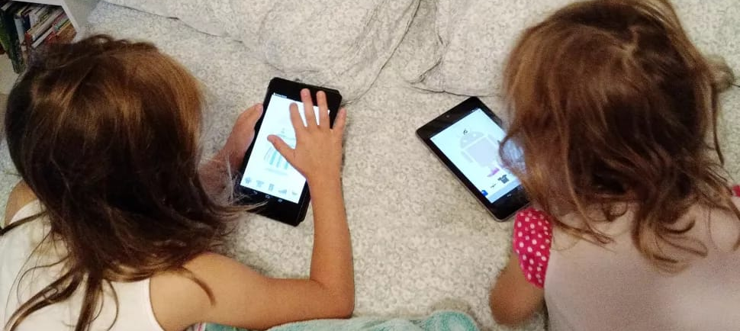
Painting for kids
Kids painting is a happy sight
Painting is a great activity for child development as well.
When they paint, children are able to experiment and express themselves, which is definitely good for them.
There are so many different options available for kids to paint.

Slide 9
SOFTWARE REQUIREMENTS
ANDROID STUDIO
JAVA JDK
XML
EMULATOR
GRADLE BUILD

Slide 10
IMPLEMENTATION
Brush:
Select brush to draw and to adjust the thickness of the brush
Undo:
Select the left arrow to undo the previous drawing
Colours:
Select the colour option to select colours of the brush
Select the files option to save the painting

Slide 11
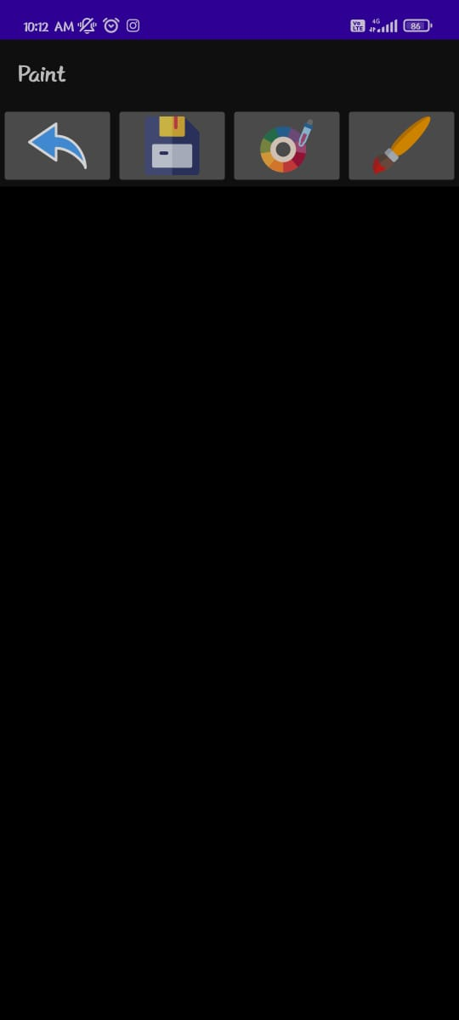
OUT PUT
App interface

Slide 12
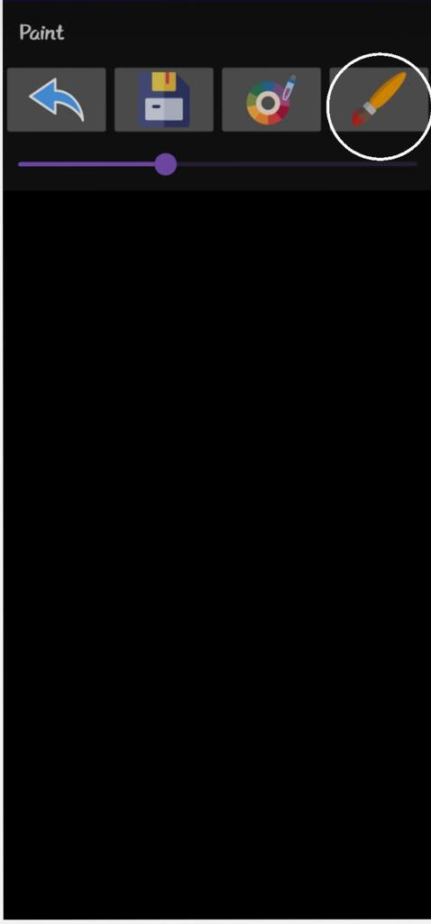
Select brush to increase thickness brush

Slide 13
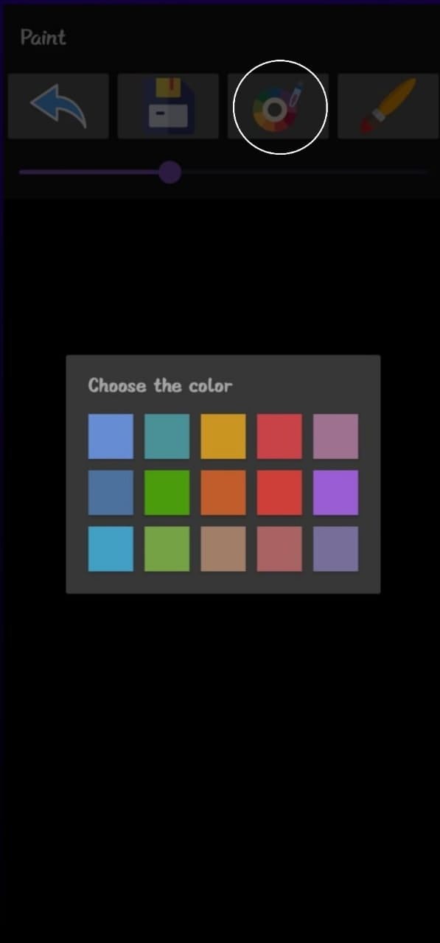
Select colour option to change the colour of brush

Slide 14
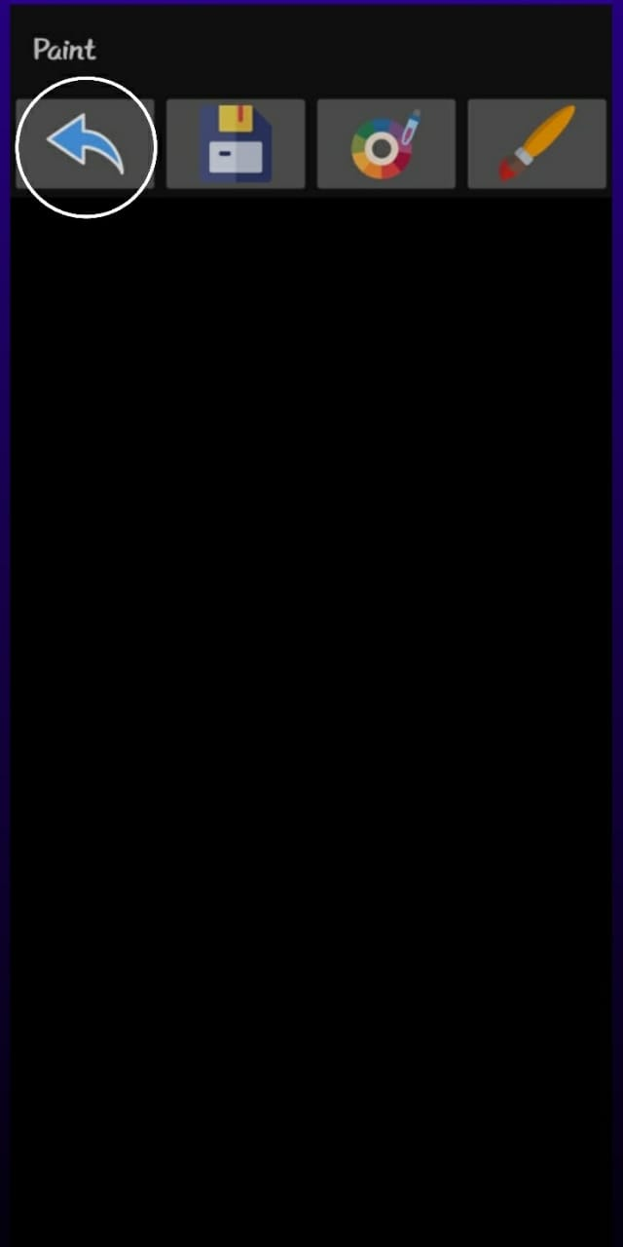
Select left arrow to undo the previous drawing

Slide 15
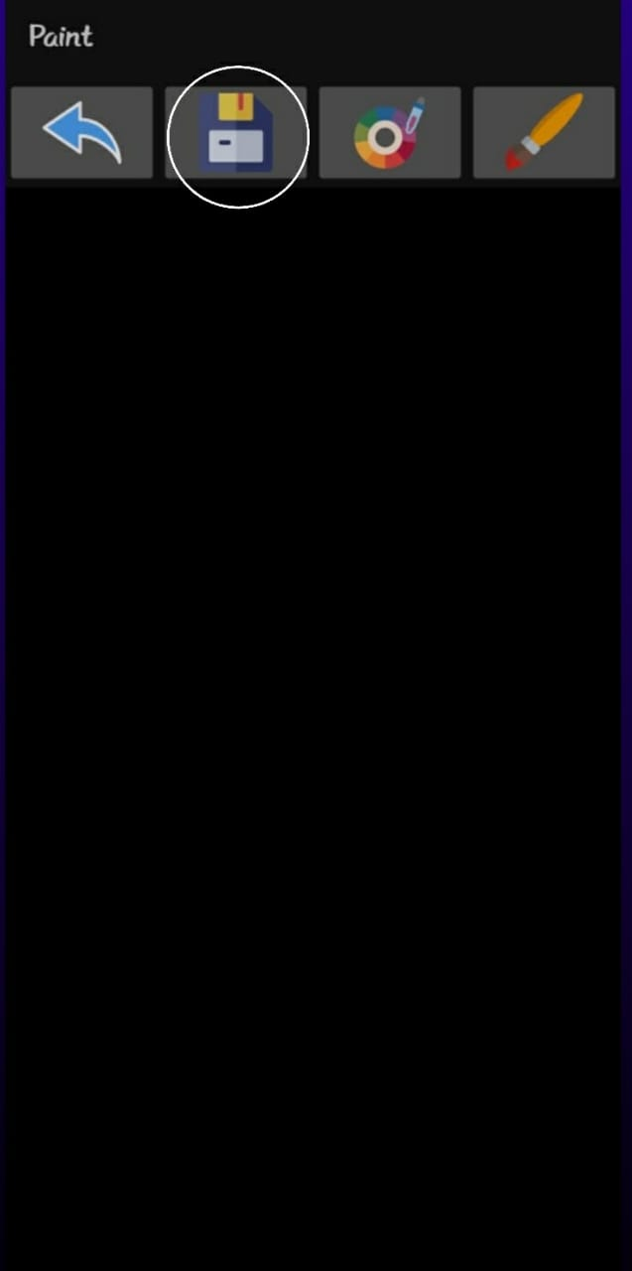
Select the files option to save the painting

Slide 16
CONCLUSION
Painting helps us to express what our heart feels, and if you are depressed it will help you to feel relaxed.
It also improves our creativity which could be used in all aspects of life to make it more beautiful.
Painting can be taken up as a hobby or as a career option also.
Other them putting up paintings in galleries and being a art teacher there are other options out there like designing book, magazine, landscape etc.
So just start painting from today itself
It just requires paper, colour and a brush. You can also portray your creativity on glass, or a vase, or wooden frame and you can be creative with it.

Slide 17
REFERANCE
[1] Amey Thakur and Karan Dhiman, “Chat Room Using HTML, PHP, CSS, JS, AJAX.”, International Research Journal of Engineering and Technology (IRJET), 1948–1951, 08 June 2021. https://doi.org/10.6084/m9.figshare.14869167.
[2] Amey Thakur and Karan Dhiman, “Chat Room Using HTML, PHP, CSS, JS, AJAX.”, ArXiv, abs/2106.14704 (2021): n. Pag.
[3] Amey Thakur."Car Rental System", Volume 9, Issue VII, International Journal for Research in Applied Science and Engineering Technology (IJRASET) Page No: 402-412, ISSN: 2321-9653, https://doi.org/10.22214/ijraset.2021.36339
[4] Amey Thakur, Mega Satish."Digital Bookstore", Volume 9, Issue VII, International Journal for Research in Applied Science and Engineering Technology (IJRASET) Page No: 1302-1313, ISSN: 2321-9653, https://doi.org/10.22214/ijraset.2021.36609

Slide 18


