Slide 1

FIX-UP
Customer Support Service
Ramsaran Narasimmaraju
Dineshkarthikeyan S
Mugunthan Murugaiah

Slide 2
Problem Statement
Customer support is a cornerstone of success for e-commerce businesses, addressing issues promptly and enhancing the overall user experience.
Fix-Up is a web-based platform specifically designed for e-commerce sites, offering robust support for server-side issues, product-related concerns, and payment queries.
By leveraging predefined solutions, custom issue handling, and real-time ticket resolution, Fix-Up ensures efficient, customer-centric service delivery.

Slide 3
Project Overview
Fix-Up empowers both customers and support teams by streamlining issue resolution and providing efficient management tools.
Customer Issue Handling
Server-Side Issues:
•Tickets are automatically raised and forwarded to the backend team for resolution.

Slide 4
Product, Purchase, and Payment Issues:
•Customers select from predefined issues, receiving instant solutions or suggestions from the database.
•If predefined solutions are unavailable, customers can submit custom issues through an intuitive form.
Automated Notifications:
•Once a ticket is resolved, an automated email is sent to inform the customer.
Refund Processing:
•Customers can raise tickets for refunds, with resolutions processed within three business days.

Slide 5
Feedback Collection:
•After resolving an issue, a feedback form is automatically presented to capture customer ratings and suggestions.
Admin Dashboard
A dedicated dashboard displays critical metrics, including:
•Number of queries resolved.
•Customer satisfaction rates.
•Feedback data to evaluate and improve support services.

Slide 6

Technical Architecture
Fix-Up is built with a robust technology stack for optimal performance, scalability, and user experience
•ASP.NET Core Web API
•C#
•SQL Server
•Angular
•HTML/CSS
•Bootstrap
•Swagger

Slide 7
Key Features
Customer-Focused Features
Admin-Focused Features
General Features

Slide 8
Customer-Focused Features
•Predefined Solutions:
Instant resolution for common issues via predefined solutions in the database.
•Custom Issue Submission:
Allows customers to report issues not covered in predefined categories.
•Refund Ticket System:
Simplifies refund requests, ensuring resolution within three business days.
•Feedback Collection:
Prompts customers for feedback after issue resolution to enhance service quality.

Slide 9
Admin-Focused Features
•Dynamic Query Management:
Displays all customer queries for efficient handling by support engineers.
•Database Updates:
Automatically stores new solutions from resolved queries, expanding the predefined solutions database.
•Admin Dashboard:
Tracks key metrics, including query resolution rates, customer satisfaction, and feedback trends.

Slide 10
General Features
•Real-Time Updates:
Keeps customers informed about the status of their tickets and issues.
•Responsive Design:
Delivers functionality and usability across desktops, tablets, and smartphones.

Slide 11
Conclusion
Fix-Up is a scalable, efficient, and customer-centric platform tailored to elevate support services for e-commerce businesses. Leveraging technologies such as ASP.NET Core, C#, SQL Server, and Angular, Fix-Up addresses server-side, product-related, and payment queries with ease. Its features, including real-time updates, feedback collection, and an intelligent admin dashboard, empower businesses to deliver exceptional customer service, improve satisfaction rates, and foster long-term customer loyalty.

Slide 12
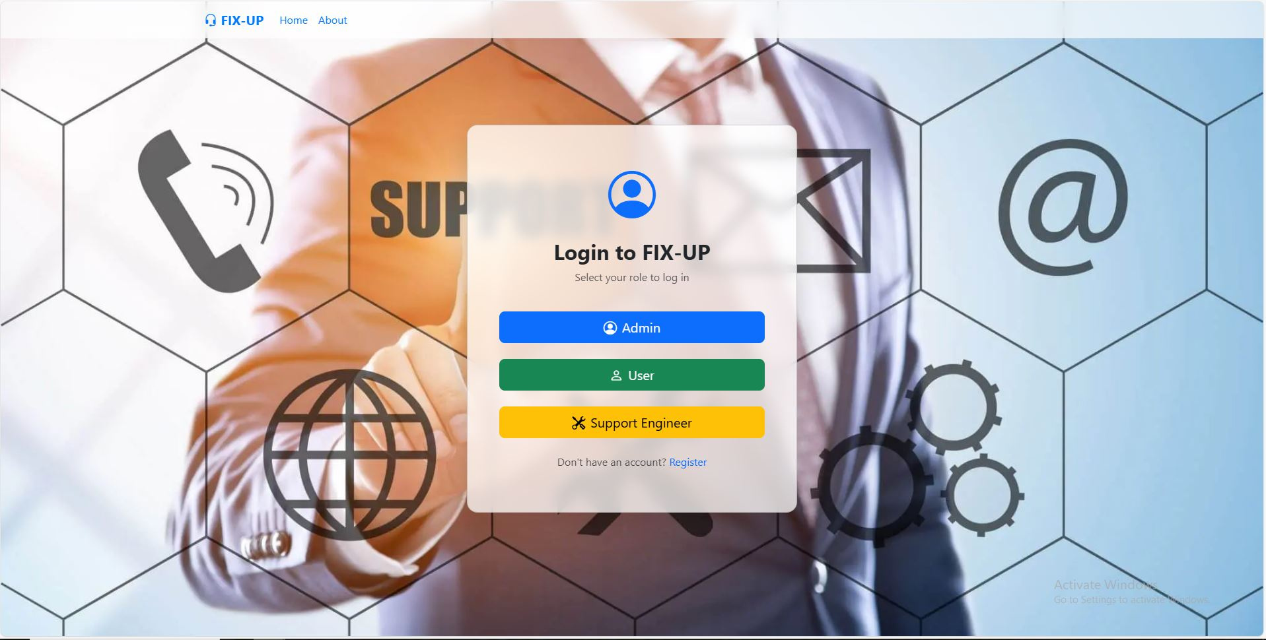
Login Page

Slide 13
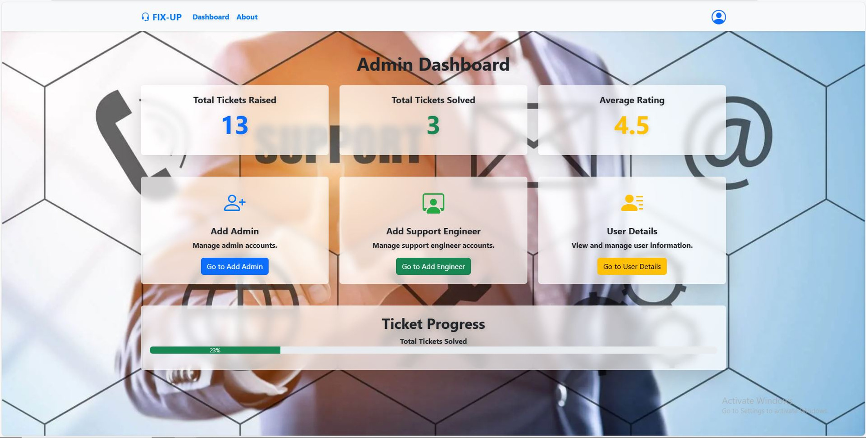
Admin Dashboard

Slide 14
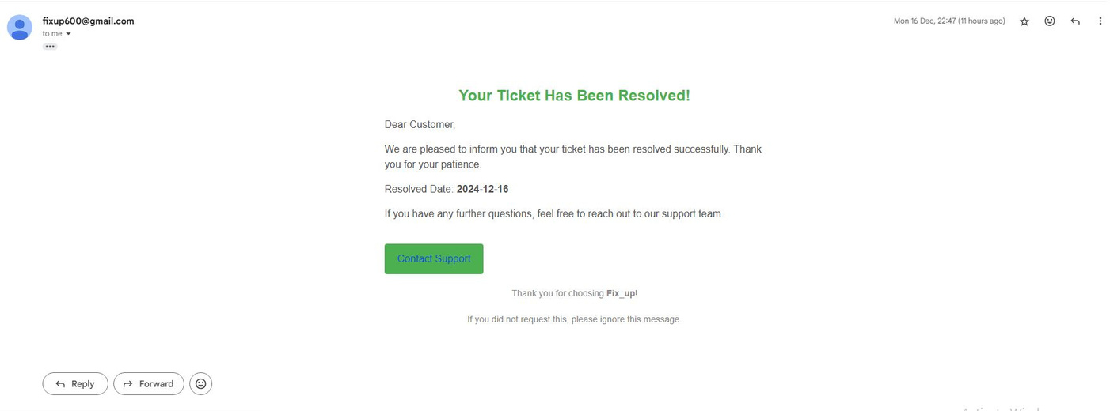
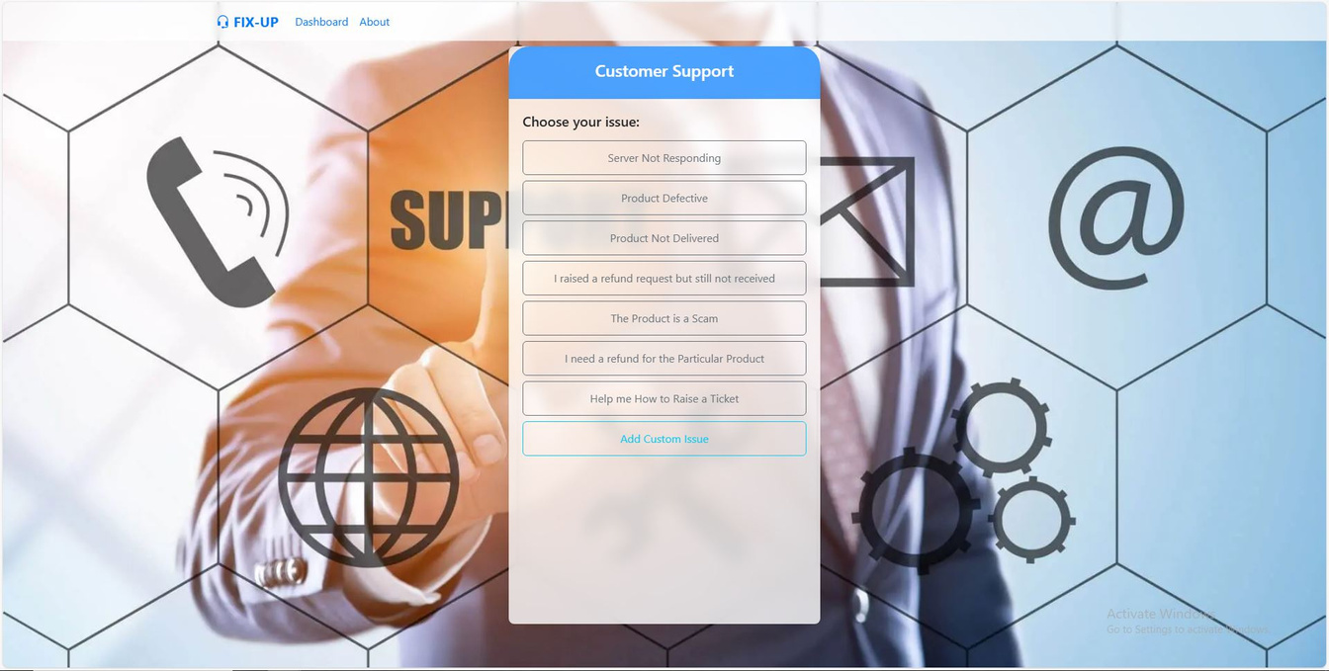
Autogenterated Mail
Help Center

Slide 15
Thank You

