Slide 1

GLA University
Project title: Shopssy
B.tech CS (3rd Year)
Submitted by: Ram Sarvagya Gaur (2115000824)
Akash Pandey (2115000098)
Ayush Tiwari (2115000271)
Date: 01/12/2023

Slide 2
INTRODUCTION
Shopssy is a dynamic e-commerce website built using HTML, CSS, and JavaScript. This project aims to provide users with a seamless and enjoyable online shopping experience.
The problem statement encompasses the need for an efficient e-commerce platform that allows users to browse products, add them to a shopping cart, and seamlessly complete their purchase Or The motivation behind creating the basic e-commerce website "Shopssy" lies in addressing the growing demand for convenient and user-friendly online shopping experiences.
Audiences engaging with "Shopssy," the basic e-commerce website developed with HTML, CSS, and JavaScript, can expect a user-friendly and visually appealing online shopping experience.

Slide 3
OBJECTIVES
The objectives of the Shopssy project, a basic e-commerce website can be outlined as follows:
1. User-Friendly Interface:
Create an intuitive and visually appealing user interface that facilitates easy navigation.
2. Product Presentation:
Display products in a visually appealing manner with high-quality images and comprehensive
information.
3. Interactive Features:
Utilize JavaScript to introduce interactive elements such as product search, sorting, and
filtering to enhance user engagement.
4. Documentation:
Create comprehensive documentation that explains the project structure, code organization,
and key functionalities.

Slide 4
The aim to achieve with a basic e-commerce website like Shopssy :
1. Learning and Skill Development:
Enable developers to gain hands-on experience and enhance their skills in HTML, CSS, and
JavaScript.
2. Showcasing Technology Proficiency:
Showcase proficiency in using fundamental web technologies to build a functional and
aesthetically pleasing website.
3. User Experience and Satisfaction:
(i) Prioritize user experience by creating an intuitive and user-friendly interface.
(ii) Aim for high user satisfaction through smooth navigation and interactive features.

Slide 5
PROBLEM STATEMENT
The traditional retail landscape is evolving rapidly, with an increasing shift towards online shopping. Consumers are seeking convenient, efficient, and secure platforms to make purchases.
The development of a basic e-commerce website like Shopssy, built with HTML, CSS, and JavaScript, is important and relevant for several reasons:
Changing Consumer Behavior:
As more consumers shift towards online shopping, having an effective and user-friendly
e-commerce platform becomes crucial for businesses to reach and engage with their
target audience.
Security and Trust:
Focusing on secure checkout processes helps build trust with users, addressing concerns
related to online security and privacy.

Slide 6
LITERATURE REVIEW
The "Shopssy" project, a basic e-commerce website made of HTML, CSS, and JavaScript, aims to address several gaps and challenges in the domain of web development and online shopping experiences:
1. Educational Gap:
Many developers and learners face a gap between theoretical knowledge and
practical application. Shopssy serves as a hands-on project, providing a tangible
example for individuals to apply and reinforce their HTML, CSS, and JavaScript
skills in the context of building a functional website.
2. User Experience Enhancement:
Some existing e-commerce websites may lack an intuitive and user-friendly
interface. Shopssy focuses on creating a seamless and visually appealing user
experience, addressing common navigation issues and optimizing the overall
design to enhance user engagement.

Slide 7
METHODOLOGY
Project Planning and Design:
Define the project requirements, including the essential features such as product listings,
shopping cart functionality, and a secure checkout process.
Plan the website's structure, layout, and user interface design to ensure a seamless and
intuitive user experience.
Algorithms, techniques, tools, languages used:
HTML (Hyper Text Markup Language):
HTML is used to structure the content of the website, defining the elements
and layout of pages such as product listings, cart, and checkout.
CSS (Cascading Style Sheets):
CSS is employed to style and format the HTML elements, providing visual
design and layout for an aesthetically pleasing user interface.
JavaScript:
JavaScript is utilized to add interactivity and dynamic behavior to the website.

Slide 8
SYSTEM ARCHITECTURE
HTML Pages:
Include pages for the homepage, product listings, individual product details, shopping
cart, and checkout.
CSS Stylesheets:
Define the styles, layout, and visual elements of the website.
JavaScript Files:
Implement client-side interactivity, dynamic content updates, and communication with
the server.
This architecture emphasizes a separation of concerns, with HTML, CSS, and JavaScript handling the client-side presentation and interactivity, potentially communicating with a server-side component for data management. The back-end (server-side) components, if included, handle business logic, database communication, and other server-related tasks. The modular structure allows for easier maintenance, scalability, and collaboration among developers.

Slide 9
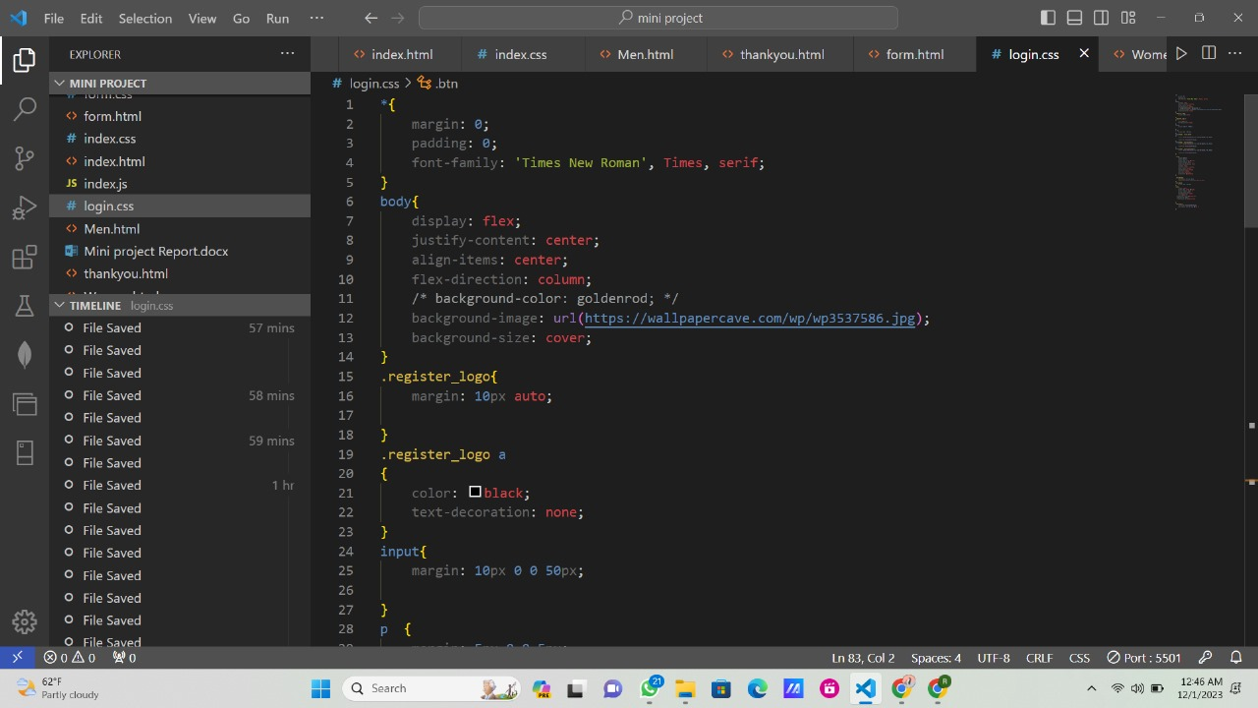
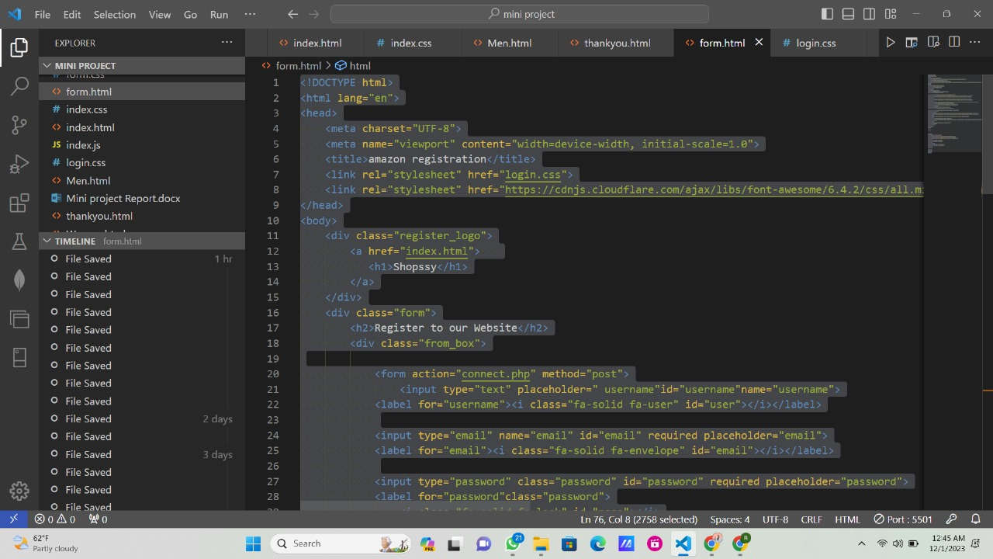
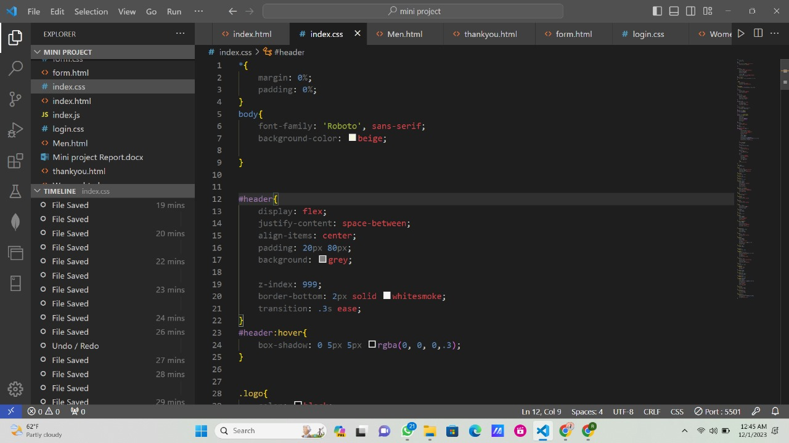
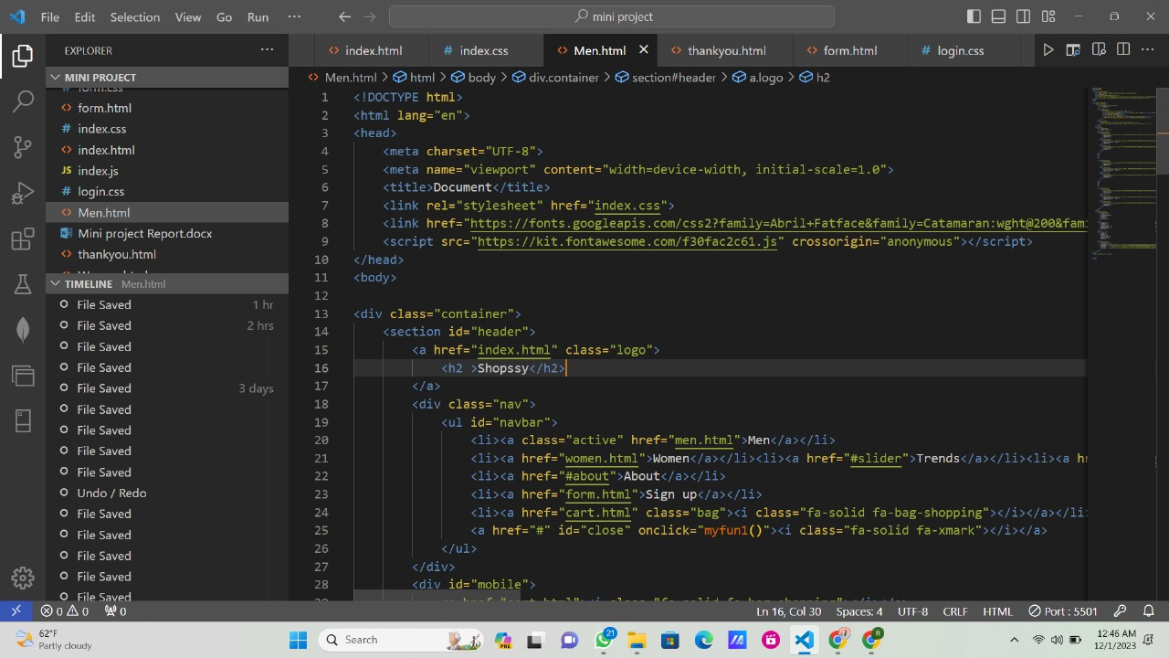
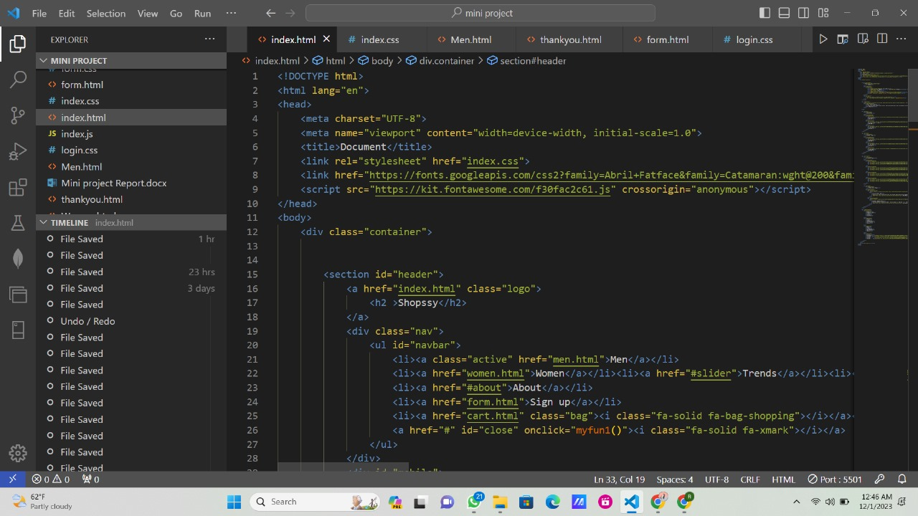
IMPLEMENTATION

Slide 10
FEATURES
Here are the key features that might be implemented in a basic e-commerce website named "Shopssy," built with HTML, CSS, and JavaScript:
Homepage:
Welcome users and provide an overview of featured products or promotions.
2. Product Listings:
Display a variety of products with images, descriptions, and prices.
Implement product filtering and sorting options for user convenience.
3. Individual Product Pages:
Present detailed information about each product, including specifications and customer
reviews.
4. Responsive Design:
Ensure the website is accessible and functional across various devices, including desktops,
tablets, and smartphones.

Slide 11
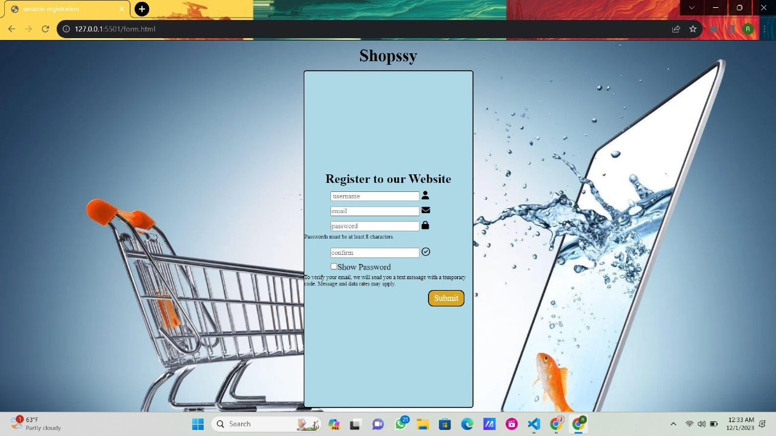
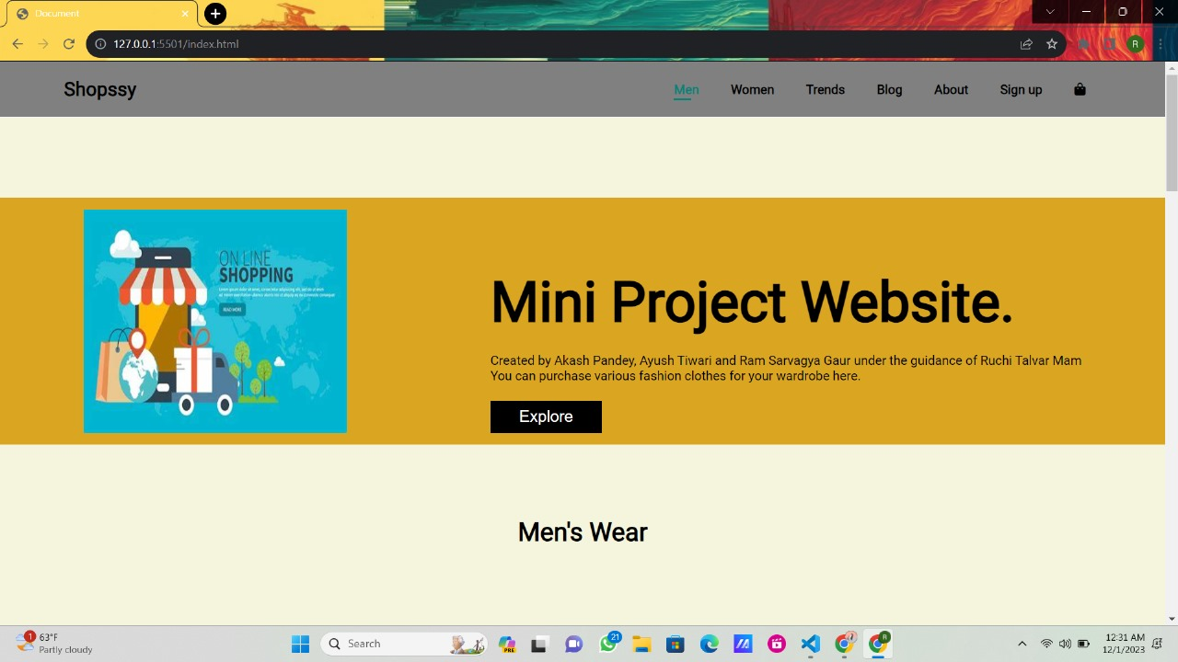
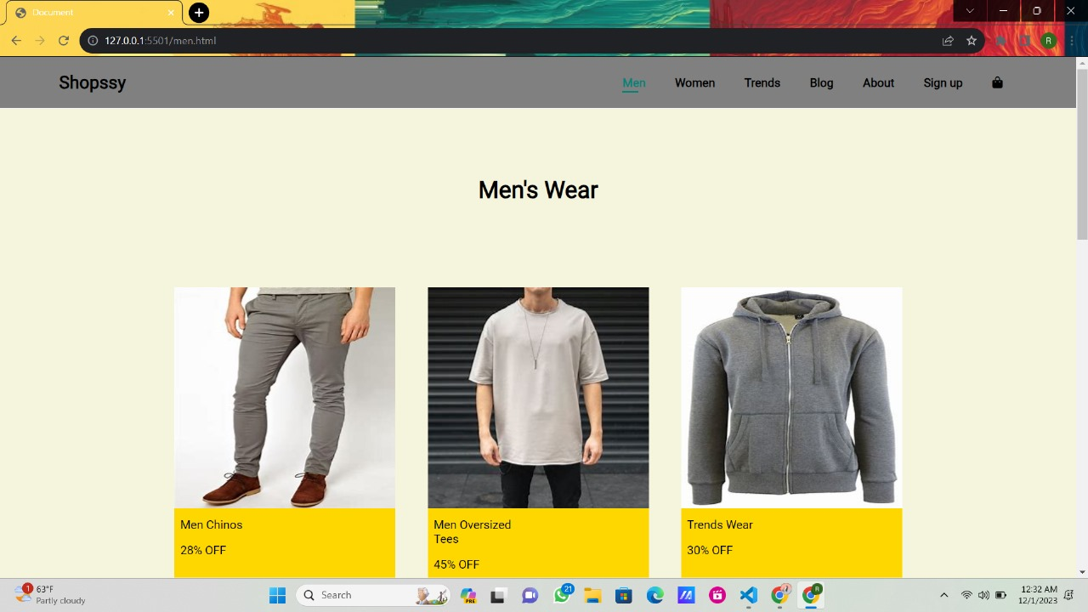
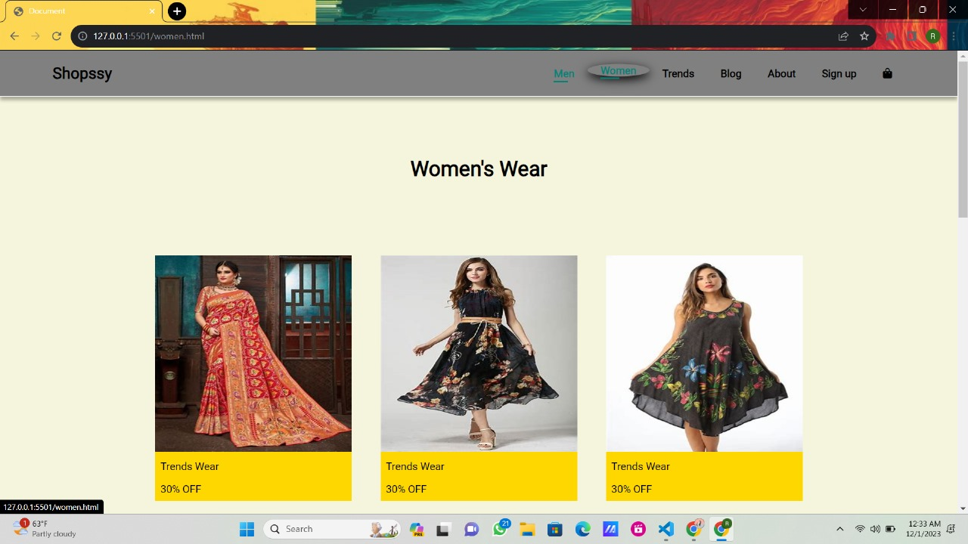
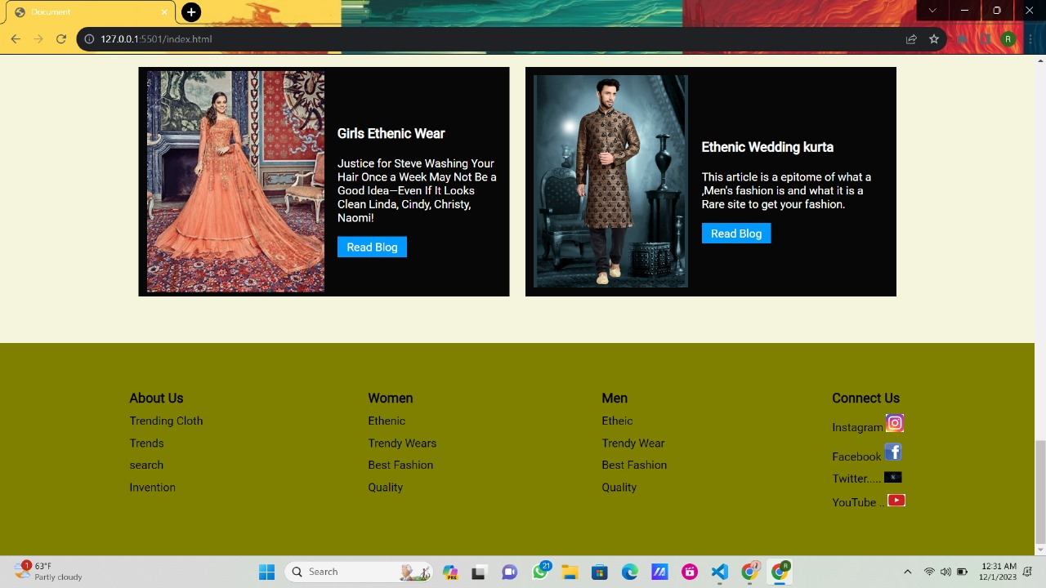
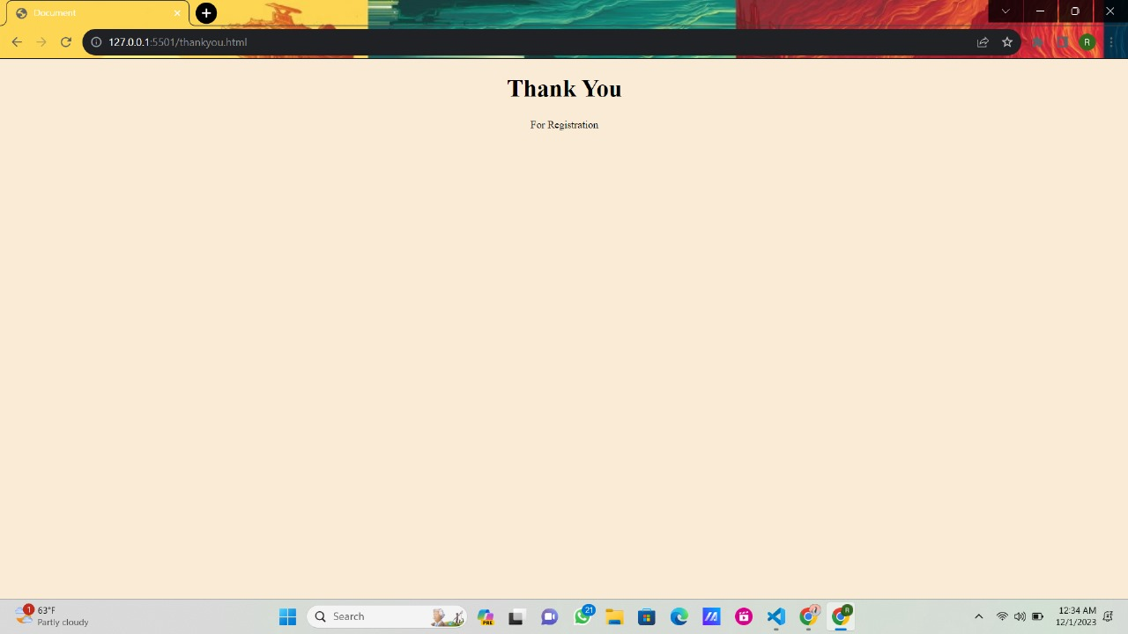
RESULTS

Slide 12
CHALLENGES FACED
1. Responsive Design Challenges:
Challenge: Ensuring a consistent and appealing design across various devices and screen
sizes can be challenging.
Solution: Employ responsive design techniques using CSS media queries to adapt the
layout based on different device characteristics. Regular testing on different
devices and browsers helps identify and resolve issues.
2. SRE Software requirement analysis:
Challenge: Estimating the SRE for this project is a big challenge for us due to complexity of
data.
Solution: We overcome this challenge by focused research on customer data and the
reviews from the existing platforms.

Slide 13
FUTURE WORK
Extending or improving a basic e-commerce website like "Shopssy" in the future involves considering enhancements in functionality, user experience, and technology. Here are several ideas to improve or extend the project:
User Accounts and Profiles:
Implement user authentication to allow users to create accounts and manage their profiles.
Enable users to view order history, track shipments, and save favorite products.
Wishlist and Favorites:
Introduce a wishlist feature where users can save items for future purchase.
Provide an option for users to mark products as favorites for quicker access.
Product Reviews and Ratings:
Allow users to leave reviews and ratings for products.
Display average ratings and reviews on product pages to assist other shoppers.

Slide 14
CONCLUSION
The development of the basic e-commerce website named "Shopssy" using HTML, CSS, and JavaScript represents a significant step in showcasing the capabilities of these fundamental web technologies. The project not only serves as a practical example for individuals learning web development but also contributes to the broader goals of providing a user-friendly and educational online shopping experience.
User-Focused Design:
The project emphasizes user experience with an intuitive and user-friendly interface. By
prioritizing responsive design, interactive features, and secure checkout processes,
"Shopssy" caters to the evolving expectations of online shoppers, contributing to the
overall improvement of user experiences in the e-commerce domain.

