Slide 1
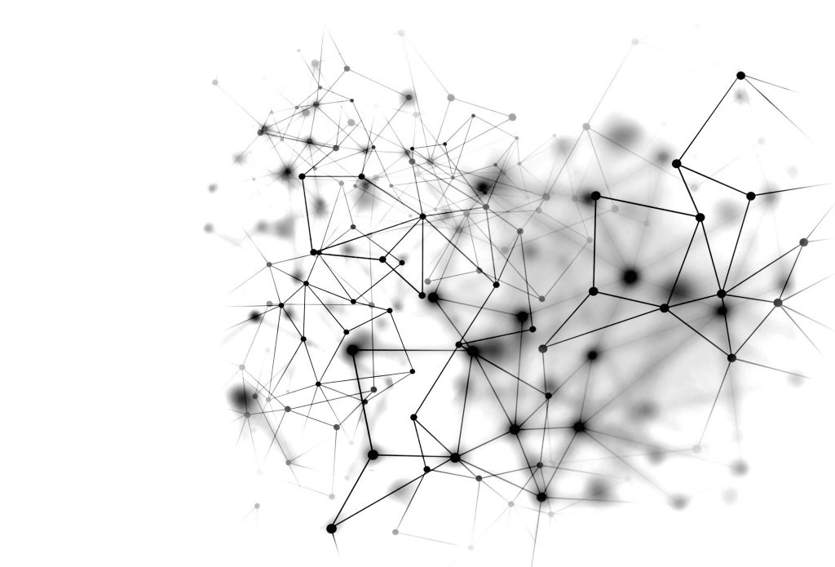
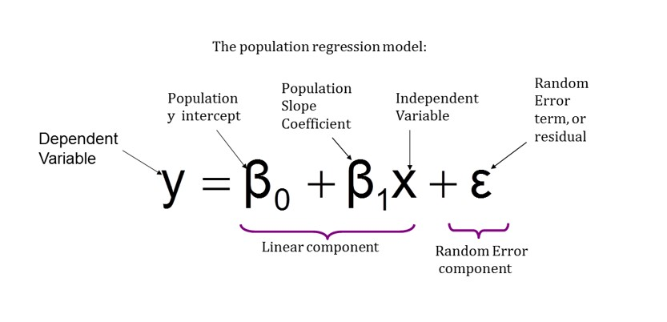
PREPARED BY: Abdulrahman Ramsey Momodu
Project
Discriminant Analysis

Slide 2
Rational Statement
Mr. John Hughes wants to develop LDA and QDA models for his raisin Dataset to evaluate its effectiveness
He wants the analysis of this project (the summary of this problem) to be presented with PPT ( with the rationale of the project clearly stated.
He wants the Pandas Profile to be created, identify and explain 2 key insights from the Pandas Profile report
He wants the confusion Matrix/Classification Report for the optimized LDA and QDA model to be presented with three (3) key insights ( i.e., Precision, Recall, F1.)
He wants a comparison of the optimized LDA to the optimized QDA with three (3) key insights (i.e., Precision, Recall, F1)
Requested two (2) recommendations, so that he will know the next step to take.

Slide 3
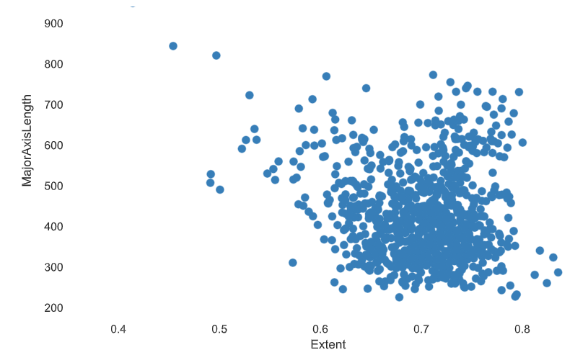
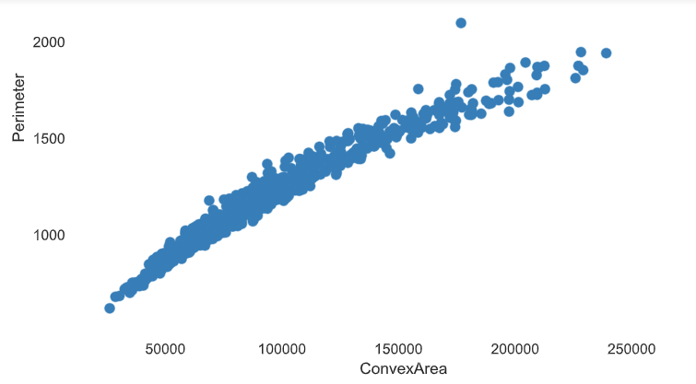
Pandas Profile Report
Pandas profiling is a statistical technique utilized in data analysis and machine learning that produces a comprehensive report outlining various aspects of a dataset, such as its distribution, correlation, statistical summary, and presence of missing values. The report incorporates diverse visualizations, including scatterplots, histograms, and correlation matrices, facilitating the identification of trends and patterns within the data.
Extent and ManorAxisLenght are highly correlated and negatively skewed
Perimeter is highly correlated with ConvexArea and they are positively skewed
Explanation
1. Extent and MajorAxisLenght are highly correlated and negatively skewed:
This means that Extent and MajorAxisLength variables are strongly related to each other, with a high degree of correlation. As one variable increases, the other variable tends to increase as well. Additionally, the data for these variables are negatively skewed, which means that most of the data points have lower values, and fewer data points have higher values.
2. Perimeter is highly correlated with ConvexArea and they are positively skewed
This means that Perimeter and ConvexArea are two variables that have a strong linear relationship with each other, with a high degree of correlation. As one variable increases, the other variable tends to increase as well. The data for these variables is positively skewed, meaning that the majority of the data points have higher values, and fewer data points have lower values.

Slide 4
Confusion Matrix/Classification Report for the Optimized LDA and QDA Model
A confusion matrix is a table that is often used to describe the performance of a classification model on a set of test data for which the true values are known. It allows us to visualize the performance of the model by showing how many examples were correctly or incorrectly classified for each class.
The confusion matrix can be used to calculate various evaluation metrics, such as accuracy, precision, recall, and F1 score, that provide insights into the performance of the classification model.
Accuracy: This metric measures the overall correctness of the model's predictions, regardless of the class. It is calculated by dividing the sum of true positives and true negatives by the total number of examples. A high accuracy indicates that the model is making correct predictions for most examples.
Precision: This metric measures the proportion of positive predictions that are correct. It is calculated by dividing true positives by the sum of true positives and false positives. A high precision value indicates that the model is making fewer false positive predictions, which can be important in applications where false positives are costly.
Recall: This metric measures the proportion of actual positives that are correctly identified by the model. It is calculated by dividing true positives by the sum of true positives and false negatives. A high recall value indicates that the model is good at detecting positive examples.
F1 score: This metric combines both precisions and recall into a single score that balances both metrics. It is the harmonic mean of precision and recall and is calculated by dividing 2 times the product of precision and recall by the sum of precision and recall. A high F1 score indicates that the model has a good balance between precision and recall.

Slide 5
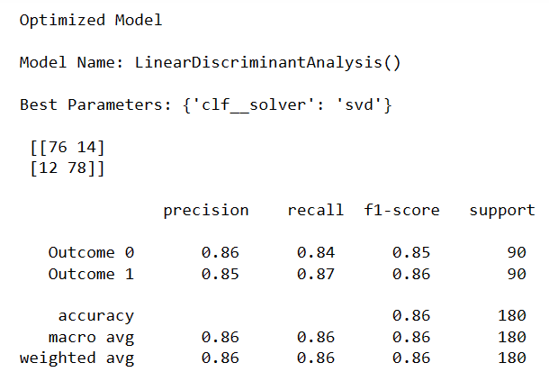
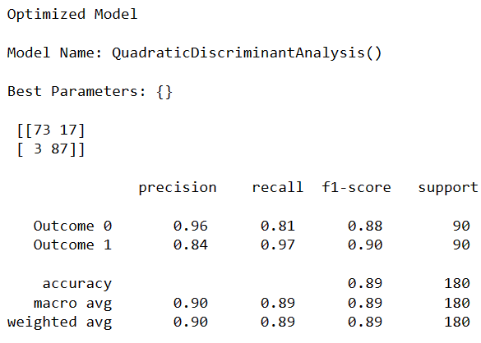
Confusion Matrix/Classification Report for the Optimized LDA and QDA Model
Linear Discriminant Analysis (LDA)
Linear Discriminant Analysis (LDA) is a statistical technique utilized to find a linear combination of variables capable of classifying observations into two or more groups or classes. LDA assumes that the input data is normally distributed and that the covariance matrix is homogenous across all classes.
Quadratic Discriminant Analysis (QDA)
Quadratic Discriminant Analysis (QDA) is a statistical technique used for classification tasks that are similar to Linear Discriminant Analysis (LDA), but it relaxes the assumption of equal covariance matrices across classes that are made by LDA. However, QDA still assumes that the input data is normally distributed.

Slide 6
Confusion Matrix/Classification Report for the Optimized LDA and QDA Model
Linear Discriminant Analysis (LDA)
Quadratic Discriminant Analysis (QDA)
Three Key Insights on LDA
Precision
According to the weighted average precision metric, the model exhibits a precision score of 86%. Specifically, it demonstrates a high level of accuracy in predicting the Besni outcome (Outcome 0) at a rate of 86%, while it demonstrates a relatively lower accuracy rate of 85% in predicting the Kecimen outcome (Outcome 1).
Recall
The model has a weighted average recall of 86%, with an accuracy of 84% in predicting Besni (Outcome 0 ) and 87% in predicting Kecimen (Outcome 1).
F1
The model's F1 score, based on the weighted average, is 86%. Specifically, it demonstrates a prediction accuracy of 84% for the Besni outcome (Outcome 0) and a prediction accuracy rate of 85% for the Kecimen outcome (Outcome 1).
Three Key Insights on QDA
Precision
According to the weighted average precision metric, the model exhibits a precision score of 90%. Specifically, it demonstrates a high level of accuracy in predicting the Besni outcome (Outcome 0) at a rate of 96%, while it demonstrates a relatively lower accuracy rate of 84% in predicting the Kecimen outcome (Outcome 1).
Recall
The model has a weighted average recall of 89%, with an accuracy of 81% in predicting Besni (Outcome 0 ) and 97% in predicting Kecimen (Outcome 1).
F1
The model's F1 score, based on the weighted average, is 89%. Specifically, it demonstrates a prediction accuracy of 88% for the Besni outcome (Outcome 0) and a prediction accuracy rate of 89% for the Kecimen outcome (Outcome 1).

Slide 7
Compare the Optimized LDA to the Optimized QDA identifying three (3) key insights (i.e., Precision, Recall, F1)
Recall Comparison for LDA and QDA
Both models have relatively high accuracy rates, although QDA has a higher accuracy rate for predicting Kecimen than LDA. This suggests that QDA may be a better model for predicting positive cases accurately.
F1 Comparison for LDA and QDA
F1-score: The QDA model has a higher overall F1-score (89%) compared to the LDA model (86%). Specifically, the QDA model demonstrates a higher F1-score for predicting the Kecimen outcome (90%) than the LDA model (86%). However, the QDA model's F1-score for predicting the Besni outcome is lower (88%) compared to the LDA model (85%).
the QDA model outperforms the LDA model in terms of precision, recall, and F1-score. However, it's important to note that the performance difference is relatively small, and the choice between the two models ultimately depends on the specific requirements and constraints of the problem at hand. Additionally, it's worth noting that the QDA model has a higher number of false negatives for the Besni outcome compared to the LDA model, which may be a factor to consider depending on the importance of correctly identifying that outcome.
Precision Comparison for LDA and QDA
The precision-weighted Avg for LDA has an overall precision score of 86%, while the Precision weighted Avg for QDA has an overall precision score of 90%. This suggests that Precision QDA is performing better than Precision LDA overall. However, the difference in precision scores between the two models is relatively small.
In terms of individual outcomes, Precision LDA has a higher accuracy rate of (86%) for predicting Besni (Outcome 0) compared to Kecimen (Outcome 1) at 85%. On the other hand, Precision QDA has a higher accuracy rate (96%) for predicting Besni (Outcome 0) compared to Kecimen (Outcome 1) at 84%.
These findings suggest that both models may have varying levels of effectiveness in predicting the different outcomes.

Slide 8
State and explain two (2) recommendations
Feature Selection and Regularization
Feature Selection: The models used in this analysis were based on all available predictor variables. However, it is possible that some of these variables may not be relevant or may even introduce noise to the model. Thus, it is recommended to perform feature selection techniques to identify the most informative predictors for the model.
Regularization: Regularization techniques such as L1 or L2 regularization can be used to reduce overfitting and improve the generalization performance of the models. It is recommended to test these regularization techniques on the current models to see if they can improve performance.
Gather more data: Both the LDA and QDA models exhibit relatively low support for the Outcome 1 class, which means the model has a smaller amount of data to learn from, which could lead to overfitting. Therefore, it is recommended to collect more data for the Outcome 1 class to improve the models' accuracy in predicting this outcome. This could lead to a more balanced dataset and more accurate predictions for both outcomes.
The performance of machine learning models is largely dependent on the quality and quantity of data used for training. Therefore, collecting more data can help improve the accuracy and robustness of the models. It is recommended to collect data that is representative of the target population and includes a wide range of predictor variables.

