Slide 1

PREPARED BY: Abdulrahman Ramsey Momodu
Student ID: 100864843
ASSIGNMENT Multiple Regression Model
Professor Sam Plati

Slide 2
Rational Statement
Mr. John Hughes wants a multivariate regression model to be created for him, using the HousingDB.csv dataset that he provided.
Mr. John Hughes wants the price of houses to be forecasted using the Multivariant Regression Model
Mr. John Hughes wants a Jupyter notebook used in building his model
Mr. John Hughes wants OneHotEncoding to be used to convert the object categorial variables
Mr. John Hughes wants his work to be presented with PowerPoint (PPT)
The present explanation for all the coefficients ( i.e., weights and effect)
State and explain the recommendation
Present the model equation ( regression model)
Present the model output and give an explanation ( i.e., Adj, R^2, MAE and RMSE)

Slide 3
THE LINEAR REGRESSION FORMULAR
Using the multilinear regression formula bellow
Y = β0 + β1x1 + β2x2 + β3x3 + β4x4 +… + βpxp
Note that Y is a dependent variable,
β0, is an intersect
while β1, β2, β3, and β4 are the coefficients of X,
X, are independent variables
Y (Price) = 68860.08 + 8634.475677(lotsize) + 1368.299630(bedroom) + 7127.520695(bathrms) + 6567.390507(stories) + 4597.365623(garagepl) + 2054.126514(recroom_yes) + 3661.398670(fullbase_yes) + 5736.782817(airco_yes)
This means for every unit increase in lotssize, there will be an increase of 8634.48 in prices,
For every unit increase in bedroom, there will be an increase of 1368.3 in price,
For every unit increase in bathrm, there will be an increase of 7127.52 in price,
For every unit increase in stories, there will be an increase of 6567.4 in price,
For every unit increase in garagepl, there will be an increase of 4597.4 in price,
For every unit increase in recroom_yes, there will be an increase of 2054.12 in price,
For every unit increase in fullbase_yes, there will be an increase of 3661.5 in price,
For every unit increase in airco_yes, there will be an increase of 5736.8 in price.

Slide 4
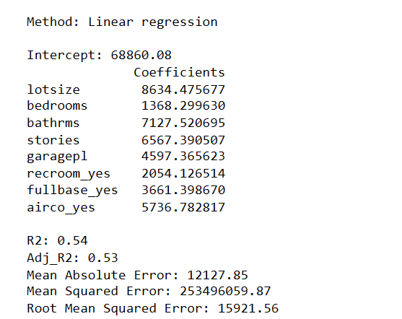
The Regression Model

Slide 5
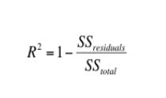
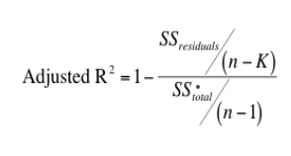
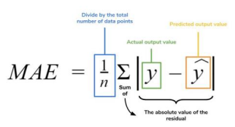
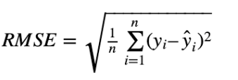
Explanation for R² , Adj_R² , MAE, and RMSE
R² And Adj_R²
The adjusted_ R² and R² results indicate how many data points fall within the regression equation's line; this also indicates how well a set of predictor variables can explain variation in the response variable. Also, R-square and adjusted R-square are used to assess the goodness of fit of a regression model. As a result, a higher R_Square indicates that the model is a good fit, whereas a lower R-Square indicates that the model is not a good fit.
MAE
MAE is a measure of error between paired observations expressing the same phenomenon. The Mean Absolute Errors is the absolute error of the absolute value between the projected value and the actual value; the mean helps us in determining how large the size of error we can expect from the forecast on average/mean, and it has the useful property of being expressed in the same units as the response variable.
RMSE
RMSE: Root Mean Square Error between the predicted value and the actual values.
it's the square root of the average squared differences between prediction and the actual and the actual observation of Mean Absolute Error,
RMSE is an absolute measure of fit
R_Square is the relative measure of fit

Slide 6
Analysis Report for R² Adj_ R² MAE and MAE RMSE
R_Squared (R² ) and Adjusted R_Squared Adj_ (R² )
In this Analysis, R² = 0.54, the R² indicates that the model is not a good fit.
Adj_ R²
Adj_ R² = 53, The value of adj_ R² and R² are almost the same or close to each other, this means that there is a relationship, but indicates that the model is not fit.
The results from the multiple linear regression show that R_Square and Adjusted_R_square have a low value, which is 0.54 and 53 respectively, hence the model is not significant or not viable
Mean Absolute Error (MAE) and Root Mean Squared Error (RMSE)
The Mean Absolute Error and the Root Mean Squared Error are used to determine the viability of a model. When the Mean Absolute Error and the Root Mean Square Error are greater than 10 percent of the mean of Y (Price), then the model is not viable
In this case…
MAE = 12127.85 and RMSE = 15921.56
The mean of price (Y) = 68121.597070 and 10% of Y(Price) => 6,812.2
MAE and RMSE are greater than 10% of the mean of (Y) Price, therefore the model is not viable

Slide 7
State and Explain two (2) Recommendations
For this model, I will recommend the following for Mr. John Hughes
Feature selection.
Regularization.
Explanation of the Above Recommendation
Feature selection: Identify and select the most relevant features for the model, as irrelevant or redundant features can decrease model accuracy.
Regularization is a procedure for trying to prevent overfitting by penalizing forecasts with high coefficients. The most common types of regularization in linear regression are ridge and lasso.

Slide 8
REFERENCE
Lecture Note, Week #12 – Linear Regression Part II - Tetikoglu F. (2022).
Lecture Note, Week #13 –Tetikoglu F. (2022).
Week 7-Data1203-F22: Inference of Numerical Data Part I - Tetikoglu F. (2022).
Multivariate/Multiple Regression
Week #13 – Multivariate/Multiple Regression Tutorials - Tetikoglu F. (2022).
Week 2 Linear Regression Modeling Techniques – Data 2204

